Slide 1

10
Production and Cost
When you have completed your study of this chapter, you will be able to
CHAPTER CHECKLIST
1 Explain and distinguish between the economic and accounting measures of a firm’s cost of production and profit.
2 Explain the relationship between a firm’s output and labor employed in the short run.
3 Explain the relationship between a firm’s output and costs in the short run.
4 Derive and explain a firm’s long-run average cost curve.
Notes:
Notes and teaching tips: 4, 8, 14, 15, 16, 17, 30, 60, 62, 64, and 67.
To view a full-screen figure during a class, click the red “expand” button.
To return to the previous slide, click the red “shrink” button.
To advance to the next slide, click anywhere on the full screen figure.
To enhance your lecture, check out the Lecture Launchers, Land Mines, and Class Activities in the Instructor’s Manual.

Slide 2
14.1 ECONOMIC COST AND PROFIT
The Firm’s Goal
To maximize profit
Accounting Cost and Profit
An accountant measures cost and profit to ensure that the firm pays the correct amount of income tax and to show the bank how the firm has used its bank loan.
Economists predict the decisions that a firm makes to maximize its profit. These decisions respond to opportunity cost and economic profit.
Notes:
This chapter serves as the basis for the next four chapters. You need to tell students this fact because without it you will definitely lose some of the class. How so? They won’t realize that this chapter is critical until they are unable to grasp the next four chapters. At that point, several possibilities exist, all unpleasant: These students flunk the course, these students drop the course, or these students camp out in your office. Most likely no one would be happy with any of these outcomes, so launch your lecture by motivating your students with the important information that Chapter 14 is truly a key to Chapters 15, 16, 17, and 18!

Slide 3
14.1 ECONOMIC COST AND PROFIT
Opportunity Cost
The highest-valued alternative forgone is the opportunity cost of a firm’s production.
This opportunity cost is the amount that the firm must pay the owners of the factors of production it employs to attract them from their best alternative use.
So a firm’s opportunity cost of production is the cost of the factors of production it employs.

Slide 4
14.1 ECONOMIC COST AND PROFIT
Explicit Costs and Implicit Costs
An explicit cost is a cost paid in money.
An implicit cost is an opportunity cost incurred by a firm when it uses a factor of production for which it does not make a direct money payment.
The two main implicit costs are economic depreciation and the cost of using the firm owner’s resources.

Slide 5
14.1 ECONOMIC COST AND PROFIT
Economic depreciation is an opportunity cost of a firm using capital that it owns—measured as the change in the market value of capital over a given period.
Normal profit is the return to entrepreneurship.
Normal profit is part of a firm’s opportunity cost because it is the cost of the entrepreneur not running another firm.

Slide 6
14.1 ECONOMIC COST AND PROFIT
Economic Profit
A firm’s economic profit equals total revenue minus total cost.
Total cost is the sum of the explicit costs and implicit costs and is the opportunity cost of production.
Because one of the firm’s implicit costs is normal profit, the return to the entrepreneur equals normal profit plus economic profit.
If a firm incurs an economic loss, the entrepreneur receives less than normal profit.
Notes:
Watch out for persistent confusion between economic profit and accounting profit. You can avoid some of this by thoroughly drilling them in opportunity cost, so that they understand that non-money cost is still cost.

Slide 7
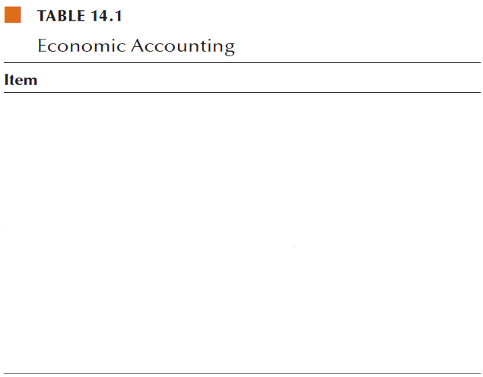
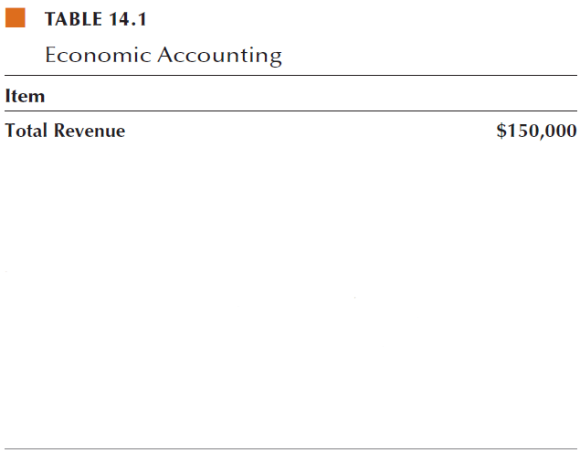
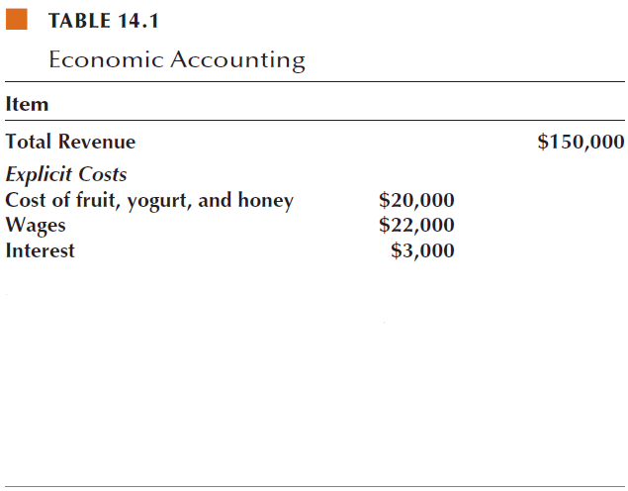
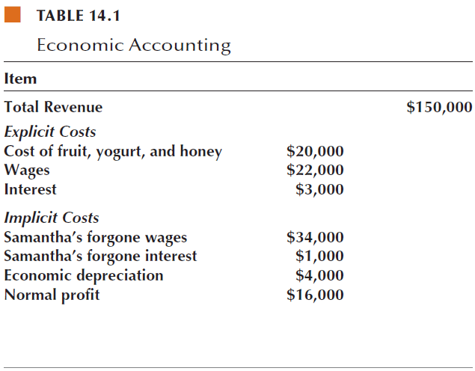
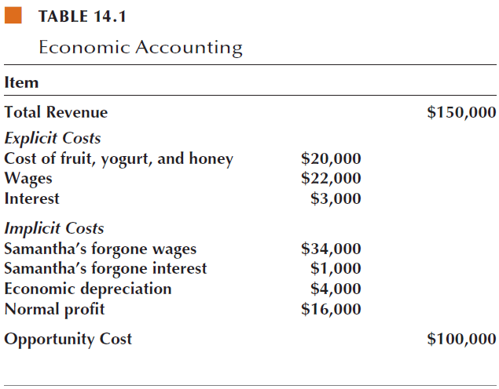
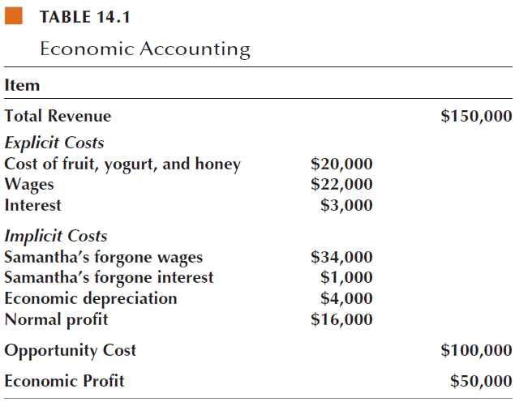
14.1 ECONOMIC COST AND PROFIT

Slide 8
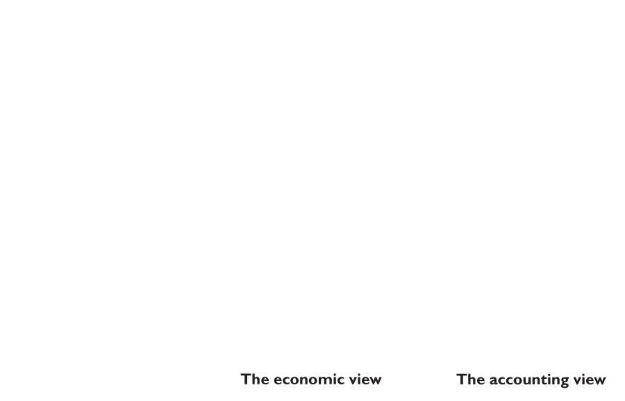
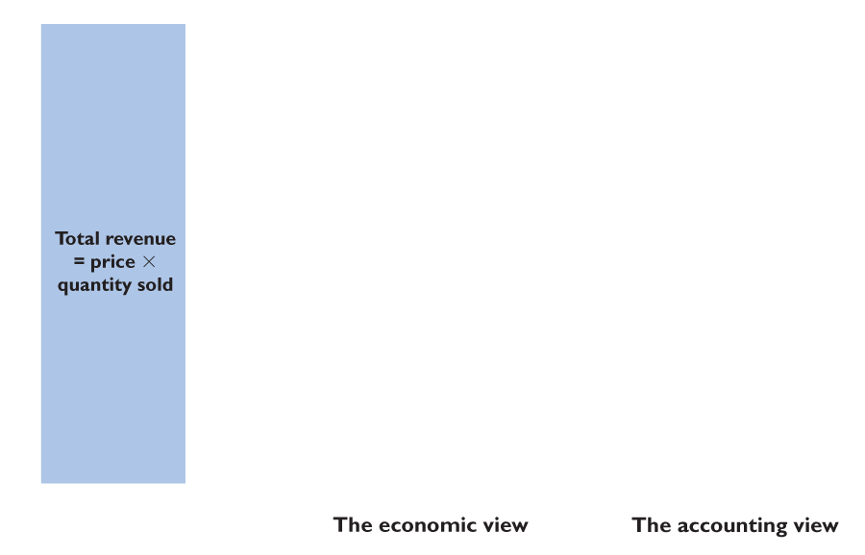
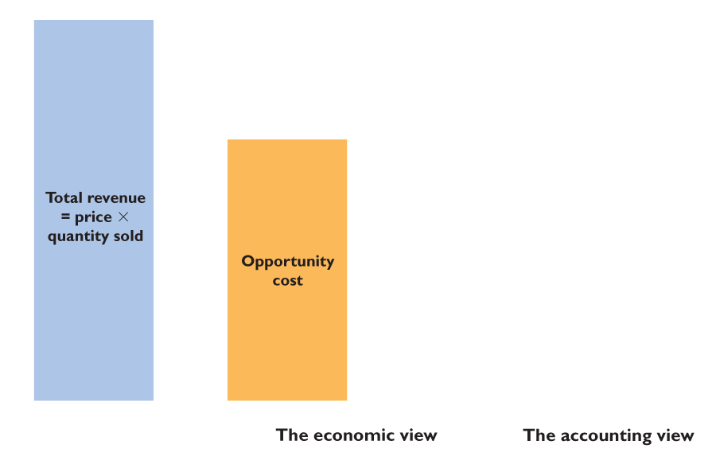
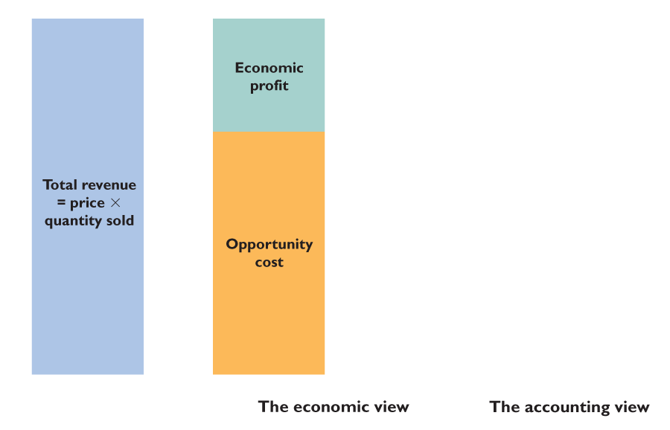
14.1 ECONOMIC COST AND PROFIT
Figure 14.1 shows two views of cost and profit.
Total revenue equals price multiplied by quantity sold.
Economists measure economic profit as total revenue minus opportunity cost.

Slide 9
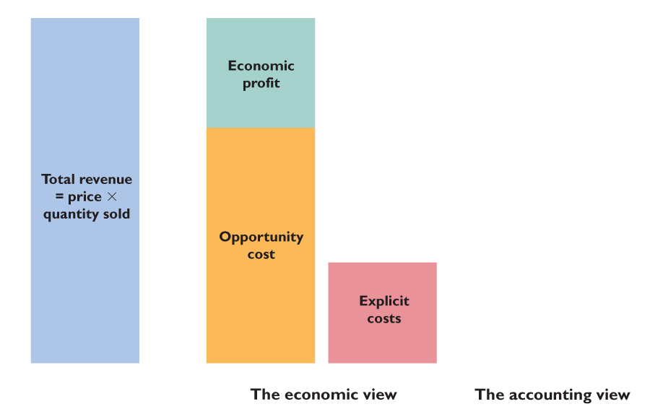
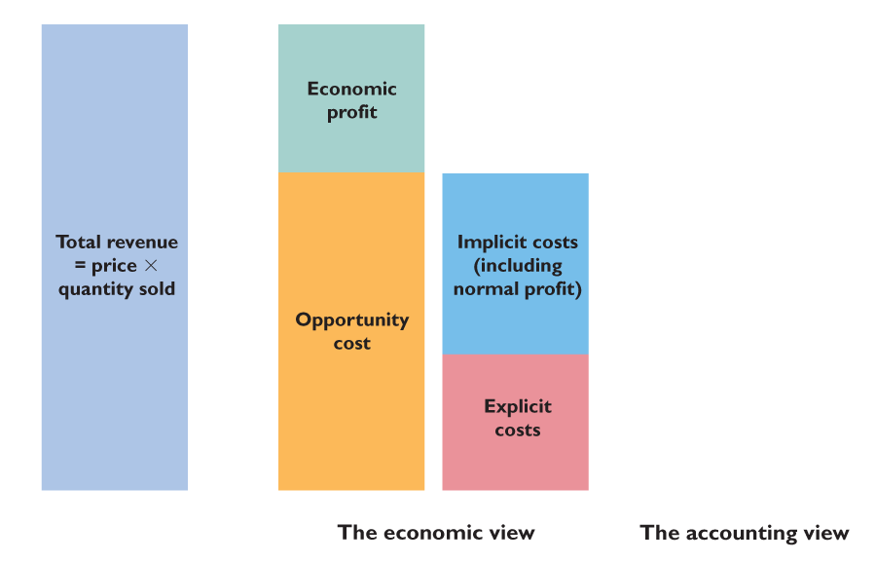
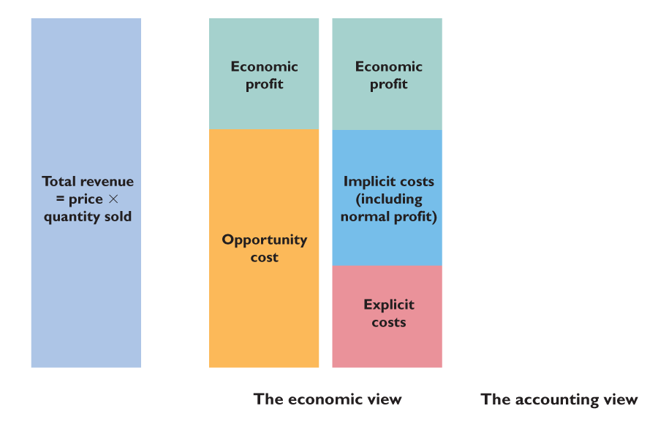
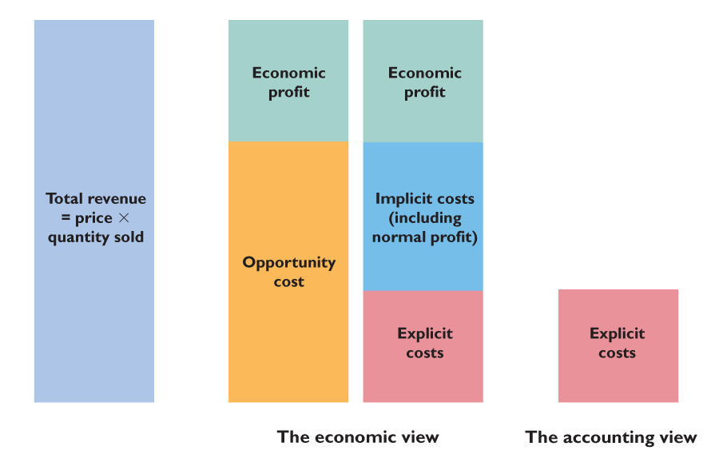
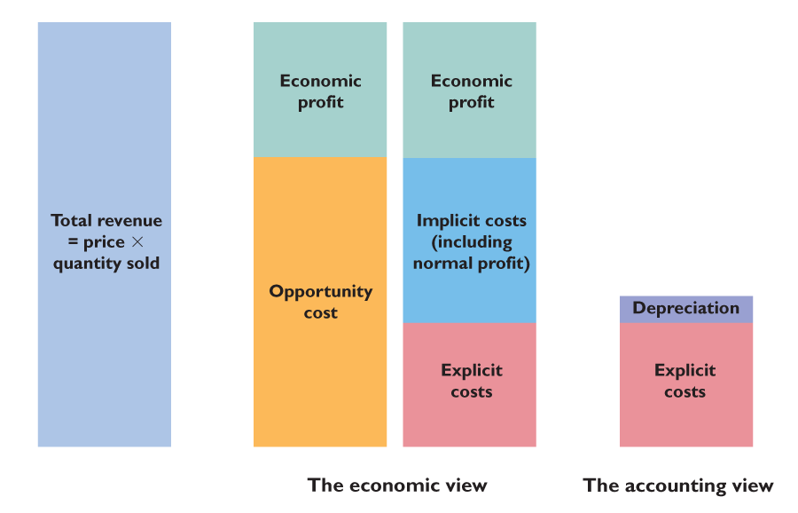
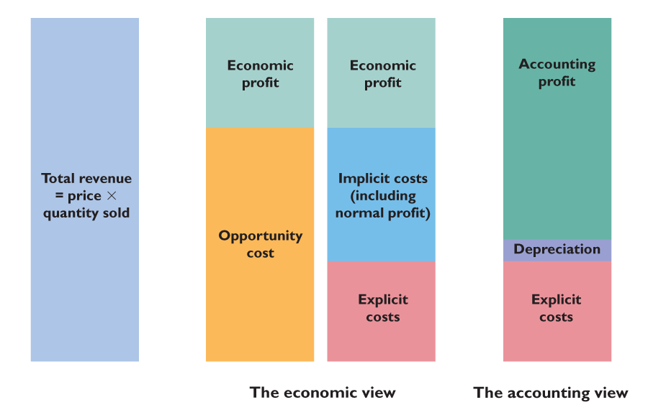

Slide 10
14.1 ECONOMIC COST AND PROFIT
Opportunity cost is the sum of
Explicit costs and
Implicit cost (including normal profit).

Slide 11
14.1 ECONOMIC COST AND PROFIT
Accountants measure cost as the sum of explicit costs and accounting depreciation.
Accounting profit is total revenue minus accounting costs.

Slide 12
SHORT RUN AND LONG RUN
The Short Run: Fixed Plant
The short run is a time frame in which the quantities of some resources are fixed.
In the short run, a firm can usually change the quantity of labor it uses but not the quantity of capital.
The Long Run: Variable Plant
The long run is a time frame in which the quantities of all resources can be changed.
A sunk cost is irrelevant to the firm’s decisions.
Notes:
Help the students to understand that the difference between the long run and short run is not related to calendar time. Compare the street vendor, who is a firm owner operating out of a food truck, to the giant automaker firm, Ford. Ask them how long it would take for the food vendor to double the size of his or her plant (truck, oven, etc.) versus Ford to double its plant size (factory buildings covering multiple blocks, sophisticated computerized assembly lines and robotics, etc.). They will realize that the length of time covered by the long run differs among firms.

Slide 13
14.2 SHORT-RUN PRODUCTION
To increase output with a fixed plant, a firm must increase the quantity of labor it uses.
We describe the relationship between output and the quantity of labor by using three related concepts:
Total product
Marginal product
Average product
Notes:
This chapter has a plethora of definitions. Students must learn the definitions, but they are secondary to the concepts they define and the insights they bring. Focus on why productivity measures and cost measures are useful for decision making. Managers must frequently make quick decisions with little information. If managers have knowledge of a useful relationship between input measures and production cost measures they can use their understanding of this link to make inferences about how production costs might behave when the firm’s output must change to accommodate market changes.

Slide 14
14.2 SHORT-RUN PRODUCTION
Total Product
Total product (TP) is the total quantity of a good produced in a given period.
Total product is an output rate—the number of units produced per unit of time.
Total product increases as the quantity of labor employed increases.
Notes:
This chapter is one more place where an in-class experiment has a huge payoff and is definitely recommended. The experiment teaches students about the product curves, and a related assignment that we describe later teaches them about the short-run cost curves. Allow 30 to 40 minutes for this production experiment. This experiment motivates the students to go beyond memorizing the cost and productivity definitions by getting them directly involved with generating their own data and productivity and cost measures. This is a fun exercise that will illustrate the concept of diminishing returns to labor, as well as how short run productivity measures and cost measures are related. Students genuinely enjoy and learn from this exercise, even though it might seem childish. You have two inputs: Capital: A table (of which the class must have an unobstructed view), some tear-off scratch pads with about 500 sheets of paper, a fully loaded stapler, and a back-up stapler (also fully loaded). Labor: Provided by your students. The capital and labor are used to produce “widgets.” A widget is a piece of paper, torn from a pad, folded twice very carefully so that the corners of the paper align, and stapled. The first fold bisects the paper along its long side and the second fold is at right angles to the first. Once folded, a staple is used to hold the folds in place. A widget is fragile and breaks if it falls off the table. Start the experiment by hiring a manager from your class and appointing an auditor. Get the manager to hire a quality controller, an accountant, and some workers. Tell the manager that he or she must produce widgets as efficiently as possible and that he or she can discuss the process with his workers and with the class.
[Continued on next slide]

Slide 15
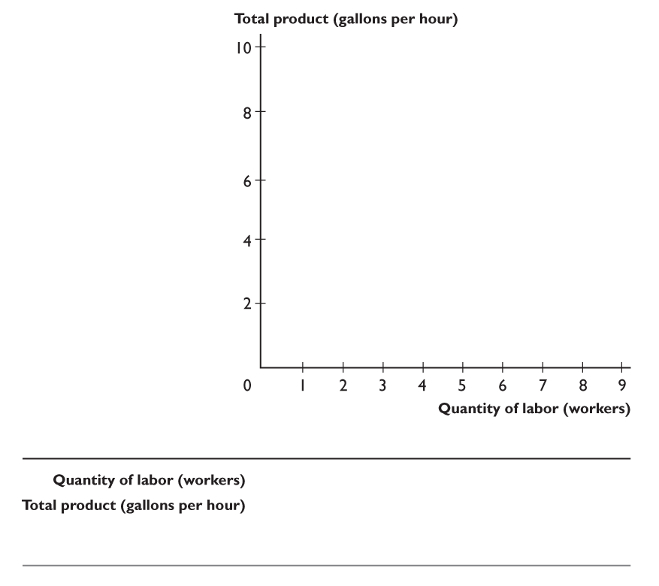
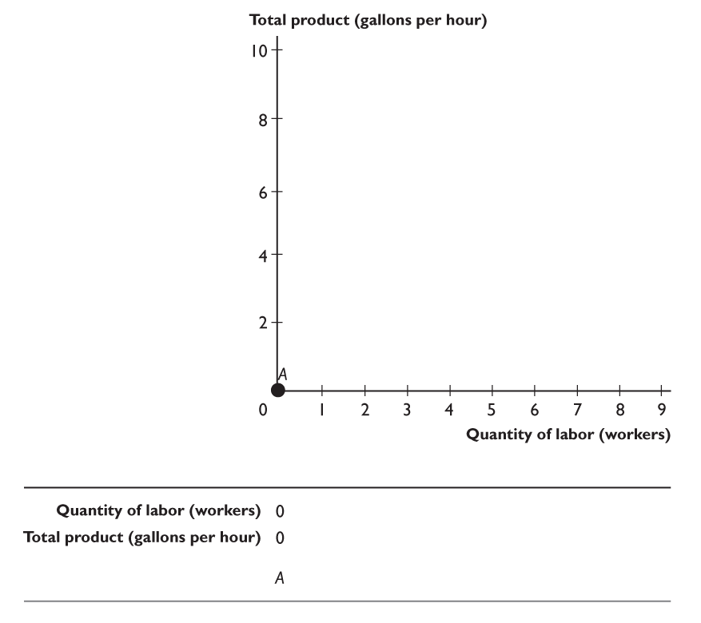
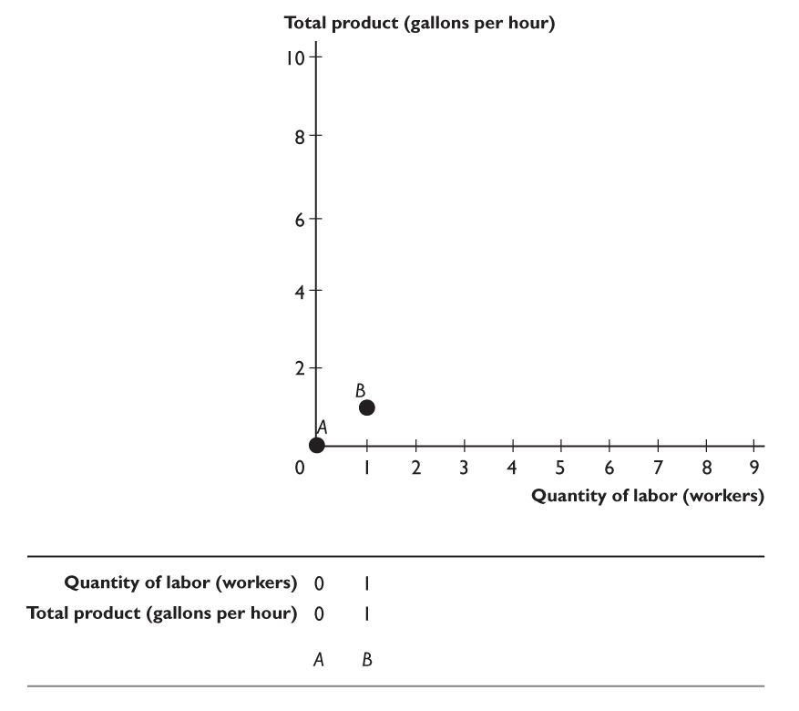
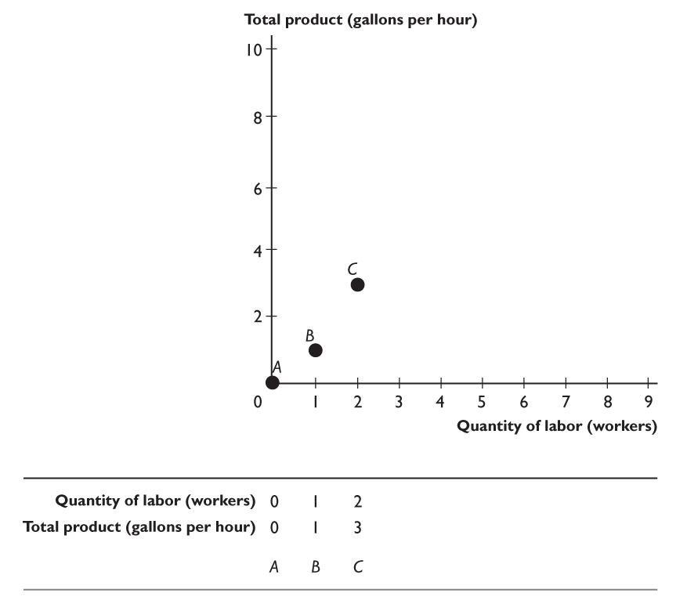
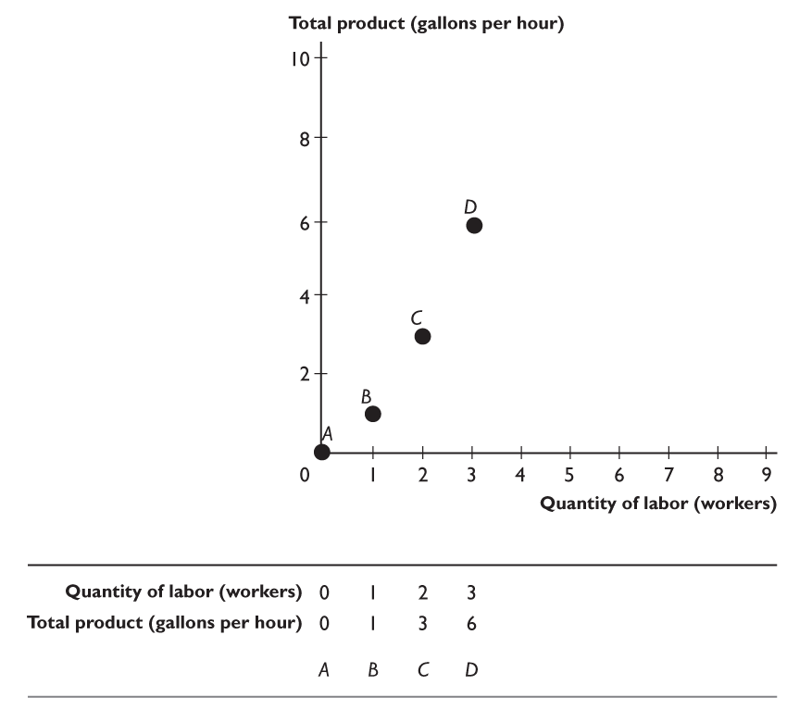
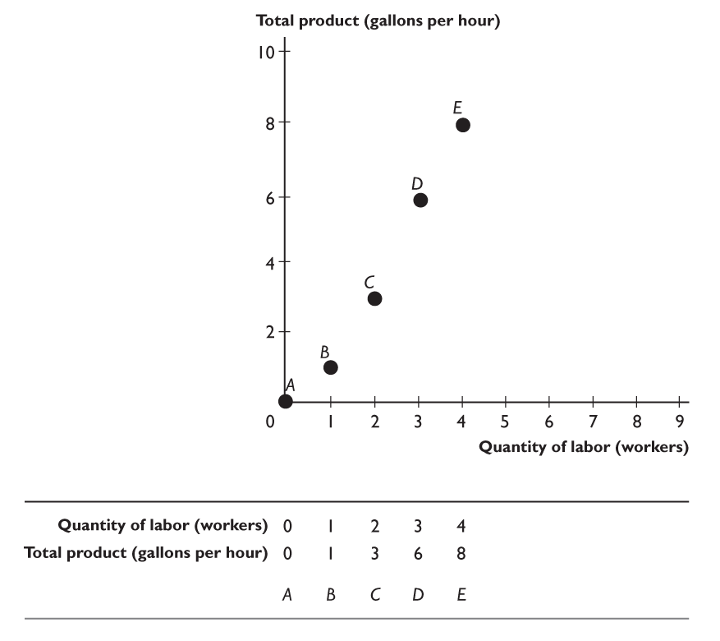
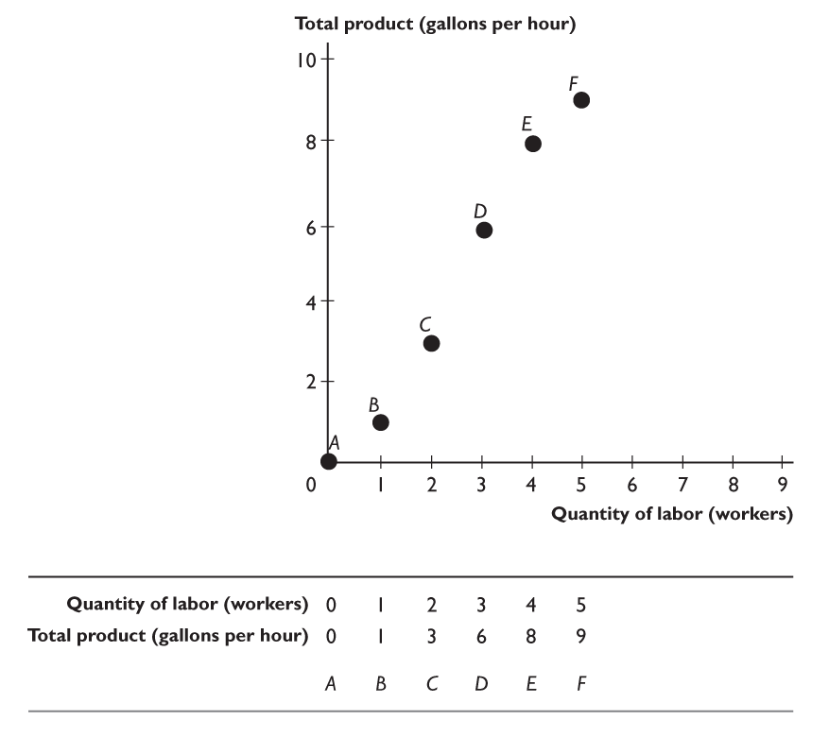
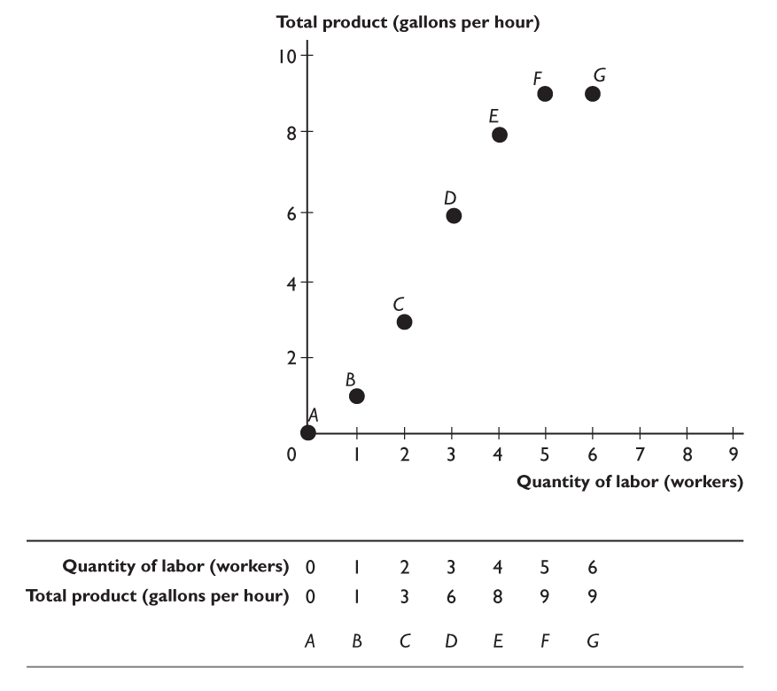
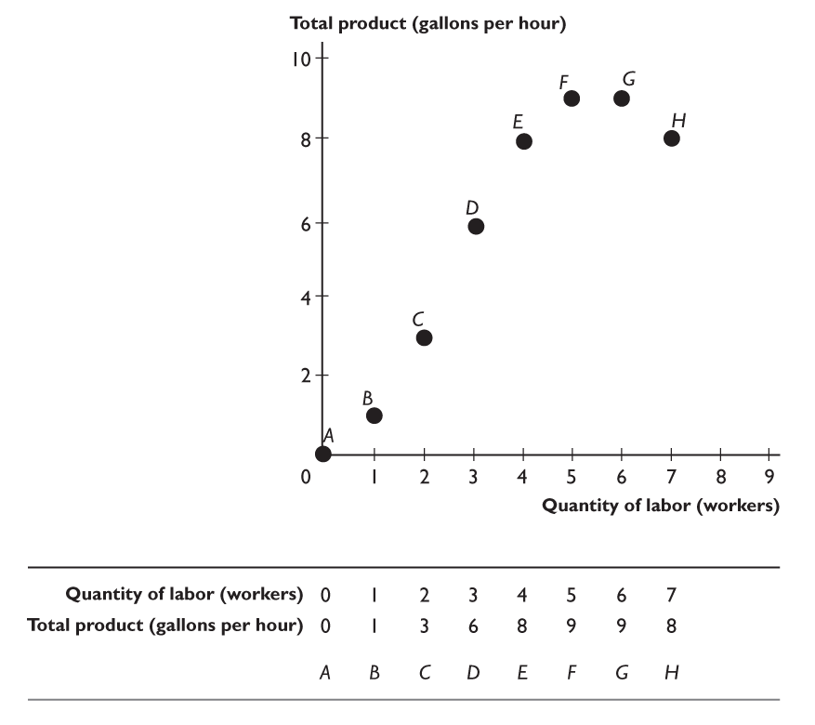
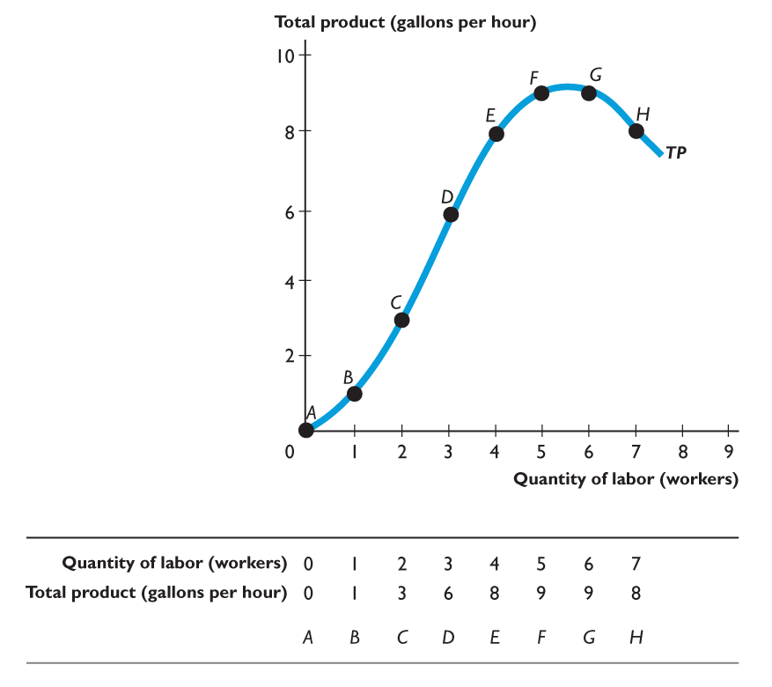
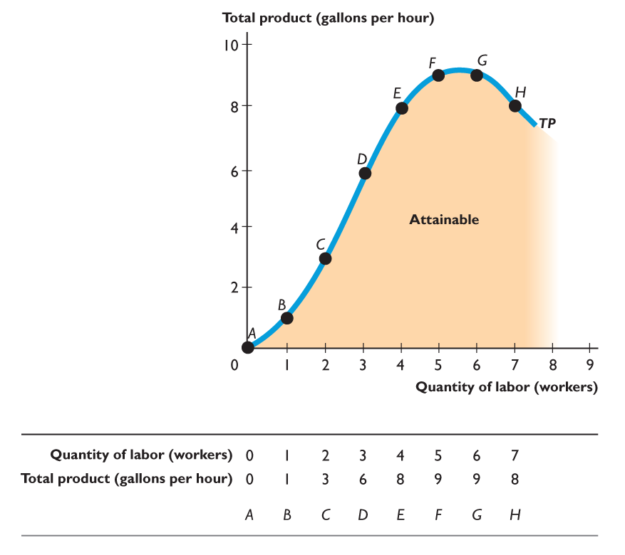
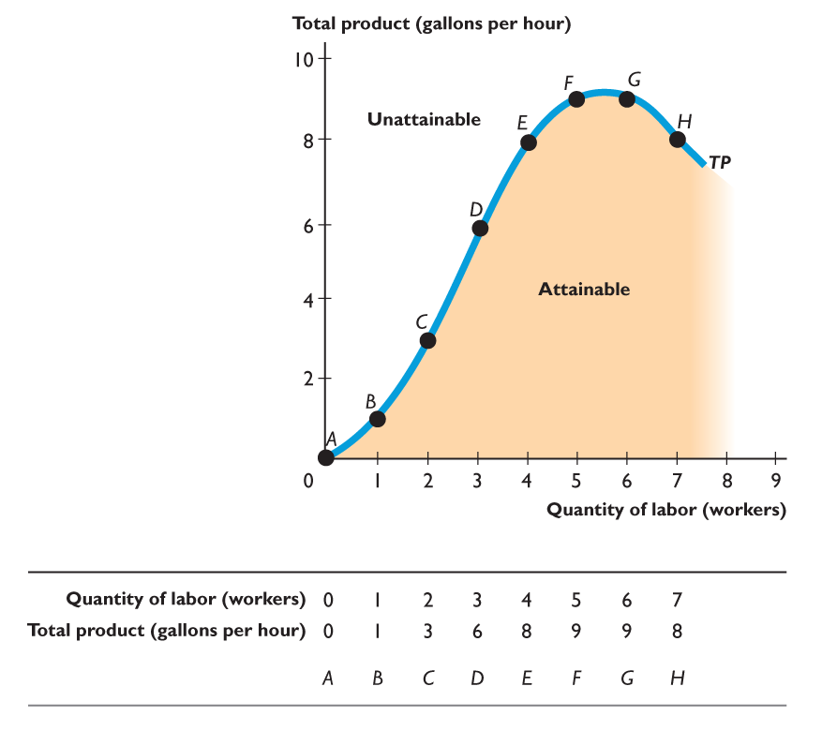
14.2 SHORT-RUN PRODUCTION
Figure 14.2 shows the total product and the total product curve.
Points A through H on the curve correspond to the columns of the table.
The TP curve is like the PPF: It separates attainable points and unattainable points.
Notes:
Start the experiment by defining that a day lasts for 1 minute. Get the class to keep time. On day 1, have 1 worker produce widgets. On day 2, have 2 workers, and so on. You’ll probably run for 10 to 12 days before you get to almost zero marginal product. Record the inputs and outputs in a table on the board. Have some fun with quality control, shirking, and cheating. The auditor must ensure that old widgets and partly made widgets don’t get used in a subsequent day. Each day must start clean. Now comes the assignment (Stage 1): Get the students to calculate marginal product and average product from the total product numbers that you’re recorded on the board. Get them to make graphs of the total product, marginal product, and average product curves. Get them to describe the curves and to explain their similarities with and differences to the curves for smoothies in the textbook. The first assignment covers only production. If you want, you can extend the experiment with another assignment (Stage 2): Use the data from your widget production experiment. Tell the students the cost of the capi240 tal and the wage rate of a worker. (Make up the numbers. Any will do.) Tell the students to calculate total cost, marginal cost, and average cost. Get them to make graphs of the total cost, marginal cost, and average cost curves. Get them to describe the curves and to explain their similarities with and differences to the curves for smoothies in the textbook. This assignment and the previous one make an outstanding assignment for credit or extra credit.

Slide 17
14.2 SHORT-RUN PRODUCTION
Marginal Product
Marginal product is the change in total product that results from a one-unit increase in the quantity of labor employed.
Marginal product tells us the contribution to total product of adding one more worker.
When the quantity of labor increases by more (or less) than one worker, calculate marginal product as:
Marginal product
Change in total product
Change in quantity of labor
=
÷

Slide 18
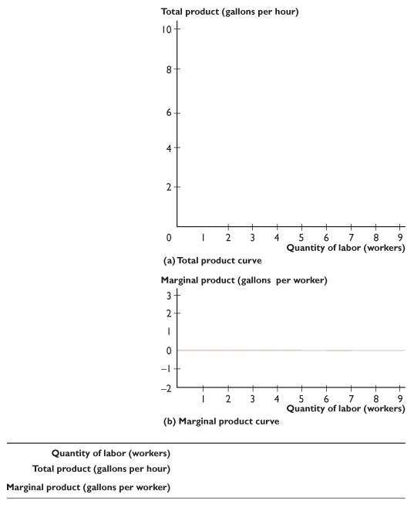
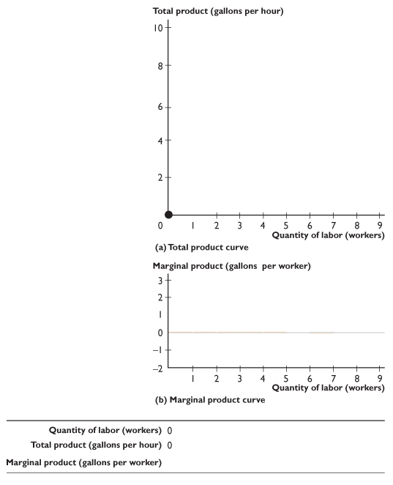
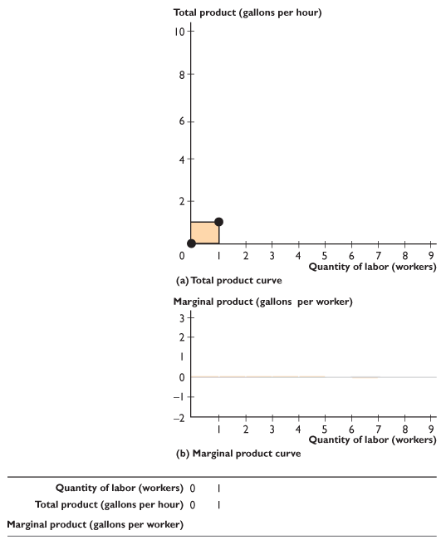
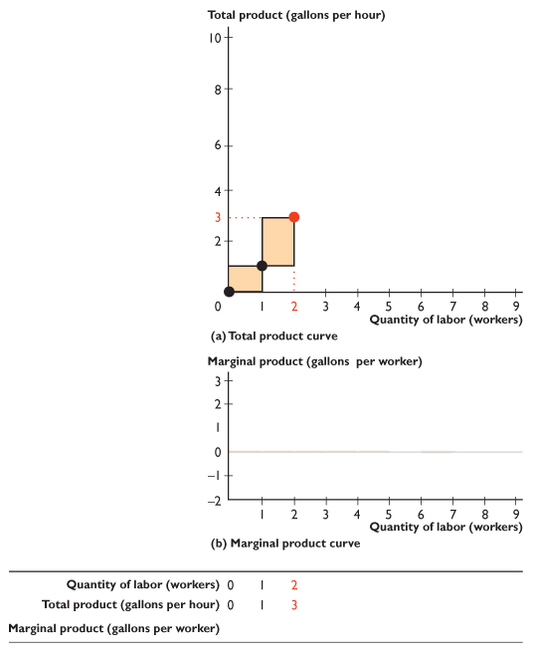
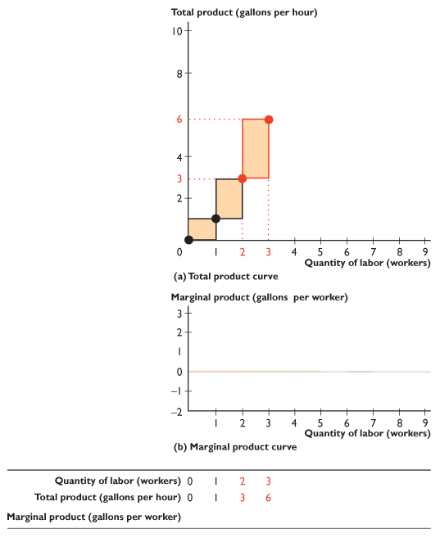
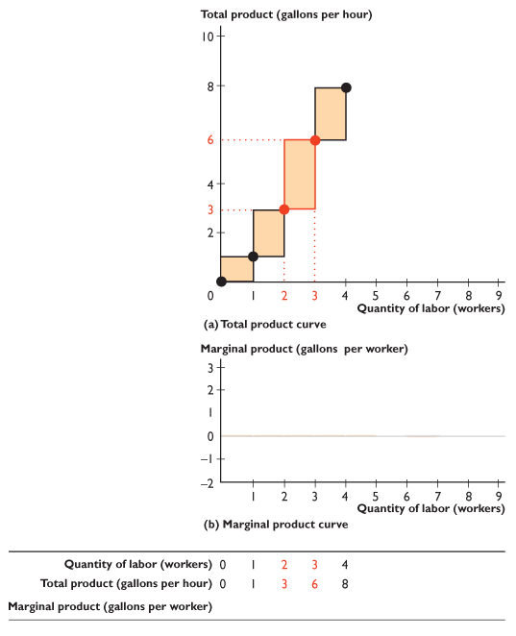
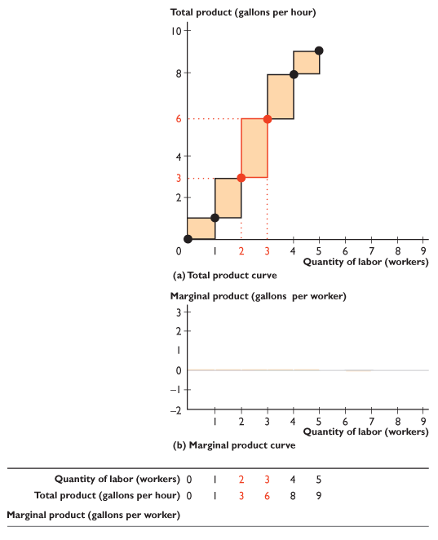

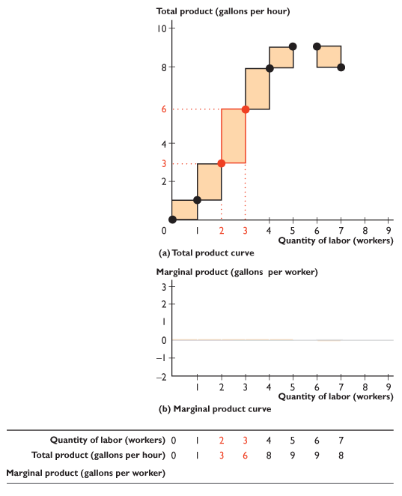
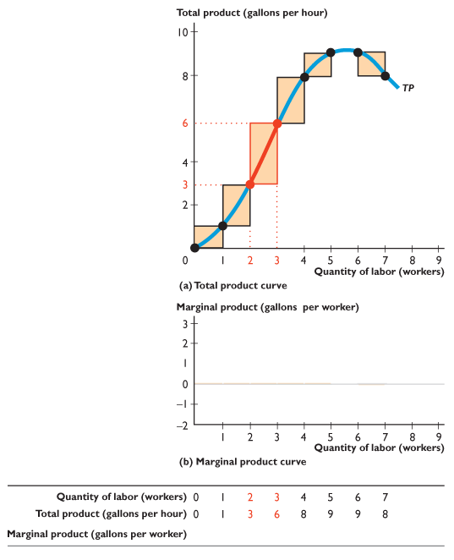
14.2 SHORT-RUN PRODUCTION
Figure 14.3 shows total product and marginal product.
We can illustrate marginal product as the orange bars that form steps along the total product curve.
The height of each step represents marginal product.

Slide 19
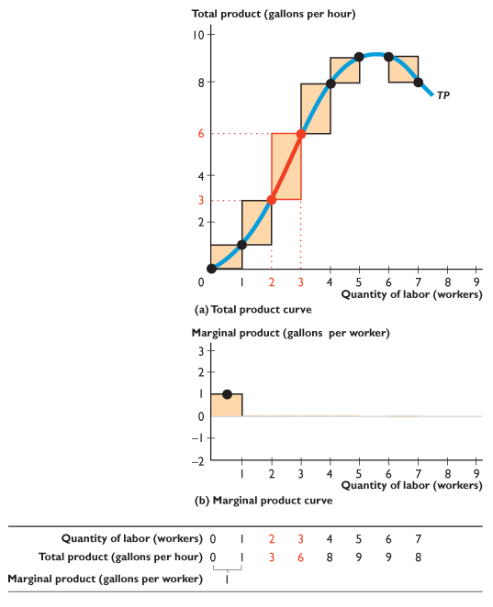
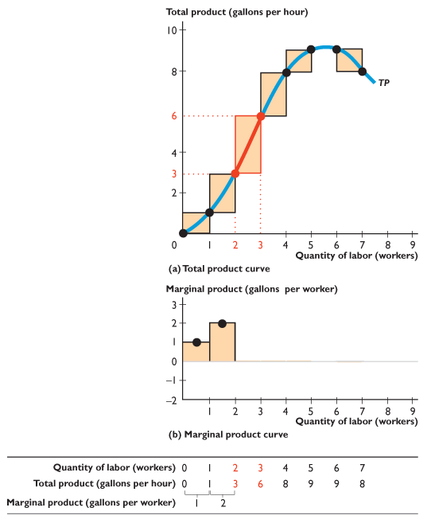
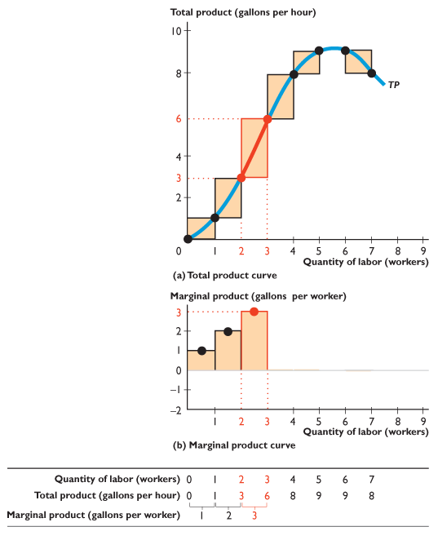
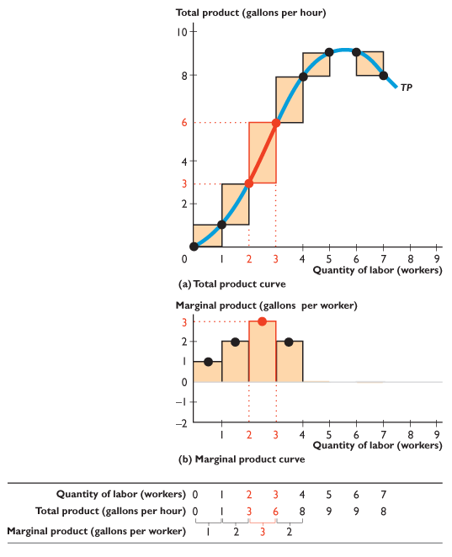
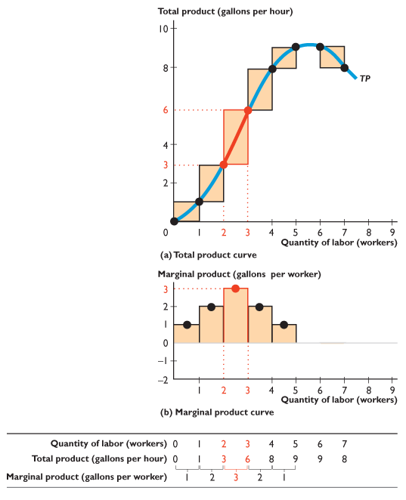
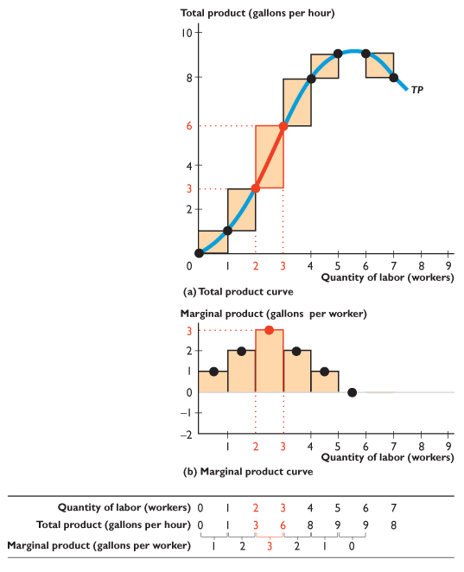
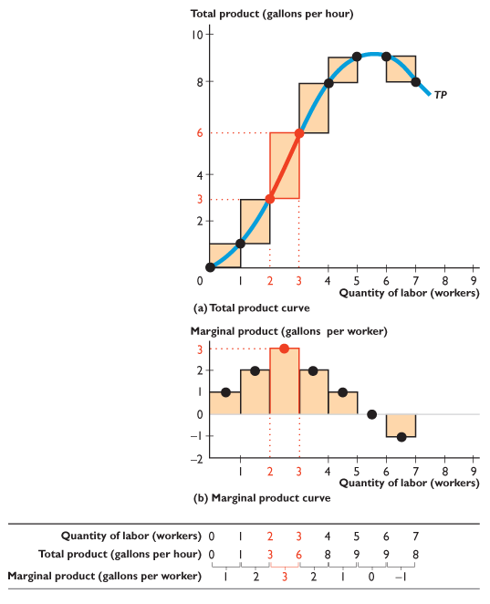
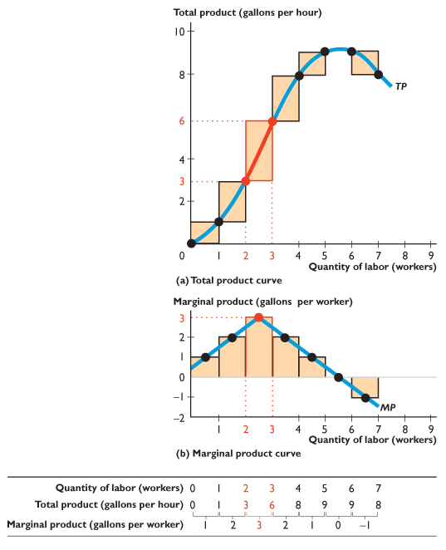
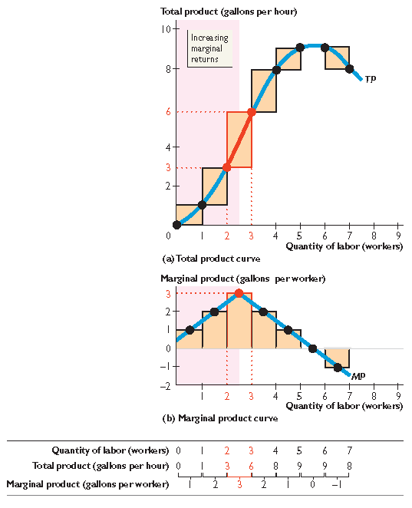
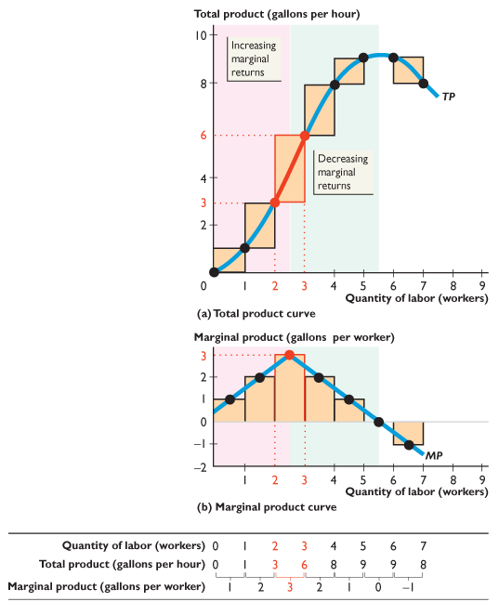
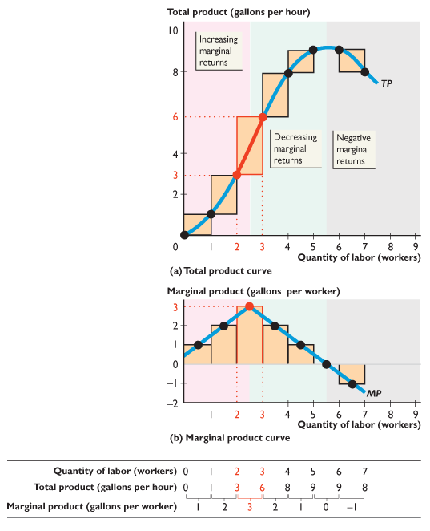

Slide 20
14.2 SHORT-RUN PRODUCTION
The table calculates marginal product and the orange bars in part (b) illustrate it.
Notice that the steeper the slope of the TP curve, the greater is marginal product.

Slide 21
14.2 SHORT-RUN PRODUCTION
The total product and marginal product curves in this figure incorporate a feature of all production processes:
Increasing marginal returns initially
Decreasing marginal returns eventually
Negative marginal returns

Slide 22
14.2 SHORT-RUN PRODUCTION
Increasing Marginal Returns
Increasing marginal returns occur when the marginal product of an additional worker exceeds the marginal product of the previous worker.
Increasing marginal returns occur when a small number of workers are employed and arise from increased specialization and division of labor in the production process.

Slide 23
14.2 SHORT-RUN PRODUCTION
Decreasing Marginal Returns
Decreasing marginal returns occur when the marginal product of an additional worker is less than the marginal product of the previous worker.
Decreasing marginal returns arise from the fact that more and more workers use the same equipment and work space.
As more workers are employed, there is less and less that is productive for the additional worker to do.

Slide 24
14.2 SHORT-RUN PRODUCTION
Decreasing marginal returns are so pervasive that they qualify for the status of a law:
The law of decreasing returns states that:
As a firm uses more of a variable factor of production, with a given quantity of fixed factors of production, the marginal product of the variable factor eventually decreases.

Slide 25
14.2 SHORT-RUN PRODUCTION
Average Product
Average product is the total product per worker employed.
It is calculated as:
Average product = Total product ÷ Quantity of labor
Another name for average product is productivity.

Slide 26
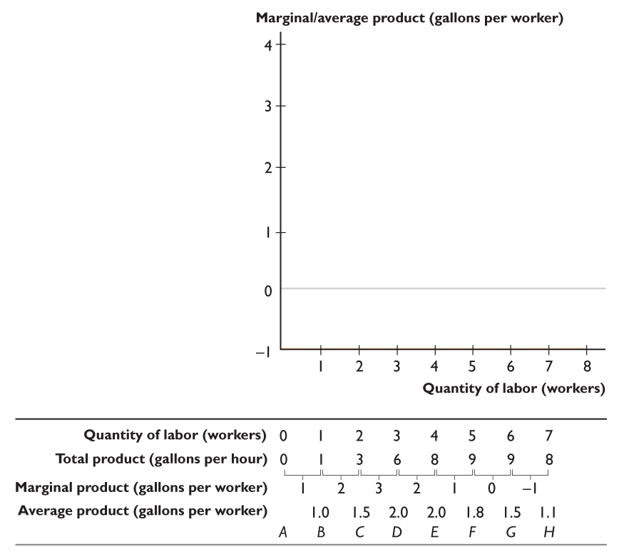
14.2 SHORT-RUN PRODUCTION
Figure 14.4 shows average product and its relationship to marginal product.
The table calculates average product.
For example, 3 workers produce a total product of 6 gallons per hour, so average product is 6 ÷ 3 = 2 gallons per worker.

Slide 27
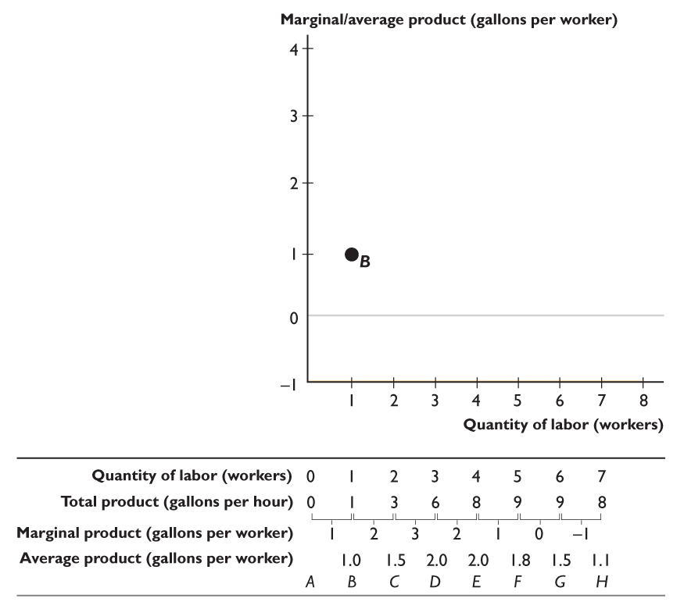










Slide 28
14.2 SHORT-RUN PRODUCTION
The figure graphs the average product against the quantity of labor employed.
The red curve labelled AP is the average product curve.
If at the quantity of labor, marginal product exceeds average product, then average product is increasing.
Notes:
The grade point average versus marginal grade example (see slide 69) in the text is outstanding to use in class to describe how the marginal product and marginal cost curves relate to the average product and average cost curves. Once students can tell a story using the same intuition, they find drawing those curves much easier. While you have the curves drawn on the board or overhead, physically pull the average cost curves down (while marginal cost is below) or pull them up (when the marginal cost curve rises above). Use theatrics: raise your hands over your head and “pull down the curves.” If you have a more sports-oriented class, you can try using a batting average percentage and at-bat outcome example (if you had a .300 batting average and you struck out at your next at-bat [the marginal factor], your batting average is pulled down).

Slide 29
14.2 SHORT-RUN PRODUCTION
If at the quantity of labor, marginal product is less than average product, then average product is decreasing.
If at the quantity of labor, marginal product equals
average product, then average product is at its maximum.

Slide 30
14.3 SHORT-RUN COST
To produce more output in the short run, a firm employs more labor, which means the firm must increase its costs.
We describe the relationship between output and cost using three cost concepts:
Total cost
Marginal cost
Average cost

Slide 31
14.3 SHORT-RUN COST
Total Cost
A firm’s total cost (TC) is the cost of all the factors of production the firm uses.
Total cost divides into two parts:
Total fixed cost (TFC) is the cost of a firm’s fixed factors of production used by a firm—the cost of land, capital, and entrepreneurship.
Total fixed cost doesn’t change as output changes.

Slide 32
14.3 SHORT-RUN COST
Total variable cost (TVC) is the cost of the variable factor of production used by a firm—the cost of labor.
To change its output in the short run, a firm must change the quantity of labor it employs, so total variable cost changes as output changes.
Total cost is the sum of total fixed cost and total variable cost. That is,
TC = TFC + TVC
Table 14.2 on the next slide shows Sam’s Smoothies’ costs.

Slide 33

14.3 SHORT-RUN COST

Slide 34




14.3 SHORT-RUN COST
Figure 14.5 shows Sam’s Smoothies’ total cost curves.
Total fixed cost (TFC) is constant—it graphs as a horizontal line.
Total variable cost (TVC) increases as output increases.
Total cost (TC) also increases as output increases.

Slide 35


Slide 36
14.3 SHORT-RUN COST
The vertical distance between the TC curve and the TVC curve is equal to TFC, as illustrated by the two arrows.

Slide 37
14.3 SHORT-RUN COST
Marginal Cost
A firm’s marginal cost is the change in total cost that results from a one-unit increase in total product.
Marginal cost tells us how total cost changes as total product changes.
Table 14.3 on the next slide calculates marginal cost for Sam’s Smoothies.

Slide 38

14.3 SHORT-RUN COST

Slide 39
14.3 SHORT-RUN COST
Average Cost
There are three average cost concepts:
Average fixed cost (AFC) is total fixed cost per unit of output.
Average variable cost (AVC) is total variable cost per unit of output.
Average total cost (ATC) is total cost per unit of output.

Slide 40
14.3 SHORT-RUN COST
The average cost concepts are calculated from the total cost concepts as follows:
TC = TFC + TVC
Divide each total cost term by the quantity produced, Q, to give
TC TFC TVC
=
+
Q Q Q
or,
ATC = AFC + AVC

Slide 41

14.3 SHORT-RUN COST

Slide 42




14.3 SHORT-RUN COST
Figure 14.6 shows the average cost curves and marginal cost curve at Sam’s Smoothies.
Average fixed cost (AFC) decreases as output increases.
The average variable cost curve (AVC) is U-shaped.
The average total cost curve (ATC) is also U-shaped.

Slide 43



Slide 44
14.3 SHORT-RUN COST
The vertical distance between ATC and AVC curves is equal to AFC, as illustrated by the two arrows.
The marginal cost curve (MC) is U-shaped and intersects the average variable cost curve and the average total cost curve at their minimum points.

Slide 45
14.3 SHORT-RUN COST
Why the Average Total Cost Curve Is U-Shaped
Average total cost, ATC, is the sum of average fixed cost, AFC, and average variable cost, AVC.
The shape of the ATC curve combines the shapes of the AFC and AVC curves.
The U shape of the average total cost curve arises from the influence of two opposing forces:
Spreading total fixed cost over a larger output
Decreasing marginal returns

Slide 46

14.3 SHORT-RUN COST

Slide 47
14.3 SHORT-RUN COST
Cost Curves and Product Curves
The technology that a firm uses determines its costs.
At low levels of employment and output, as the firm hires more labor, marginal product and average product rise, and marginal cost and average variable cost fall.
Then, at the point of maximum marginal product, marginal cost is a minimum.
As the firm hires more labor, marginal product decreases and marginal cost increases.

Slide 48
14.3 SHORT-RUN COST
But average product continues to rise, and average variable cost continues to fall.
Then, at the point of maximum average product, average variable cost is a minimum.
As the firm hires even more labor, average product decreases and average variable cost increases.

Slide 49



14.3 SHORT-RUN COST
Figure 14.7 illustrates the relationship between the product curves and cost curves.
A firm’s marginal cost curve is linked to its marginal product curve.
If marginal product rises, marginal cost falls.
If marginal product is a maximum, marginal cost is a minimum.

Slide 50






Slide 51
14.3 SHORT-RUN COST
A firm’s average variable cost curve is linked to its average product curve.
If average product rises, average variable cost falls.
If average product is a maximum, average variable cost is a minimum.

Slide 52
14.3 SHORT-RUN COST
At small outputs, MP and AP rise and MC and AVC fall.
At intermediate outputs, MP falls and MC rises and AP rises and AVC falls.
At large outputs, MP and AP fall and MC and AVC rise.

Slide 53
14.3 SHORT-RUN COST
Shifts in the Cost Curves
Technology
A technological change that increases productivity shifts the TP curve upward. It also shifts the MP curve and the AP curve upward.
With a better technology, the same inputs can produce more output, so an advance in technology lowers the average and marginal costs and shifts the short-run cost curves downward.

Slide 54
14.3 SHORT-RUN COST
Prices of Factors of Production
An increase in the price of a factor of production increases costs and shifts the cost curves.
But how the curves shift depends on which resource price changes.
An increase in rent or another component of fixed cost
Shifts the fixed cost curves (TFC and AFC) upward.
Shifts the total cost curve (TC) upward.
Leaves the variable cost curves (AVC and TVC) and the marginal cost curve (MC) unchanged.

Slide 55
14.3 SHORT-RUN COST
An increase in the wage rate or another component of variable cost
Shifts the variable curves (TVC and AVC) upward.
Shifts the marginal cost curve (MC) upward.
Leaves the fixed cost curves (AFC and TFC) unchanged.

Slide 56
14.4 LONG-RUN COST
Plant Size and Cost
When a firm changes its plant size, its cost of producing a given output changes.
Will the average total cost of producing a gallon of smoothie fall, rise, or remain the same?
Each of these three outcomes arise because when a firm changes the size of its plant, it might experience:
Economies of scale
Diseconomies of scale
Constant returns to scale

Slide 57
14.4 LONG-RUN COST
Economies of Scale
Economies of scale exist if when a firm increases its plant size and labor employed by the same percentage, its output increases by a larger percentage and average total cost decreases.
The main source of economies of scale is greater specialization of both labor and capital.

Slide 58
14.4 LONG-RUN COST
Diseconomies of Scale
Diseconomies of scale exist if when a firm increases its plant size and labor employed by the same percentage, its output increases by a smaller percentage and average total cost increases.
Diseconomies of scale arise from the difficulty of coordinating and controlling a large enterprise.
Eventually, management complexity brings rising average total cost.
Notes:
Distinguish between decreasing marginal product in the short run versus diseconomies of scale in the long run. Decreasing returns occur when additional units of labor are combined with a fixed amount of capital. Diseconomies of scale do not occur for the same reason, because in the long run both labor and capital can change. Diseconomies of scale occur because of chaos, organizational overloads, etc

Slide 59
14.4 LONG-RUN COST
Constant Returns to Scale
Constant returns to scale exist if when a firm increases its plant size and labor employed by the same percentage, its output increases by the same percentage and average total cost remains constant.
Constant returns to scale occur when a firm is able to replicate its existing production facility including its management system.

Slide 60
14.4 LONG-RUN COST
The Long-Run Average Cost Curve
The long-run average cost curve shows the lowest average cost at which it is possible to produce each output when the firm has had sufficient time to change both its plant size and labor employed.
Notes:
Point out to the students that the long-run average cost curve yields the lowest average cost of production possible when plant size is free to change. Once a firm commits to a specific plant size, it is locked into a specific short run cost curve configuration. Any significant departure from the range of output per period that best suits that configuration means the firm will incur higher short-run average total costs than it would have had it chosen a more appropriate plant size. If the firm’s competitors chose their plant size more wisely, the firm might have a tough time surviving! This observation explains why successful firms often spend much money on long run market analysis.

Slide 61

14.4 LONG-RUN COST
Figure 14.8 shows a long-run average cost curve.
In the long run, Sam’s Smoothies can vary both capital and labor inputs.

Slide 62








Notes:
Point out to the students that the long-run average cost curve yields the lowest average cost of production possible when plant size is free to change. Once a firm commits to a specific plant size, it is locked into a specific short run cost curve configuration. Any significant departure from the range of output per period that best suits that configuration means the firm will incur higher short-run average total costs than it would have had it chosen a more appropriate plant size. If the firm’s competitors chose their plant size more wisely, the firm might have a tough time surviving! This observation explains why successful firms often spend much money on long run market analysis.

Slide 63
14.4 LONG-RUN COST
With its current plant, Sam’s ATC curve is ATC₁.
With successively larger plants, Sam’s ATC curves would be ATC₂, ATC₃, and ATC₄.

Slide 64
14.4 LONG-RUN COST
The long-run average cost curve, LRAC, traces the lowest attainable average total cost of producing each output.

Slide 65
14.4 LONG-RUN COST
Sam’s experiences economies of scale as output increases to 14 gallons an hour, …
Notes:
Leave your students with two big ideas:
First, a firm’s long-run production costs depend on the freedom to choose all inputs. Long-run flexibility enables firms to produce at a lower cost than is possible in the short run when some inputs are fixed.
Second, in the short run, with one or more fixed inputs, production costs vary with output in a predictable way because they are directly linked to input productivity.

Slide 66
14.4 LONG-RUN COST
constant returns to scale for outputs between 14 gallons and 19 gallons an hour, …

Slide 67
14.4 LONG-RUN COST
and diseconomies of scale for outputs that exceed 19 gallons an hour.

Slide 68

Walmart’s “small” supercenters measure 99,000 square feet and serve an average of 30,000 customers a week.
The average 7–Eleven store, mostly attached to gas stations, measures 2,000 square feet and serves about 5,000 customers a week.
Which retailing technology has the lower operating cost?
The answer depends on the scale of operation.
At a small number of customers per week, it costs less per customer to operate a store of 2,000 square feet than a store of 99,000 square feet.

Slide 69


The ATC curve of a store of 2,000 square feet is ATC_{7–Eleven}.

Slide 70

The ATC curve of a store of 99,000 square feet is ATC_{Walmart}.

Slide 71

The dark blue curve is a retailer’s LRAC curve.

Slide 72

With Q customers a week, the average total cost of a transaction is the same in both stores.

Slide 73

For a store that serves more than Q customers a week, the least-cost method is the big store.

Slide 74

For a store that serves fewer than Q customers a week, the least-cost method is the small store.

