Slide 1

17
Markets for Factors of Production
CHAPTER CHECKLIST
When you have completed your study of this chapter, you will be able to
1 Explain how the value of marginal product determines the demand for a factor of production.
2 Explain how wage rates and employment are determined and how labor unions influence labor markets.
3 Explain how capital and land rental rates and natural resource prices are determined.
Notes:
Notes and teaching tips: 4, 6, 28, and 43.
To view a full-screen figure during a class, click the red “expand” button.
To return to the previous slide, click the red “shrink” button.
To advance to the next slide, click anywhere on the full screen figure.
To enhance your lecture, check out the Lecture Launchers, Land Mines, and Class Activities in the Instructor’s Manual.

Slide 2
THE ANATOMY OF FACTOR MARKETS
The four factors of production that produce goods and services are
Labor
Capital
Land (natural resources)
Entrepreneurship
Notes:
Go back to Chapter 1 and the major questions of microeconomics. Point out that the course so far has addressed the first two questions: “what?” and “how?” and that you’re now going to answer the third big question: “for whom?” Explain that we can cover all this material in just two chapters (the current one and Chapter 19) because we’re able to draw on what the students already know. Understanding choices at the margin, demand and supply, market forces that bring equilibrium and coordinate activity are all used in this chapter. Note the power of the economic tools that the students already know and how big the payoff is from keeping on top of the entire course as it builds.

Slide 3
THE ANATOMY OF FACTOR MARKETS
Factor markets are the markets in which the services of the factors of production are traded.
Factor prices are the prices of factors of production.

Slide 4
THE ANATOMY OF FACTOR MARKETS
Markets for Labor Services
Labor services are the physical and mental work effort that people supply to producers of goods and services.
A labor market is a collection of people and firms who are trading labor services.
Notes:
To avoid any possible confusion on the part of students, point out that in the labor market the tables have been turned compared to the goods and services market. The household that is on the demand side of the markets for consumption of goods and services is now on the supply side of the market. Stress that we are not talking about the demand for jobs and the supply of jobs. Rather we study the demand for labor and the supply of labor.

Slide 5
THE ANATOMY OF FACTOR MARKETS
Markets for Capital Services
Capital consists of the tools, instruments, machines, and other constructions that have been produced in the past and that businesses use to produce goods and services.
A market for capital services is a rental market—a market in which the services of capital are hired.
For example, the truck and crane rental market.
The price of capital services is a rental rate.

Slide 6
THE ANATOMY OF FACTOR MARKETS
Markets for Land Services and Natural Resources
Land consists of all the gifts of nature—natural resources.
A market for land as a factor of production is the market for the services of land.
Most natural resources can be used repeatedly (such as a farm) but a few are nonrenewable.
Nonrenewable natural resources are resources that can be used only once—for example, oil and coal.

Slide 7
19.1 DEMAND FOR A FACTOR OF PRODUCTION
The demand for a factor of production is a derived demand.
It is derived from the demand for the goods and services the factor of production is used to produce.
Value of marginal product is the value to a firm of hiring one more unit of a factor of production, which equals price of a unit of output multiplied by the marginal product of the factor of production.

Slide 8
19.1 DEMAND FOR A FACTOR OF PRODUCTION
Value of Marginal Product
Table 19.1 on the next slide walks you through the calculation of the value of marginal product.

Slide 9
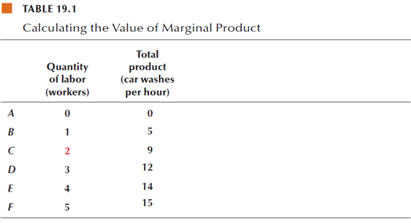
19.1 DEMAND FOR A FACTOR OF PRODUCTION
The first two columns of the table are the firm’s total product schedule.

Slide 10
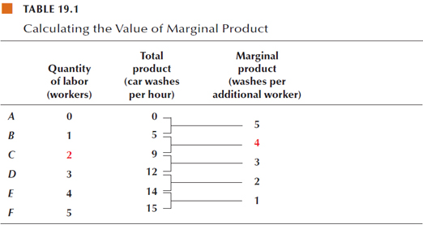
19.1 DEMAND FOR A FACTOR OF PRODUCTION
To calculate marginal product, find the change in total product as the quantity of labor increases by 1 worker.

Slide 11
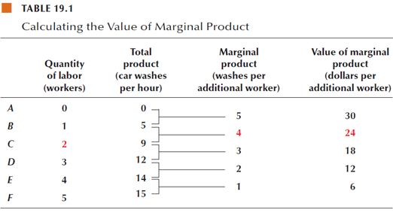
19.1 DEMAND FOR A FACTOR OF PRODUCTION
To calculate the value of marginal product, multiply the marginal product numbers by the price of a car wash, which in this example is $6.

Slide 13
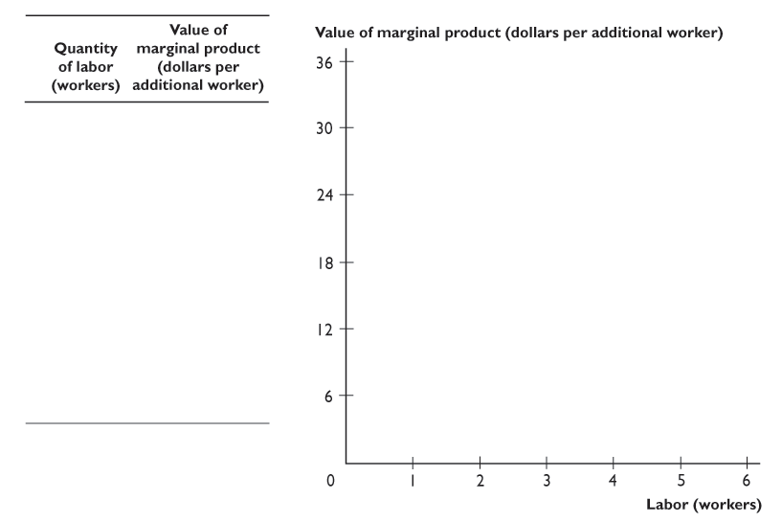
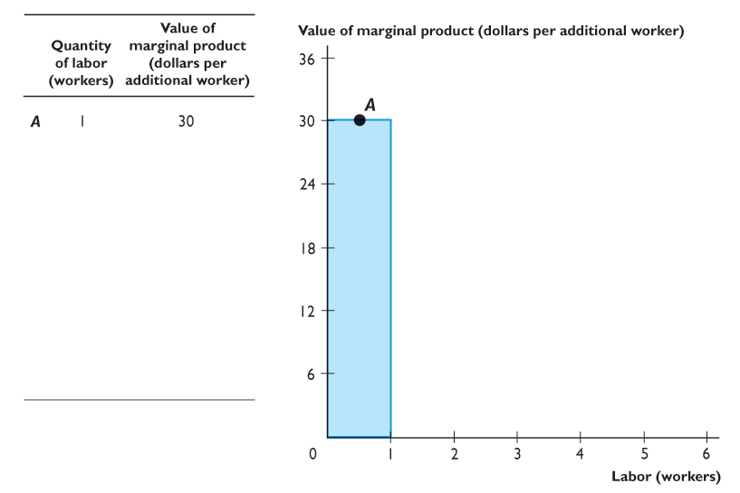
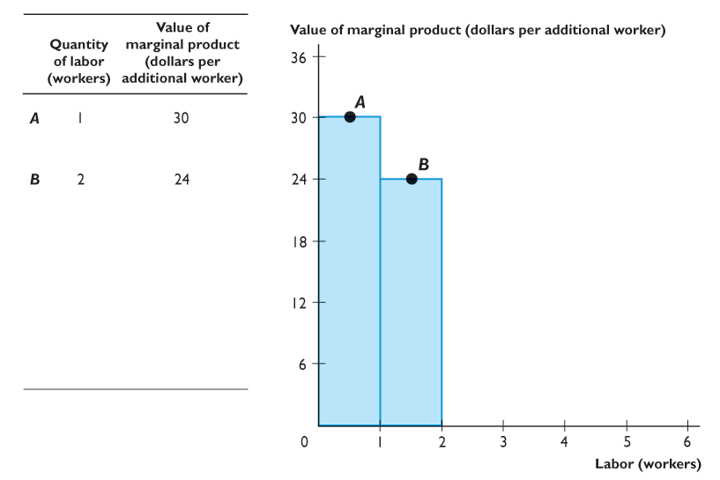
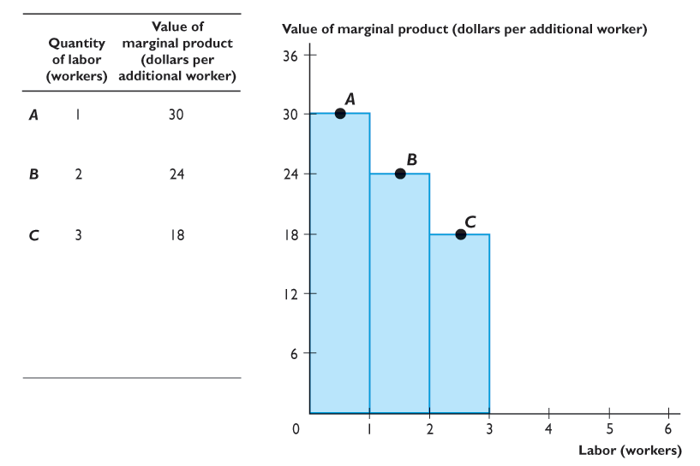
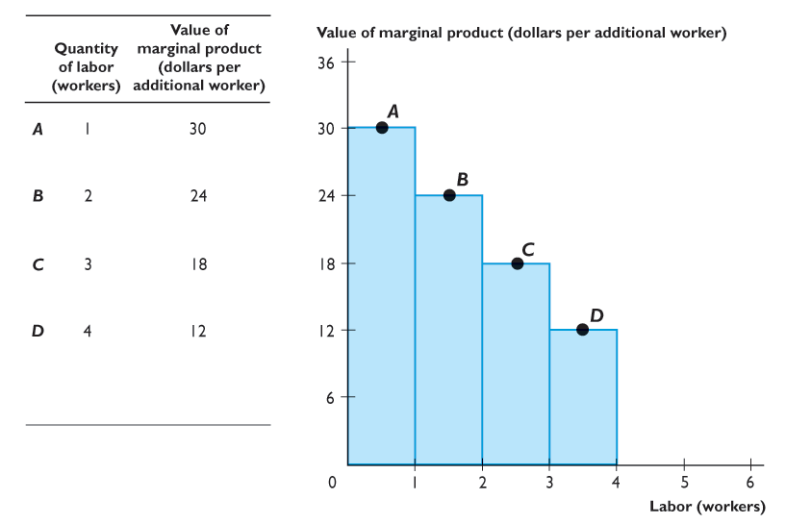
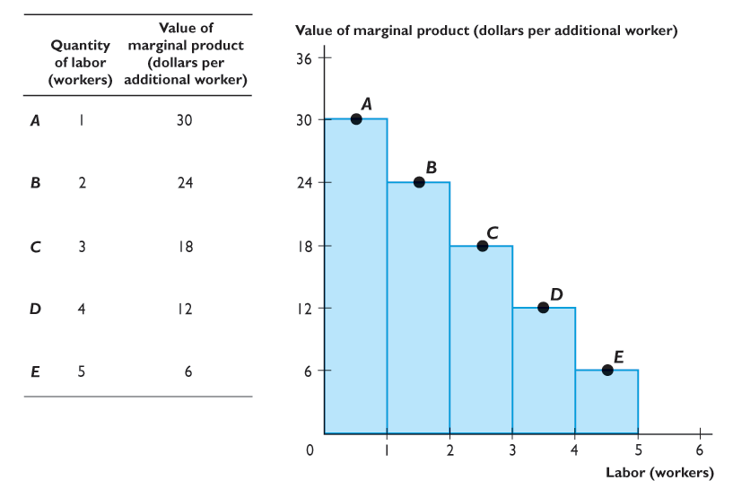
19.1 DEMAND FOR A FACTOR OF PRODUCTION
Figure 19.1 shows the value of the marginal product at Max’s Wash ’n’ Wax.
The blue bars show the value of the marginal product of the labor that Max hires based on the numbers in the table.

Slide 14


Slide 15
19.1 DEMAND FOR A FACTOR OF PRODUCTION
The orange line is the firm’s value of the marginal product of labor curve.

Slide 16
19.1 DEMAND FOR A FACTOR OF PRODUCTION
A Firm’s Demand for Labor
A firm hires labor up to the point at which the value of marginal product equals the wage rate.
If the value of marginal product of labor exceeds the wage rate, a firm can increase its profit by employing one more worker.
If the wage rate exceeds the value of marginal product of labor, a firm can increase its profit by employing one fewer worker.

Slide 17
19.1 DEMAND FOR A FACTOR OF PRODUCTION
A Firm’s Demand for Labor Curve
A firm’s demand for labor curve is also its value of marginal product curve.
If the wage rate falls, a firm hires more workers.

Slide 18
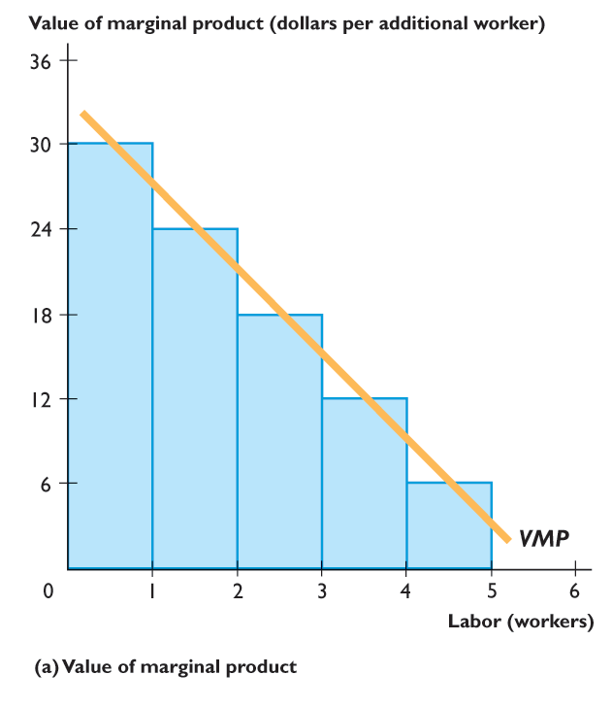
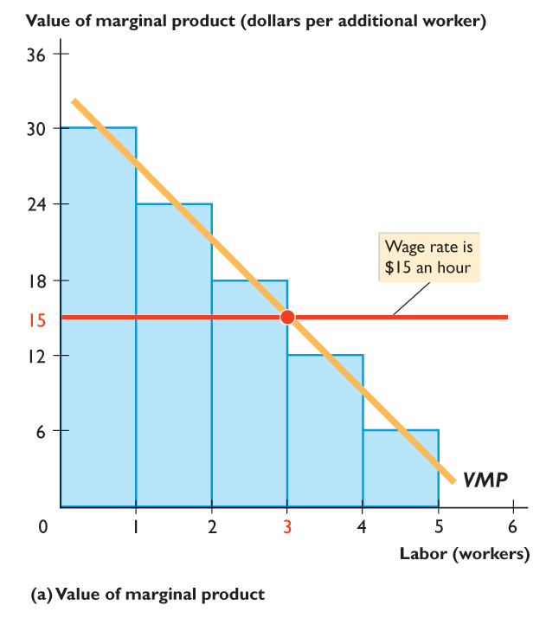
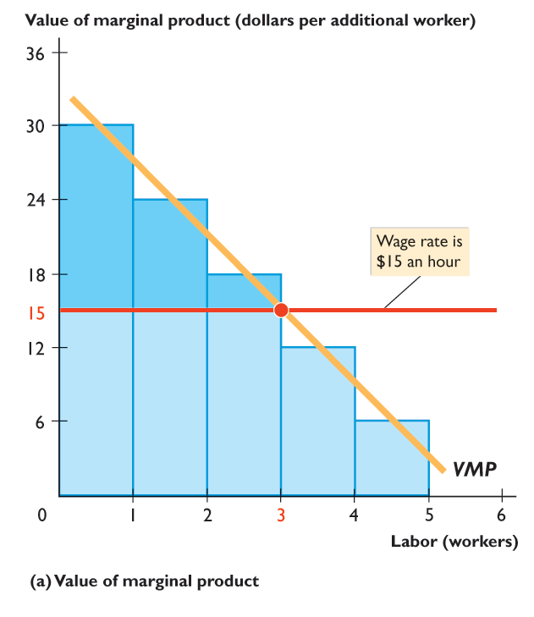
19.1 DEMAND FOR A FACTOR OF PRODUCTION
Figure 19.2 shows the demand for labor at Max’s Wash ’n’ Wax.
At a wage rate of $15 an hour, Max makes a profit on the first 3 workers but would incur a loss on the fourth worker.

Slide 19
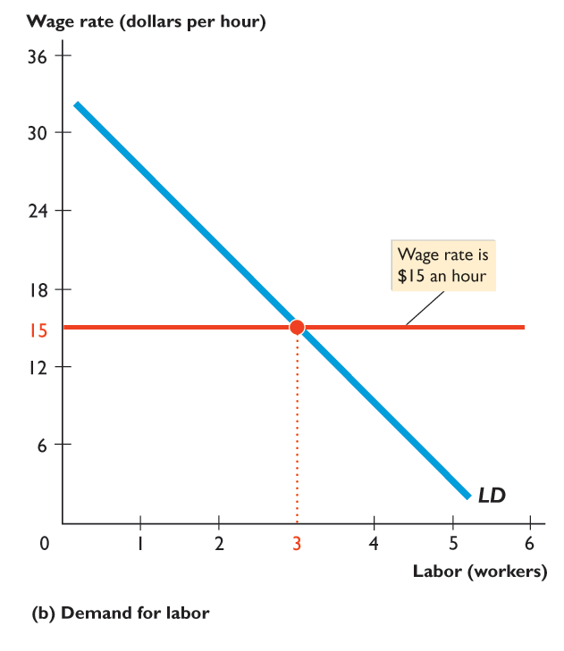
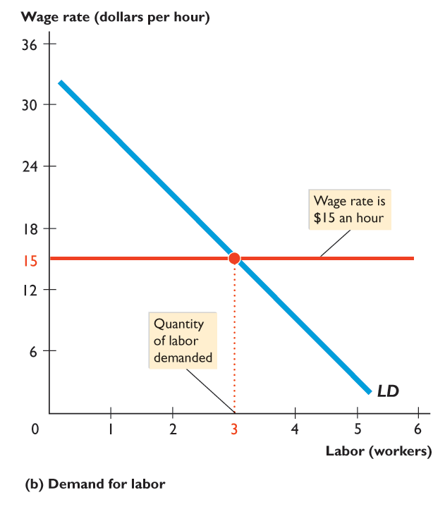

Slide 20
19.1 DEMAND FOR A FACTOR OF PRODUCTION
Max’s demand for labor curve is the same as the value of marginal product curve.
At a wage rate of $15 an hour, Max makes a profit on the first 3 workers but would incur a loss on the fourth worker.
So Max’s quantity of labor demanded is 3 workers.

Slide 21
19.1 DEMAND FOR A FACTOR OF PRODUCTION
The demand for labor curve slopes downward because the value of the marginal product of labor diminishes as more labor is employed.

Slide 22
19.1 DEMAND FOR A FACTOR OF PRODUCTION
Changes in the Demand for Labor
The demand for labor depends on
The price of the firm’s output
The prices of other factors of production
Technology

Slide 23
19.1 DEMAND FOR A FACTOR OF PRODUCTION
The Price of the Firm’s Output
The higher the price of the good or service produced by the firm, the greater is the firm’s demand for labor.
The Prices of Other Factors of Production
If the price of using capital decreases relative to the wage rate, a firm substitutes capital for labor and increases the quantity of capital it uses.
Usually, the demand for labor will decrease when the price of using capital falls.

Slide 24
19.1 DEMAND FOR A FACTOR OF PRODUCTION
Technology
New technologies decrease the demand for some types of labor and increase the demand for other types.

Slide 25
19.2 LABOR MARKETS
The Supply of Labor
People supply labor to earn an income.
Many factors influence the quantity of labor that a person plans to provide, but the wage rate is a key factor.
Figure 19.3 on the next slide shows an individual’s labor supply curve.

Slide 26
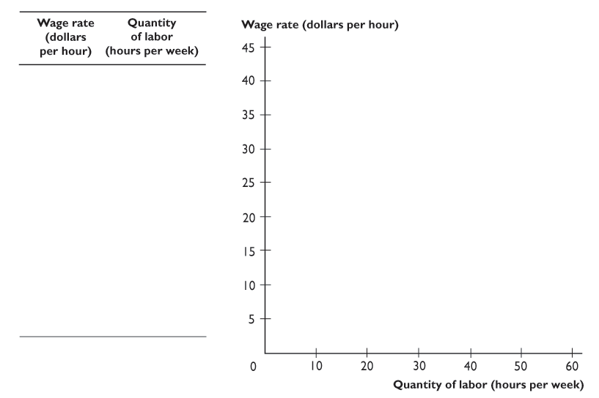
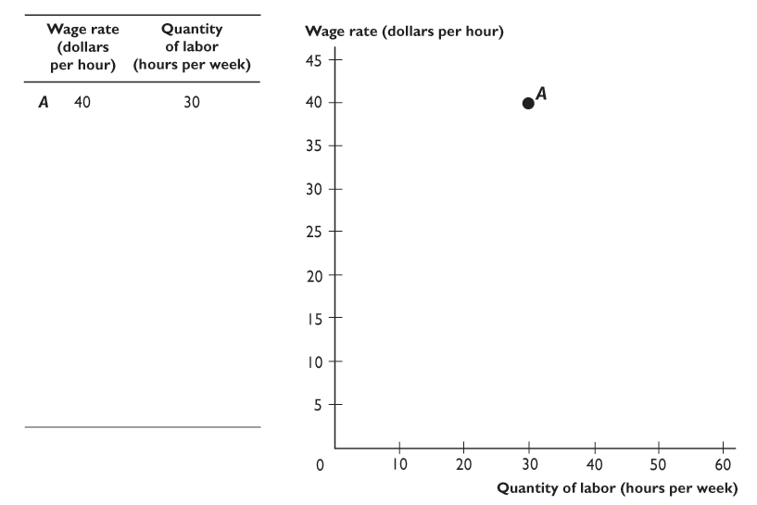
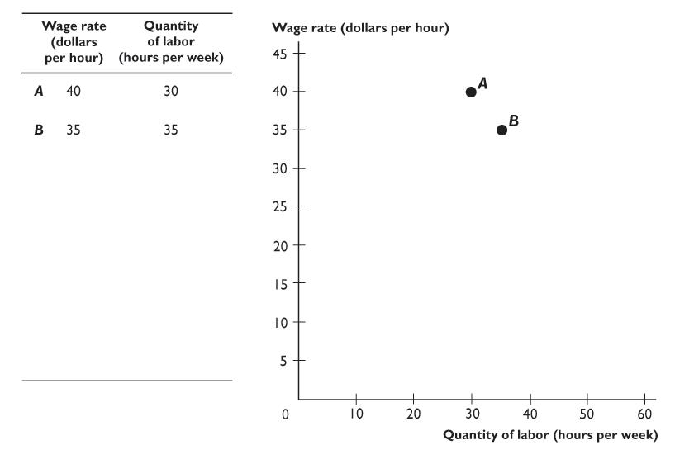
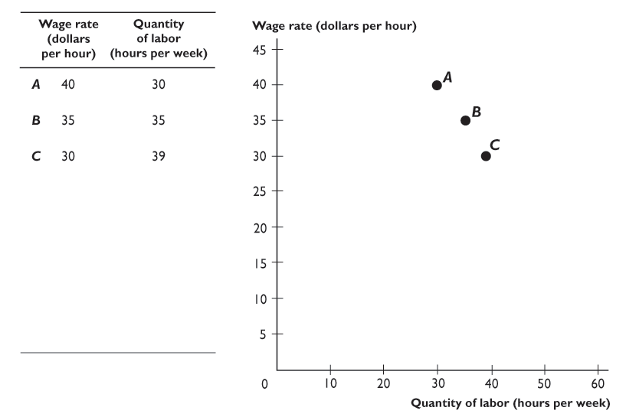
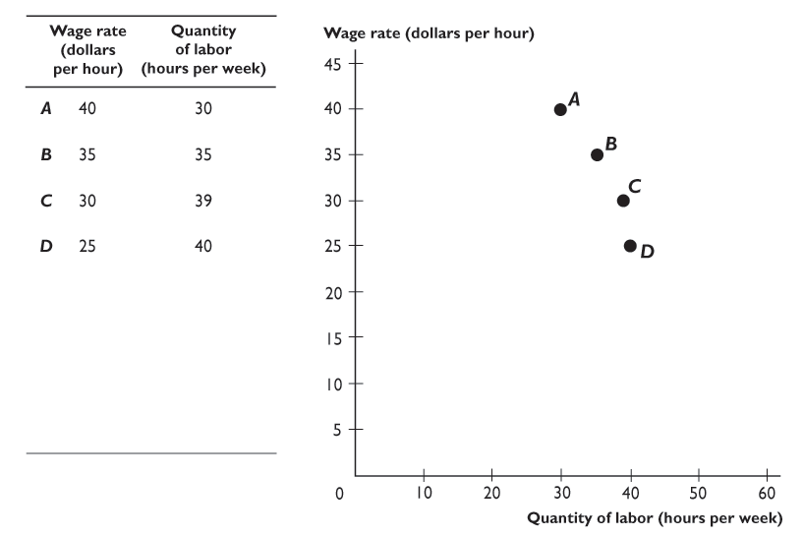
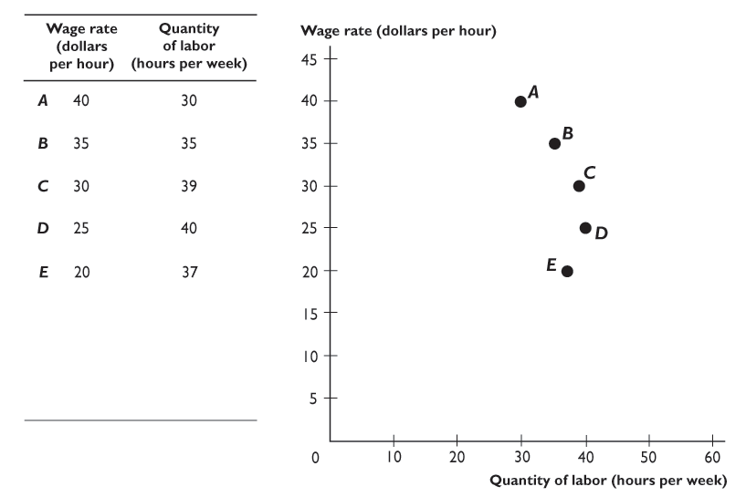
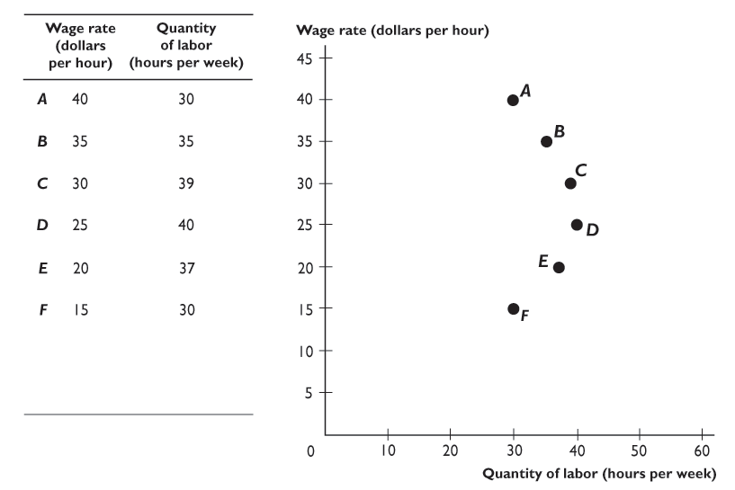
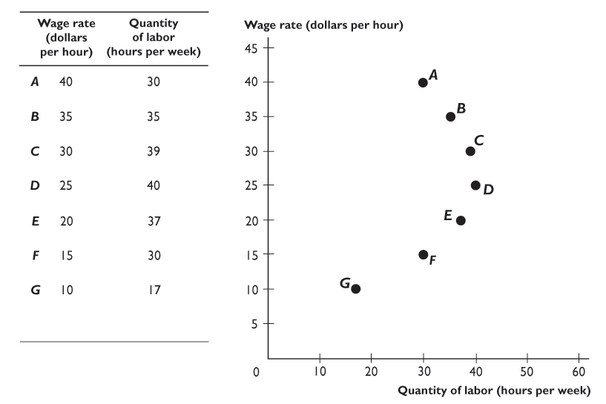
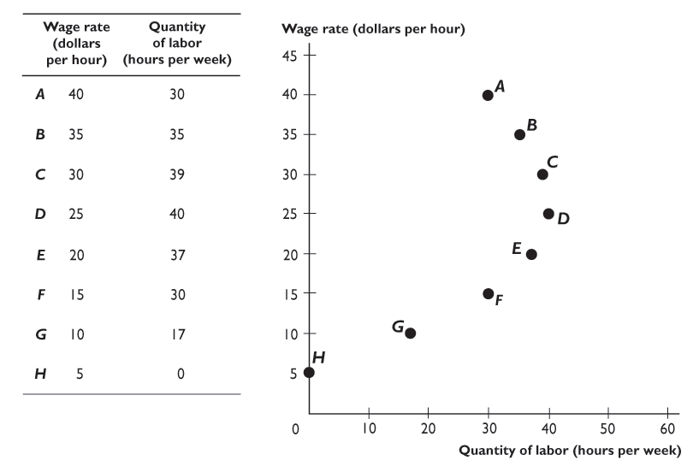
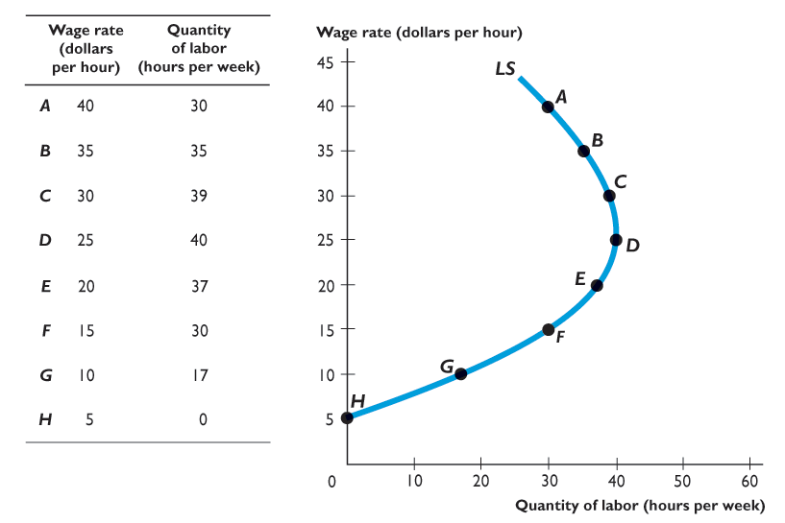
19.2 LABOR MARKETS
The table shows Larry’s labor supply schedule …
which is plotted in the figure as Larry’s labor supply curve.
Notes:
Ask the students if they would be willing to work 40 hours each week at a wage rate of $20 per hour (which is about $40,000 per year). Next, ask them whether they would increase their labor supplied to 48 hours per week if they could earn $40 per hour (about $80,000 per year, if working 40 hours per week). Most students would be willing to work more hours per week at this wage rate. Then ask them how many hours per week they would work if they were paid $10,000 per hour. In this case, working only one day per week would garner them about $8 million per year, leaving the remaining six days of each week to enjoy their high income. Many would not be willing to continue working 48 hours a week, thereby creating a backward-bending supply of labor curve.

Slide 27
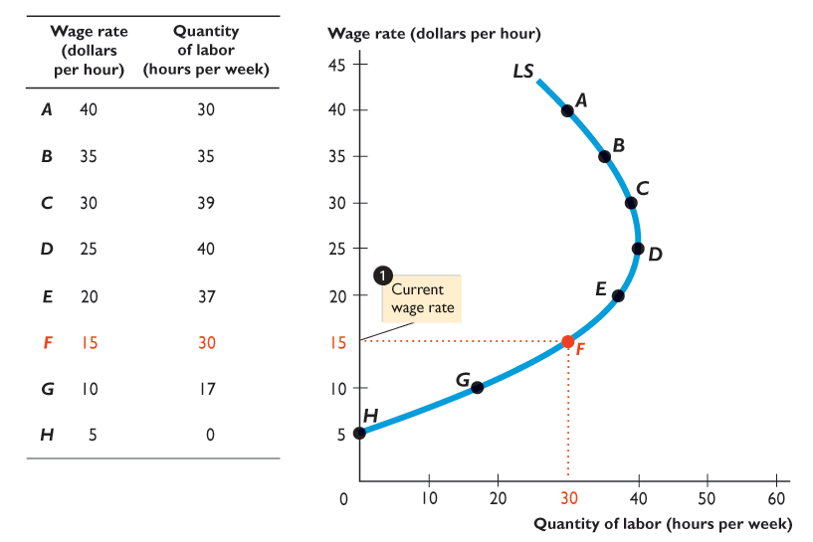
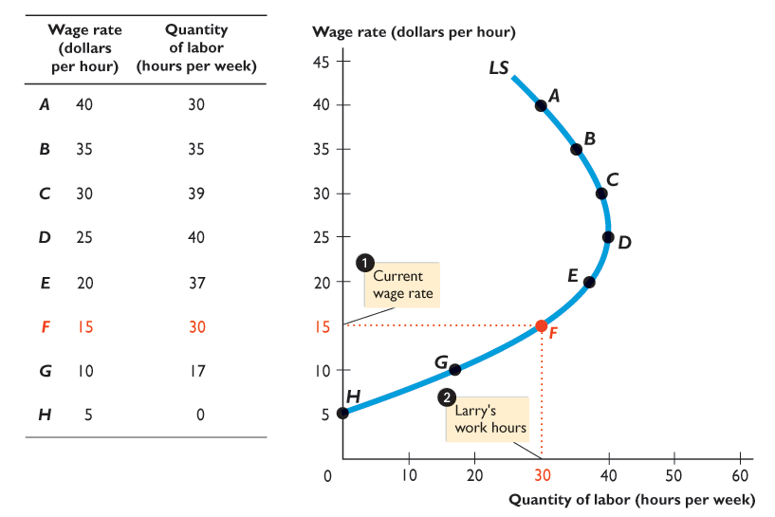
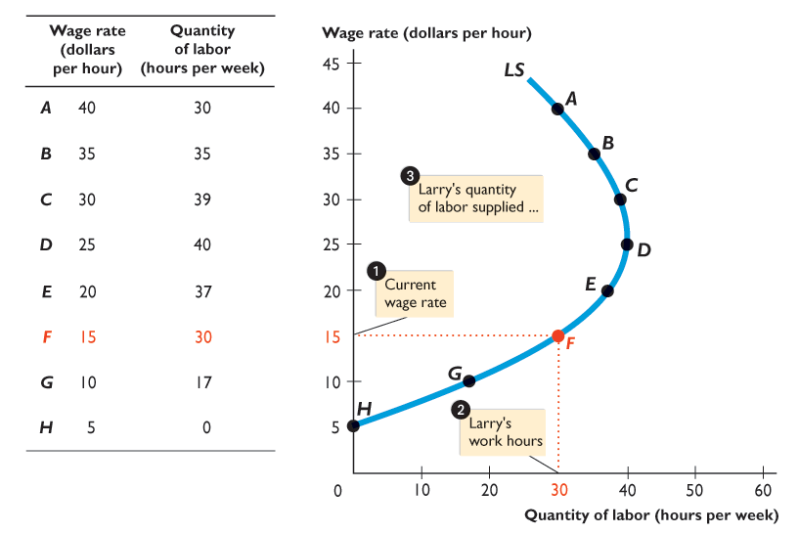
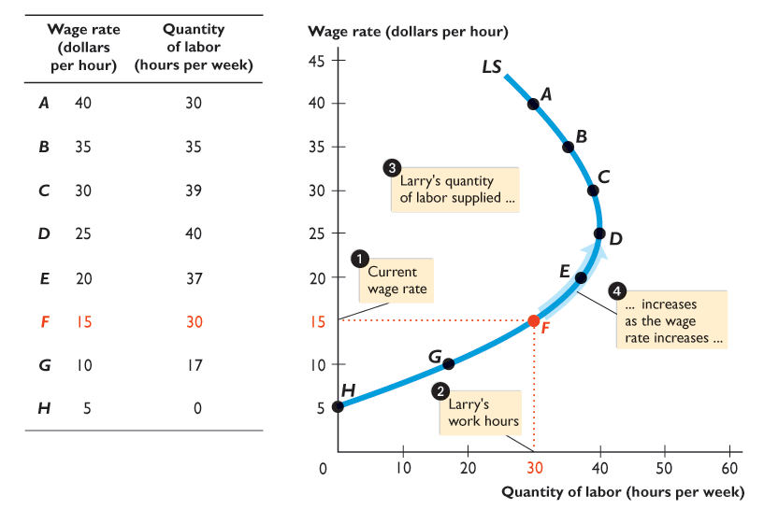
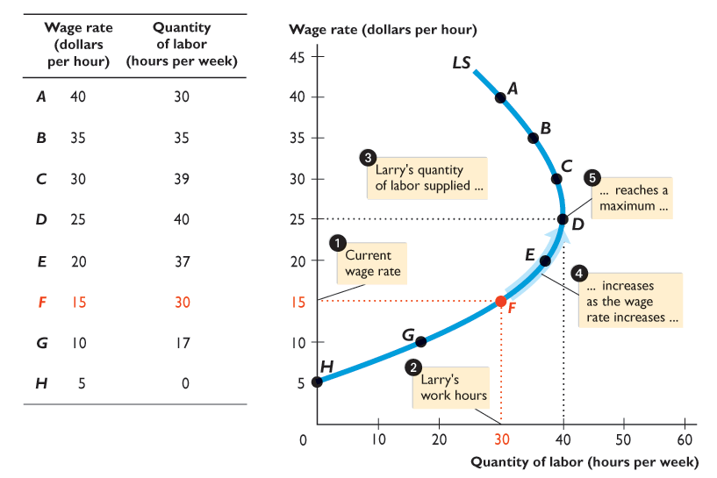
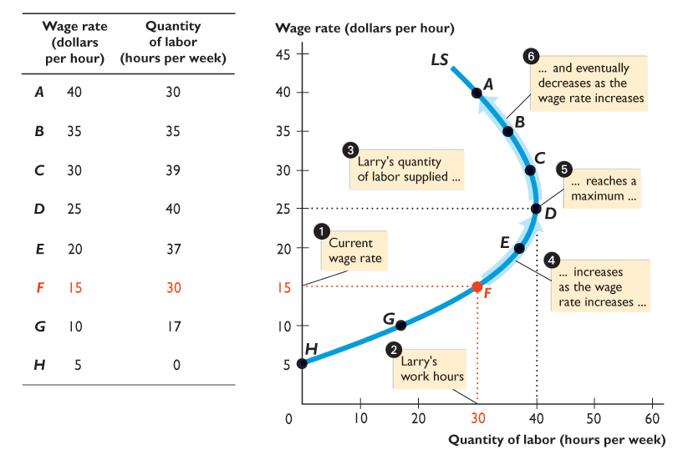

Slide 28
19.2 LABOR MARKETS
At a wage rate of $15 an hour, Larry …
supplies 30 hours of labor a week.

Slide 29
19.2 LABOR MARKETS
As the wage rate rises, Larry’s quantity of labor supplied …
increases,
reaches a maximum,
then decreases.

Slide 30
19.2 LABOR MARKETS
Larry’s labor supply curve eventually bends backward.

Slide 31
19.2 LABOR MARKETS
Market Supply Curve
A market supply curve shows the quantity of labor supplied by all households in a particular job.
It is found by adding together the quantities of labor supplied by all households at each wage rate.
Figure 19.4 on the next slide shows the supply of car wash workers.

Slide 32
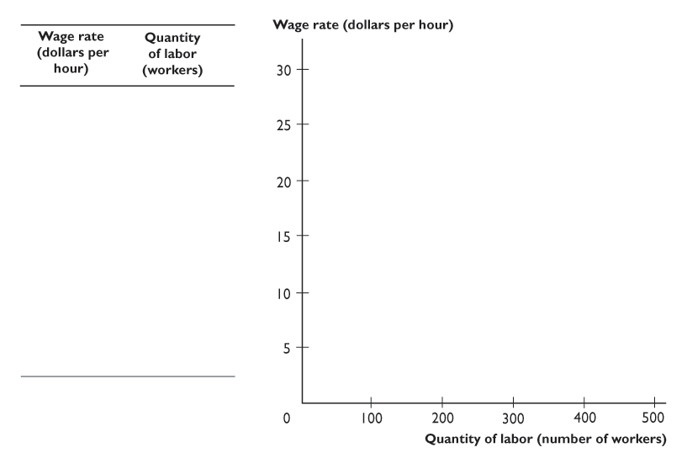
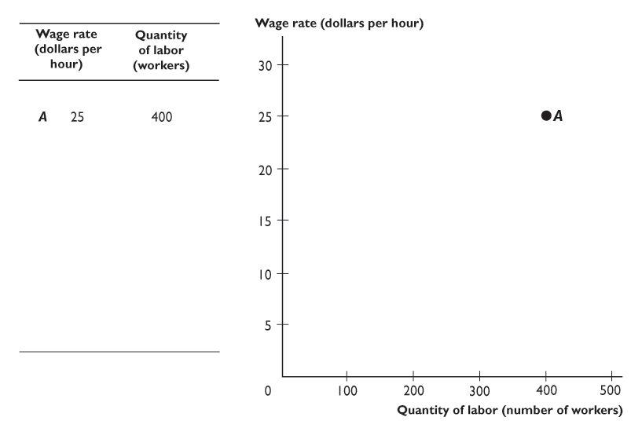
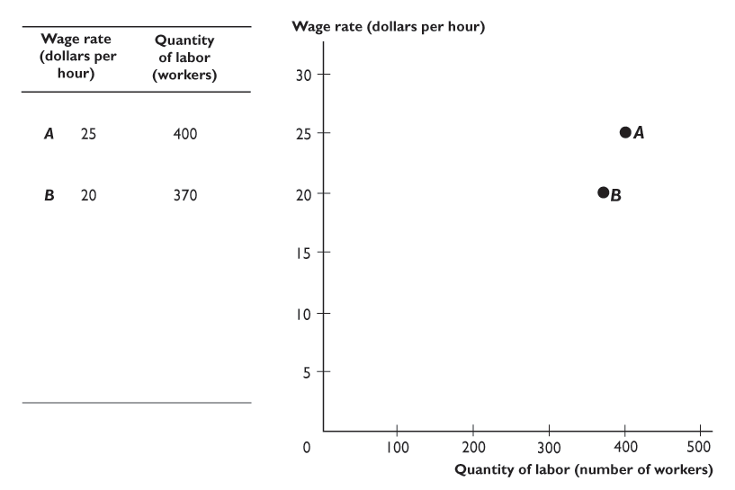
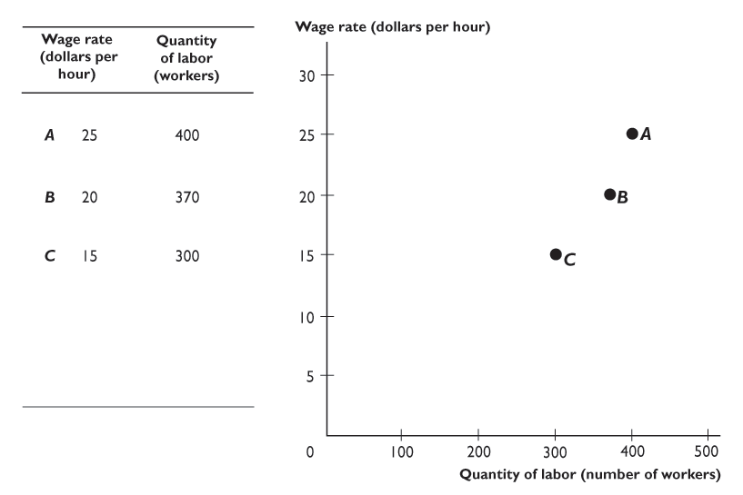
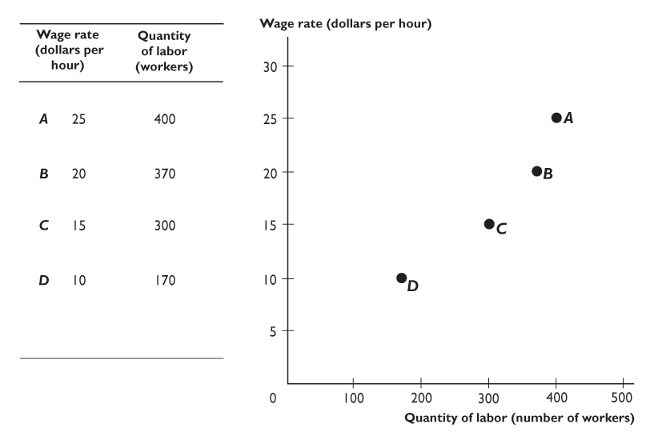
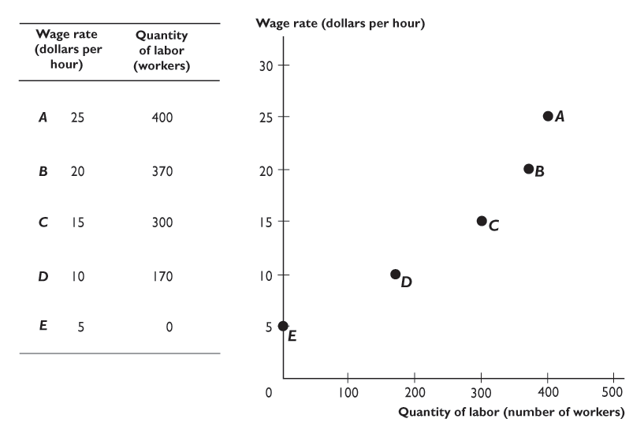
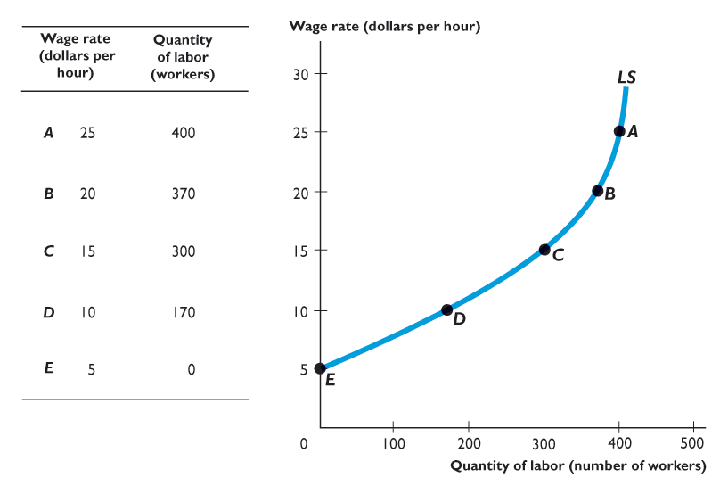
19.2 LABOR MARKETS
This supply curve shows how the quantity of labor supplied changes when the wage rate changes, other things remaining the same.

Slide 34
19.2 LABOR MARKETS
In a market for a specific type of labor, the quantity supplied increases as the wage rate increases, other things remaining the same.

Slide 35
19.2 LABOR MARKETS
Influences on the Supply of Labor
Three key factors influence the supply of labor:
Adult population
Preferences
Time in school and training

Slide 36
19.2 LABOR MARKETS
Adult Population
An increase in the adult population increases the supply of labor.
Preferences
There has been a large increase in the supply of female labor since 1960.
The percentage of men with jobs has shrunk slightly.

Slide 37
19.2 LABOR MARKETS
Time in School and Training
The more people who remain in school for full-time education and training, the smaller is the supply of low-skilled labor.

Slide 38
19.2 LABOR MARKETS
Competitive Labor Market Equilibrium
Labor market equilibrium determines the wage rate and employment.
Figure 19.5 on the next slide illustrates equilibrium in the market for car wash workers.

Slide 39
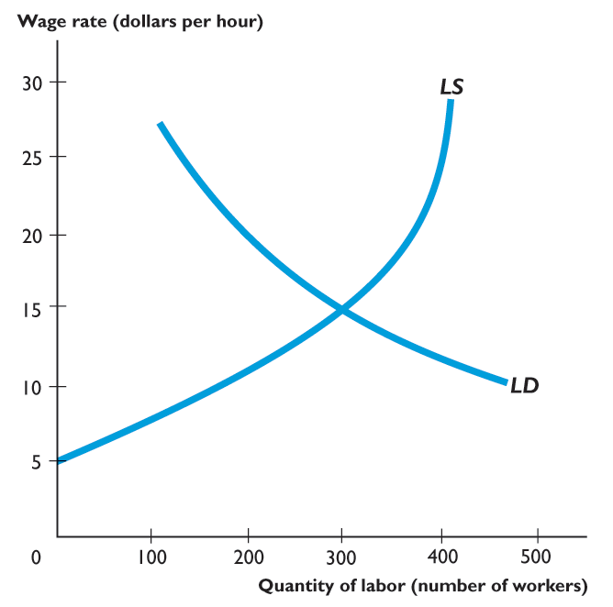
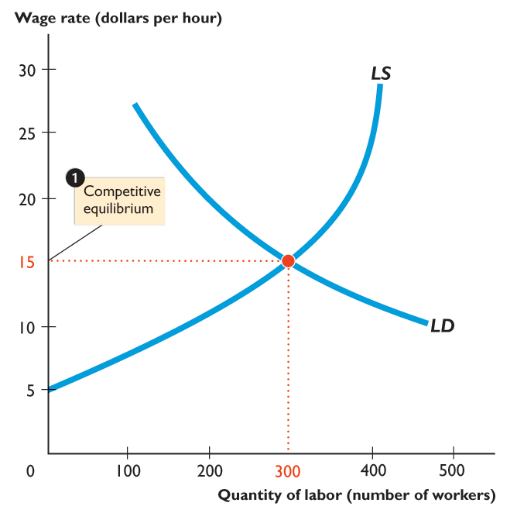
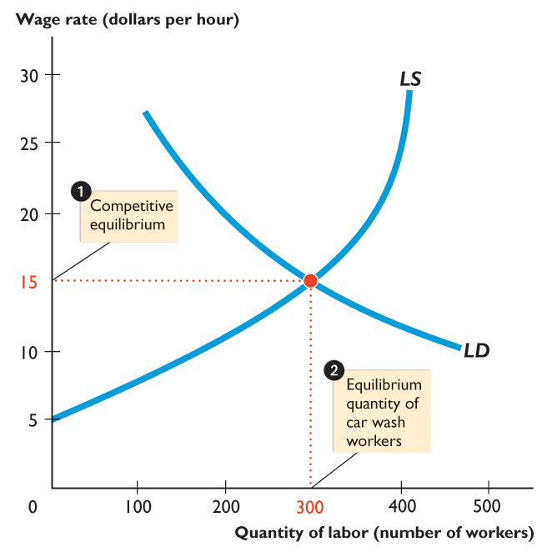
19.2 LABOR MARKETS
The equilibrium wage rate is $15 an hour.
The equilibrium quantity of labor is 300 workers.

Slide 41
19.2 LABOR MARKETS
Labor Unions
A labor union is an organized group of workers that aims to increase wages and influence other job conditions.
In some labor markets, labor unions have a powerful effect on the wage rate and employment.
Figure 19.6 shows what happens when a union enters a competitive labor market.
Notes:
Professional associations are among the most successful labour market monopolists. Students are usually interested in the fact that doctors and lawyers control entry into their professions and raise the compensation above the competitive equilibrium level. The outcome is inefficient.

Slide 42
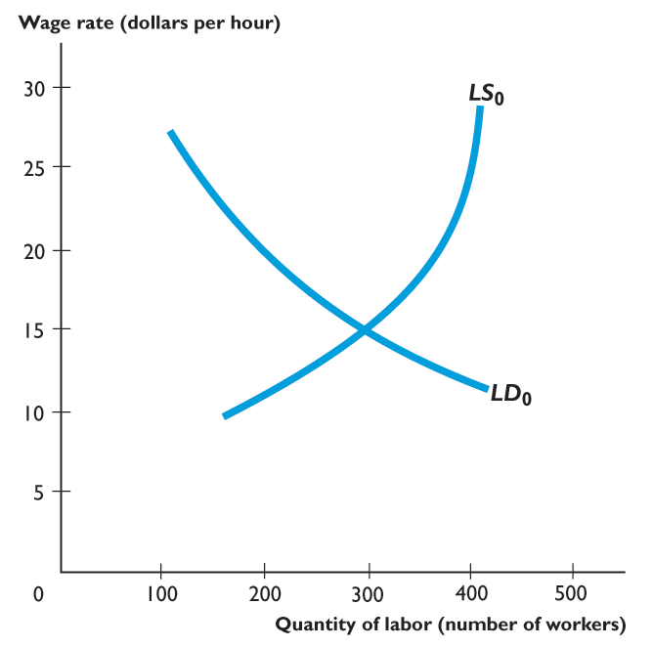
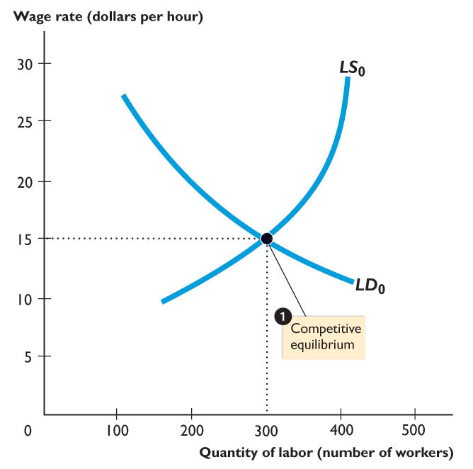
19.2 LABOR MARKETS
A Union Enters a Competitive Labor Market
In a competitive labor market, the demand for labor is LD₀ and the supply of labor is LS₀,
The equilibrium wage rate is $15 an hour and the equilibrium quantity of labor is 300 workers.

Slide 43
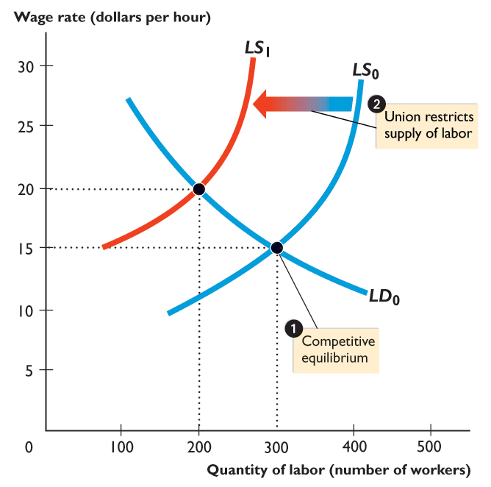
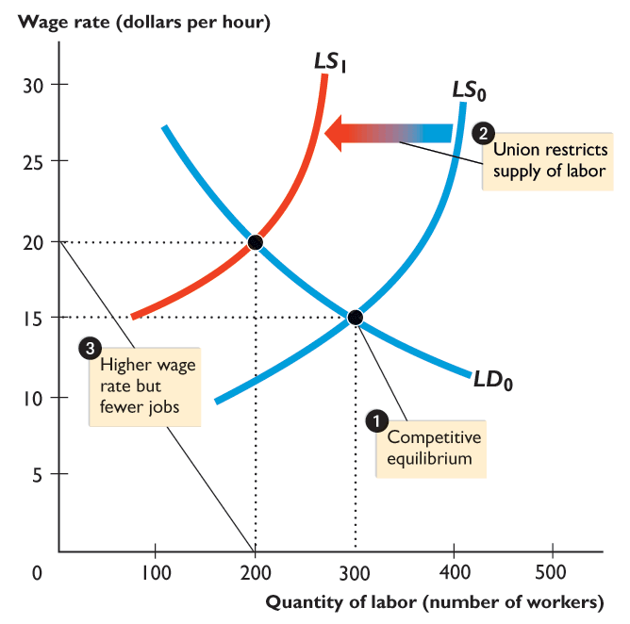
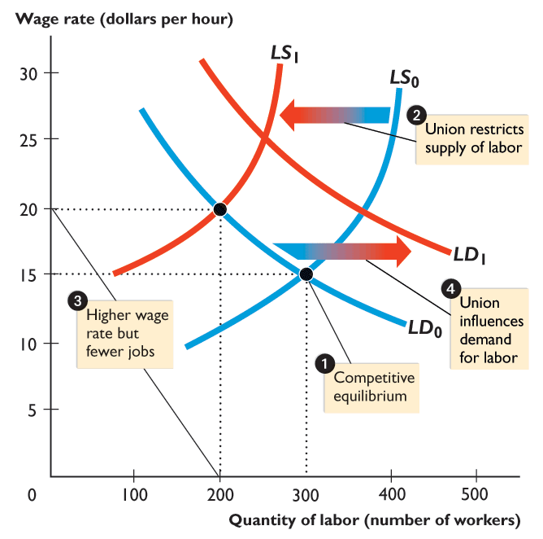
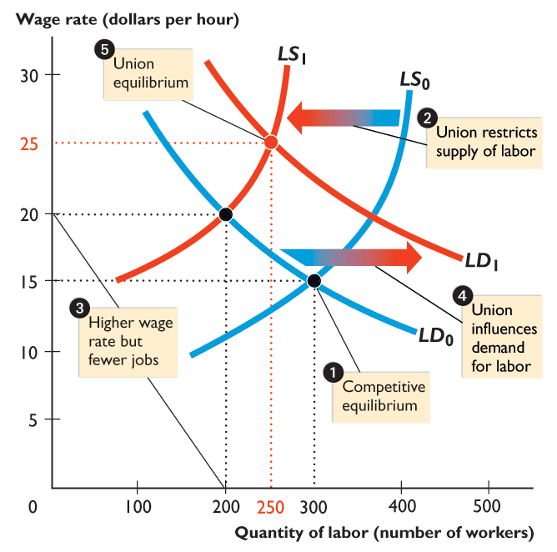

Slide 44
19.2 LABOR MARKETS
A labor union restricts the supply of labor and the supply of labor curve shifts leftward to LS₁.
The wage rate rises to $20 an hour, but employment decreases to 200 workers.
Jobs are traded off for a higher wage rate.

Slide 45
19.2 LABOR MARKETS
If union action increases labor productivity, the demand for union labor increases and the demand for labor curve shifts rightward to LD₁.
The wage rate rises to $25 an hour and employment increases to 250 workers.

Slide 46
19.2 LABOR MARKETS
How Labor Unions Try to Increase the Demand for Labor
Unions try to change the demand for labor by
Increasing the value of marginal product of union members
Supporting minimum wage laws
Supporting immigration restrictions
Supporting import restrictions

Slide 47
19.2 LABOR MARKETS
Can Unions Restrict the Supply of Labor?
The union’s ability to restrict the supply of labor is limited by how well it can prevent nonunion workers from offering their labor in the same market as union workers.
It is difficult for unions to operate in markets where there is an abundant supply of willing nonunion workers.

Slide 48
19.2 LABOR MARKETS
The Scale of Union-Nonunion Wage Gap
How much of a difference to wage rates do unions make?
To answer this question, we must look at the wages of unionized and nonunionized workers who do similar work.
The evidence suggests that after allowing for skill differences, the union-nonunion wage gap lies between 10 percent and 25 percent.

Slide 49
19.3 CAPITAL AND NATURAL RESOURCE MARKETS
Capital Markets
The demand for capital is based on the value of marginal product of capital.
Profit-maximizing firms hire capital services up to the point at which the value of marginal product of capital equals the rental rate of capital.
The lower the rental rate, other things remaining the same, the greater is the quantity of capital demanded.

Slide 50
19.3 CAPITAL AND NATURAL RESOURCE MARKETS
The supply of capital responds in the opposite way to the rental rate.
The higher the rental rate, other things remaining the same, the greater is the quantity of capital supplied.
The equilibrium rental rate makes the quantity of capital demanded equal to the quantity supplied.
Figure 19.7 illustrates the market for the rental of tower cranes, capital used to construct high-rise buildings.

Slide 51
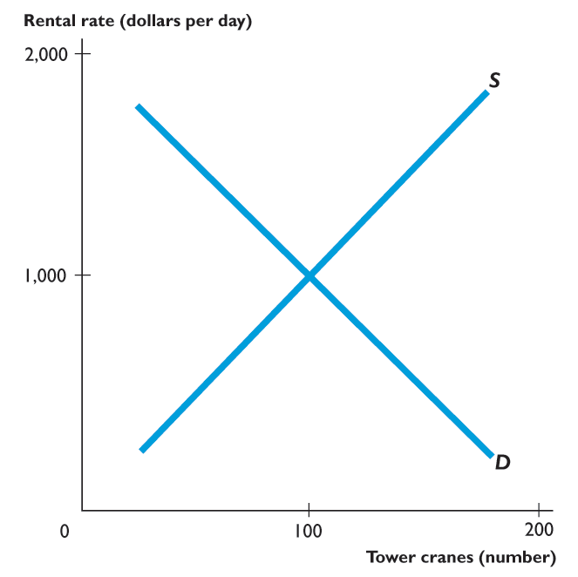
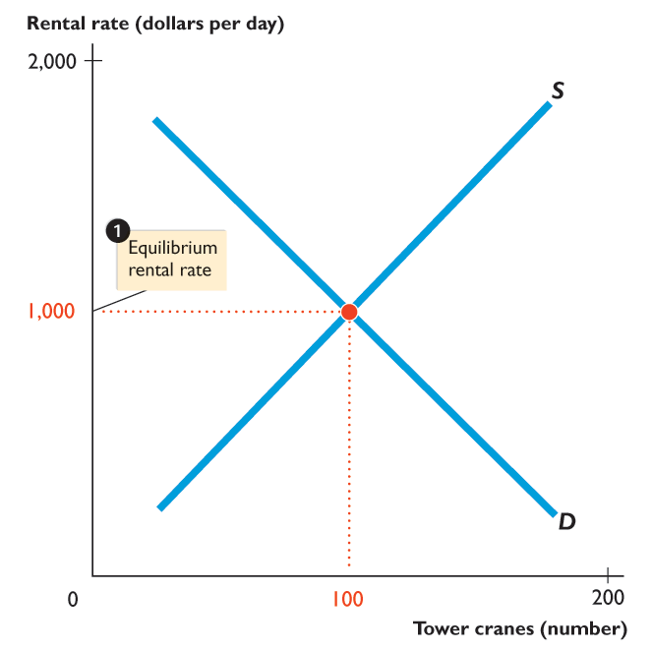
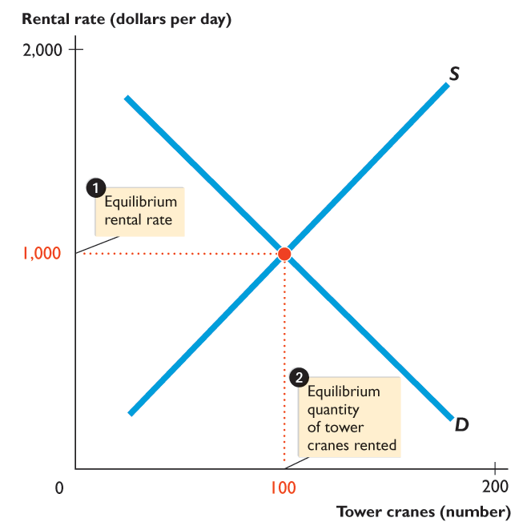
19.3 CAPITAL AND NATURAL RESOURCE MARKETS
The demand curve for capital is D and the supply curve is S.
The equilibrium rental rate is $1,000 per day.
The equilibrium quantity of capital rented is 100 tower cranes.

Slide 53
19.3 CAPITAL AND NATURAL RESOURCE MARKETS
Land Markets
The demand for land is based on the value of marginal product of land.
Firms maximize profits by renting the quantity of land at which the value of marginal product of land equals the rental rate of land.
The lower the rental rate, other things remaining the same, the greater is the quantity of land demanded.
But the supply of land is special: The quantity is fixed.
The supply of each block of land is perfectly inelastic.

Slide 54
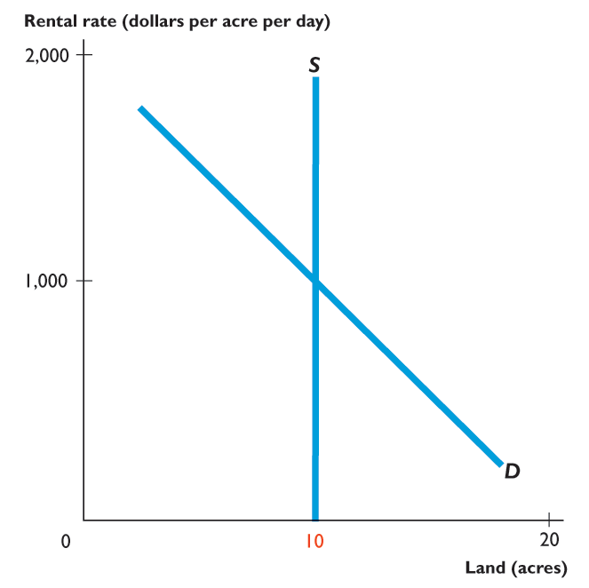
19.3 CAPITAL AND NATURAL RESOURCE MARKETS
Figure 19.8 illustrates the market for a given parcel of land, a 10-acre block on Manhattan’s 5th Avenue.
The quantity supplied is 10 acres regardless of the rent.

Slide 55


Slide 56
19.3 CAPITAL AND NATURAL RESOURCE MARKETS
The demand curve for a 10-acre block of land is D.
Equilibrium rental rate is $1,000 an acre per day.

Slide 57
19.3 CAPITAL AND NATURAL RESOURCE MARKETS
Nonrenewable Natural Resource Markets
The supply side of a nonrenewable natural resource market is special.
Over time, the quantity of a nonrenewable resource decreases as it is used up. The stock decreases.
But the proven reserves of a natural resource increase because advances in technology enable ever less accessible sources of the resource to be discovered.
Using a natural resource decreases its supply and increases its price; new discoveries increase supply and decrease its price.

Slide 58
19.3 CAPITAL AND NATURAL RESOURCE MARKETS
The Supply of a Nonrenewable Natural Resource
The owner of a nonrenewable natural resource is willing to supply any quantity for the right price.
But what is the right price?
It is the price that gives the same expected profit from supplying the resource now as holding the resource and supplying it next year.
This price is lower than the price expected next year by an amount determined by the interest rate.

Slide 59
19.3 CAPITAL AND NATURAL RESOURCE MARKETS
Equilibrium in a Nonrenewable Natural Resource Market
In a nonrenewable natural resource market, the equilibrium price is the one that gives suppliers an expected profit equal to the interest rate.
The equilibrium quantity is the quantity demanded at that price.
Over time, the equilibrium quantity of a natural resource used changes as the demand for it changes.
The price of a natural resource also changes over time.

Slide 60
19.3 CAPITAL AND NATURAL RESOURCE MARKETS
The price changes over time for two reasons:
Expectations change.
Suppliers of a natural resource expect the price to rise by the same percentage as the interest rate.
The expected future price of a natural resource depends on the expected future rate of use and rate of discovery of new sources of supply.
But one person’s expectation about a future price also depends on guesses about other people’s expectations.
When the expected future price of a natural resource changes, its supply changes to reflect that expectation.

Slide 61
19.3 CAPITAL AND NATURAL RESOURCE MARKETS
Suppliers of a natural resource expect the price to rise by the same percentage as the interest rate.
If expectations are on the average correct and nothing happens to change expectations, the price does rise by the same percentage as the interest rate.
The proposition that the price of a nonrenewable natural resource is expected to rise at a rate equal to the interest rate is called the Hotelling Principle.
It was first realized by Harold Hotelling, an economist at Columbia University.

Slide 62

Nick Saban, head coach of the Alabama Crimson Tide, earns $7 million a year, 70 times what the University of Alabama pays an average economics professor.
Why does the University of Alabama pay a football coach the same amount that it pays 70 professors?
Nick Saban is worth 70 professors because his value of marginal product (VMP ) to the University of Alabama is 70 times that of a professor.
Few people have the talent and willingness to work hard and take the stress of being head coach of a topflight college football team.
Notes:
<number>

Slide 63
The supply of coaches like Nick Saban is small and inelastic.
To hire a top coach, the University of Alabama must pay the market price and that price is determined by the small supply and a high VMP.
The VMP of a football coach is high, because of the revenue that a successful football team generates.
Most of the revenue comes from increased donations by alumni and wealthy local and national patrons.
The better the coach, the better is the team’s performance and the greater is the revenue from these sources.
Notes:
<number>

Slide 64
Nick Saban brings in at least $7 million a year to the University of Alabama.
In contrast, a professor, even an outstanding one, generates a modest revenue for the University.
He or she attracts a few students and obtains some research grant funds from the National Science Foundation or other private foundations.
But the VMP of a professor is modest—around a 70th of the VMP of Nick Saban.
Notes:
<number>

