Slide 1
Week 10 Pension funds
What is a pension?
Types of pensions
Financing of pensions
UK pension arrangements
How are pensions invested?

Slide 2
What is meant by Pension?
A pension is an income paid to retired people, which replaces their earnings from employment.
Pensions are needed because peoples’ capacity to earn a living from employment declines with age.
Provide financial security after retirement.
Help ensure a comfortable standard of living post-work.
A pension plan is an asset pool that accumulates over an individual’s working years and is paid out during the nonworking years.
2 / 31

Slide 3
Types of Pensions
Pensions can be:
Private Pension Plans: any pension plan set up by employers, groups, or individuals - “funded” type
Public Pension Plan: any pension plan set up by a government body for the general public – generally PAYG type
3 / 31

Slide 4
Types of Pensions
Another way of categorizing, based on benefits:
Defined-Benefit (DB) Pension Plans
Provides a fixed monthly benefit in retirement, based on salary and years of service.
e.g. Annual Retirement Payment = 2% × average of final 3 years’ income × years of service
Key Features:
Predictable income.
Employer bears investment risk – need to ensure that the pension fund is sufficiently funded to meet the guaranteed benefits promised to employees, regardless of investment performance.
Example: BT Group, Royal Mail, Unilever and Lloyds Banking Group
4 / 31

Slide 5
Types of Pensions
2. Defined-Contribution (DC) Pension Plan: a plan where a set amount is invested for retirement, but the benefit payout available at retirement depends on the value of those investments.
Key Features:
Contributions are flexible.
Employee bears investment risk - the retirement benefit depends on how well the investments grow, and there is no guaranteed payout.
Example: Tesco, HSBC, Barclays, Aviva.
5 / 31

Slide 6
Methods of financing pensions
“Unfunded” schemes– pensions are paid from the earnings of current workers.
They are socially funded (rather than unfunded)
Also known as Pay-as-you-go (PAYG)
Funded schemes – workers accumulate a fund during their working lives which is used to provide them with a pension when they retire.
6 / 31

Slide 7
UK pension arrangements
1. The state pension – is a 'contribution-based' benefit run by the government and provided on a PAYG basis.
The basic state pension is a Government-administered scheme, funded by national insurance (NI) contributions, to give people who've reached state retirement age a guaranteed weekly income (DB type pension)
Current state pension age is 66, but for anyone born after 1978 it will be 68.
Current state pension benefit is a maximum of £203.85 per week (£10,610 a year).
To qualify for a full pension amounts, an individual is required to pay NI contributions for at least 35 years.
Is this sufficient to live?
In the US, this system is known as Social Security. Current maximum social security payment is £2900 a month, (£34,800 a year).
7 / 31

Slide 8
UK pension arrangements
2. Workplace (or Occupational) pension: A percentage of your pay is put into the pension scheme automatically every payday.
In most cases, your employer also adds money into the pension scheme for you, and you get tax relief from the government.
e.g. In the The Teachers Pension, the govt pays 12.50% and the employee pays 6.25%.
The money is used to pay you an income for the rest of your life when you start getting the pension.
You can usually take some of your workplace pension as a tax-free lump sum when you retire.
8 / 31

Slide 9
UK pension arrangements
3. Individual (private) pensions – funded pensions sold by insurance companies.
A personal pension is a type of defined-contribution pension. You choose the provider and make arrangements for your contributions to be paid.
If you haven't got a workplace pension, getting a personal pension could be a good way of saving for retirement.
Whilst virtually all UK retirees receive a pension from the state, many also receive an employer’s pension and/or an individual pension.
A person retiring today might, for example, derive 50% of their total pension from the state, 40% from their former employer and 10% from an individual pension.
9 / 31

Slide 10
Pension Fund for Self-Employed Individuals
Self-employed individuals must actively set up their pensions. They receive
tax relief on contributions.
Self-Invested Personal Pension (SIPP)
Flexible, allows contributions up to £60,000 per year.
Wide range of investment options (stocks, bonds, funds).
Access from age 55 (rising to 57 in 2028).
Stakeholder Pension
Low-cost, simple pension plan.
Minimum contributions as low as £20/month.
The investment choices are predefined, and you cannot select individual assets. Most stakeholders invest in a mix of funds chosen by the provider.
Small Self-Administered Scheme (SSAS)
Suitable for small business owners.
Offers control over investments, including company shares and commercial property.
Contributions made by the business.
9 / 31

Slide 11
Structure and operational aspects of pension funds
Pension fund companies are non-deposit taking institutions which exist to provide pensions to retired people.
In the UK pension funds are usually set up as trusts with a board of trustees whose job it is to see that a fund is run in the best interest of its members.
Trustees appoint a manager, often a specialist company, to collect and invest member’s contributions and organize their pension payments.
There is a government-set limit (called charge cap) on fund management fees that can be charged within DC schemes, currently set at 0.75% of funds under management.
11 / 31

Slide 12
Money flows through pension funds
There are four ways in which money flows through a pension fund
Inflows
1. Contributions – payments made by or on behalf of workers to their pension funds.
2. Investment earnings
Outflows
3. Pension payments
4 Charges and taxes
12 / 31

Slide 13
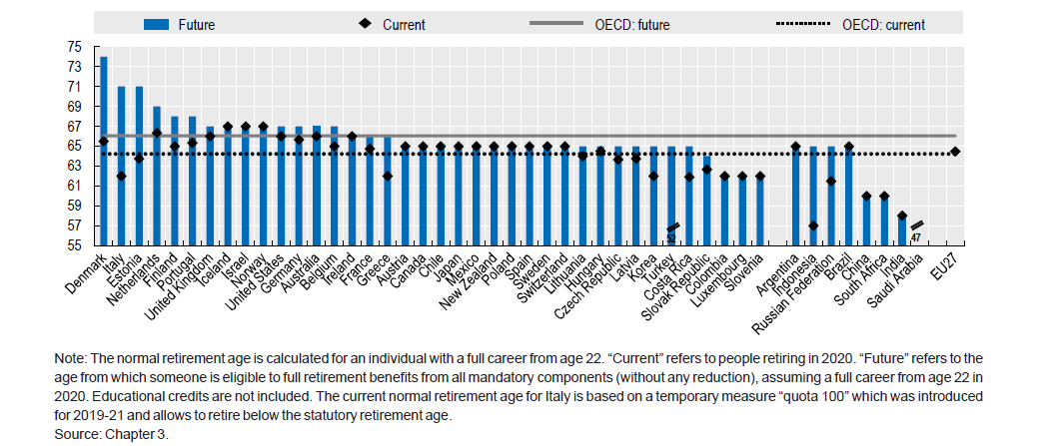
The normal retirement age is rising in many OECD countries
12 / 31

Slide 14
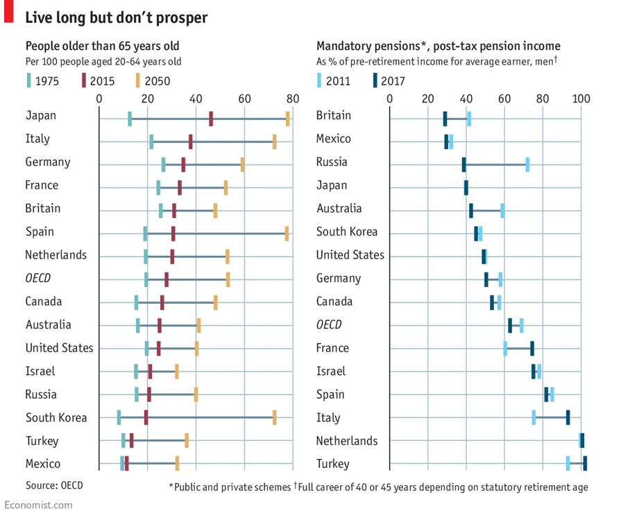
The Pensions Struggle
Source: The Economist article, “The Pensions Struggle” (2018)
14 / 31
Notes:
In Britain for example, the shift away from the more munificent “defined benefit” schemes has seen active membership of such open private sector schemes fall to 0.5m in 2016 from 1.4m ten years earlier. And in the past two years, one-third of the OECD’s members have changed required contribution levels, and three countries have raised their retirement ages. In about half of the club's states, men will work an extra 1.5 years and women an additional 2.1 years by 2060.
The cost of longer periods of retirement is that they will not be so richly enjoyed.

Slide 15
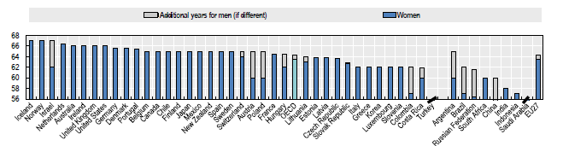
Current normal retirement age by gender
Source: OECD Pension Report 2020
14 / 31

Slide 16
14 / 31

Slide 17
Solvency of DB Pension Funds
For a DB pension fund to be solvent, there must be enough money available to pay all the pensions to which members are entitled.
DB funds are subject to periodic actuarial valuations to determine their solvency. This means that they are checked up on.
Recently, many UK and US DB funds have been found to be insolvent.
Carillion's 2018 collapse left 27,000 members of its 13 UK defined benefit pension schemes with a £2.6 billion deficit, covered by the Pension Protection Fund.
McClatchy Co., the second-largest newspaper publisher in the U.S., faced a liquidity crisis in late 2019 and was unable to make a required $124 million payment to its pension fund due in 2020.
Increases in life expectancy and lower interest rates left these schemes with significant financial deficits.
It is the responsibility of employers to make good any deficits in their DB funds.
17 / 31

Slide 18
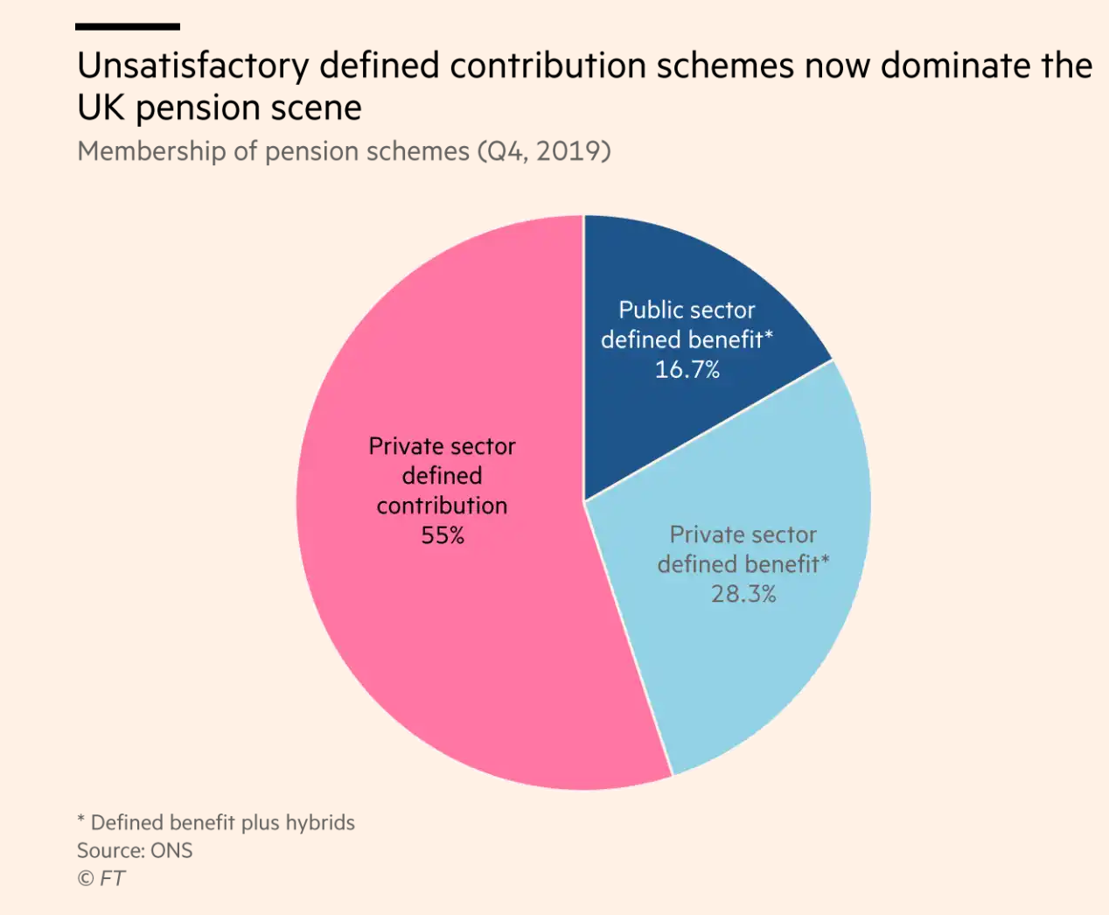
Transition of the UK pensions from Defined Benefit (DB) to Defined Contribution (DC)
For this reason, many employers are closing their DB funds and offering DC pensions instead.
Because DC pensions do not promise a fixed amount of retirement income, DC funds cannot fall into financial deficit.
Thus, moving employees to DC plans has an obvious benefit for employers.
However, DC pensions are potentially problematic for employees.
Source: Martin Wolf in Financial Times (2021), “Radical reform of British pension provision is urgent
18 / 31

Slide 19
Data source: Office for National Statistics
19 / 31

Slide 20
What determines pension income
The amount of pension income depends upon:
how much is contributed
contributions to DC funds are typically lower than to DB funds
the investment income earned
Pensions funds tend to be invested in low-risk low-return assets.
20 / 31

Slide 21
20 / 31

Slide 22
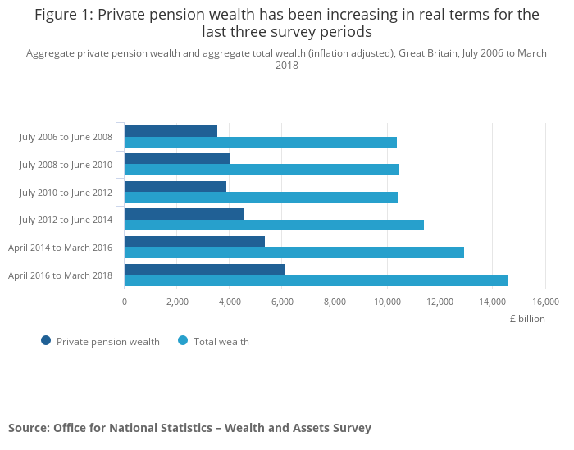
Total wealth includes property, financial, physical and private pension wealth
20 / 31

Slide 23
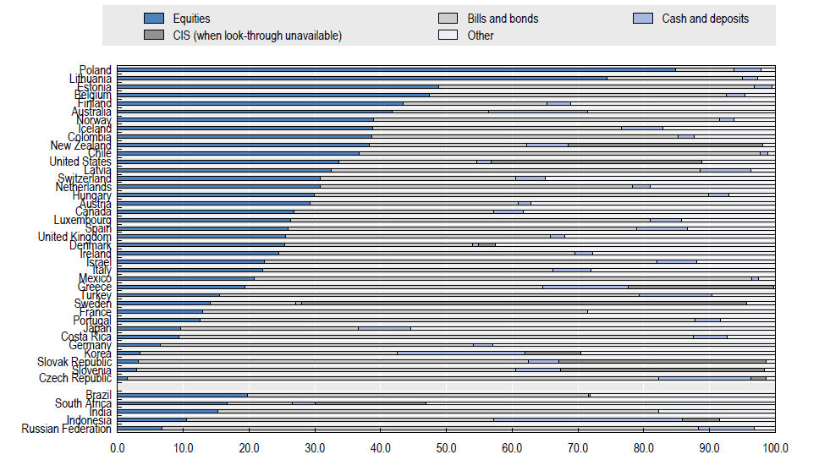
Allocation of assets in retirement savings plans in selected asset classes and investment vehicles, 2020 (as a percentage of total investment)
20 / 31

Slide 24
How Pensions are Invested
Investment Strategies
Asset Allocation: How pension funds are invested in different asset classes (equities, bonds, real estate, etc.).
Risk and Return: Higher-risk investments (e.g., equities) generally offer higher potential returns but with greater volatility.
Diversification: Spreading investments across various asset classes to reduce risk.
Fund Managers: Pension funds may be managed by professional fund managers who decide on investment strategies.
24 / 31

Slide 25
Types of Investment Assets
Equities (Stocks): High risk, potentially high returns, long-term growth.
Bonds: Lower risk, fixed returns, stable income.
Real Estate: Moderate risk, income through rental properties or capital gains.
Cash/Short-Term Investments: Low risk, low return, liquidity.
24 / 31

Slide 26
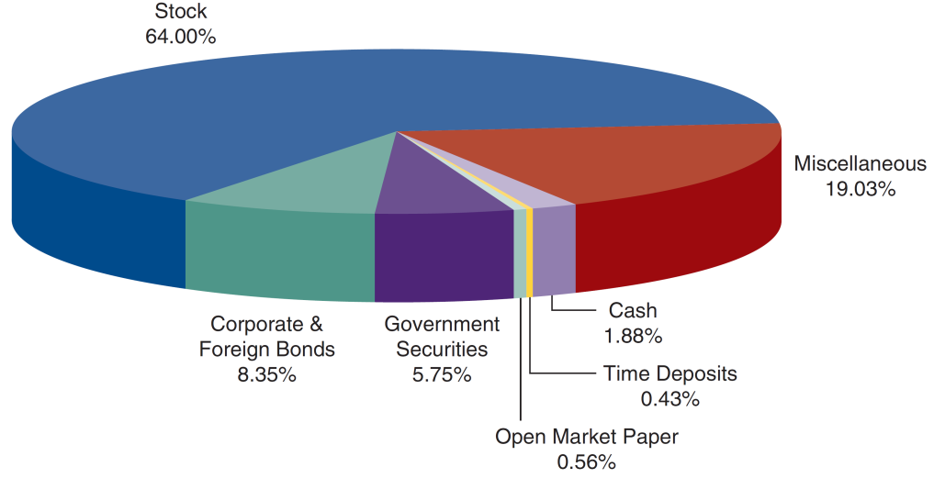
Investment of American Pension Funds in the US (in 2015)
Where are pension funds invested?
Source: http://www.federalreserve.gov/releases/z1/current/z1.pdf, Table L116.
26 / 31

Slide 27
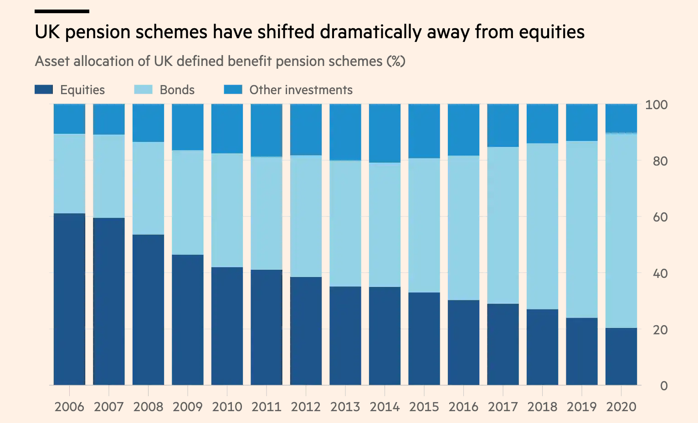
Where are pension funds invested?
Source: Martin Wolf in Financial Times (2021), “Radical reform of British pension provision is urgent
<number> / 31

Slide 28
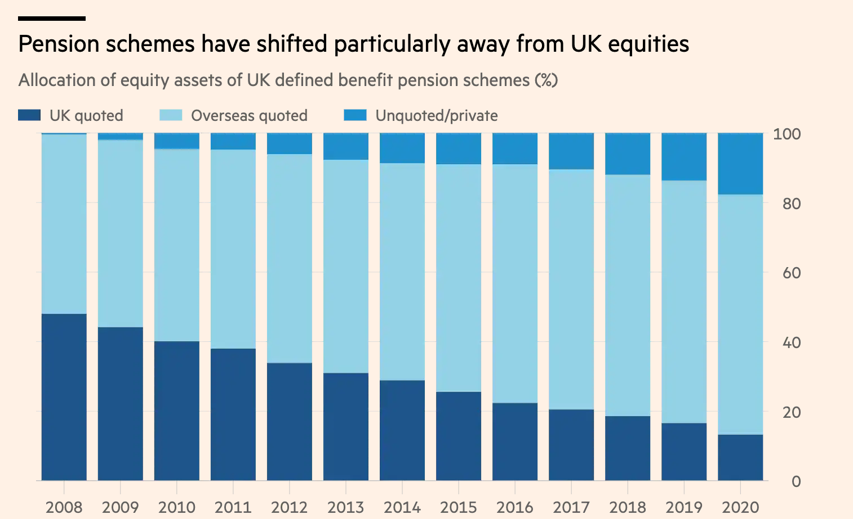
Where are pension funds invested?
Source: Martin Wolf in Financial Times (2021), “Radical reform of British pension provision is urgent
<number> / 31

Slide 29
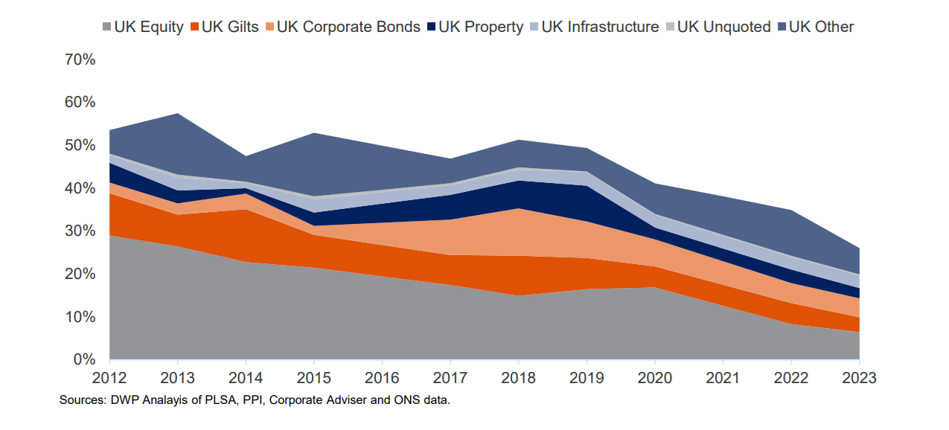
The Private Sector Defined Contribution Assets Allocation in the UK
Source: Pension fund investment and the UK economy
<number> / 31

Slide 30
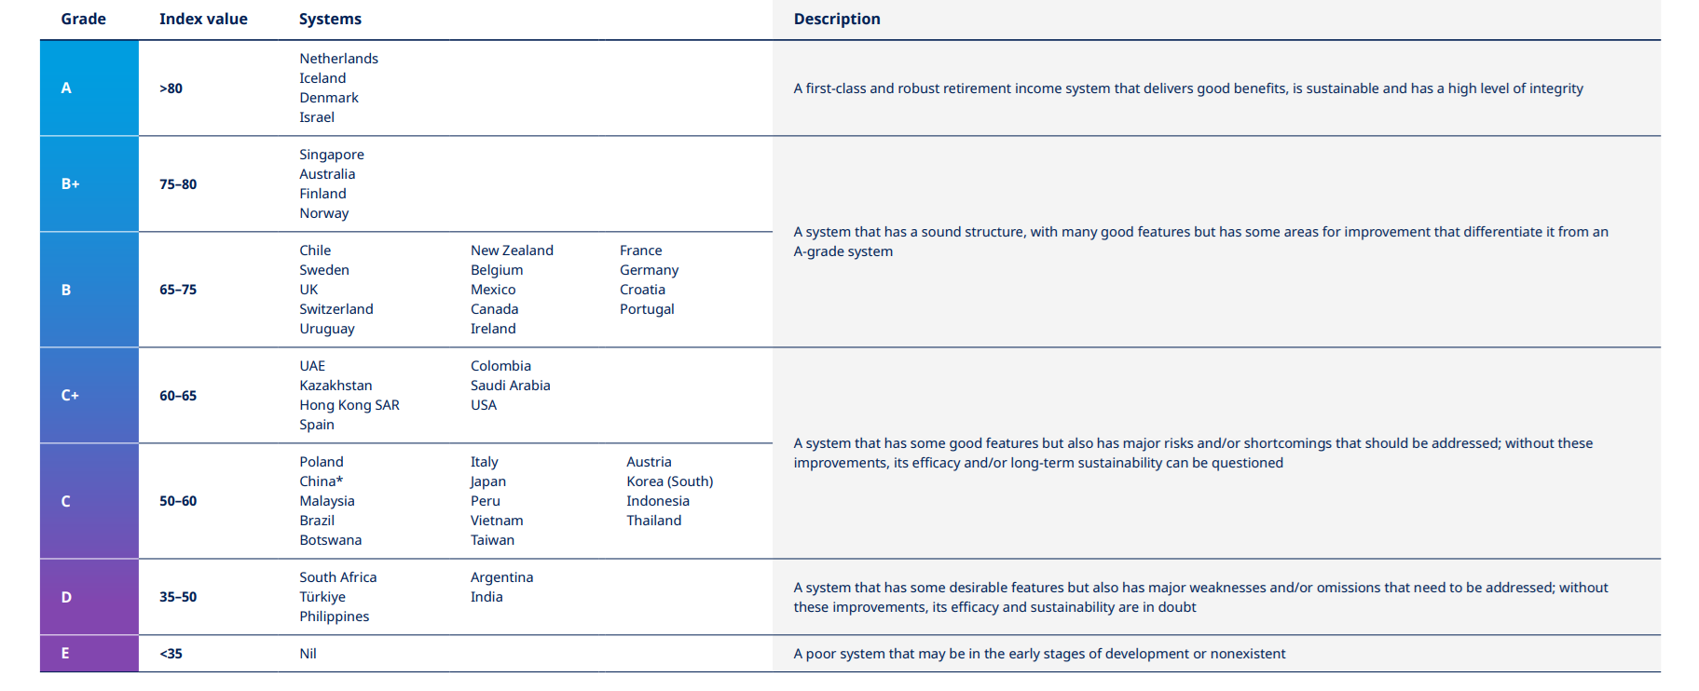
Summary of Selected Pension System
Source: mercer-global-pension-index-2024.pdf
<number> / 31

Slide 31
Thank you
<number> / 31

