Slide 1
Week 8 Insurance companies

Slide 2
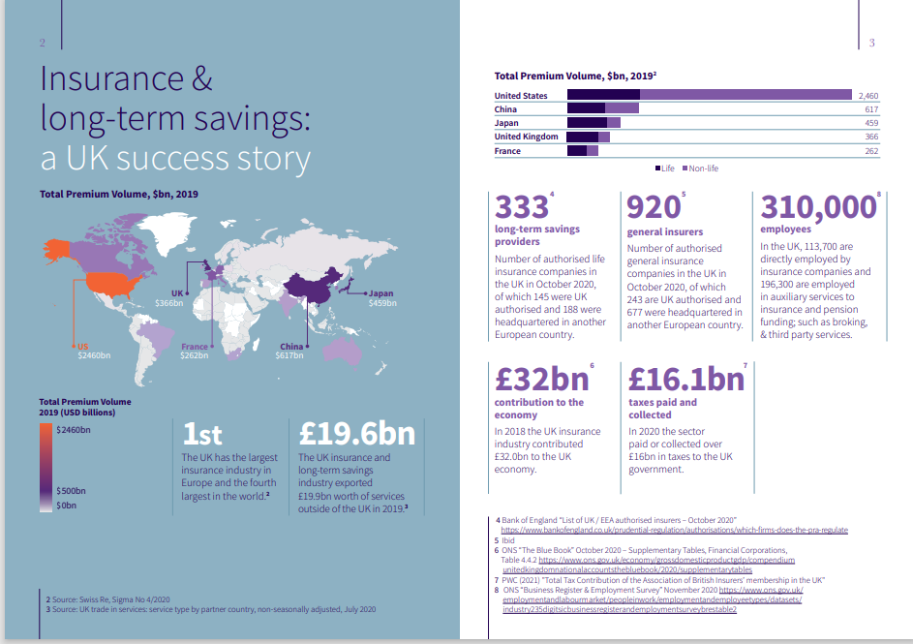

Slide 3
Learning Objectives
At the end of this lesson, you will be able to:
define what is an insurance company
describe the fundamentals of insurance
explain how insurance company manages the effect of information asymmetry
discuss types of insurance
describe challenges faced by insurance companies during GFC and COVID.

Slide 4
Insurance
The primary purpose of insurance is to provide financial protection against loss, not to allow the insured to profit or gain financially from the event occurring.
How It Works:
- Policyholder buys an insurance policy.
- Regular premiums are paid to the insurance company.
- Insurance company provides compensation for covered losses.
Key Components:
- Risk Pooling: Premiums from many create a fund.
- Claims: Filed for covered events.
- Payout: Compensation provided after evaluation.

Slide 5
Insurance Companies
Insurance companies are non-depository financial institutions.
Like pension funds, they are contractual saving institutions.
Insurance is the transfer of a pure risk to an entity that pools the risk of loss and provides payment if a loss occurs.
Insurance companies assume the risk of their clients in return for a fee, called the premium.
Pooling means that losses suffered by a small number of insureds are spread over the entire group of insureds so insurance purchasers substitute the average loss (a small amount) in place of the uncertainty that they might suffer a large loss.
Most people purchase insurance because they are risk-averse - they would rather pay a certainty equivalent (the premium) than accept a gamble.
People might be tempted to use insurance companies to gamble or speculate on future events.
Taken to an extreme, this behavior could undermine the ability of insurance companies to protect persons in real need.

Slide 6
Fundamentals of Insurance
In order to maintain the integrity of insurance process, all types of insurance are subject to certain basic principles:
There must be a relationship between the insured (the party covered by insurance) and the beneficiary (the party who receives the payment should a loss occur). (avoid people form buying insurance as a form of gambling)
The insured must provide full and accurate information to the insurance company.
The insured is not to profit as a result of insurance coverage.
If a third party compensates the insured for the loss, the insurance company’s obligation is reduced by the amount of the compensation.

Slide 7
Fundamentals of Insurance
The insurance company must have a large number of insured so that the risk can be spread out among many different policies.
The loss must be quantifiable. For example, in health insurance, the loss is quantified based on medical expenses incurred due to illness or injury.
The insurance company must be able to compute the probability of the loss’s occurring.

Slide 8
Information Asymmetry problems in insurance
Despite these principles, insurance business is prone to “information asymmetry” problems.
i.e. situations where one party knows more than the other
In general, there are two types of these problems:
1st type- Adverse selection: unobservable characteristics of a person (or a product)
Examples:
In the used car market, the owner has more accurate information about the quality of a car than the buyer
In the credit market, a borrower has more accurate information on their own risk of default than the lender.
In the insurance market, those most likely to suffer loss are most likely to apply for insurance
In the extreme, insurance companies should turn anyone who applies for an insurance policy.
However, insurance companies have found reasonable solutions to deal with this problem:
Health insurance policies require a physical exam and preexisting conditions may be excluded from the policy.

Slide 9
Adverse Selection and Moral Hazard in Insurance
2nd type of information asymmetry problem:
Moral hazard: unobservable/unexpected actions of a person
Moral hazard occurs in the insurance industry when the insured fails to take proper precautions (or takes on more risk) to avoid losses because losses are covered by the insurance policy.
Insurance companies use deductibles and co-insurance to help control this problem.

Slide 10
How do insurance companies manage the potential problem of information asymmetries
Many management practices specific to the insurance industry are designed to tackle information asymmetry problems.
Screening - to reduce adverse selection, insurance companies try to screen out poor insurance risks from good ones (eg: medical screening required before buying health insurance)
Risk-Based Premium – to reduce adverse selection; charge insurance premiums based on how much risk a policyholder poses for the insurance company (eg: younger drivers pay higher premium)
Restrictive Provisions – to reduce moral hazard; provisions discourage policyholders from engaging in risky activities that make an insurance claim more likely (eg: life insurance does not cover for suicide)
Prevention of Fraud – to reduce moral hazard; conducting investigations to prevent fraud so that only policyholders with valid claims receive compensation (eg: a person who has not complied with the restrictive provisions of an insurance contract may still submit claim – driving under the influence of alcohol)

Slide 11
How do insurance companies manage the potential problem of information asymmetries
Many management practices specific to the insurance industry are designed to tackle information asymmetry problems.
Cancellations of Insurance – to reduce moral hazard; threaten to cancel a policy when the insured person engages in risky activities (eg: auto insurance company may cancel coverage if a driver gets too many speeding tickets)
Deductibles – to reduce moral hazard; deductible is the fixed amount by which the insured’s loss is reduced when a claim is paid off (eg: a £250 deductibles on an auto policy means that when the claim is £1000, the insurance company will pay you only £750)
Coinsurance – to reduce moral hazard; a policyholder shares a percentage of the losses along with the insurance company (eg: medical insurance plans provide coverage for 80% of medical bills, and the insured person pays 20%)
Limits on the Amount of Insurance – to reduce moral hazard; the higher the insurance coverage, the more the insured person can gain from risky activities that make an insurance claim more likely (eg: if a car is insured for more than its true value, the owner will not take proper precautions to prevent its theft).

Slide 12
Types of Insurance in the UK
1. Health Insurance - Covers medical expenses, private healthcare, and specialized treatments.
2. Critical Illness Insurance - Pays a lump sum if diagnosed with a serious illness like cancer or heart disease.
3. Life Insurance - Provides financial support to dependents in the event of the policyholder’s death.
4. Car Insurance - Mandatory by law; includes third-party, third-party fire and theft, or comprehensive cover.
5. Home Insurance / Buildings Insurance - Covers structural damage & Contents Insurance - Covers belongings inside the home.
6. Business Insurance - Protects businesses from risks such as liability, property damage, and employee-related issues.
7. Travel Insurance - Covers trip cancellations, medical emergencies, and lost luggage.
8. Income Protection Insurance - Provides a percentage of income if unable to work due to illness or injury.
9. Pet Insurance - Covers veterinary expenses for pets.
10. Reinsurance - allocates a portion of the risk to another company in exchange for a portion of the premium.

Slide 13
Life Insurance
You could die too young and not have time to provide for your loved ones, or you could live too long and run out of retirement assets.
Getting life insurance relieves some of the concern associated with either case.
Life insurance pays off if you die, protecting those who depend on your continued earnings.
Disability insurance replaces part of your income should you become unable to continue working due to illness or an accident
An annuity is an insurance product that will help if you live longer than you expect.
For an initial fixed sum or stream of payments, the insurance company agrees to pay you a fixed amount for as long as you live. If you live a short life, the insurance company pays out less than expected. If you live unusually long, the insurance company may pay out much more than expected.
Insurance companies insure so many millions of people, the law of large numbers tends to make the company’s predictions quite accurate and allows companies to price the policies so that they can earn a profit.

Slide 14
Life Insurance
Broad categories of life insurance:
Term Life: Insurance against death. The insured is covered while the policy is in effect, usually 10–20 years (not very popular). Does not accrue cash.
Whole Life: similar to term life but allows the policyholder to borrow against the policy’s cash value account - a type of savings account that grows tax free over time and that you can withdraw from or borrow against while you are alive. When the term of policy expires, the insured can get the cash value of the policy.
Annuity: Insurance against life

Slide 15
Health Insurance
Healthcare for most UK residents is available for free on the NHS but the number of people choosing to turn to private insurance for health problems has risen sharply: 44% more people used insurer-provided healthcare services in 2021 than in pre-pandemic 2019, according to the Association of British Insurers (ABI).
Some of that will be to do with NHS waiting lists hitting a record high. The number of people waiting longer than 18 months for NHS treatment in England was growing.
Health insurance policies will often cover drugs or treatments that people cannot access through the NHS because they are too new to have been approved or are too expensive.
One area becoming increasingly popular is the use of virtual GPs. The ABI says access to online GP appointments through health insurance rose by 440% between 2019 and 2021.
Health insurance policies are vulnerable to the adverse selection problem - those with health problems are more likely to seek coverage.
Individual policies must be priced assuming adverse selection.

Slide 16
Health Insurance
Health insurance is a politically charged topic in the US, focusing on increased costs and availability of coverage.
Most health insurance in the US is offered through employer-provided group policies.
Insurance companies are attempting to shift costs to the employers.
Cost of the Healthcare in the US

Slide 17
Insurance
What are the Weirdest Things You can Insure?
https://www.youtube.com/watch?v=uSjPULBdzZ0

Slide 18
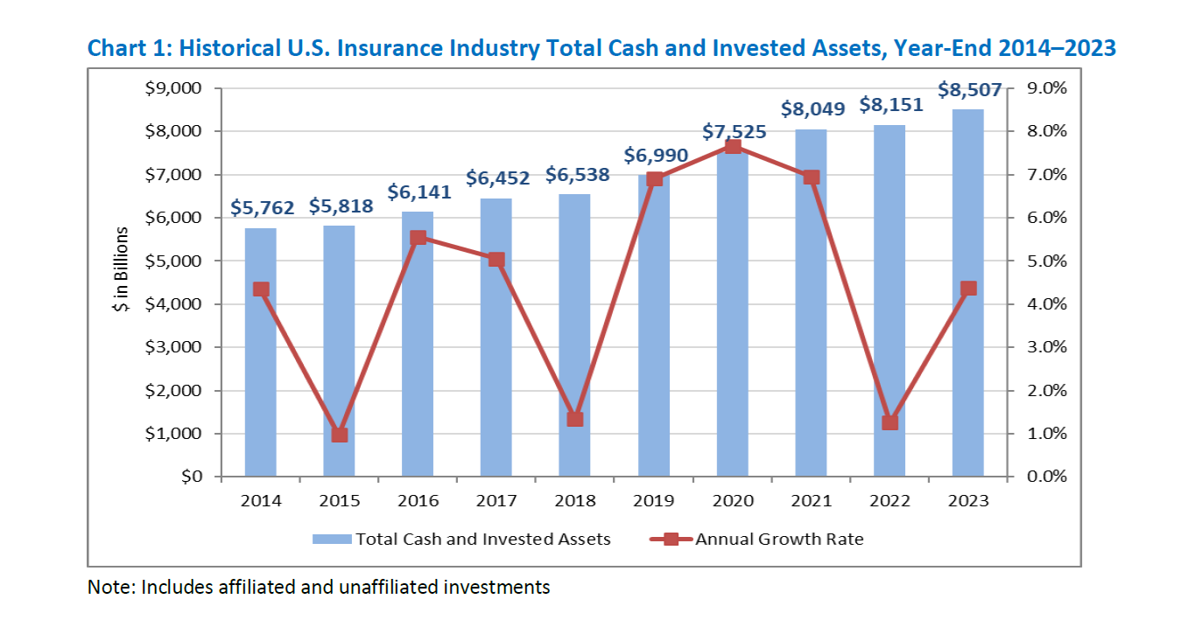
Source: Asset Mix YE 2023

Slide 19
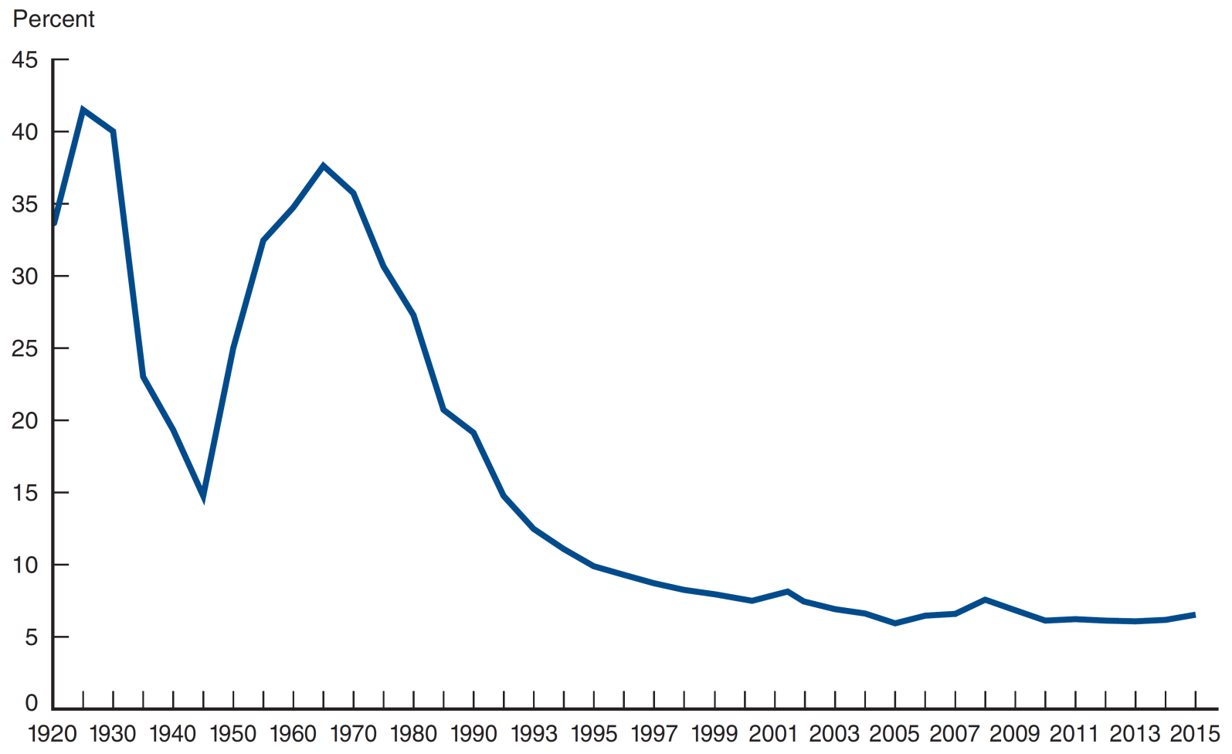
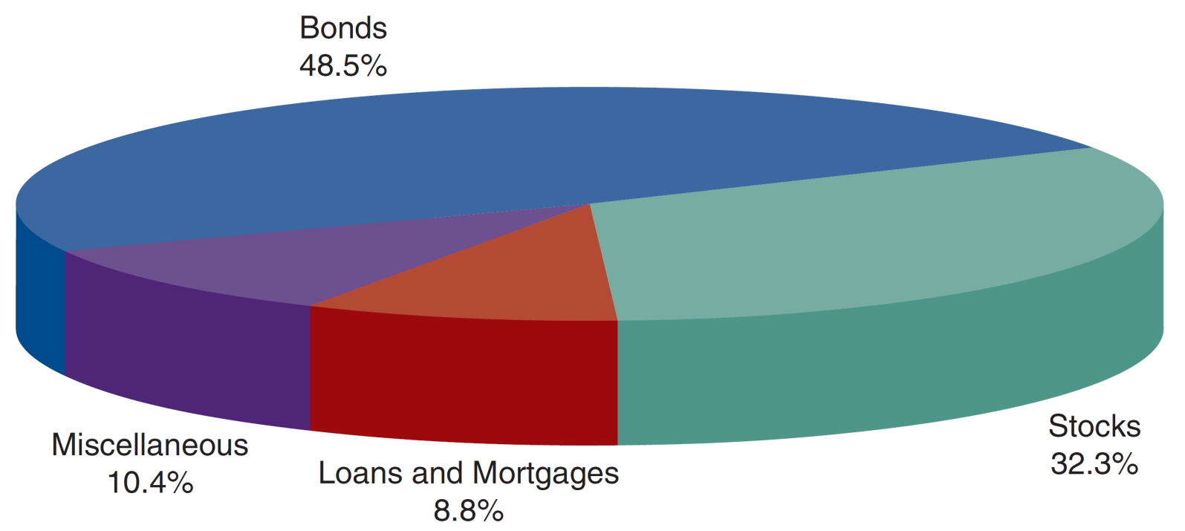
Distribution of Life Insurance Company Assets (2015) in the US
Life Insurance: Company Assets and Investments
Compared to other types of insurance, life insurers are less susceptible to large and unexpected claims
They can invest proportionately more of their assets in less liquid assets such as mortgages.
Today, they put more of their assets into stocks and bonds (more liquid assets).
Share of Life Insurance Company Assets in Mortgages
in the US, 1920–2015
Source: Federal Reserve Flow of Funds Accounts, Table L117, http://www.federalreserve.gov/releases/z1/Current/z1.pdf.
Source: Life Insurance Company Fact Book, 2015, Table 2.1 (American Council of Life Insurers), https://www.acli.com/Tools/Industry%20Facts/Life%20Insurers%20Fact%20Book/Pages/RP12.

Slide 20
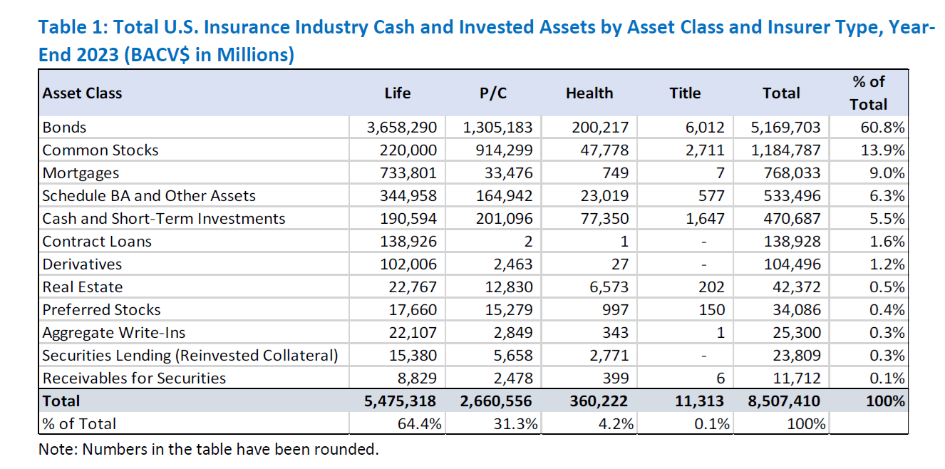
Source: Asset Mix YE 2023

Slide 21
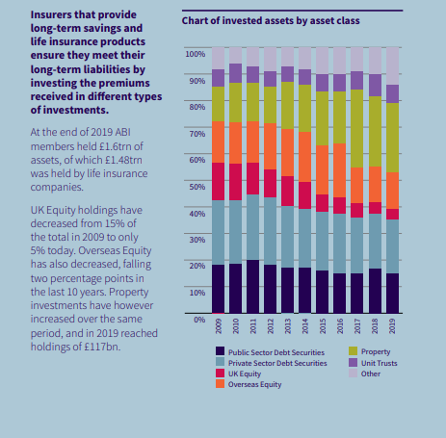

Slide 22


Slide 23
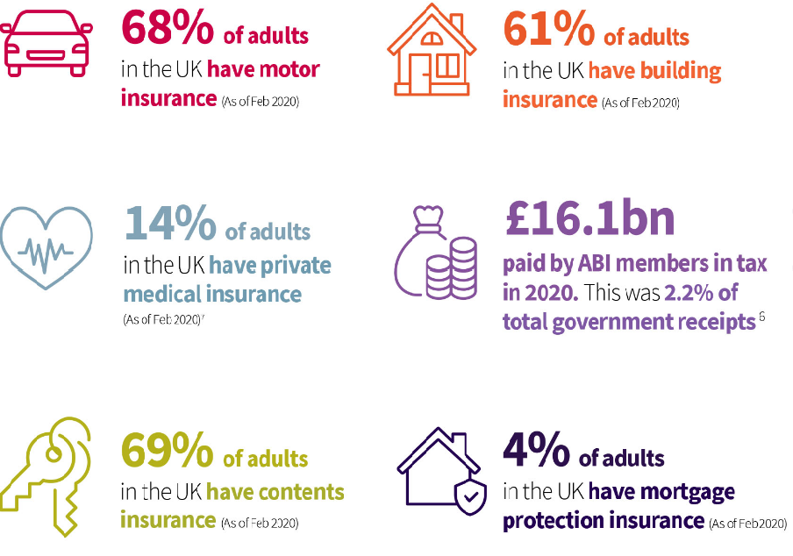
UK Insurance industry
(from the Association of British Insurers https://www.abi.org.uk/)

Slide 24
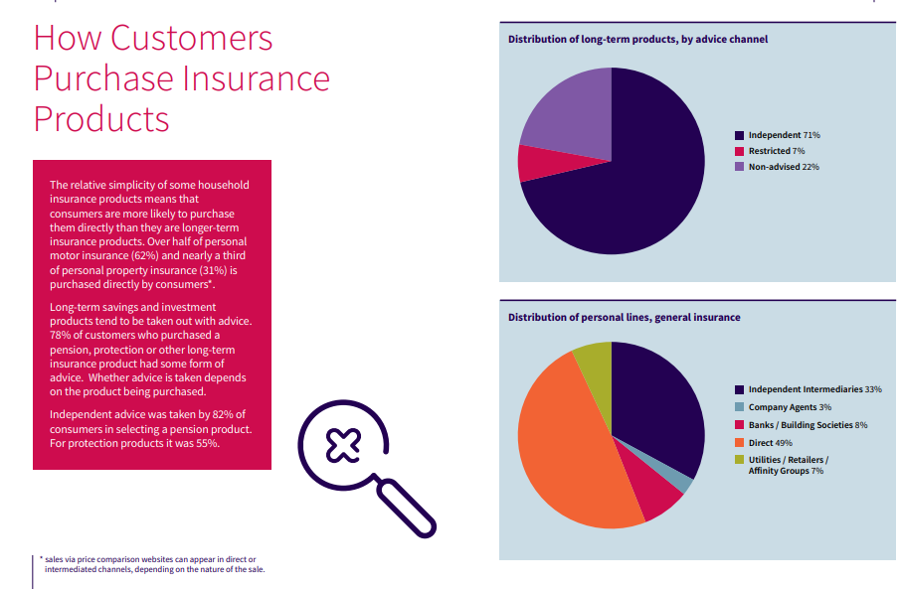

Slide 25
Insurance companies in 2008 crisis
A Credit Default Swap (CDS) is a type of insurance against default on a financial instrument, usually some kind of securitized bond.
When the probability of default is low, the cost of the CDS is similarly low.
By lowering the risk of these insured bonds with default insurance, the market price of the bonds would increase.
Market essentially was non-existent before 1995, when JP Morgan “invented” CDS.
By 2008, there were about $62 trillion of CDS outstanding!
Who sold CDS? Hedge funds, banks, investment banks, and some (not most) insurance companies.
CDSs market allowed speculators to buy insurance against a firm failure if they saw a firm that looked unhealthy, even though they may not hold any interest in the firm.
The CDS market allowed speculators to bet on the health of a company, a usual no-no in insurance.

Slide 26
Credit Default Swaps: The AIG Blowup
AIG’s Financial Products division (based in London) insured over $400 billion of CDS securities, of which $57 billion were debt securities backed by subprime mortgages.
Once the MBS market collapsed, customers who bought these CDS starting asking for money from those who sold them.
Most banks and hedge funds who sold CDS were not terribly affected, because they were simultaneously on both sides of the CDS trade. They would buy CDS protection on the one hand and then sell CDS protection to someone else at the same time. So they netted out.
Except for AIG. AIG was on one side of these trades only: They sold CDS. They never bought. Once bonds started defaulting, they had to pay out and nobody was paying them. AIG seems to have thought CDS were just an extension of the insurance business. But they’re not.
Creditors quickly realized the losses may bankrupt AIG – AIG could not raise any capital
The Fed organized a bailout but took a big stake in AIG as payment.

Slide 27
Insurance Companies During COVID-19
Impact of COVID on Health Insurance - Increased claims for COVID-19 treatments and hospitalizations & rise in demand for private health insurance policies.
Life Insurance Adjustments - Higher payouts due to increased mortality rates & stricter underwriting policies for new applicants.
Travel Insurance Challenges - Surge in claims for trip cancellations and medical emergencies abroad & policy exclusions for pandemics created confusion and disputes.
Business Insurance - Claims for business interruptions surged, but many were denied due to lack of pandemic coverage.
Adaptations by Insurance Companies - Flexible payment options for policyholders facing financial difficulties; introduction of pandemic-specific products.
Future Implications - Increased focus on pandemic risk modelling; higher premiums to offset losses during COVID-19 and Greater consumer awareness of policy terms and exclusions.

