Slide 1
Week 12 Investment funds

Slide 2
Learning Objectives
By the end of this lecture, you will be able to:
Identify the rationale for investing in investment funds.
Distinguish between the different types of investment funds.
Examine current developments and trends in the investment fund industry.

Slide 3
Investment Funds
When investors decide to invest, there are two ways to do:
Direct investment in assets (shares of a company, government securities, corporate bonds…etc) - individual personally buys the assets. Example: buy Tesco Plc shares
Indirect investment in assets (shares of a company, government securities, corporate bonds…etc) - individual buys a stake in an investment fund, such as a mutual fund
Achieving an adequate spread of investments through holding direct investments requires a large amount of money.
Investment funds pool the resources of many investors to provide access to a range of investments.
Their aim to pursue a common investment objective.

Slide 4
Benefits of Investment Funds
economies of scale
diversification;
access to professional investment management;
access to geographical markets, asset classes or investment strategies which might otherwise be inaccessible to the individual investor;
in some cases, the benefit of regulatory oversight.
in some cases, tax deferral.

Slide 5
Benefits of Investment Funds
Example: an investor has only £3,000 to invest
Share price of ABC Plc is £10 – can only buy 300 shares
If he or she wants to buy shares of 30 different companies – can only buy £100 worth of each shares
Large amount of money will be spent on commission (eg: £10 x 30)
Alternatively, £3,000 can be used to buy an investment fund that invest in 80 companies.
Since the investment of many investors are pooled together, the commission as a proportion of the fund is very small.
Investment can be made in different asset types, sectors and countries.

Slide 6
Investment styles
1. Active management
2. Passive management

Slide 7
Active management
Where professional investment managers aim to make capital gains for the fund’s members by buying and selling equities on a daily basis.
Investment managers buy shares they believe will rise in value and sell those they suspect will fall in value.
Actively managed funds are more expensive to run, because part of the capital gains earned must go to paying the fees of the investment managers.
The investment managers will usually receive a regular fee for their professional services and often an annual bonus based on the amount of money they have earned for the fund.

Slide 8
Passive management
Sometimes known as “index tracker” funds
They aim to profit from a rise in some index of shares such as the FTSE-100.
The managers of index tracker funds buy and hold a portfolio of shares which mirrors the composition of the index they are tracking.
e.g. if Vodafone shares represent 5 per cent of the index, and Tesco shares represent 8 per cent, then 5 per cent of the tracker fund will be invested in Vodafone shares and 8 per cent in Tesco shares.
Because tracker fund portfolios mirror the index being tracked, any change in the underlying index will be reflected in an equivalent change in the prices of the shares in the tracker fund’s portfolio.
A 10 per cent rise in the index implies a 10 per cent rise in the value of the tracker fund’s share portfolio.
Because tracker funds buy and hold shares, rather than trade them, they are less expensive to manage.

Slide 9
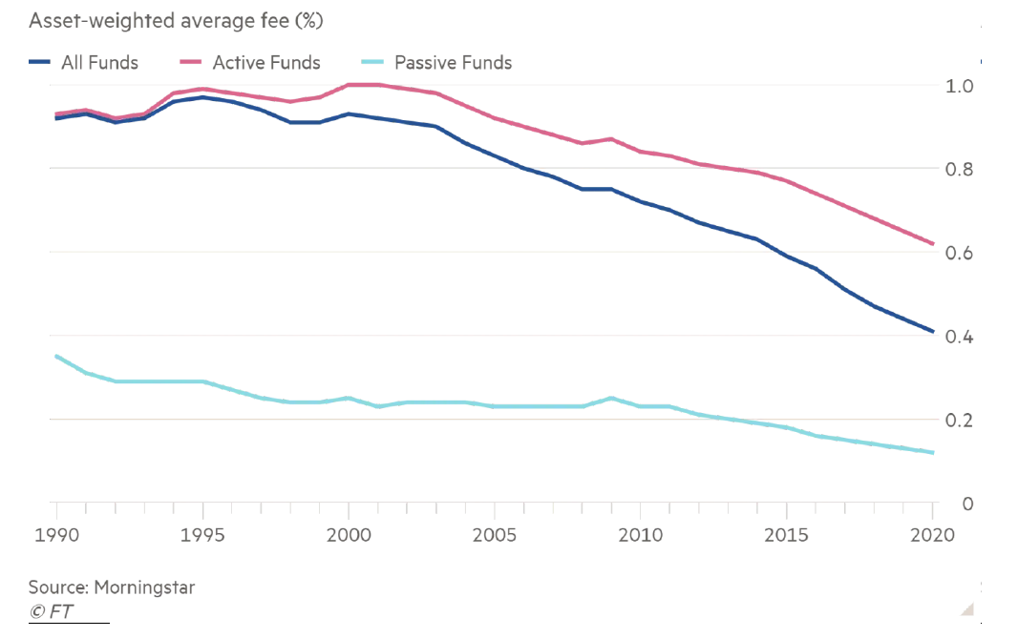

Slide 10
Types of Investment Funds
An investor is likely to come across a range of different types of investment funds, as many are now established in one country and then marketed internationally.
Funds of European origin are often labelled as “undertakings for collective investment in transferable securities” (UCITS) funds.
The main European center for establishing funds is Luxembourg.
In the UK, funds are generally structured as “unit trusts” or “investment trusts”
Funds originating in the US are called “mutual funds”

Slide 11
Close-Ended Funds
Definition - A type of mutual fund with a fixed number of shares that are traded on stock exchanges like stocks, rather than being bought or sold directly with the fund manager. The capital of the fund is therefore fixed, and does not expand or contract.
Key Features:
Fixed Share Capital: The number of shares is set at the time of the Initial Public Offering (IPO) and does not change.
Exchange-Traded: Shares are bought and sold on the stock market, and the price is determined by supply and demand.
Market Price vs NAV: Shares may trade at a premium or discount to the fund's Net Asset Value (NAV).
No Redemption: Investors cannot redeem shares directly with the fund; they must sell them in the open market.

Slide 12
Open-ended Mutual Funds
Definition - A type of investment fund that issues and redeems shares at the Net Asset Value (NAV) on a continuous basis. Each investor has a proportional share of the underlying portfolio and so will share in any growth of the fund. The value of each share is in proportion to the total value of the underlying investment portfolio.
Key Features:
Flexible Share Issuance: Investors can buy or sell shares directly with the fund manager.
NAV-based Pricing: Shares are bought or sold based on the NAV, which is calculated at the end of each trading day.
Liquidity: Investors can redeem their shares at any time, ensuring liquidity.
Diversification: Typically invests in a wide range of assets (stocks, bonds, etc.), offering diversification to reduce risk.
No Fixed Share Capital: The number of shares fluctuates based on investor demand, increasing or decreasing as new shares are issued or redeemed.

Slide 13
Feature | Open-Ended Fund | Closed-Ended Fund
Number of units/shares | Variable | Fixed
How investors buy/sell | Directly with fund | On stock exchange
Pricing | NAV | Market price (may differ from NAV)
Liquidity | High (fund provides) | Depends on market trading
Premium/discount | No | Yes
Best suited for | Flexible, liquid investments | Long-term, illiquid assets

Slide 14
Types of Investment funds
Mutual Funds: The US version investment funds, could be close-ended, or open-ended.
Open-ended mutual funds are called unit trusts in the UK.
Closed-ended mutual funds are called investment trusts in the UK.

Slide 15
Classes of Mutual Funds
Equity Funds
Capital appreciation funds: seek rapid increase in share prices (not concerned in dividends); risky
Total return funds: seek combination of current income and price appreciation; less risky
World equity funds: invest primarily in foreign stocks; diversification
2) Bond funds – provide current income; government bonds (risk free); municipal bond (tax free)

Slide 16
Classes of Mutual Funds
3) Hybrid funds – combine 1 & 2
4) Money market funds - invests in short-term, low-risk instruments such as Treasury bills, certificates of deposit, and commercial paper, aiming to provide liquidity and preserve capital with modest returns.
5) Index Funds
Mutual funds with passive management
Contains the stock of the index it is mimicking.
Offers benefits of traditional mutual funds without the fees of the professional money manager.

Slide 17
Fee Structure of Mutual Funds
Front Load funds charge an upfront fee for buying the shares. Example: fund sold by brokers involves commission.
Deferred load funds charge a fee when the shares are redeemed. Usually, declining fee over five years to discourage early withdrawals.
No-load funds - do not charge fee. Purchased directly by investors without agent.
Other fees charged by mutual funds include expenses for marketing, advertising, and commissions.

Slide 18
Exchange Traded Funds (ETFs)
An investment fund designed to track a particular index, such as FTSE 100.
The investor buys shares in the ETF which are quoted on the stock exchange, like investment trusts.
However, unlike investment trusts, ETFs are open-ended funds.
This means that the fund gets bigger as more people invest and gets smaller as people withdraw their money.
The main difference between ETF and an index fund:
ETFs are traded on stock exchanges throughout the day like individual stocks, with their price fluctuating in real time based on supply and demand.
Index fund are mutual funds that track a specific market index and are bought or sold only at the end of the trading day at the net asset value (NAV)

Slide 19
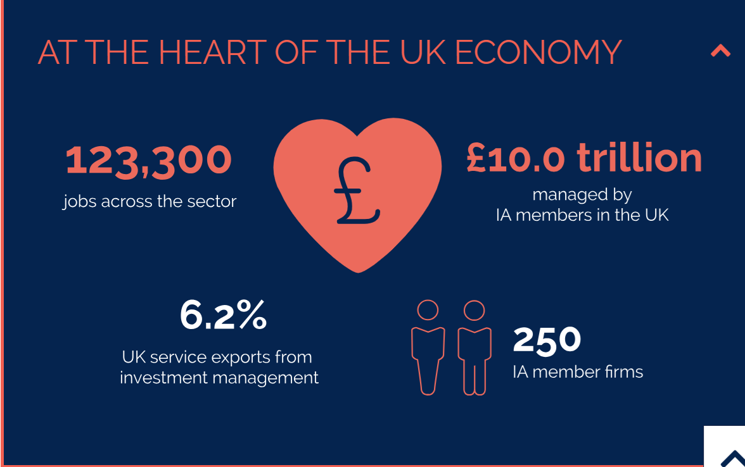
Source: The Investment Association

Slide 20
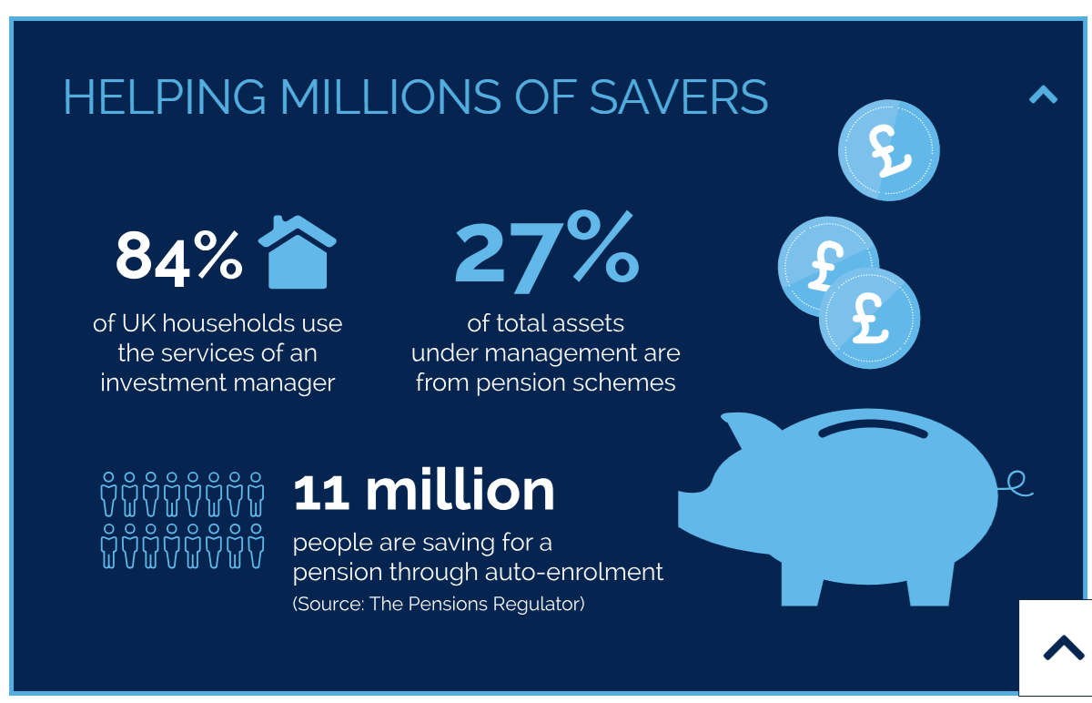
Source: The Investment Association

Slide 21
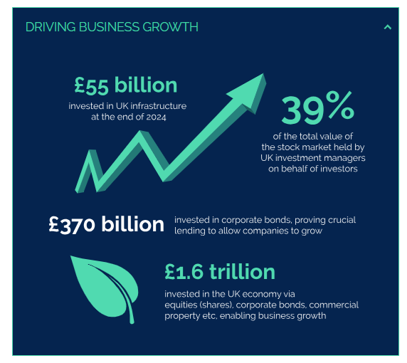
Source: The Investment Association

Slide 22
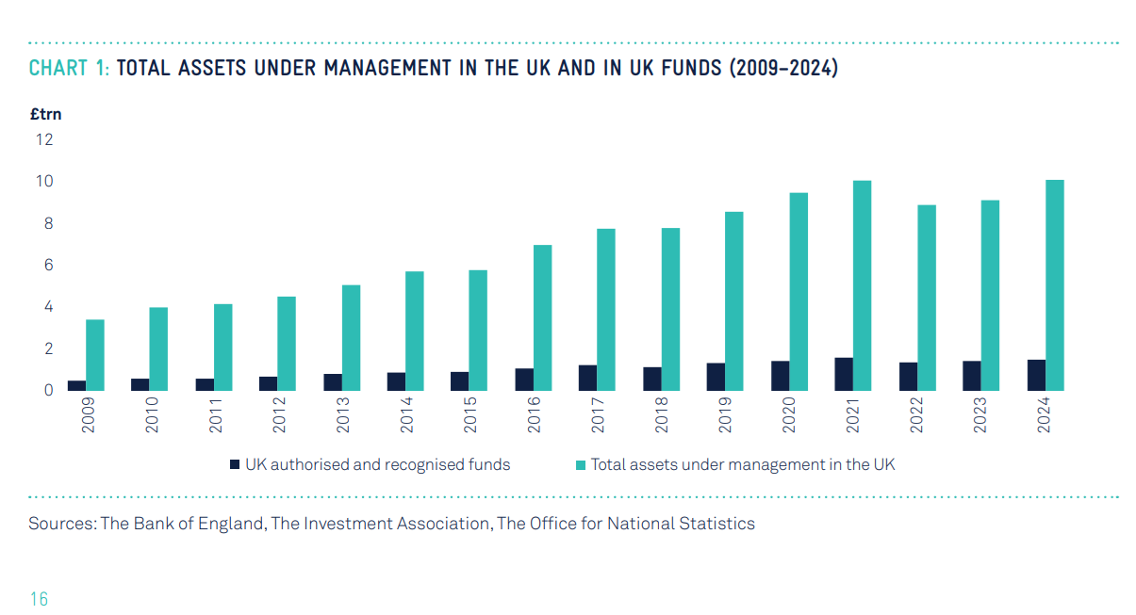

Slide 23
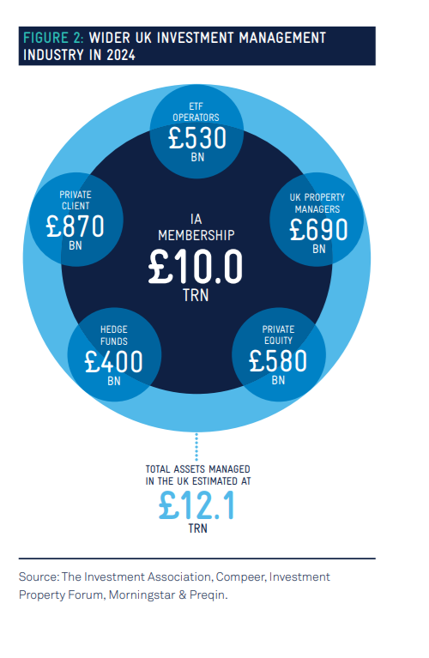

Slide 24
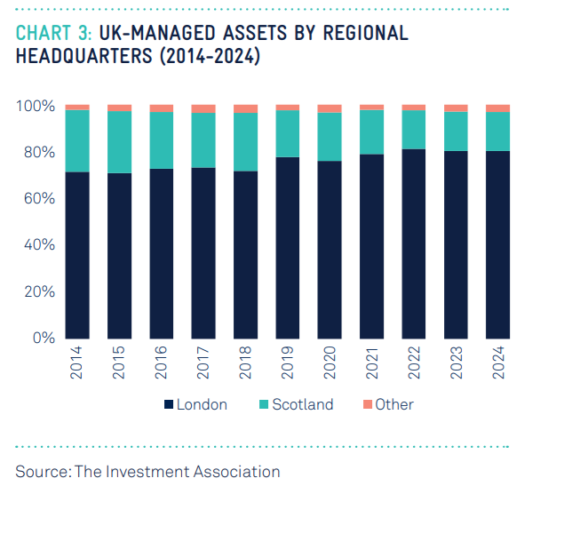

Slide 25
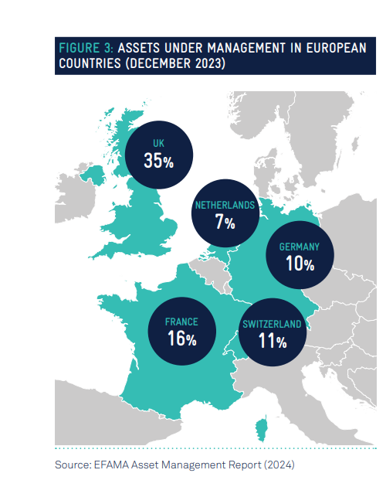

Slide 26
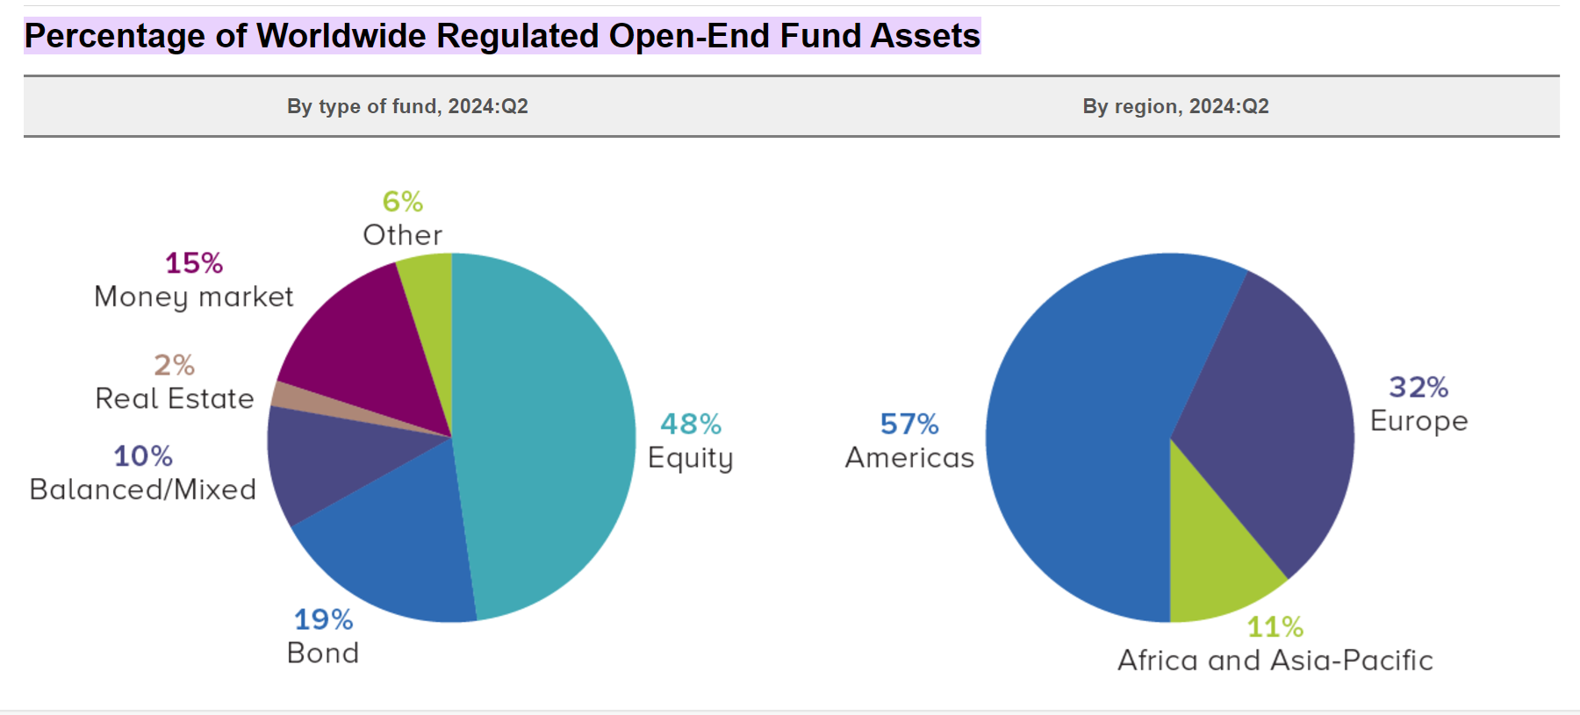
Source: Worldwide Regulated Open-End Fund Assets and Flows, Second Quarter 2024 | Investment Company Institute

Slide 27
In trillions of USD

Slide 28

Fund Management Companies in the UK
Monthly company rankings | The Investment Association (theia.org)

Slide 29
(percentage)

Slide 32
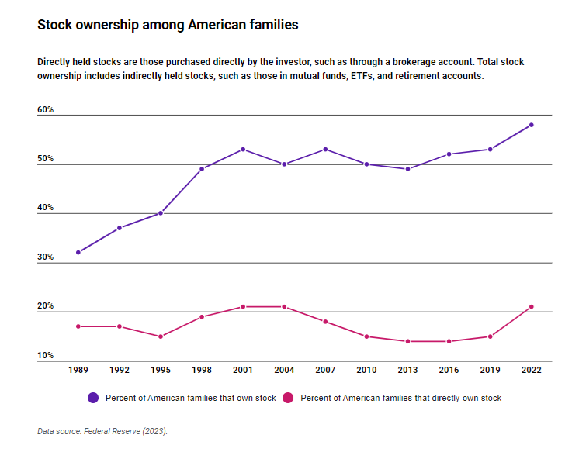

Slide 33
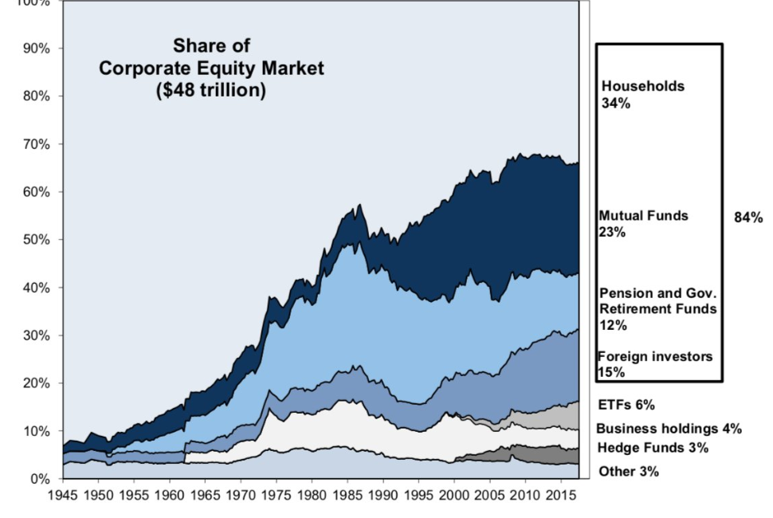
Ownership of the US equities (i.e. US companies’ stocks)

Slide 34
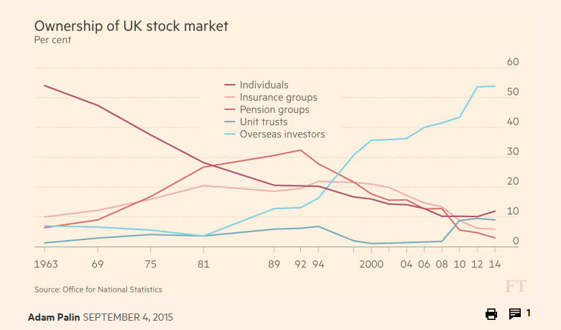
Ownership of UK equities
Source: Financial Times

Slide 35
