Slide 1
Week 5 Banking systems across the world: USA and China
Readings (on the Reading List)
On the USA:
Excerpts from “Chapter 19” of Miskin & Eakins textbook, Financial Markets and Institutions
On China:
“Part II: Key Questions” of the Brookings Institute Report on “The Chinese Financial System: An Introduction and Overview” (2013)
“The Chinese banking system: Much more than a domestic giant” by Cerutti and Zhou, from VOX, CEPR Policy Portal (2018).

Slide 2
Outline
Various Banking systems
Historical Development of the US Banking System
Differences between the US vs UK banking systems
Bank Consolidation in the US
Separation of Banking and Other Financial Service Industries
Chinese banking system

Slide 3
Various Banking Systems
Traditional Universal Banking (German Model)
In its Historical Form (Pre-2000s): Complete integration of commercial and investment banking, large equity stakes in industrial companies (e.g. Deutsche Bank held major stakes in Daimler-Benz, Siemens…)
Over time, universal banking systems changed: Reduced industrial holdings due to capital requirements, More arms-length relationships with industrial companies

Slide 4
Various Banking Systems
B. Market-Based System (US Model)
In its historical form (1933-1999): Clear separation between commercial and investment banks (e.g. Citibank was strictly commercial vs. Morgan Stanley, only an investment bank)
Over-time, market-based system changed too: Large financial conglomerates became a mix of commercial and investment banking (e.g. Morgan Stanley expanded into retail banking)

Slide 5
Various Banking Systems
Universal Banking Advantages: - One-stop shopping for financial services, Economies of scope, Stable corporate relationships and more reliable affordable credit for industrial growth
Universal Banking Disadvantages: Complex risk management and Potential conflicts of interest
Market-Based System Advantages: Competitive market for services, Clear separation of risks
Market-Based System Disadvantages: Higher transaction costs, Multiple banking relationships were needed (credit not as convenient for industrial companies)

Slide 6
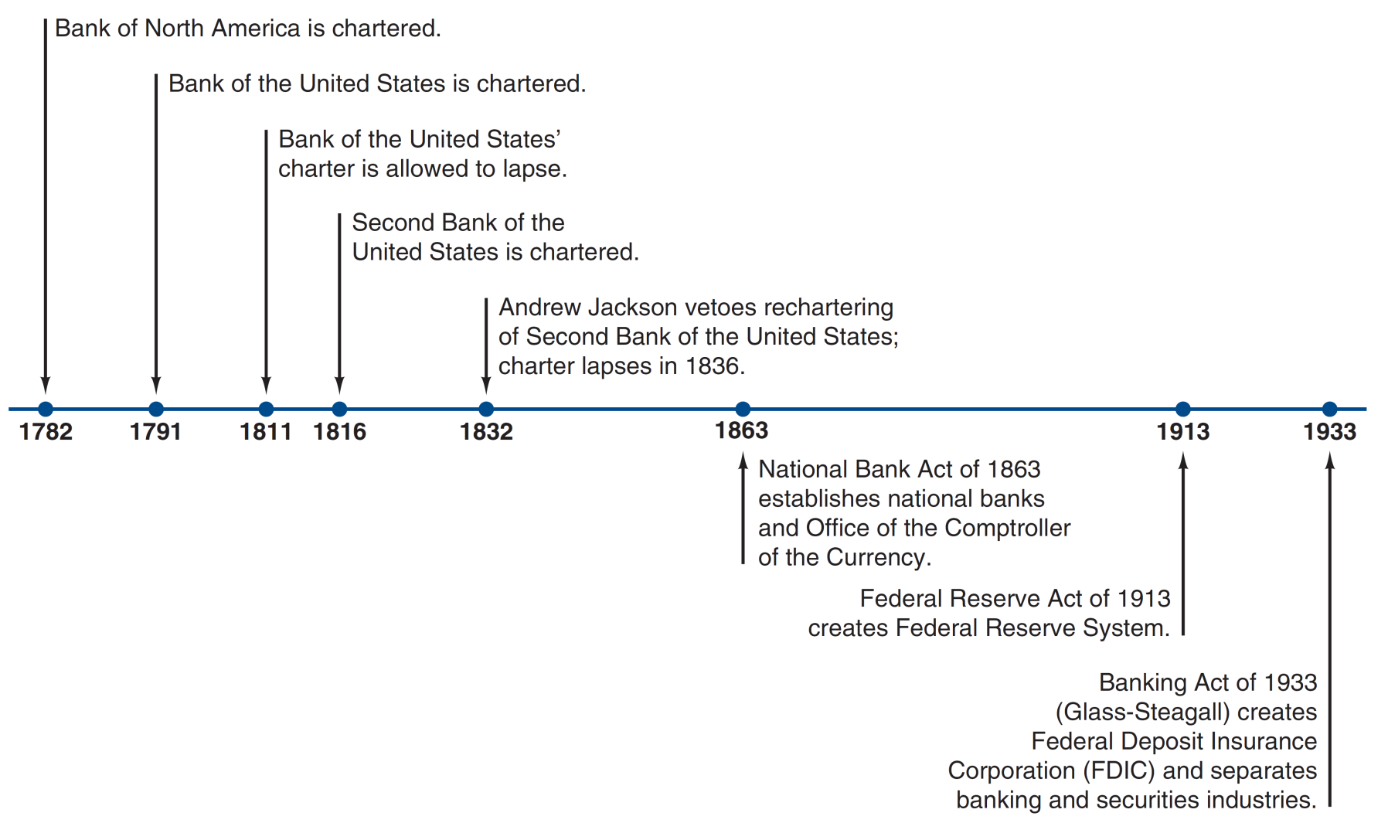
Timeline of the Early History of Commercial Banking in the United States

Slide 7
Differences between the UK and the US Banking System
1. Reserve requirements:
Reserve requirements are used by the central banks to increase or decrease the amount of money in the economy and influence interest rates.
US banks are required to hold a fraction of their funds in reserve with the Fed
The current “reserve requirement ratio” in the US is 0% (since March 2020) in response to covid-19 crisis.
There is no reserve requirement in the UK system.
There are minimum capital requirements in line with international standards.

Slide 8
2. Difference in Electronic Payment systems
The development of computer systems and the internet has made electronic payments a more cost-effective method over paper cheques or money.
The US is still far behind Europe in the use of this technology.
Americans write close to 10 billion cheques every year.
In Europe, however, two-thirds of noncash transactions are electronic.
Europeans have been using giro payments for decades.
Giro payment: bank transfers initiated by the payer (similar to debit car payments)

Slide 9
3. Differences in Deposit Insurance Schemes
Deposit insurance protects bank depositors, in full or in part, from losses caused by a bank's inability to pay its debts.
The U.S. was the first country to introduce a national deposit insurance system.
The Federal Deposit Insurance Corporation (FDIC) was founded in 1933 after the bank failures of the Great Depression.
Its goal was to restore confidence in the liquidity of bank deposits and the banking system
Currently, deposits up to $250,000 are fully covered.
In the UK, the system was established after the 1980s.
Currently deposits up to £85,000 are protected.

Slide 10
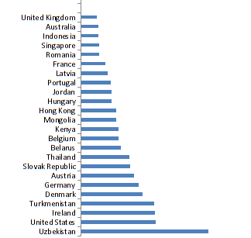
Safety Net Index around the world
Higher values (longer bars) denote more generosity in deposit insurance schemes.
Potential “moral hazard” issue?
Moral hazard arises when people's actions do not reflect the full cost of their actions.
With deposit insurance, people could put their money into banks that made excessively risky loans without fear of losing their money should the bank fail.
Source: Demirguc-Kunt, Asli, Edward Kane and Luc Laeven, Deposit Insurance Database,
World Bank Policy research working Paper, 2014

Slide 11
Size Distribution of Insured Commercial Banks in the U.S., 2016
Assets | Number of Banks | Share of # of Banks (%) | Share of Assets Held (%)
Less than $100 million | 1,663 | 27.2 | 0.6
$100 million–$1 billion | 3,734 | 61 | 7.2
$1 billion–$10 billion | 616 | 10.1 | 10.6
More than $10 billion | 109 | 1.7 | 81.6
Total | 6,122 | 100 | 100
FDIC statistics on banking
http://www.fdic.gov/bank/statistical/index.html
There are many many small banks in the US banking system
But, a very large portion of the US banking assets are held by the top 100 or so banks

Slide 12
Ten Largest U.S. Banks, 2016
Bank | Assets ($ millions) | Share of All Bank Assets (%)
1. J.P. Morgan Chase | 1,915 | 12.2
2. Bank of America | 1,639 | 10.4
3. Wells Fargo and Co. | 1,611 | 10.3
4. Citigroup | 1,300 | 8.3
5. U.S. Bank | 417 | 2.7
6. PNC Bank | 348 | 2.2
7. Bank of New York Mellon | 319 | 2
8. Capital One | 273 | 1.7
9. TD Bank | 246 | 1.6
10. State Street Bank and Co. | 241 | 1.5
Total | 8,309 | 50.9

Slide 13
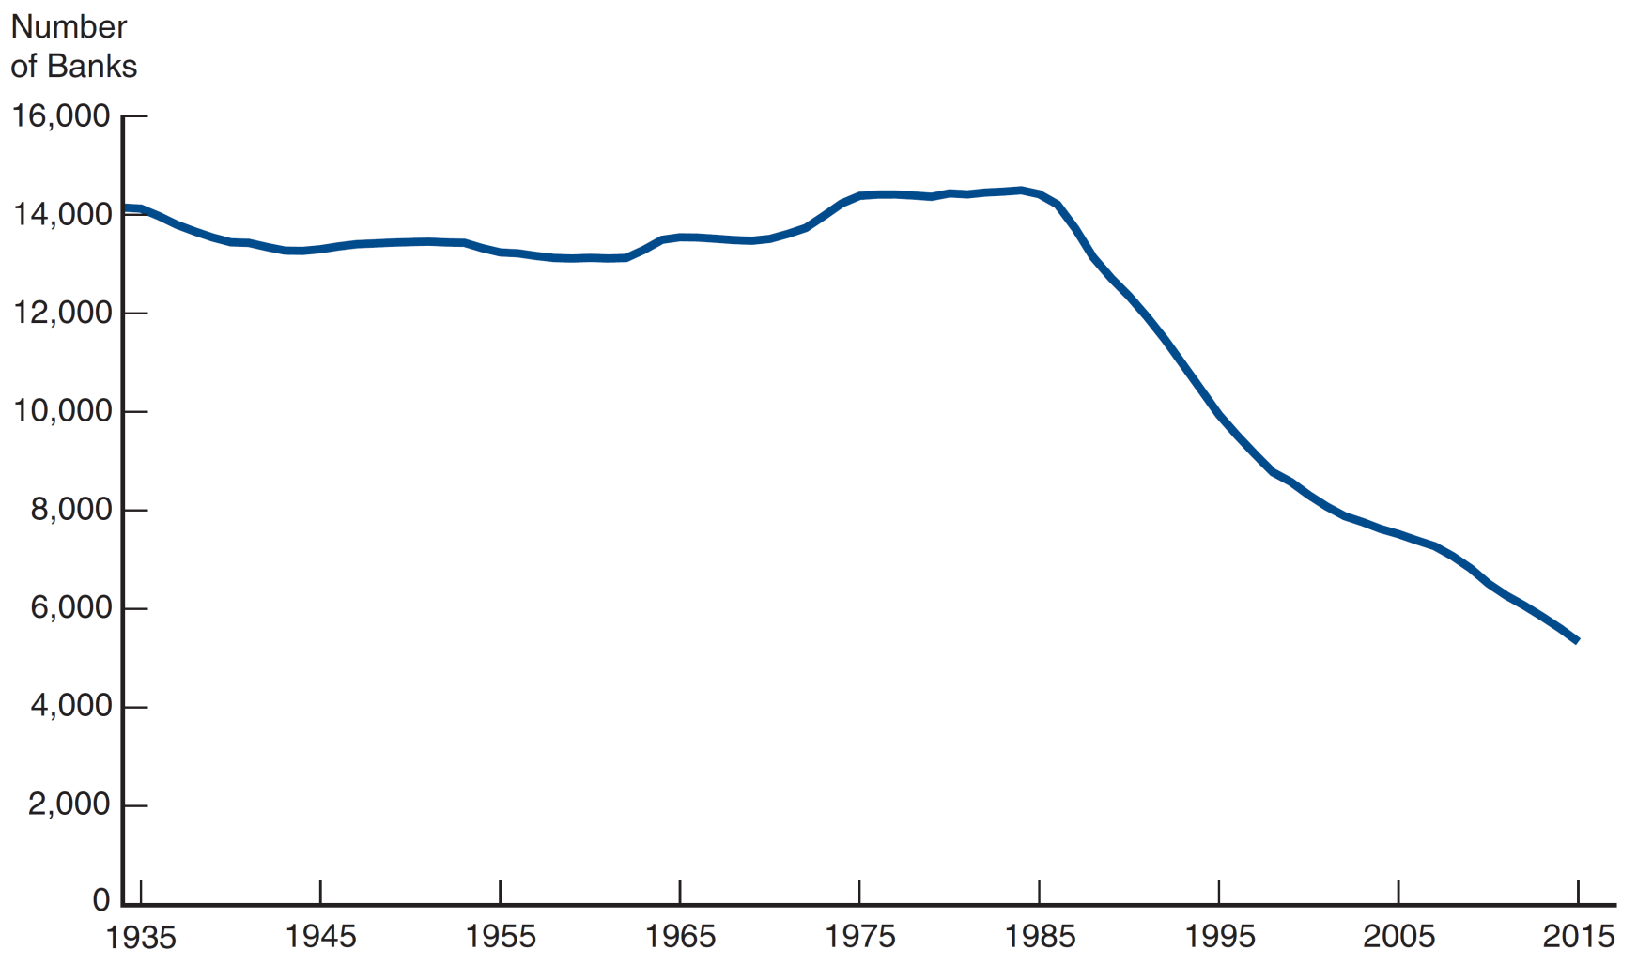
Number of Insured Commercial Banks in the U.S., 1934–2016
Consolidation (Merger and acquisitions) is the main reason behind falling numbers of banks

Slide 14
Bank Consolidation in the US
Since 1980s, many mergers and acquisitions (M&A).
Reasons behind M&A?
Economies of scale
Increased with new technologies
Scope economies also present in using data for pricing, new products, etc.
Changes in regulation about interstate banking
Intestate banking restrictions were leaving banks vulnerable to local economic crises.
Riegle-Neal Act of 1994 allowed full interstate branching

Slide 15
Reversal of the Separation of different types of Banking
Glass-Steagall Act (1933)
separated investment and commercial banking
similar to ring-fencing happening in the UK and EU today
prohibited underwriting / brokerage services, real estate / insurance business for commercial banks
By 1990s, large banks were looking for ways to evade this law
Glass-Steagall Act was repealed in 1999
This further contributed to consolidation. Today many large banks in the US are “Bank Holding Companies”

Slide 16
10 largest banks in the world in 2020 (by assets)
Source: S&P Global Market Intelligence report
Barclays is #18, Lloyds is #25

Slide 17
Chinese Banking System
Immediately after the foundation of People's Republic in 1949, banks were nationalized and consolidated.
During 1980s: banking system expanded and diversified
From 1979 to 1985, the volume of deposits and loans nearly tripled
By 1987 the banking system included the
People's Bank of China,
Agricultural Bank of China,
Bank of China,
China Investment Bank,
China Industrial and Commercial Bank,
People's Construction Bank,
Communications Bank,
People's Insurance Company of China,
rural credit cooperatives, and
urban credit cooperatives.
All banks were state owned.
This helped China’s economic growth a lot.

Slide 18
By 2016, the size of Chinese banking assets surpassed even all euro area banking systems put together.
From the article on the reding list, also available at
https://voxeu.org/article/chinese-banking-system

Slide 19
Chinese Banking system
4 largest Chinese Banks are state-owned enterprises.
Other banks have some state ownership, as well as private ownership through shares sold in stock markets (in Shanghai, Shenzhen and Hong Kong stock markets).
“Big Four” have 50% of the market share (relatively concentrated market)
Banks dominate the Chinese financial system, providing the loans amounting to about 128% of Gross Domestic Product (GDP) in 2012 (compared to 48% for the US).
The banking sector is more focused on state-owned enterprises, large development and infrastructure projects and politically favoured businesses.
This focus of banking sector helped fuel China’s economic development.

Slide 20
Chinese Banking system
Downsides to having a state-owned banking system:
1) Borrowing is hard for small businesses.
Small businesses end up relying on loan sharks, pawn brokers, informal cooperatives of locals lending to each other…channels outside of formal banking sector (sometimes referred as shadow banking).
China's leaders are well aware that there's too much infrastructure spending and too little spending by consumers.
2) For large banks, non-performing loans (NPL) was a serious problem in mid-2000s, shaking the confidence in the Chinese banking system.
Due to excessive loans to state-owned enterprises before 2000.
The Chinese government injected a lot of funds into the banking system to strengthen it.

Slide 21
Increasing role of Chinese banks in the rest of the world
Based on the article “The Chinese banking system: Much more than a domestic giant,” in the reading list.
Growth in Total assets of banks in China by portfolio type

Slide 22
Cross-border lending of various countries, by 2017
Why would countries (through their banks) lend money to residents of other countries?
To support payments for international trade
To invest in real investment projects
To invest in financial opportunities not available at home

Slide 23
No apparent relationship between trade and banking linkages with China.

Slide 24
China’s cross-border lending seems to be more correlated with its outward Foreign Direct Investment (FDI).
Lending from Chinese banks has been used to fund the construction of large-scale infrastructure projects overseas

Slide 25
Thank you

