Slide 1
Week 8 Financial Crises – Part 1
Check out the reading list for 4 sources of readings

Slide 2
For more information on CISI Qualifications
Check out their website:
Chartered Institute for Securities & Investment
Contact Programme Leader Fazelina Sahul-Hamid
at Fazelina.SahulHamid@uwe.ac.uk

Slide 3
Outline
What is Securitization?
Benefits of securitization
Securitization during the 2008 financial crisis
Role of Investment Banks and credit rating agencies in the 2008 crisis

Slide 4
Banking Without Securitization
In traditional banking, banks used to “Originate and hold” loans on their balance sheet until maturity
Loans are illiquid assets
e.g. mortgages are typically for 25 years
Deposits are liquid liabilities
e.g. even savings accounts are typically for 12 months
A “maturity mismatch” arises in bank balance sheet
Liabilities are short-term and liquid, assets are long-term and illiquid

Slide 5
Banking Without Securitization
In traditional banking:
When the bank needs financing to meet the mismatch, it could borrow money
i.e. issue debt
The banks has to pay an interest on that debt
The interest paid to investors depends on the overall bank riskiness.

Slide 6
Banking with Securitization
Banking with Securitization is also called – “Originate-to-distribute model”
Securitization refers to converting illiquid loans like mortgages into liquid, marketable securities that can be sold to other institutions.
Instead of “holding” loans and their risk on their own books, securitization allows banks to pass them onto others and “distribute” them.

Slide 7
Securitization – step by step step
Initial lender of the loan: the originator bank
Loans are passed on to a special-purpose entity (SPE) or a special-purpose vehicle (SPV) - separate from the originator bank
The SPV issues new securities, using the pledged loans to securitize the offering.
A credit rating agency rates new securities so that investors have a better idea what the new financial securities are worth
An investment bank underwrites these securities
New securities are then sold in the money and capital markets with the help of an underwriter

Slide 8
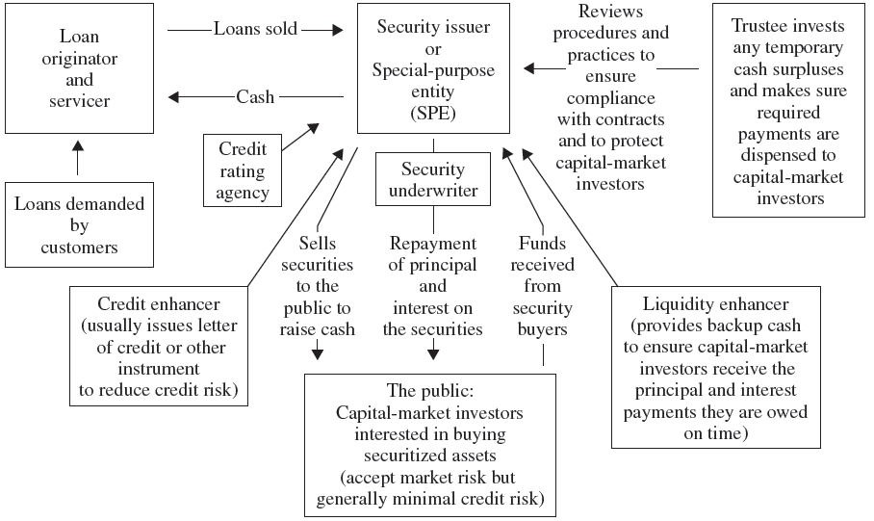
Securitization Process with Incomes generated in the process

Slide 9
Question: Loan creation process in traditional banking is known as
Originate-and-distribute
Originate-and-hold
Securitization
Collateralization

Slide 10
Question: The traditional financial intermediation role of banking has been to make ________-term loans and to fund them with ________-term deposits.
short; long
long; short
short; short
long; long

Slide 11
More terms !
Mortgage-backed securities (MBS): original loans are mortgages
Asset-backed securities (ABS): all other types of loans
‘Tranching’ of the securities created by the SPV: Pool of mortgages or loans are sliced into tranches with with varying risk and maturity features.

Slide 12
Securitization example: creation of an MBS

Slide 13
Securitization of securities!
Began around 1999
Investors who bought different tranches of MBS, and other ABSs pooled them again and created new securities called CDOs (collateralized debt obligations)
CDOs were tranched similarly:
‘senior’ CDOs: backed by highly rated MBS and other ABS,
‘mezzanine’ tranches pooled together a higher proportion of junior tranches.
Rating agencies were also actively engaged in rating of CDOs

Slide 14
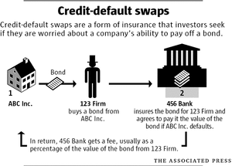
One last thing: Credit Default Swaps (CDS)
During sub-prime mortgage boom,
Investors of MBS and CDOs, also
bought CDS to protect themselves
against the failure of these securities

Slide 15
Benefits of Securitization
Diversifies a bank’s credit risk exposure
Creates liquid assets out of illiquid assets
Transforms these assets into new sources of capital
Allows the bank to better manage interest rate risk
Allows the bank to generate fee income

Slide 16
Securitization during the financial crisis of 2008 The role of investment banks and credit rating agencies in the process of securitization

Slide 17
Securitization in the 2008 crisis
Securitization, especially in the form of MBS and CDOs, was a key driver of the 2008 global financial crisis.
Caused excessive risk-taking
Brought many major financial around the world to bankruptcy when the U.S. real estate bubble burst.

Slide 18
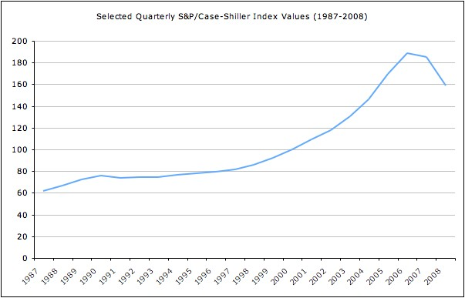
Housing bubble in the US
House prices started increasing fast after 2000.
One reason was low interest rates
Another reason was lax lending practices of mortgage lenders

Slide 19
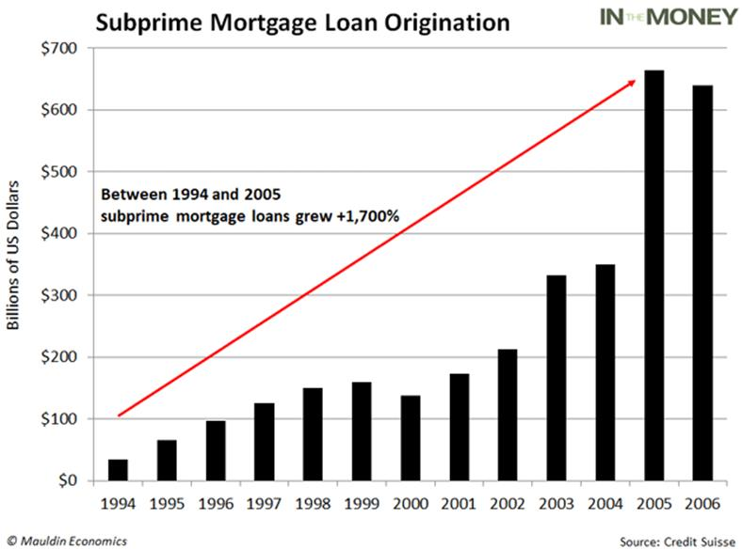
Housing bubble in the US
A growing number of American banks began selling mortgages to so-called sub-prime borrowers.
These were the individuals to whom banks would normally refuse loans – people with very low and insecure incomes who represented a very bad risk.
The average credit score was 624 for subprime borrowers. Prime mortgage borrowers 742.

Slide 20
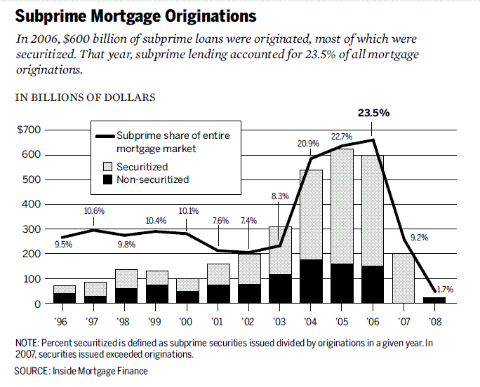

Slide 21
Securitizing Sub-Prime Mortgages
Why would profit maximising banks willingly lend to people they knew would almost certainly fail to repay their loans?
Mortgages are loans secured against the houses they are used to purchase. In the event of a default, banks could recover their money by selling the mortgaged property.
Banks could charge sub-prime borrowers higher fixed interest rates – typically 2% more
Sub-prime borrowers were also offered very low variable interest rates known as teaser rates- for the first year or two of their loans.
Banks used securitization techniques to finance all of this.
Securitization became a major profit source for financial intermediaries

Slide 22
Crunch Time
In the mid 2000s, the US interest rates started to rise, just as many sub-prime borrowers were coming off their teaser rates.
Thousands of sub-prime borrowers began defaulting on their mortgages.
Many houses were repossessed by the banks and put up for sale, causing house prices to fall sharply to levels below the value of the original mortgage loans.
Since the value of the and MBS and CDOs depended on the value of the houses that underpinned them, banks and other financial institutions realised that they were holding almost worthless CDOs.
That’s when banks stopped lending to each other in the interbank market, causing a systemic LIQUIDITY problem that is known as the credit crunch.

Slide 23
The role of credit rating agencies (CRA) in the process
"Big Three" CRAs—Moody's, Standard & Poor's, and Fitch Ratings
Many investors such as pension funds are restricted by law to invest only in the safest securities. i.e. "triple-A".
CRAs became “arbiters of risk,” as everyone, even regulators, came to rely on their risk assessment.
However, CRAs faced a conflict of interest in their fee structure.
They get paid by issuers of securities for whom higher ratings mean higher earnings.
They are publicly traded firms with pressures to grow and increase profits.
The triple A security pool had more than 3 trillion dollars of sub-prime loans in it by 2007. These were all downgraded to "junk" status after the crisis in 2010.

Slide 24
The role of investment banks in the process
Investment banks are the underwriters of the securitization process.
They purchased, repackaged and sold all types of ABS, MBS, CDOs…etc and earned commission income from the sales.
The collapse Lehman Brothers triggered the crisis. Many were bailed out by the governments.
Conflict of interest was again the problem
e.g. Goldman Sachs was marketing risky CDOs to its clients, whilst also placing large bets against the losses in those CDOs (remember credit default swaps).
When the markets collapsed Goldman made millions in profits from the CDSs.
They made money by betting against their own products and clients.

Slide 25
Other investment banks during the financial crisis
Citigroup -its principal U.S. broker-dealer subsidiary was charged with misleading investors about a $1 billion CDO tied to the housing market in which Citigroup bet against investors as the housing market showed signs of distress. The court approved a settlement of $285 million which will be returned to harmed investors. (10/19/11)
Merrill Lynch - charged with making faulty disclosures about CDOs that it structured and marketed to investors, and maintaining inaccurate books and records for a third CDO. Merrill Lynch agreed to pay $131.8 million to settle the charges. (12/12/13)
J.P. Morgan Securities - charged with misleading investors in a complex mortgage securities transaction. J.P. Morgan agreed to pay $153.6 million in a settlement that enables harmed investors to receive all of their money back. (6/21/11)

