Slide 1
Week 9 Financial Crises - Part 2

Slide 2
Outline
Information Perspective on financial crisis
Stages of a Financial Crises
Great Depression: a case study of financial crisis
Reading:
Read “Chapter 8: Why Do Financial Crises Occur?” in Mishkin and Eakins (on the reading list)

Slide 3
What Is a Financial Crisis? An Information Perspective
We learned about moral hazard and adverse selection problems in week 2
Asymmetric information creates barriers between savers and firms with productive investment opportunities.
A financial crisis occurs when information flows in financial markets experience a particularly large disruption.
Financial markets may stop functioning completely.

Slide 4
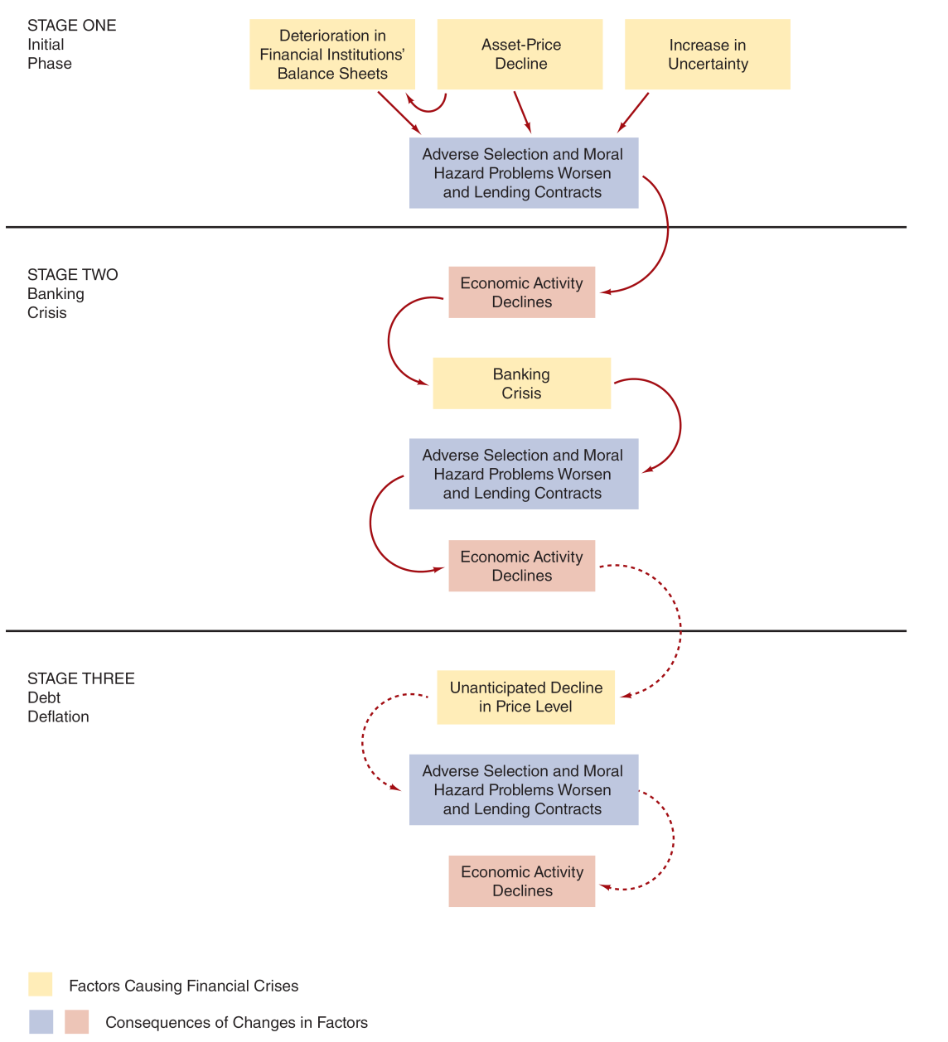
Stages of Financial Crises in Advanced Economies
Factors causing financial crises
-----lead to information problems
-----which lead to further disruptions

Slide 5
Stage One: Initial Phase
Financial crises can be caused by:
Credit Boom and Bust
Financial institutions rapidly expand lending, risk management standards decline.
Banks compete aggressively and extend credit to increasingly risky borrowers, supported by inflated collateral values.
Eventually, loan losses accumulate, borrowers default and asset values fall, forcing banks to cut back on lending (deleveraging).

Slide 6
Stage One: Initial Phase
Why Do Credit Booms happen in the first place?
elimination of restrictions,
lack of regulation
introduction of new types of loans or other financial products i.e. “innovation”
low interest rates –encourages excessive lending and borrowing

Slide 7
Stage One: Initial Phase
What’s does this have to do information problems?
Banks don't just lend money - they're experts at figuring out which businesses are trustworthy borrowers and monitoring how they use loans.
During a credit bust, when banks stop lending, this crucial evaluation system breaks down.
Banks can't tell good borrowers from bad ones anymore (Adverse Selection)
No one's watching to make sure borrowers use money responsibly (Moral Hazard)
Even healthy businesses can't get loans because there's no one left to properly evaluate them.
This makes the economic downturn worse as good businesses can't get the funding they need to operate and grow.

Slide 8
Stage One: Initial Phase
Financial crises can also be caused by:
Asset- price boom and bust:
During booms, asset prices (like stocks or real estate) rise above their real value, creating a bubble.
When this bubble pops, it triggers a dangerous chain reaction:
Falling asset prices reduce the value of businesses and their collateral, making them more likely to take risks since they have less to lose (the moral hazard problem)
Financial institutions suffer losses on these same assets, forcing them to reduce lending and sell more assets. This selling pushes prices down further, creating a negative spiral
Bursting of asset bubbles hits both borrowers and lenders at the same time
Companies become riskier borrowers just as banks become less able to absorb losses, leading to a credit crunch and potential financial crisis.

Slide 9
Stage One: Initial Phase
Increase in uncertainty triggers the crisis
Credit booms and asset-price booms create fragility through high debt and inflated asset prices.
When uncertainty hits, it triggers a vicious cycle:
No one knows who's safe to lend to
Asset prices fall as confidence drops
Falling prices create more uncertainty
Banks stop lending
This causes more asset sales and price drops
Booms set up the dominoes, and uncertainty (often from a big firm's failure) knocks them down.
Each falling domino (asset prices, lending, confidence) knocks down the next, deepening the crisis.

Slide 10
Stage Two: Banking Crisis
When banks' financial health declines (bad loans, falling asset values)
Depositors get scared, people rush to withdraw money from all banks ("bank run")
Banks must sell assets quickly at fire-sale prices to get cash
These rushed sales make banks' finances even worse
The Damage:
Banks stop lending as they fight for survival
Good borrowers can't get loans (adverse selection)
Desperate firms take bigger risks (moral hazard)
Economy suffers as credit freezes - recovery takes years as trust must be rebuilt
When people suspect some banks are sick but don't know which ones, they run from all banks - creating a self-fulfilling crisis that hurts even healthy banks.

Slide 11
Stage Three: Debt Deflation
When prices fall sharply but debt amounts stay fixed:
Asset values drop but loan amounts remain the same
Real debt burden increases for borrowers
E.g. House worth £200K → £150K, but £180K mortgage remains
This Creates a Dangerous Cycle:
Borrowers struggle with higher real debt loads
More likely to default or take risks (moral hazard)
Banks reduce lending further
Economic activity remains depressed for a long time

Slide 12
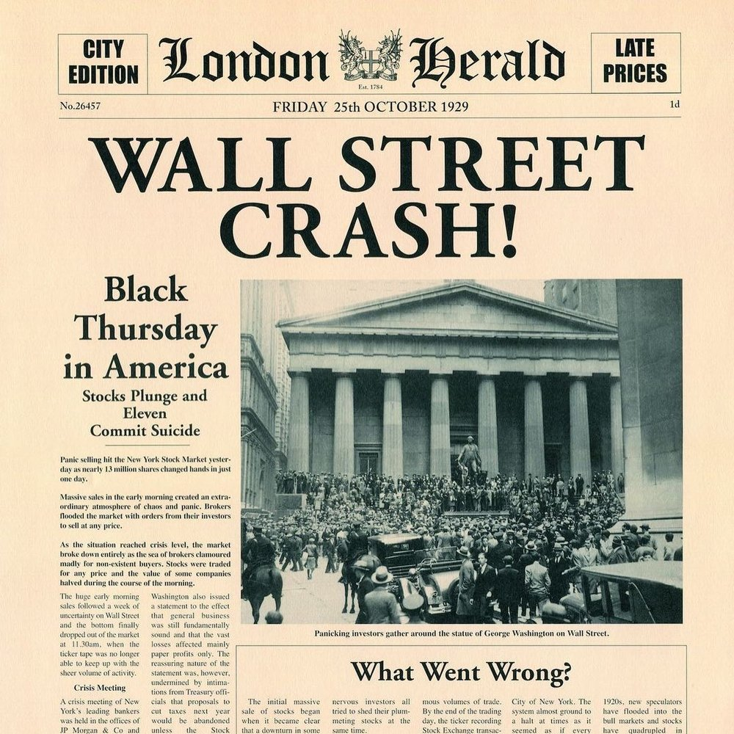
Great Depression – a case
How it started and the impact it had:
Focusing on the US
See the reading for more detail on this, as well as a case of Eurozone crisis

Slide 13
Case: The Great Depression
In 1928 and 1929, stock prices doubled in the U.S.
Check out the Dow Jones Industrial Stock Price Index data at this link
The Fed tried to curb this period of excessive speculation with a tight monetary policy.
Higher rates made borrowing more expensive
Investors forced to sell stocks to repay loans
Once selling started, prices fell sharply
A downward spiral: selling → price drops → more selling
A stock market collapse - Bubble burst!

Slide 14
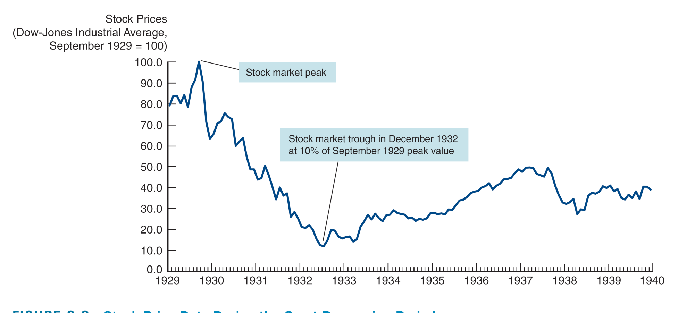
Stock Price Data During the Great Depression Period
Source: Federal Reserve Bank of St. Louis, FRED database: https://fred.stlouisfed.org/series/M1109BUSM293NNBR
The decline continued for several years.

Slide 15
Case: The Great Depression
Recession turned into something far worse, when severe droughts in 1930 led to a sharp decline in agricultural production.
Reduced agricultural incomes, declining land values, loan defaults by farmers put banks in financial difficulty
Caused loss of confidence among depositors
Caused bank runs
Between 1930 and 1933, one-third of U.S. banks went out of business
For more than two years, the Fed sat idly, doing nothing to help banks or the economy

Slide 16
Case: The Great Depression
Adverse selection and moral hazard in credit markets became severe.
Firms with productive uses of funds were unable to get financing.
As seen in the next slide, credit spreads increased from 2% to nearly 8% during the height of the Depression in 1932.
A credit spread is the extra interest that borrowers must pay compared to a government, showing how nervous lenders are about getting their money back.

Slide 17
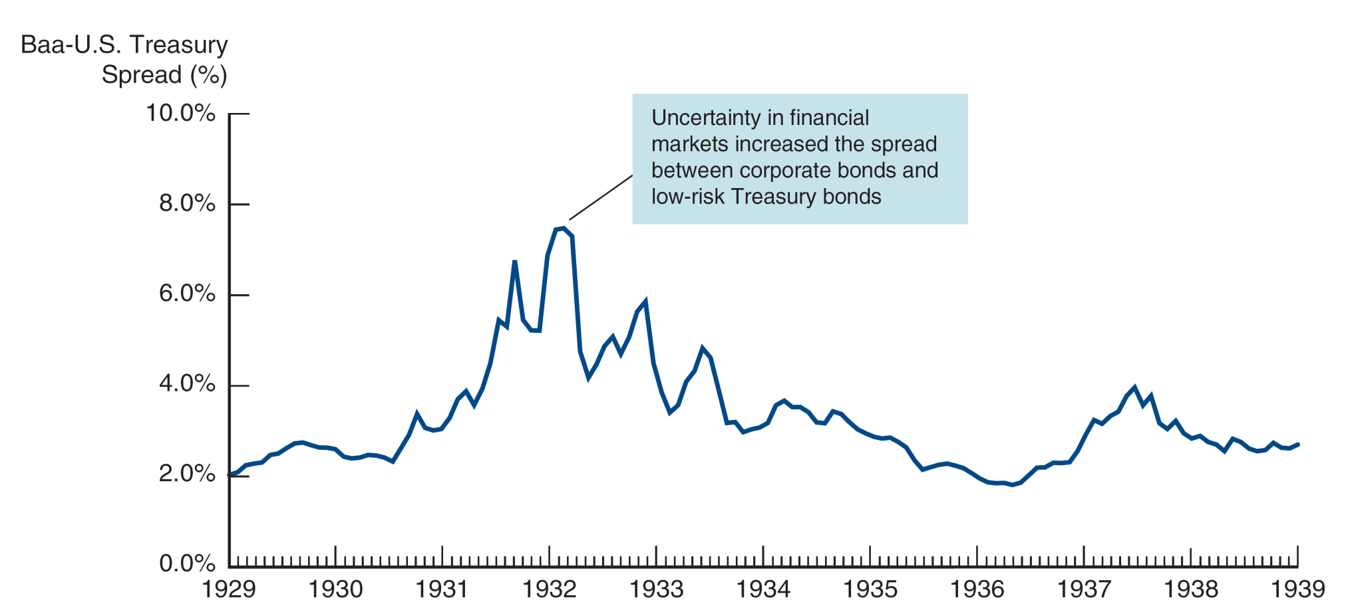
Credit Spreads During the Great Depression
A credit spread is the difference in return between a risky bond (typically corporate) and a risk-free bond (typically government) of the same maturity,
It serves as an indicator of credit market stress.
Source: Federal Reserve Bank of St. Louis, FRED database: https://fred.stlouisfed.org/series/M13036USM193NNBR, https://fred.stlouisfed.org/series/LTGOVTBD.

Slide 18
Case: The Great Depression
The deflation during this period: to a 25% decline in price levels.
The prolonged economic contraction brought an unemployment rate around 25%.
The Depression was the worst financial crisis ever in the U.S.

Slide 19
Case: The Great Depression
Bank panics in the U.S. spread to the rest of the world, and the contraction of the U.S. economy decreased demand for foreign goods.
The worldwide depression caused great hardship, and the resulting discontent which led to the rise of fascism and WWII.

