Slide 1

Big-mart-Sales-data-Analysis Kartik Kumar (19BCE0887)

Slide 2

INTRODUCTION
In today’s world, Data Science finds a huge application in the field of Market analysis. Be it sales prices or the volatility of a crypto currency, prediction is the one thing that holds a position of paramount importance in the field of marketing and trading.

Slide 3
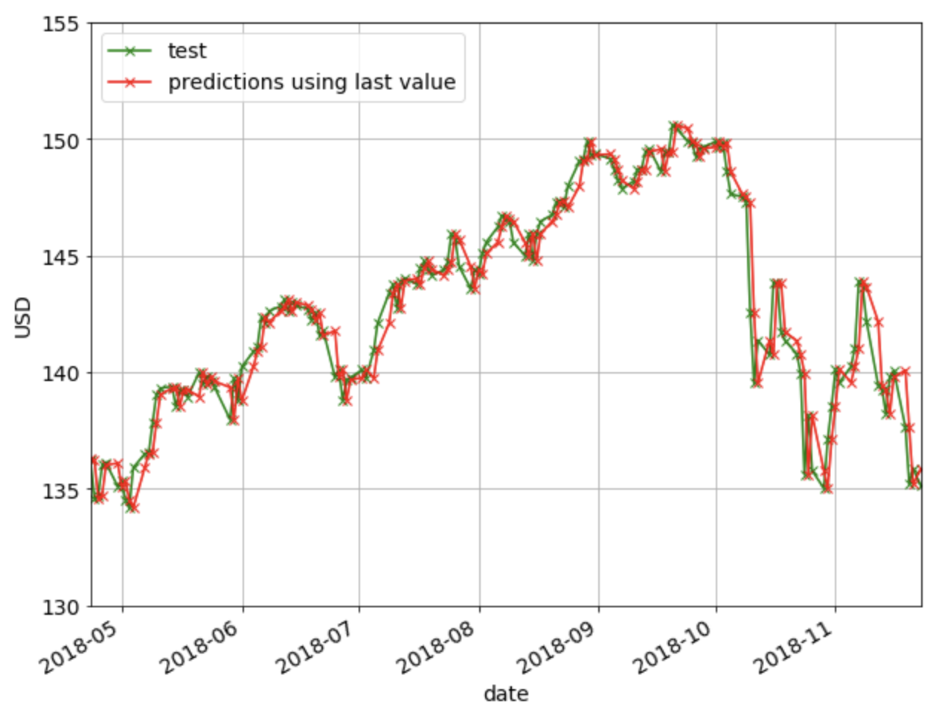
In This Brief Project, I Will Be Downloading A Very Popular Dataset – Big Mart Sales From Kaggle And Will Try To Fit An Appropriate Machine Learning Model That Can Provide Me With An Estimated Price Given Several Features About The Item.

Slide 4
The steps I will go through are:
Data pre-processing
Exploratory Data Analysis
Model training
Model validation
Model predictions
Visualization of results

Slide 5
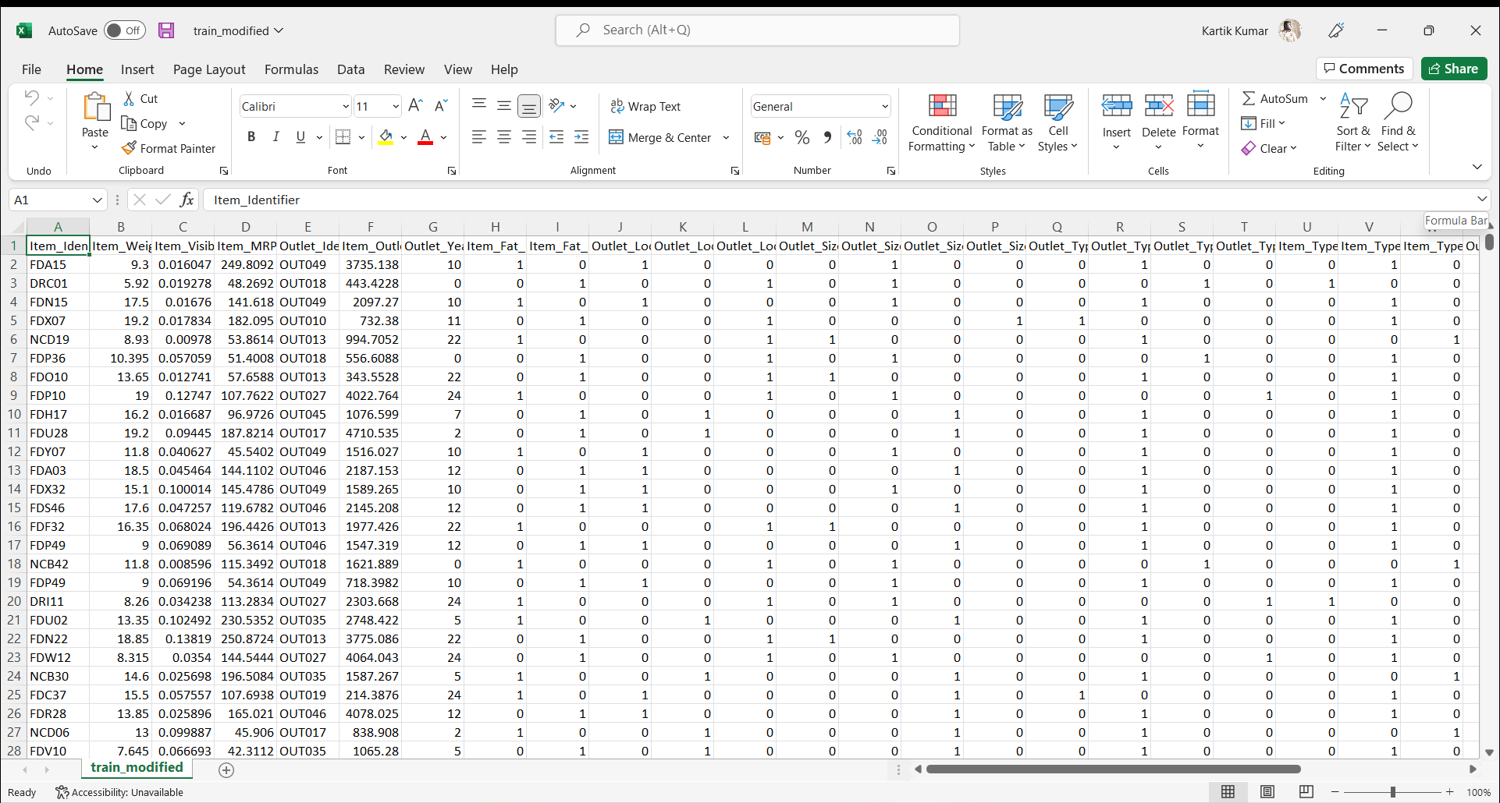
DATASET
The input dataset is an Excel file with information about sales of 8523 items sold at Big Mart. For each item sold, in addition to the price at which the item was sold, the dataset contains additional features such as the weight, MRP, the type, the year at which it was sold and 11 such others.

Slide 6
THANK YOU

