Slide 1
NETWORK PROBE SELECTION PROBLEM – CS
Kunal Gupta
Bhor Verma

Slide 2
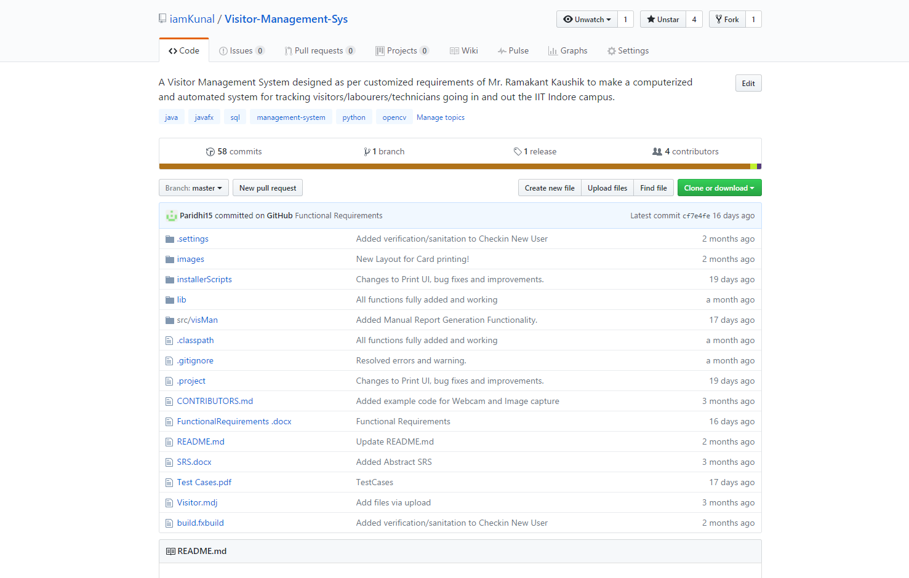
DESKTOP PROJECT
Visitor Management System.

Slide 3
About our Project
Effective use of the monitoring tools demands an understanding of monitoring requirements that system administrators most often lack. Instead of a well-defined process of defining monitoring strategy, system administrators adopt an ad-hoc, manual, and intuition-based approach. This leads to inconsistent and inadequate data collection and retention policies.
For this project, we propose a solution to adapt the monitoring level of a system component using probes.

Slide 4
Processes involved
Setting Objectives & Mathematical Formulation
Converting to Matrix Form
Solving LP by implementation of solving techniques

Slide 5
1.
Mathematical Formulation
Understanding the problem, setting objectives and coverting it to a mathematical one.

Slide 6
Problem Statement
The key idea is to send probes in the network, infer the system state from the probe results, and adjust the monitoring of system components based on the inferred system state. The key objective of the problem is:
Probe selection - how to select the right set of probes such that criticality of components can be correctly estimated and appropriate recommendations can be provided for each component.

Slide 7
Assumptions
Network is like a undirected graph, with each node in graph denoting a node in the network.
Given,
List of probes. (We can select out of these)
List of nodes monitored by each node.
Minimum number of probes by which each node has to be monitored. (For data consistency check)

Slide 8
Notations
Let the set of all probes be P and p represent any probe in P. N is the total number of probes.
Then,
nodes(p) represents all the nodes that p can monitor,
C(p) is the cost associated with probe p, where cost is defined as length of the probe = |nodes(p)|,
and c is the minimum number of probes that monitor each node.

Slide 9
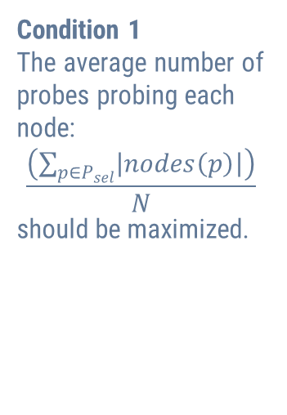
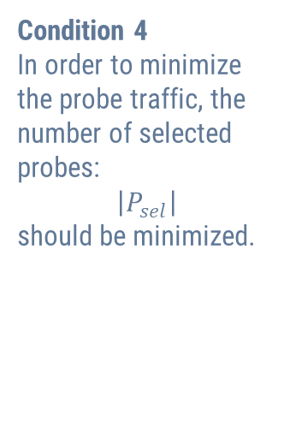
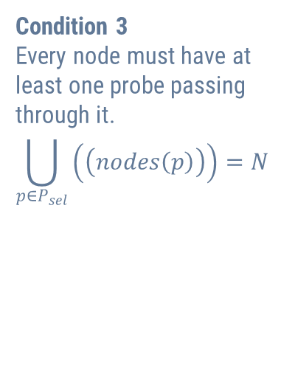
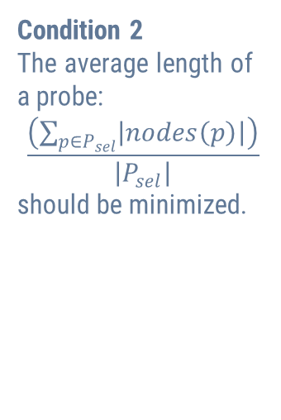
Conditions
Condition 1
The average number of probes probing each node:
$$\frac{\left(\sum_{p∈P_{sel}}{\left|nodes\left(p\right)\right|}\right)}{N}$$
should be maximized.
Condition 2
The average length of a probe:
$$\frac{\left(\sum_{p∈P_{sel}}{\left|nodes\left(p\right)\right|}\right)}{\left|P_{sel}\right|}$$
should be minimized.
Condition 3
Every node must have at least one probe passing through it.
$$\bigcup_{p∈P_{sel}}{\left(\left(nodes\left(p\right)\right)\right)}=N$$
Condition 4
In order to minimize the probe traffic, the number of selected probes:
$$\left|P_{sel}\right|$$
should be minimized.

Slide 10
Objective Function
We use LP formulation of the standard set cover with a slight modification to incorporate the desired constraints. The modification is required as the set cover problem requires each element to be covered in the selected subsets only once. Whereas, our requirement is that the node should be probed multiple times (condition 1). That is, each element in the universe must get covered at least c times in selected subsets.

Slide 11
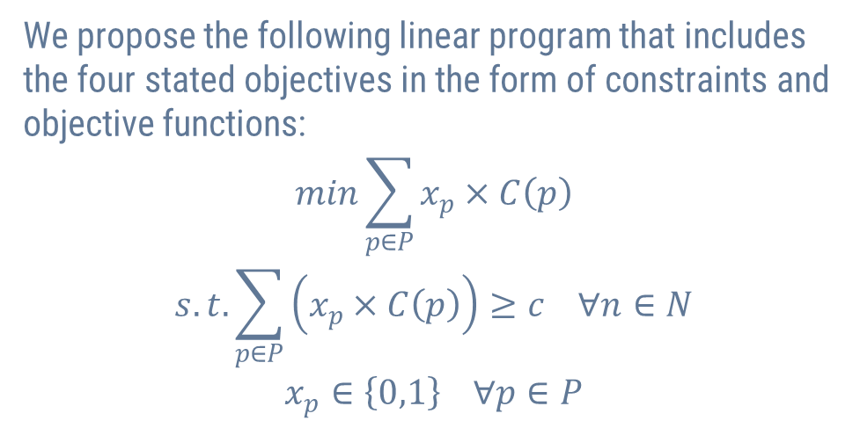
Objective Function
We propose the following linear program that includes the four stated objectives in the form of constraints and objective functions:
$$min\sum_{p∈P}{x_{p}×C\left(p\right)}$$
$$s.t.\sum_{p∈P}{\left(x_{p}×C\left(p\right)\right)}≥c ∀n∈N$$
$$x_{p}∈\left\{0,1\right\} ∀p∈P$$

Slide 12
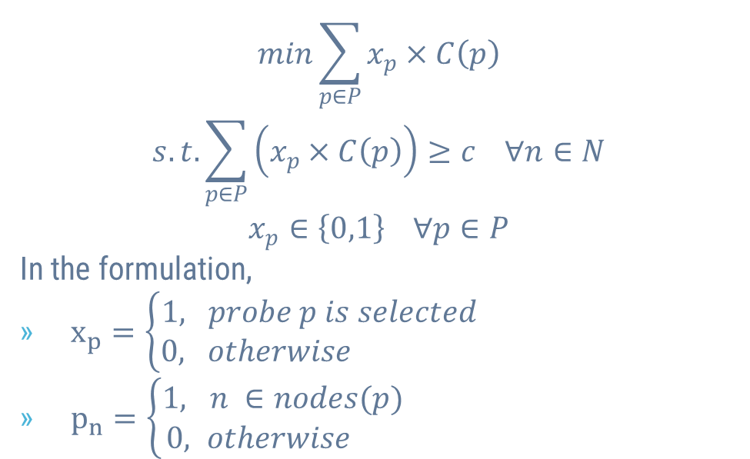
Objective Function
$$min\sum_{p∈P}{x_{p}×C\left(p\right)}$$
$$s.t.\sum_{p∈P}{\left(x_{p}×C\left(p\right)\right)}≥c ∀n∈N$$
$$x_{p}∈\left\{0,1\right\} ∀p∈P$$
In the formulation,
$x_{p}=\left\{\begin{aligned}1, probe p is selected \\ &0, otherwise \end{aligned}\right.$
$p_{n}=\left\{\begin{aligned}1, n ∈nodes(p) \\ &0, otherwise \end{aligned}\right.$

Slide 13
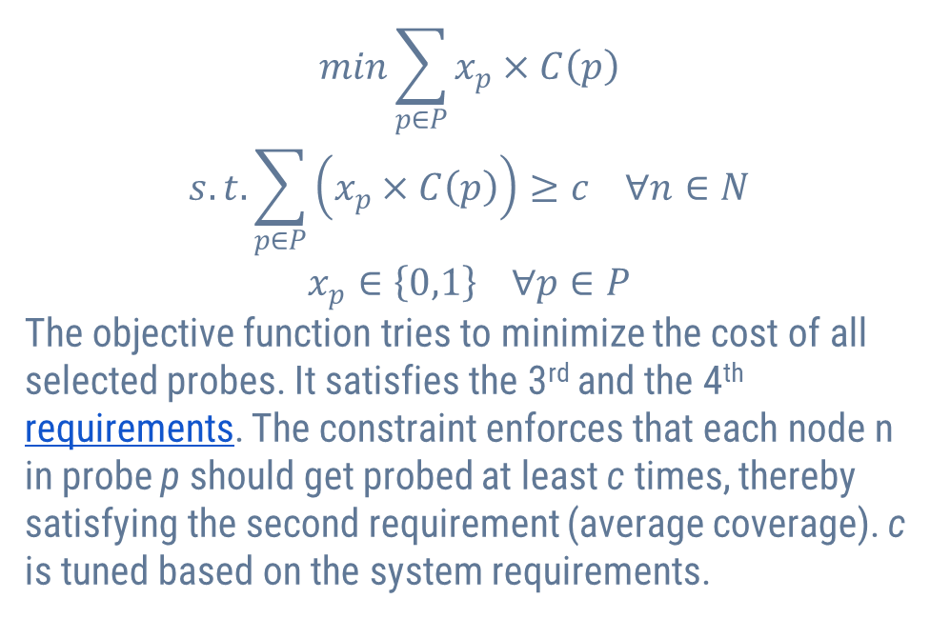
Objective Function
$$min\sum_{p∈P}{x_{p}×C\left(p\right)}$$
$$s.t.\sum_{p∈P}{\left(x_{p}×C\left(p\right)\right)}≥c ∀n∈N$$
$$x_{p}∈\left\{0,1\right\} ∀p∈P$$
The objective function tries to minimize the cost of all selected probes. It satisfies the 3rd and the 4th requirements. The constraint enforces that each node n in probe p should get probed at least c times, thereby satisfying the second requirement (average coverage). c is tuned based on the system requirements.

Slide 14
2. Coversion to Matrix Form

Slide 15
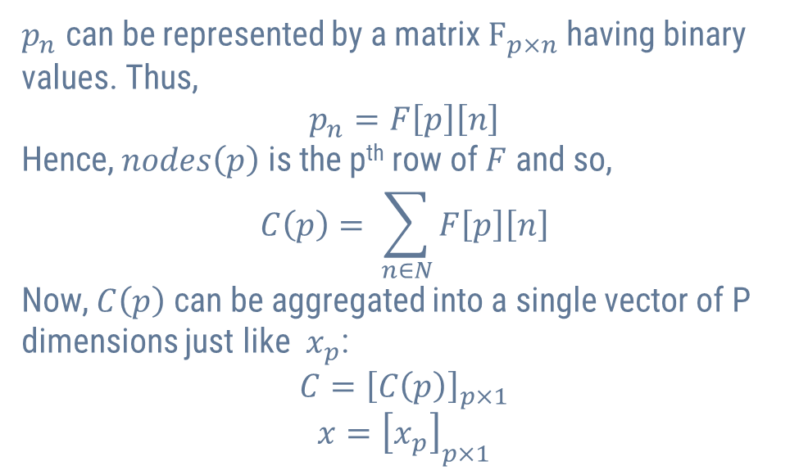
Observation
$p_{n}$ can be represented by a matrix $F_{p×n}$ having binary values. Thus,
$$p_{n}=F\left[p\right]\left[n\right]$$
Hence, $nodes\left(p\right)$ is the p^{th} row of $F$ and so,
$$C\left(p\right)= \sum_{n∈N}{F\left[p\right]\left[n\right]}$$
Now, $C\left(p\right)$ can be aggregated into a single vector of P dimensions just like $x_{p}$:
$$C={\left[C\left(p\right)\right]}_{p×1}$$
$$x={\left[x_{p}\right]}_{p×1}$$

Slide 16
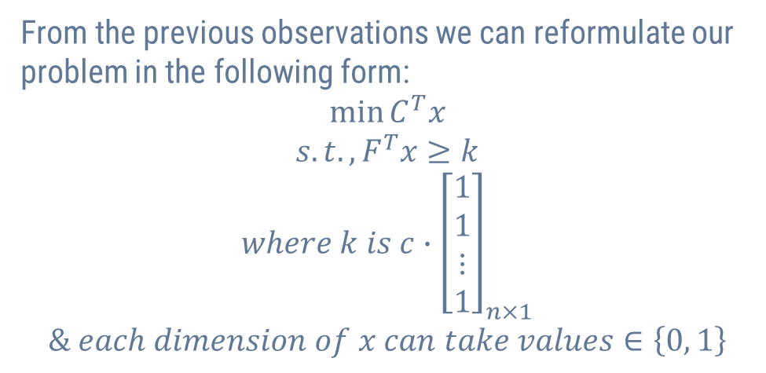
Reformulation
From the previous observations we can reformulate our problem in the following form:
$$\min{C^{T}x}$$
$$s.t., F^{T}x≥k$$
$$where k is c∙{\left[\begin{aligned}1 \\ 1 \\ ⋮ \\ 1\end{aligned}\right]}_{n×1}$$
$$\& each dimension of x can take values∈\left\{0, 1\right\}$$

Slide 17
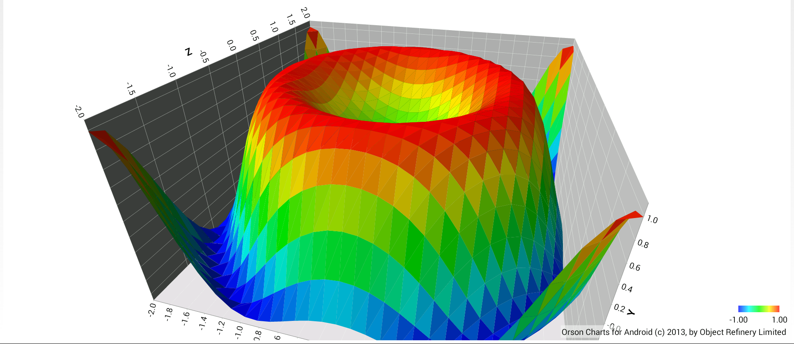
Solving Methods and Implementation

Slide 18
Solving Methods
Base on the type of final LP we got after final reformulation, we found the following methods to solve it:
BALAS
Interior Point
Lagrange and Sub-gradient

Slide 19
BALAS Algorithm
BALAS uses the Branch and Bound technique to eliminate many cases by eliminating whole subtrees of possible solution tree.
Click here to view BALAS.

Slide 20
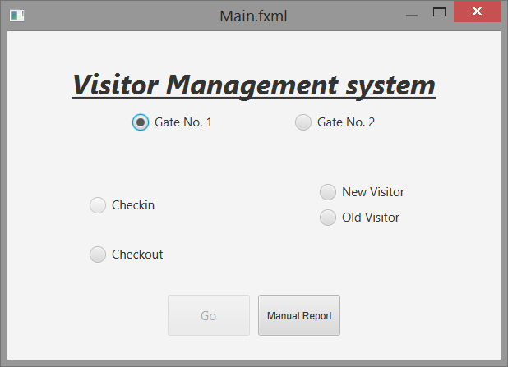
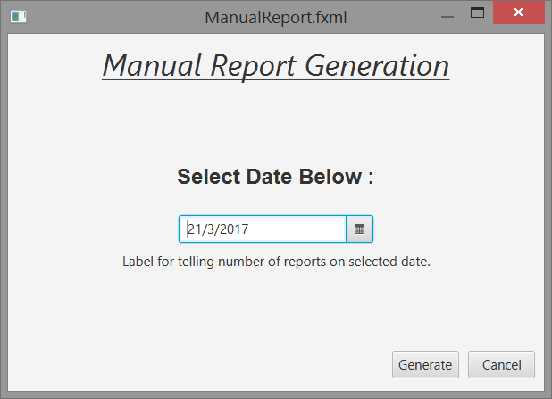
UI Design
Main Screen
Report Generation

Slide 21
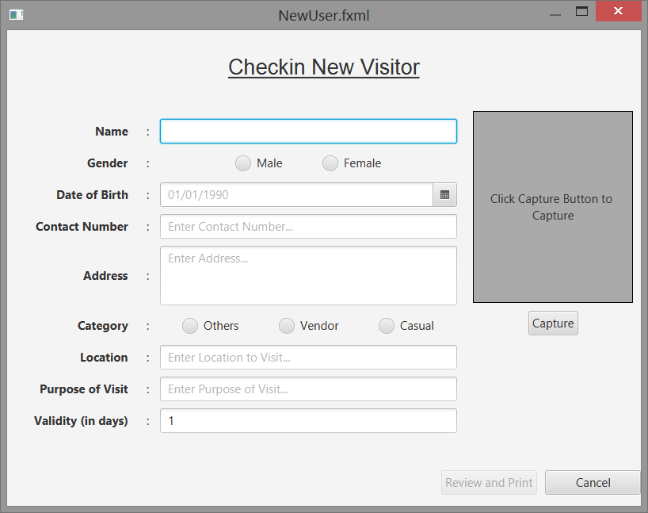
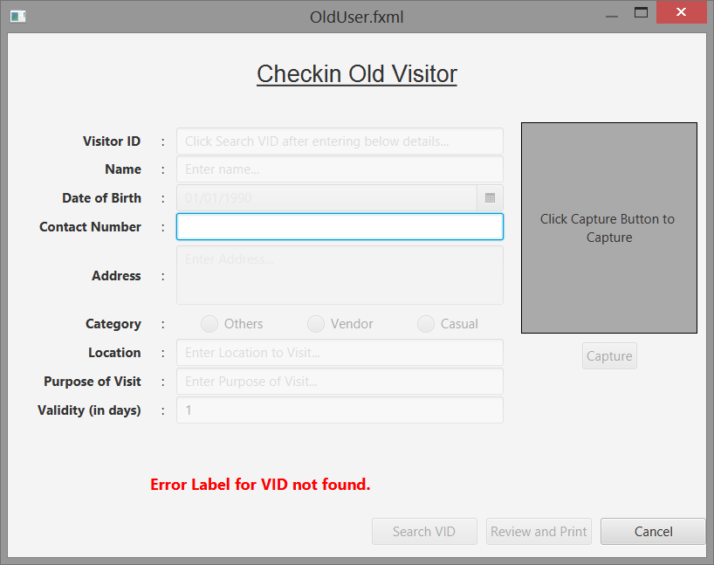
UI Design
New Visitor Entry
Old Visitor Entry

Slide 22
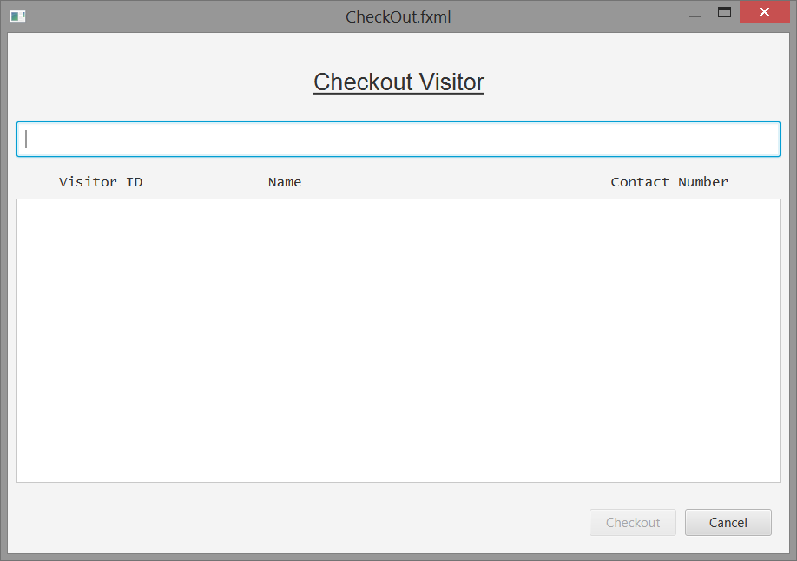
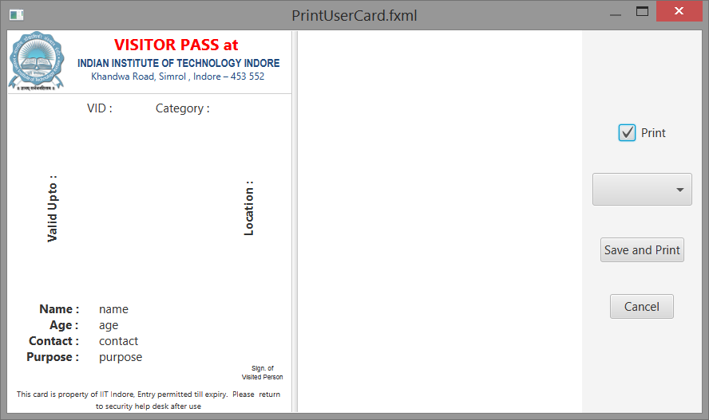
UI Design
Checkout Screen
Card Printing Screen

Slide 23
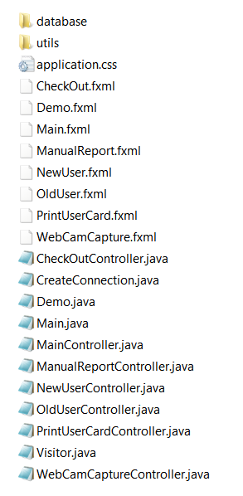
Project File Structure
- Database connections and Functions
- Utilities (like printing) and common functions
JavaFX FXML – UI Design
Java Files with the core code.

Slide 24
Commit History (as found on GitHub)

Slide 25
3.
TESTING
The developer’s nightmare

Slide 26
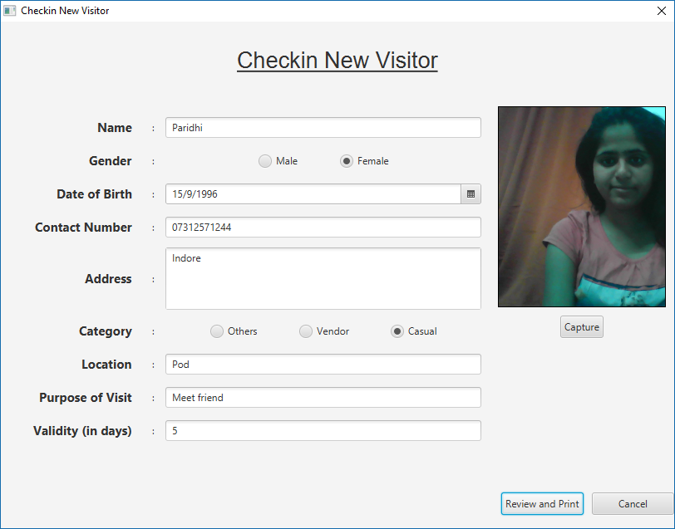
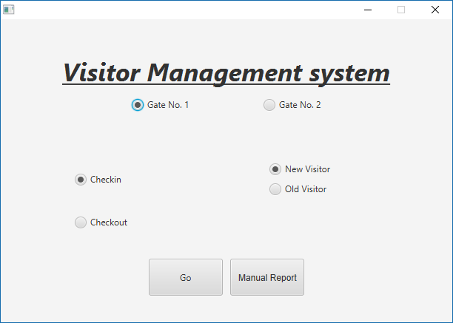
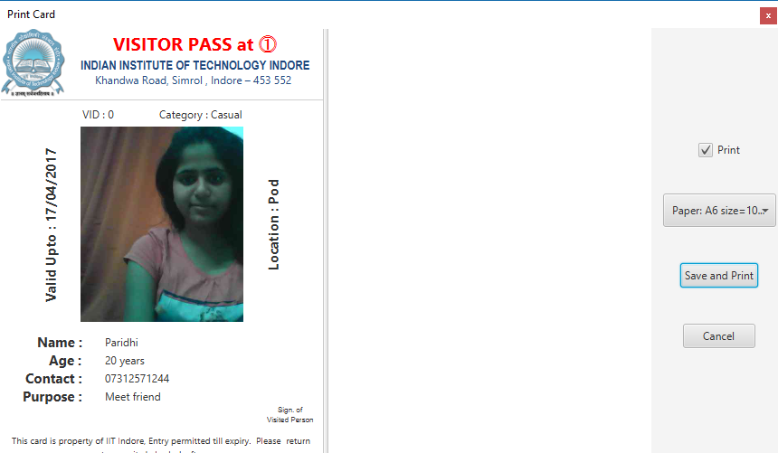
Test Cases

Slide 27
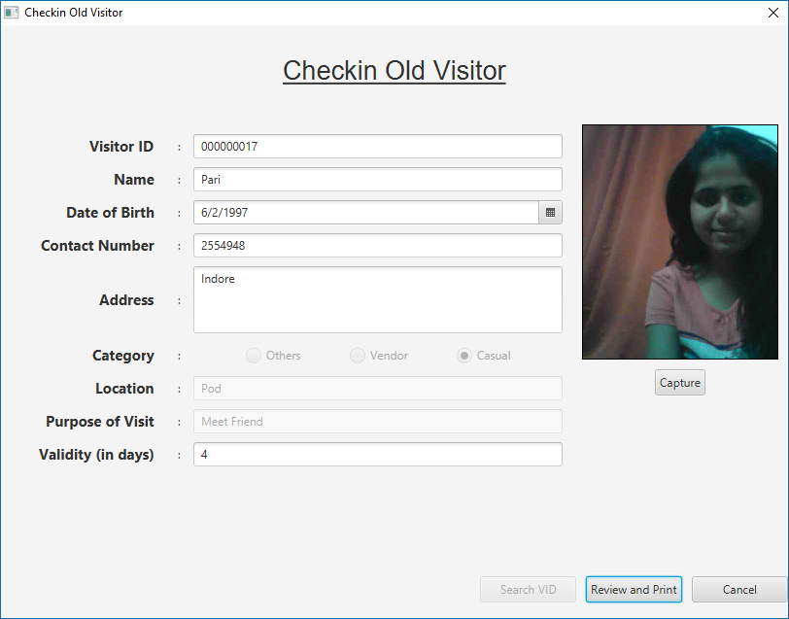
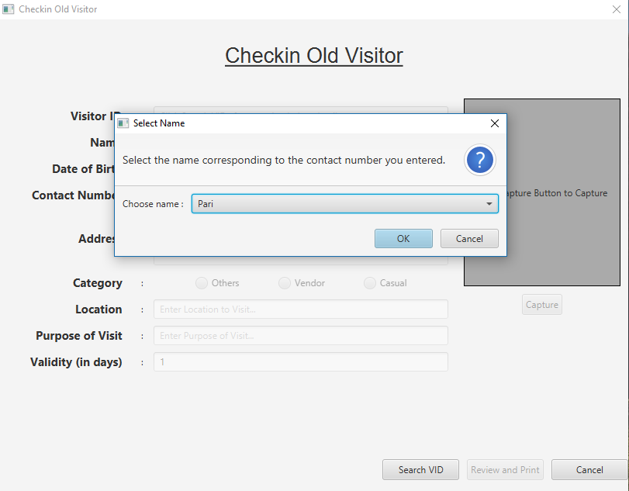
Test Cases

Slide 28
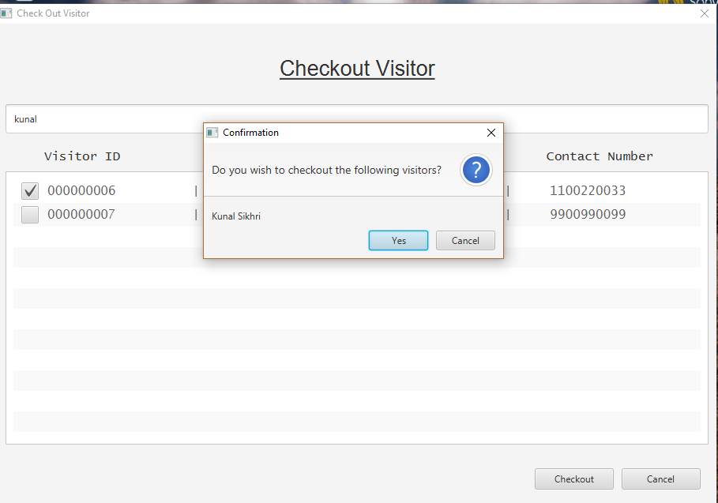
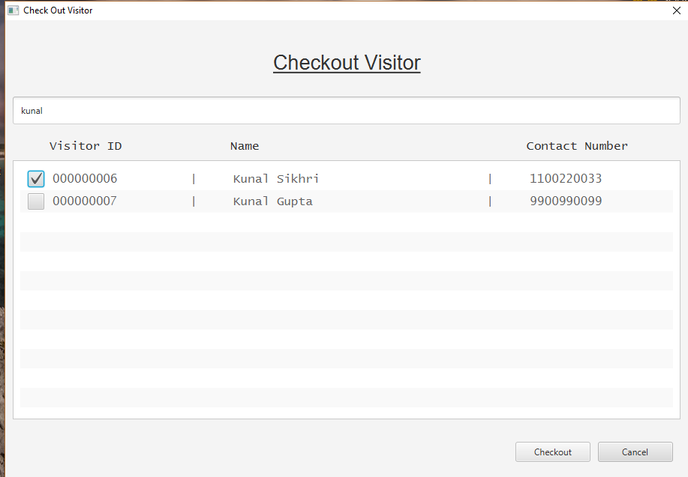
Test Cases

Slide 29
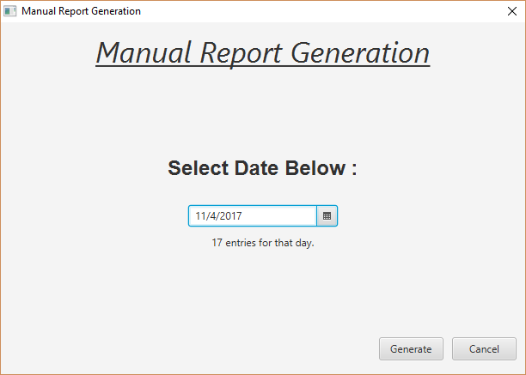
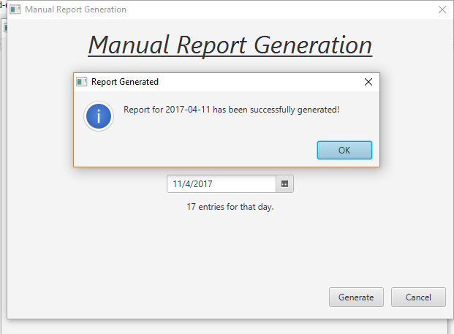
Test Cases

Slide 30
Testing
Our project is currently in α – Testing, set up in the 2nd week of April at the IIT Indore entry gate.
Maintenance is done and feedback taken regularly.

Slide 31
Challenges Faced

Slide 32
FUTURE WORK PLANNED
New printer, webcam and laptop to be bought.
Server space planned.
Interconnectivity between both gates.
Barcode based reading.
Smart Card based passes.
Biometric-enrolment (if possible)

Slide 33
LEARNING
Great experience for:
Making desktop apps with a clickable UI.
Making real-word based projects.
Implementation and Deployment of Software.
Learning new programming languages and standards.

Slide 34
THANKS!

