Slide 1
CLOTHING PALLETTE

Slide 2
DEVELOPED BY
Mahmudul Hasan (150201043)
Nazmul Alam Nowfel (150201045)
Nilaya Kumar Ghosh (150201041)
Afsara Afia (150201037)

Slide 3
OUTLINE
OBJECTIVES
FEATURES
GRAPHICAL USER INTERFACE
MAINTENANCE
ADVANTAGES
WHAT WE HAVE USED
FUTURE PLAN

Slide 4
OBJECTIVES
To represent a clothing company.
Make things easier for the users to have idea about their desired clothing products.
To establish a communication system between the users and the authority.
To ensure a user friendly interface to the visitors for their desired need.

Slide 5
FEATURES
Displaying products with respect to every particular category.
Search functionality.
Messaging system.
Getting idea about related products when visiting a particular category.
Displaying latest updated products.
Dynamic page display system.
Pagination system.

Slide 6
GRAPHICAL USER INTERFACE
Home Page
Products Page
Products Details Page
Contact Page

Slide 7
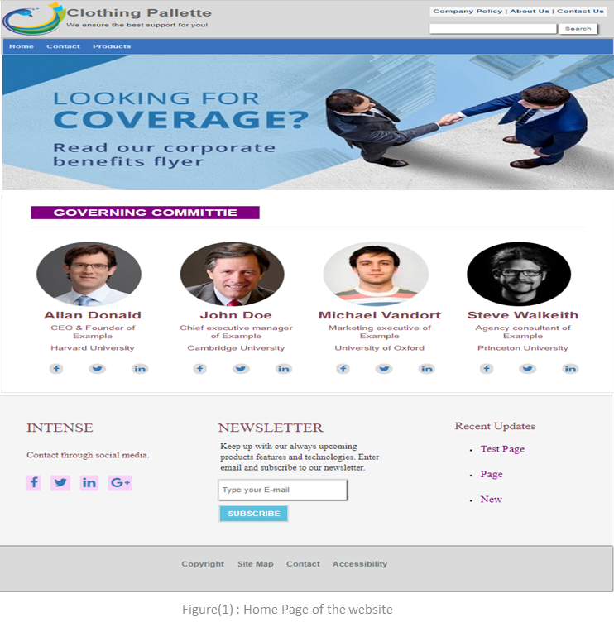
HOME PAGE

Slide 8
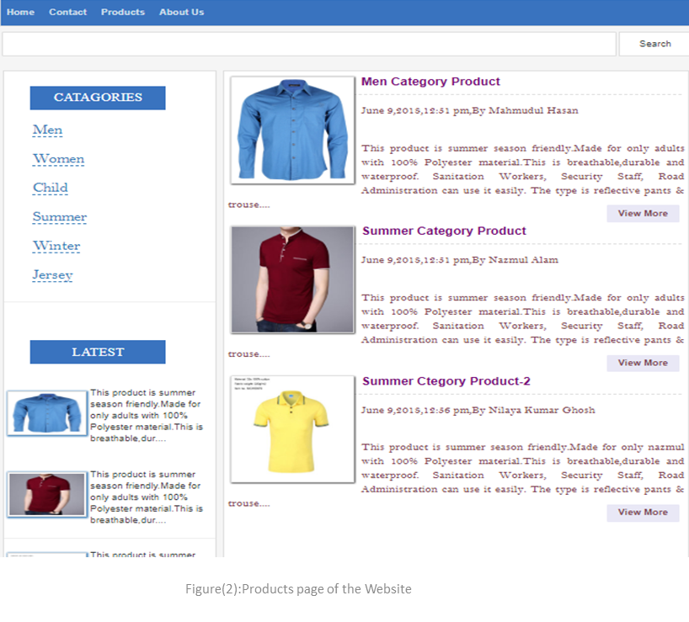
PRODUCTS PAGE

Slide 9
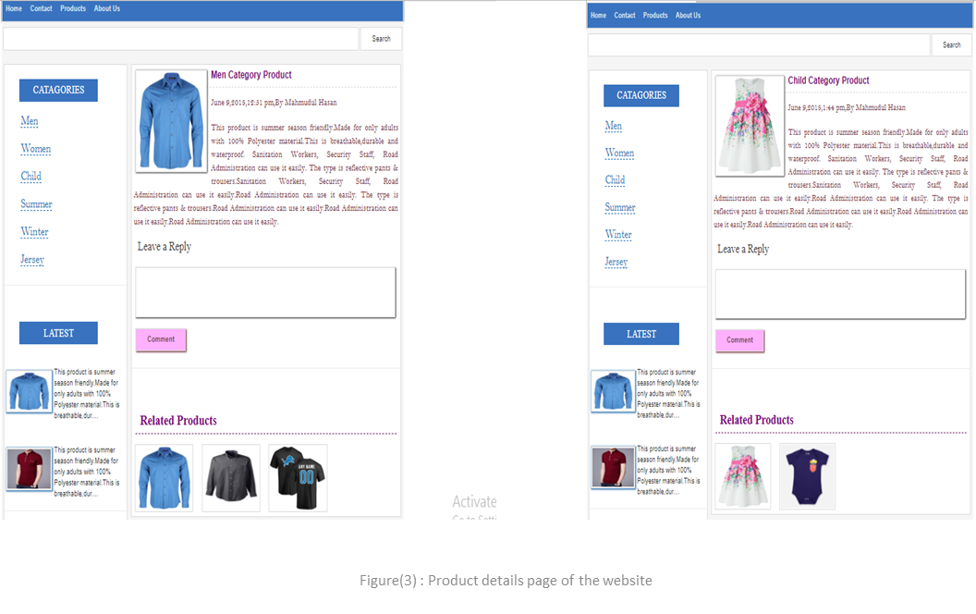
PRODUCT DETAILS PAGE

Slide 10
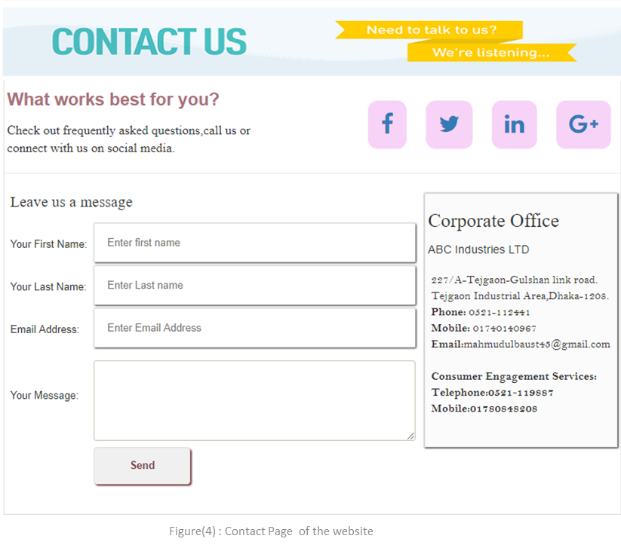
CONTACT PAGE

Slide 11
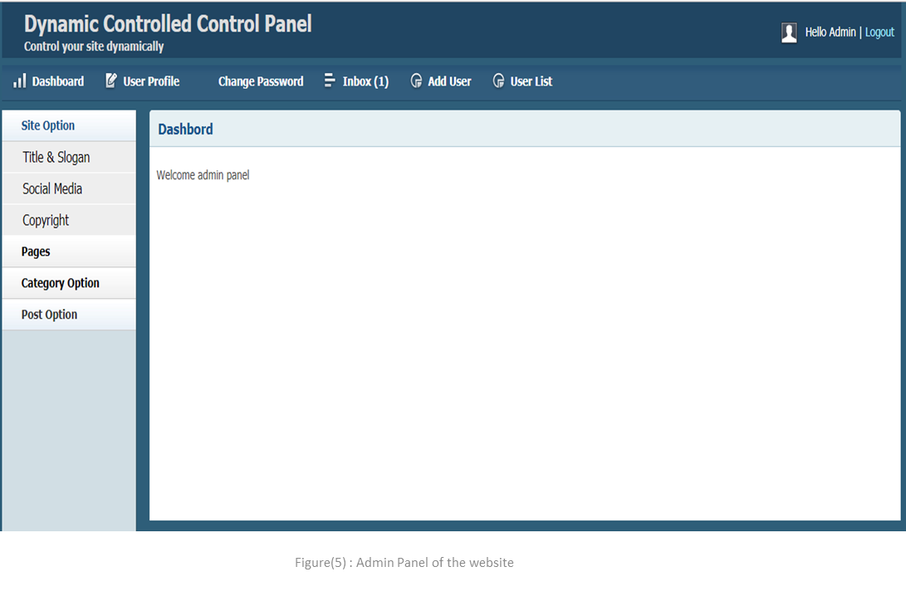
MAINTENANCE

Slide 12
ADVANTAGES
Easily knowing facility of different products from anywhere.
Communication system with the authority.
Getting desired products easily when visiting the website.
Displaying latest updated products easily to the visitors.
Sharing own opinion to any particular product.
All the products are decorated nicely and very much user friendly interface to the visitors.

Slide 13
WHAT WE HAVE USED
Front End :
Html
Css
Bootstrap
JavaScript
Back End :
Custom Code : php
Database: Mysql

Slide 14
FUTURE PLAN
Adding more e-commerce mechanism.
Adding commenting system.
Adding much more dynamic features.
Adding products rating system.

Slide 15
THANK YOU

