Slide 1


Mav’s Ice cream emporium
Developer: Nihar Gupte

Slide 2
Introduction
Mav’s Ice cream Emporium, also known as the MICE, is a GUI-based application for a billing-based ice cream shop.
Basic Features of MICE include:
Add new flavors (scoops), containers (cones) and toppings (sprinkles)
Add new customer, server and manager with their name, ID and phone number, plus wage per hour for the server.
Three order states- unfilled, filled and paid with an option to cancel the order
Ability to change role as an user to be the owner, manager, server or customer. (appropriate options would be grayed out)
Save and Load the emporium to ensure data is not lost every time on starting the application.

Slide 3
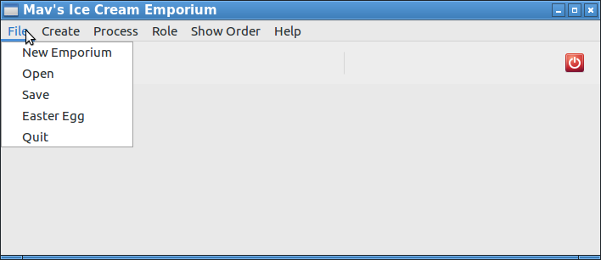
FILE MENU
The file menu has options to load, save and quit the emporium and only the manager/ owner is permitted to use them

Slide 4
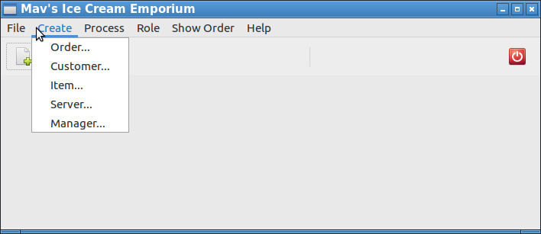
CREATE MENU
The create menu has options to Create an order, customer, server, manager or add a new type of item to the emporium

Slide 5
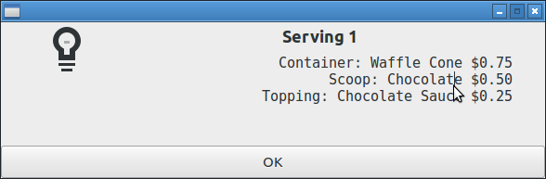
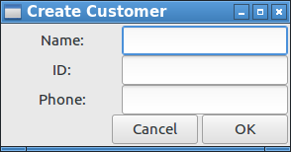
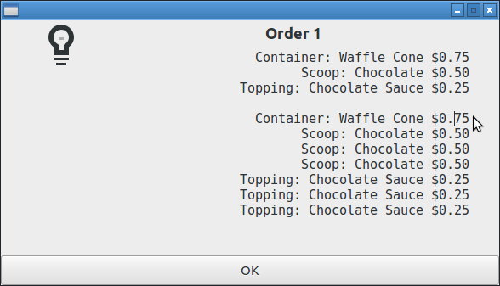
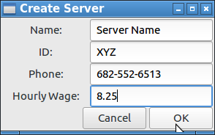
Some of the functionalities under create menu
Serving confirmation
Order confirmation

Slide 6
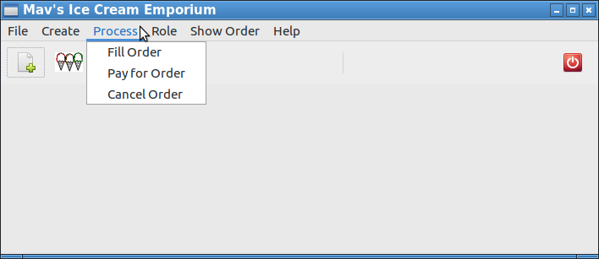
PROCESS MENU
The process menu has options to change the state of the order.

Slide 7
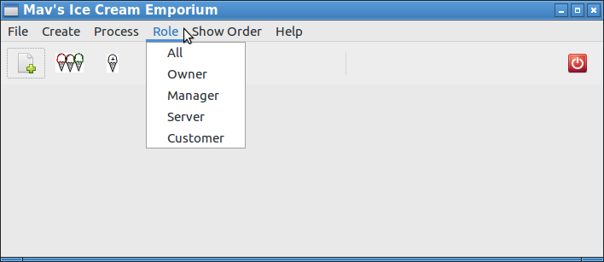
ROLE MENU
The role menu enables the user to select whether the user wants to play the role of the owner, manager, server or customer

Slide 8
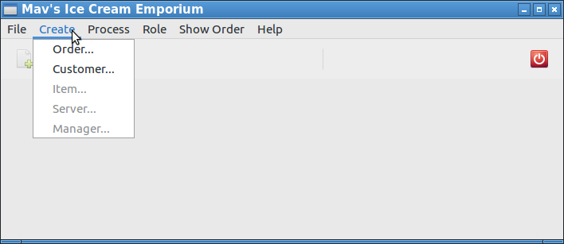
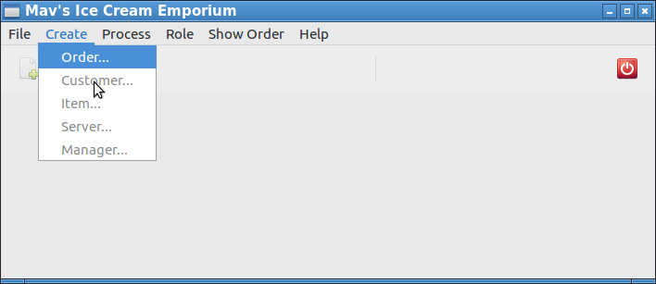
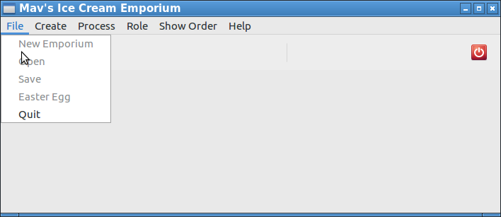
Various previews for various users
SERVER PREVIEW
CUSTOMER PREVIEW
SERVER AND CUSTOMER PREVIEW

Slide 9
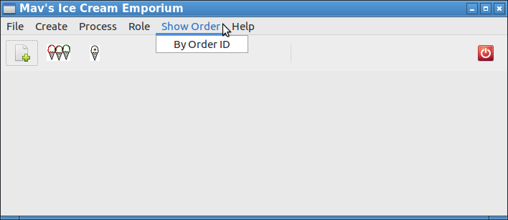
ORDER HISTORY
The show order menu can be used to retrieve any order via its order number

Slide 10
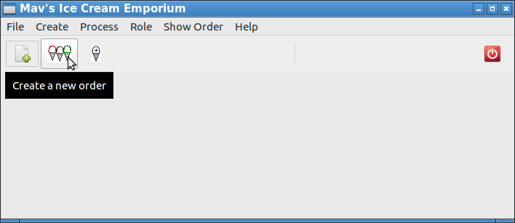
Miscellaneous: Toolbar with icons
Includes a toolbar with representative items for quicker access to functions

Slide 11
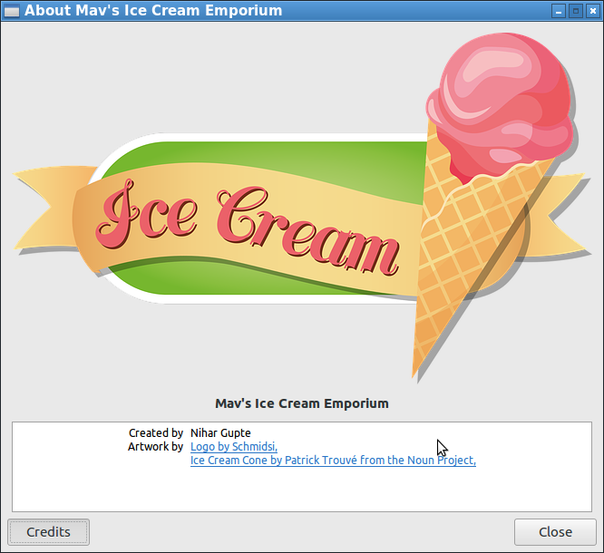
CREDITS & COPYRIGHTS

