Slide 1


Normi-OS
Project

Slide 2
PRESENTED BY ,
1. Vinod Kumar .L - 950019104050
Under the guidance of:
Dr.S.Sabena AP/CSE

Slide 3
ABSTRACT
✦ Linux is a family of open-source Unix-like operating systems based on the Linux kernel.
✦ Linux is the most secure operating system, It may take time for people to adapt.
✦ This OS includes the following modules : Baseline Profile Files Module, Buliding personal ISO Module, Multiple profile Building Module, Buliding Normi-OS ISO Module.
✦ Each linux distro has its own purpose to fullfill the needs.
✦ For Normal people aka. Normi, Normi – OS come into play to fullfill all needs of all kind people.

Slide 4
OBJECTIVE
To Develop a GUI based Upgraded linux based Operating system named as Normi-OS which can Impress normal people to use linux based OS.
Highly secure os.

Slide 5

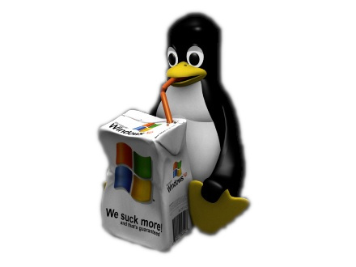
LITERATURE SERVEY - Microsoft Windows
Windows is a group of several proprietary graphical operating system families developed and marketed by Microsoft. Each family caters to a certain sector of the computing industry.However, Windows is not the most used operating system when including both mobile and desktop OSes, due to Android's massive growth.
Advantage:
Beginner-friendly.
Disadvantages:
✦ Less secure than Linux.
✦ Proprietary software.
✦ Can slow down over time.
✦ Can have bugs and reliability issues.
✦ Must be purchased.

Slide 6

LITERATURE SERVEY - Cononical’s : Ubuntu
Ubuntu is a Linux distribution based on Debian and composed mostly of free and open-source software. Ubuntu is officially released in three editions: Desktop, Server, and Core for Internet of things devices and robots. All of the editions can run on a computer alone, or in a virtual machine. Ubuntu is developed by British company Canonical.
Advantage:
A Well-Rounded Operating System for Desktop Computing.
Disadvantages:
✦ Limited Functionality Due to Limited Applications.
✦ Designed for specific use case.
✦ Issues About Commercialization Versus Open Source.
✦ Few customizations.
✦ Not responsive community.

Slide 7

LITERATURE SERVEY - Garuda Linux
Garuda Linux is a Linux distribution based on the Arch Linux operating system. Garuda Linux is available in wide range of popular Linux desktop environments, including modified versions of the KDE Plasma 5 desktop environment. It features a rolling release update model using Pacman as its package manager.
Advantage:
Easy installation with Calamares installer.
Disadvantages:
✦ Designed for specific use case.
✦ Need more resources to run.
✦ Need more Hard Disk space.

Slide 8

LITERATURE SERVEY – BlackArch
BlackArch is a penetration testing distribution based on Arch Linux that provides a large amount of cyber security tools. It is an open-source distro created specially for penetration testers and security researchers. The repository contains more than 2800 tools that can be installed individually or in groups.
Advantage:
✦ Most scure linux distribution.
✦ Designed to audit security.
✦ Best for penetration testing.
Disadvantages:
✦ Designed for specific use case.
✦ Only for advanced user..

Slide 9
TOOLS
To Build OS :-
OnServer S:
Google Colab.
OnLocal:
Arch linux with required tools installed.
To Test OS :-
A working laptop or computer.
To Deploying OS :-
A working laptop or computer.

Slide 10
REQUIREMENT SPECIFICATIONS
Hardware Requirements:
Processor : Minimum 2Ghz Processor.
RAM : Minimum 2.00GB & Recommended 4. GB
Hard Disk : Minimum 15 GB .
Graphics : HD Graphics Card.
Monitor.
Mouse.
Keyboard.

Slide 11
PROBLEM DESCRIPTION
✦ The Microsoft windows operating system has following disavantages like vulnerable to security threats, One such is the attack from hackers, Cybercriminals often target Windows OS due to its high popularity.
✦ Switching to another os is the easiest way to solve this problem and the best option is to use a linux based operating system because linux is very secure and its open source so, the code can be audited by cyber-security analysts.
✦ Linux may take time for people to adapt for production purposes.
✦ Normi-OS provides various versions of its own ISO each catered for specific purposes.

Slide 12
LIST OF MODULES
✦ Baseline Profile, ISO Building and Testing Module.
✦ Multiple bootstrap Scripts Building Module.
✦ Multiple bootstrap Scripts Testing Module.
✦ Normi-OS Live/Rescue CD ISO Building and Testing Module.

Slide 13
MODULES IN DETAILS
Basic Profile, ISO Building and Testing Module:
✦ An basic profile consists of all the configuration files of base components needed to install a full-fledged GUI operating system.
✦ Using automated tool archiso all the configuration files from the profile are used to build an ISO image.
✦ The command is :
# mkarchiso -v -w /path/to/work_dir -o /path/to/out_dir /path/to/profile/
✦ The obtained basic ISO image is then burned into a CD or USB.
✦ Then the USB is plugged into different systems with different specifications to check if the basic ISO is successfully booted in the device.

Slide 14
MODULES IN DETAILS
Personal profile, ISO Building and Testing Module :
✦ An personal profile consists of all the configuration files of base components and tools needed for personal needs.
✦ Using automated tool archiso all the configuration files from the profile are used to build an ISO image.
✦ The command is :
# mkarchiso -v -w /path/to/work_dir -o /path/to/out_dir /path/to/profile/
✦ The obtained personal ISO image is then burned into a CD or USB.
✦ Then the USB is plugged into different systems with different specifications to check if the basic ISO is successfully booted in the device.

Slide 15
MODULES IN DETAILS
Multiple profile Building Module:
Normi Profile :
Ready to go version of iso which contains all the tools and software installed for users who wants use linux as daily driver.
Media Production Profile :
Ready to go version of iso which contains all the tools required for media production work.
Gaming Profile :
Ready to go version of iso which contains all the components needed for gaming with preconfigured for all types of hardwares.
Penetration testing Profile:
Ready to go version of iso which contains all tool needed for penetration testing and preconfigured as which can run on all harwares.

Slide 16
MODULES IN DETAILS
Normi-OS ISO Building and Testing Module:
✦ An Mutiple profile consists of all the configuration files of base components and tools needed for mutiple needs.
✦ Using automated tool archiso all the configuration files from mutiple profiles are used to build an ISO image.
✦ The command is :
# mkarchiso -v -w /path/to/work_dir -o /path/to/out_dir /path/to/profile/
✦ The obtained personal ISO image is then burned into a CD or USB.
✦ Then the USB is plugged into different systems with different specifications to check if the basic ISO is successfully booted in the device.

Slide 17
SUMMARY
Thus, the Normi-OS helps people adapt to linux easily while also fulfilling their needs.

Slide 18
REFERENCE:
Arch linux Wiki:
https://wiki.archlinux.org/title/archiso
Archiso documentation:
https://gitlab.archlinux.org/archlinux/archiso/-/blob/master/docs/README.profile.rst
Windows:
https://www.microsoft.com/en-us/windows
Ubuntu:
https://ubuntu.com/
Garuda Linux:
https://garudalinux.org/
BlackArch:
https://www.blackarch.org/

Slide 19
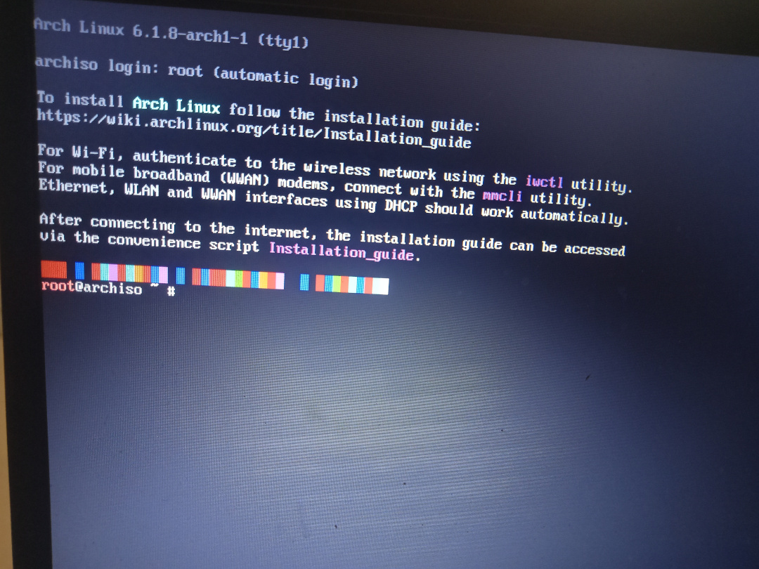
25% - COMPLETION

