Slide 1




MPRASHANT

Slide 3
Topics
What is mongodb?
Installation (MAC & Windows)
Mongodb ATLAS
CRUD Operations
Operators (conditions, logical, relations)
Aggregate Framework
Data Modeling (Relationship)
Schema Validations
Indexes
Python + Mongodb
Interview questions

Slide 4

What is a Database?

Slide 5
What is a Database?
An organised collection of data.
A method to manipulate and access the data.

Slide 6


Unorganized
Organized

Slide 7
MPRASHANT
What is MongoDB?

Slide 8
MPRASHANT
MongoDB is a NoSQL database that stores data in flexible, JSON-like documents, making it easy to scale and handle large volumes of unstructured data.

Slide 9
MPRASHANT
MongoDB Structure
MongoDB stores data in collections and documents.
A collection is a group of MongoDB documents
A document is a set of key-value pairs.

Slide 10


Users
Raju
Sham
Baburao

Slide 11

collection: users
name: Raju
age: 25
name: Sham
age: 28
name: Baburao
age: 45
fields
documents

Slide 12
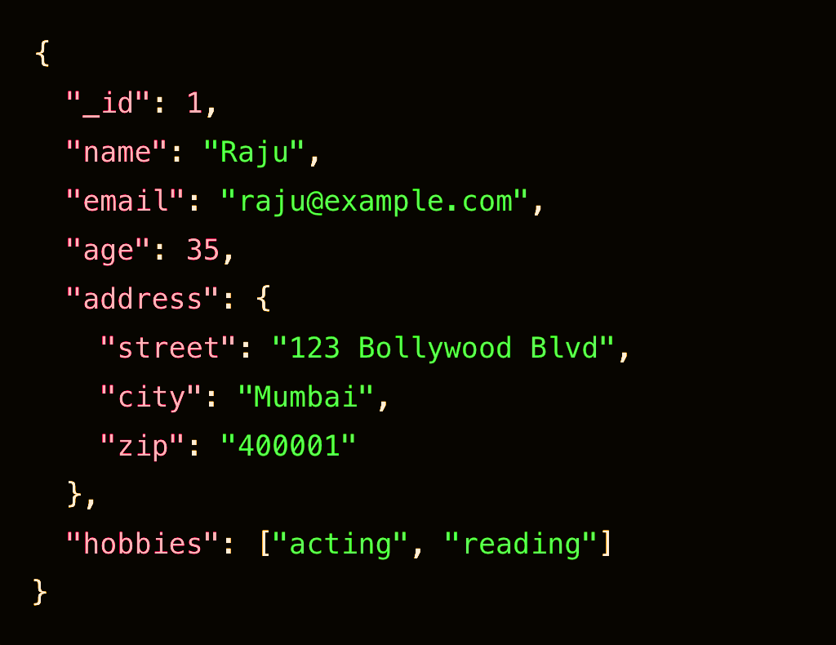
MPRASHANT

Slide 13
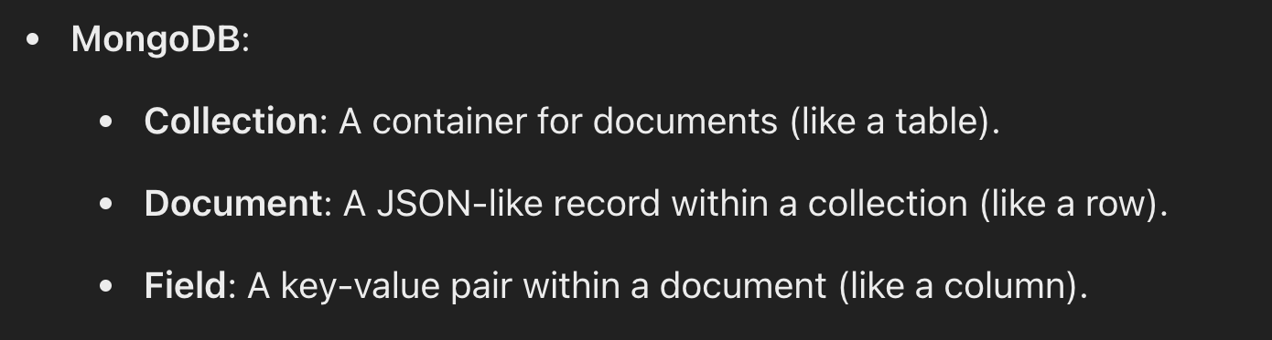
MPRASHANT

Slide 14
Brief history and background.
MondoDB was first released in 2009. It was developed by a company called 10gen, which later rebranded as MongoDB, Inc.

Slide 15
MPRASHANT
MongoDb Features
Scalable: Easy to distribute data across multiple machines as data grows.
Flexible: Each document can have different number and types of fields.
Performance: NoSQL databases are optimized for high-speed read and write operations, making them ideal for real-time data processing and analytics.

Slide 16
MPRASHANT
SQL vs NoSQL

Slide 17
MPRASHANT
Scalability
NoSQL: Designed to scale horizontally by adding more servers, distributing the load across multiple nodes.
SQL: Typically scales vertically by adding more resources to a single server, which has limits and can be costly. Horizontal scaling (sharding) is more complex and less efficient.

Slide 18
MPRASHANT
Schema Flexibility
NoSQL: Schema-less design allows for easy storage of diverse and rapidly changing data without needing to alter the schema.
SQL: Requires a predefined schema. Altering the schema (e.g., adding new columns) can be complex and time-consuming, especially with large datasets.

Slide 19
MPRASHANT
Performance
NoSQL: Optimized for high-speed read and write operations, making it ideal for real-time data processing and analytics.
SQL: Though performant, it can suffer from slower read/write operations when dealing with very large volumes of data due to ACID transaction overhead and complex joins.

Slide 20
MPRASHANT
Handling Unstructured Data
NoSQL: Efficiently handles unstructured or semi-structured data, which is common in real-time analytics (e.g., varied user activity types).
SQL: Best suited for structured data. Handling unstructured data requires complex transformations or additional systems (e.g., storing JSON data in columns).

Slide 21


MPRASHANT
Installation

Slide 22
Default port of mongodb is 27017
To listen on different port, we can use
mongod --port 27019

Slide 23
Database
Creating, connect, listing, droping
CRUD
Create - New collection
Inserting data
Read - How to read data
Update data
Delete data

Slide 24
MPRASHANT
Create
Database and Collection

Slide 25
use database_name
db.createCollection("myCollection")
show dbs
show collections

Slide 26
MPRASHANT
DROP
Database and Collection

Slide 27
collection_name.drop()
db.dropDatabase()

Slide 28
MPRASHANT
CRUD Operations

Slide 29



CRUD
CREATE
READ
UPDATE
DELETE

Slide 30
MPRASHANT
CREATE
READ
insertOne()
insertMany()
find()
findOne()
UPDATE
DELETE
updateOne()
updateMany()
deleteOne()
deleteMany()

Slide 31

MPRASHANT
maker
model
fuel type
transmission
engine
cc
torque
features
sunroof
airbags

Slide 32
MPRASHANT
UPDATE
updateOne()
updateMany()

Slide 33
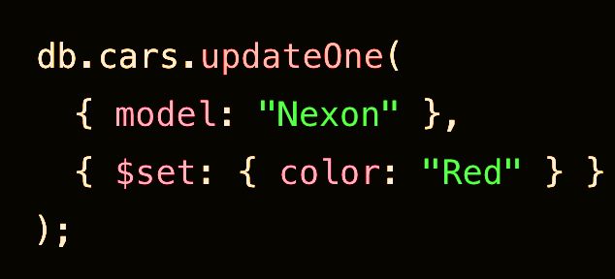
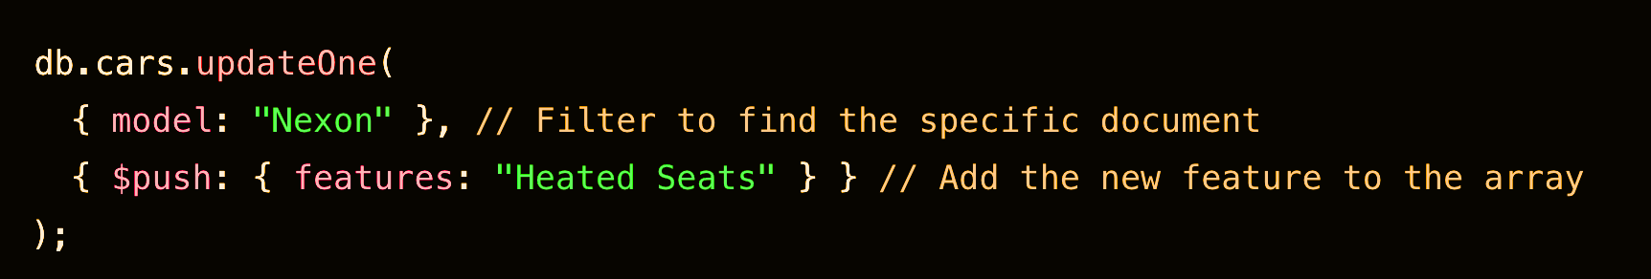
MPRASHANT

Slide 34
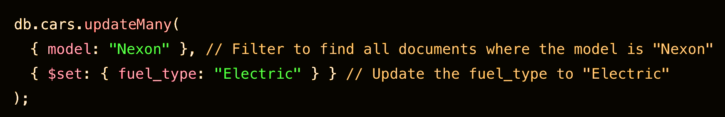
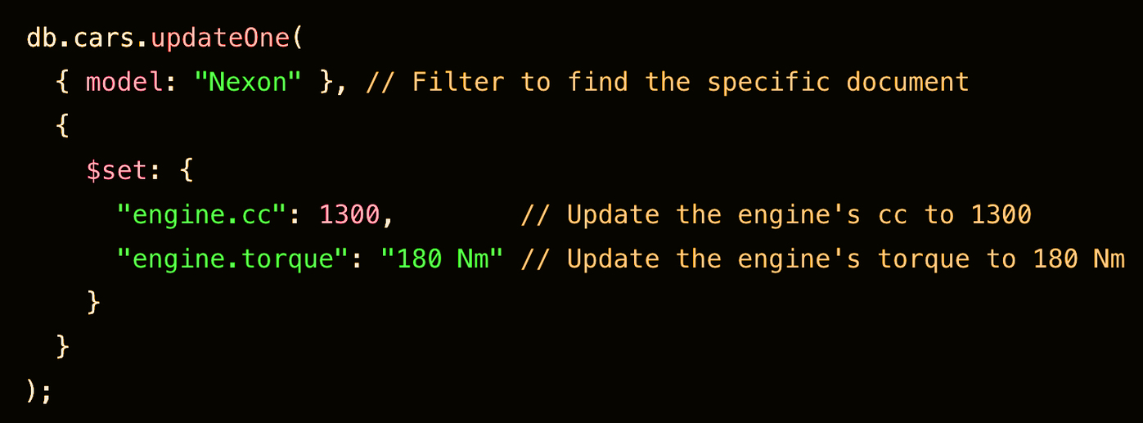
MPRASHANT

Slide 35
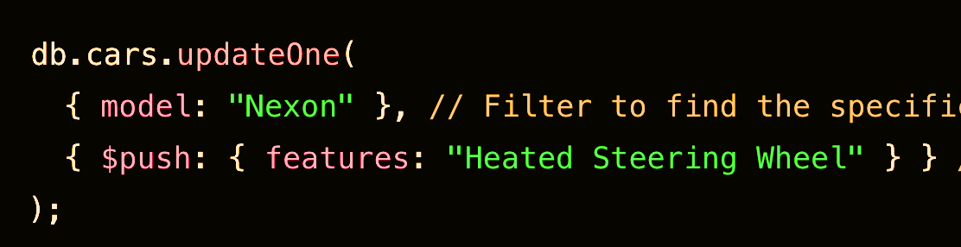
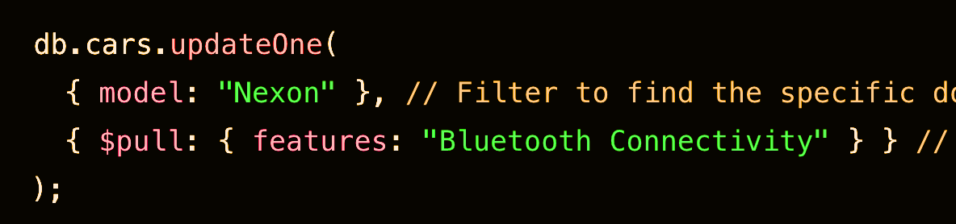
Updating Array
MPRASHANT

Slide 36
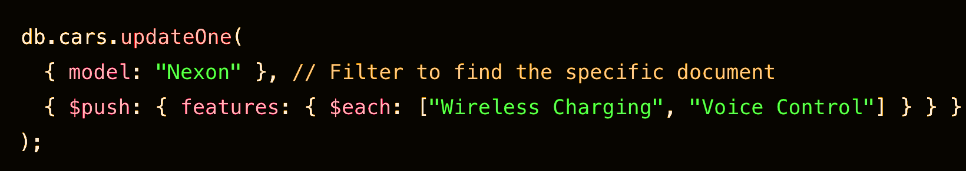
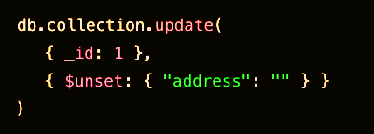
MPRASHANT
Updating Multiple Values Array
Unset Field

Slide 37
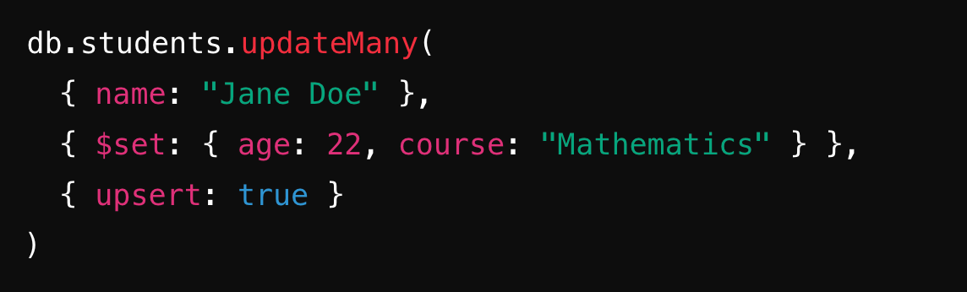
upsert is a combination of the operations "update" and "insert."
If no document matches the query criteria, MongoDB will insert a new document into the collection.

Slide 39
MPRASHANT
Data Types

Slide 40
MPRASHANT
MongoDB stores data in BSON (Binary JSON) format.
BSON includes all JSON datatypes and adds more.
Choosing the correct datatype is essential for efficient storage and querying.

Slide 41
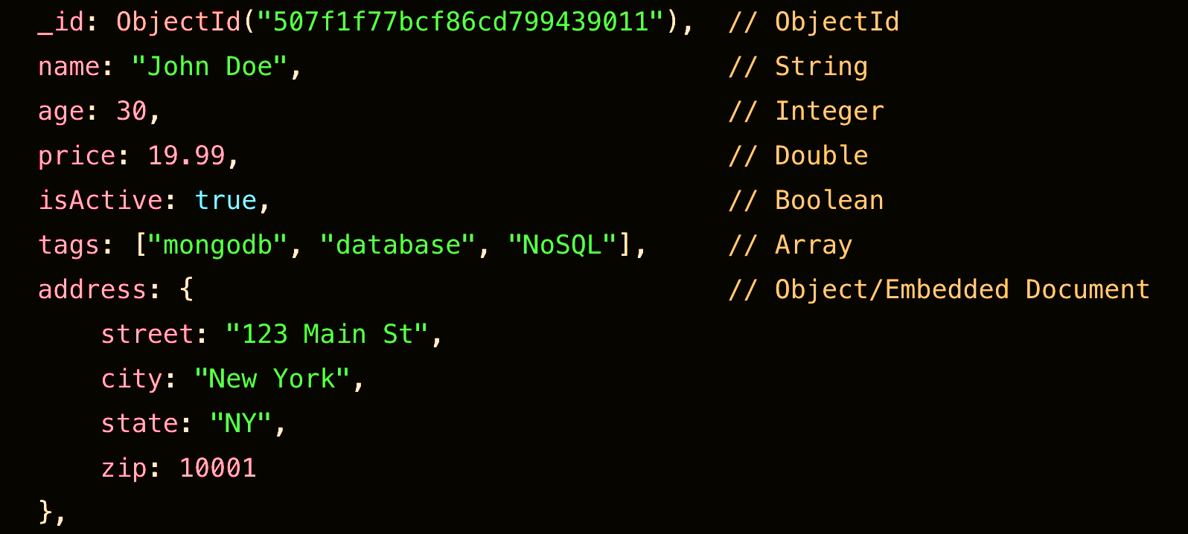
MPRASHANT

Slide 42
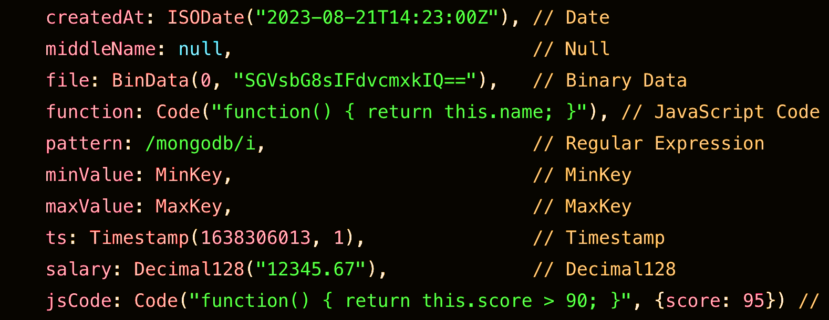
MPRASHANT

Slide 44
MPRASHANT
Operators

Slide 45
MPRASHANT
Case: Find the cars with engine more than 1400cc

Slide 46
Relational Operators

Slide 47
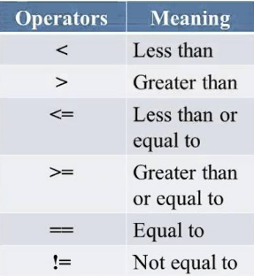

Slide 48
MPRASHANT
Comparison Operators
$eq $lt $gt $lte $gte $ne
= < > <= >= !=
Example: {age:{$eq:25}}

Slide 49
MPRASHANT
Case: Find the cars with engine having 1498 and 2179cc
Here we are trying search based on multiple values

Slide 50
MPRASHANT
$in $nin
{age:
{$in:[20,30]}
}

Slide 51
MPRASHANT
Case: I want a car which is
Diesel, Sunroof & Turbocharged Engine
Car with all these features

Slide 52
Logical Operators

Slide 53
Diesel
AND
Turbocharged
I want a car with both Diesel and Turbocharged

Slide 54
Automatic
OR
Sunroof
I want a car with either
Automatic or Sunroof
or both will work.

Slide 55
Automatic
NOR
Sunroof
I don’t want a car with either Automatic or Sunroof

Slide 56
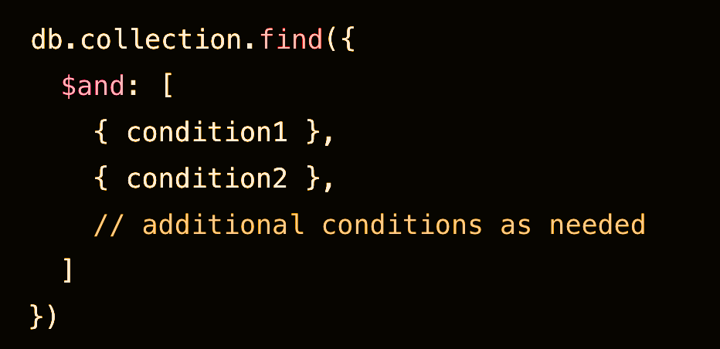
MPRASHANT
Logical Operators

Slide 57
MPRASHANT
$and $or $nor $not
{$or:[
{age:{$eq:28}},
{name:"raju"}
]}

Slide 58
Element Operators

Slide 59
MPRASHANT
$exists
{age:{$exists:true}}
$type
Here we can filter the content based on BASON type like string, bool etc
This can be useful to find field with null values
{name:{$type:"string"}}

Slide 60
Array Operators

Slide 61
MPRASHANT
$size
Return all documents that match specified array size
db.collection.find({hobbies:{$size:4}})
$all
Return all documents that match the pattern
(all user with hobbies of play and read)
db.collection.find({hobbies:{$all:["play","read"]}})

Slide 62
UseCase:
How to find no. of records/documents?

Slide 63
Cursor Methods

Slide 64
Count
find().count()
Sort
find().sort({"name":1}) -1 is for descending order
Limit
find().limit(2)
Skip
find().skip(3)

Slide 66

MPRASHANT
Aggregate Framework

Slide 67
Aggregation is a powerful framework for Complex operations
like filtering, grouping, sorting, reshaping, and summarizing data in a flexible way via pipeline.

Slide 68

stage 1
stage 2
stage 3

Slide 69
MPRASHANT
db.collection.aggregate(
[
{stage1},
{stage2}...
], {option}
)

Slide 70
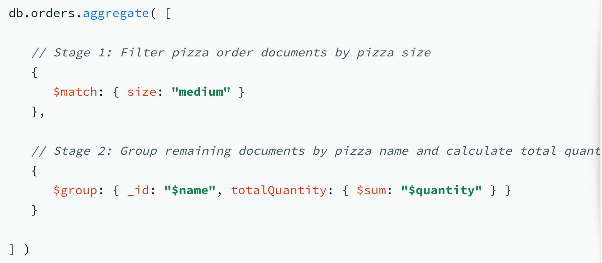
MPRASHANT

Slide 71
Most commonly used stages in MongoDB aggregation:
$match
$group
$project
$sort
$limit
$unwind
$lookup
$addFields
$count
$skip

Slide 72
GROUPING

Slide 73
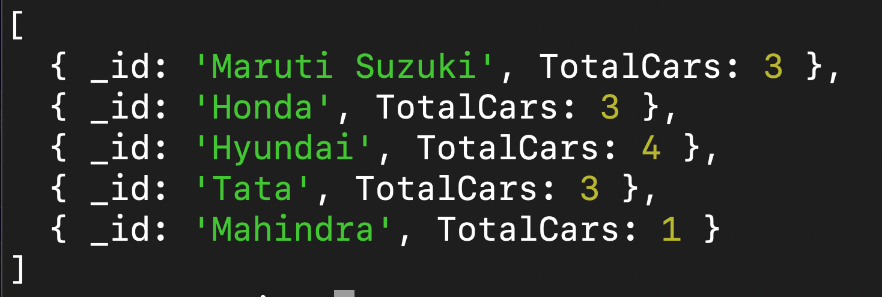
No. of cars of each Brand (maker)

Slide 74



Slide 75
Hyundai
Tata
Toyota
Honda
Suzuki

Slide 76
GROUP

Slide 77
Syntax of ‘group’
db.collection.aggregate([
{
$group: {
_id: "$category",
totalAmount: { $sum: "$amount" },
averageAmount: { $avg: "$amount" },
minAmount: { $min: "$amount" },
maxAmount: { $max: "$amount" },
amountsList: { $push: "$amount" },
uniqueAmounts: { $addToSet: "$amount" }
}
}
])

Slide 78
MPRASHANT
Print all the car brands..
db.cars.aggregate([
{$group:
{_id:"$maker"}
}])

Slide 79
MPRASHANT
Find no. of cars of each brand (we have to group)
db.cars.aggregate([
{ $group:
{ _id: "$maker",
TotalCars: { $sum: 1 }
}
}] )
The $sum: 1 operation counts the number of documents in each group.

Slide 80
MPRASHANT
Find no. of cars of different fuel_type
db.cars.aggregate([
{ $group:
{ _id: "$fuel_type",
TotalCars: { $sum: 1 }
} }] )

Slide 81
MATCH

Slide 82
MPRASHANT
Hyundai cars having engine of more than 1200cc
db.cars.aggregate(
[{$match:
{maker:"Hyundai",
"engine.cc":{$gt:1000}
}}])

Slide 83
COUNT

Slide 84
MPRASHANT
Print Total no. of Hyundai cars
db.cars.aggregate(
[{$match:
{maker:"Hyundai"}},
{$count: "Total_cars"}
])

Slide 85
MPRASHANT
Count no. of diesel and petrol cars of Hyundai brand
db.cars.aggregate(
[ {$match:{maker:"Hyundai"}},
{$group:
{_id:"$fuel_type",
Totalcars:{$sum:1}}
}
])

Slide 86
Project

Slide 87
MPRASHANT
Find all the Hyundai cars and only show Maker, Model and Fuel_type details
db.cars.aggregate(
[{ $match: { maker: "Hyundai" }},
{ $project:
{ maker: 1, model: 1, fuel_type: 1,_id:0 }}
])

Slide 88
SORT

Slide 89
MPRASHANT
For the previous output, sort the data based on Model
db.cars.aggregate(
[{ $match: { maker: "Hyundai" }},
{ $project:
{ maker: 1, model: 1, fuel_type: 1,_id:0 }},
{ $sort: {model:1}}
])
Similarly we can use { $limit: 10 }, {$skip:5}

Slide 90
sortByCount

Slide 91
MPRASHANT
Group the cars by Maker and then sort based on count(no. of cars)
db.cars.aggregate(
{$sortByCount:"$maker"}
)

Slide 92
Unwind

Slide 93
MPRASHANT
We do have multiple owners for each car right (owners are list of documents), now if you want to work on each owner then we can use unwind
db.cars.aggregate([
{ $unwind: "$owners" }
])

Slide 94
String Operators
$concat $toUpper $toLower $regexMatch
$ltrim $split
Document -
https://www.mongodb.com/docs/manual/reference/operator/aggregation/#string-expression-operators

Slide 95
db.collection.aggregate([
{
$project: {
fullName: { $concat: ["$firstName", " ", "$lastName"] }
// Concatenates firstName and lastName with a space
}
}
])

Slide 96
MPRASHANT
List down all the Hyundai cars and print the name as
Maker + Model i.e. CarName Hyundai Creta
db.cars.aggregate(
[ { $match: { maker: "Hyundai" } },
{ $project: { _id: 0,
CarName: { $concat: ["$maker", " ",
"$model"] } } }] )

Slide 97
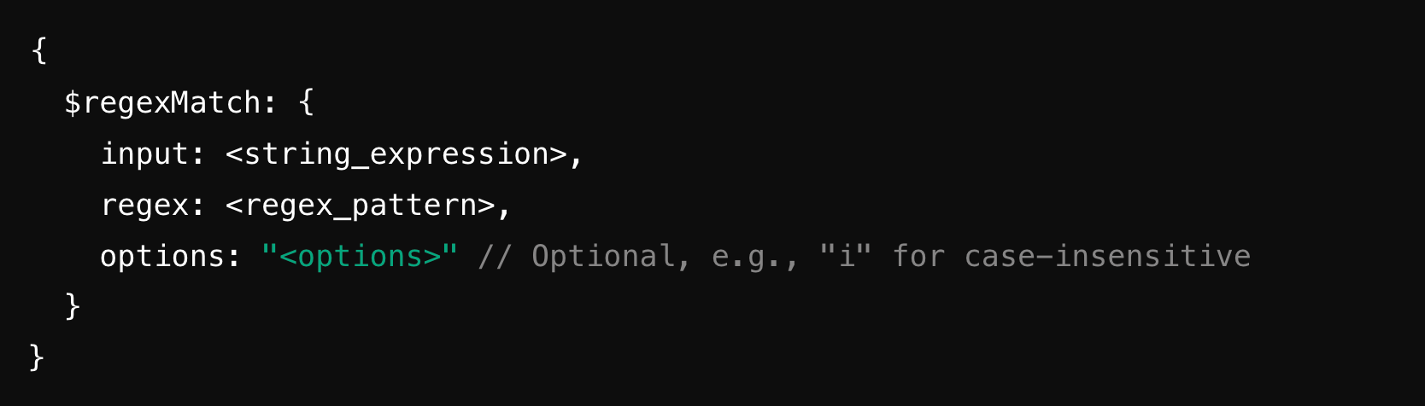
$regexMatch
Performs a regular expression (regex) pattern matching and returns true or false.

Slide 98
MPRASHANT
Add a flag is_diesel = true/false for each car
db.cars.aggregate([
{ $project: { model: 1, _id: 0,
is_diesel:
{ $regexMatch:
{ input: "$fuel_type",
regex: "Die" }
} } }])

Slide 99
OUT

Slide 100
MPRASHANT
After aggregating, store the result in an another collection 'hyundai_cars'
db.cars.aggregate(
[ { $match: { maker: "Hyundai" } },
{ $project: { _id: 0,
CarName: { $concat: ["$maker", " ",
"$model"] } } },
{$out:"hyundai_cars"}] )

Slide 101
Airthmetic Operators
$add $subtract $divide $multiply $round
$abs $ceil
Document -
https://www.mongodb.com/docs/manual/reference/operator/aggregation/#arithmetic-expression-operators

Slide 102
db.collection.aggregate([
{
$project: {
sum: { $add: [2, 3] } // 2 + 3
}
}
])

Slide 103
MPRASHANT
Print all the cars model and price with hike of 55000 (similarly we can use $subtract too)
db.cars.aggregate(
{$project:
{model:1, _id:0,
price:{$add:["$price",50000]}}})

Slide 104
AddFields / Set

Slide 105
MPRASHANT
Print details of cars with price in lakhs (15 lakhs)
db.cars.aggregate([
{$project:{model:1,_id:0,price:1}},
{$addFields:
{price_in_lakhs:
{$divide: ["$price", 100000]}}}])

Slide 106
MPRASHANT
Calculate Total service cost of each Hyundai Car.
db.cars.aggregate([
{ $match: { maker: "Hyundai" } },
{ $set: { total_service_cost: { $sum: "$service_history.cost" } } },
{$project: {model:1, maker:1, _id:0, total_service_cost:1}}])

Slide 107
Conditional Operators
$cond $ifNull $switch
Document -
https://www.mongodb.com/docs/manual/reference/operator/aggregation/#conditional-expression-operators

Slide 108
The $cond operator in MongoDB is a ternary conditional operator
{ $cond: [ <condition>, <true-case>, <false-case> ] }

Slide 109
Suppose we want to check if a car's fuel_type is "Petrol"
and categorize the cars into ‘Petrol Car’ & ‘Non-Petrol’
db.cars.aggregate([
{ $project: {
_id: 0, maker: 1, model: 1,
fuelCategory: {
$cond: {
if: { $eq: ["$fuel_type", "Petrol"] },
then: "Petrol Car",
else: "Non-Petrol Car"
}
}}}])

Slide 110
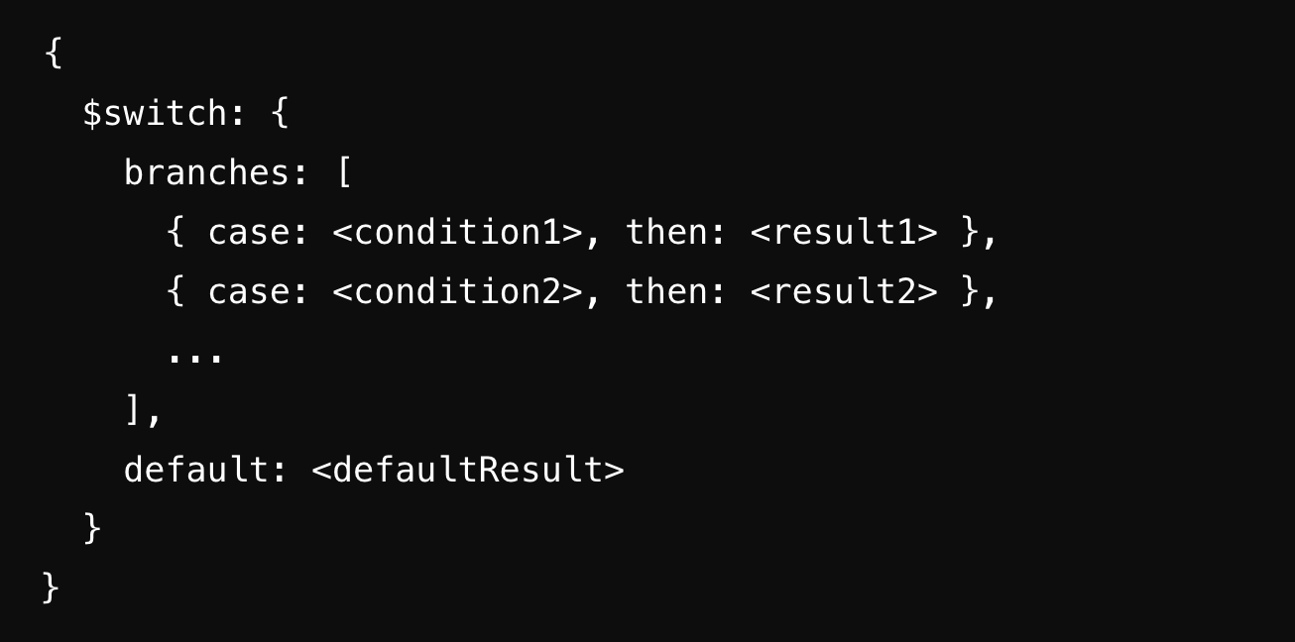
$switch

Slide 111
Suppose we want to categorize the price of the car into three categories: "Budget", "Midrange", and "Premium"
db.cars.aggregate([
{$project: {
_id: 0, maker: 1, model: 1,
priceCategory: {
$switch: {
branches: [
{ case: { $lt: ["$price", 500000] },
then: "Budget" },
{ case: { $and: [{ $gte: ["$price", 500000] }, { $lt: ["$price", 1000000] }] },
then: "Midrange" },
{ case: { $gte: ["$price", 1000000] },
then: "Premium" }
],
default: "Unknown"
}
}}} ]);

Slide 112
DATE Operators
$dateAdd $dateDiff $month $year $hour
$dateOfMonth $dayOfYear
Document -
https://www.mongodb.com/docs/manual/reference/operator/aggregation/#date-expression-operators

Slide 113
db.collection.aggregate([
{
$project: {
newDate: {
$dateAdd: {
startDate: new Date("2024-08-29"), // Starting date
unit: "day", // Unit to add (e.g., "day", "month", "year")
amount: 7 // Amount to add
}
}
}
}
])

Slide 115
Variables

Slide 116
System Generated Variables
Document:
https://www.mongodb.com/docs/manual/reference/aggregation-variables/#system-variables
db.cars.aggregate(
{$project:{_id:0,model:1,date:"$$NOW"}})

Slide 117
User Defined Variables
These variables allow you to store values and reuse them within the same pipeline, making the pipeline more readable and efficient in certain scenarios.

Slide 118
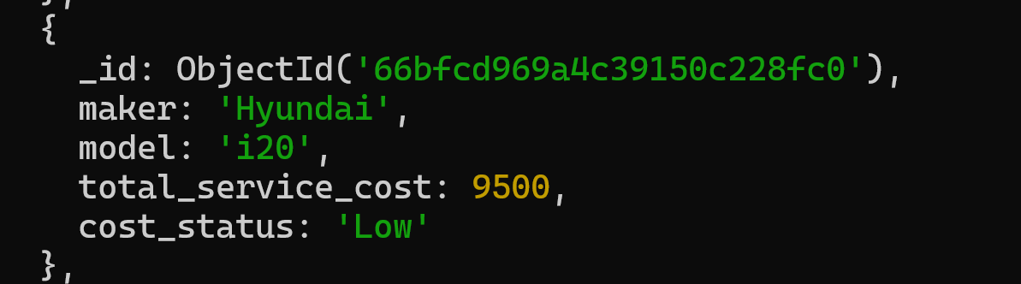

Slide 119
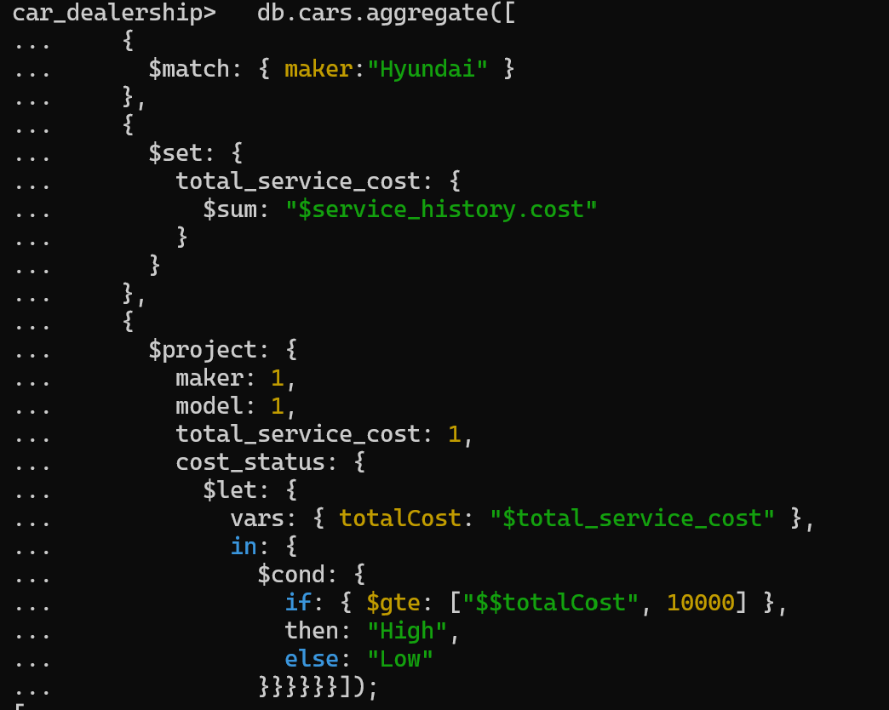

Slide 120

Data Modeling

Slide 121
MPRASHANT
Relations

Slide 122
MPRASHANT
MongoDB is a NoSQL database, it doesn't enforce strict schema relationships like foreign keys in relational databases.

Slide 123
MPRASHANT
We can still model relationships between documents in MongoDB using a few approaches.
The two main types of relationships are:
Embedded Documents (Denormalization)
Referenced Documents (Normalization)

Slide 124
Types of Relationship
One to One
One to Many
Many to Many

Slide 125
1 : 1

Slide 126

User
Contact

Slide 127
1 : MANY

Slide 128


Posts
User

Slide 129
Many : Many

Slide 130


Courses
Students

Slide 131


Raju
Java
Sham

Slide 132
Python
SQL
Mongodb
Raju
Math
Sham

Slide 133
How can we maintain relationship in MongoDB?

Slide 134



orders
users

Slide 135
{
"_id": "user1",
"name": "Amit Sharma",
"email": "amit.sharma@example.com",
"orders": [
{
"_id": "order1",
"product": "Laptop",
"amount": 50000,
"order_date": "2024-08-01"
},
{
"_id": "order2",
"product": "Mobile Phone",
"amount": 15000,
"order_date": "2024-08-05"
}
]
}
Embedded Documents
userA
orderA
orderB

Slide 136
Referenced Documents
{
"_id": "order1",
"user_id": "user1",
"product": "Laptop",
"amount": 50000,
"order_date": "2024-08-01"
},
{
"_id": "order2",
"user_id": "user2",
"product": "Mobile Phone",
"amount": 15000,
"order_date": "2024-08-05"
}
{
"_id": "user1",
"name": "Amit Sharma",
"email": "amit.sharma@example.com",
"phone": "+91-987654210",
"address": "MG Road, Mumbai, Maharashtra"
},
{
"_id": "user2",
"name": "Priya Verma",
"email": "priya.verma@example.com",
"phone": "+91-987654211",
"address": "Nehru Place, New Delhi, Delhi"
}
users
orders

Slide 137
MPRASHANT
JOIN with $lookup
db.users.aggregate([
{
"$lookup": {
"from": "orders", // The target collection to join with
"localField": "_id", // The field from the 'users' collection
"foreignField": "user_id", // The field from the 'orders' collection
"as": "orders" // The name of the new array field to add to the 'users'
}
}
])

Slide 138
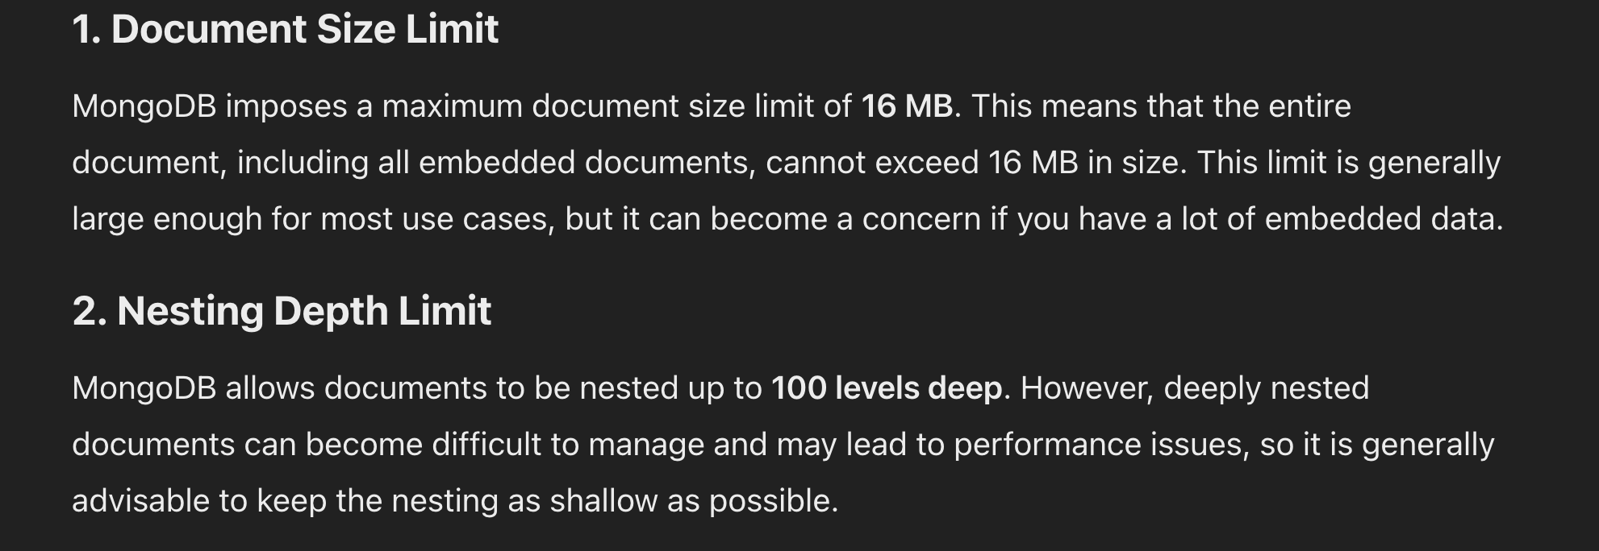
Embedded Documents

Slide 139

MPRASHANT
Schema Validation

Slide 140
MPRASHANT
MongoDB uses a JSON Schema format to define the validation rules.
Allows you to specify various constraints and rules for your documents, such as required fields, field types, and value ranges.

Slide 141
We can add validation while creating collection...

Slide 142
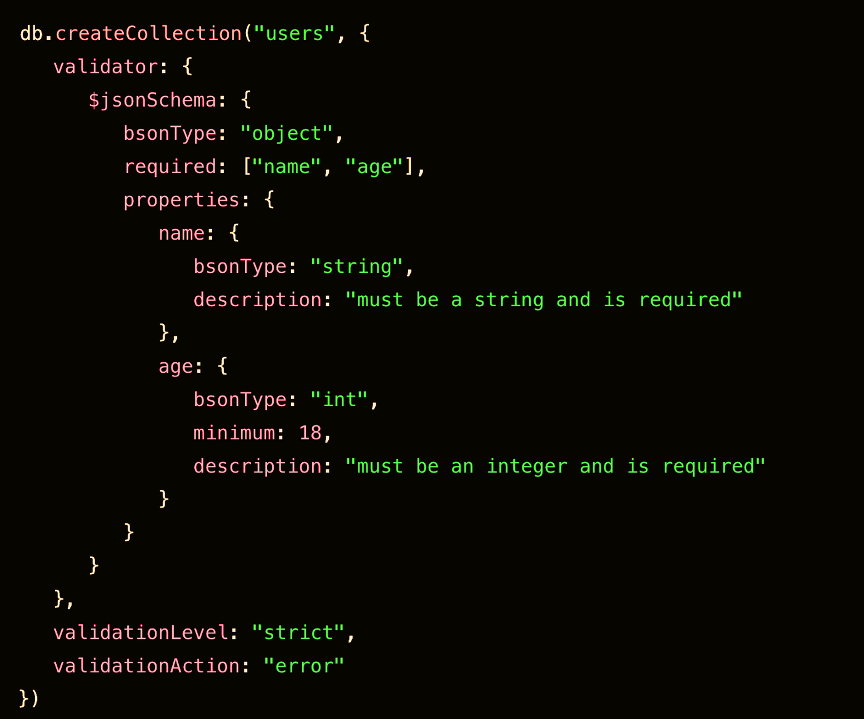

Slide 143
we can update the existing collection to add validation

Slide 144
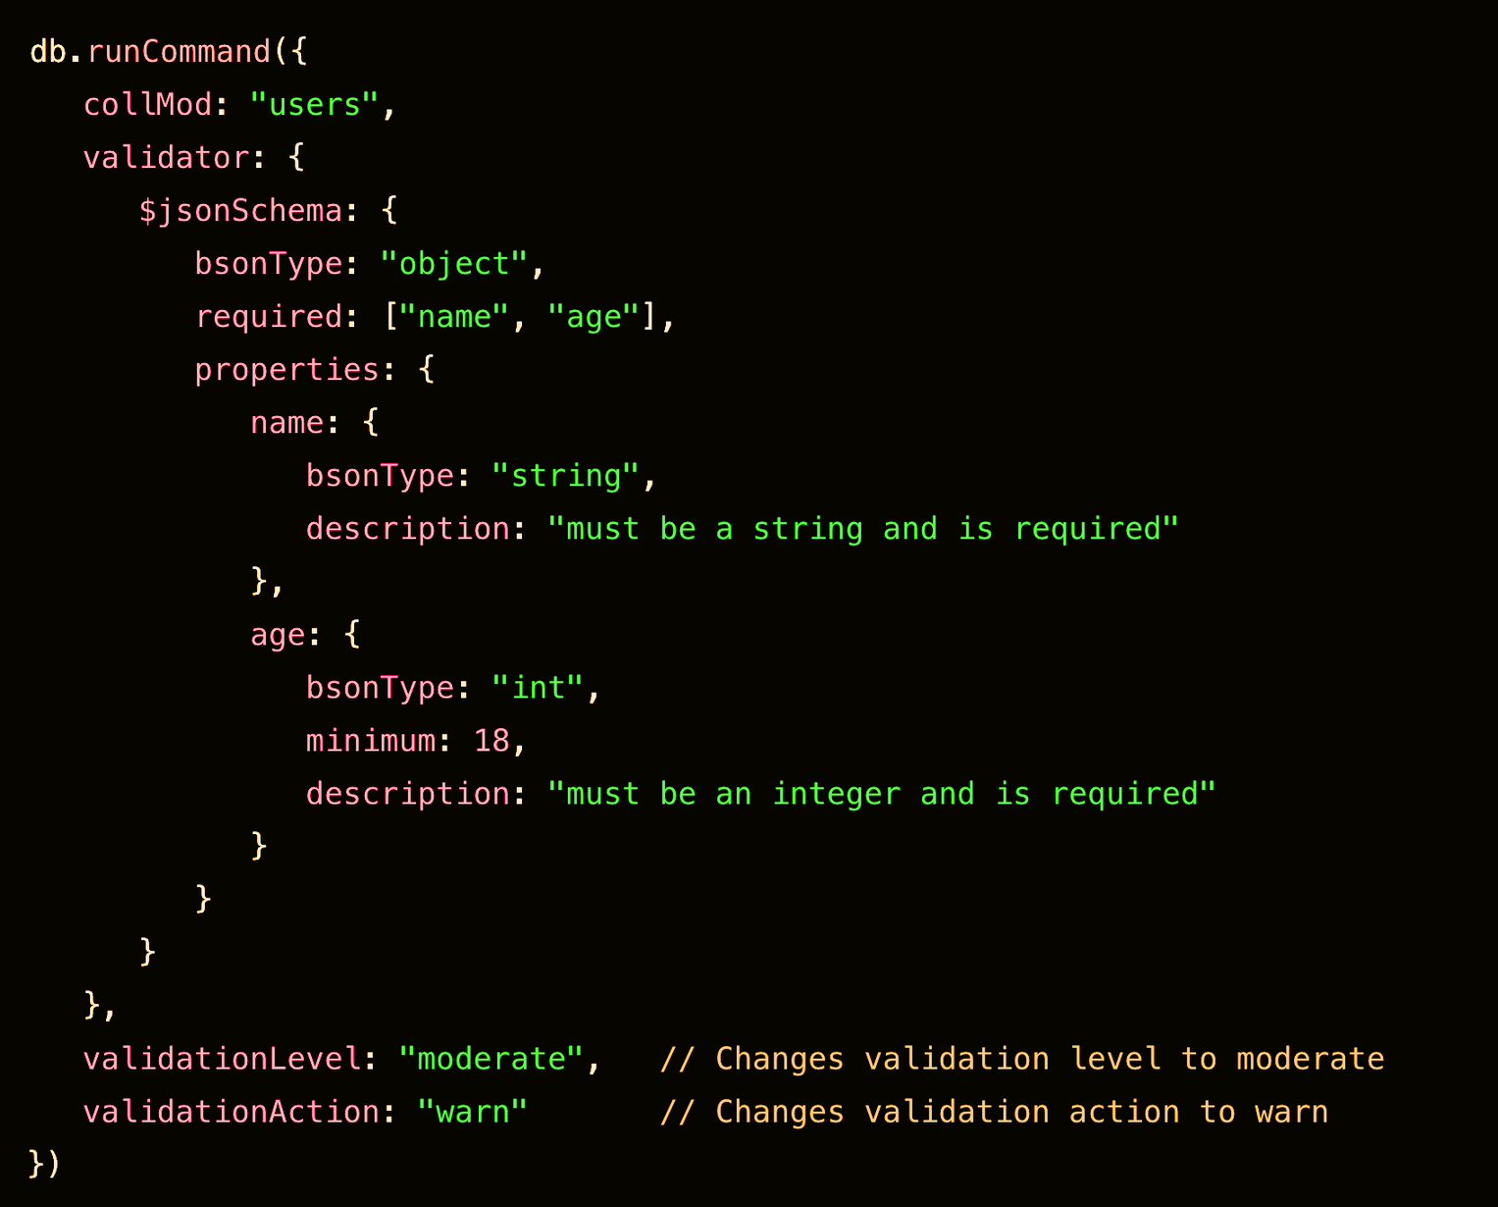

Slide 145
MPRASHANT
Validation Levels:
strict: The document must fully comply with the schema validation rules. If a document does not comply, it will not be inserted or updated in the collection.
moderate: Only new documents and modified fields in existing documents are validated against the schema. This allows for partial validation and can be useful for legacy systems or gradual schema enforcement.

Slide 146
MPRASHANT
Validation Actions:
error: If a document does not meet the schema validation criteria, MongoDB will throw an error and reject the insert or update operation.
warn: MongoDB logs a warning message when a document does not meet the schema validation criteria but still allows the insert or update operation.

Slide 148
MPRASHANT
INDEXES

Slide 149
MPRASHANT
An INDEX is a data structure that improves the speed of query operations by allowing the database to quickly locate and access the required data without scanning every document in a collection.

Slide 150
MPRASHANT
Stores the indexed fields in a sorted order, along with pointers to the actual documents in the collection.

Slide 151
MPRASHANT
name: Raju
age: 25
Index based on name
Baburao
Raju
Sham
name: Sham
age: 28
name: Baburao
age: 45

Slide 152
MPRASHANT
db.collection.createIndex(
{ <field1>: <type1>,
<field2>: <type2>, ... }, {<options> })

Slide 153
MPRASHANT
db.cars.createIndex({ maker: 1 })
db.cars.createIndex({ model: 1 }, { unique: true })
db.cars.dropIndex(“maker”)
db.cars.getIndexes()

Slide 154
MPRASHANT
Types of Indexes:
Single Field Index
Compound Index: Involves multiple fields.
Unique Index: Index that ensures no two documents have the same value for the indexed field.
TTL Index: TTL (Time to Live) indexes that are used to automatically remove documents after a certain period.

Slide 155
MPRASHANT
Performance Considerations:
Impact on Write Operations: While indexes speed up reads, they can slow down insertions, updates, and deletions because the indexes need to be maintained.
Indexing Large Collections: Learn about the considerations when indexing large collections, such as index size and the impact on RAM.

Slide 156
MPRASHANT
Transaction

Slide 157
A transaction in MongoDB is a sequence of operations that are executed as a single unit, ensuring that all operations either complete successfully or are fully rolled back, maintaining ACID properties across multiple documents and collections.

Slide 158

Example of a Multi-Document Transaction:
You want to transfer money from one account to another, which requires updating two documents within a single transaction.
-1000
+1000

Slide 159
MPRASHANT
Replications

Slide 160
Replication is a group of MongoDB servers that maintain identical copies of data to ensure high availability, redundancy, and data durability, with one primary node handling writes and multiple secondary nodes replicating the data.

Slide 161
MPRASHANT
Sharding

Slide 162
Sharding is a method of distributing data across multiple servers (shards) to enable horizontal scaling, allowing the database to handle large datasets and high-throughput operations efficiently.

Slide 163
MPRASHANT
Interview Questions

Slide 164
MPRASHANT
What is MongoDB, and how is it different from a relational database?
Answer: MongoDB is a NoSQL database that stores data in flexible, JSON-like documents, allowing for schema-less data storage. Unlike relational databases, which use tables and rows, MongoDB uses collections and documents. This allows for more flexible and scalable data models.

Slide 165
MPRASHANT
Explain the structure of a MongoDB document. What are its key components?
Answer: A MongoDB document is a BSON (Binary JSON) object that consists of field-value pairs. The key components include fields (which are similar to columns in relational databases) and values (which can be of various data types, such as strings, numbers, arrays, or even nested documents).

Slide 166
MPRASHANT
What are the advantages of using MongoDB over traditional RDBMS systems?
Answer: Advantages include:
Flexibility in schema design.
Horizontal scalability via sharding.
High availability through replica sets.
Easier to manage unstructured or semi-structured data.
Rich querying and aggregation capabilities.

Slide 167
MPRASHANT
How does MongoDB store data? Explain the concept of collections and documents.
Answer: MongoDB stores data in BSON format within documents. These documents are grouped into collections, which are analogous to tables in relational databases. Each document within a collection can have a different structure, allowing for flexible data modeling.

Slide 168
MPRASHANT
What is a replica set in MongoDB? How does it help in ensuring high availability?
Answer: A replica set in MongoDB is a group of mongod instances that maintain the same data set. One node acts as the primary node, and others are secondary nodes. The replica set ensures high availability by automatically failing over to a secondary node if the primary node goes down.

Slide 169
MPRASHANT
What is a sharded cluster in MongoDB, and why is it used?
Answer: A sharded cluster in MongoDB is a method for distributing data across multiple servers. Sharding is used to handle large datasets and high-throughput operations by distributing data and load across multiple machines.

Slide 170
MPRASHANT
Explain the differences between a find() query and an aggregate() query in MongoDB.
Answer: The find() query is used to retrieve documents from a collection based on certain criteria. The aggregate() query, on the other hand, is used for more complex data processing, allowing for data transformation and computation through an aggregation pipeline.

Slide 171
MPRASHANT
How does MongoDB handle indexing, and what are the types of indexes available?
Answer: MongoDB supports various types of indexes to improve query performance, including:
Single field index
Compound index (multiple fields)
Multikey index (for arrays)
Text index (for searching text)
Geospatial index (for querying geographical data)
TTL index (for automatic deletion of documents after a certain period)

Slide 172
MPRASHANT
What is the role of the _id field in MongoDB? Can it be modified or removed?
Answer: The _id field is a unique identifier for each document in a MongoDB collection. It is mandatory and cannot be removed. However, it can be modified if necessary, though this is not recommended as it may lead to data inconsistency.

Slide 173
MPRASHANT
What is the difference between insert() and insertMany() operations in MongoDB?
Answer: insert() is used to insert a single document into a collection, while insertMany() allows for the insertion of multiple documents in a single operation. insertMany() is more efficient for bulk inserts.

Slide 174
MPRASHANT
Explain how MongoDB's aggregation framework works. What are some common stages used in an aggregation pipeline?
Answer: The aggregation framework in MongoDB allows for processing data in a pipeline, where each stage transforms the data. Common stages include:
$match: Filters documents based on a condition.
$group: Groups documents by a specified key and performs aggregation operations.
$sort: Sorts documents.
$project: Reshapes the documents by including/excluding fields.
$lookup: Performs a left join with another collection.

Slide 175
MPRASHANT
How does MongoDB handle transactions, and what is the significance of multi-document transactions?
Answer: MongoDB supports multi-document transactions, which allow for ACID-compliant operations across multiple documents or collections. This ensures that either all operations within a transaction are applied, or none are, providing consistency and reliability in complex operations.

Slide 176
MPRASHANT
What are the pros and cons of embedding documents versus using references in MongoDB?
Embedding (Pros):
Better performance for read operations.
Simpler queries.
Embedding (Cons):
Can lead to large documents and duplication of data.
References (Pros):
More normalized data structure.
Reduces duplication.
References (Cons):
Requires additional queries (joins) which can be slower.

Slide 177
MPRASHANT
What is the difference between updateOne(), updateMany(), and replaceOne() in MongoDB?
Answer:
updateOne(): Updates the first document that matches the query criteria.
updateMany(): Updates all documents that match the query criteria.
replaceOne(): Replaces the entire document with a new one, based on the query criteria.

Slide 178
MPRASHANT
How does MongoDB handle concurrency and ensure data consistency?
Answer: MongoDB handles concurrency using a combination of locks (e.g., collection-level locks) and journaling. It uses the WiredTiger storage engine, which provides document-level locking, allowing for higher concurrency. Consistency is maintained through replica sets and transactions.

Slide 179
MPRASHANT
What are the different types of data modeling strategies in MongoDB?
Answer: Common data modeling strategies include:
Embedding documents for data that is frequently accessed together.
Referencing documents to normalize data and avoid duplication.
Hybrid models that combine embedding and referencing for different use cases.

Slide 180
MPRASHANT
Explain the concept of TTL (Time to Live) indexes in MongoDB and when they might be useful.
Answer: TTL indexes automatically delete documents from a collection after a specified period. This is useful for data that becomes irrelevant after a certain time, such as session logs, temporary data, or caching.

Slide 181
MPRASHANT
How would you optimize a MongoDB query for better performance?
Answer: To optimize a MongoDB query:
Use indexes effectively.
Avoid full collection scans by using selective queries.
Limit the amount of data returned by using projections.
Use the explain() method to analyze query performance.
Consider denormalization to reduce the number of joins.

Slide 182
MPRASHANT
Explain how to perform a backup and restore operation in a MongoDB database.
Answer:
Backup: Use mongodump to create a binary backup of the database.
Restore: Use mongorestore to restore the data from a backup. Additionally, for cloud deployments, MongoDB Atlas provides automated backups.

Slide 183
MPRASHANT
Describe the process of migrating data from a relational database to MongoDB. What challenges might you face?
Answer: The migration process involves:
Analyzing the relational schema.
Designing a MongoDB schema, often using denormalization and embedding.
Exporting data from the relational database (e.g., using SQL queries).
Importing data into MongoDB (e.g., using mongoimport or custom scripts).
Challenges: Schema design differences, handling joins, data type conversion, and ensuring data consistency during migration.

Slide 184
MPRASHANT
What are MongoDB's limitations, and how can you work around them?
Answer: Limitations include:
No built-in support for joins (use aggregation or manual joins).
Limited support for multi-document ACID transactions (introduced in later versions).
Large documents can impact performance (use references to mitigate).
Working around limitations often involves thoughtful schema design, indexing, and understanding MongoDB's strengths.

Slide 185
MPRASHANT
How does MongoDB Atlas differ from running MongoDB on-premises?
Answer: MongoDB Atlas is a fully managed cloud database service that automates deployment, scaling, and backups. It offers built-in security features and integration with other cloud services. Running MongoDB on-premises requires manual management of hardware, scaling, backups, and security.

Slide 186
MPRASHANT
Explain the role of journaling in MongoDB. How does it help in ensuring durability?
Answer: Journaling in MongoDB is a mechanism that logs write operations to a journal file before applying them to the database. In case of a crash, MongoDB can use the journal to recover to a consistent state, ensuring durability of write operations.

Slide 187
MPRASHANT
How would you handle schema versioning in a MongoDB application?
Answer: Schema versioning can be handled by:
Embedding a version field in each document.
Using a migration script to update existing documents to the new schema version.
Designing the application to handle multiple schema versions during the transition period.

Slide 188
MPRASHANT

Slide 189
MPRASHANT

