Slide 1

ALRIGHT!

Slide 2



SQL TUTORIAL
ZERO TO HERO

Slide 3
Section - 1

Slide 4
What is database?
Database vs DBMS
DBMS vs RDBMS
Other available databases
SQL vs PostgreSQL

Slide 5

What is a Database?

Slide 6
What is a Database?
An organised collection of data.
A method to manipulate and access the data.

Slide 7


Unorganized
Organized

Slide 8
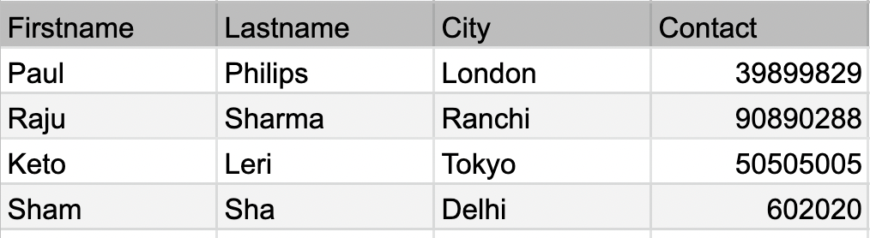

Slide 9
Database
vs
DBMS

Slide 10
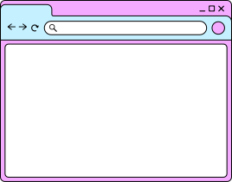
App
Database

Slide 11
App
DBMS
Database

Slide 12

App
DBMS
Database
PostGresql, MySQL, Oracle etc

Slide 13
What is RDBMS?

Slide 14
What is RDBMS?
A type of database system that stores data in structured tables (using rows and columns) and uses SQL for managing and querying data.

Slide 15
Some Other Databases are:
MongoDB
Oracle
MySQL
SQLite
PostgreSQL
MaxDB
Firebird
Redis

Slide 16
SQL vs PostgreSQL

Slide 17
SQL
Structured Query Language
Which is used to talk to our databases.
Example: SELECT * FROM person_db;

Slide 18
App
DBMS
Database
PostGresql, MySQL, Oracle etc

Slide 19
Installation

Slide 20
Database
vs
Schema
vs
Table

Slide 21
Section - 2

Slide 22
Database
Creating, connect, listing, droping
CRUD
Create - New collection
Inserting data
Read - How to read data
Update data
Delete data

Slide 23
Databases

Slide 24
List down existing databases
SELECT datname FROM pg_database;
\l

Slide 25
Some Important Queries in starting
\l - list all databases
\q - quit
\c db_name - connect to database
\dt - list all tables
\d tb_name - desc a table
\d+ tb_name- list all column
\! cls. - list all column

Slide 26
Creating a new Database
CREATE DATABASE <db_name>;

Slide 27
Change a Database
\c <db_name>;

Slide 28
Deleting a Database
DROP DATABASE <db_name>;

Slide 29



CRUD
CREATE
READ
UPDATE
DELETE

Slide 30
CREATING Tables

Slide 31
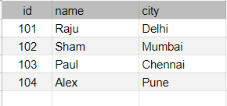
Table
A table is a collection of related data held in a table format within a database.

Slide 32
Creating a new Table
CREATE TABLE person (
id INT,
name VARCHAR(100),
city VARCHAR(100)
);
CREATE TABLE person (id INT, name VARCHAR(100), city VARCHAR(50))

Slide 33
Checking your table
\d TABLE_NAME

Slide 34
INSERTING Data

Slide 35
Adding data into a Table
INSERT INTO person(id, name, city)
VALUES (101, ‘Raju’, ‘Delhi’);
INSERT INTO students VALUES (101, "Rahul")

Slide 36
READING DATA

Slide 37
Reading data from a Table
SELECT * FROM <table_name>
SELECT <column_name> from students

Slide 38
UPDATING DATA

Slide 39
Modify/Update data from a Table
UPDATE person
SET city=’London’
WHERE id=2;

Slide 40
DELETING DATA

Slide 41
DELETE data from a Table
DELETE FROM students
WHERE name='Raju';

Slide 42
WHERE

Slide 43
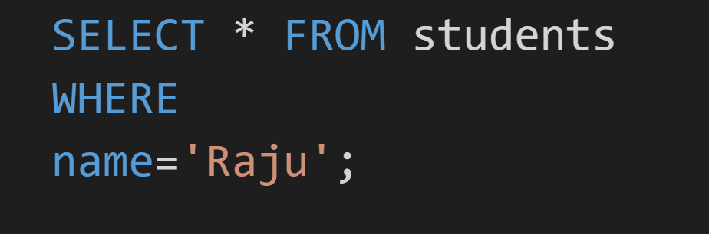

Slide 44
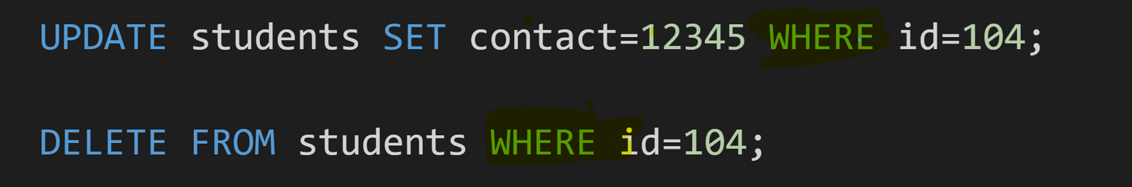

Slide 45
Section - 3

Slide 46
Datatypes
Constraint
Primary Key
NOT NULL
Default
Serial
Unique

Slide 47
DataTypes
An attribute that specifies the type of data in a column of our database - table.

Slide 48
Most widely used are
Numeric - INT DOUBLE FLOAT DECIMAL
String - VARCHAR
Date - DATE
Boolean - BOOLEAN

Slide 49
DATAYPES
What will happen when we store values like 15.35?

Slide 50
DATAYPES
Digits after decimal
DECIMAL(5,2)
Total digit

Slide 51


DATAYPES
DECIMAL(5,2)
Example: 155.38
119.12
28.15
1150.15

Slide 52
Constraint
A constraint in PostgreSQL is a rule applied to a column.

Slide 53

Primary Key
The PRIMARY KEY constraint uniquely identifies each record in a table.
Primary keys must contain UNIQUE values, and cannot contain NULL values.
A table can have only ONE primary key.

Slide 54

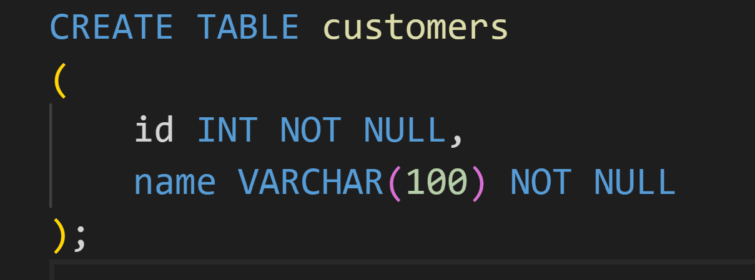
NOT NULL

Slide 55
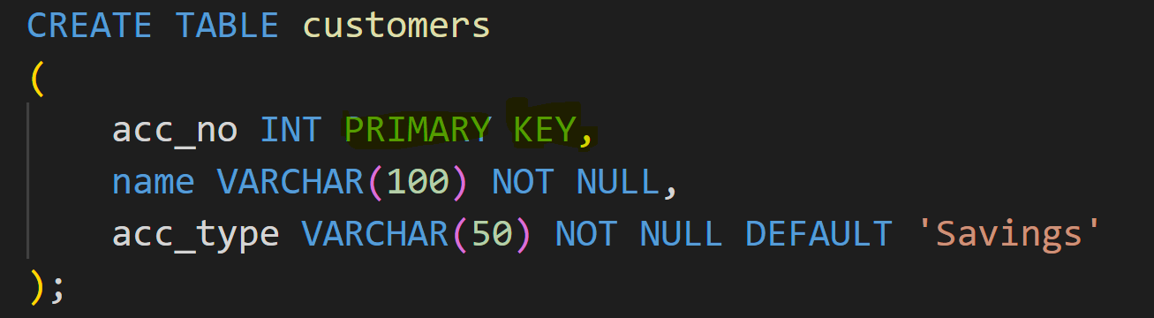
DEFAULT Value

Slide 56
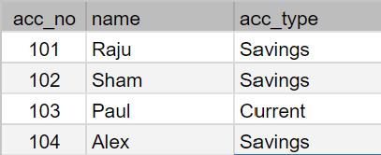

Slide 57
AUTO_INCREMENT

Slide 58
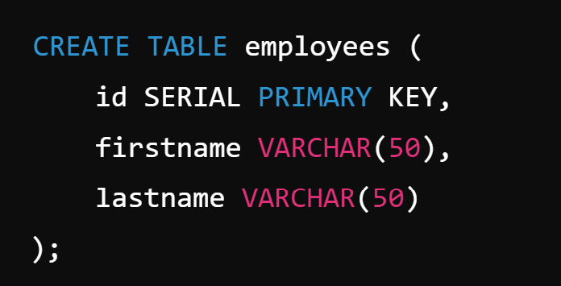

Slide 59
TASK 1:
Creating New Table

Slide 60
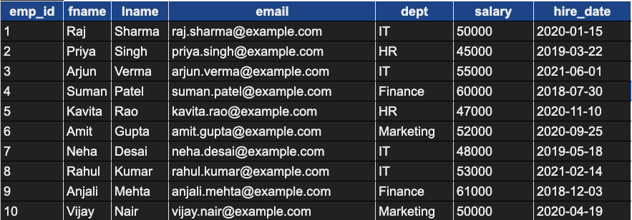

Slide 61
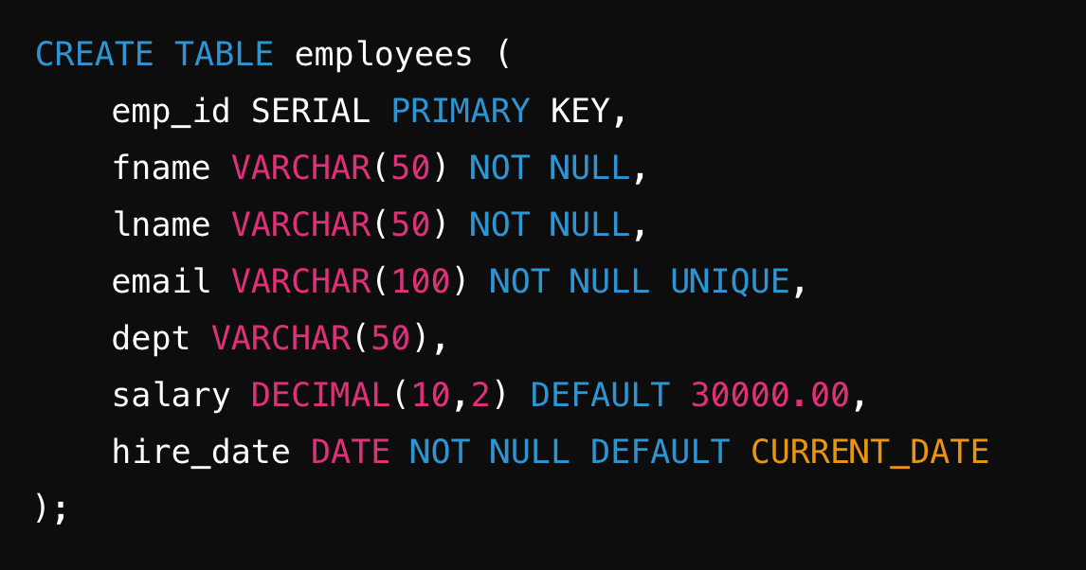

Slide 62
INSERT INTO employees (emp_id, fname, lname, email, dept, salary, hire_date)
VALUES
(1, 'Raj', 'Sharma', 'raj.sharma@example.com', 'IT', 50000.00, '2020-01-15'),
(2, 'Priya', 'Singh', 'priya.singh@example.com', 'HR', 45000.00, '2019-03-22'),
(3, 'Arjun', 'Verma', 'arjun.verma@example.com', 'IT', 55000.00, '2021-06-01'),
(4, 'Suman', 'Patel', 'suman.patel@example.com', 'Finance', 60000.00, '2018-07-30'),
(5, 'Kavita', 'Rao', 'kavita.rao@example.com', 'HR', 47000.00, '2020-11-10'),
(6, 'Amit', 'Gupta', 'amit.gupta@example.com', 'Marketing', 52000.00, '2020-09-25'),
(7, 'Neha', 'Desai', 'neha.desai@example.com', 'IT', 48000.00, '2019-05-18'),
(8, 'Rahul', 'Kumar', 'rahul.kumar@example.com', 'IT', 53000.00, '2021-02-14'),
(9, 'Anjali', 'Mehta', 'anjali.mehta@example.com', 'Finance', 61000.00, '2018-12-03'),
(10, 'Vijay', 'Nair', 'vijay.nair@example.com', 'Marketing', 50000.00, '2020-04-19');

Slide 63
Section - 4

Slide 64
Clauses
Where
Distinct
Order By
Limit
Like

Slide 65

Relational Operators

Slide 66


Find employees whose salary is more than
65000

Slide 67
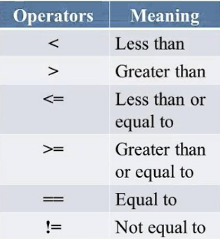
We have relational
operators
=
=

Slide 68
SELECT * FROM employees
WHERE salary > 65000;

Slide 69
Logical Operators

Slide 70
AND
OR

Slide 71
Condition 1
AND
Condition 2
When both the conditions are true

Slide 72
salary=25000
AND
dept=Loan

Slide 73
Condition 1
OR
Condition 2
When either of the condition is true

Slide 74
salary=65000
OR
desig='Lead'

Slide 75
IN, NOT IN

Slide 76
Find employees From following department
IT
Finance
HR

Slide 77
SELECT * FROM employees
WHERE dept = 'IT'
OR dept = 'HR'
OR dept = 'Finance';

Slide 78
SELECT * FROM employees
WHERE dept IN ('IT', 'HR', 'Finance');

Slide 79
BETWEEN

Slide 80
Find employees whose salary is more than
40000 and Less than 65000
>40000
<65000

Slide 81
SELECT * FROM employees
WHERE
salary >=40000 AND salary <=65000;

Slide 82
SELECT * FROM employees
WHERE
salary BETWEEN 40000 AND 65000;

Slide 83
DISTINCT
SELECT DISTINCT fname FROM employees;

Slide 84
ORDER BY
SELECT * FROM employees ORDER BY fname;

Slide 85
LIMIT
SELECT * FROM employees LIMIT 3;

Slide 86
LIKE
Select * FROM employees
WHERE dept LIKE "%Acc%";

Slide 87
Starts with 'A': LIKE 'A%'
Ends with 'A': LIKE '%A'
Contains 'A': LIKE '%A%'
Second character is 'A': LIKE '_A%'
Case-insensitive contains 'john': ILIKE '%john%'

Slide 88
Section - 5

Slide 89
How to find total no. of employees?
Employee with Max salary
Average salary of employees

Slide 90
COUNT
SUM
AVG
MIN
MAX

Slide 91
COUNT
SELECT COUNT(*) FROM employees;

Slide 92
MAX & MIN
SELECT MAX(age) FROM employees;
SELECT MIN(age) FROM employees;

Slide 93
SELECT emp_id, fname, salary FROM employees
WHERE
salary = (SELECT MAX(salary) FROM employees);

Slide 94
SUM & AVG
SELECT SUM(salary) FROM employees;
SELECT AVG(salary) FROM employees;

Slide 95

GROUP BY

Slide 96
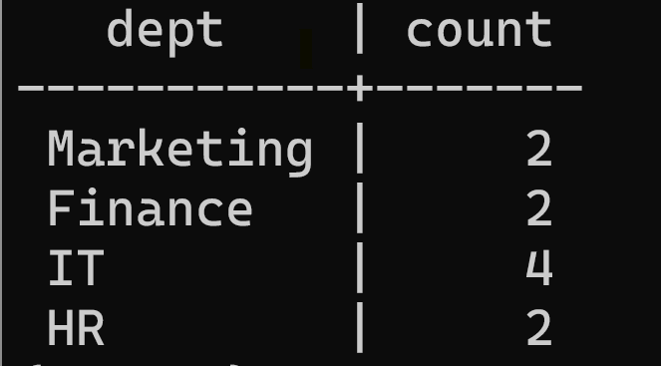
No. of employees in each department

Slide 97
HR
Finance
Marketing
Deposit
IT

Slide 98
SELECT dept FROM employees GROUP BY dept;
SELECT dept, COUNT(fname) FROM employees GROUP BY dept;

Slide 99
Section - 6
String Functions

Slide 100
CONCAT, CONCAT_WS
SUBSTR
LEFT, RIGHT
LENGTH
UPPER, LOWER
TRIM, LTRIM, RTRIM
REPLACE
POSITION

Slide 101
CONCAT
CONCAT(first_col, sec_col)
CONCAT(first_word, sec_word, ...)

Slide 102
CONCAT_WS
CONCAT_WS('-', fname, lname)

Slide 103
SUBSTRING
SELECT SUBSTRING('Hey Buddy', 1, 4);

Slide 104
SUBSTRING
SELECT SUBSTRING('Hey Buddy', 1, 4);
1
4
Result: Hey

Slide 105
REPLACE
Hey Buddy
Hello Buddy
Hey
Hello

Slide 106
REPLACE(str, from_str, to_str)
REPLACE('Hey Buddy', 'Hey', 'Hello')

Slide 107
REVERSE
SELECT REVERSE('Hello World');

Slide 108
LENGTH
Select LENGTH('Hello World');

Slide 109
UPPER & LOWER
SELECT UPPER('Hello World');
SELECT LOWER('Hello World');

Slide 110
Other Functions

Slide 111
SELECT LEFT('Abcdefghij', 3);
SELECT RIGHT('Abcdefghij', 4);
SELECT TRIM(' Alright! ');
SELECT POSITION('OM' in ‘Thomas’);

Slide 113
Exercise

Slide 114
Task 1:
1:Raj:Sharma:IT
Task2:
1:Raju Sharma:IT:50000

Slide 115
Task3
4:Suman:FINANCE
Tas﻿k4
I1 Raju
H2 Priya

Slide 116
Exercise
DISTINCT, ORDER BY, LIKE and LIMIT

Slide 117
1: Find Different type of departments in database?
2: Display records with High-low salary
3: How to see only top 3 records from a table?
4: Show records where first name start with letter 'A'
5: Show records where length of the lname is 4 characters

Slide 118
Exercise
COUNT, GROUP BY, MIN, MAX and SUM and AVG

Slide 119
1: Find Total no. of employees in database?
2: Find no. of employees in each department.
3: Find lowest salary paying
4: Find highest salary paying
5: Find total salary paying in Loan department?
6: Average salary paying in each department

Slide 120
Section - 7

Slide 121
ALTERING Tables

Slide 122

How to add or remove a column?

Slide 123


Slide 124
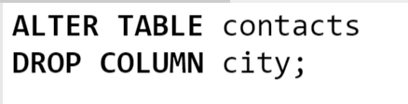

Slide 125
How to rename a column or table name?

Slide 126
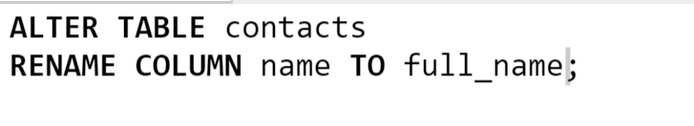
How to rename a column?

Slide 127


How to rename a table name?

Slide 128
How to modify a column?
Ex: Changing datatype
or adding Default values etc

Slide 129
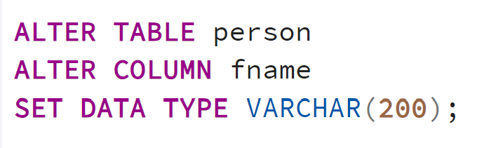
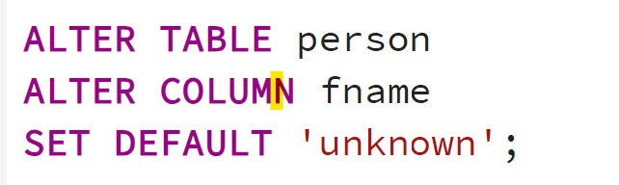
How to add DEFAULT value to a column?

Slide 130
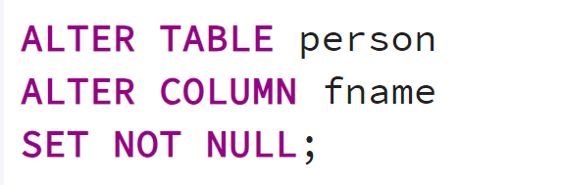
How to set NOT NULL?

Slide 131
CHECK
CONSTRAINT

Slide 132
We want to make sure phone no. is atleast 10 digits...

Slide 133
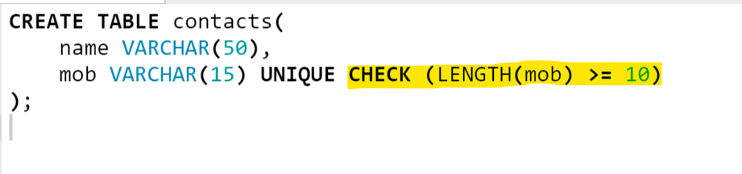

Slide 134
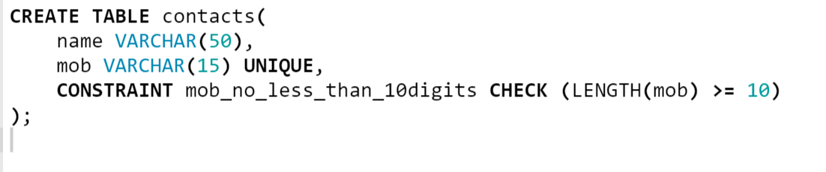
NAMED CONSTRAINT

Slide 135
How to Add or Drop Constraints?

Slide 136

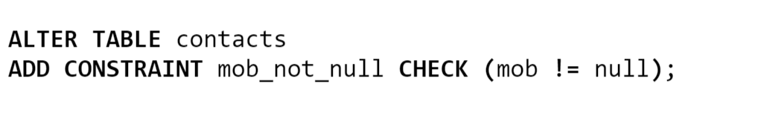

Slide 137
Additional Topcis

Slide 138

CASE

Slide 139
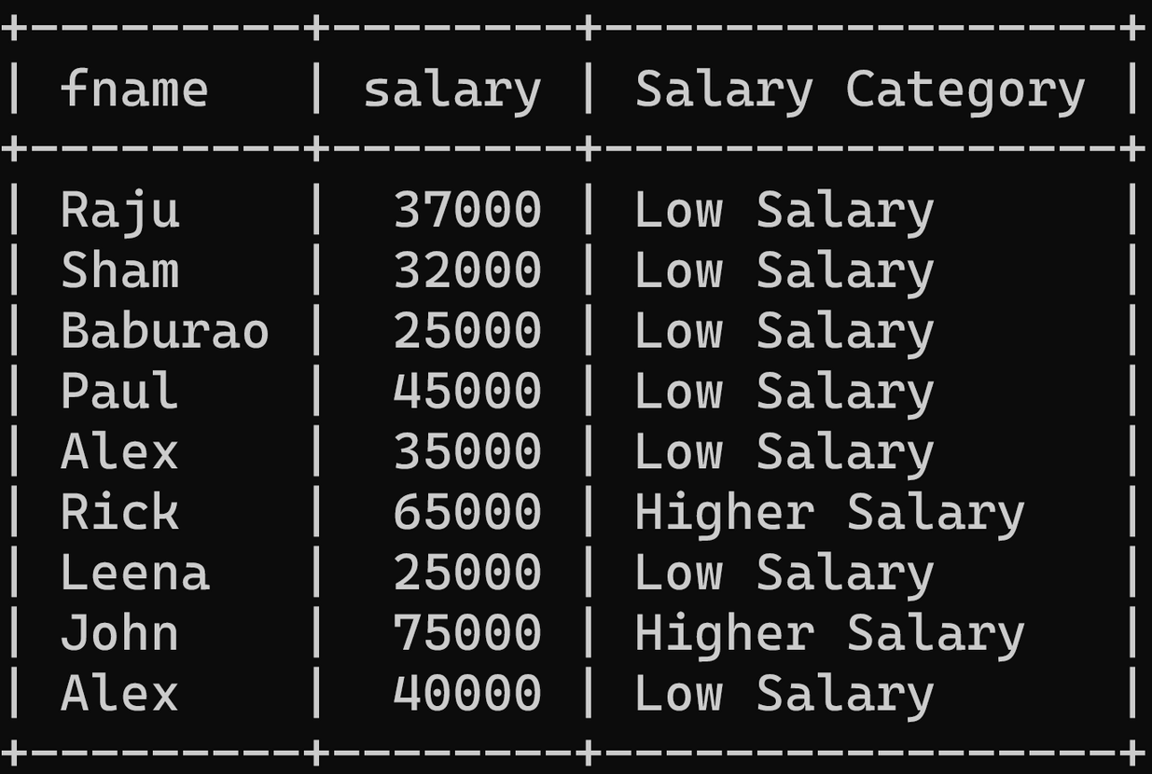


Slide 140
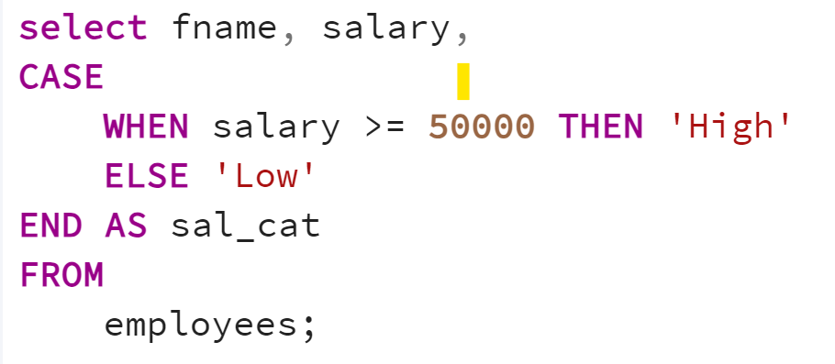

Slide 141
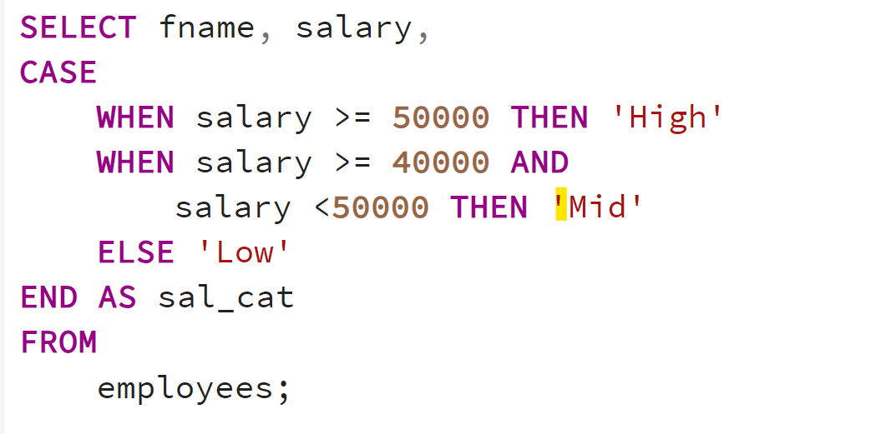

Slide 142
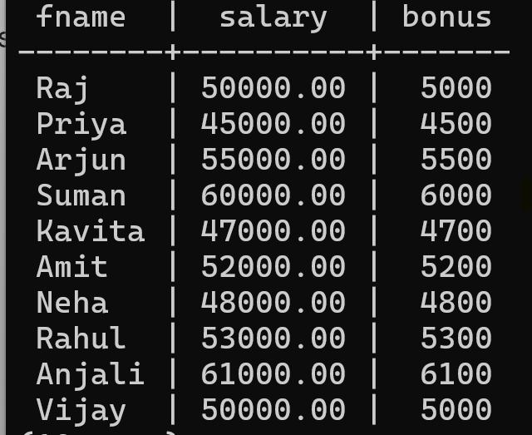
Task

Slide 143
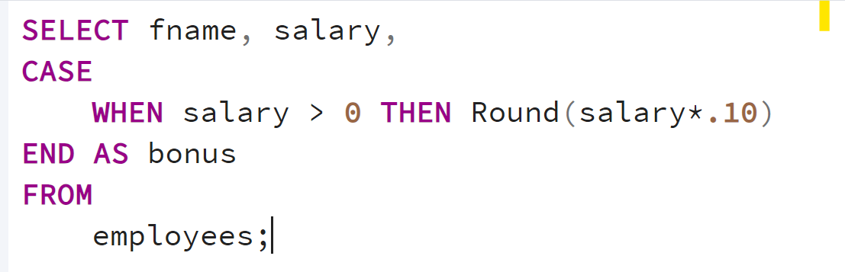

Slide 144
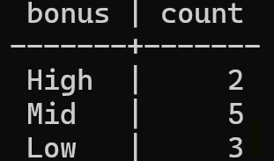
Task

Slide 145
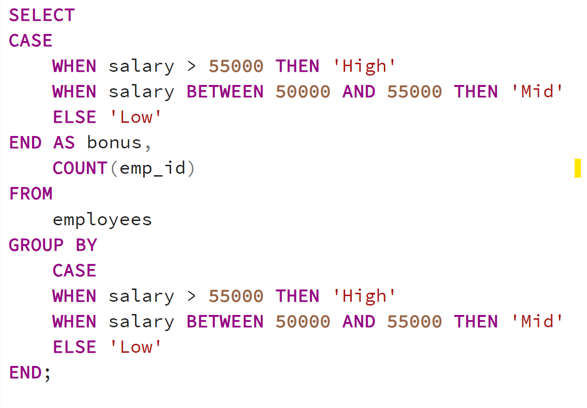

Slide 146
IS NULL

Slide 147
IS NULL
SELECT * FROM employees
WHERE fname IS NULL;

Slide 148
NOT LIKE

Slide 149
IS NULL
SELECT * FROM employees
WHERE fname NOT LIKE 'A%';

Slide 150
SECTION - 8

Slide 151
RElATIONSHIP

Slide 152
Employees

Slide 153
Salary
Attendance
Employees
offices
requests
task

Slide 154
Types of Relationship
One to One
One to Many
Many to Many

Slide 155
1 : 1

Slide 156
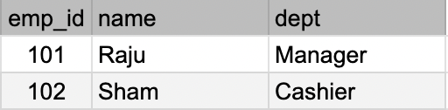

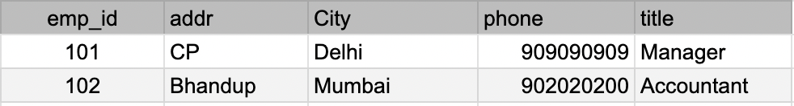
Employees
Employee
Details

Slide 157
1 : MANY

Slide 158
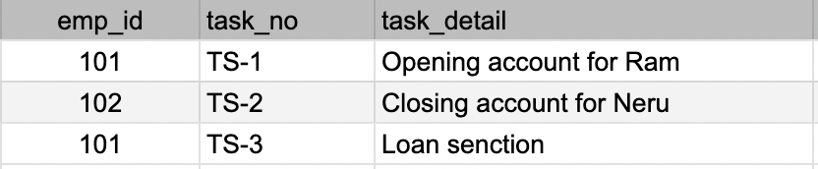
Employees
Employee Task

Slide 159
Many : Many

Slide 160


Books
Authors

Slide 161
Book B
Book C
Book D
Author A
Book A
Author B

Slide 162
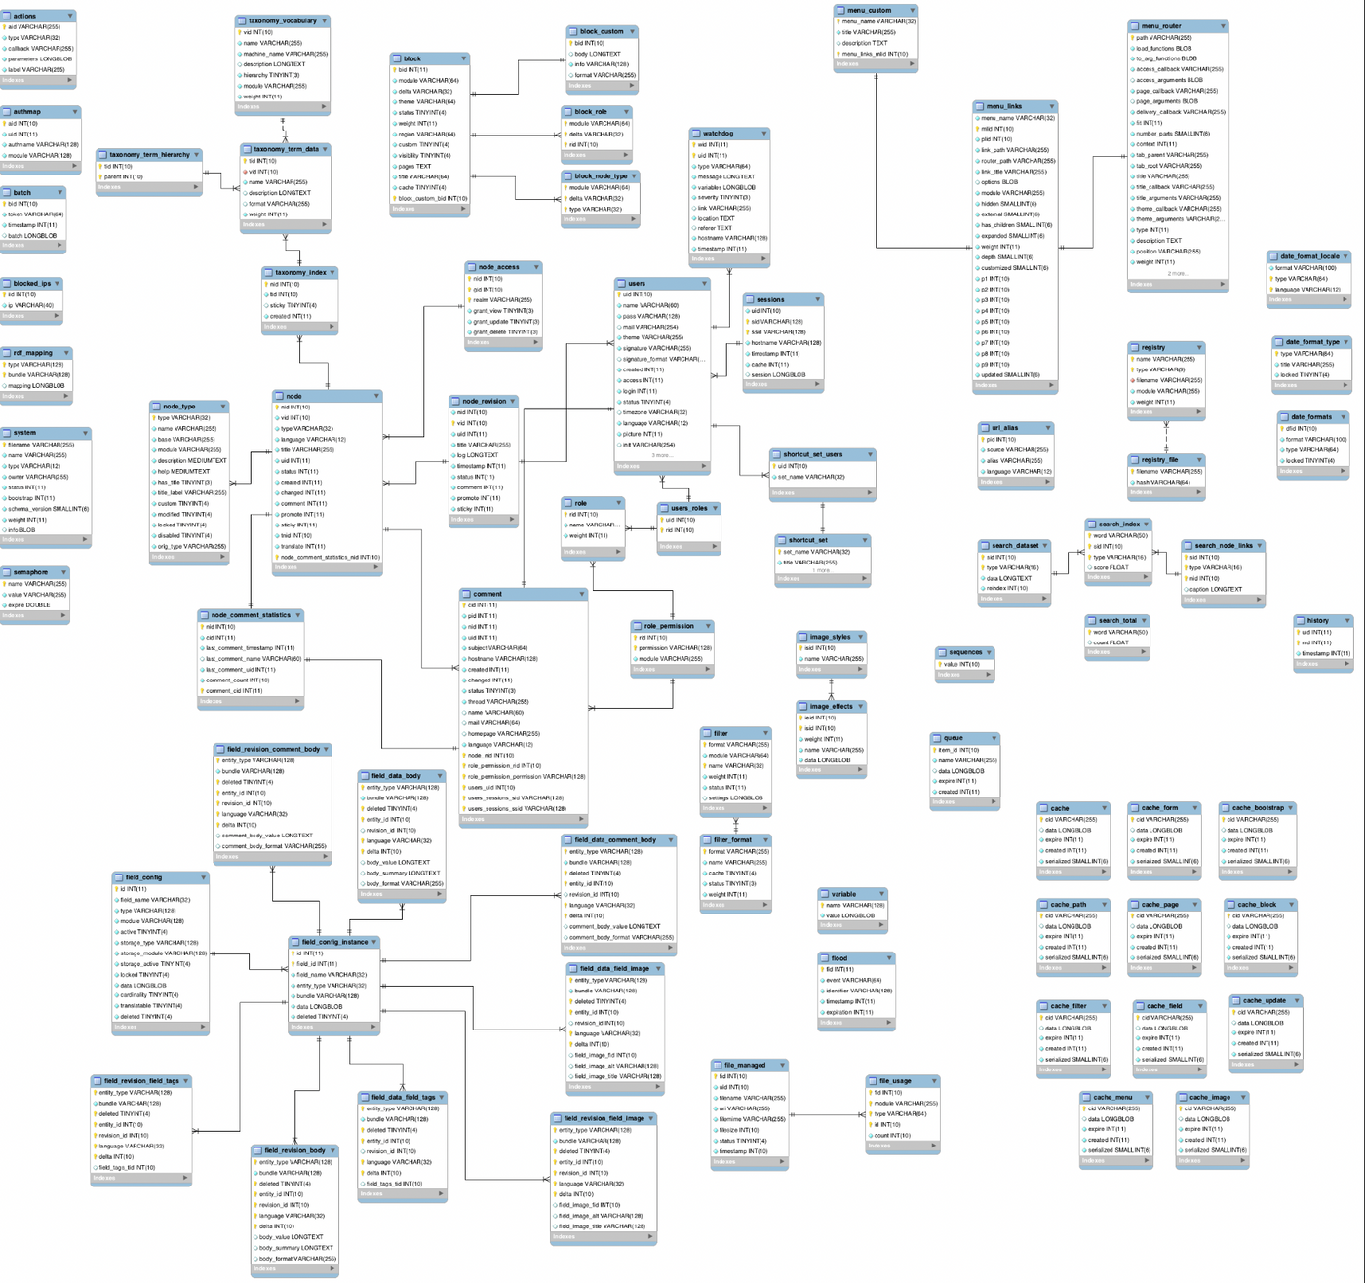

Slide 163
Let's Understand a Use-Case of
1:Many

Slide 164



Slide 165
Suppose we need to store the following data
customer name
customer email
order date
order price

Slide 166
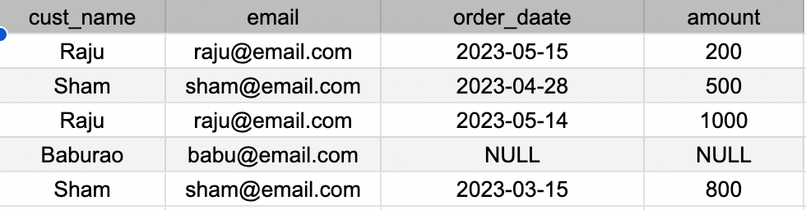

Slide 167
Customers
Orders
cust_id
cust_name
cust_email
order_id
order_date
order_amount

Slide 168
Customers
Orders
cust_id
cust_name
cust_email
order_id
order_date
order_amount
cust_id

Slide 169
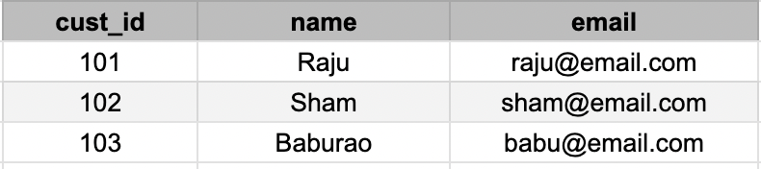
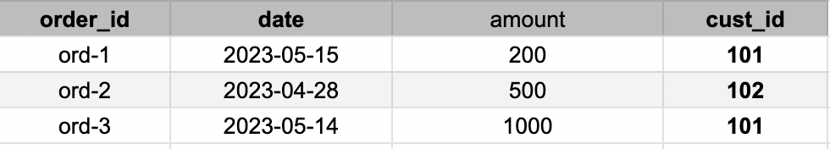
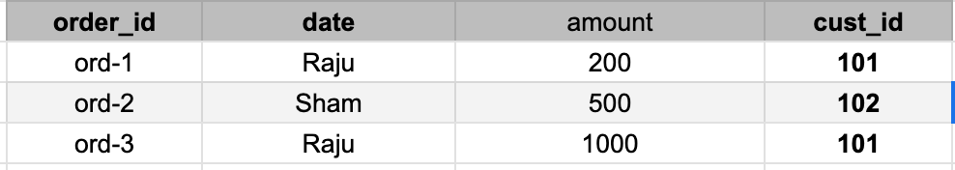
Customers
Orders

Slide 170
Foreign Key

Slide 171
Customers
Orders

Slide 172
Primary Key
Customers
Foreign Key
Primary Key
Orders

Slide 173
Let's work practically with Foreign Key..

Slide 174
CREATE TABLE customers (
cust_id SERIAL PRIMARY KEY,
cust_name VARCHAR(100) NOT NULL
);
Customers
CREATE TABLE orders (
ord_id SERIAL PRIMARY KEY,
ord_date DATE NOT NULL,
price NUMERIC NOT NULL,
cust_id INTEGER NOT NULL,
FOREIGN KEY (cust_id) REFERENCES
customers (cust_id)
);
Orders

Slide 175
INSERT INTO customers (cust_name)
VALUES
('Raju'), ('Sham'), ('Paul'), ('Alex');
Customers
INSERT INTO orders (ord_date, cust_id, price)
VALUES
('2024-01-01', 1, 250.00),
('2024-01-15', 1, 300.00),
('2024-02-01', 2, 150.00),
('2024-03-01', 3, 450.00),
('2024-04-04', 2, 550.00);
Orders

Slide 177
JOINS

Slide 178
JOIN operation is used to combine rows from two or more tables based on a related column between them.

Slide 179
Primary Key
Customers
Foreign Key
Primary Key
Orders

Slide 180
Types of Join
Cross Join
Inner Join
Left Join
Right Join

Slide 181
Cross Join
Every row from one table is combined with every row from another table.

Slide 182
Inner Join
Returns only the rows where there is a match between the specified columns in both the left (or first) and right (or second) tables.

Slide 183
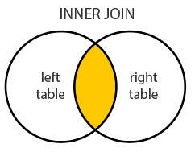

Slide 184
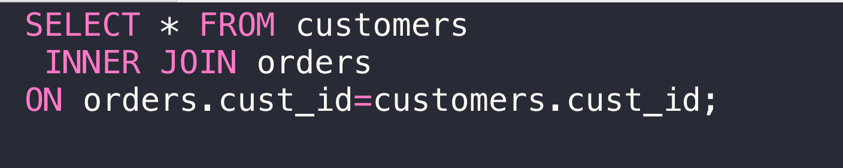

Slide 185
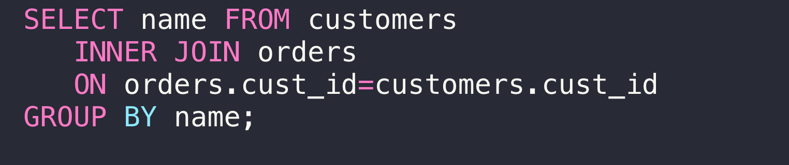
Inner Join with Group By

Slide 186
Left Join
Returns all rows from the left (or first) table and the matching rows from the right (or second) table.

Slide 187
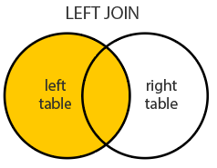

Slide 188


Slide 189
Right Join
Returns all rows from the right (or second) table and the matching rows from the left (or first) table.

Slide 190
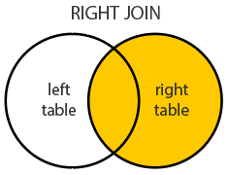

Slide 191
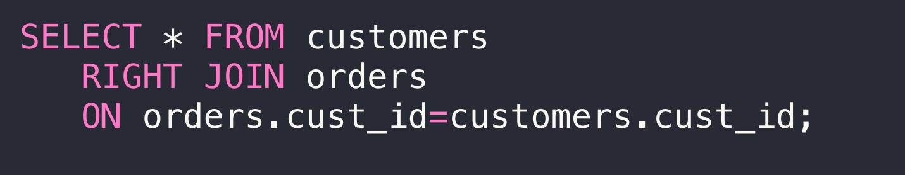

Slide 192
Many : Many

Slide 193
Let's Understand a Use-Case of
Many : Many

Slide 194


Students
Courses

Slide 195


Course A
Student A
Course B
Course C

Slide 196


Student A
Course A
Student B
Student C

Slide 197
students
id
student_name
courses
id
course_name
fees

Slide 198
students
id
student_name
student_course
student_id
course_id
courses
id
course_name
fees

Slide 199
students
id
student_name
enrollment
student_id
course_id
courses
id
course_name
fees

Slide 201

TASK

Slide 202
Create a one-to-many and many-to-many relationship in a shopping store context using four tables:
customers
orders
products
order_items
Include a price column in the products table and display the relationship between customers and their orders, along with the details of the products in each order.

Slide 203
Customers
Orders
Products
cust_id
cust_name
ord_id
ord_date
cust_id
p_id
p_name
price
ord_items
items_id
ord_id
p_id
quantity

Slide 204
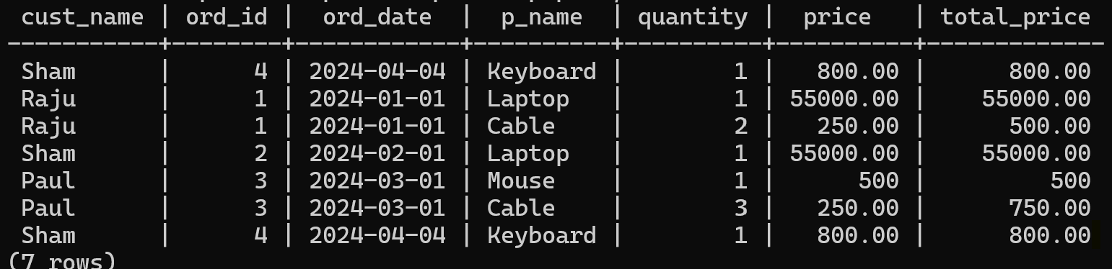
End Result

Slide 206
VIEWS

Slide 207
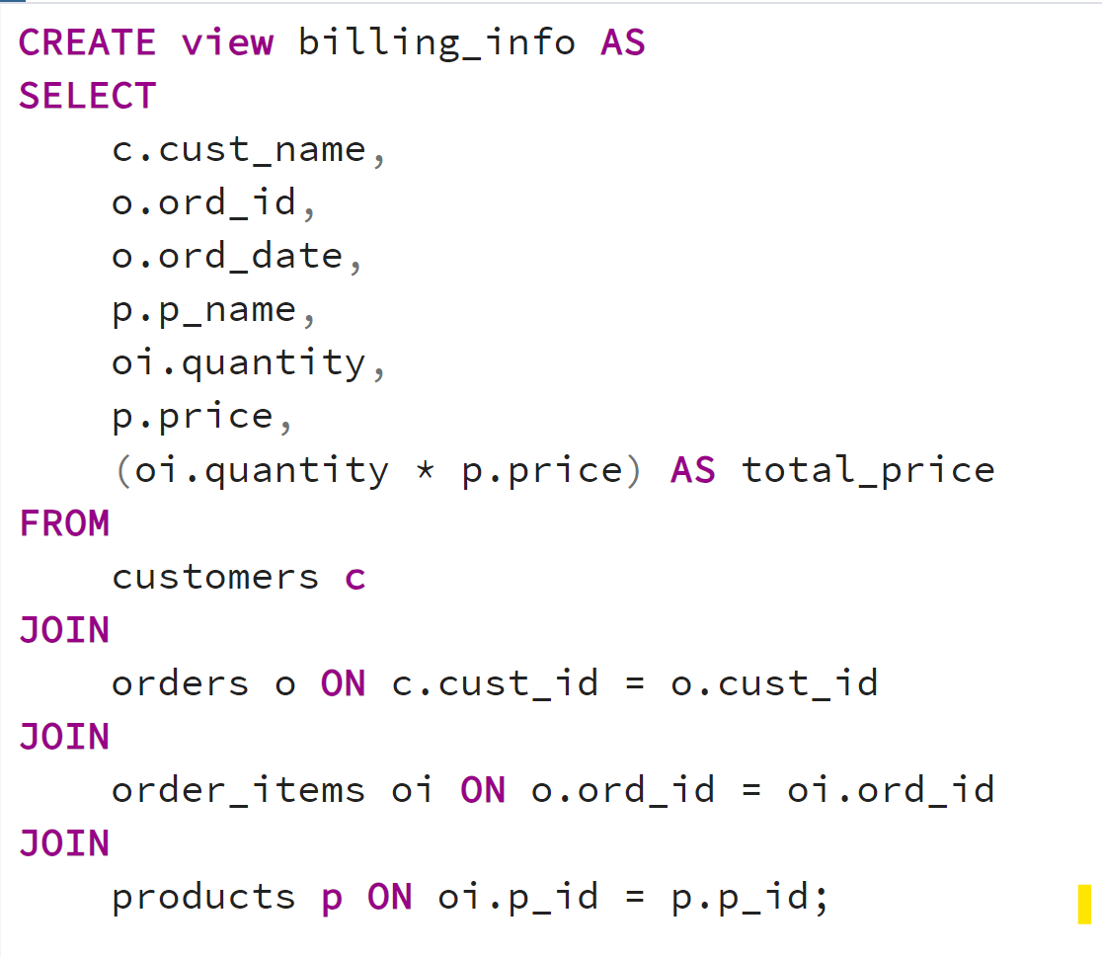

Slide 208
HAVING Clause

Slide 209
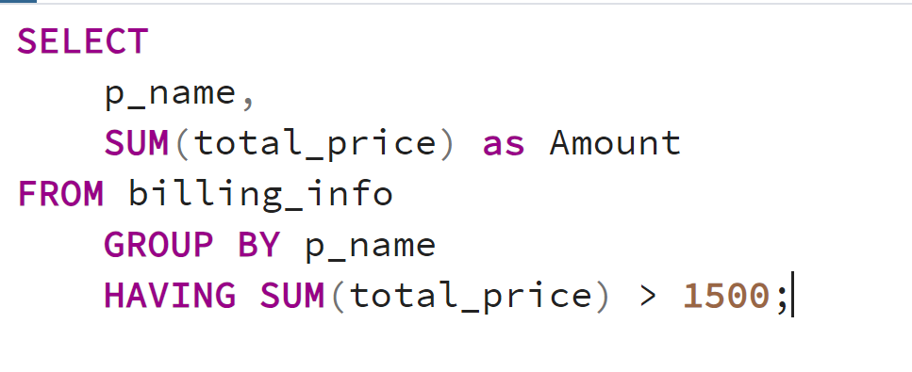

Slide 210
GROUP BY ROLLUP

Slide 211
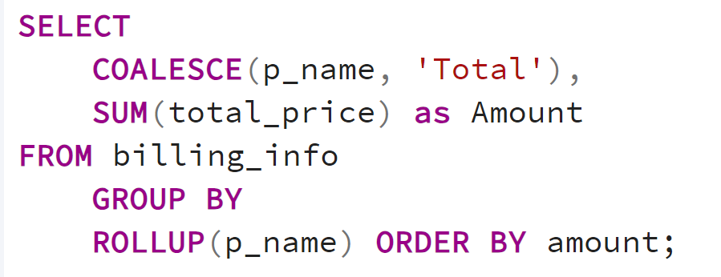
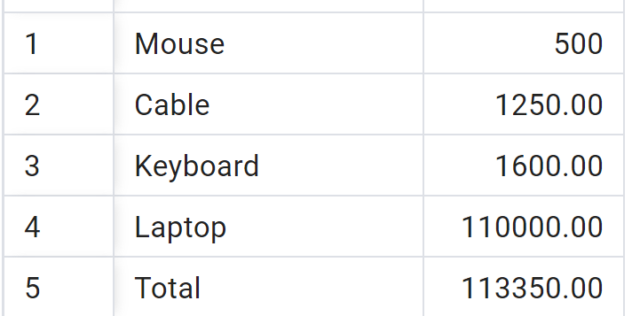

Slide 212
STORED Routine

Slide 213
STORED Routine
An SQL statement or a set of SQL Statement that can be stored on database server which can be call no. of times.

Slide 214
Types of STORED Routine
STORED Procedure
User defined Functions

Slide 215
STORED Procedure

Slide 216
STORED PROCEDURE
Set of SQL statements and procedural logic that can perform operations such as inserting, updating, deleting, and querying data.

Slide 217
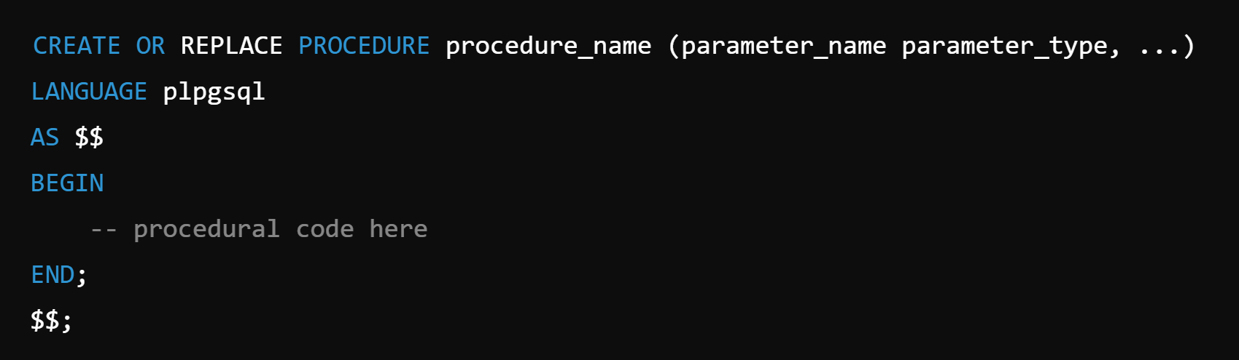

Slide 218
CREATE OR REPLACE PROCEDURE update_emp_salary(
p_employee_id INT,
p_new_salary NUMERIC
)
LANGUAGE plpgsql
AS $$
BEGIN
UPDATE employees
SET salary = p_new_salary
WHERE emp_id = p_employee_id;
END;
$$;

Slide 219
CREATE OR REPLACE PROCEDURE add_employee(
p_fname VARCHAR,
p_lname VARCHAR,
p_email VARCHAR,
p_dept VARCHAR,
p_salary NUMERIC
)
LANGUAGE plpgsql
AS $$
BEGIN
INSERT INTO employees (fname, lname, email, dept, salary)
VALUES (p_fname, p_lname, p_email, p_dept, p_salary);
END;
$$;

Slide 220
USER DEFINED FUNCTIONS
custom function created by the user to perform specific operations and return a value.

Slide 221
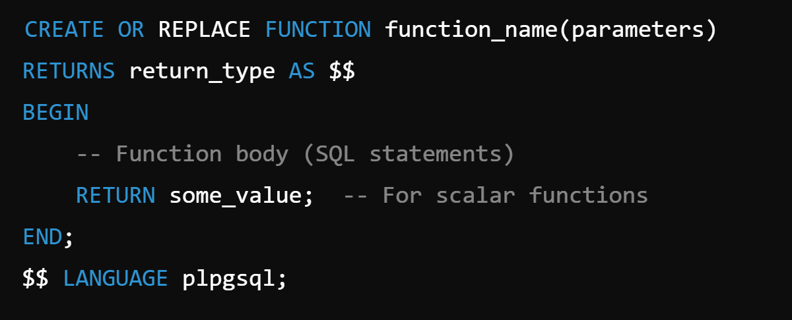

Slide 222
Find name of the employees in each department having maximum salary.

Slide 223
CREATE OR REPLACE FUNCTION dept_max_sal_emp1(dept_name VARCHAR)
RETURNS TABLE(emp_id INT, fname VARCHAR, salary NUMERIC)
AS $$
BEGIN
RETURN QUERY
SELECT
e.emp_id, e.fname, e.salary
FROM
employees e
WHERE
e.dept = dept_name
AND e.salary = (
SELECT MAX(emp.salary)
FROM employees emp
WHERE emp.dept = dept_name
);
END;
$$ LANGUAGE plpgsql;

Slide 224
WINDOW FUNCTIONS

Slide 225
Window functions, also known as analytic functions allow you to perform calculations across a set of rows related to the current row.
Defined by an OVER() clause.

Slide 226
Benefits of Window Functions
Advanced Analytics: They enable complex calculations like running totals, moving averages, rank calculations, and cumulative distributions.
Non-Aggregating: Unlike aggregate functions, window functions do not collapse rows. This means you can calculate aggregates while retaining individual row details.
Flexibility: They can be used in various clauses of SQL, such as SELECT, ORDER BY, and HAVING, providing a lot of flexibility in writing queries.

Slide 227
ROW_NUMBER()
RANK()
DENSE_RANK()
LAG()
LEAD()

Slide 228
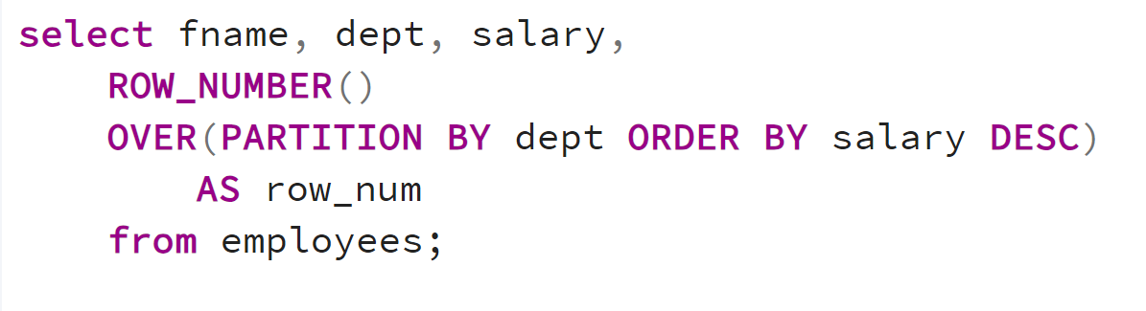

Slide 230
CTE
Common Table Expression

Slide 231
CTE (Common Table Expression) is a temporary result set that you can define within a query to simplify complex SQL statements.

Slide 232


Slide 233
Use Cases - 1
We want to calculate the average salary per department and then find all employees whose salary is above the average salary of their department.

Slide 234


Slide 235
WITH AvgSal AS (
SELECT
dept, AVG(salary) AS avg_salary FROM employees
GROUP BY
dept
)
SELECT
e.emp_id, e.fname, e.dept, e.salary,
a.avg_salary
FROM
employees e
JOIN
AvgSal a ON e.dept = a.dept
WHERE
e.salary > a.avg_salary;

Slide 236
Use Cases - 2
We want to find the highest-paid employee in each department.

Slide 237


Slide 238
WITH HighestPaid AS (
SELECT
dept,
MAX(salary) AS max_salary
FROM
employees
GROUP BY
dept
)
SELECT
e.emp_id,
e.fname,
e.lname,
e.desig,
e.dept,
e.salary
FROM
employees e
JOIN
HighestPaid h ON e.dept = h.dept AND e.salary = h.max_salary;

Slide 239
Points:
Once CTE has been created it can only be used once. It will not be persisted.

Slide 241
TRIGGERS
Triggers are special procedures in a database that automatically execute predefined actions in response to certain events on a specified table or view.

Slide 242


Slide 243


Slide 244
Use Case
Create a Trigger so that
If we insert/update negative salary in a table, it will be triggered and set it to 0.

Slide 245


Slide 247
CASCADE ON DELETE

Slide 248
Primary Key
Customers
Foreign Key
Primary Key
Orders

Slide 249


