Slide 1
New Restaurant in Toronto

Slide 2
Contents
Introduction
Data
Methodology
Results and Analysis
Inference
Conclusions
Future scope

Slide 3
Introduction
Background :
Client wishes to start a new restaurant in Canada , Toronto as part of the business plan
Need to find out a good location and type based on the existing data
Business problem :
Find out Few best locations so client can choose from
Find out Best type of restaurant to start in that location

Slide 4
Data
Below data’s are used for the analysis
To get neighbourhood data in Toronto : https://en.wikipedia.org/wiki/List_of_postal_codes_of_Canada:_M
Geospatial data to get the latitude and longitude data:
http://cocl.us/Geospatial_data
To fetch the restaurants in Toronto :
Foursquare API

Slide 5
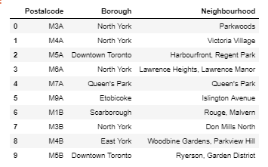
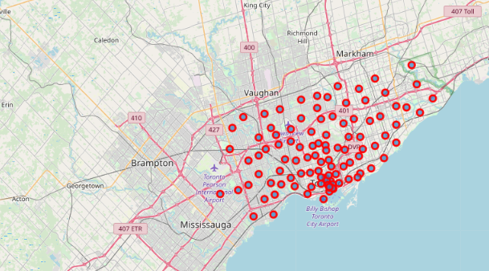
Methodology
Clean the neighbourhood data to analyze further
Plot the neighbourhood locations using folium

Slide 6
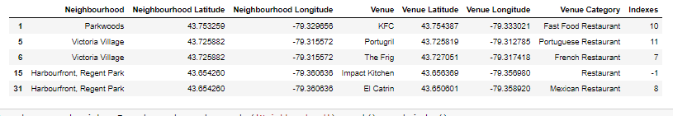
Methodology (cont..)
Find the restaurants in Toronto using Four Square API
Clean and analyze the neighbourhood data and restaurant data to get best restaurant types and best locations in Toronto

Slide 7
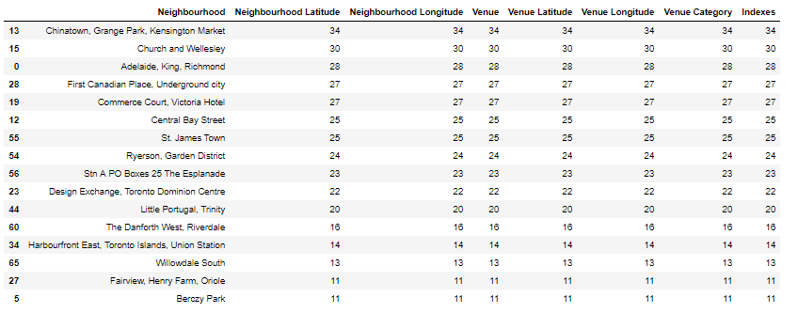
Results and Analysis
Neighbour hood locations with most number of restaurants

Slide 8
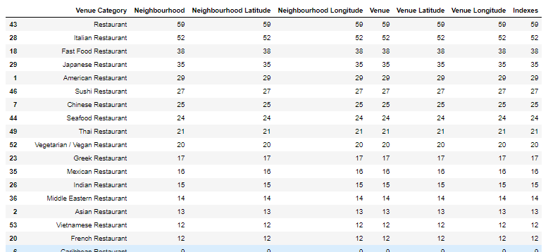
Results and Analysis
Most popular restaurant types in Toronto

Slide 9
Inference
An ideal place for restaurant should not be too crowded with existing restaurants: Minimise the competition
The best type of restaurant should be the ones that is most popular in that area: Maximising the profit

Slide 10
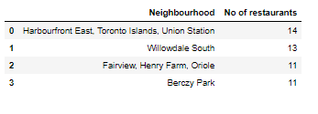
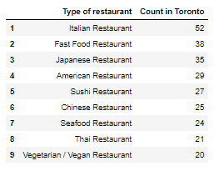
Conclusions
Best places to start a new restaurant
Most popular Restaurant types in Toronto

Slide 11
Future Scope
We can use this idea to find best cinema location or other type of places and to make recommendations.
This algorithm can be extended to find out more tips and tricks that attracts people to restaurant, which can help our current client in future.
We can also use this algorithm to suggest best restaurant locations all over the world if this is success.
The feedback can be used to improve the algorithm and finding faults.

Slide 12
Thank you

