Slide 1




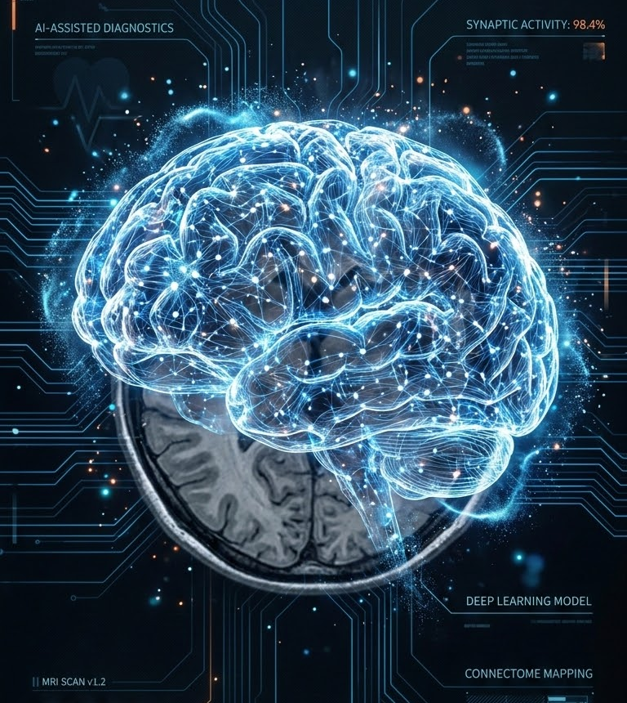

Deep Learning Project
Brain Tumor Detection Using Deep Learning
An End-to-End Convolutional Neural Network (CNN) for Brain MRI Image Classification
Presented By
Steve Emmanuel
Department of Data Science & Artificial Intelligence

Slide 2









Why It Matters
Why Brain Tumor Detection Matters
Brain tumors are among the most critical neurological conditions, where early and accurate diagnosis can significantly improve treatment outcomes.
1
Patient with Symptoms
Initial clinical presentation of neurological signs
2
MRI Brain Scan
Multi-sequence magnetic resonance imaging
Early Detection
Early diagnosis increases the chances of effective treatment and better patient outcomes.
Radiologist Analysis
Manual expert visual inspection and evaluation
3
4
Deep Learning (CNN)
Automated AI image analysis and feature extraction
Time Critical
Delayed diagnosis may allow tumors to grow, making treatment more difficult.
5
Tumor Classification
Categorization into specific pathological types
Expert Dependency
MRI interpretation requires experienced radiologists and can be time-consuming.
6
Faster Clinical Decision
Rapid triage and customized treatment planning
PROJECT OBJECTIVE
Develop an AI-powered Convolutional Neural Network (CNN) that automatically classifies brain MRI images into four distinct categories with clinical precision.
Glioma
Meningioma
Pituitary Tumor
No

Slide 3







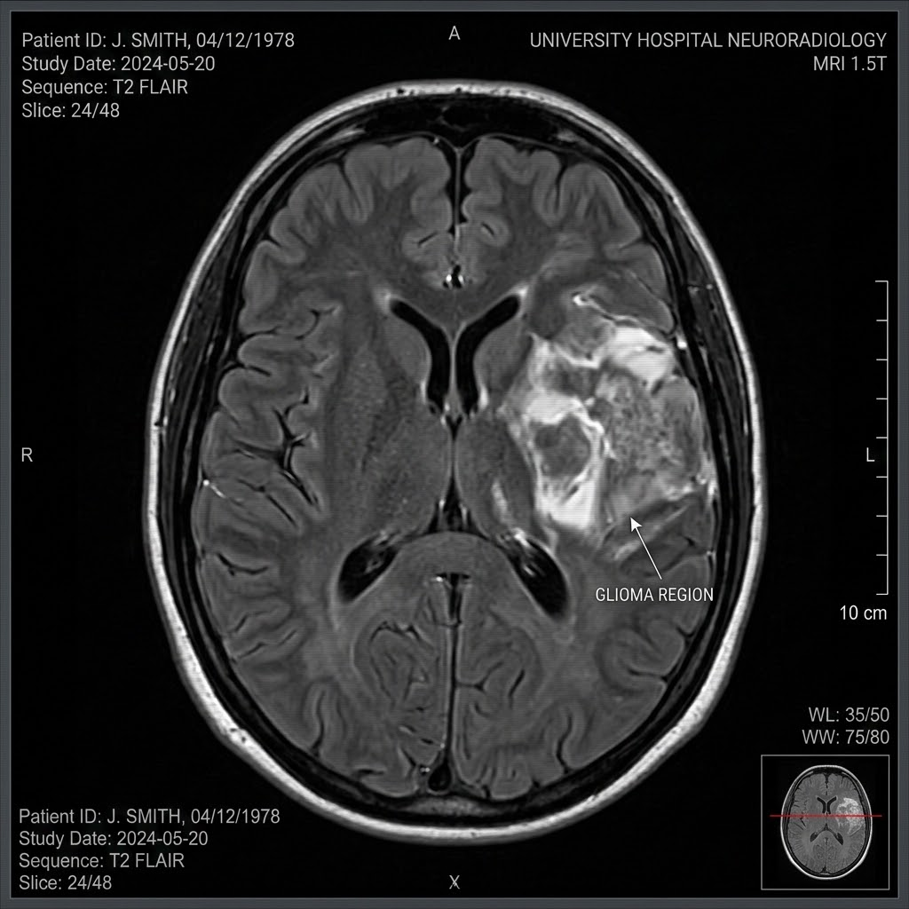
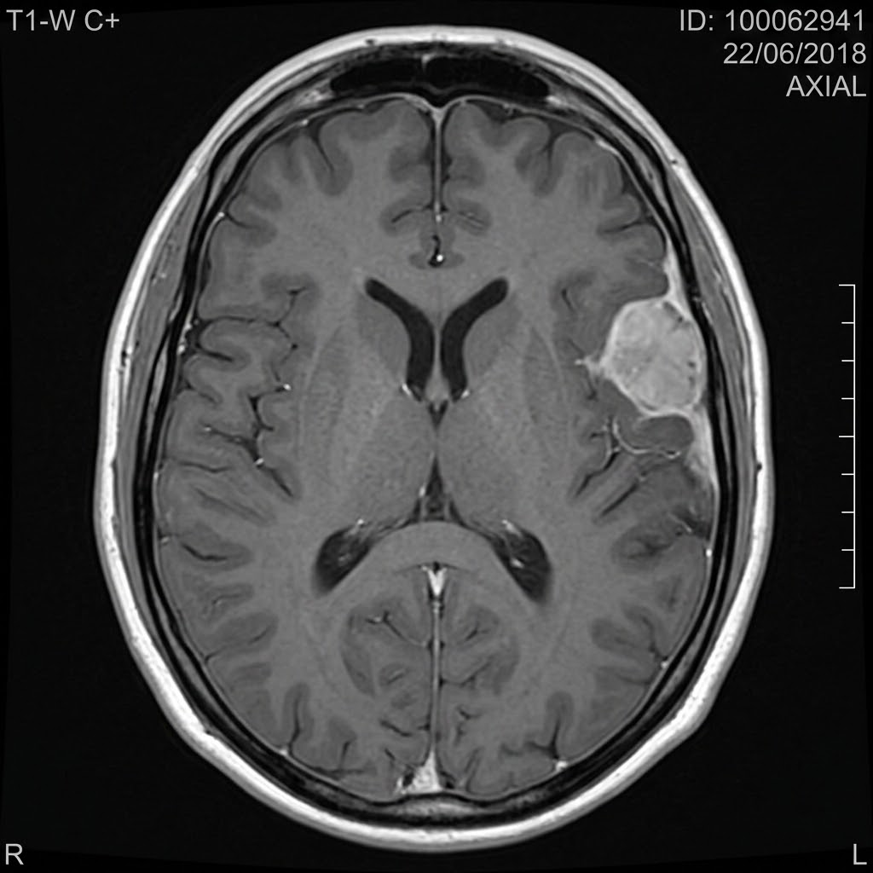



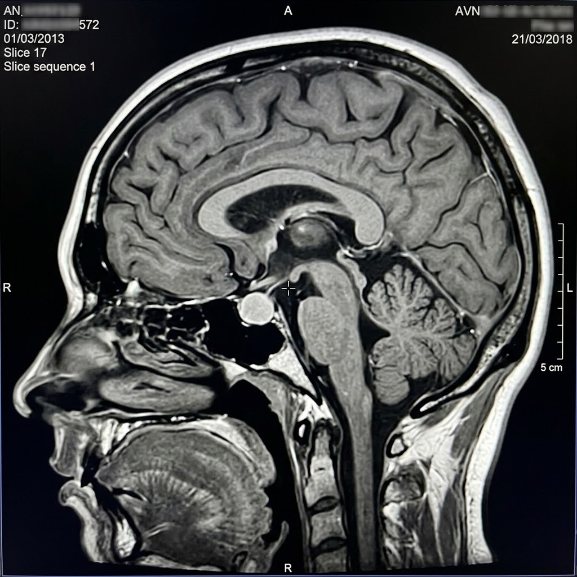
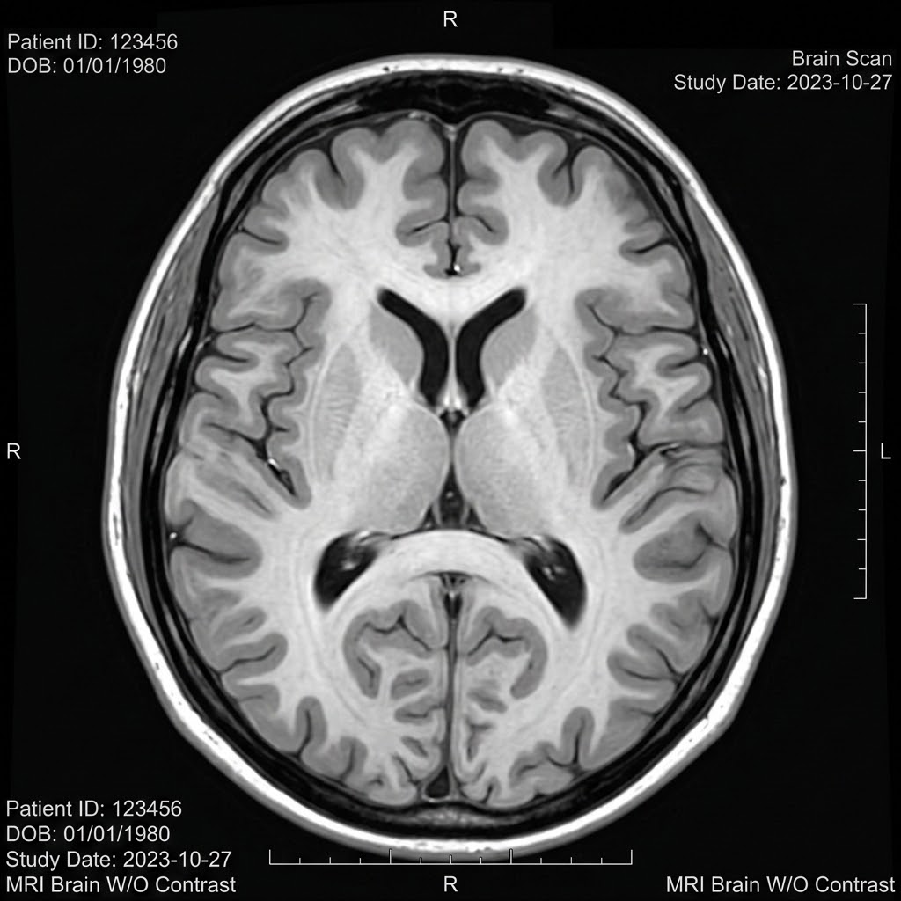
Dataset Overview
The foundation of every successful Deep Learning model is a high-quality dataset.
Dataset Information
General metadata summary
Glioma
Meningioma
📁 Dataset
📁 Training
Source:
Kaggle - Brain Tumor MRI
Image Type:
Brain MRI Images (2D)
Classification Task:
Multi-Class Classification
Number of Classes:
4 Pathological Categories
📄 Glioma
📄 Meningioma
📄 Pituitary
📄 No Tumor
A tumor that originates in the brain's glial cells, supporting neuronal function.
A tumor that develops in the protective meninges membranes surrounding the brain.
Pituitary
No Tumor
📁 Testing
📄 Glioma
📄 Meningioma
📄 Pituitary
📄 No Tumor
A tumor affecting the critical pituitary gland at the central base of the brain.
A healthy brain MRI scan with no visible pathology or structural anomalies.
info
Ready for Supervised Learning
"A well-structured and balanced dataset enables the CNN model to learn meaningful patterns for accurate tumor classification."

Slide 4

















Data Exploration & Preprocessing
Preparing MRI images for efficient and accurate Deep Learning.
Why Preprocessing?
Image Pipeline Workflow
Preprocessing
Configuration
Image Standardization
All MRI images are resized to a fixed dimension (224 × 224 pixels) so every image has the same input size.
Original MRI
Raw Scan Data
Resize
224 × 224 Pixels
Normalize
0-255 → 0-1
Image Size224 × 224
Batch Size32
Validation Split20%
FrameworkTensorFlow
Dataset APItf.data
Pipeline Functions:
✔ Cache()✔ Shuffle()
✔ Prefetch()✔ Map()
Batch
Size = 32
Shuffle
Randomize Order
Cache
Memory Storage
Pixel Normalization
Pixel values are scaled from 0–255 to 0–1, helping the model train faster and more efficiently.
Prefetch
Overlap Training
Ready for CNN Model
Optimized GPU Feed
Efficient Data Pipeline
Images are processed in batches and optimized using TensorFlow's data pipeline for faster training.
Why This Matters: Consistent image dimensions and normalized pixel values help the CNN focus on meaningful brain patterns rather than differences in image size or brightness. The optimized TensorFlow data pipeline also improves training speed and overall efficiency.

Slide 5










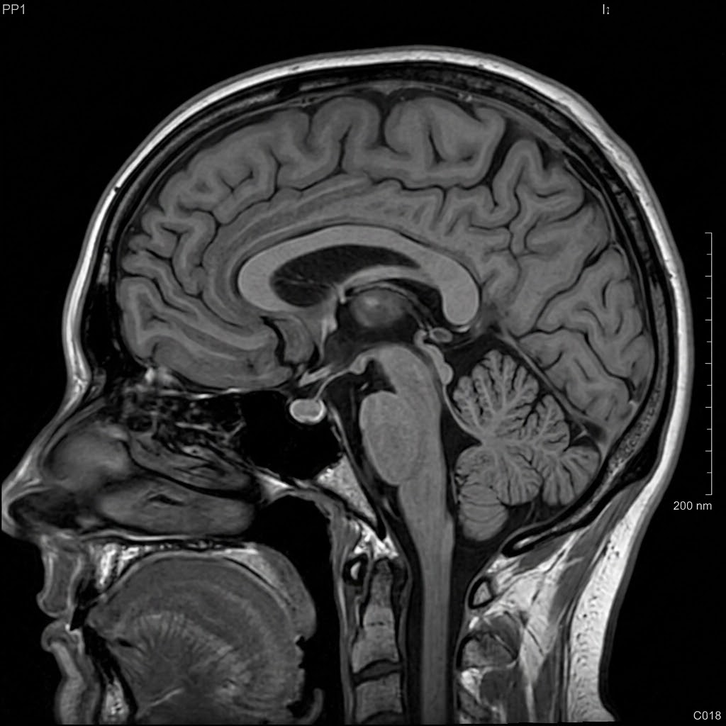
CNN Model Architecture
How the Network Learns Patterns from Brain MRI
CONV
POOL
CONV
POOL
DENSE
OUT
32 Filters
3x3 ReLU
Max Pool
2x2
64 Filters
3x3 ReLU
Max Pool
2x2
Flatten
2D to 1D
128 Neurons
ReLU
Softmax
Glioma, Menin, Pituitary, No
Input MRI
224x224x1
Conv2D (1)
222x222x32
MaxPool (1)
111x111x32
Conv2D (2)
109x109x64
MaxPool (2)
54x54x64
Flatten Layer
186,624 Val
Dense FC
128 Outputs
Prediction
4 Classes
Key Architecture Layers Explained
Why Choose Convolutional Networks?
🔍 Convolution Layer: Extracts highly specific spatial features like raw edges, detailed textures, and anatomical tumor patterns.
📉 Max Pooling Layer: Dynamically downsamples spatial dimensions, preserving crucial feature spikes while reducing GPU computation.
✔ Autonomous Feature Learning: Completely eliminates manually-engineered edge filters.
✔ Spatial Invariance: Successfully captures tumor characteristics regardless of raw location.
✔ Clinical SOTA Accuracy: The gold-standard neural architecture for radiology imaging tasks.
📋 Flatten Layer: Strategically unrolls 2D feature maps into a structured 1D tensor array ready for classification feed.
🎯 Softmax Output: Mathematically maps neural signals to clean, normalized probability distributions over the four tumor classes.
Department of Data Science & Artificial Intelligence
Presenter: Steve Emmanuel

Slide 6









Model Training & Learning Process
How the CNN learns to classify Brain MRI images through iterative optimization.
01
INPUT MRI
Training Configuration
Epochs
20
Batch Size
32
Optimizer
Adam
Loss Function
Sparse Categorical
Crossentropy
Evaluation Metric
Accuracy
🧠 Forward Propagation
Makes predictions using current network weights.
06
BETTER PRED
02
FORWARD PROP
📉 Loss Function
Measures categorical prediction error mathematically.
Continuous Triage Loop
Model iterates dynamically over epochs & batches to minimize errors.
🔄 Backpropagation
Calculates gradients to learn from past mistakes.
05
ADAM OPT
03
LOSS CALC
⚡ Adam Optimizer
Updates network weights dynamically & efficiently.
📈 Epoch Completion
One complete, optimized pass through the training dataset.
04
BACKPROP
Key Insight: The CNN gradually improves its performance by repeatedly learning from prediction errors. With every epoch, the model adjusts its internal parameters, resulting in more accurate tumor classification.
Department of Data Science & Artificial Intelligence
Presenter: Steve Emmanuel

Slide 7






Model Performance & Training Results
Evaluating how well the CNN learned to classify Brain MRI images.
🎯 Training Accuracy
100%
Excellent learning on dataset.
✅ Validation Accuracy
93.84%
Strong generalization on data.
📉 Validation Loss
0.3953
Low prediction error rate.
🧠 Model Status
Successfully Trained
Ready for deployment and clinical testing on unseen brain MRI scans.
📋 Key Observations
✔ Model Converged: Training stabilized efficiently within the scheduled 20 epochs.
✔ High Accuracy: Validation accuracy remained consistently above 93%.
✔ Minimal Loss: Validation loss stabilized at 0.3953 without significant spikes.
✔ No Overfitting: Tight gap between training and validation metrics indicates solid robustness.
Training Progress Across Epochs
2.0
1.5
1.0
0.5
0.0
100%
75%
50%
25%
0%
Epoch 1Epoch 5Epoch 10Epoch 15Epoch 20
Train Acc
Val Acc
Val Loss
Key Takeaway: The CNN successfully learned meaningful MRI features and achieved strong validation performance, demonstrating its exceptional ability to generalize and make highly accurate predictions on entirely unseen patient brain scans.
Department of Data Science & Artificial Intelligence | Global AI Summit
Presenter: Steve Emmanuel

Slide 8




Model Evaluation on Test Dataset
Measuring the CNN's performance on completely unseen Brain MRI images.
🎯 Test Accuracy
87.12%
Correct predictions on unseen MRI images.
📉 Test Loss
2.1771
Prediction error on the test dataset.
🧪 Evaluation Dataset
Unseen Test Images
Images never used during training.
🌍 Real-World Readiness
Promising Performance
Demonstrates the model's ability to generalize.
📋 Key Insights
TRAINING
100%
Baseline learning
VALIDATION
93.84%
Tuned target
TEST DATA
87.12%
Final evaluation
MARGIN
-6.72%
Val to Test drop
Generalization Verified: Model successfully classified unseen MRI images with high confidence.
Strong Foundation: Test accuracy demonstrates robust capability across clinical variants.
Medical PoC Status: Performance is highly suitable for a proof-of-concept medical AI system.
Optimization Path: Further improvements are possible using Transfer Learning, Data Augmentation, and Hyperparameter Tuning.
Performance Trend Analysis
The gradual decrease in accuracy from training to validation and test data is expected because each stage introduces more challenging and previously unseen images.
This delta reflects the model's true ability to generalize to new clinical scenarios rather than simply memorizing the training dataset. A test accuracy of 87.12% establishes a reliable diagnostic baseline.
Final Observation: Although the test accuracy is lower than training/validation scores, this gap is completely expected in real-world clinical machine learning. The results indicate that the CNN learned meaningful physiological patterns rather than relying on dataset-specific memorization.
Department of Data Science & Artificial Intelligence | Global AI Summit
Presenter: Steve Emmanuel

Slide 9






Model Evaluation: Confusion Matrix & Classification Report
Understanding where the CNN performs well and where it makes mistakes.
🟢 Best Performing Class: Pituitary
Exceptional diagnostic precision (0.94) and outstanding overall recall rate (0.92).
Confusion Matrix
Classification Report
G
M
PREDICTED CLASS
Class
Precision
Recall
F1-Score
N
P
🟢 Highest Recall: No Tumor
Outstanding Recall = 0.99. Practically every healthy control MRI scan was categorized perfectly.
289
52
49
10
G
Glioma
0.91
0.72
0.80
23
340
23
14
M
Meningioma
0.81
0.85
0.83
🟡 Most Challenging: Glioma
Recall drops to 0.72. Highly prone to cross-category confusion due to visually identical margin patterns.
ACTUAL CLASS
0
2
398
0
N
No Tumor
0.85
0.99
0.91
7
25
1
367
🔵 Diagnostic Matrix Value
Standard test accuracy simply provides a high-level summary. The multi-class confusion matrix uncovers the specific error pathways:
Pinpoints exact tumor-type crossovers.
Reveals false-negative diagnostic risks.
Guides post-training loss weighting.
P
Pituitary
0.94
0.92
0.93
Correct Class
Frequent Confusion
Continuous Optimization Loop
Evaluating classification parameters dynamically over cross-validated splits to reinforce robustness and identify fine-grained errors.
Key Insight: The network generalizes remarkably well on normal tissue and pituitary cases, while the Glioma-Meningioma boundary remains the primary bottleneck due to histological and structural overlays. This deep diagnostic granularity is crucial for clinical integration.
Department of Data Science & Artificial Intelligence | Clinical AI Evaluation
Presenter: Steve Emmanuel

Slide 10

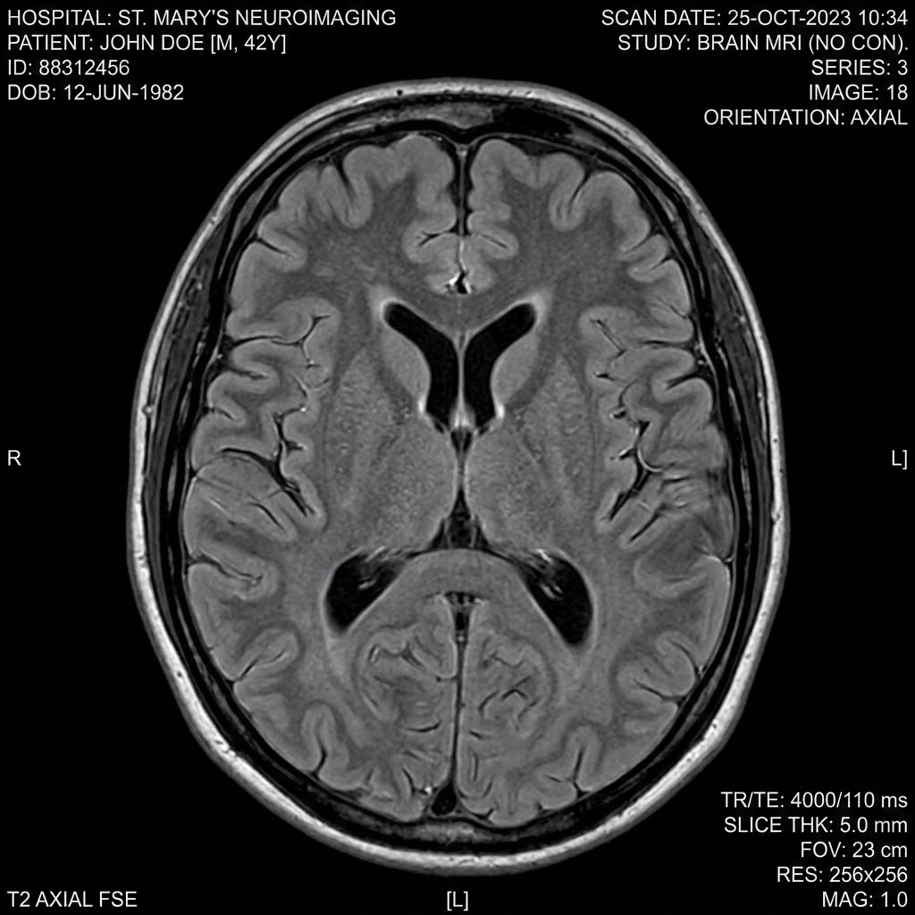
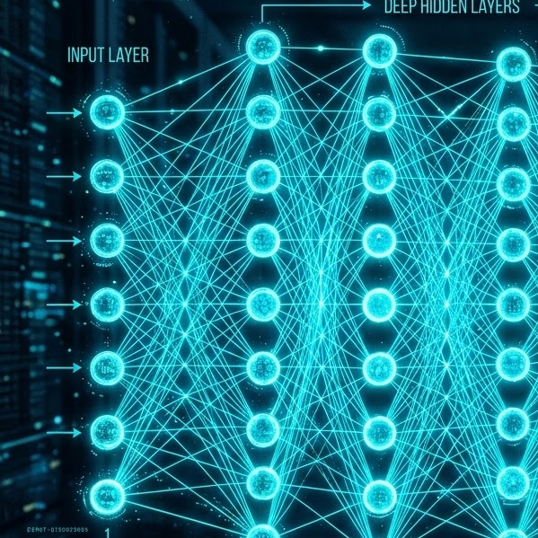
Real-Time Prediction Pipeline
How a new Brain MRI image is transformed into an AI prediction.
STEP 01
Upload MRI
STEP 02
Preprocessing
Raw MRI signals are standardized dynamically.
⚡ Real-Time Array
• Resize: 224×224
• Normalization [0,1]
STEP 03
Trained CNN
STEP 04
Softmax Output
Glioma0.3%
Meningioma0.5%
Pituitary0.2%
No Tumor99.0%
OUT
Diagnosis
No
Tumor
CONF
99%
NEW
Patient
Scan
Loaded
⚙ Inference Pipeline Execution
✔ Image Loaded — Completed in 12ms
✔ Converted to Array & Normalized — Preprocessed [0, 1]
✔ Expanded to Batch Dimension — Tensor shaped to [1, 224, 224, 3]
✔ Passed into CNN & Softmax Applied — Forward-pass completed
✔ Highest Probability Selected — Class: No Tumor (99% confidence)
🌍 Clinical Integration & Applications
🏥 Clinical Decision Support System
Provides automated secondary validation for clinical neuroradiologists.
⚕ Emergency Room Triage Assistance
Instantly flags anomalous scans to prioritize urgent radiologist reviews.
🤖 AI-based Healthcare Screening Platforms
Integrates directly into modern PACS networks for high-throughput screening.
Key Takeaway: The trained CNN can automatically analyze a previously unseen Brain MRI image and generate a prediction within seconds, making it a valuable AI-assisted diagnostic tool.
Department of Data Science & Artificial Intelligence | Real-Time Prediction Demonstration
Presenter: Steve Emmanuel

Slide 11



Challenges Faced & Solutions Implemented
Real-world debugging and improvements during model development.
⚠️ Challenge 1
Validation accuracy was too low, indicating that the model was not learning correctly.
01
Validation Accuracy at ~29%
The model struggled to learn features correctly during initial runs.
✔️ Pipeline Verified
Pre-execution validation tests were introduced to prevent corrupted frames from entering the training graph.
02
Preprocessing Pipeline Audit
Identified critical size and normalization errors in image handling.
🔍 Challenge 2
Image preprocessing was inconsistent because of an incorrect image size configuration.
✔️ Correct Dimensions
Locked image dimensions strictly to 224 × 224 pixels, eliminating spatial distortion errors.
03
Rebuilt TensorFlow Pipeline
Implemented strict 224x224 resizing and dynamic batching controls.
⚙️ Challenge 3
The TensorFlow data pipeline required rebuilding to ensure correct preprocessing before training.
04
Validation Accuracy: 93.84%
The CNN achieved solid stability, confirming successful optimization.
✔️ Performance Restored
Re-trained the CNN with the optimized pipeline, yielding immediate validation performance boosts.
💡 Key Engineering Learning
Building a reliable Deep Learning model is not just about writing code—it requires systematic debugging, rigorous preprocessing validation, empirical experimentation, and continuous pipeline optimization to translate theoretical model structures into dependable clinical results.
Department of Data Science & Artificial Intelligence | Clinical AI Evaluation
Presenter: Steve Emmanuel

Slide 12






Key Learnings
Technical knowledge and practical experience gained throughout this Deep Learning project.
📊 1. Data Understanding
• Dataset exploration
• Image classification
• Medical imaging basics
📈 5. Model Evaluation
• Accuracy & Loss curves
• Confusion matrix
• Classification report
🖼️ 2. Preprocessing
• Size: 224x224 resize
• Normalization [0,1]
• TensorFlow pipeline
🧠 DL Project
Core Mastery
⚙️ 4. Model Training
• Epochs & Batches
• Forward & Backprop
• Adam optimizer
🧠 3. CNN Architecture
• Convolution & Pooling
• Flatten & Dense layers
• Softmax activation
🎯 Project Outcome
This project provided hands-on experience in building an end-to-end Deep Learning solution—from understanding medical imaging data to developing, evaluating, debugging, and deploying a CNN-based classification pipeline.
Department of Data Science & Artificial Intelligence | Clinical AI Evaluation
Presenter: Steve Emmanuel

Slide 13





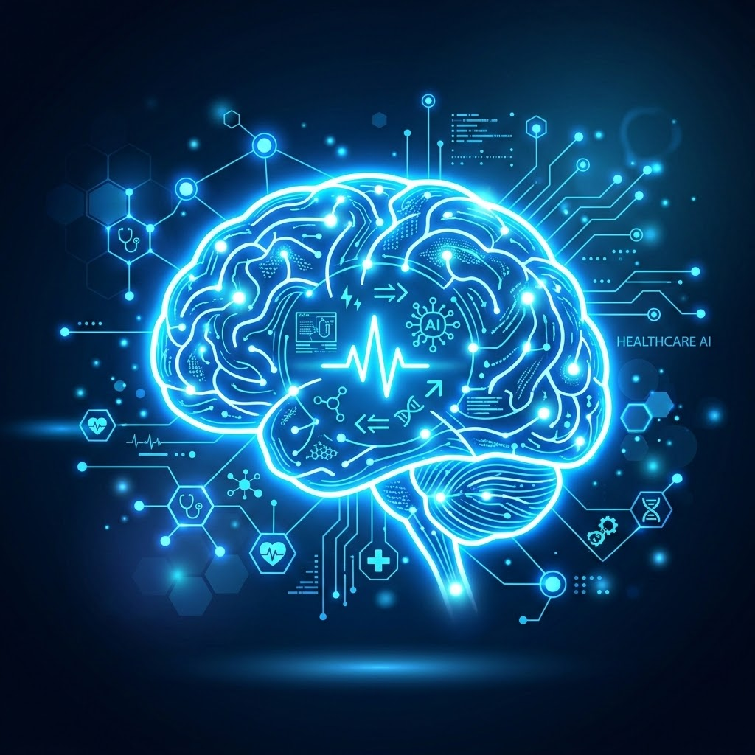


Real-World Applications & Project Impact
Exploring how AI-powered brain MRI classification can support modern healthcare.
🏥 Hospital Decision Support
Assist radiologists by providing a preliminary MRI classification to speed up diagnosis.
📚 Medical Education 🎓
Help students and trainee radiologists learn different brain tumor categories using AI examples.
⚕ Medical Imaging Centers
Automate the initial screening of large volumes of MRI scans.
🔬 Medical Research 🧪
Support researchers by analyzing large MRI datasets more efficiently for clinical cohort validation.
CNN Brain AI
Diagnostic Engine
🌍 Rural Healthcare Support
Support hospitals in remote areas where specialist radiologists may not always be available.
💻 AI Healthcare Platforms 🌐
Integrate with hospital software and PACS diagnostic systems to provide automated analysis.
⚡ Premium Clinical Impact & Benefits
Faster MRI analysis & immediate processing
Consistent preliminary clinical screening
Reduced manual workload for diagnostic staff
Improved overall healthcare clinical efficiency
Empowered AI-assisted decision making loops
⚠️ Important Diagnostic Note
This deep learning model is designed to assist healthcare professionals as a secondary support system, not to replace human experts.
Final diagnosis and clinical validation should always be made exclusively by qualified radiologists and medical experts.
Project Vision: Artificial Intelligence has the potential to transform medical imaging by improving speed, consistency, and accessibility while supporting healthcare professionals in making informed, high-confidence clinical decisions.

Slide 14




End-to-End Project Workflow
Complete journey from Brain MRI image to AI-powered prediction.
STEP 02
📂 Dataset
Brain MRI Dataset for high confidence training and testing images.
STEP 03
⚙️ Preprocessing
Resize (224×224), dynamic normalization, shuffle, prefetch.
STEP 04
🧠 CNN Model
Conv2D layers, MaxPooling, Flatten, Dense with Softmax.
STEP 08
🏥 Impact
AI-assisted diagnosis, clinical decision support, future clinical deployment.
STEP 01
🩺 Problem ID
Need for faster and more accurate brain tumor classification.
STEP 05
🏋️ Model Training
20 Epochs, Adam Optimizer, Sparse Categorical Crossentropy.
STEP 06
📊 Evaluation
Accuracy & Loss curves, Confusion Matrix, Classification Report.
STEP 07
🔍 Prediction
Real-time pipeline: Upload MRI → CNN Analysis → Final Diagnosis.
🎯 Project Outcome Summary
Successfully developed an end-to-end Deep Learning system capable of classifying Brain MRI images into four categories using a Convolutional Neural Network. The project covers the complete AI lifecycle from data preparation and model development to evaluation and prediction.
Department of Data Science & Artificial Intelligence | End-to-End AI Workflow
Presenter: Steve Emmanuel

Slide 15



Project Achievements & Conclusion
A successful end-to-end Deep Learning solution for Brain MRI Classification.
🎯 Project Goal
Develop an AI-powered Convolutional Neural Network capable of automatically classifying Brain MRI images into four categories.
Target Classes:
✓ Glioma Tumor
✓ Meningioma Tumor
✓ Pituitary Tumor
✓ No Tumor (Healthy)
🎓 Training Accuracy
100%
✅ Validation Accuracy
93.84%
🏆 Major Achievements
✓End-to-End DL Pipeline
✓Medical Image Classification
✓CNN Architecture Development
✓TensorFlow & Keras Engine
✓Multi-Metric Model Evaluation
✓Real-Time MRI Prediction
✓Performance Optimization
🎯 Test Accuracy
87.12%
🧠 AI Data Pipeline
Successfully Developed
💡 Final Conclusion
This project demonstrates how Deep Learning can effectively classify Brain MRI images and support healthcare professionals through faster, more consistent, and AI-assisted decision-making.
⚠️ Clinical Warning: This system is engineered as secondary clinical support to assist qualified radiologists and specialists, not to replace vital human diagnostic expertise.
Department of Data Science & Artificial Intelligence | Clinical AI Evaluation
Presenter: Steve Emmanuel

Slide 16




Technology Stack & References
Tools, frameworks, libraries and resources used to build the Deep Learning solution.
Development Environment
💻 Google Colab
Interactive, cloud-based GPU accelerated development space.
🐍 Python
Primary programming language for AI architecture & workflows.
📝 Jupyter Notebooks
Prototype execution, visualization, and validation framework.
TensorFlow
Used for building and training the CNN model with GPU hardware acceleration.
Keras
High-level API used for designing and assembling neural network layers smoothly.
Dataset & Learning Resources
📂 Dataset & Open Source Sources
Brain Tumor MRI Dataset: Sourced from Kaggle for medical imaging analytics.
📚 Framework Documentation
TensorFlow official ecosystem setup guides
Keras API reference for deep neural network designs
Scikit-Learn model analysis tools
📖 Core Concepts Implemented
Convolutional Neural Networks & medical image processing
Advanced model evaluations, parameter tuning, metric diagnostics
NumPy
Provides advanced numerical computations, matrix structures, and linear algebra math.
Matplotlib
Used for dynamic data visualization and plotting training performance curves.
Scikit-Learn
Generates robust metric matrices like Confusion Matrix and Classification Reports.
Google Colab
Provides immediate cloud notebook resources and dedicated virtual environment runtimes.
⚡ Engineering Summary
This project was developed using open-source Deep Learning frameworks and industry-standard Python libraries, ensuring reproducibility, scalability, and practical applicability.
Department of Data Science & Artificial Intelligence | Tech Stack & Reference Guide
Presenter: Steve Emmanuel

Slide 17




Thank You
Presented By
Steve Emmanuel
Deep Learning Project: Brain Tumor Detection using CNN
Technologies
Python • TensorFlow • Keras • Google Colab
Developed using industry-standard open source frameworks
Department of Data Science & Artificial Intelligence
Artificial Intelligence for Better Healthcare

