Slide 1
DELOITTE AUSTRALIA
Internship Presentation
Data Analytics Job Simulation
Aman kumar Cloud Computing Roll No. CS-2341531

Slide 2




About the Job Simulation
Deloitte Australia – Forensic & Data Analytics
A self-paced, risk-free way to experience real work at Deloitte — built around example tasks from the forensic and data analytics team, with no live sessions and no formal grading.
What You Earn
Certificate
Completion certificate for resume & LinkedIn
1–2
2
0
Hours
self-paced
Guided
tasks
Grades or
assessments
Resume Snippet
A ready summary of skills demonstrated
Two guided tasks formed the core of the simulation: Data Analysis using Tableau, and Forensic Technology using Excel.
Interview Tips
Guidance to speak confidently about it
Skills
Data analysis, modelling, visualisation, spreadsheets
Deloitte Australia – Data Analytics Job Simulation
2

Slide 3
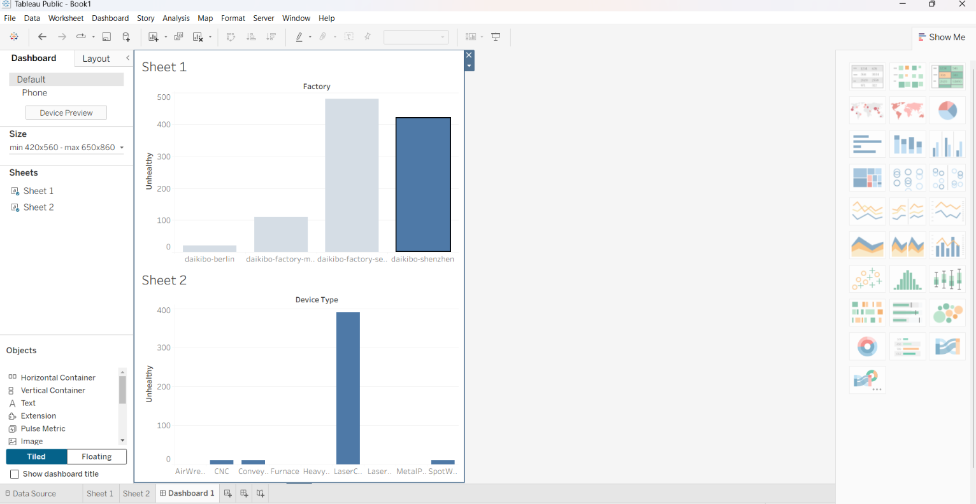
Task 1 — Data Analysis
Building a Tableau dashboard from IoT telemetry data
The Brief
Daikibo Robotics needed a way to explore telemetry from IoT sensors across its factories. The goal: learn Tableau, and build a dashboard that surfaces where equipment health issues are concentrated.
The Dataset
160,000+ device telemetry records
4 factories: Berlin, Meiyo, Sendai, Shenzhen
8 device types — CNC, laser cutters, presses, etc.
Fields: status, temperature, location, timestamp
Two-part dashboard: “unhealthy” device counts by factory, and by device type — Shenzhen and Sendai stood out, with laser cutters flagged most often.
Deloitte Australia – Data Analytics Job Simulation
3

Slide 4


Task 2 — Forensic Technology
Investigating unfair pay with Excel classification
A forensic technology team needed help drawing conclusions from payroll data at Daikibo Factory Meiyo. Each job role carried a calculated “equality score” — my task was to add a column classifying every role into an equality class.
Sample — Equality Classification
Job Role
Score
Class
C-Level
-25
Highly Discriminative
VP
-26
Highly Discriminative
From spreadsheet to conclusion
Director
-19
Unfair
Roles with strongly negative scores at senior levels (C-Level, VP, Director) were classified “Highly Discriminative” or “Unfair”; roles near a neutral score were classified “Fair” — turning raw numbers into a client-ready finding.
Sr. Manager
-15
Unfair
Manager
-14
Unfair
Sr. Engineer
-5
Fair
Deloitte Australia – Data Analytics Job Simulation
4

Slide 5

Reflections & Learnings
This simulation gave me a hands-on introduction to how data analytics and forensic technology work in a real professional-services setting, rather than just reading about it.
Data Visualisation
Spreadsheet & Classification
Analytical Thinking
Learned to turn 160K+ raw records into a clear Tableau dashboard that shows where problems are concentrated.
Built classification logic in Excel to convert numeric scores into defensible, client-ready conclusions.
Practised spotting anomalies and outliers in data — a skill that carries over well from cybersecurity coursework.
Deloitte Australia – Data Analytics Job Simulation
5

Slide 6

Conclusion
The Deloitte Australia Data Analytics Job Simulation was a short but effective way to experience the kind of work performed by forensic and analytics professionals — strengthening practical skills in data analysis, visualisation, and spreadsheet-based problem solving, and giving me a clearer picture of a career path in this field.
Aman kumar
Cloud Computing
Roll No. CS-2341531
Deloitte Australia
Data Analytics Job Simulation
August 2026
Certified in:
Data Analysis • Forensic Technology
Thank you

