Slide 1



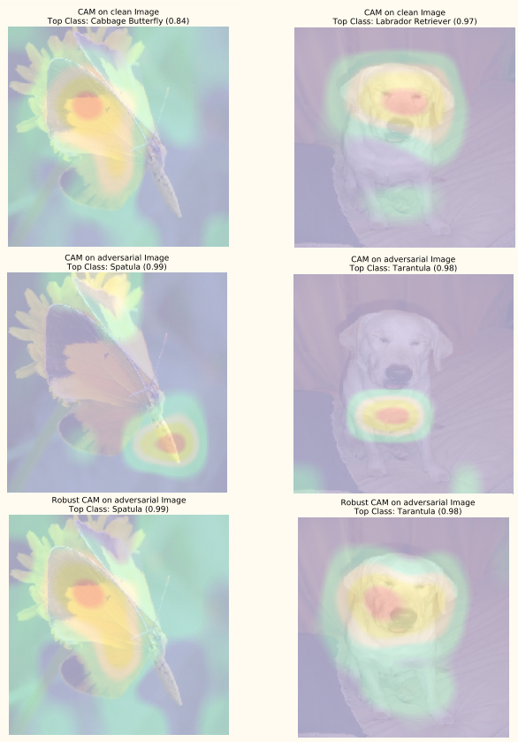
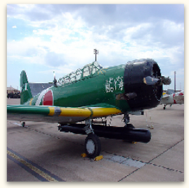
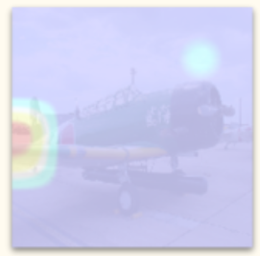
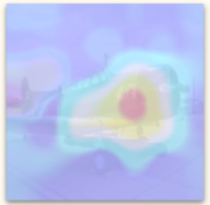
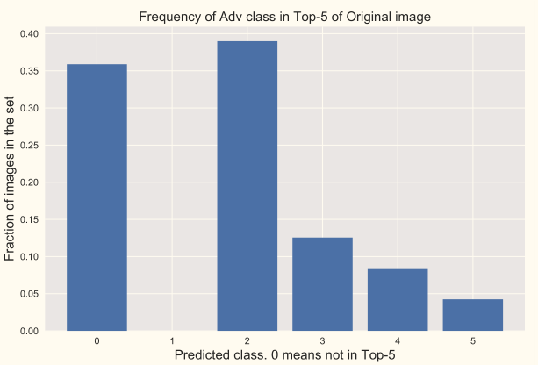

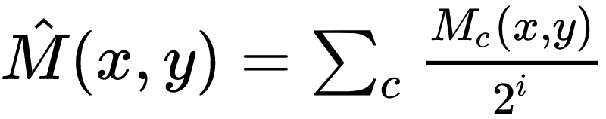
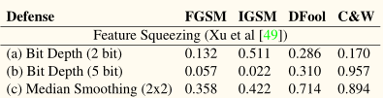
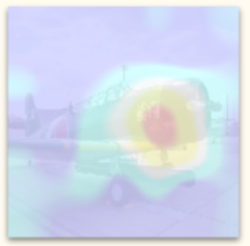
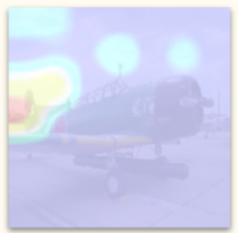
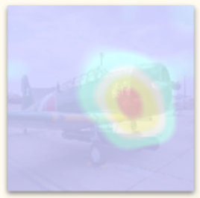
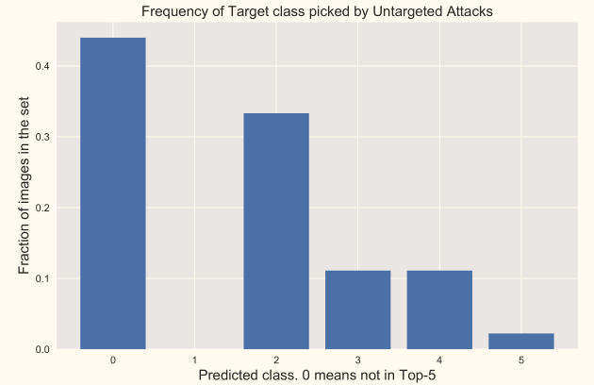
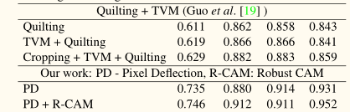
Robust Discriminative Localization Maps A. Prakash, N. Moran, S. Garber, A. DiLillo & J. Storer
aprakash@brandeis.edu, iamaaditya.github.io
github.com/iamaaditya/robust-activation-maps
+
=
Class Activation Maps
Adversarial Systems
Bad ! Bad !! FAKE Activation Maps !!
Visual Question Answering | Image Classification | Image Compression | Image Retrieval | Guided Attention | Adversarial Defense
[Zhou, 2015] | [Zhou, 2016] | [Prakash, 2017] | [Jimenez, 2017] | [Li, 2018] | [Prakash, 2018]
CAM(Clean)
CAM(Advr)
RDM(Advr)
Freq of Advr class in Top-5 of Original Image
Class Activation Map
Image
Meatloaf [99%]
Meatloaf [99%]
CAM(Clean
Robust Discriminative Map
CAM(Advr)
Warplane [91%]
Flatworm [99%]
Flatworm [99%]
Freq of Target class picked by Untargeted Attack
RDM(Advr)

