Slide 1

Mini Project on Classification of Resumes
By-
Aamir Ansari (21/10/JC/017)
Salman Khurshid (21/10/JC/027

Slide 2
Table of Contents
Introduction
Library Used
Dataset Used
Workflow
K Nearest Neighbour
Tf-Idf
Model Building
One Vs Rest

Slide 3
Introduction
Classification of Resume is a type of resume scanning software used by recruiters and employers during the hiring process to collect, sort, scan, and rank the job applications they receive for their open positions.
Today, approximately 99 percent of Fortune 500 companies rely on these software to help streamline their recruitment process.

Slide 4
Libraries Used
Matplotlib
Matplotlib is an open-source drawing library that supports various drawing types
You can generate plots, histograms, bar charts, and other types of charts with just a few lines of code
Pandas
It offers data structures and operations for manipulating numerical tables and time series.
Sklearn
The sklearn library contains a lot of efficient tools for machine learning and statistical modeling including classification, regression, clustering and dimensionality reduction.
Tkinter
GUI
RE
Regular Expression is used for pattern searching and pattern matching.

Slide 5
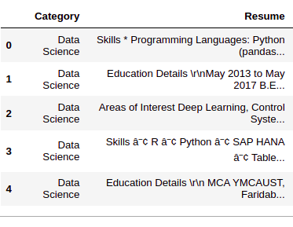
Dataset Used
Dataset
Source: https://www.kaggle.com/gauravduttakiit/resume-dataset
Total Data points=962
80% Data is used for training the model.
20% Data is used for validation of the model.
2 column : Category + Resume

Slide 6
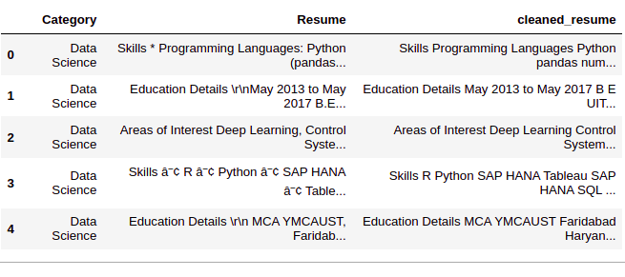
Workflow
Data Preprocessing
Step 1: Clean the ‘Resume’ column
In this step, we remove any unnecessary information from resumes like URLs, hashtags, and special characters.

Slide 7
Step 2: Encoding ‘Category’
We will encode the ‘Category’ column using LabelEncoding.
The ‘Category’ column is our ‘target’ column.
By performing LabelEncoding each category will become a class and we will be building a multiclass classification model.
Step 3: Preprocessing ‘cleaned_resume’ column
Here we will preprocess and convert the ‘cleaned_resume’ column into vectors.
We will be using the ‘Tf-Idf’ method to get the vectors in this approach.

Slide 8

TF-IDF
TF-IDF stands for Term Frequency Inverse Document Frequency.
Term frequency works by looking at the frequency of a particular term you are concerned with relative to the document.
$Term Frequency = \frac{Number of repetition of particular word in sentence}{Total number of words in a sentence}$
Inverse document frequency looks at how common (or uncommon) a word is amongst the corpus.
$IDF = \log{(\frac{Number of repetition of words in sentence}{Number of Sentences containing words}})$
$TF ∗ IDF$will give us the vectors of features of Resumes.

Slide 9
Model Building
We will be using the ‘One vs Rest’ method with ‘KNeighborsClassifier’ to build this multiclass classification model.

Slide 10
One Vs Rest
Also known as one-vs-all, this strategy consists in fitting one classifier per class.
For each classifier, the class is fitted against all the other classes.
In multi-class classification, there are more than two classes. For example, given a set of attributes of fruit, like it’s shape and color, a multi-class classification task would be to determine the type of fruit.
Algorithm used is K Nearest Neighbour (KNN).

Slide 11
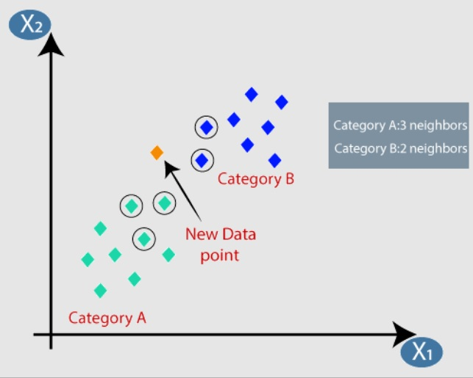
K Nearest Neighbour
K-Nearest Neighbour is one of the simplest Machine Learning algorithms based on Supervised Learning technique.
K-NN algorithm assumes the similarity between the new case/data and available cases and put the new case into the category that is most similar to the available categories.
K-NN algorithm stores all the available data and classifies a new data point based on the similarity. This means when new data appears then it can be easily classified into a well suite category by using K- NN algorithm.
The optimal K value usually found is the square root of N, where N is the total number of samples.

Slide 12
THANK YOU NOW, LET'S MOVE ONTO PROJECT

