Slide 1

SESSION 2025-2026
Smart Garbage Detection System
PRESENTED BY :
1.Abhinav Srivastava (2501921530013)
2.Abhinav Singh (2501921530012)
3.Abhishek Maurya (2501921530018)
4.Abhishek Kumar Gupta (2501921530016)
UNDER SUPERVISION OF :
Dr. Santosh Srivastava

Slide 2
INDEX
No. | Topic | Pg.
01 | Introduction | 03
02 | Motivation | 04
03 | Literature Survey | 05
04 | Problem Formulation | 06
05 | Objectives | 07
06 | Existing System / Related Work | 08
07 | Methodology | 09
08 | Requirement Analysis – Hardware | 10
09 | Requirement Analysis – Software | 11
10 | Description of Project | 12
11 | Project Details (Modules) | 13
12 | Implementation | 14
13 | Conclusion & Scope of Project | 15
14 | References | 16

Slide 3
INTRODUCTION
➢ The Challenge: Overflowing dustbins and roadside litter are persistent campus hygiene hazards. Manual inspection rounds are slow, labour-intensive, and reactive, while commercial IoT sensors are costly to install and maintain at scale.
➢ Edge AI Approach: Repurposes an idle, fully functional smart device as an AI-enabled IP camera streaming live video over Wi-Fi—achieving zero dedicated sensor hardware cost.
➢ Dual-ROI Vision Pipeline: Deploys YOLOv8 computer vision to simultaneously estimate bin fill percentage (%) and detect floor litter overflow in real time using dedicated regions of interest.
➢ Automated Alerting: Dispatches instant annotated email alerts with snapshot evidence and cooldown controls to sanitation staff upon threshold breach, configured via a no-code calibration tool.

Slide 4
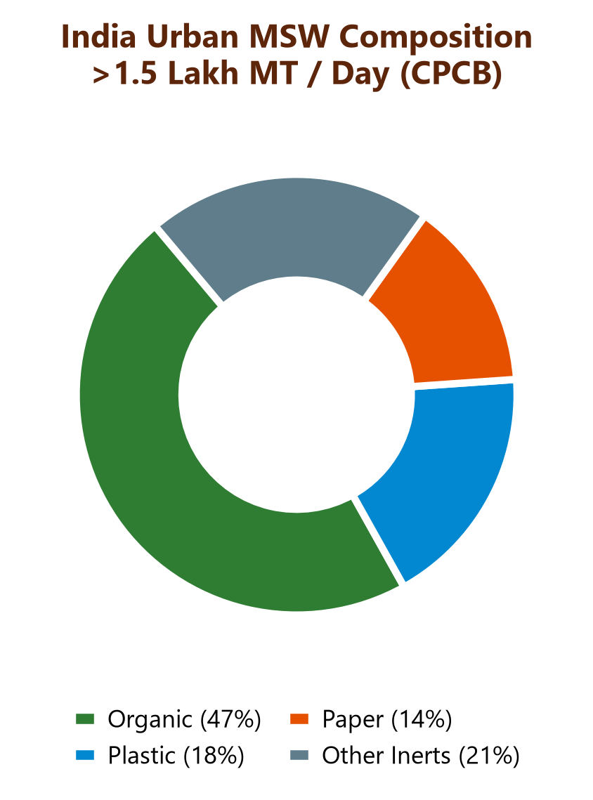
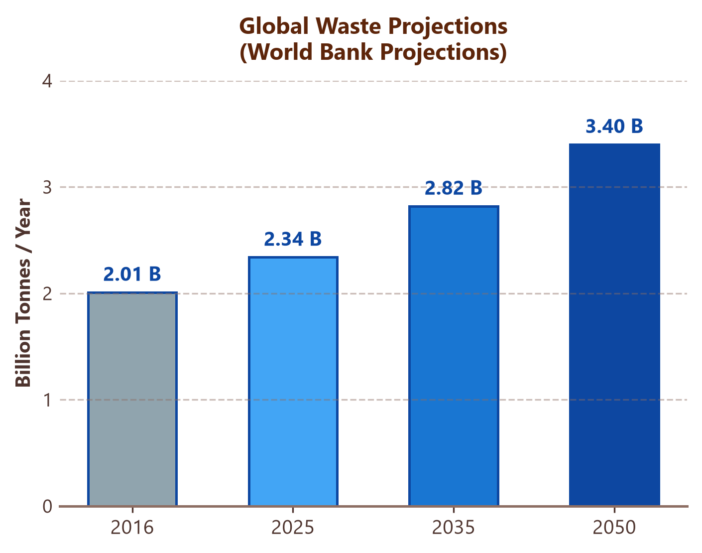
MOTIVATION
❑ Critical Waste Volume: Indian cities generate >1.5 Lakh MT of solid waste daily (CPCB); global waste is projected to reach 3.4 Billion tonnes/year by 2050 (World Bank, +70% rise).
❑ Prohibitive Hardware Costs: Commercial IoT smart bins require dedicated ultrasonic/optical sensors and recurring battery maintenance per bin, making large-scale municipal deployment unviable.
❑ Reactive Waste Clearing: Disposal behaviour is inherently reactive: bins are rarely serviced until overflow spills onto floors, creating avoidable campus health and hygiene hazards.
❑ Data-Driven Response: Real-time automated alerts with annotated snapshot proof trigger immediate, targeted caretaker action—replacing blind manual rounds with demand-based servicing.

Slide 5
LITERATURE SURVEY
S.No | Source | Year | Content
1 | Scientific Reports | 2025 | Real-time garbage monitoring using YOLOv8 & YOLOv5 — two-stage lightweight models classify bin fill status and flag litter outside containers; assumes continuous power.
2 | ScienceDirect (Egyptian J. Remote Sensing) | 2025 | Dynamic-perception YOLO variant for bin detection (DDCN-YOLO) — enhanced architecture improves detection accuracy in cluttered, occluded real-world scenes.
3 | Artificial Intelligence Review | 2024 | A survey of smart dustbin systems using IoT and deep learning — confirms most systems demand constant maintenance, making municipal-scale rollout costly.
4 | Electronics (Springer-indexed) | 2023 | Garbage detection using an advanced YOLO algorithm (YOLOv5-OCDS) — fuses camera, ultrasonic sensor, GPS and LoRa on Raspberry Pi; higher hardware complexity.

Slide 6
PROBLEM FORMULATION
❖ High Cost & Poor Scalability: Dedicated smart-bin hardware (ultrasonic/IR/LoRa) incurs high unit installation and recurring battery maintenance costs, preventing affordable scaling.
❖ Unmonitored Dual Failures: Manual inspection rounds are slow and inconsistent; furthermore, bin overflow and surrounding ground litter are co-dependent failure modes rarely tracked together.
❖ Unified Dual-Area Monitoring: How to continuously and autonomously track both the dustbin fill level (%) and the cleanliness of its surrounding floor zone using only a repurposed smartphone camera and open-source computer vision (YOLOv8).
❖ Real-Time Automated Alerting: How to reliably detect threshold breaches and dispatch rich, annotated visual alerts to caretakers in real time—with zero specialized per-bin sensor hardware.

Slide 7
OBJECTIVES
1
Develop an AI-enabled monitoring system that uses an existing device as an IP camera for real-time video surveillance.
2
Estimate dustbin fill level (%) in real time and detect litter overflow on the surrounding floor area using YOLOv8 object detection on the bin's interior region.
3
Automatically notify the admin/caretaker via a rich email with an annotated snapshot when a threshold is crossed.

Slide 8
EXISTING SYSTEM/RELATED WORK
1
2
3
4
Ultrasonic / IR bin sensors
IoT smart-bin nodes
CCTV-based manual monitoring
Citizen complaint apps
Dedicated sensor mounted inside each bin measures fill level.
Needs per-bin wiring, batteries and maintenance.
Microcontroller (ESP32/Arduino) + sensors + cloud dashboard.
Accurate but costly to scale across many bins.
Staff watch live camera feeds to spot overflow.
Slow, labour-intensive and error-prone, not real time.
Reactive systems that depend on people reporting issues after they occur.
Like Municipal Corporation Complaint System.
The Gap: Most existing solutions need dedicated sensors or manual watching per bin — none combine a repurposed smartphone camera with AI for a zero-hardware-cost, automated alert system.

Slide 9
METHODOLOGY
1
Configure an existing camera-enabled device to provide a real-time video stream over a local Wi-Fi network using HTTP/RTSP, which is then processed by the Python AI engine.
2
Run YOLOv8 detection on the bin-interior ROI and estimate percentage fill from detected object coverage within it, in real time.
3
Define a second ROI over the surrounding floor and apply the same detector to flag objects outside the bin as litter or overflow.
4
On threshold breach, capture an annotated snapshot and dispatch a formatted HTML email to the admin/caretaker via SMTP.
5
Apply a time-based cooldown after each alert to prevent inbox flooding, plus periodic status summaries regardless of threshold state.
6
Offer a standalone calibration script where a user marks ROI corners on a captured frame by dragging — no manual coordinate entry.

Slide 10
REQUIREMENT ANALYSIS
H
HARDWARE
A camera enabled device — acts as the IP camera
Local Wi-Fi router for streaming video over the network
PC or laptop to run the Python AI engine (GPU optional, speeds up YOLOv8 inference)

Slide 11
REQUIREMENT ANALYSIS
S
SOFTWARE
Python 3.x runtime environment
IP Webcam — streams HTTP/RTSP video from the phone
Ultralytics YOLOv8 — real-time object detection model
OpenCV — video capture, frame processing, ROI & drawing
SMTP email (Gmail App Password / Outlook / Yahoo) for alerts
Supporting libraries: python-dotenv, numpy, pillow

Slide 12
DESCRIPTION
IP WEBCAM
PYTHON AI ENGINE
(WI-FI HTTP/RTSP STREAM)
DUAL ROI PROCESSOR
BIN INTERIOR ROI
FILL LEVEL ESTIMATION %
FLOOR ROI
LITTER & OVERFLOW DETECTION
SMART ALERTING & COOLDOWN ENGINE
REAL-TIME VISUAL HUD / ON-SCREEN DISPLAY
SMTP EMAIL WITH ANNOTATED IMAGE ➜ ADMIN INBOX

Slide 13
PROJECT DETAILS (Description Of Various Modules)
1
CORE MODULES
2
3
4
main.py
Main application loop — resilient stream reconnection, HUD overlay, periodic status dispatch & instant alert triggers.
detector.py
YOLOv8 inference wrapper; filters garbage/waste classes (COCO or custom Roboflow model) and flags overflow/littering.
roi_manager.py
Handles Bin ROI & Floor ROI coordinate math, intersection with detected boxes, and fill-percentage estimation.
email_notifier.py
Formats HTML/plain-text alert emails with fill %, floor status, object counts, annotated image and cooldown control.
5
CONFIG FILES
6
7
8
calibrate_roi.py
Standalone tool to capture a test frame and interactively mark ROI boundaries by dragging.
config.json / .env
Stream URL, ROI coordinates, thresholds, email settings and secure SMTP credentials.
test_mock_stream.py
Synthetic/demo frames to validate the pipeline end-to-end before the physical phone is set up.
README.md
Setup guide: IP Webcam configuration, Gmail App Password, and custom dataset training steps.

Slide 14
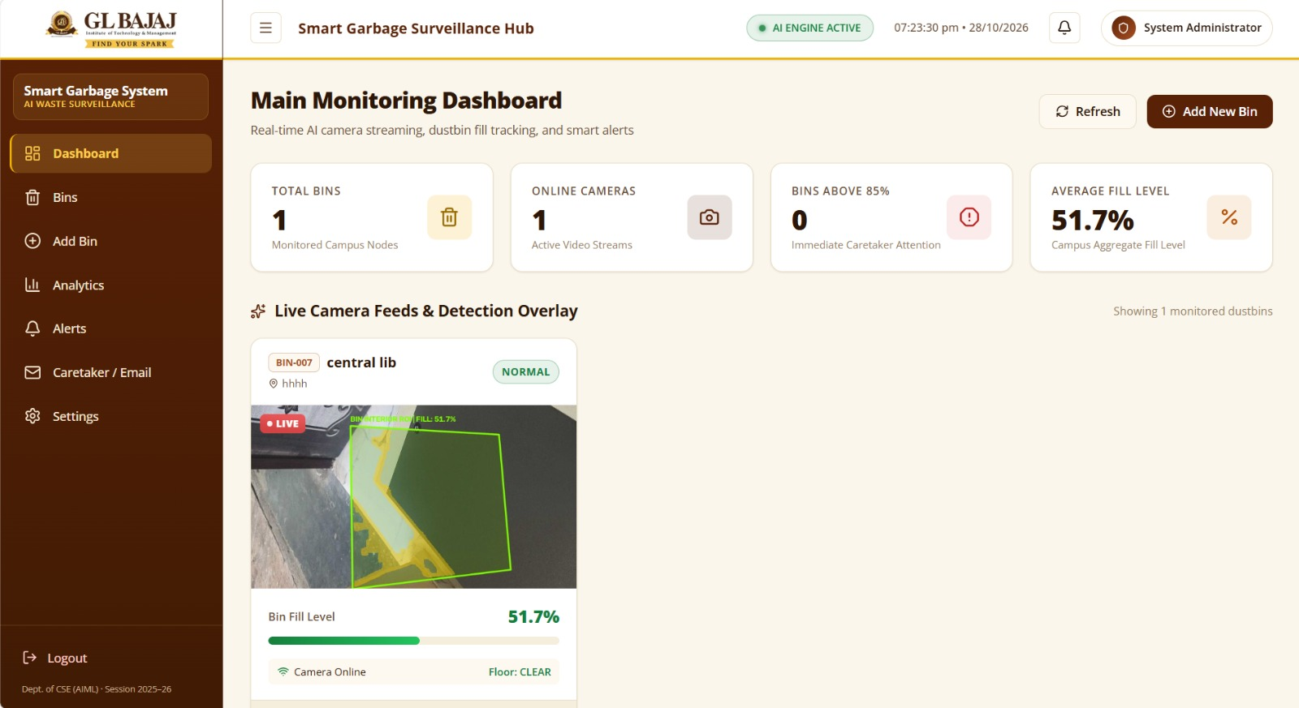
IMPLEMENTATION

Slide 15
CONCLUSION & SCOPE OF PROJECT
CONCLUSION
FUTURE SCOPE
This project successfully uses a camera and open-source AI (YOLOv8) to build a fully automated, garbage monitoring and alerting system — reducing dependence on manual inspection and enabling a much faster cleanup response for both bin overflow and surrounding litter.
Custom-trained, garbage-specific YOLO model (Roboflow dataset) for higher accuracy than generic COCO classes
Multi-bin / multi-camera support with a centralised web dashboard
SMS / WhatsApp alerts alongside email notifications
Cloud deployment for remote monitoring across multiple sites
Solar-powered phone mount for reliable outdoor deployment
Historical analytics and fill-level trend prediction

Slide 16
REFERENCES
[1]
M. M. Abo-Zahhad and M. Abo-Zahhad, “Real time intelligent garbage monitoring and efficient collection using YOLOv8 and YOLOv5 deep learning models for environmental sustainability,” Scientific Reports, vol. 15, art. 16024, May 2025.
[2]
Q. Sun, X. Zhang, Y. Li, and J. Wang, “YOLOv5-OCDS: An improved garbage detection model based on YOLOv5,” Electronics, vol. 12, no. 16, p. 3403, 2023.
[3]
M. P. Arthur, S. Shoba, and A. Pandey, “A survey of smart dustbin systems using the IoT and deep learning,” Artificial Intelligence Review, vol. 57, no. 3, 2024.
[4]
D. Voskergian and I. Ishaq, “Smart e-waste management system utilizing Internet of Things and Deep Learning approaches,” Journal of Smart Cities and Society, vol. 2, no. 2, pp. 77–98, 2023.
[5]
S. Dong, W. Xu, H. Zhang, and L. Gong, “Cot-DCN-YOLO: Self-attention-enhancing YOLOv8s for detecting garbage bins in urban street view images,” Egyptian J. Remote Sensing and Space Science, vol. 28, no. 1, 2025.
[6]
G. Jocher, A. Chaurasia, and J. Qiu, Ultralytics YOLOv8 Documentation. [Online]. Available: https://docs.ultralytics.com
[7]
G. Bradski, “The OpenCV Library,” Dr. Dobb’s Journal of Software Tools, 2000.
[8]
J. Redmon and A. Farhadi, “YOLOv3: An incremental improvement,” arXiv preprint arXiv:1804.02767, 2018.
[9]
IP Webcam, Android application for HTTP/RTSP video streaming. [Online]. Available: Google Play Store.
[10]
Python Software Foundation, Python 3 Documentation. [Online]. Available: https://docs.python.org/3/

Slide 17
Thank You

