Slide 1


IoT-Based Air Quality Monitoring System
Introducing a smarter way to breathe cleaner air using IoT technology.
Presented by the team from Chandigarh University, May 2023.

Slide 2


Team
Team Members
Abhishek Mishra Ritik Rana Supriya Kumari Arnav Kumar

Slide 3

Abstract and Team
Abstract
Address urban air pollution with real-time, affordable IoT monitoring.
Provides hyperlocal data access for public and authorities.

Slide 4
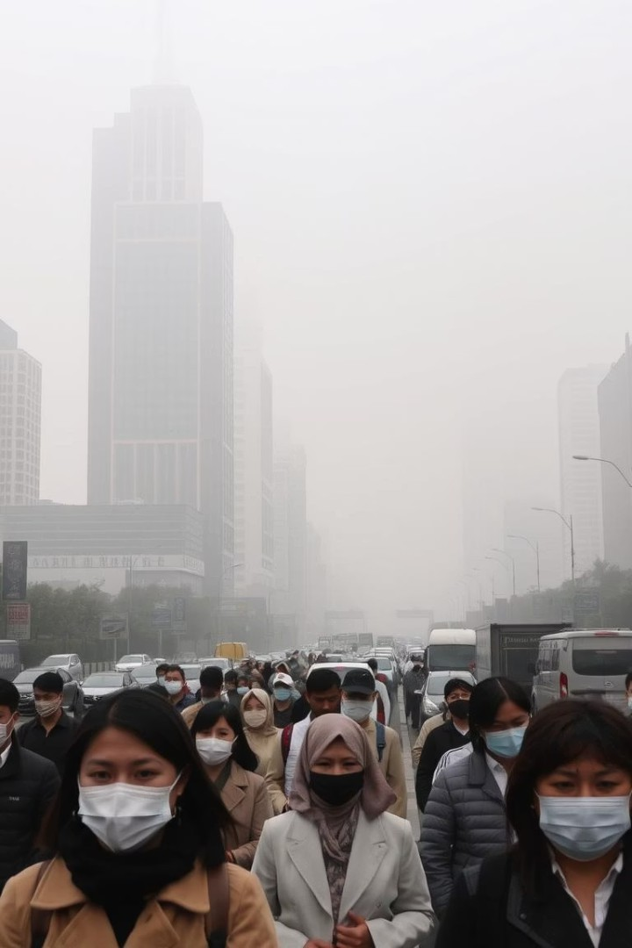
Problem Identification
Key Issues
High pollution levels in urban areas
Traditional systems cost over $150,000 per station Lack of real-time, hyperlocal public access
Need for community-centric solutions

Slide 5
Global and Indian Air Quality Context
Global Context
7 million deaths yearly due to air pollution (WHO) WHO and UNEP urge for low-cost monitoring solutions
Indian Context
Delhi and Mumbai frequently exceed AQI safety limits Crop burning and dust storms intensify pollution

Slide 6


Need for IoT-Based
IoT Advantages
Enables dense sensor deployment
Traditional Limitations
Sparse monitoring stations
High setup and maintenance costs
1
Delivers real-time, continuous data
2
Public access through mobile apps

Slide 7
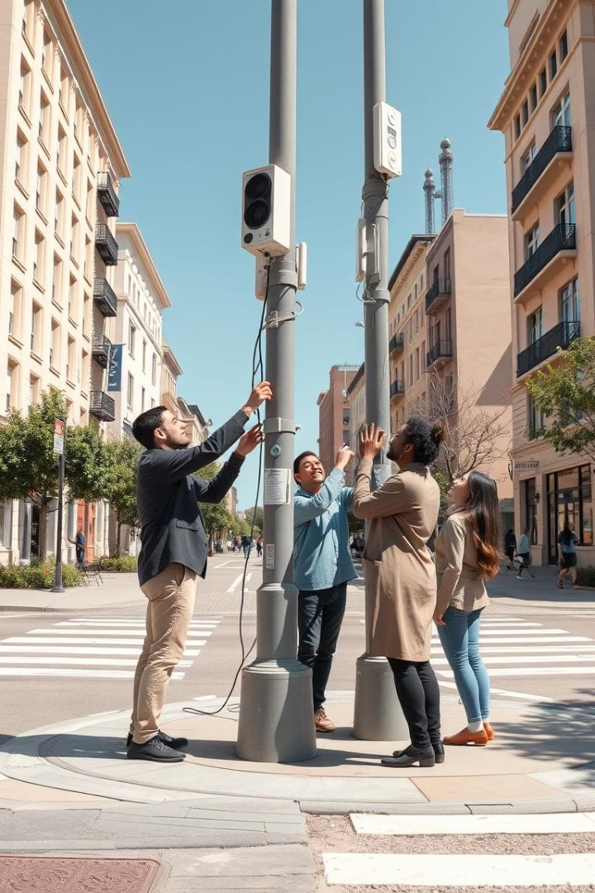

Project Goals and Objectives
Democratize Data
Make air quality info accessible to all citizens.
Strengthen Resilience
Build smarter cities responsive to pollution changes.
Foster Responsibility
Encourage environmental stewardship and awareness.
Key Actions
Design sensors Deploy system Analyze data Educate public

Slide 8

Historical and Current Context
1
1952 London Smog
Major air pollution crisis causing thousands of deaths.
2
1970 US Clean Air Act
Landmark legislation to regulate air pollutants.
3
2024 UNEP Call
Global push for citizen sensor deployment in monitoring.
4
Current Trends
IoT, machine learning, and citizen engagement drive progress.

Slide 9
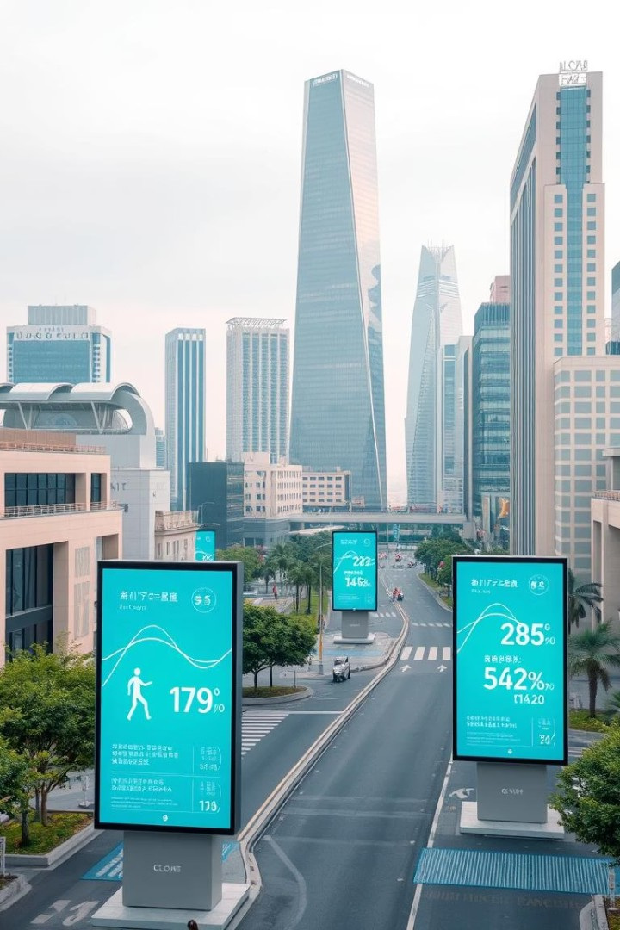
Key Takeaways and Future Directions
Affordable Monitoring
Low-cost IoT systems enable wide coverage.
Real-time Access
Public apps empower citizens with hyperlocal data.
Community Engagement
Awareness and participation improve air quality outcomes.
Scalable Solutions
Systems adaptable to diverse urban settings worldwide.

Slide 10

Air Quality Monitoring Solutions
This presentation covers modern air quality monitoring innovations, system design, and future directions.

Slide 11
Existing Solutions
Traditional Systems
Government monitors with fixed stations Satellites for large-scale observations
Modern Innovations
IoT sensor networks for real-time data Smart city projects integrating IoT Mobile apps providing pollution alerts

Slide 12

System Design
Architecture
Sensors: MQ135, SDS011, DHT22
Microcontroller: ESP32
Solar-powered unit with battery backup
Integration
AWS IoT Core cloud platform
Mobile App for real-time Air Quality Index

Slide 13

Key Features
Pollutant Detection
Multi-pollutant detection including PM2.5, NO2, CO, SO2
Power and Updates
Solar power with battery backup and OTA firmware updates
Security and Mapping
AES encrypted communication and GPS mapping

Slide 14
Design Constraints & Risk
Constraints
Regulatory RF compliance Cost below $100 per unit IP54+ weatherproof enclosures Data privacy considerations
Risk Mitigation
Regular sensor calibration
Backup batteries for power reliability Secure AES encryption for data

Slide 15

Implementation Methodology
Edge Computing
Processing data at local sensor level
Data Flow
Sensor -> Preprocessing -> Cloud -> Mobile App
Alerts & Updates
Real-time pollution alerts and OTA updates

Slide 16
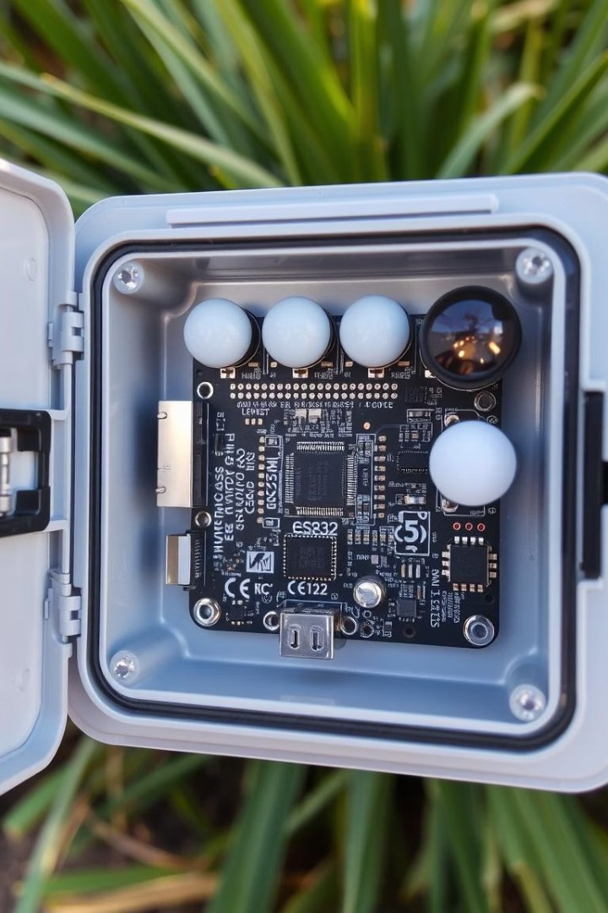
Hardware Implementation Highlights
Integrated Hardware
ESP32 and multiple sensors on custom PCB
Durability
Weatherproof IP54 enclosure for urban use
Power System
Solar panel with lithium battery for power backup

Slide 17
Software & Cloud Implementation
Firmware &
Arduino IDE for firmware development MQTT protocol for secure data transfer
Cloud & Frontend
AWS IoT Core and DynamoDB for data storage React dashboard and Flutter mobile app

Slide 18

Testing, Results & Future
Testing Outcomes
Strong correlation with government data (r > 0.85) Accurate with low MAE and RMSE
Stress-tested under varied conditions
Future Plans
Add O3, CO, NO2 sensors
AI-driven pollution forecasting
Smart city integration and global deployment

Slide 19


