Slide 1

FLOWCHART & PSEUDOCODE ASSIGNMENT
AYOMILALA NWANI
COMPUTER SCIENCE 100LEVEL
07085729414

Slide 2

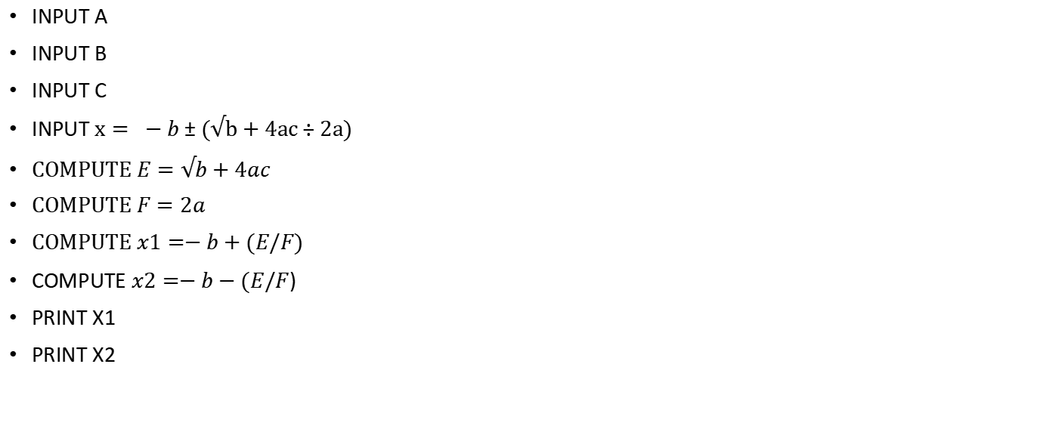
PSEUDOCODE FOR QUADRATIC EQUATION

Slide 3








START
IIFLOW CHART FOR QUADRATIC EQUATION
A
B
C
PRINT X1
PRINT X2
END

Slide 4
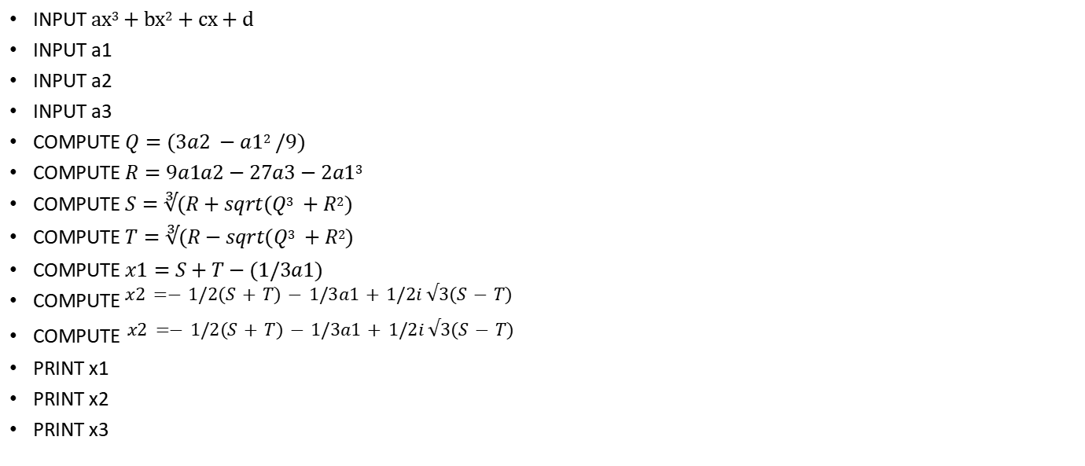
2. PSEUDOCODE FOR QUADRATIC EQUATION

Slide 5


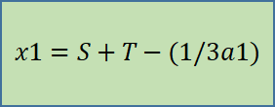







START
2. II) FLOWCHART FOR CUBIC EQUATION
a1
a2
a3
PRINT X1
PRINT X2
PRINT X3
END

Slide 6
3. PSEUDOCODE TO GET THE MAX VALUE OUT OF 3 VALUES
INPUT NUM1
INPUT NUM2
INPUT NUM3
IF NUM 1 > NUM 2 AND NUM 1 > NUM 3
PRINT NUM 1
IF NUM 2 > NUM 1 AND NUM 2> NUM 3
PRINT NUM 2
IF NUM 3 > NUM 2 AND NUM 3 > NUM 1
PRINT NUM 3
ELSE
PRINT ALL NUMS ARE EQUAL
END

Slide 7
START
NUM 1
3.II) FLOWCHART TO GET THE MAX VALUE OUT OF 3 VALUES
NUM 2
NUM 3
IF NUM 1>NUM 2 AND NUM1 >NUM 3
True
PRINT NUM1
False
IF NUM 2>NUM 1 AND NUM2 >NUM 3
True
PRINT NUM2
False
IF NUM 3>NUM 1 AND NUM 3>NUM 2
True
PRINT NUM3
False
PRINT all numbers are equal
END

Slide 8
4. PSEUDOCODE TO GET HCF OF 2 NUMBERS
INPUT NUM1
INPUT NUM 2
IF NUM 1 > NUM2 =TRUE
PRINT Smaller num=NUM2
IF NUM 2 > NUM1 =TRUE
PRINT Smaller num=NUM1
COMPUTE I=RANGE(Smaller num+1)
if X%I==0 AND Y%I==0
HCF=I

Slide 9
START
NUM 1
4.II) FLOWCHART TO GET HCF OF 2 NUMBERS
NUM 2
IF NUM 1>NUM 2
True
smaller num=NUM2
False
smaller num=NUM 1
I=Range(smaller num+1)
IF X% I==0 AND Y%I==0
FALSE
PRINT (“NO HCF EXIST FOR THESE 2 SET OF NUM”)
TRUE
HCF=I
PRINT (HCF)
END

Slide 10
4. III) FLOWCHART TO GET LCM OF 2 NUMBERS
INPUT NUM1
INPUT NUM 2
IF NUM 1 > NUM2 =TRUE
PRINT Smaller num=NUM1
IF NUM 2 > NUM1 =TRUE
PRINT Smaller num=NUM2
COMPUTE I=RANGE(Smaller num+1)
if X%I==0 AND Y%I==0
LCM=I
IF X% I==0 AND Y%I==0<num

Slide 11
START
NUM 1
4. IV) FLOWCHART TO GET LCM OF 2 NUMBERS
NUM 2
IF NUM 1>NUM 2
True
smaller num=NUM2
False
smaller num=NUM 1
I=Range(smaller num+1)
TRUE
IF X% I==0 AND Y%I==0
IF X% I==0 AND Y%I==0<num
FALSE
TRUE
FALSE
lcm=I
PRINT (HCF)
END

Slide 12
5. PSEUDOCODE TO GET FACTORIAL OF A NUMBER
INPUT NUM
INPUT FACT=1
IF NUM<0
PRINT (“NO FACTORIAL EXIST FOR THIS VALUE”)
IF NUM=0
PRINT (FACT)
COMPUTE N=N-1
COMPUTE FACT=FACT*N
PRINT (FACT)

Slide 13
START
5.II) FLOWCHART TO GET FACTORIAL OF A NUMBER
INPUT NUM
FACT=1
IF NUM<0
IF NUM=0
FALSE
FALSE
FACT=FACT*N
N=N-1
TRUE
TRUE
PRINT( “NO FACTORIALS EXIST FOR NEGATIVE NUMBERS”)
PRINT(FACT)
PRINT FACT
END

