Slide 1


Bill Management System For BIAM - BMS
BIAM Foundation, Dhaka
http://10.107.10.104
Developer:
MD. ADAL KHAN,
BSc(Mathematics),
MSc(Mathematics)

Slide 2
Flow
Computer Operator
Canteen Manager
Admin Officer
ACC Officer
End

Slide 3
Key Features
Creating Bills, Submitting bills for review, adding hall rent, receive bills and Processing different Types of Report
Bill Format: Department Code+Numeric Form of Bill Date+Serial:
E.G Bill for Canteen: 10+Bill Date 12/12/2024 + Serial
01 = 10 12122024 01 = 101212202401

Slide 4
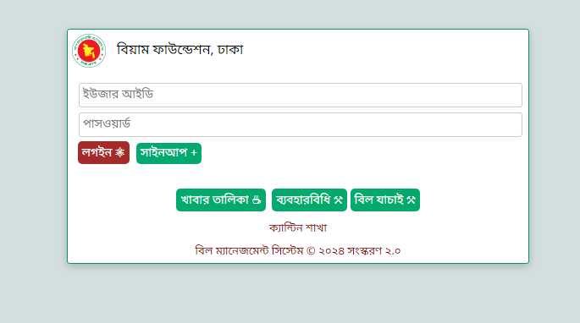
Login Window

Slide 5
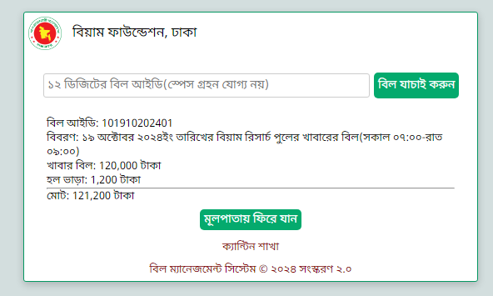
Public Access
Bill Verify

Slide 6
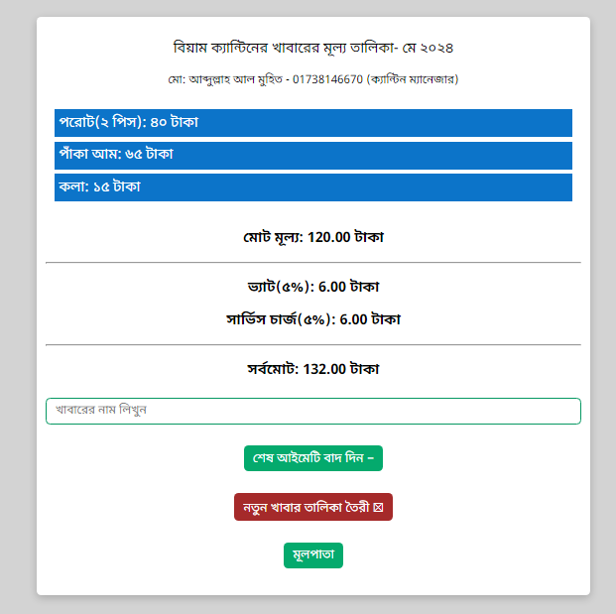
Public Access
Food Price/MENU GENERATOR

Slide 7
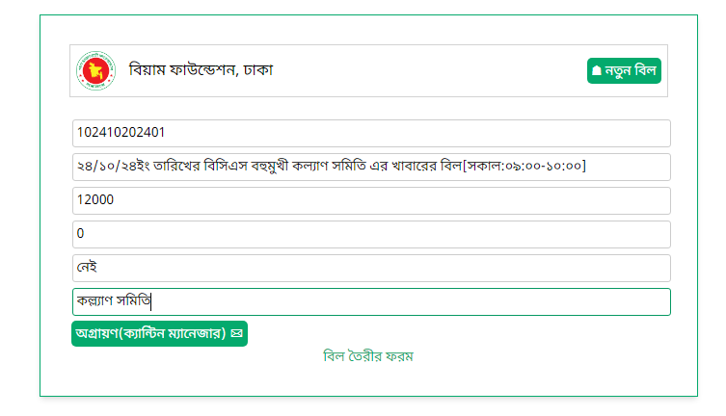
Creating bill

Slide 8
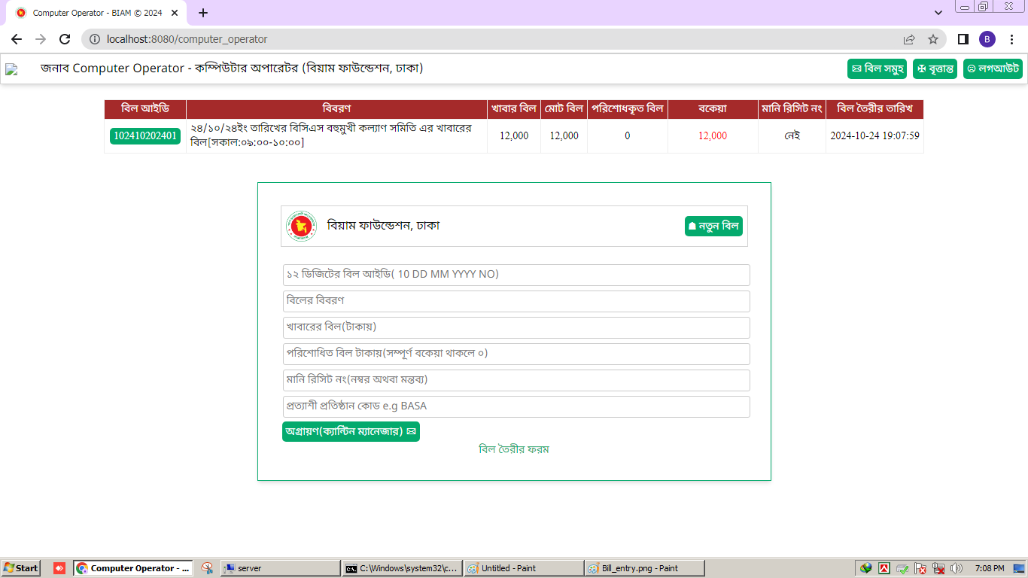
List of bills under review(Send to CM)

Slide 9
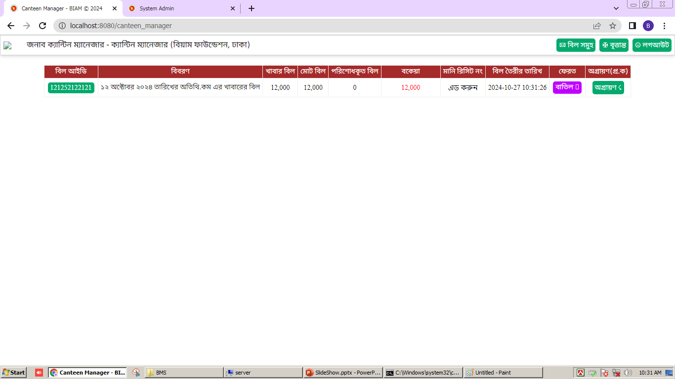
Canteen Manger

Slide 10
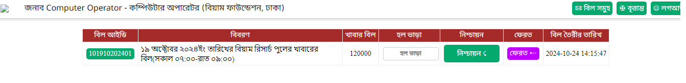
Adding Hall Rent

Slide 11
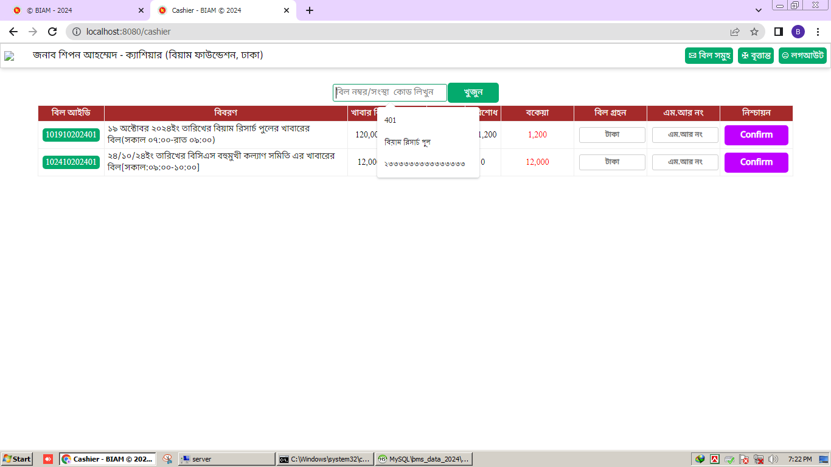
Receiving bill

Slide 12
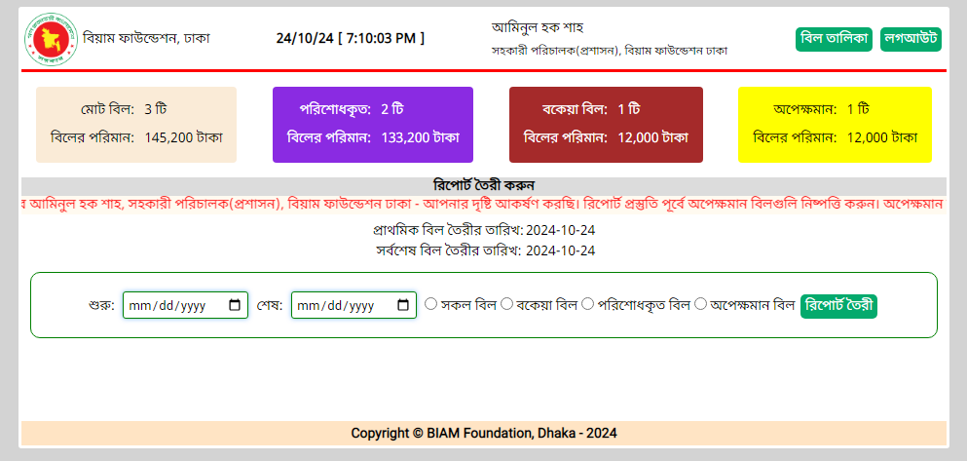
Dashboard for Admin(Report Generation)

Slide 13
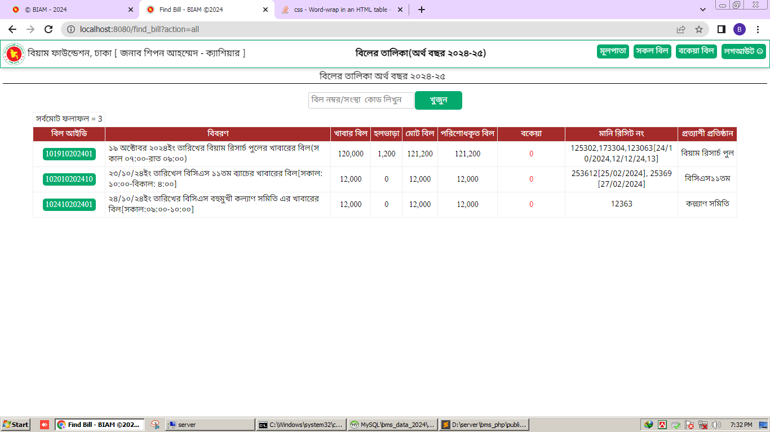
View All Bills

Slide 14
App Security Features
Back End: PHP 8. ( No Framework like Laravel/Symfony used)
Encrypted Database System(My SQL), Bcrypt for Password Hasing
Secure Routing System with Dynamic URL Parsing(Fully Customized)
Rate Limiting
Input Sanitization to Prevent XSS attacks
CSRF Protection
No Javascript for better security.
Server: Microsoft IIS on Windows 10

Slide 15
Thank You

