Slide 1
Chapter 1. Introduction
What Is Data Mining?
Data Mining: An Essential Step in Knowledge Discovery
Diversity of Data Types for Data Mining
Mining Various Kinds of Knowledge
Data Mining: Confluence of Multiple Disciplines
Data Mining and Applications
Data Mining and Society
Summary

Slide 2
What Is Data Mining?
We live in a world where vast amounts of data are generated constantly and rapidly
Data mining is the process of discovering interesting patterns, models and other kinds of knowledge in large data sets
“Data mining”: a misnomer? It should be “knowledge mining from data”
Other terms: Knowledge mining from data, KDD (Knowledge Discovery from Data), pattern discovery, knowledge extraction, data analytics, information harvesting
Data mining is a young, dynamic, and promising field
Example: Data mining turns a large collection of data into knowledge
Google’s Flu Trends found a close relationship between the number of people who search for flu-related info. and the number of people who have flu symptoms
It can estimate flu activity up to two weeks faster than traditional systems

Slide 3
Data Mining: An Essential Step in Knowledge Discovery
Knowledge Discovery Process
Data preparation
Data cleaning
Data integration
Data transformation
Data selection
Data mining
Pattern/model evaluation
Knowledge presentation

Slide 4
Diversity of Data Types for Data Mining (I)
Structured vs. unstructured data
Structured: uniform, record- or table-like structures, defined by data dictionaries, with a fixed set of attributes, each with a fixed set of value ranges and semantic meaning
Ex. Data stored in relational databases, data cubes, data matrices, and many data warehouses
Semi-structured: allow a data object to contain a set value, a small set of heterogeneous typed values, or nested structures, or to allow the structure of objects or sub-objects to be defined flexibly and dynamically
Data having certain structures with clearly defined semantic meaning, such as transactional data set, sequence data set (e.g., time-series data, gene or protein data, or Weblog data)
Graph or network data: A more sophisticated type of semi-structured data set
Unstructured data: text data and multimedia (e.g., audio, image, video) data
The real-world data can often be a mixture of structured, semi-structured data and unstructured data
Notes:
Structured : Stored in databases (Oracle,MySQL) and spreadsheets. Has tables with rows and columns.
Semi-structured : Does not have rigid structure. Contains tags or markers to separate different elements and enable hierarchies. E.g- JSON, XML, NoSQL databases
Unstructured : Lacks structure or schema. Represents the vast majority of data available in the world. E.g- Text files, images, video, audio files.

Slide 5
Diversity of Data Types for Data Mining (II)
Data associated with different applications
Different applications: different data sets and require different data analysis methods
Sequence data: Biological sequences vs. shopping transaction sequences
Time-series: ordered set of numerical values with equal time interval
Spatial, temporal and spatiotemporal data
Graph and network data: Social networks, computer communication networks, biological networks, and information networks may carry rather different semantics
On the same data set, finding different kinds of patterns: require different mining methods
Ex. software programs: finding plagiarized modules vs. finding copy-and-paste bugs
Stored vs. streaming data
Stored data: Finite, stored in various kinds of large data repositories
Streaming data (e.g., video surveillance or remote sensing): Dynamic, constantly coming, infinite, real-time response―posing challenges on effective data mining
Notes:
Example of time series data : Hourly temperature readings in a city over a week. Time series data: Time | Temperature or Daily closing prices of a particular stock over the year. Time series data: Date | Closing Price
Spatial data : Information about the physical location and shape of geometric objects. E.g- Coordinates of building along with shape.
Temporal data : Data related to time. E.g- Daily temperature recording.
Spatiotemporal data : Information that varies over time and space. E.g- Tracking hurricane path

Slide 6
Mining Various Kinds of Knowledge
Multidimensional Data Summarization
Mining Frequent Patterns, Associations, and Correlations
Classification and Regression for Predictive Analysis
Cluster Analysis
Deep Learning
Outlier Analysis
Are All Mining Results Interesting?
Notes:
Association analysis : Customers who buy diapers also buy milk. Or buying laptop bag, antivirus software along with new laptop.
Classification : Used for discrete target variables. Classify flowers in iris species (Setosa, Versicolor, Virginica) based on petal width and petal length.
Regression : Used for continuous target variables. Forecasting the future price of a stock is a regression task because price is a continuous-valued attribute.
Cluster analysis : Collection of words correspond to news articles about economy.
Outlier analysis : Credit card fraud detection.

Slide 7
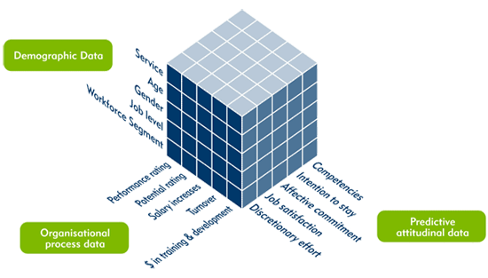
Multidimensional Data Summarization
Information integration and data warehouse construction
Data cleaning, transformation, integration, and multidimensional data model
Data cube technology
Scalable methods for computing (i.e., materializing) multidimensional aggregates
OLAP (online analytical processing)
Multidimensional concept description: Characterization and discrimination
Generalize, summarize, and contrast data characteristics, e.g., dry vs. wet region
Notes:
The output of data summarization is presented as pie chart, bar chart, curves etc.

Slide 8
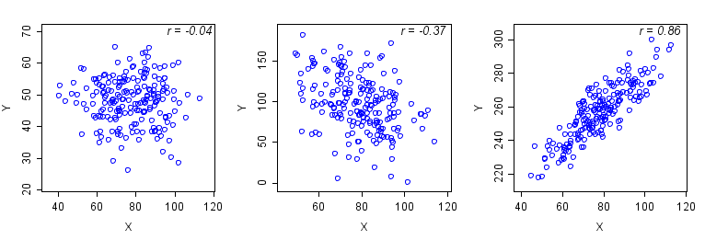
Pattern Discovery: Mining Frequent Patterns, Associations, and Correlations
Frequent patterns (or frequent itemsets)
What items are frequently purchased together in your Walmart?
Association and Correlation Analysis
A typical association rule
Diaper → Beer [0.5%, 75%] (support, confidence)
Are strongly associated items also strongly correlated?
How to mine such patterns and rules efficiently in large datasets?
How to use such patterns for classification, clustering, and other applications?

Slide 9
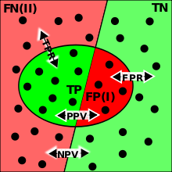
Classification and Regression for Predictive Analysis
Classification and label prediction
Construct models (functions) based on some training examples
Describe and distinguish classes or concepts for future prediction
Ex. 1. Classify countries based on (climate)
Ex. 2. Classify cars based on (gas mileage)
Predict some unknown class labels
Typical methods
Decision trees, naïve Bayesian classification, support vector machines, neural networks, rule-based classification, pattern-based classification, logistic regression, …
Typical applications:
Credit card fraud detection, direct marketing, classifying stars, diseases, web-pages, …

Slide 10
Cluster Analysis
Unsupervised learning (i.e., Class label is unknown)
Group data to form new categories (i.e., clusters), e.g., cluster houses to find distribution patterns
Principle: Maximizing intra-class similarity & minimizing interclass similarity
Many methods and applications
Notes:
Maximize intra-class similarity : In a cluster of animals, all the animals should have similar characteristics like species, size.
Minimize inter-class similarity : Animals in one cluster (e.g., mammals) should be quite different from animals in another cluster (e.g., birds).

Slide 11
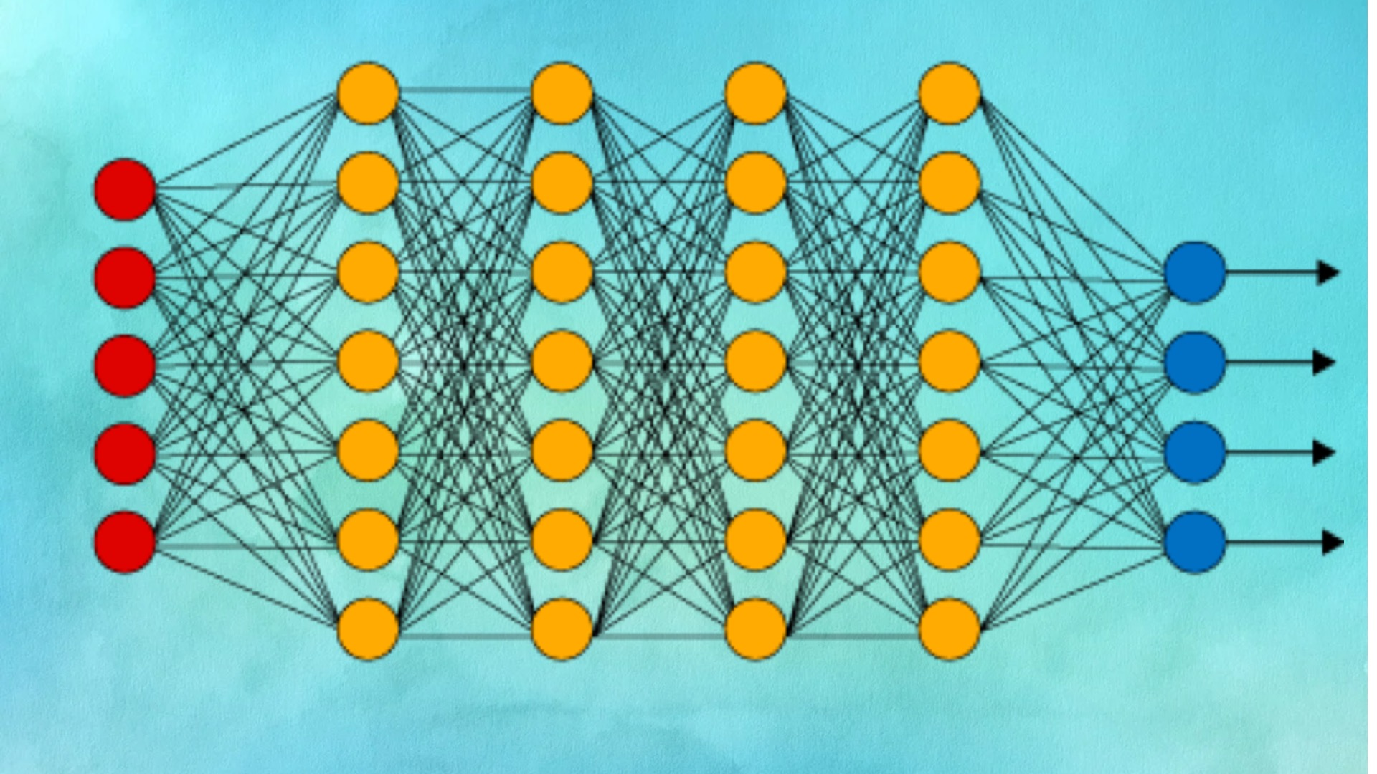
Deep Learning
Deep learning: A fast-expanding dynamic frontier in machine learning
Deep learning has developed various neural network architectures
Feed-forward neural networks
Convolutional neural networks
Recurrent neural networks
Graph neural networks
Transformer
Deep learning has broad applications in computer vision, natural language processing, machine translation, social network analysis, and so on
Deep learning has been reshaping a variety of data mining tasks
Ex. classification, clustering, outlier detection, and reinforcement learning
Notes:
If want to predict that a pandemic is imminent, data such as the number of daily positive cases, number of daily tests, number of daily hospitalization etc. is collected. Deep learning can do feature engineering i.e. generate meaningful features (like weekly positive rates) from initial input features.

Slide 12
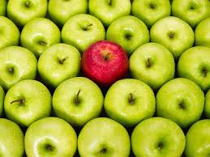
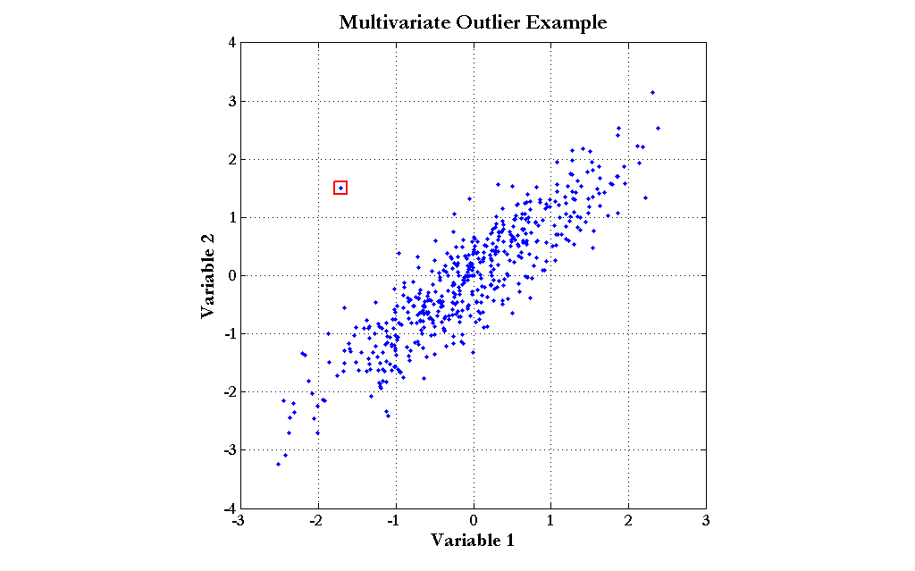
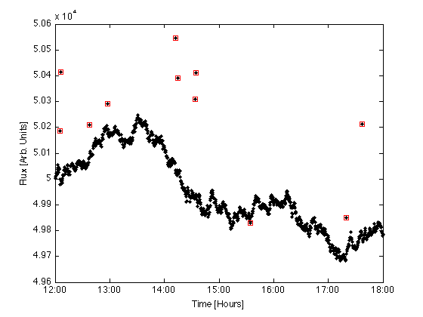
Outlier Analysis
Outlier analysis
Outlier: A data object that does not comply with the general behavior of the data
Noise or exception?―One person’s garbage could be another person’s treasure
Methods: by product of clustering or regression analysis, …
Useful in fraud detection, rare events analysis

Slide 13
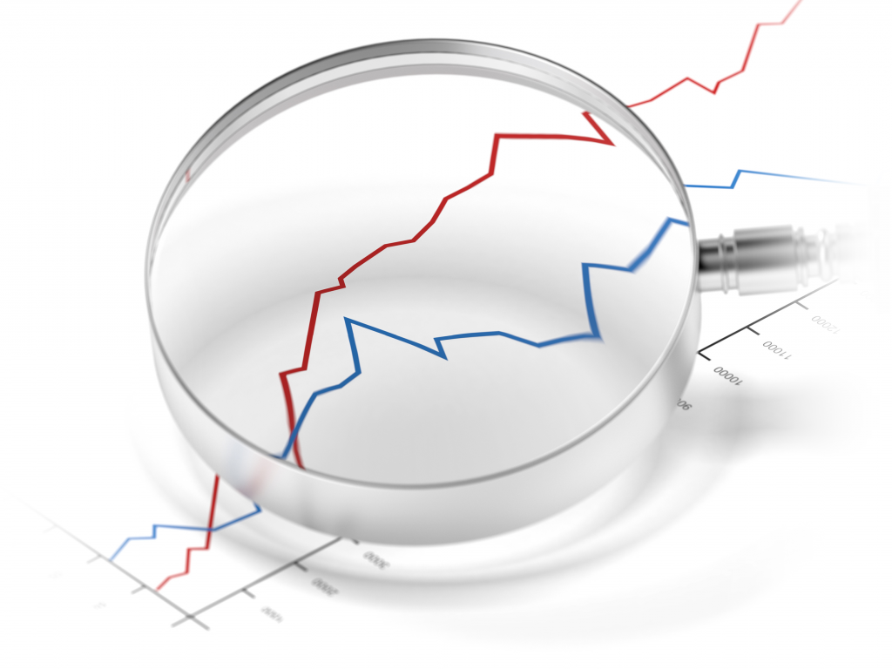
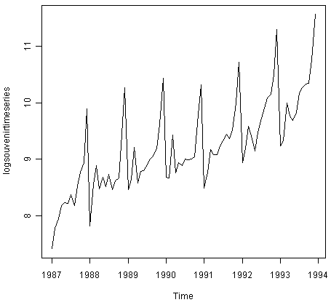
Other Data Mining Functions: Time and Ordering: Sequential Pattern, Trend and Evolution Analysis
Sequence, trend and evolution analysis
Trend, time-series, and deviation analysis
e.g., regression and value prediction
Sequential pattern mining
e.g., buy digital camera, then buy large memory cards
Periodicity analysis
Motifs and biological sequence analysis
Approximate and consecutive motifs
Similarity-based analysis
Mining data streams
Ordered, time-varying, potentially infinite, data streams
Notes:
Periodicity analysis : Higher electricity consumption during summer or winter due to heating and cooling demands. By analyzing the periodicity in energy usage data, utility companies can predict peak usage times, optimize energy production and manage load efficiently.
Motif : Proteins are made up of amino acids, and certain sequences of these amino acids, known as motifs, are conserved across different proteins because they perform essential biological functions.
Similarity-based analysis : E-commerce platforms like Amazon or Netflix use similarity-based analysis to recommend products or content to users.

Slide 14
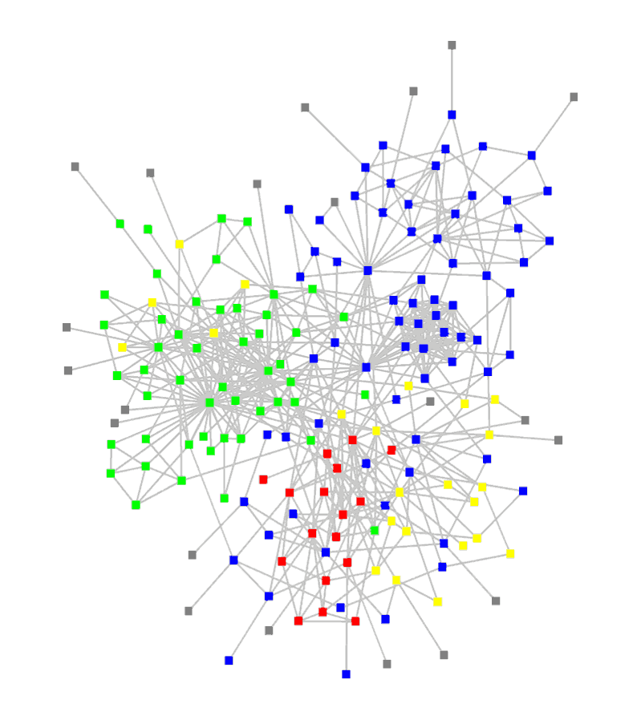
Other Data Mining Functions: Structure and Network Analysis
Graph mining
Finding frequent subgraphs (e.g., chemical compounds), trees (XML), substructures (web fragments)
Information network analysis
Social networks: actors (objects, nodes) and relationships (edges)
e.g., author networks in CS, terrorist networks
Multiple heterogeneous networks
A person could be multiple information networks: friends, family, classmates, …
Links carry a lot of semantic information: Link mining
Web mining
Web is a big information network: from PageRank to Google
Analysis of Web information networks
Web community discovery, opinion mining, usage mining, …

Slide 15

Evaluation of Knowledge
Are all mined knowledge interesting?
One can mine tremendous amount of “patterns”
Some may fit only certain dimension space (time, location, …)
Some may not be representative, may be transient, …
Evaluation of mined knowledge → directly mining only interesting knowledge?
Descriptive vs. predictive
Coverage
Typicality vs. novelty
Accuracy
Timeliness
…
Notes:
A pattern like “a large earthquake often follows a cluster of small quakes” is highly actionable if users can act on the information to save life.
Descriptive evaluation : A company conducts a descriptive analysis of customer's purchasing behavior to discover that people who buy baby products are also likely to buy diapers and baby food.
Predictive evaluation : Company can forecast future sales of diapers, seasonal trends. They can estimate how much stock needed in next quarter.
Coverage : How widely applicable a pattern is. E.g- A dataset has 10,000 customer transactions. Out of these, 2000 customers have purchased Product A. Among those 2000 customers, 1200 customers also purchased Product B.
Typicality : How common a particular pattern is within the dataset. e.g- a bank discovers that "customers who earn above 10L per annum are more likely to own premium credit cards.“ This aligns with the general understanding that higher income individuals are more likely to opt for premium financial products.
Novelty : Unusual, unexpected pattern. e.g- analysis reveals "a significant number of customers who frequently travel internationally earn less than 10L annually
and also own premium cards". This pattern can uncover new customer segments.

Slide 16
Data Mining: Confluence of Multiple Disciplines
Notes:
NLP can convert unstructured text data into structured format that data mining algorithms can analyze. e.g- A company wants to analyze customer reviews on its products to understand the general sentiment (positive, negative, neutral) towards its offerings.
NLP can use tokenization to break down customer reviews into individual words. Then do feature extraction of sentiment-bearing words like "good", "bad".
Data mining can assign labels like positive, negative, neutral for each review and identify patterns such as common issues in negative reviews. It can also
track sentiments over time to see how customer opinions are evolving.

Slide 17
Why Confluence of Multiple Disciplines?
Tremendous amount of data
Algorithms must be scalable to handle big data
High-dimensionality of data
Micro-array may have tens of thousands of dimensions
High complexity of data
Data streams and sensor data
Time-series data, temporal data, sequence data
Structure data, graphs, social and information networks
Spatial, spatiotemporal, multimedia, text and Web data
Software programs, scientific simulations
New and sophisticated applications
Notes:
Add a definition/description of “traditional data analysis”.

Slide 18

Data Mining and Applications
Web page analysis: classification, clustering, ranking
Collaborative analysis & recommender systems
Basket data analysis to targeted marketing
Biological and medical data analysis
Data mining and software engineering
Data mining and text analysis
Data mining and social and information network analysis
Built-in (invisible data mining) functions in Google, Microsoft, LinkedIn, Meta, …
Major dedicated data mining systems/tools
SAS, MS SQL-Server Analysis Manager, Oracle Data Mining Tools)

Slide 19
Data Mining and Society
Data mining technology may benefit society
Ex.: Help scientific discovery, business management, economy recovery, and security protection (e.g., the real-time discovery of intruders and cyberattacks)
Need to guard against the misuse of data mining
Data mining also poses the risk of unintentionally disclosing some confidential business or government information and disclosing an individual’s personal information
Studies on data security in data mining and privacy-preserving data publishing and data mining are important, ongoing research theme
The philosophy is to observe data sensitivity and preserve data security and people’s privacy while performing successful data mining
These and other related issues will be discussed throughout the book

Slide 20
Summary
Data mining: Discovering interesting patterns and knowledge from massive amounts of data
A KDD process includes data cleaning, data integration, data selection, transformation, data mining, pattern evaluation, and knowledge presentation
Different data mining method on a wide variety of data
Data mining functionalities: summarization, pattern discovery, classification, clustering, deep learning, outlier analysis, trend and outlier analysis, …
Data mining is a confluence of multiple disciplines
Data mining has broad applications
Promote secure data mining to benefit society

