Slide 1
Pointers in C

Slide 2
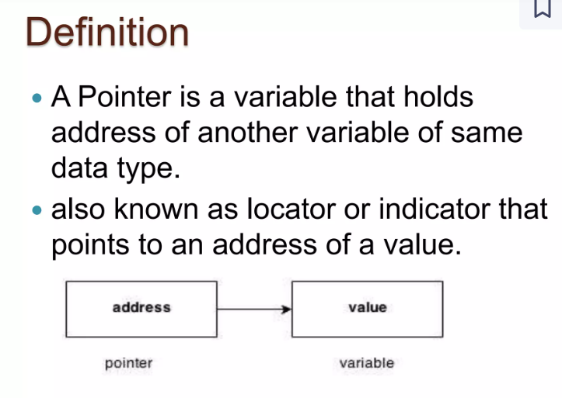

Slide 3
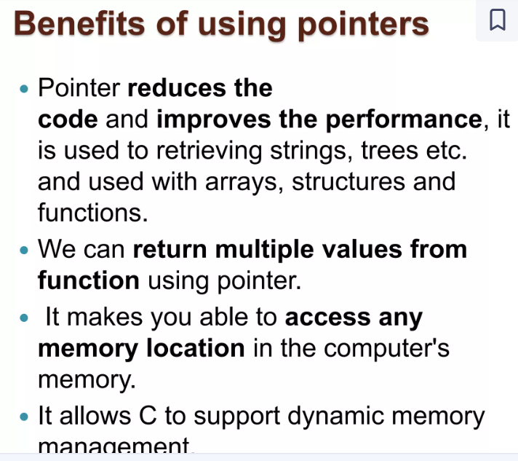

Slide 4
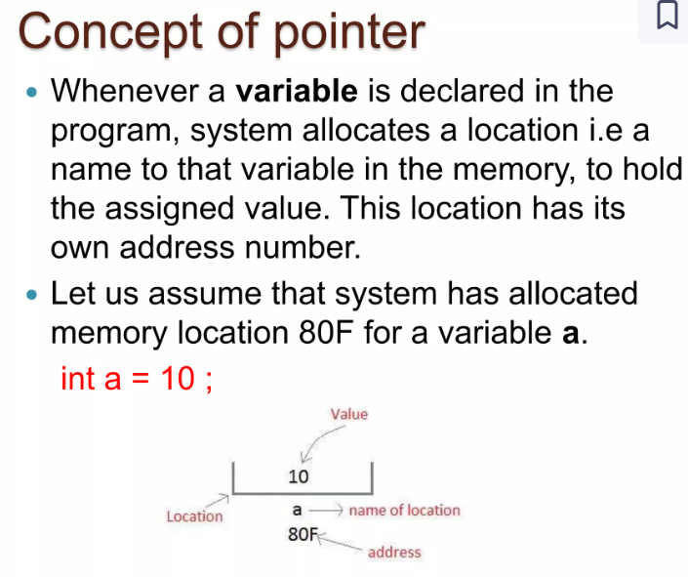

Slide 5
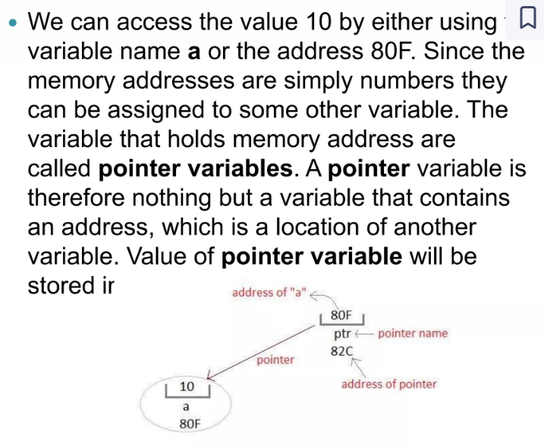

Slide 6
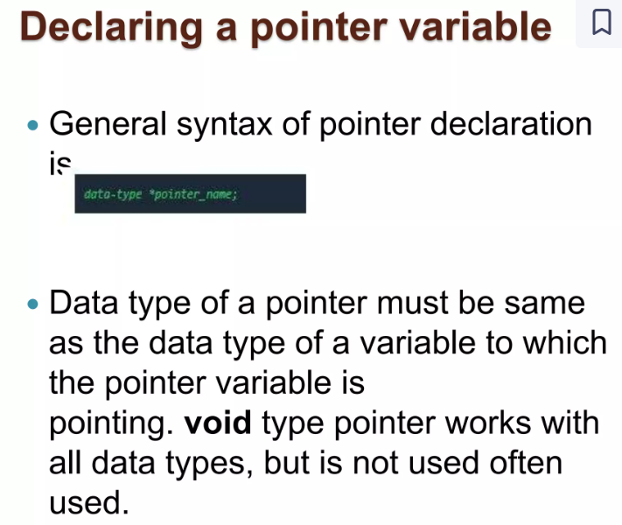

Slide 7
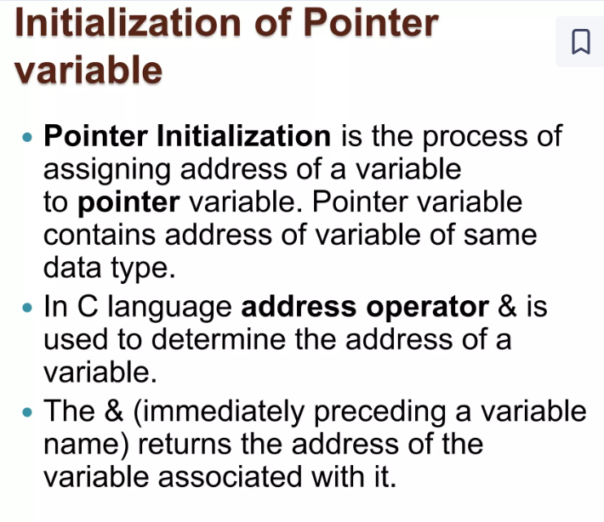

Slide 8
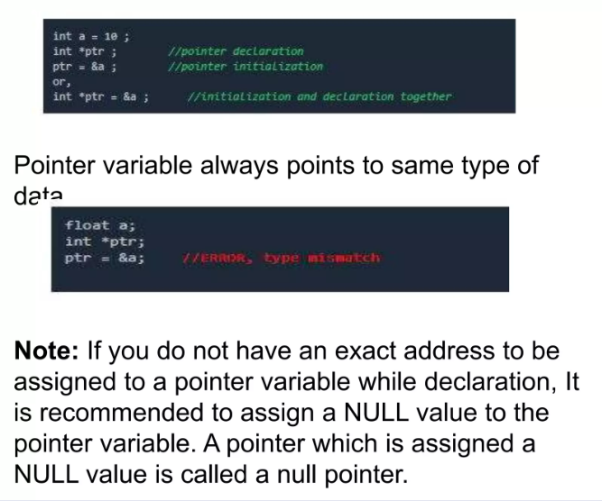

Slide 9
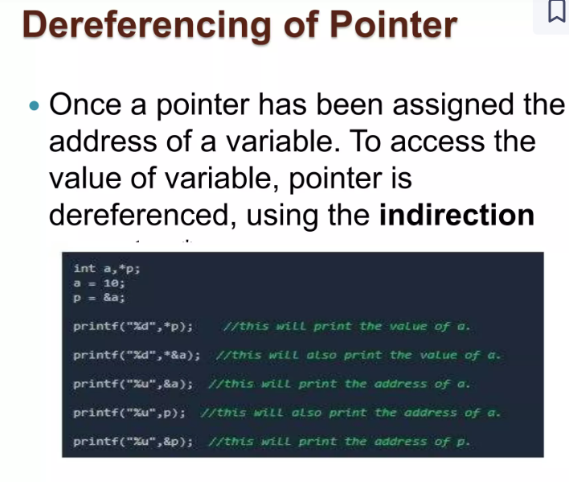

Slide 10
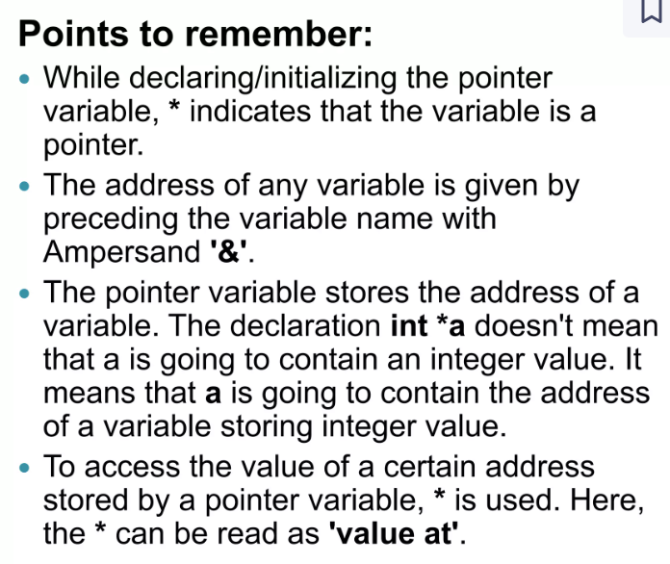

Slide 11
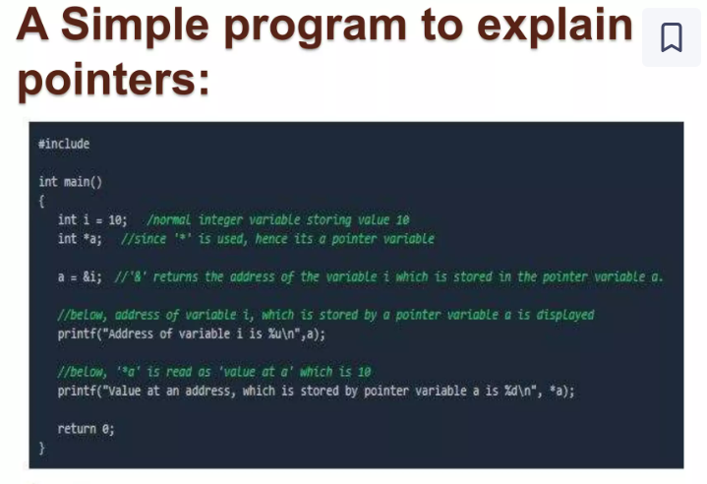

Slide 12
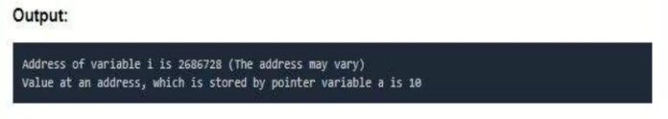

Slide 13
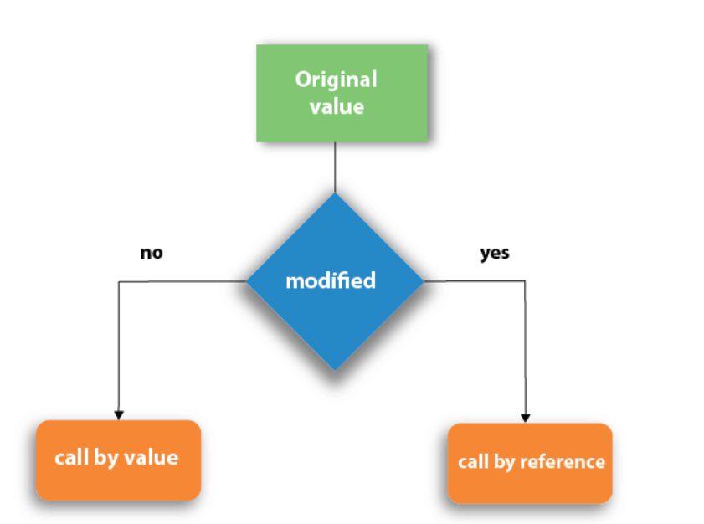
Write a program that takes two integers as input from the user and swaps their values using call by value in c Display the values of the numbers before and after swapping.
call by value," the actual parameters passed to the function are not modified, but the function can still perform the swap internally.

Slide 14
#include <stdio.h>
// Function to swap values using call by value
void swap(int a, int b) {
int temp;
temp = a;
a = b;
b = temp;
// Display values inside the swap function
printf("Inside swap function - After swapping: a = %d, b = %d\n", a, b);
}
int main() {
int x, y;
// Taking two integers as input from the user
printf("Enter the first integer: ");
scanf("%d", &x);
printf("Enter the second integer: ");
scanf("%d", &y);
// Display values before swapping
printf("Before swapping - x = %d, y = %d\n", x, y);
// Call the swap function
swap(x, y);
// Display values after attempting to swap
printf("After attempting to swap - x = %d, y = %d\n", x, y);
return 0;
}

Slide 15
In C, "call by reference“both actual parameters and formal parameters refer to the same memory location. Therefore, any changes made to the formal parameters will get reflected to actual parameters. Also instead of passing values, we pass address.

Slide 16
#include <stdio.h>
// Function to swap values using call by reference
void swap(int *a, int *b) {
int temp;
temp = *a;
*a = *b;
*b = temp;
}
int main() {
int x, y;
// Taking two integers as input from the user
printf("Enter the first integer: ");
scanf("%d", &x);
printf("Enter the second integer: ");
scanf("%d", &y);
// Display values before swapping
printf("Before swapping - x = %d, y = %d\n", x, y);
// Call the swap function with addresses of x and y
swap(&x, &y);
// Display values after swapping
printf("After swapping - x = %d, y = %d\n", x, y);
return 0;
}

