Slide 1
Graphs

Slide 2
Introduction
A graph is an abstract data structure that is used to implement the graph concept from mathematics. A graph is basically, a collection of vertices (also called nodes) and edges that connect these vertices. A graph is often viewed as a generalization of the tree structure, where instead of a having a purely parent-to-child relationship between tree nodes, any kind of complex relationships between the nodes can be represented.
Why graphs are useful?
Graphs are widely used to model any situation where entities or things are related to each other in pairs; for example, the following information can be represented by graphs:
Family trees in which the member nodes have an edge from parent to each of their children.
Transportation networks in which nodes are airports, intersections, ports, etc. The edges can be airline flights, one-way roads, shipping routes, etc.

Slide 3
Definition
A graph G is defined as an ordered set (V, E), where V(G) represent the set of vertices and E(G) represents the edges that connect the vertices.
The figure given shows a graph with V(G) = { A, B, C, D and E} and E(G) = { (A, B), (B, C), (A, D), (B, D), (D, E), (C, E) }. Note that there are 5 vertices or nodes and 6 edges in the graph.
A
B
C
D
E

Slide 4
Definition
A graph can be directed or undirected. In an undirected graph, the edges do not have any direction associated with them. That is, if an edge is drawn between nodes A and B, then the nodes can be traversed from A to B as well as from B to A. The above figure shows an undirected graph because it does not gives any information about the direction of the edges.
The given figure shows a directed graph. In a directed graph, edges form an ordered pair. If there is an edge from A to B, then there is a path from A to B but not from B to A. The edge (A, B) is said to initiate from node A (also known as initial node) and terminate at node B (terminal node).
A
B
C
D
E

Slide 5
Graph Terminology
Adjacent Nodes or Neighbors: For every edge, e = (u, v) that connects nodes u and v; the nodes u and v are the end-points and are said to be the adjacent nodes or neighbors.
Degree of a node: Degree of a node u, deg(u), is the total number of edges containing the node u. If deg(u) = 0, it means that u does not belong to any edge and such a node is known as an isolated node.
Regular graph: Regular graph is a graph where each vertex has the same number of neighbors. That is every node has the same degree. A regular graph with vertices of degree k is called a k‑regular graph or regular graph of degree k.
O regular graph | 1 regular graph | 2 regular graph

Slide 6
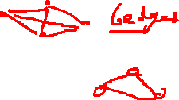
Graph Terminology
Path: A path P, written as P = {v0, v1, v2,….., vn), of length n from a node u to v is defined as a sequence of (n+1) nodes. Here, u = v0, v = vn and vi-1 is adjacent to vi for i = 1, 2, 3, …, n.
Closed path: A path P is known as a closed path if the edge has the same end-points. That is, if v0 = vn.
Simple path: A path P is known as a simple path if all the nodes in the path are distinct with an exception that v0 may be equal to vn. If v0 = vn, then the path is called a closed simple path.
Cycle: A closed simple path with length 3 or more is known as a cycle. A cycle of length k is called a k – cycle.
Connected graph: A graph in which there exists a path between any two of its nodes is called a connected graph. That is to say that there are no isolated nodes in a connected graph. A connected graph that does not have any cycle is called a tree.
Complete graph: A graph G is said to be a complete, if all its nodes are fully connected, that is, there is a path from one node to every other node in the graph. A complete graph has n(n-1)/2 edges, where n is the number of nodes in G.

Slide 7
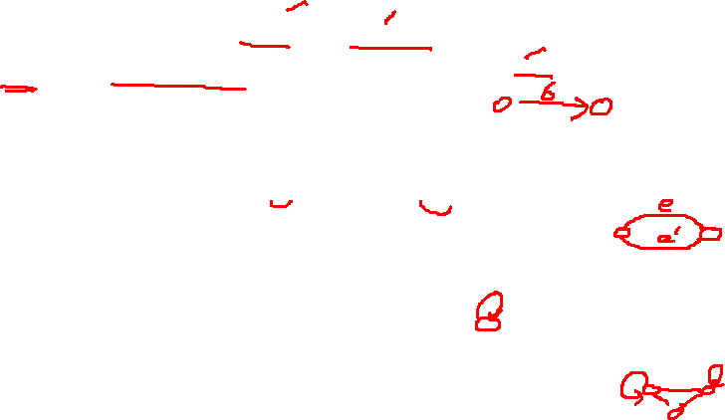
Graph Terminology
Labeled graph or weighted graph: A graph is said to be labeled if every edge in the graph is assigned some data. In a weighted graph, the edges of the graph are assigned some weight or length. Weight of the edge, denoted by w(e) is a positive value which indicates the cost of traversing the edge.
Multiple edges: Distinct edges which connect the same end points are called multiple edges. That is, e = {u, v) and e’ = (u, v) are known as multiple edges of G.
Loop: An edge that has identical end-points is called a loop. That is, e = (u, u).
Multi- graph: A graph with multiple edges and/or a loop is called a multi-graph.
Size of the graph: The size of a graph is the total number of edges in it.

Slide 8
Graph Terminology
(a) Multi-graph | (b) Tree | (c) Weighted Graph
A
B
C
3
4
e1
A
B
C
A
B
e4
2
e2
e3
D
E
F
7
1
C
e6
D
B
e5
e7
3

Slide 9
Directed Graph
A directed graph G, also known as a digraph, is a graph in which every edge has a direction assigned to it. An edge of a directed graph is given as an ordered pair (u, v) of nodes in G. For an edge (u, v)-
The edge begins at u and terminates at v
U is known as the origin or initial point of e. Correspondingly, v is known as the destination or terminal point of e
U is the predecessor of v. Correspondingly, v is the successor of u
nodes u and v are adjacent to each other.

Slide 10
Terminology of a Directed Graph
Out-degree of a node: The out degree of a node u, written as outdeg(u), is the number of edges that originate at u.
In-degree of a node: The in degree of a node u, written as indeg(u), is the number of edges that terminate at u.
Degree of a node: Degree of a node written as deg(u) is equal to the sum of in-degree and out-degree of that node. Therefore, deg(u) = indeg(u) + outdeg(u)
Source: A node u is known as a source if it has a positive out-degree but an in-degree = 0.
Sink: A node u is known as a sink if it has a positive in degree but a zero out-degree.
Reachability: A node v is said to be reachable from node u, if and only if there exists a (directed) path from node u to node v.

Slide 11
Terminology of a Directed Graph
Strongly connected directed graph: A digraph is said to be strongly connected if and only if there exists a path from every pair of nodes in G. That is, if there is a path from node u to v, then there must be a path from node v to u.
Unilaterally connected graph: A digraph is said to be unilaterally connected if there exists a path from any pair of nodes u, v in G such that there is a path from u to v or a path from v to u but not both.
Parallel/Multiple edges: Distinct edges which connect the same end points are called multiple edges. That is, e = {u, v) and e’ = (u, v) are known as multiple edges of G.
Simple directed graph: A directed graph G is said to be a simple directed graph if and only if it has no parallel edges. However, a simple directed graph may contain cycle with an exception that it cannot have more than one loop at a given node

Slide 12
Directed Graph
Definition:
For a directed graph G = (V,E), where V is the set of vertices and E is the set of edges, the transitive closure of G is a graph G* = (V,E*). In G*, for every vertex v, w in V there is an edge (v, w) in E* if and only if there is a valid path from v to w in G.
Why and where is it needed?
Finding the transitive closure of a directed graph is an important problem in many computational tasks that listed below.
Transitive closure is used to find the reachability analysis of transition networks representing distributed and parallel systems
It is used in the construction of parsing automata in compiler construction
Recently, transitive closure computation is being used to evaluate recursive database queries (because almost all practical recursive queries are transitive in nature).

Slide 13
Directed Graph
Algorithm
The algorithm to find transitive enclosure of a graph G is given in figure below. In order to determine the transitive closure of a graph, we define a matrix t where tkij = 1, (for i, j, k = 1, 2, 3, …n) if there exists a path in G from the vertex i to vertex j with intermediate vertices in the set (1, 2, 3, .., k) and 0 otherwise. That is, G* is constructed by adding an edge (i, j) into E* if and only if tkij = 1.

Slide 14
Directed Graph
When k = 0 | T⁰_{ij} = 0 if (i, j) is not in E 1 if (I, j) is in E
When k ≥ 1 | T^{k}_{ij} = T^{k-1}_{ij} V (T^{k-1}_{ik} Λ T^{k-1}_{kj})
Transitive_Closure( A, t, n)
Step 1: SET i=1, j=1, k=1
Step 2: Repeat Steps 3 and 4 while i<=n
Step 3: Repeat Step 4 while j<=n
Step 4: IF (A[i][j] = 1), then
SET t[i][j] = 1
ELSE
SET t[i][j] = 0
INCREMENT j
INCREMENT i
Step 5: Repeat Steps 6 to 11 while k<=n
Step 6: Repeat Step 7 to 10 while i<=n
Step 7: Repeat Step 8 and 9 while j<=n
Step 8: SET t[i,j] = t[i][j] V ( t[i][k] Λ t[k][j])
Step 9: INCREMENT j
Step 10: INCREMENT i
Step 11: INCREMENT k
Step 12: END

Slide 15
Bi Connected Graphs
A vertex v of G is called an articulation point if removing v along with the edges incident to v, results in a graph that has at least two connected components.
A bi-connected graph is defined as a connected graph that has no articulation vertices. That is, a bi-connected graph is connected and non-separable, in the sense that even if we remove any vertex from the graph, the resultant graph is still connected. By definition,
A bi-connected undirected graph is a connected graph that is not broken into disconnected pieces by deleting any single vertex
In a bi-connected directed graph for any two vertices v and w there are two directed paths from v to w which have no vertices in common other than v and w.

Slide 16
Bi Connected Graphs
A
H
B
C
I
A
H
B
I
D
J
D
J
E
F
E
F
Note that the graph shown on the left is not a bi-connected graph as deleting vertex C from the graphs results in two connected components of the original graph (figure on right)

Slide 17
Bi Connected Graphs
A
B
Bi-connected graph. Removal of any vertex from the graph will not disconnect the graph
D
C
Like graphs, there is a related concept for edges. An edge in a graph is called a bridge, if removing that edge results in a disconnected graph. Also, an edge on the graph that does not lie on a cycle is a bridge. This means that a bridge has at least one articulation point at its end, although it is not necessary that the articulation point is linked in a bridge.
A
B
C
D
E
REPRESENTATION OF GRAPHS
There are two common ways of storing graphs in computer’s memory. They are:
Sequential representation by using an adjacency matrix
Linked representation by using an adjacency list that stores the neighbors of a node using a linked list

Slide 18
Adjacency Matrix Representation
An adjacency matrix is used to represent which nodes are adjacent to one another. By definition, we have learnt that, two nodes are said to be adjacent if there is an edge connecting them.
In a directed graph G, if node v is adjacent to node u, then surely there is an edge from u to v. That is, if v is adjacent to u, we can get from u to v by traversing one edge. For any graph G having n nodes, the adjacency matrix will have dimensions of n X n.
In an adjacency matrix, the rows and columns are labeled by graph vertices. An entry aij in the adjacency matrix will contain 1, if vertices vi and vj are adjacent to each other. However, if the nodes are not adjacent, aij will be set to zero.
1 if v_{i} is adjacent to v_{j}, that is there is an edge (v_{i}, v_{j})
aij
0 otherwise
Since an adjacency matrix contains only 0s and 1s, it is called a bit matrix or a Boolean matrix. The entries in the matrix depend on the ordering of the nodes in G. therefore, a change in the order of nodes will result in a different adjacency matrix.

Slide 19
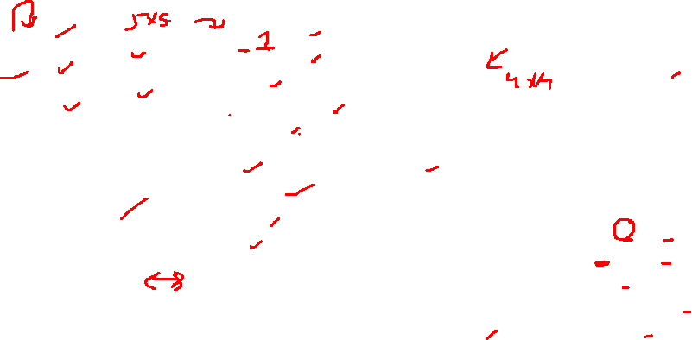
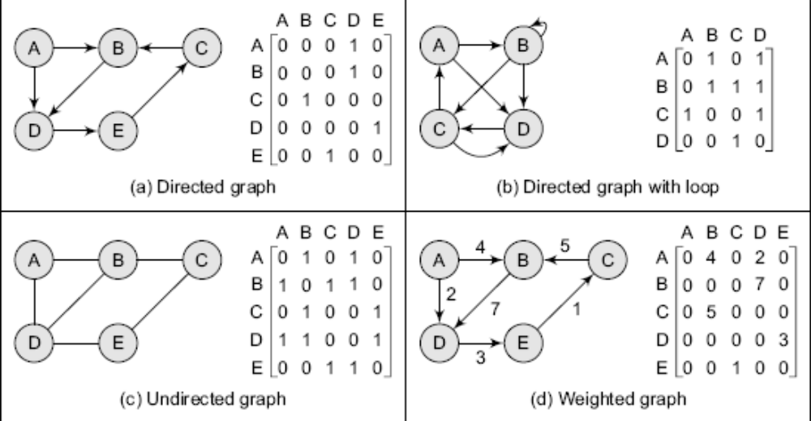
Adjacency Matrix Representation

Slide 20
Adjacency Matrix Representation
From adjacency matrix A1, we have learnt that an entry 1 in the ith row and jth column means that there exists a path of length 1 from vi to vj. Now consider, A2, A3 and A4
a_{ij} ² = ∑ a_{ik} a_{kj}
Any entry a_{ij} = 1 if a_{ik} = a_{kj} = 1. That is, if there is an edge (v_{i}, v_{k}) and (v_{k}, v_{j}). This implies that there is a path from vi to vj of length 2.
Similarly, every entry in the ith row and jth column of A3 gives the number of paths of length 3 from node vi to vj.
In general terms, we can conclude that every entry in the ith row and jth column of An (where n is the number of nodes in the graph) gives the number of paths of length n from node vi to vj.

Slide 21
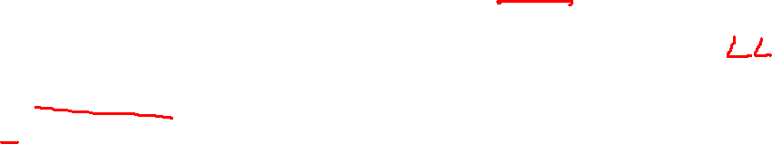
Adjacency List
The adjacency list is another way in which graphs can be represented in computer’s memory. This structure consists of a list of all nodes in G. Furthermore, every node is in turn linked to its own list that contains the names of all other nodes that are adjacent to itself.
The key advantage of using an adjacency list includes:
It is easy to follow, and clearly shows the adjacent nodes of a particular node
It is often used for storing graphs that have a small to moderate number of edges. That is an Adjacency list is preferred for representing sparse graphs in computer’s memory; otherwise, an adjacency matrix is a good choice.
Adding new nodes in G is easy and straightforward when G is represented using an Adjacency list. Adding new nodes in an Adjacency matrix is a difficult task as size of the matrix needs to be changed and existing nodes may have to be reordered.

Slide 22
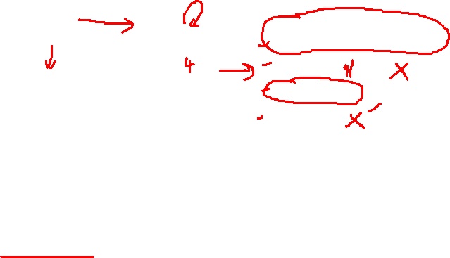
Adjacency List
A
B
A
B
C
D
B
C X
B
D X
C
D
D X
A
B X
Graph G and its adjacency list
For a directed graph, the sum of lengths of all adjacency lists is equal to the number of edges in G. However, for an undirected graph, the sum of lengths of all adjacency lists is equal to twice the number of edges in G because an edge (u, v) means an edge from node u to v as well as an edge v to u. The adjacency list can also be modified to store weighted graphs.

Slide 23
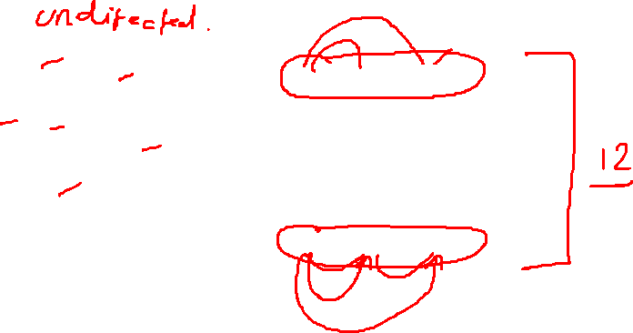
Adjacency List
A
B
C
A
B
C
D
E
B
D X
A
C
D X
D
E
B
E X
A
B
E X
C
D X

Slide 24
Graph Traversal Algorithms
By traversing a graph, we mean the method of examining the nodes and edges of the graph. There are two standard methods of graph traversal which we will discuss in this section. These two methods are-
Breadth first search
Depth first search
While breadth first search will use a queue as an auxiliary data structure to store nodes for further processing, the depth-first search scheme will use a stack. But both these algorithms will make use of a variable STATUS. During the execution of the algorithm, every node in the graph will have the variable STATUS set to 1, 2 or depending on its current state. Table I shows the value of status and its significance.

Slide 25
Graph Traversal Algorithms
STATUS | STATE OF THE NODE | DESCRIPTION
1 | Ready | The initial state of the node N
2 | Waiting | Node N is placed on the queue or stack and waiting to be processed
3 | Processed | Node N has been completely processed

Slide 26
Breadth First Search
Breadth-first search (BFS) is a graph search algorithm that begins at the root node and explores all the neighboring nodes. Then for each of those nearest nodes, the algorithm explores their unexplored neighbor nodes, and so on, until it finds the goal.
That is, we start examining the node A and then all the neighbors of A are examined. In the next step we examine the neighbors of neighbors of A, so on and so forth

Slide 27
Breadth First Search
Algorithm for breadth-first search in a graph G beginning at a starting node A
Step 1: SET STATUS = 1 (ready state) for each node in G.
Step 2: Enqueue the starting node A and set its STATUS = 2 (waiting state)
Step 3: Repeat Steps 4 and 5 until QUEUE is empty
Step 4: Dequeue a node N. Process it and set its STATUS = 3 (processed state).
Step 5: Enqueue all the neighbors of N that are in the ready state (whose STATUS = 1) and set their STATUS = 2 (waiting state)
  [END OF LOOP]
  Step 6: EXIT
Example: Consider the graph G given below. The adjacency list of G is also given. Assume that G represents the daily flights between different cities and we want to fly from city A to H with minimum stops. That is, find the minimum path P from A to H given that every edge has length = 1.

Slide 28
Breadth First Search
A
Adjacency Lists
A: B, C, D B: E C: B, G D: C, G E: C, F F: C, H G: F, H, I H: E, I I: F
B
C
D
E
F
G
H
I
Initially add A to QUEUE and add NULL to ORIG, so
FRONT = 1 | QUEUE = A
REAR = 1 | ORIG = \0

Slide 29
Breadth First Search
Dequeue a node by setting FRONT = FRONT + 1 (remove the FRONT element of QUEUE) and enqueue the neighbors of A. Also add A as the ORIG of its neighbors, so
FRONT = 2 QUEUE = A B C D
REAR = 4 ORIG = \0 A A A
Dequeue a node by setting FRONT = FRONT + 1 and enqueue the neighbors of B. Also add B as the ORIG of its neighbors, so
FRONT = 3 QUEUE = A B C D E
REAR = 5 ORIG = \0 A A A B
Dequeue a node by setting FRONT = FRONT + 1 and enqueue the neighbors of C. Also add C as the ORIG of its neighbors. Note that C has two neighbors B and G. Since B has already been added to the queue and it is not in the Ready state, we will not add B and add only G, so
FRONT = 4 QUEUE = A B C D E G
REAR = 6 ORIG = \0 A A A B C

Slide 30
Breadth First Search
Dequeue a node by setting FRONT = FRONT + 1 and enqueue the neighbors of D. Also add D as the ORIG of its neighbors. Note that D has two neighbors C and G. Since both of them have already been added to the queue and they are not in the Ready state, we will not add them again, so
FRONT = 5 QUEUE = A B C D E G
REAR = 6 ORIG = \0 A A A B C
Dequeue a node by setting FRONT = FRONT + 1 and enqueue the neighbors of E. Also add E as the ORIG of its neighbors. Note that E has two neighbors C and F. Since C has already been added to the queue and it is not in the Ready state, we will not add C and add only F, so

Slide 31
Breadth First Search
FRONT = 6 QUEUE = A B C D E G F
REAR = 7 ORIG = \0 A A A B C G
Dequeue a node by setting FRONT = FRONT + 1 and enqueue the neighbors of G. Also add G as the ORIG of its neighbors. Note that G has three neighbors F, H and I.
FRONT = 7 QUEUE = A B C D E G F H I
REAR = 10 ORIG = \0 A A A B C G G G
Since I is our final destination, we stop the execution of this algorithm as soon as it is encountered and added to the QUEUE. Now backtrack from I using ORIG to find the minimum path P. thus, we have P as A -> C -> G -> I.

Slide 32
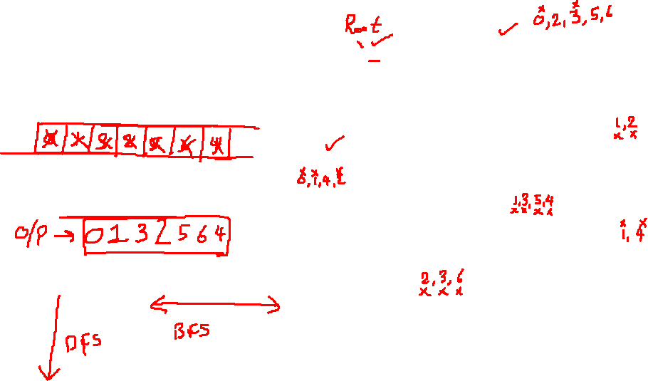
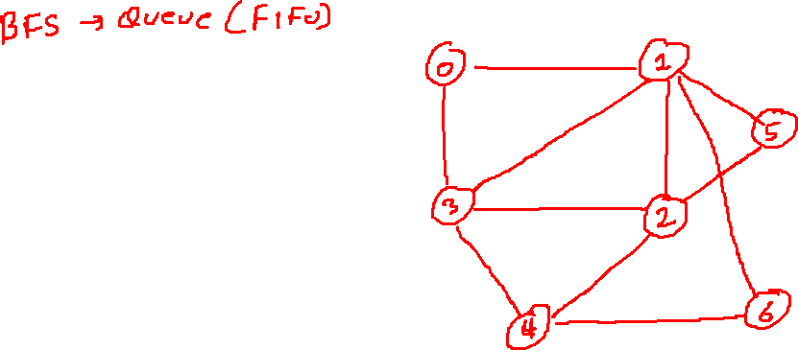

Slide 33
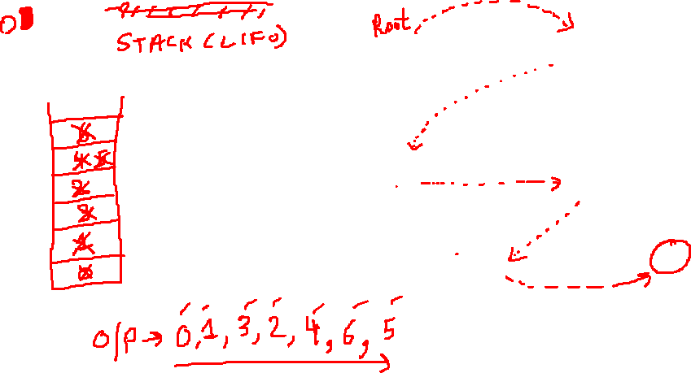

Slide 34
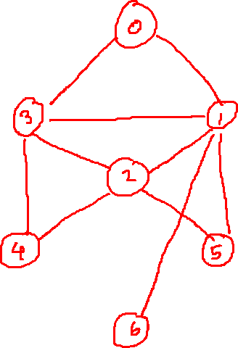


Slide 35
Depth First Search Algorithm
The Depth First Search algorithm progresses by expanding the starting node of G and thus going deeper and deeper until a goal node is found, or until a node that has no children is encountered. When a dead- end is reached, the algorithm backtracks, returning to the most recent node that has not been completely explored.
In other words, the Depth- First Search algorithm begins at a starting node A which becomes the current node. Then it examines each node N along a path P which begins at A. That is, we process a neighbor of A, then a neighbor of neighbor of A and so on. During the execution of the algorithm, if we reach a path that has a node N that has already been processed, then we backtrack to the current node. Otherwise, the un-visited (un-processed node) becomes the current node.

Slide 36
Depth First Search Algorithm
Algorithm for depth-first search in a graph G beginning at a starting node A
Step 1: SET STATUS = 1 (ready state) for each node in G.
Step 2: Push the starting node A on the stack and set its STATUS = 2 (waiting state)
Step 3: Repeat Steps 4 and 5 until STACK is empty
Step 4: Pop the top node N. Process it and set its STATUS = 3 (processed state).
Step 5: Push on to the stack all the neighbors of N that are in the ready state (whose STATUS = 1) and set their STATUS = 2 (waiting state)
  [END OF LOOP]
  Step 6: EXIT

Slide 37
Depth First Search Algorithm
Example: Consider the graph G given below. The adjacency list of G is also given. Suppose we want to print all nodes that can be reached from the node H (including H itself). One alternative is to use a Depth- First Search of G starting at node H. the procedure can be explained as below.
A
Adjacency Lists
A: B, C, D B: E C: B, G D: C, G E: C, F F: C, H G: F, H, I H: E, I I: F
B
C
D
E
F
G
H
I

Slide 38
Depth First Search Algorithm
Push H on to the stack
STACK: H
Pop and Print the top element of the STACK, that is, H. Push all the neighbors of H on to the stack that are in the ready state. The STACK now becomes:
STACK: E, I
Pop and Print the top element of the STACK, that is, I. Push all the neighbors of I on to the stack that are in the ready state. The STACK now becomes:
STACK: E, F
PRINT: I
Pop and Print the top element of the STACK, that is, F. Push all the neighbors of F on to the stack that are in the ready state. (Note F has two neighbors C and H. but only C will be added as H is not in the ready state). The STACK now becomes:
PRINT: F
STACK: E, C
Pop and Print the top element of the STACK, that is, C. Push all the neighbors of C on to the stack that are in the ready state. The STACK now becomes:

Slide 39
Depth First Search Algorithm
STACK: E, B, G
PRINT: C
Pop and Print the top element of the STACK, that is, G. Push all the neighbors of G on to the stack that are in the ready state. Since there are no neighbors of G that are in the ready state no push operation is performed. The STACK now becomes:
PRINT G:
STACK: E, B
Pop and Print the top element of the STACK, that is, B. Push all the neighbors of B on to the stack that are in the ready state. Since there are no neighbors of B that are in the ready state no Push operation is performed. The STACK now becomes:
PRINT e:
STACK: E
Pop and Print the top element of the STACK, that is, E. Push all the neighbors of E on to the stack that are in the ready state. Since there are no neighbors of E that are in the ready state no Push operation is performed. The STACK now becomes empty: PRINT: E. Since the STACK is now empty, the depth-first search of G starting at node H is complete and the nodes which were printed are-H, I, F, C, G, B E. These are the nodes which are reachable from the node H.

Slide 40
Topological Sorting
Topological sort of a directed acyclic graph (DAG) G, is defined as a linear ordering of its nodes in which each node comes before all nodes to which it has outbound edges. Every DAG has one or more number of topological sorts.
That is, a topological sort of a directed acyclic graph (DAG) G is an ordering of the vertices of G such that if G contains an edge (u, v), then u appears before v in the ordering.
Note that topological sort is possible only on directed acyclic graphs that do not have any cycle. For a DAG that contains cycle, no linear ordering of its vertices is possible.
In simple words, a topological ordering of a DAG G, is an ordering of its vertices such that any directed path in G, traverses vertices in increasing order.
Topological sorting is widely used in scheduling applications, jobs or tasks. The jobs that have to be completed are represented by nodes, and there is an edge from node u to v if job u must be completed before job v can be started. A topological sort of such a graph gives an order in which the given jobs must be performed.

Slide 41
Topological Sorting
Algorithm to find a Topological Sort T of a Directed Acyclic Graph, G
Step 1: Find the indegree INDEG(N) of every node in the graph
Step 2: Enqueue all the nodes with a zero in-degree
Step 3: Repeat Steps 4 and 5 until the QUEUE is empty
Step 4: Remove the front node N of the QUEUE by setting FRONT = FRONT + 1
Step 5: Repeat for each neighbor M of node N:
a) Delete the edge from N to M by setting INDEG(M) = INDEG(M) – 1
b) IF INDEG(M) = 0, then Enqueue M, that is, add M to the rear of the queue
[END OF INNER LOOP]
[END OF LOOP]
Step 6: Exit

Slide 42
Minimum Spanning Tree
A spanning tree of a connected, undirected graph G, is a sub-graph of G which is a tree that connects all the vertices together. A graph G can have many different spanning trees.
When we assign weights to each edge (which is a number that represents how unfavorable the edge is), and use it to assign a weight to a spanning tree by calculating the sum of the weights of the edges in that spanning tree.
A minimum spanning tree (MST) is defined as a spanning tree with weight less than or equal to the weight of every other spanning tree. In other words, a minimum spanning tree is a spanning tree that has weights associated with its edges, and the total weight of the tree (the sum of the weights of its edges) is at a minimum.

Slide 43
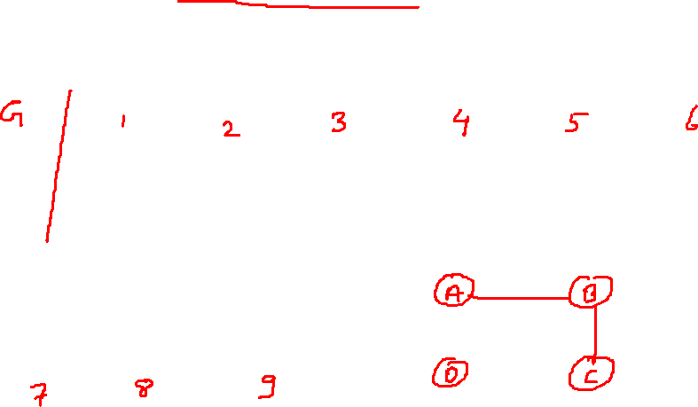
Minimum Spanning Tree
Example: Consider an un-weighted graph G given below. From G we can draw many distinct spanning trees. (Eight of them are given here). For an un-weighted graph, every spanning tree is a minimum spanning tree.
A
B
A
B
A
B
A
B
A
B
A
B
A
B
C
D
C
D
C
D
C
D
C
D
C
D
C
D
Unweighted Graph
A
B
A
B
A
B
C
D
C
D
C
D

Slide 44
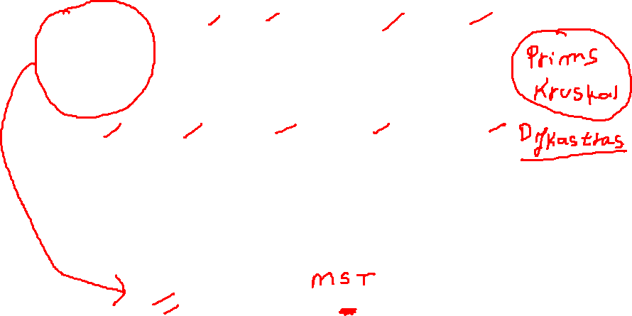
Minimum Spanning Tree
Example: Consider a weighted graph G given below. From G we can draw three distinct spanning trees. But only a single minimum spanning tree can be obtained, that is, the one that has minimum weight (cost) associated with it.
A
3
B
A
3
B
A
3
B
A
B
A
3
B
4
7
5
7
5
6
7
4
6
C
D
C
D
C
D
C
2
D
C
D
2
2
2
2
3
3
3
A
B
A
B
A
B
A
B
A
B
3
4
5
5
6
4
7
5
7
6
C
D
C
D
C
D
C
D
C
D
2
2
Thus, we see that of all the given spanning trees, the tree given below is called the minimum spanning tree as it has the lowest cost associated with it.
A
3
B
4
Total Cost = 9
C
D
2

Slide 45
Prim’s Algorithm for creating a minimum Spanning Tree
Tree vertices: Vertices that are a part of the minimum spanning tree T.
Fringe vertices: Vertices that are currently not a part of T, but are adjacent to some tree vertex.
Unseen Vertices: Vertices that are neither tree vertices nor fringe vertices fall under this category.
The steps in the Prim algorithm can be given as shown in figure.
Choose a starting vertex
Branch out from the starting vertex and during each iteration select a new vertex and edge. Basically, during each iteration of the algorithm, we have to select a vertex from the fringe vertices in such a way that the edge connecting the tree vertex and the new vertex has minimum weight assigned to it.

Slide 46
Prim’s Algorithm for creating a minimum Spanning Tree
Prim Algorithm
Step 1: Select a starting vertex
Step 2: Repeat Steps 3 and 4 until there are fringe vertices
Step 3: Select an edge e connecting the tree vertex and fringe vertex that has minimum weight
Step 4: Add the selected edge and the vertex to the minimum spanning tree T
  [END OF LOOP]
  Step 5: EXIT

Slide 47
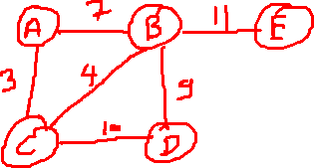
Prim’s Algorithm for creating a minimum Spanning Tree
Example: Construct a minimum spanning tree of the graph given below.
7
11
A
B
E
3
4
9
C
D
10
Choose a starting vertex, A for example.
A
Add the fringe vertices (that are adjacent to A). The edges connecting the vertex and fringe vertices are shown with dotted lines.
7
A
B
3
C

Slide 48
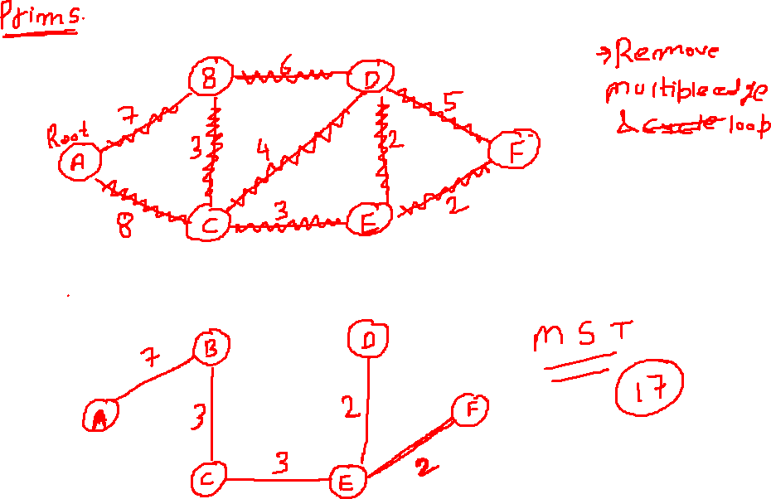

Slide 49
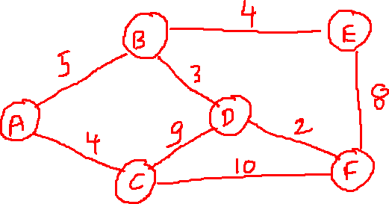
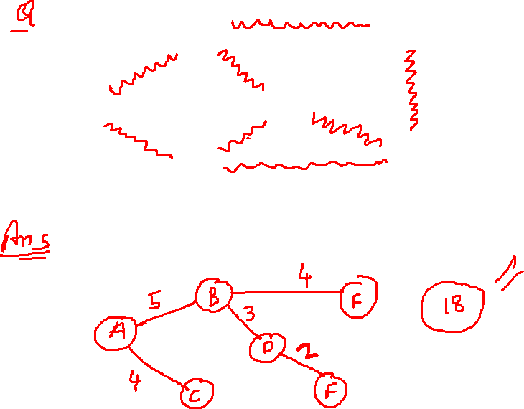

Slide 50
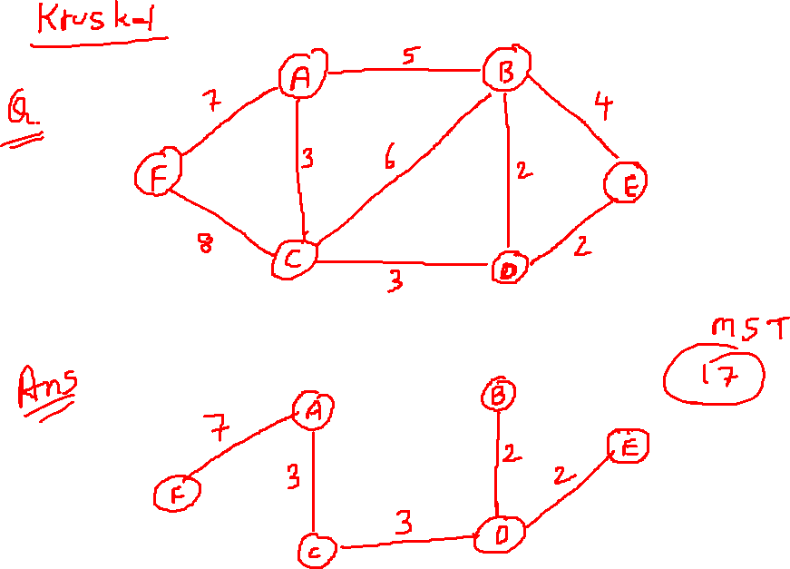

Slide 52
Prim’s Algorithm for creating a minimum Spanning Tree
Select an edge connecting the tree vertex and fringe vertex that has minimum weight and add the selected edge and the vertex to the minimum spanning tree T. Since the edge connecting A and C has less weight, so add C to the tree. Now C is not a fringe vertex but a tree vertex.
7
A
B
3
C
Add the fringe vertices (that are adjacent to C).
A
7
B
3
4
C
D
10

Slide 53
Prim’s Algorithm for creating a minimum Spanning Tree
Select an edge connecting the tree vertex and fringe vertex that has minimum weight and add the selected edge and the vertex to the minimum spanning tree T. Since the edge connecting C and B has less weight, so add B to the tree. Now B is not a fringe vertex but a tree vertex.
A
B
3
4
C
D
10
Add the fringe vertices (that are adjacent to B).
11
A
B
E
3
4
9
C
D
10

Slide 54
Prim’s Algorithm for creating a minimum Spanning Tree
Select an edge connecting the tree vertex and fringe vertex that has minimum weight and add the selected edge and the vertex to the minimum spanning tree T. Since the edge connecting B and D has less weight, so add D to the tree. Now D is not a fringe vertex but a tree vertex.
11
A
B
E
3
4
9
C
D
Note, now node E is not connected, so we will add it in the tree because a minimum spanning tree is one in which all n nodes are connected with n-1 edges that has minimum weight. So the minimum spanning tree can now be given as,
11
A
B
E
3
4
9
C
D

Slide 55
Kruskal’s Algorithm
Like the Prim’s algorithm, the Kruskal's algorithm is used to find a minimum spanning tree for a connected weighted graph. That is, the algorithm aims to find a subset of the edges that forms a tree that includes every vertex. The total weight of all the edges in the tree is minimized. However, if initially, the graph is not connected then it finds a minimum spanning forest (Note that a forest is a collection of trees. Similarly, a minimum spanning forest is a collection of minimum spanning trees).
Kruskal's algorithm is an example of a greedy algorithm as it makes the locally optimal choice at each stage with the hope of finding the global optimum. The algorithm can be given as shown in figure.

Slide 56
Kruskal’s Algorithm
KRUSKAL’S ALGORTIHM
Step 1: Create a forest in such a way that each graph is a separate tree.
Step 2: Create a priority queue Q that contains all the edges of the graph.
Step 3: Repeat Steps 4 and 5 while Q is NOT EMPTY
Step 4: Remove an edge from Q
Step 5: IF the edge obtained in Step 4 connects two different trees, then
  Add it to the forest (for combining two trees into one tree).
ELSE
Discard the edge
Step 6: END

Slide 57
Kruskal’s Algorithm
Example: Apply Kruskal’s algorithm on the graph given below
7
A
1
B
8
C
5
D
4
5
E
F
2
Initially, we have F = {{A}, {B}, {C}. {D}, {E}, {F}}
MST = {}
Q = {(A, D), (E, F), (C, E), (E, D), (C, D), (D, F), (A, C), (A, B), (B, C)}
Step 1: Remove the edge (A, D) from Q and make the following changes

Slide 58
Kruskal’s Algorithm
A
7
A
1
6
D
B
D
B
8
C
C
5
3
4
5
F = {{A, D}, {B}, {C}, {E}, {F}}
MST = {A, D}
Q = {(E, F), (C, E), (E, D), (C, D), (D, F), (A, C), (A, B), (B, C)}
Step 2: Remove the edge (E, F) from Q and make the following changes
E
E
F
F
2
7
A
6
1
B
8
C
5
D
3
4
5
E
F
2

Slide 59
Kruskal’s Algorithm
F = {{A, D}, {B}, {C}, {E, F}}
MST = {(A, D), (E, F)}
Q = {(C, E), (E, D), (C, D), (D, F), (A, C), (A, B), (B, C)}
Step 3: Remove the edge (C, E) from Q and make the following changes
7
A
6
1
B
8
C
5
D
4
5
3
E
F
2
F = {{A, D}, {B}, {C, E, F}}
MST = {(A, D), (C, E), (E, F)}
Q = {(E, D), (C, D), (D, F), (A, C), (A, B), (B, C)}

Slide 60
Kruskal’s Algorithm
Step 4: Remove the edge (E, D) from Q and make the following changes
7
A
1
6
D
B
8
C
5
F = {{A, C, D, E, F}, {B}}
MST = {(A, D), (C, E), (E, F), (E, D)}
Q = {(C, D), (D, F), (A, C), (A, B), (B, C)}
Step 5: Remove the edge (C, D) from Q. Note this edge does not connect different trees, so simply discard this edge. (Only an edge connecting (A, D, C, E, F) to B will be added to the MST). So now,
F = {{A, C, D, E, F}, {B}}
MST = {(A, D), (C, E), (E, F), (E, D)}
Q = {(D, F), (A, C), (A, B), (B, C)}
Step 6: Remove the edge (D, F) from Q. Note this edge does not connect different trees, so simply discard this edge. (Only an edge connecting (A, D, C, E, F) to B will be added to the MST).
4
5
3
E
F
2

Slide 61
Kruskal’s Algorithm
F = {{A, C, D, E, F}, {B}}
MST = {(A, D), (C, E), (E, F), (E, D)}
Q = {(A, C), (A, B), (B, C)}
Step 7: Remove the edge (A, C) from Q. Note this edge does not connect different trees, so simply discard this edge. (Only an edge connecting (A, D, C, E, F) to B will be added to the MST).
F = {{A, C, D, E, F}, {B}}
MST = {(A, D), (C, E), (E, F), (E, D)}
Q = {(A, B), (B, C)}
Step 8: Remove the edge (A, B) from Q and make the following changes
7
A
1
B
8
C
D
3
4
E
F
2

Slide 62
Kruskal’s Algorithm
F = {A, B, C, D, E, F}
MST = {(A, D), (C, E), (E, F), (E, D), (A, B)}
Q = {(B, C)}
Step 9: The algorithm continues until Q is empty. But since the entire forest has become one tree, all remaining edges will simply be discarded. The resultant MST can be given as shown below.
F = {A, B, C, D, E, F}
MST = {(A, D), (C, E), (E, F), (E, D), (A, B)}
Q = {}
7
A
1
B
D
C
3
4
E
F
2

Slide 63
Dijsktra’s Algorithm
Dijkstra's algorithm, given by a Dutch scientist Edsger Dijkstra in 1959, is used to find the shortest path tree. This algorithm is widely used in network routing protocols, most notably IS-IS and OSPF (Open Shortest Path First).
Given a graph G and a source node A, the algorithm is used to find the shortest path (one having the lowest cost) between A (source node) and every other node. Moreover, Dijkstra’s algorithm is also used for finding costs of shortest paths from a source node to a destination node.

Slide 64
Dijsktra’s Algorithm
Dijkastra’s Algorithm
  Select the source node also called the initial node
Define an empty set N that will be used to hold nodes to which a shortest path has been found.
Label the initial node with 0, and insert it into N.
Repeat Steps 5 to 7 until the destination node is in N or there are no more labeled nodes in N.
Consider each node that is not in N and is connected by an edge from the newly inserted node.
    a. If the node that is not in N has no labeled then SET the label of the node = the label of the newly inserted node + the length of the edge.
  b. Else if the node that is not in N was already labeled, then SET its new label = minimum (label of newly inserted vertex + length of edge, old label)
  Pick a node not in N that has the smallest label assigned to it and add it to N

Slide 65
Dijsktra’s Algorithm
Dijkstra's algorithm labels every node in the graph where the labels represent the distance (cost) from the source node to that node. There are two kinds of labels: temporary and permanent. While temporary labels are assigned to nodes that have not been reached, permanent labels are given to nodes that have been reached and their distance (cost) to the source node is known. A node must be a permanent label or a temporary label, but not both.
The execution of this algorithm will produce either of two results-
If the destination node is labeled, then the label will in turn represent the distance from the source node to the destination node.
If it the destination node is not labeled, then it means that there is no path from the source to the destination node.

Slide 66
Dijsktra’s Algorithm
Example: Consider the graph G given below. Taking D as the initial node, execute the Dijkastra’s algorithm on it.
4
A
B
17
2
15
C
5
D
23
E
9
11
F
G
13

Slide 67
Dijsktra’s Algorithm
Step 1: SET the label of D = 0 and N = {D}.
Step 2: Label of D = 0, B = 15, G = 23 and F = 5. Therefore, N = {D, F}.
Step 3: Label of D = 0, B = 15, G has been re-labeled 18 because minimum (5 + 13, 23) = 18, C has been re-labeled 14 (5 + 9). Therefore, N = {D, F, C}.
Step 4: Label of D = 0, B = 15, G = 18. Therefore, N = {D, F, C, B}.
Step 5: Label of D = 0, B = 15, G = 18 and A = 19 (15 + 4). Therefore, N = {D, F, C, B, G}.
Step 6: Label of D = 0 and A = 19. Therefore, N = {D, F, C, B, G, A}
Note that we have no label for node E, this means that E is not reachable from D. only the nodes that are in N are reachable from B.

Slide 68
Warshall’s Algorithm
If a graph G is given as G = (V, E), where, V is the set of vertices and E is the set of edges, the path matrix of G can be found as explained in section 1.3. That is, P = A + A2 + A3 +.. + An. This is a lengthy process, so Warshall has given a very efficient algorithm to calculate the shortest path between two vertices. Warshall’s algorithm defines matrices P0, P1, P2, …. Pn as given as
0 otherwise
P_{k}[i][j]
1 if there is a path from v_{i} to v_{j.} The path should not use any other nodes except v₁, v₂, …., v_{k}

Slide 69
Warshall’s Algorithm
This means, if P0[i][j] = 1, then there exists an edge from node vi to vj.
If P1[i][j] = 1, then there exists an edge from vi to vj that does not use any other vertex except v1.
If P2[i][j] = 1, then there exists an edge from vi to vj that does not use any other vertex except v1 and v2.
Note P0 is equal to the adjacency matrix of G. If G contains n nodes then Pn = P which is the path matrix of the graph G.

Slide 70
Warshall’s Algorithm
Therefore, we can conclude that, Pk[i][j] is equal to 1 only when wither of the two cases occur:
There is a path from vi to vj that does not use any other node except v1, v2, …, vk-1. Therefore, Pk-1[i][j] = 1.
There is a path from vi to vk and a path from a path from vk to vj where every edge does not use any other node except v1, v2, …, vk-1.
Therefore,
Pk-1[i][k] = 1 AND Pk-1[k][j] = 1
Hence, the path matrix Pn can be calculated with the formula given as,
Pk[i][j] = Pk-1[i][j] V (Pk-1[i][k] Λ Pk-1[k][j])

Slide 71
Warshall’s Algorithm
Warshall’s algorithm to find path matrix P
Step 1: [Initialize the Path Matrix] Repeat Step 2 for I = 0 to n-1, where n is the number of nodes in the graph
Step 2: Repeat Step 3 for J = 0 to n-1
Step 3: IF A[I][J] = 0, then SET P[I][J] = 0
ELSE P[I][J] = 1
[END OF LOOP]
[END OF LOOP]
Step 4: [Calculate the path matrix P] Repeat Step 5 for K = 0 to n-1
Step 5: Repeat Step 6 for I = 0 to n-1
Step 6: Repeat Step 7 for J=0 to n-1
Step7: SET P_{K}[I][J] = P_{K-1}[I][J] V (P_{K-1}[I][K] Λ P_{K-1}[K][J])
Step 8: EXIT

Slide 72
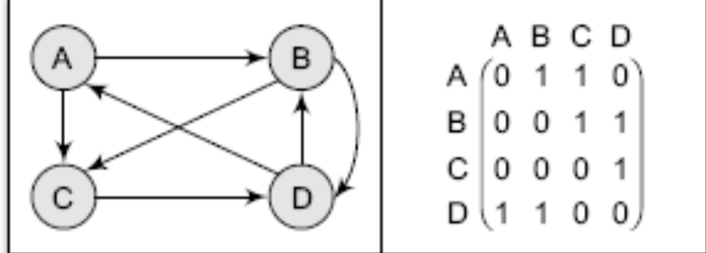
Warshall’s Algorithm
Example: Consider the graph given below and its adjacency matrix A. We can straight away calculate path matrix P using the Warshall’s algorithm.

Slide 73
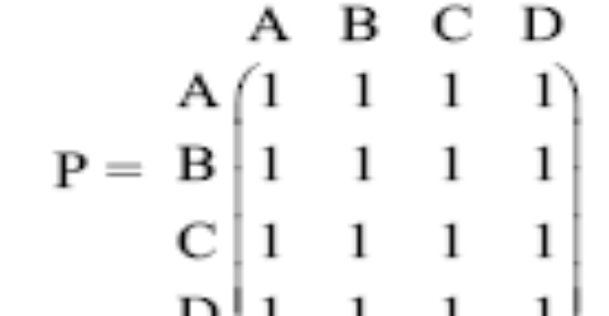
Warshall’s Algorithm
Now path matrix, P can be given in a single step as
P =
Thus, we see that calculating A, A2, A3, A4,.., A5 to calculate P is a very slow and inefficient technique as and when compared to the Warshall’s technique.

Slide 74
Warshall’s Algorithm
MODIFIED WARSHALL’S ALGORITHM TO FIND SHORTEST PATH
The modified Warshall’s algorithm is used to obtain a matrix that gives the shortest paths between the nodes in graph G. As an input to the algorithm, we will take the Adjacency matrix A of G and replace all those values of A which are zero by infinity (∞). Infinity (∞) denotes a very large number and indicates that there no path between the vertices. In Warshall’s modified algorithm, we will obtain a set of matrices Q0, Q1, Q2,…., Qm using the formula given below.
Qk[i][j] = Minimum( Mk-1[i][j], Mk-1[i][k] + Mk-1[k][j])
Q0 is exactly the same as A with a little difference that every element that has a zero value in A is replaced by (∞) in Q0. Using the formula given above the matrix Qn will give the path matrix that has the shortest path between the vertices of the graph.

Slide 75
Warshall’s Algorithm
Warshall’s modified algorithm to find the shortest path matrix P
Step 1: [Initialize the Shortest Path Matrix, Q] Repeat Step 2 for I = 0 to n-1, where n is the number of nodes in the graph
Step 2: Repeat Step 3 for J = 0 to n-1
Step 3: IF A[I][J] = 0, then SET Q[I][J] = Infinity (or 9999)
ELSE Q[I][J] = A[I][j]
[END OF LOOP]
[END OF LOOP]
Step 4: [Calculate the shortest path matrix Q] Repeat Step 5 for K = 0 to n-1
Step 5: Repeat Step 6 for I = 0 to n-1
Step 6: Repeat Step 7 for J=0 to n-1
Step7: IF Q[I][J] <= Q[I][K] + Q[K][J]
SET Q[I][J] = Q[I][J]
ELSE SET Q[I][J] = Q[I][K] + Q[K][J]
[END OF IF]
[END OF LOOP]
[END OF LOOP]
[END OF LOOP]
Step 8: EXIT

