Slide 1
Engineering Economics Estimating Models

Slide 2
Benefits of Estimating:
Accurate estimating is crucial for effective project management and decision-making. Some benefits include:
Resource Allocation: Proper estimates help allocate resources effectively, ensuring that projects have the necessary manpower, materials, and budget.
Risk Management: Accurate estimates allow for better identification and management of potential risks, helping to mitigate negative impacts.
Project Planning: Estimates are essential for creating realistic project schedules, setting milestones, and defining project objectives.
Cost Control: Accurate cost estimates help control project budgets and prevent cost overruns.
Client Communication: Clear and accurate estimates enhance communication with clients, establishing trust and transparency.

Slide 3
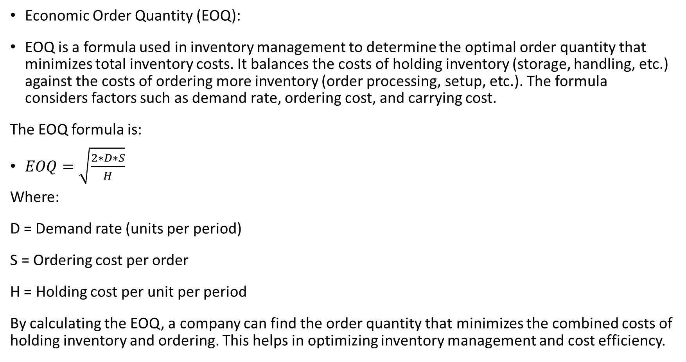
Economic Order Quantity (EOQ):
EOQ is a formula used in inventory management to determine the optimal order quantity that minimizes total inventory costs. It balances the costs of holding inventory (storage, handling, etc.) against the costs of ordering more inventory (order processing, setup, etc.). The formula considers factors such as demand rate, ordering cost, and carrying cost.
The EOQ formula is:
$EOQ=\sqrt{\frac{2∗D∗S}{H}}$
Where:
D = Demand rate (units per period)
S = Ordering cost per order
H = Holding cost per unit per period
By calculating the EOQ, a company can find the order quantity that minimizes the combined costs of holding inventory and ordering. This helps in optimizing inventory management and cost efficiency.

Slide 4
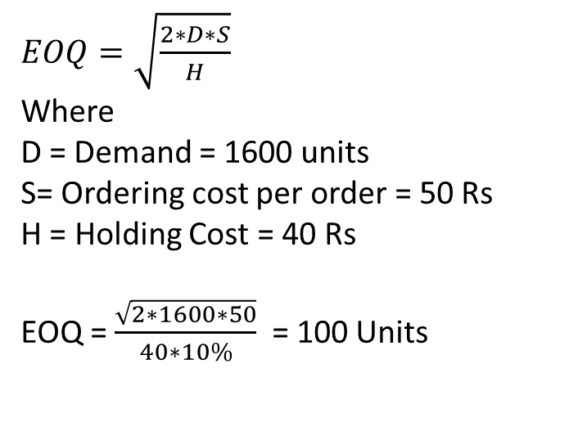
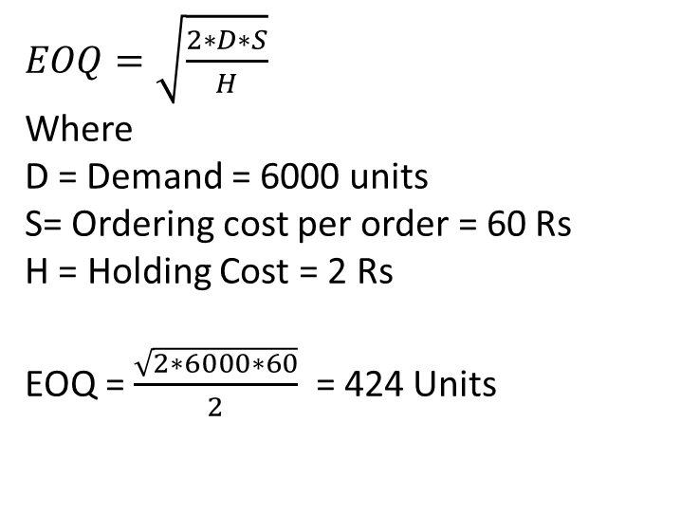
Question 1
Calculate Economic Order Quantity (EOQ) from the following:
Annual consumption 6,000 units
Cost of ordering Rs. 60
Carrying costs Rs. 2
Question 2
From the following particulars, calculate the Economic Order Quantity (EOQ):
Annual requirements 1,600 units
Cost of materials per units Rs. 40
Cost of placing and receiving one order: Rs. 50
Annual carrying cost for inventory value 10%
$EOQ=\sqrt{\frac{2∗D∗S}{H}}$
Where
D = Demand = 6000 units
S= Ordering cost per order = 60 Rs
H = Holding Cost = 2 Rs
EOQ = $\frac{\sqrt{2∗6000∗60}}{2}$ = 424 Units
$EOQ=\sqrt{\frac{2∗D∗S}{H}}$
Where
D = Demand = 1600 units
S= Ordering cost per order = 50 Rs
H = Holding Cost = 40 Rs
EOQ = $\frac{\sqrt{2∗1600∗50}}{40∗10\%}$ = 100 Units

Slide 5
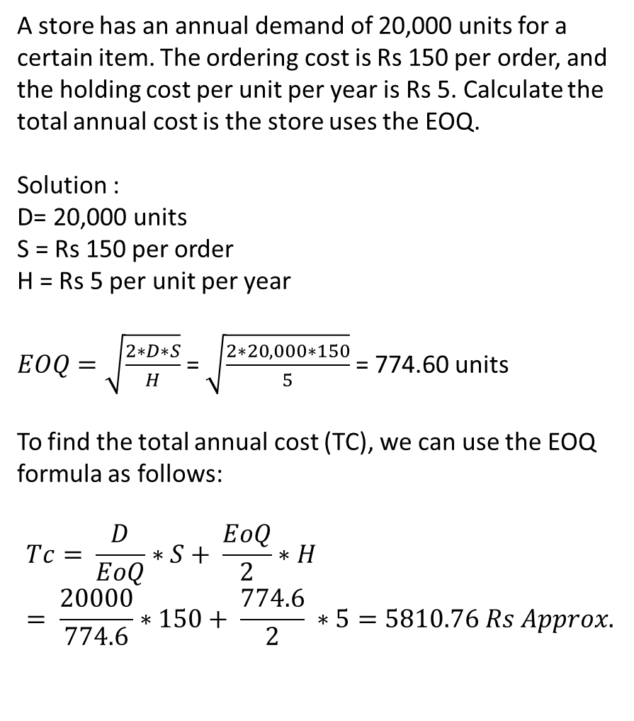
A store has an annual demand of 20,000 units for a certain item. The ordering cost is Rs 150 per order, and the holding cost per unit per year is Rs 5. Calculate the total annual cost is the store uses the EOQ.
Solution :
D= 20,000 units
S = Rs 150 per order
H = Rs 5 per unit per year
$EOQ=\sqrt{\frac{2∗D∗S}{H}}$ = $\sqrt{\frac{2∗20,000∗150}{5}}$ = 774.60 units
To find the total annual cost (TC), we can use the EOQ formula as follows:
$$Tc= \frac{D}{EoQ}∗S+ \frac{EoQ}{2}∗H= \frac{20000}{774.6}∗150+ \frac{774.6}{2} ∗5=5810.76 Rs Approx.$$

Slide 6
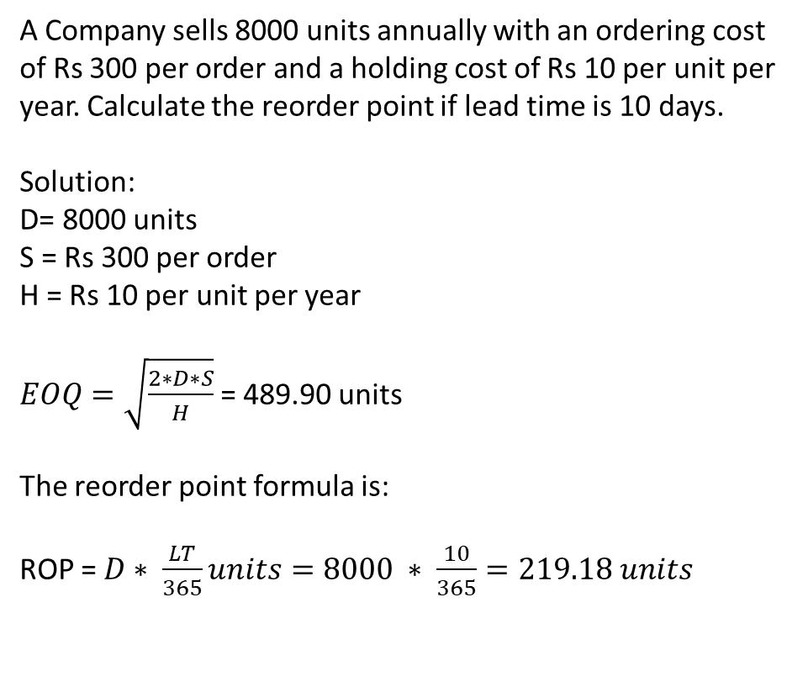
A Company sells 8000 units annually with an ordering cost of Rs 300 per order and a holding cost of Rs 10 per unit per year. Calculate the reorder point if lead time is 10 days.
Solution:
D= 8000 units
S = Rs 300 per order
H = Rs 10 per unit per year
$EOQ=\sqrt{\frac{2∗D∗S}{H}}$ = 489.90 units
The reorder point formula is:
ROP = $D∗ \frac{LT}{365}units=8000 ∗ \frac{10}{365}=219.18 units$

Slide 7
Practice Problem
A company has an annual demand of 10,000 units, an ordering cost of INR 150 per order, and a holding cost of INR 7 per unit per year. Calculate the optimal reorder quantity and the minimum total cost.

Slide 8
Estimating Models
Estimating models for engineering economics involve using various mathematical and analytical techniques to predict and evaluate the financial performance of engineering projects and investments. These models help engineers and decision-makers make informed choices about whether to proceed with a project based on its potential economic returns. Here are some common estimating models used in engineering economics:
Net Present Value (NPV)
Internal Rate of Return (IRR)
Payback Period
Benefit-Cost Ratio (BCR)
Sensitivity Analysis
Scenario Analysis
Monte Carlo Simulation
Capital Budgeting Techniques
Internal Rate of Return (IRR)
Replacement Analysis
Real Options Analysis

Slide 9
Net Present Value (NPV)
NPV is a fundamental concept in engineering economics. It involves estimating the present value of all expected cash inflows and outflows associated with a project or investment. The NPV is calculated by discounting future cash flows to their present value using a predetermined discount rate. If the NPV is positive, the project is usually considered economically viable.

Slide 10
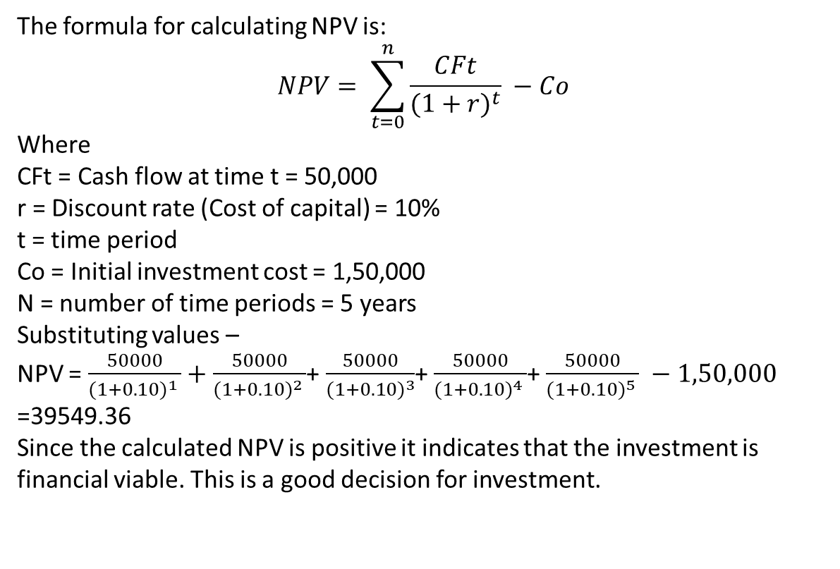
You are considering an investment opportunity to purchase a piece of equipment for your manufacturing business. The initial cost of the equipment is 1,50,000 INR. The equipment is expected to generate cash flows of 50,000 INR at the end of each year for the next 5 years. The cost of capital for your business is 10%. Calculate the Net Present Value (NPV) of the investment and determine whether it's a financially viable decision.
The Net Present Value (NPV) of an investment is calculated by discounting the future cash flows generated by the investment back to their present value and subtracting the initial investment cost.
The formula for calculating NPV is:
$$NPV= \sum_{t=0}^{n}{\frac{CFt}{{(1+r)}^{t}} −Co}$$
Where
CFt = Cash flow at time t = 50,000
r = Discount rate (Cost of capital) = 10%
t = time period
Co = Initial investment cost = 1,50,000
N = number of time periods = 5 years
Substituting values –
NPV = $\frac{50000}{{(1+0.10)}^{1} }+$ $\frac{50000}{{(1+0.10)}^{2} }$+ $\frac{50000}{{(1+0.10)}^{3}}$+ $\frac{50000}{{(1+0.10)}^{4} }$+ $\frac{50000}{{(1+0.10)}^{5} } −1,50,000$
=39549.36
Since the calculated NPV is positive it indicates that the investment is financial viable. This is a good decision for investment.

Slide 11
Practice Problem
You are considering investing in a real estate project. The project involves purchasing a piece of land for 2,00,000 INR. You anticipate that the project will generate cash flows of 30,000 INR at the end of each year for the next 8 years. However, the cost of capital for this type of project is 12%. Calculate the Net Present Value (NPV) of the investment and determine whether it's financially feasible.
Ans -- NPV = -22578.67
Since the calculated NPV is negative (-22,578.67 INR), it indicates that the investment is not financially feasible. A negative NPV suggests that the project's potential returns do not exceed the cost of capital, making it an unfavorable investment decision. In such cases, it's generally advisable to avoid pursuing the investment as it may not provide satisfactory returns.

Slide 12
Internal Rate of Return (IRR):
IRR is the discount rate that makes the NPV of a project equal to zero. It represents the effective interest rate at which an investment breaks even. Projects with an IRR higher than the required rate of return are generally considered attractive.

Slide 13
Problem: Calculating Internal Rate of Return (IRR) for a Software Engineering Project
Suppose a software engineering company is evaluating an investment in a new project that involves developing a cutting-edge software product. The project requires an initial investment of 3,00,000 INR to cover development costs and equipment purchase. The company expects to generate cash flows of 1,00,000 INR at the end of each year for the next five years from selling licenses of the software. After five years, the company also plans to sell the project at an estimated net cash flow of 1,50,000 INR. The company's required rate of return is 12%. Calculate the Internal Rate of Return (IRR) for this project and determine whether the company should proceed with it.

Slide 14
Step 1: Identify the cash flows for each year, including the initial investment and future cash flows:
Initial Investment: -3,00000 (outflow)
End of Year 1: 1,00000 (inflow)
End of Year 2: 1,00000 (inflow)
End of Year 3: 1,00000 (inflow)
End of Year 4: 1,00000 (inflow)
End of Year 5: 1,00000 (inflow)
End of Year 6 (sale of project): 1,50,000 (inflow)

Slide 15
Step 2: Calculate the Net Cash Flows for each year:
Year 1: 1,00000 – 3,00000 = -2,00000
Year 2: 1,00000
Year 3: 1,00000
Year 4: 1,00000
Year 5: 1,00000
Year 6: 1,50000

Slide 16
Step 3: Set up the equation to find the IRR. The IRR is the discount rate that makes the present value of cash inflows equal to the initial investment:
NPV = 0 = -3,00000 + (1,00000 / (1 + IRR)^1) + (1,00000 / (1 + IRR)^2) + (1,00000 / (1 + IRR)^3) + (1,00000 / (1 + IRR)^4) + (1,00000 / (1 + IRR)^5) + (1,50000 / (1 + IRR)^6)
Step 4: Solve for IRR using trial and error or by using computational tools (e.g., financial calculators, spreadsheet software). In this case, the calculated IRR is approximately 16.35%.
Step 5: Compare the calculated IRR (16.35%) with the company's required rate of return (12%). Since the calculated IRR (16.35%) is greater than the required rate of return (12%), the project is considered financially viable. The company should proceed with the software engineering project as it is expected to provide returns that exceed the company's cost of capital.

Slide 17
Conclusion:
The software engineering company should proceed with the project because the calculated Internal Rate of Return (IRR) of approximately 16.35% is higher than the company's required rate of return of 12%. This indicates that the project is expected to generate a return that justifies the initial investment and provides additional value to the company.

Slide 18
Payback Period
The payback period is the time required for an investment to generate sufficient cash flows to recover the initial investment cost. Projects with shorter payback periods are often preferred as they provide quicker returns.
The Payback Period is a financial metric used to evaluate the time it takes for an investment to generate enough cash flows to recover the initial investment cost. In the context of an engineering project, it helps assess the time it will take for the project to recoup its initial costs through the cash flows it generates. The formula to calculate the payback period is:
Payback Period = Initial Investment / Annual Cash Flow

Slide 19
Here's how you can calculate the Payback Period for an engineering project:
Determine the Initial Investment: Identify all the costs associated with starting the engineering project. This could include expenses like equipment costs, labor costs, research and development expenses, etc. Add up all these costs to get the initial investment.
Estimate Annual Cash Flows: Estimate the cash flows the project is expected to generate on an annual basis. This could include revenue from sales, cost savings, or any other relevant income generated by the project.
Calculate the Payback Period: Divide the Initial Investment by the Annual Cash Flow to calculate the payback period in years.
Payback Period = Initial Investment / Annual Cash Flow
It's important to note that the Payback Period metric has its limitations. It doesn't take into account the time value of money (the fact that money received in the future is worth less than money received today due to inflation and the opportunity cost of not investing the money elsewhere). Additionally, it doesn't provide insights into the profitability of the project beyond the payback period itself.
In engineering projects, it's advisable to use the Payback Period in conjunction with other financial metrics like Net Present Value (NPV), Internal Rate of Return (IRR), and Discounted Payback Period to get a more comprehensive view of the project's financial viability and potential risks. These metrics consider the time value of money and provide a better understanding of the project's long-term profitability.

Slide 20
Suppose a company invests $100,000 in a project, and it expects to receive annual cash inflows of $25,000.
Payback Period = Initial Investment / Annual Cash Flow = 100000/25000 = 4 Years

Slide 21
Benefit-Cost Ratio (BCR)
The BCR is the ratio of the present value of benefits to the present value of costs. A BCR greater than 1 indicates that the benefits outweigh the costs, making the project potentially desirable.
Problem: Inefficient Resource Allocation for Infrastructure Projects
Many government agencies and organizations struggle with the efficient allocation of resources for infrastructure projects. Limited budgets and competing project options often lead to decisions that may not yield the best outcomes in terms of societal benefits and costs. Without a proper assessment of projects, there is a risk of investing in projects with low returns and missing out on those with higher potential.

Slide 22
Solution: Benefit-Cost Ratio (BCR) Analysis
The Benefit-Cost Ratio (BCR) analysis is a valuable tool for evaluating and comparing the economic feasibility of different infrastructure projects. It helps decision-makers make informed choices by quantifying the ratio of the benefits derived from a project to the costs incurred. The BCR is calculated by dividing the present value of the project's benefits by the present value of its costs.
Steps for BCR Analysis:
Identify and quantify benefits: Identify the positive impacts that the project will bring to society, such as increased productivity, reduced travel time, improved safety, and environmental benefits. Quantify these benefits in monetary terms whenever possible.
Estimate project costs: Consider all relevant costs associated with the project, including construction costs, operational costs, maintenance costs, and any other direct or indirect expenses.
Timeframe and discounting: BCR analysis takes into account the time value of money by discounting future benefits and costs to present value. This ensures that the impact of money over time is properly considered.

Slide 23
Calculate BCR: Divide the present value of the benefits by the present value of the costs to calculate the BCR. A BCR greater than 1 indicates that the benefits outweigh the costs, making the project economically viable.
Compare projects: Rank and compare different projects based on their BCR values. Projects with higher BCR values are generally preferred, as they indicate a higher return on investment.
Sensitivity analysis: Since BCR analysis involves assumptions and estimates, it's important to perform sensitivity analysis to assess the impact of variations in key parameters. This helps decision-makers understand the robustness of their decisions.

Slide 24
Benefits of BCR Analysis:
Informed decision-making: BCR analysis provides a clear and quantitative basis for comparing projects, helping decision-makers allocate resources to projects with the highest potential benefits relative to costs.
Efficient resource allocation: By prioritizing projects with higher BCR values, organizations can maximize the impact of their limited resources.
Accountability and transparency: BCR analysis provides a transparent method for justifying project choices to stakeholders and the public, enhancing accountability.
Risk assessment: BCR analysis encourages the consideration of potential risks and uncertainties, fostering better risk management practices.
In conclusion, the Benefit-Cost Ratio (BCR) analysis is a powerful tool for addressing the problem of inefficient resource allocation for infrastructure projects. By utilizing BCR analysis, decision-makers can ensure that the projects they choose to invest in are economically sound and deliver the greatest societal benefits relative to the costs incurred.

Slide 25
A city is considering a road construction project that aims to improve traffic flow and reduce congestion. The estimated costs and benefits of the project are as follows:
Estimated construction cost: 50,00,000
Annual operational and maintenance cost: 2,00,000
Project duration: 10 years
Annual benefits in reduced travel time and fuel savings: 15,00000
Salvage value of the project at the end of 10 years: 5,00000
The city uses a discount rate of 8% for project evaluations. Calculate the Benefit-Cost Ratio (BCR) to determine whether the road construction project is economically viable.

Slide 26
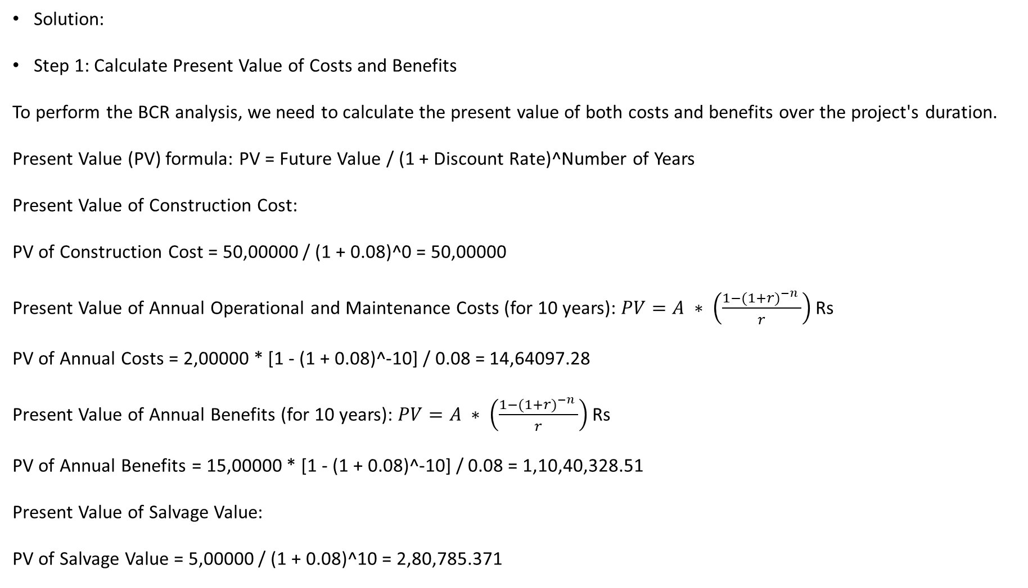
Solution:
Step 1: Calculate Present Value of Costs and Benefits
To perform the BCR analysis, we need to calculate the present value of both costs and benefits over the project's duration.
Present Value (PV) formula: PV = Future Value / (1 + Discount Rate)^Number of Years
Present Value of Construction Cost:
PV of Construction Cost = 50,00000 / (1 + 0.08)^0 = 50,00000
Present Value of Annual Operational and Maintenance Costs (for 10 years): $PV=A ∗ \left(\frac{1−{(1+r)}^{−n} }{r}\right)$ Rs
PV of Annual Costs = 2,00000 * [1 - (1 + 0.08)^-10] / 0.08 = 14,64097.28
Present Value of Annual Benefits (for 10 years): $PV=A ∗ \left(\frac{1−{(1+r)}^{−n} }{r}\right)$ Rs
PV of Annual Benefits = 15,00000 * [1 - (1 + 0.08)^-10] / 0.08 = 1,10,40,328.51
Present Value of Salvage Value:
PV of Salvage Value = 5,00000 / (1 + 0.08)^10 = 2,80,785.371

Slide 27
Step 2: Calculate Net Present Value (NPV)
Net Present Value (NPV) = PV of Benefits - PV of Costs
NPV = (11040328.51 + 280785.37) - (5000000 + 1464097.28) = 5857016.6
Step 3: Calculate BCR
BCR = (PV of Benefits + PV of Salvage Value) / (PV of Costs)
BCR = (11040328.51 + 280785.37) / (5000000 + 1464097.28) ≈ 2.22
Interpretation: The calculated BCR is approximately 2.22. Since the BCR is greater than 1, it indicates that the benefits of the road construction project outweigh the costs. A BCR greater than 1 indicates that for every dollar invested, there are 2.22 INR in benefits. Therefore, the road construction project is economically viable and would likely provide positive returns.
This analysis helps the city make an informed decision by quantifying the economic feasibility of the project and demonstrating its potential to generate significant benefits relative to the costs involved.

Slide 28
Sensitivity Analysis:
This involves analyzing how changes in key input parameters (such as cost estimates, revenue projections, and discount rates) affect the financial viability of a project. Sensitivity analysis helps identify the sensitivity of the project's outcome to variations in these parameters.

Slide 29
Case Study: Sensitivity Analysis in Financial Investment
Background:
ABC Investments is a financial firm that offers investment advice and manages portfolios for their clients. They have recently proposed an investment strategy to a high-net-worth client, Mr. Smith, which involves allocating his portfolio across various assets such as stocks, bonds, and real estate. Mr. Smith is concerned about the potential risks and uncertainties associated with this strategy, and he wants to understand how sensitive his returns would be to changes in certain key variables.
Objective: The objective of this sensitivity analysis is to assess the impact of changes in key variables on the overall returns of Mr. Smith's investment portfolio. This analysis will help Mr. Smith understand the potential risks and uncertainties associated with the proposed investment strategy.

Slide 30
Variables of Interest:
Stock Market Performance: This variable represents the annual return of the stock market, which directly influences the returns from the stocks in Mr. Smith's portfolio.
Interest Rates: Fluctuations in interest rates affect the returns from bonds and other fixed-income investments.
Real Estate Market: Changes in the real estate market impact the value and returns of the real estate holdings in the portfolio.
Inflation Rate: Inflation erodes the purchasing power of investments, affecting their real returns.
Methodology:
ABC Investments uses a financial modeling tool to perform sensitivity analysis. They create a model that simulates the performance of Mr. Smith's portfolio based on historical data, economic forecasts, and assumptions. Monte Carlo simulation is employed to generate multiple scenarios by randomly varying the input variables within defined ranges.

Slide 31
Steps:
Data Collection: ABC Investments gathers historical data on stock market returns, interest rates, real estate market trends, and inflation rates. They also collect information about Mr. Smith's portfolio allocation.
Scenario Definition: ABC Investments defines ranges for each key variable. For instance, they might consider a range of -2% to +2% for stock market returns, ±0.5% for interest rates, etc.
Model Development: Using the collected data and assumptions, ABC Investments builds a financial model that calculates the overall returns of Mr. Smith's portfolio based on different combinations of input variables.
Monte Carlo Simulation: They run the model through thousands of iterations, randomly selecting values for each key variable within their defined ranges. For each iteration, the model calculates the portfolio returns.
Results Analysis: ABC Investments analyzes the simulation results to identify patterns and trends. They create various visualizations, such as histograms and scatter plots, to demonstrate the distribution of possible portfolio returns under different scenarios.

Slide 32
Sensitivity Metrics: ABC Investments calculates sensitivity metrics such as the standard deviation of portfolio returns, correlation coefficients, and value-at-risk (VaR) to quantify the impact of each variable on the portfolio's overall performance.
Recommendations: Based on the analysis, ABC Investments provides Mr. Smith with insights into the potential range of returns and risks associated with the proposed investment strategy. They discuss strategies to mitigate risks, such as diversification and hedging.
Conclusion: Sensitivity analysis helps Mr. Smith and ABC Investments understand the potential vulnerabilities and uncertainties in the proposed investment strategy. By quantifying the impact of key variables on portfolio returns, they can make more informed decisions and tailor the strategy to Mr. Smith's risk tolerance and financial goals.

Slide 33
Scenario Analysis:
Similar to sensitivity analysis, scenario analysis involves examining different scenarios that could impact the project's financial performance. It goes beyond single-variable changes and considers multiple variables together.

Slide 34
Suppose you are a financial analyst evaluating an investment opportunity in a startup company. The company is developing a new product, and its success will depend on various market conditions. You've identified three potential scenarios with associated probabilities and projected cash flows. You want to use scenario analysis to assess the investment's potential returns.
Scenarios:
Optimistic Market (Probability: 40%)
Projected Cash Flow: 3,00000
Moderate Market (Probability: 50%)
Projected Cash Flow: 1,50000
Pessimistic Market (Probability: 10%)
Projected Cash Flow: -50,000 (Negative value indicates a loss)
Calculate the expected cash flow and standard deviation of cash flows to assess the investment's potential outcomes.

Slide 35
Solution:
Expected Cash Flow = (Probability of Scenario 1 * Cash Flow of Scenario 1) + (Probability of Scenario 2 * Cash Flow of Scenario 2) + (Probability of Scenario 3 * Cash Flow of Scenario 3)
Expected Cash Flow = (0.40 * 300000) + (0.50 * 150000) + (0.10 * -50000) = 120000 + 75000 - 5000 = 190000
The expected cash flow for the investment is 190000.
Standard Deviation of Cash Flows = √[ (Probability of Scenario 1 * (Cash Flow of Scenario 1 - Expected Cash Flow)^2) + (Probability of Scenario 2 * (Cash Flow of Scenario 2 - Expected Cash Flow)^2) + (Probability of Scenario 3 * (Cash Flow of Scenario 3 - Expected Cash Flow)^2) ]
Standard Deviation of Cash Flows = √[ (0.40 * (300000 - 190000)^2) + (0.50 * (150000 - 190000)^2) + (0.10 * (-50000 - 190000)^2) ]
Standard Deviation of Cash Flows = √[ (40000)^2 + (-40000)^2 + (240000)^2 ] = √[ 1600000000 + 1600000000 + 57600000000 ] = √60160000000 = 245148.68
The standard deviation of cash flows for the investment is approximately 245148.68 INR.
Conclusion: Based on scenario analysis, the expected cash flow from the investment is 190000 INR, with a standard deviation of approximately 245148.68 INR. This indicates that while the investment has a positive expected outcome, there is a notable level of uncertainty associated with the potential cash flows.

Slide 36
Monte Carlo Simulation:
This advanced technique involves running thousands of simulations using probability distributions for key input parameters. It provides a range of possible outcomes and their associated probabilities, offering a more comprehensive understanding of project risk.
Monte Carlo simulation is a computational technique used to estimate outcomes or analyze complex systems by generating random samples and analyzing their statistical properties. The technique is named after the famous casino in Monaco because of the element of randomness involved, similar to the random outcomes in gambling.
Monte Carlo simulation is widely used in various fields, including physics, engineering, finance, statistics, and more.

Slide 37
Monte Carlo Simulation: Process Flow
Problem Formulation: Start with a problem that involves uncertainty or randomness. This could be anything from calculating the value of a financial option to predicting the behavior of a physical system.
Modeling: Create a mathematical or computational model that represents the system you're analyzing. This model should include variables with uncertain values or parameters.
Random Sampling: Generate a large number of random samples for the uncertain variables. These samples are often drawn from probability distributions that reflect the uncertainty of the real-world system.
Simulation: For each set of random samples, use the model to simulate the behavior of the system. This might involve performing calculations, running simulations, or following a set of rules based on the model.
Statistical Analysis: Collect data from the simulations and perform statistical analysis on the results. This could include calculating averages, standard deviations, percentiles, and other relevant measures.
Interpretation: The statistical analysis provides insights into the behavior of the system and the potential outcomes. You can use these results to make predictions, assess risks, or make informed decisions.

Slide 38
Capital Budgeting Techniques:
Techniques like the Profitability Index, Equivalent Annual Cost, and Modified Internal Rate of Return (MIRR) take into account the time value of money and are used to evaluate the financial performance of complex projects with varying cash flows over time.
Capital budgeting techniques are methods used by businesses and organizations to evaluate and prioritize potential investment projects or expenditures that involve significant financial resources. These techniques help in assessing the feasibility, profitability, and overall value of different investment opportunities.

Slide 39
Here are some common capital budgeting techniques:
Net Present Value (NPV): NPV calculates the present value of future cash flows generated by an investment project, taking into account the initial investment cost. If the NPV is positive, it indicates that the project is expected to generate more cash inflows than outflows and is potentially a profitable investment.
Formula: NPV = Σ [CFt / (1 + r)^t] - Initial Investment
Where CFt = Cash flow at time t, r = discount rate, and t = time period.
Decision rule: Accept the project if NPV > 0; reject if NPV < 0.
Internal Rate of Return (IRR): IRR is the discount rate at which the NPV of an investment becomes zero. It represents the rate of return the project is expected to generate. Comparing the IRR to the company's required rate of return helps determine project feasibility.
Decision rule: Accept the project if IRR > Required Rate of Return; reject if IRR < Required Rate of Return.
Payback Period: The payback period is the time it takes for an investment to recover its initial cost through generated cash flows. It's a simple measure of liquidity and risk. Shorter payback periods are generally preferred, as they indicate quicker recovery of the initial investment.
Decision rule: Accept the project if Payback Period < Preset Time; reject if Payback Period > Preset Time.

Slide 40
Discounted Payback Period: Similar to the payback period, this method considers the time it takes for an investment to recover its initial cost, but it takes into account discounted cash flows. This accounts for the time value of money.
Decision rule: Accept the project if Discounted Payback Period < Preset Time; reject if Discounted Payback Period > Preset Time.
Profitability Index (PI): The profitability index is the ratio of the present value of future cash flows to the initial investment. It measures the bang for the buck—the higher the index, the more desirable the investment.
Formula: PI = Present Value of Future Cash Flows / Initial Investment
Decision rule: Accept the project if PI > 1; reject if PI < 1.
Modified Internal Rate of Return (MIRR): MIRR overcomes some of the limitations of the traditional IRR by assuming that intermediate cash flows are reinvested at a specified rate, rather than at the project's IRR. It provides a more realistic estimate of an investment's profitability.
These techniques have their strengths and weaknesses, and they may be used in combination to make well-informed decisions about capital investments. The choice of which technique(s) to use depends on the specific circumstances of the investment and the company's preferences for risk, return, and other factors.

Slide 41
Replacement Analysis:
Used for deciding when to replace an existing asset, this analysis considers factors such as the asset's current value, future maintenance costs, and the value of the replacement asset.
Replacement analysis, also known as capital budgeting or asset replacement analysis, is a financial evaluation technique used by businesses to decide whether to replace an existing asset or piece of equipment with a new one. This analysis is typically performed when an existing asset becomes outdated, inefficient, or no longer cost-effective to maintain, and the business is considering investing in a replacement.
The primary objective of replacement analysis is to determine whether the benefits and cost savings associated with the new asset justify the investment required. The analysis involves comparing the costs and benefits of keeping the existing asset versus replacing it with a new one.

Slide 42
Here's a general process for conducting replacement analysis:
Identify the Existing Asset: Determine the characteristics, current condition, and operational costs of the existing asset that needs replacement.
Estimate the Remaining Useful Life: Estimate how much longer the existing asset can continue to provide value before it becomes obsolete or its maintenance costs outweigh its benefits.
Identify the New Asset: Identify the potential replacement asset and gather information about its cost, expected useful life, operating costs, and any other relevant factors.
Estimate Costs and Benefits: Calculate the total costs associated with keeping the existing asset, including maintenance, repair, and any other relevant expenses. Similarly, calculate the total costs associated with acquiring and operating the new asset.
Quantify Benefits: Identify and quantify the benefits that the new asset will bring, such as increased efficiency, reduced operating costs, improved quality, increased production capacity, and other potential advantages.

Slide 43
Discounted Cash Flow Analysis: Apply techniques like discounted cash flow (DCF) analysis to assess the net present value (NPV) of both the existing asset and the new asset over their respective useful lives. This involves discounting future cash flows back to their present value to account for the time value of money.
Compare NPVs: Compare the NPV of the existing asset with the NPV of the new asset. A positive NPV indicates that the investment in the new asset is likely to be financially beneficial, while a negative NPV suggests that sticking with the existing asset may be a better option.
Sensitivity Analysis: Perform sensitivity analysis by varying key assumptions (such as useful life, discount rate, maintenance costs, and benefits) to assess the impact on the decision. This helps understand the robustness of the decision under different scenarios.
Make the Decision: Based on the comparison of NPVs and the results of sensitivity analysis, make an informed decision on whether to replace the existing asset with the new one.
It's important to note that replacement analysis can be complex, as it involves predicting future costs and benefits over the life of the assets. Different industries and businesses may have unique factors to consider. Therefore, careful consideration of assumptions, accurate data, and sound financial analysis are crucial for making the best decision.

Slide 44
Problem: Replacement Analysis in Software Engineering
Company XYZ is considering whether to replace an old software system with a new one. The old system was purchased 5 years ago for 150000 INR and has an expected remaining useful life of 3 years. The new system is expected to cost 250000 INR and has an expected useful life of 5 years. The salvage value of the old system is negligible, while the salvage value of the new system is estimated to be 50000 INR after 5 years. The company's required rate of return is 10%. Should the company replace the old system with the new one?
Solution: To determine whether the company should replace the old system with the new one, we can use the Net Present Value (NPV) method. NPV helps us calculate the present value of cash flows associated with each option and compare them to make an informed decision.
Calculate the Cash Flows:
For the old system:
Initial cost: 150000
Salvage value: 0
Remaining useful life: 3 years
Cash flows for the old system:
Year 0: -150000
Year 1: 0
Year 2: 0
Year 3: 0

Slide 45
For the new system:
Initial cost: 250000
Salvage value: 50000
Useful life: 5 years
Cash flows for the new system:
Year 0: -250000
Year 1: 0
Year 2: 0
Year 3: 0
Year 4: 0
Year 5: 50000
Calculate Present Values:
Using the formula for present value:
PV = CF / (1 + r)^n
Where:
PV = Present Value
CF = Cash Flow
r = Required rate of return
n = Time period
Present value of each cash flow for the old system (r = 10%):
Year 0: -150000 / (1 + 0.10)^0 = -150000
Year 1: 0 / (1 + 0.10)^1 = 0
Year 2: 0 / (1 + 0.10)^2 = 0
Year 3: 0 / (1 + 0.10)^3 = 0

Slide 46
Present value of each cash flow for the new system (r = 10%):
Year 0: -250000 / (1 + 0.10)^0 = -250000
Year 1: 0 / (1 + 0.10)^1 = 0
Year 2: 0 / (1 + 0.10)^2 = 0
Year 3: 0 / (1 + 0.10)^3 = 0
Year 4: 0 / (1 + 0.10)^4 = 0
Year 5: 50,000 / (1 + 0.10)^5 = 50,000 / 1.61051 ≈ 31,026.55
Calculate Net Present Value (NPV):
NPV = Sum of Present Values of Cash Flows - Initial Cost
For the old system: NPV = (-150000) + 0 + 0 + 0 - (-150000) = 0
For the new system: NPV = (-250000) + 0 + 0 + 0 + 0 + 31026.55 ≈ -218973.45
Since the NPV of the new system is negative (-218973.45), it means that the new system's expected cash flows do not cover the initial investment and are not sufficient to generate a return greater than the required rate of return. Therefore, the company should not replace the old system with the new one based on the NPV analysis.
Keep in mind that other factors like strategic alignment, technological advancements, and qualitative considerations may also influence the decision-making process.

Slide 47
Real Options Analysis:
This approach applies option pricing principles from finance to evaluate projects with uncertainty. It considers the flexibility to adapt and change course as new information emerges.
Real Options Analysis (ROA) is a decision-making framework used in finance and investment to evaluate projects or investment opportunities that possess embedded "real options." These real options refer to the strategic choices available to a business or investor regarding their investments, operations, or projects in response to changing market conditions, uncertainty, and future developments. Unlike financial options, which are tradable securities, real options are the non-financial choices that can affect the value of an investment.
The concept of real options emerged as a way to address the limitations of traditional discounted cash flow (DCF) methods, which are commonly used to evaluate investment projects. DCF methods typically assume that once an investment decision is made, it cannot be changed and that cash flows are certain and known. However, in reality, managers often have flexibility to adapt and change their decisions based on new information and changing market conditions.
Real Options Analysis takes into account the flexibility to adjust or change investment decisions over time.

Slide 48
It involves estimating the value of real options within an investment by considering various factors, including:
Timing Options: The option to delay or accelerate an investment decision based on the timing of market developments.
Expansion or Contraction Options: The option to expand or contract the scale of an investment based on market conditions.
Abandonment or Shutdown Options: The option to abandon or shut down an investment if it becomes unprofitable or unfavorable.
Switching Options: The option to switch between different lines of business or projects based on changing circumstances.
Growth Options: The option to invest in additional stages or phases of a project if the initial stages are successful.
The real options approach involves using various quantitative techniques to estimate the value of these options and incorporating them into the investment evaluation process. Some common methods and models used in Real Options Analysis include the Binomial Option Pricing Model, Black-Scholes Option Pricing Model (adapted for real options), Decision Trees, Monte Carlo Simulation, and others.

Slide 49
Real Options Analysis can provide a more nuanced understanding of the value of an investment opportunity, especially in situations where uncertainty is high, and the ability to adapt to changing circumstances is crucial. However, it's worth noting that implementing ROA can be complex and data-intensive, requiring accurate estimates of various parameters and assumptions. As a result, it's often applied to significant investment decisions where the potential benefits of incorporating real options outweigh the added complexity.
The choice of estimating model depends on the complexity of the project, the availability of data, and the level of accuracy required in the economic evaluation. It's important to carefully select and apply the appropriate model(s) to ensure that investment decisions are well-informed and aligned with the organization's goals.

