Slide 1
In the name of Allah, the gracious, the merciful!
Hi!
Thank you for your interest in our experiment!
The experiment will take about 30 minutes.
Please click the ‘Next’ button to start.

Slide 2
About the experiment
In this experiment you will see 76 different pictures of food, non-food, flower and expired food, while you are video recorded.
Please rate how each picture makes you feel.
(Just rate your first impression, don’t care about the calories in the picture)
There are no right or wrong answers, only your true feelings count!
(It’s important for us that you are motivated and answer all questions seriously.
At the end of the experiment there is a question to rate your seriousness.)
Please follow the instructions carefully.
Click on the ‘Next’ button below to continue

Slide 3
Informed consent
There are no known or anticipated risks associated with this study.
Your responses and the videos will only be used for academic research and dissemination purposes.
You are free to withdraw and stop at any point of the experiment. However, the data will be best useful if you complete the entire experiment.
By ticking “I agree” below you indicate that you have read and signed the written consent form, and voluntarily participate in this study. (‘Next’ button will appear after ticking “I agree”)

Slide 4
Instructions 1
The image on the right shows the tool you will use to rate your feelings.
On this scale you will rate how pleasant you find the
item in this image.
Valence:
Very pleasant: good, liked, delicious, satisfied, pleased
Very unpleasant: bad, disliked, disgusting, unsatisfied, annoyed
On this scale you will rate how activating or intense you
find the item in this image.
Arousal:
Extremely: stimulated, excited, frenzied, jittery, wide-awake, aroused
Not at all: completely relaxed, calm, sluggish, dull, sleepy, unaroused
How pleasant is the item presented in the image?
Very unpleasant
Very pleasant
How arousing is the item presented in the image?
Not at all
Extremely
You can click on any point of the scale that matches your feelings
Click on the ‘next’ button below to continue

Slide 5
Instructions 2
The image on the right shows the tool you will use to rate your feelings.
On this scale you will rate how healthy you find
the item in this image.
On this scale you will rate your desire to eat
the item in this image.
How healthy do you think the item presented in the image is?
Very
unhealthy
Very healthy
How much would you like to eat this food right now if it was in front of you?
Not at all
Extremely
You can click on any point of the scale that matches your feelings
Click on the ‘next’ button below to continue

Slide 6
Practice
To get familiar with the experiment and the use of the scales, you can now first practice by rating 2 picture stimuli.
Please start by keeping your eye on the ‘+’ sign in the next page
The pictures may show food, non-food and/or expired food.
There will be few seconds waiting after the picture displayed, and you will then see the scales to rate.
Please rate all the scales and click on ‘I have answered all 5 questions!’. ‘Next’ button will appear after that.
Click ‘Next’ to start the 2 test trials.

Slide 7
Get started!
This is the end of the practice test. Now it’s time to start the actual experiment!
To break the monotony, we have will show you 76 pictures in 5 sessions. Each session will contain 15/16 pictures. At the end of each session you will be requested to drink some water placed beside you.
Please remember:
Your head needs to be steady in front of camera or the screen while looking to the pictures. Voluntary movement of the head during looking to the pictures will cause the data useless.
Just rate your first impression about the food in the picture
Please be serious in observing the pictures and giving rating
Please click the ‘Next’ button to start.

Slide 8
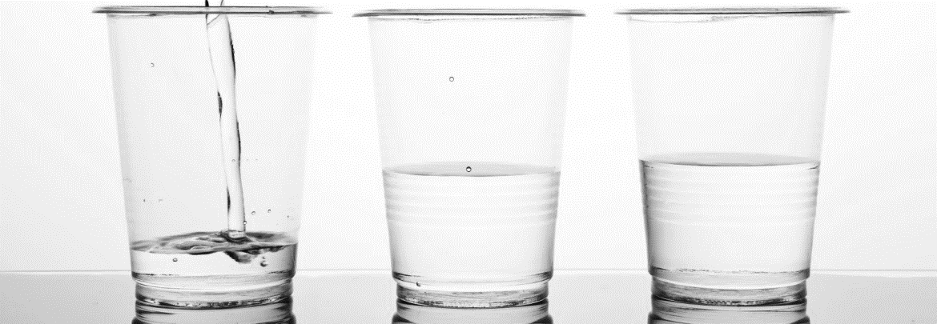
Great! Let’s start a session!
Please drink the water from one of the glasses placed beside you and then click the ‘Next’ button to start the next picture.

Slide 9
Seriousness check
“It would be very helpful if you could tell us at this point
whether you have taken part seriously, so that we can use
your answers for our scientific analysis.”
Please rate your answer in the scale and then click ‘Next’.

Slide 10
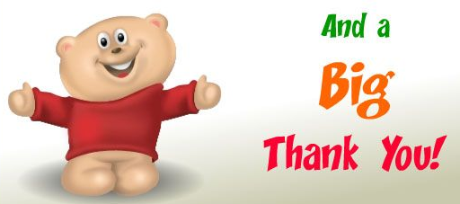
Thank you!
Congratulations: You have finished the experiment!
In case you have any question/comment you can contact the researcher:
Mohammad A. Haque, mah@create.aau.dk,
+45 9126 4921 or +86 182 0132 7463

