Slide 1
L1 = English, L2 = French
Language Differences Arising in Second Language Acquisition

Slide 2
Contents
Introduction to SLA
SLA learning theories
SLA research (data collection)
SL Variation in French as Foreign Language
Conclusion

Slide 3
Introduction
Language acquisition is the study of the processes through which humans acquire language.
Generally, the term language acquisition itself refers to first language acquisition, which mainly studies children's’ acquisition of their native language.
Second language: Any language learnt after the first language/mother tongue
Second language acquisition/Second language learning

Slide 4
Differences from learning L1
Already have a language for communicating
In many cases, no constant interaction with L2

Slide 5
Role of L1 in L2 acquisition process
Can be a facilitator or inhibitor of the learning process.
Learners from different L1s will tend to follow the same developmental patterns, but move along the different learning stages more or less quickly depending on their L1. (English vs Italian vs Chinese)
Learners often fall back to L1 when they lack knowledge of a rule in L2.

Slide 6
Some early challenges for English learners (point of grammatical differences)
Adjective placed after the noun it is describing
une table ronde
un mot francais
English pronouns distinguish between human and inanimate referents (him, her, it, etc.) whereas in French, ‘le’ and ‘la’ point to human as well as inanimate references
Struggle with infinitives:
Mon frère regarde(r) la télévision

Slide 7
SLA Theories
How language learning takes place
Variables important for SLA
How to better second language learning

Slide 8
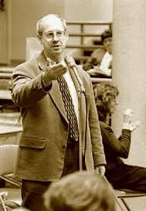
1. MONITOR MODEL (KRASHEN)
“Language acquisition does not require extensive use of conscious grammatical rules, and does not require tedious drill”
- Stephen Krashen

Slide 9
MONITOR MODEL (KRASHEN)
Krashen’s Theory of SLA consists of five hypotheses:
The acquisition/learning hypothesis
The natural order hypothesis
The input hypothesis
The monitor hypothesis
The affective filter hypothesis

Slide 10
The Acquisition/Learning Hypothesis
Language acquisition is different from language learning and acquisition is the only way in which competence in a second language occurs.

Slide 11
The Natural Order Hypothesis
Grammatical structures are acquired in a predictable order and it does little good to try to learn them in another order

Slide 12
The Input Hypothesis
People acquire language best from inputs that are just slightly beyond their current competence level: i + 1

Slide 13
The Monitor Hypothesis
Conscious learning operates only as a monitor or editor that checks or repairs the output of what has been acquired.

Slide 14
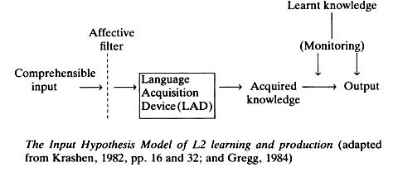
The Affective Filter Hypothesis
The learner’s emotional state, along with other factors, can act as a filter that impedes or blocks inputs necessary for language acquisition.

Slide 15

2. Acculturation model (Schumann)
“Second language acquisition is just one aspect of acculturation and the degree to which a learner acculturates to the target language group will control the degree to which he/she acquires the second language”
- John Schumann (1978)

Slide 16
Based on the social psychology of acculturation
The process by which a human being acquires the culture of a particular society from infancy
Certain social and psychological variables => Acculturation
Learners will acquire the target language to the degree they acculturate to the target language group

Slide 17
Acculturation
Social and psychological integration of the learner with the target language (TL) group
Social and psychological distance between the second language learner (2LL) and the target language (TL) community is a major factor in determining the degree to which the language learner will acquire the L2.

Slide 18
Two types of acculturation:
Learners are socially integrated with the TL group and develop sufficient contacts with TL speakers to enable them to acquire the TL.
Learners consciously o unconsciously desire to adopt the life style and values of the TL group
Social and psychological contact with TL group is the essential element in acculturation
Adopting value and life-style of TL group is not necessary, although it reduces the probability of acquiring the TL

Slide 19
2 social groups coming into contact with each other
Social variables like Social dominance pattern, integration strategies, enclosure, congruence, attitude, etc

Slide 20
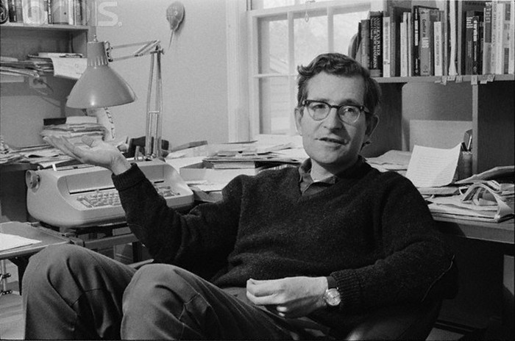
3. UG and SLA (Chomsky)
“Language acquisition cannot be reduced to the operation of response and stimulus, every sentence that we utter contains a new set of words or a mixture of words”
- Noam Chomsky

Slide 21
UNIVERSAL GRAMMAR
Some of the rules of grammar are hard-wired into the brain, and manifest without being thought.

Slide 22
The system of principles, conditions and rules that are elements or properties of all human languages. The essence of human language. (Chomsky, 1976)
All humans share a part of their knowledge of language; UG is their common possession regardless of which language they speak (Cook, 1996).

Slide 23
DO L2 LEARNERS HAVE ACCESS TO UG?
Full access hypothesis: SLA identical to L1 acquisition UG accessible in SLA for adults as well as children
Partial access hypothesis: L2 learners have access to UG but only through L1
No access hypothesis: L2 learners no longer have access to the principles and parameters of UG. General learning principles replace UG

Slide 24
Some problems of UG in the Context of SLA:
The process of FLA is natural, unconscious. Not true for SLA
Cognitive ability of children is still in the immature stage while that of an adult is already mature.
In the process of FLA, there is no language-interference while learning. But L2 learners use their mother tongue constantly. Mother tongue and L2 knowledge interact with each other somehow.

Slide 25
SLA Research
How to better second language learning focus on improvements
Data Collection methods
Studies in our context

Slide 26
Some variations in French (L1 vs L2 speaker)
Studied in an instructed manner between 2012-2016
Online forums (reddit, Duolingo podcasts)
Well documented (Ashby (1981), Regan (1997), Green (2012))

Slide 27
Degree of ne omission/retention (morphosyntactic variation)
‘ne’ + verb + ‘pas’
Il mange: He is eating.
Il ne mange pas: He does not eat/ He is not eating.
Je sais: I know.
Je ne sais pas: I do not know

Slide 28
`ne’ mostly omitted by native speakers of French
Almost always used by non-native French speaker.
Students learning and speaking French in foreign countries like Canada, India, UK, etc. almost never omit `ne' whereas in France, it is omitted by the native speakers.

Slide 29
Same levels even with increased attention to speech
It has been observed that more exposure to native French (via a stay in Francophone regions/ contact with native French forums/media, etc.) correlated positively with ne omission.
Leads to hypercorrection

Slide 30
Use of on/nous for 1st person plural referents
‘Nous’ vs ‘On’ for ‘We’
Nous vous attendons: We are waiting for you. (H)
On vous attend: We are waiting for you. (L)

Slide 31
A native speaker of French will generally use the word `On' for `We' whereas speakers in foreign language use `Nous’.
Even outside classroom environment, always used ‘Nous’ and practiced ‘ne’ retention.
Nous allons aller au parc
On va aller au parc

Slide 32
/l/ deletion/retention (phonological variation)
While pronouncing third person subject pronouns, namely `Il' (He), `Elle'(She), `Ils'(They) and `Elles'(They).
Excluded by NS, Almost always included by NNS
NNS who have never been to France show almost no /l/ deletion

Slide 33
Some stats based on French SLA variationist studies:

Slide 34
Rehner (2010)
42%
98%
Conducted on Canadian University level students -
Ne-omission rates amongst L2 speakers
Omission rates amongst L1 speakers

Slide 35
Sax (2003)
09%
Conducted on American Learners of French -
On usage by those with no native exposure
93%
On usage by those with native exposure (upto 1 year spent abroad)

Slide 36
Lemee, Vera (2006)
06%
33%
Conducted on various L2 learners of French -
/l/ deletion (no native exposure)
After spending up to 1 year in France
90%
Native speakers

Slide 37
Conclusion
One fairly consistent finding so far is the over-use of formal variants (L1 and L2 variations).
It has been linked to restricted access to sufficiently diverse linguistic input.
Lack of access makes it very difficult for L2 users to pick up the variation patterns (develop sociolinguistic competence).
Instructed L2 learners are mainly exposed to formal speech styles and written material.

Slide 38
Conclusion
Both variants are equally ‘native’ in appropriate settings. Students learning French in third world countries often have very little knowledge of these variations
Classroom model requires richer sociolinguistic perspectives, encouragement to interact with native media.
According to Dewaele and Regan (2002), without spending significant time abroad, learners are ‘scared to express themselves’ with NSs (Their self-assessed low competence levels discourage them from using the L2 outside the classroom. (communicative anxiety)

Slide 39
MERCI BEAUCOUP!

Slide 40
References
Long H., Michael, Larsen Freeman, Diane. An Introduction to Second Language Acquisition Research.
Green, Elizabeth (2010). Sociolinguistic variation in French as a foreign language: a case study.
Lemee, Isabelle Regan, Vera. (2006). The L2 acquisition of a phonological variable: The case of /l/ deletion in French.

