Slide 1
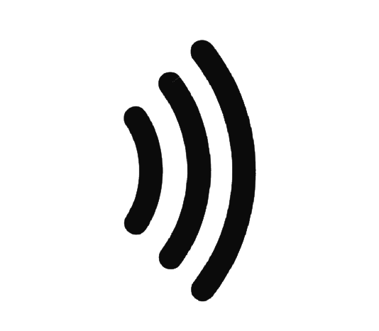
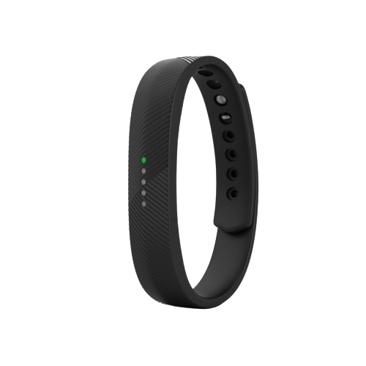
SoundSpark
TEAM PIXELS

Slide 2

What is SoundSpark
SoundSpark is a wearable technology that helps people who suffer from loss of hearing by monitoring the surrounding sound and turning it into appropriate vibrations on their hands.

Slide 3

Who will need SoundSpark
People with hearing loss.
Elderly people who have reduced sense of hearing.

Slide 4
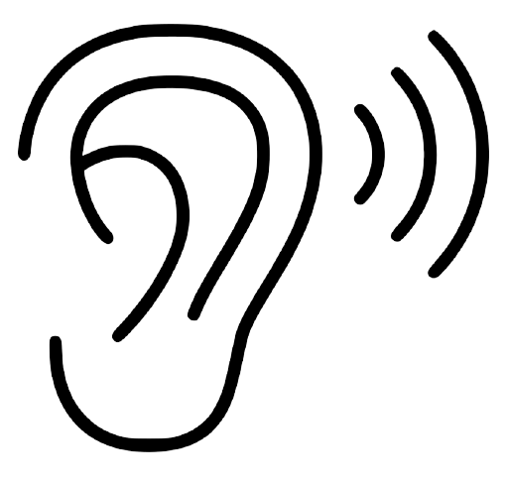
How will they use the device?
Wearable technology that can be turned on and off on requirement.
The duration of the vibration can be set manually.
It needs to be charged prior to use.

Slide 5
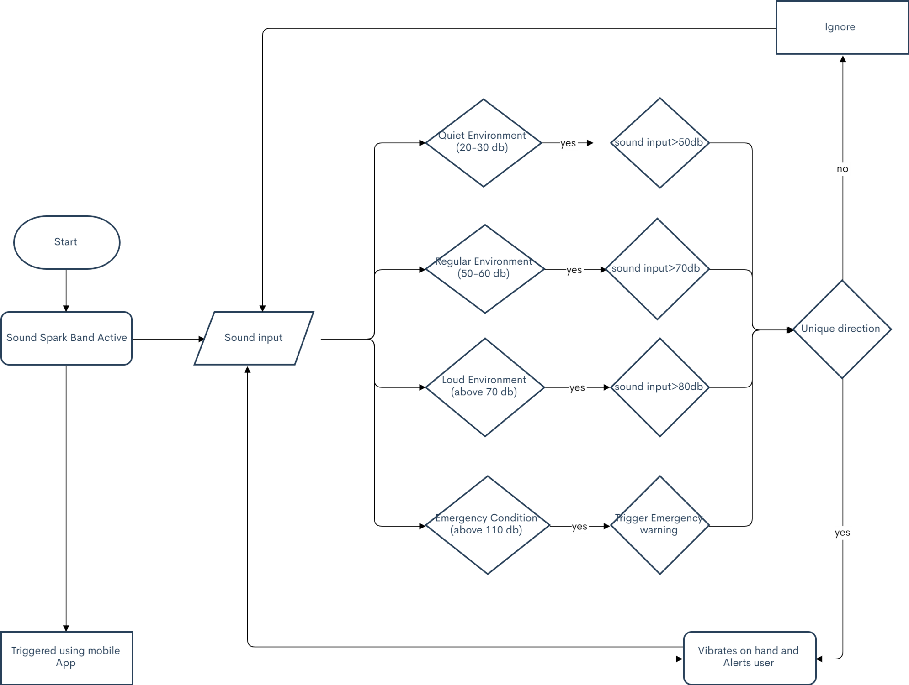
Implementation Algorithm

Slide 6
How is our product different
Existing solutions :
BUZZ Wearable Wristband
BEWARNED Application
Our Solution:
Concerns more on safety rather than user experience.
Phone has its own usages, relying on it for all time safety will not be wise.
Cost Effectiveness:
Total cost including 4 vibration motors, an omni directional microphone, other software and hardware implementation is approximately 2000 INR, which is less than 10% of the price of BUZZ Wearable Wristband.

Slide 7
REAL LIFE SCENARIOS

Slide 8
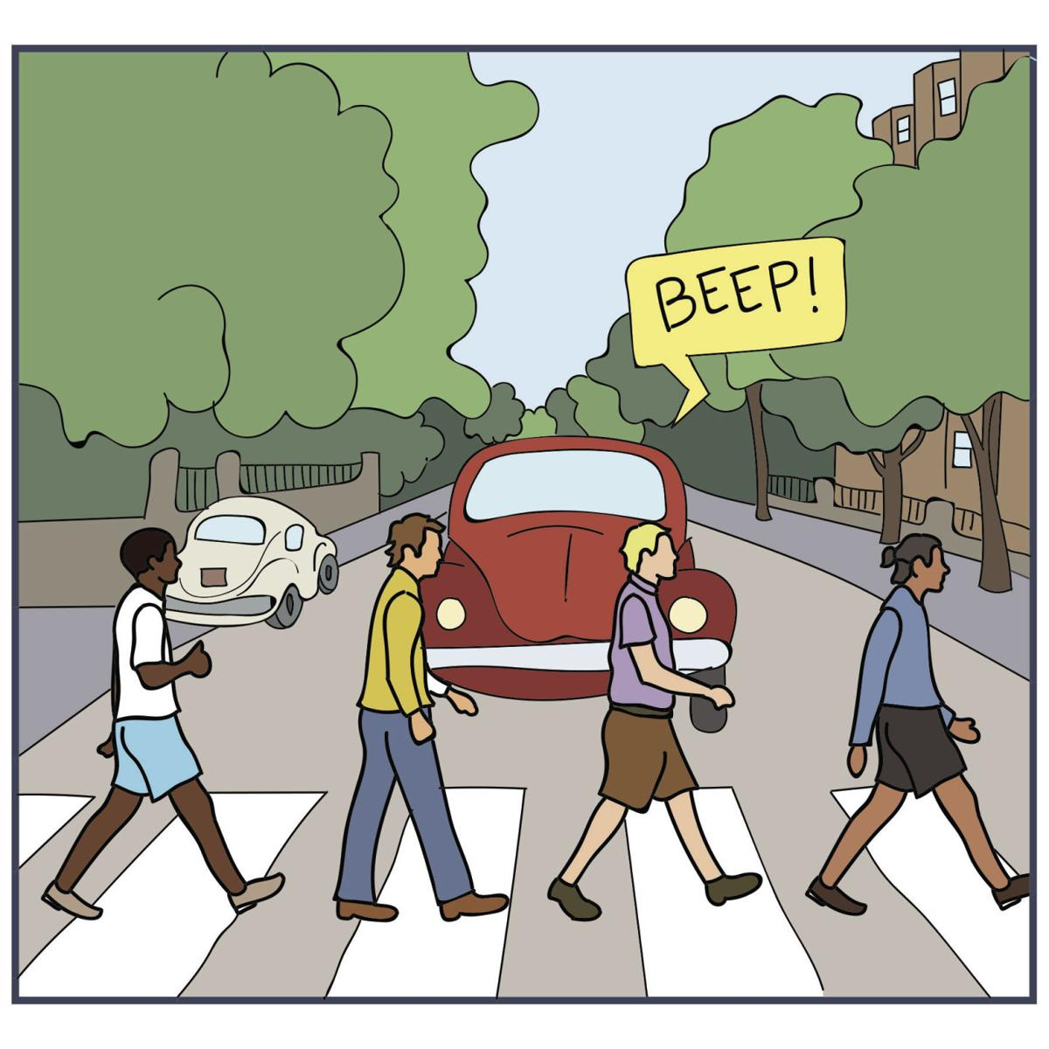

Slide 9
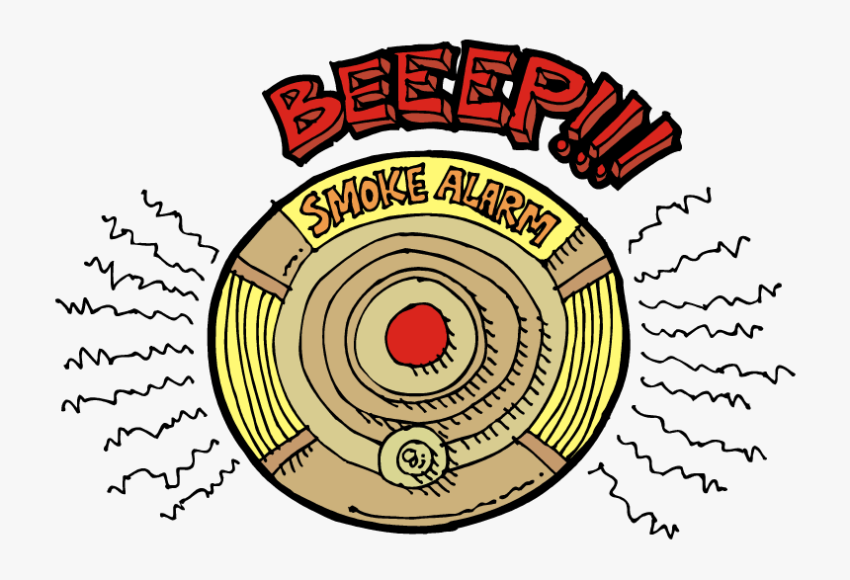
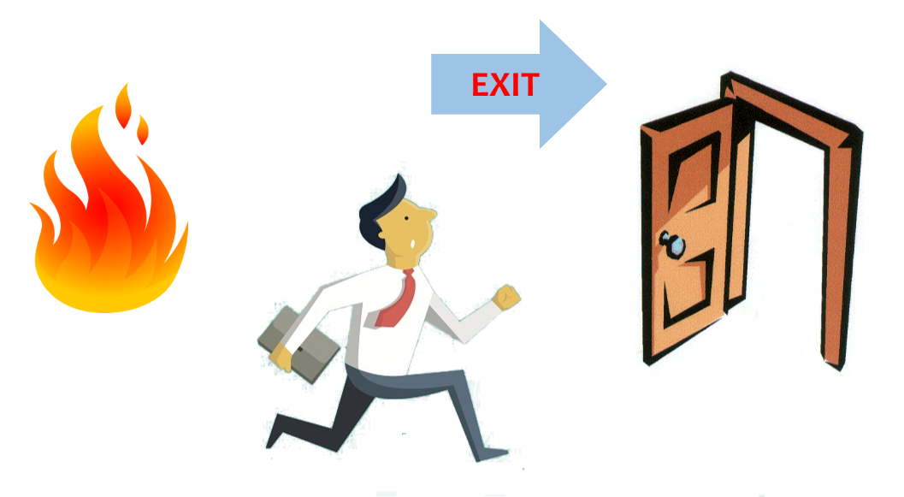

Slide 10


Slide 11


