Slide 1
Case Study
Implementing IaaS and PaaS in Azure
By Akhil Dsouza

Slide 2
Contents
Business Requirements
Implementation flow
Takeaway Learnings

Slide 3

Business Requirements
Nilavembu Herbs provides a safer alternative to modern medicine wherever possible and to offer simple, effective and safe remedies for common problems. spreads awareness about the medicinal uses of these natural and safe herbs all over the world and to make it easily available through their online store for all those who want to enjoy its benefits
Nilavembu Herbs requires
A low cost solution based on demand of dynamic business conditions.
As the business expands across EastUS and SEA, they would like to have their DataCenter virtualised using cloud computing.
Critical Data should be made available in case of disaster
As of now they want to have Proof Of Concept(POC) in Microsoft Azure
You have been deployed for POC
The following slides will provides required details.

Slide 4
SEA region
2 web servers with 99.95% high availability
These web services has to be utilised with proper balance with client affinity with Public IP
Selected web servers should be reachable via RDP from internet
A jump port should accessible from internet to upload contents to web servers.
Protect web server traffic restricted to allowed based on ip addresses which will be updated as warranted
Enable backup for WebServers
Have alert generated in case of 80% above cpu usage

Slide 5
EastUS
EastUS server (Server11) should be accessible from internet via public IP
Establish secure Connection to SEA-EUS Azure sites
All servers should be reachable with internal ip addresses

Slide 6
Storage Requirements
EUS based resources should provide data resiliency in case of azure datacentre failure.
The storage should be accessible by applications with secure access. provide access urls and keys.
Sales manager should access his resource from windows explorer.
SEA data resources must provide high resiliency in case of even multiple azure data center failures

Slide 7
Azure Resource management
Create Vmadmin user who can manage all VM in the subscription
Create Backup_admin user who can manage backup only in EUS servers in EURG

Slide 8
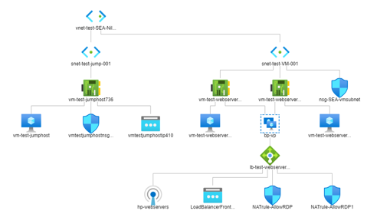


Implementation Flow
South East Asia region
Create a resource group - RG-SEA-NilavembuHerbs
Create a Virtual network - vnet-test-SEA-NilavembuHerbs001
Create Subnets for webservers and Jumphost
Create an Availability set
Create a Public Load Balancer - lb-test-webservers001
Create Health Probe and Backend pool
Create a load balancer Rule with Client affinity
Create a Virtual Machine – Webserver001 and add it to Backend pool
Create a Virtual Machine – Webserver002 and add it to Backend pool
Install webserver feature using run command feature
Create a Jumphost - vm-test-jumphost
Create an NSG for Webservers
Use Jumphost to upload contents to web servers
Create an Inbound NAT rule to allow RDP from internet
Create a Backup and Site Recovery
Create an alert Rule
Create an Action Group – VM admin
Set an Alert Rule - rule-CPU80

Slide 9
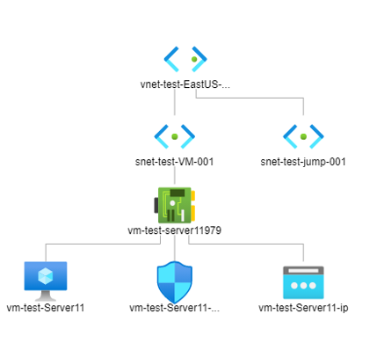
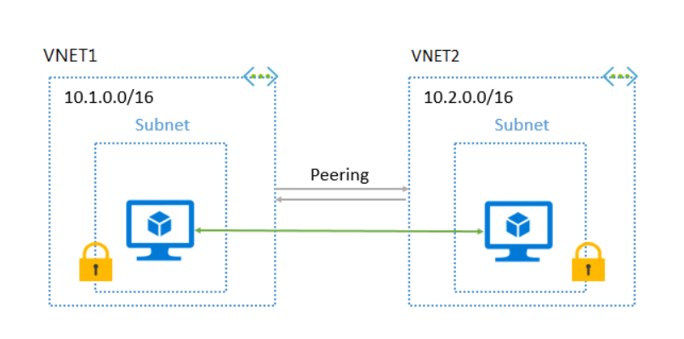
Implementation Flow
East US region
East US Resource group
Create a VNET for East US region - vnet-test-EastUS-NilavembuHerbs001
Create a VM - vm-test-Server11
Add a VNET peering to Connect both VNETS across multiple regions

Slide 10
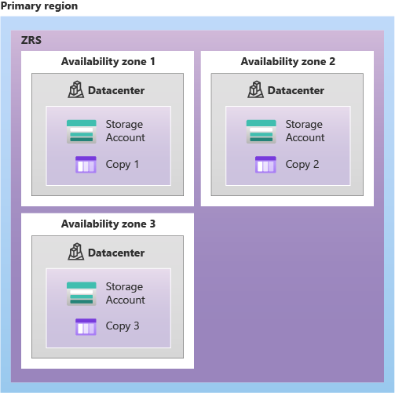
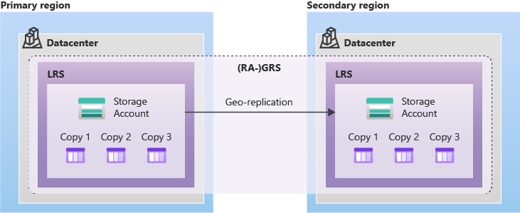
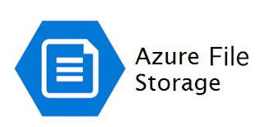
Implementation Flow
Storage Requirements
Create a Storage account in East US region with ZRS
Generate Storage access keys
Connect to Storage account using Azure Storage Explorer
Create a File share
Create a storage account in South East Asia Location with GRS

Slide 11





Implementation Flow
Azure Resource Management
Create vmadmin User -Azure Active Directory
Create a new group and add the user to vmadmin group
Create backupadmin user – Azure Active Directory
Add Role – RBAC.
Add Virtual Machine Administrators login role to vmadmin group.
Navigate to East US resource group and add “Backup contributor” role to backup_admin group.
vmadmin
backupadmin

Slide 12
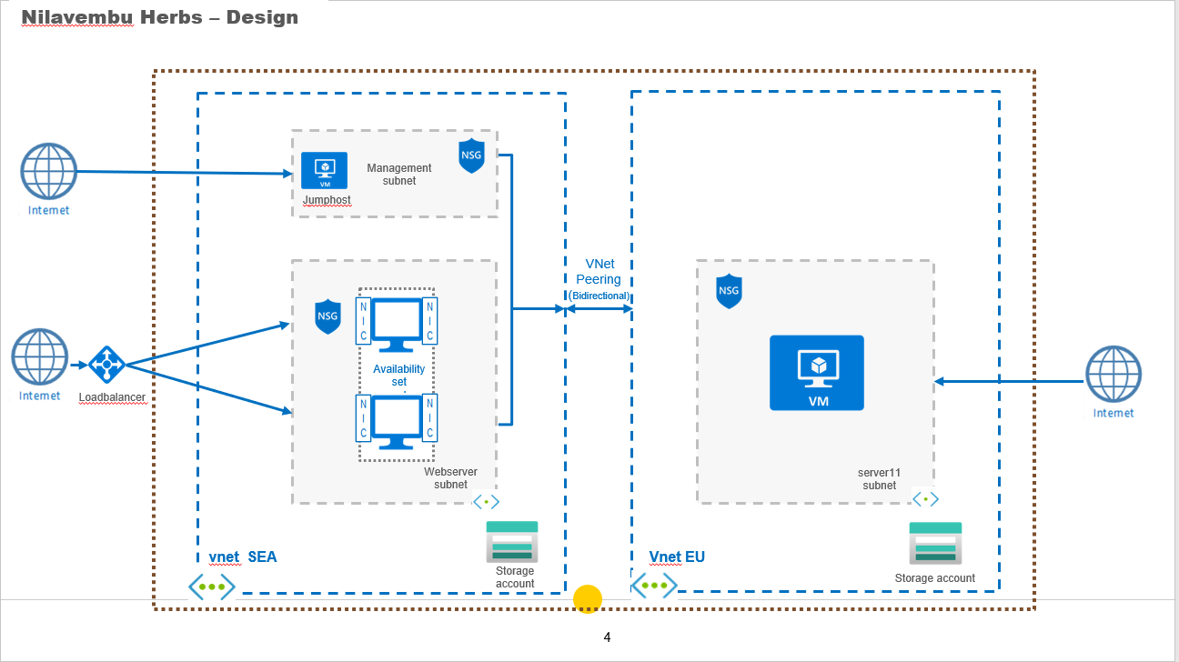
Architecture

Slide 13
Network Proposal
Description | SEA | EUS
Resource Group | RG-SEA-NilavembuHerbs | RG-EastUS-NilavembuHerbs
VNET | 10.2.0.0/16 | 10.1.0.0/16
Subnet | snet-test-jump-001 (10.1.4.0/24) snet-test-VM-001 (10.1.3.0/24) | snet-test-jump-001 (10.2.4.0/24) snet-test-VM-001 (10.2.3.0/24)
VM | vm-test-webserver001 vm-test-webserver002 | vm-test-Server11
IP Private/Public | Static/- | Static/Static
website Content | Nilavembu Herbs | -
Jumphost | vm-test-jumphost RDP enabled | -
Storage account | stgseanilavembu001 | stgeusnilavembu001
Load balancer | lb-test-webservers001 | -

Slide 14
Network component required
Description | Vnet\subnet | NSG | Public IP | Availability set | Public Load balancer
vm-test-webserver001 | vnet-test-EastUS-NilavembuHerbs001\ snet-test-VM-001 | nsg-SEA-vmsubnet | No | avail-test-SEA-NilavembuHerbs | lb-test-webservers001
vm-test-webserver002 | vnet-test-EastUS-NilavembuHerbs001\ snet-test-VM-001 | nsg-SEA-vmsubnet | No | avail-test-SEA-NilavembuHerbs | lb-test-webservers001
vm-test-jumphost | vnet-test-EastUS-NilavembuHerbs001\ snet-test-jump-001 | vmtestjumphostnsg944 | Yes | No | No
vm-test-Server11 | vnet-test-EastUS-NilavembuHerbs001\snet-test-VM-001 | vm-test-Server11-nsg | Yes | No | No

Slide 15
Backup and recovery component
Description | Backup enabled | Recovery Services vault
vm-test-webserver001 | yes | backup-test-EUS-001
vm-test-webserver002 | yes | backup-test-EUS-001
vm-test-jumphost | No | -
vm-test-Server11 | No | -

Slide 16
Storage Accounts
Storage account name | Replication
stgeusnilavembu001 | Zone-redundant storage(ZRS)
stgseanilavembu001 | Read-access geo-redundant storage (RA-GRS)

