Slide 1
EDA for 2020-2021 Kaggle Machine Learning Data Science Surveys
Presented by: Amal AlThaqafi.

Slide 2
Outline
Introduction.
Dataset Description.
Processing.
Results.
Conclusion.

Slide 3
Introduction
Analyzing data for a set of data related to Kaggle surveys to
see the difference and the change between 2020 and 2021.

Slide 4
Dataset Description.
The datasets come from Kaggle " 2020 Kaggle Data Science & Machine Learning Survey and 2021 Kaggle Machine Learning & Data Science Survey ". The survey questions range from demographic questions, such as gender and level of higher education, to questions about programming languages, tools, and machine learning algorithms used. Most of the columns are categorical. The dataset has 25974 rows and 369 columns.

Slide 5
Processing
1
2
Filtering
Visualization
To get columns that related to the questions
Using the Matplotlib and Seaborn

Slide 6
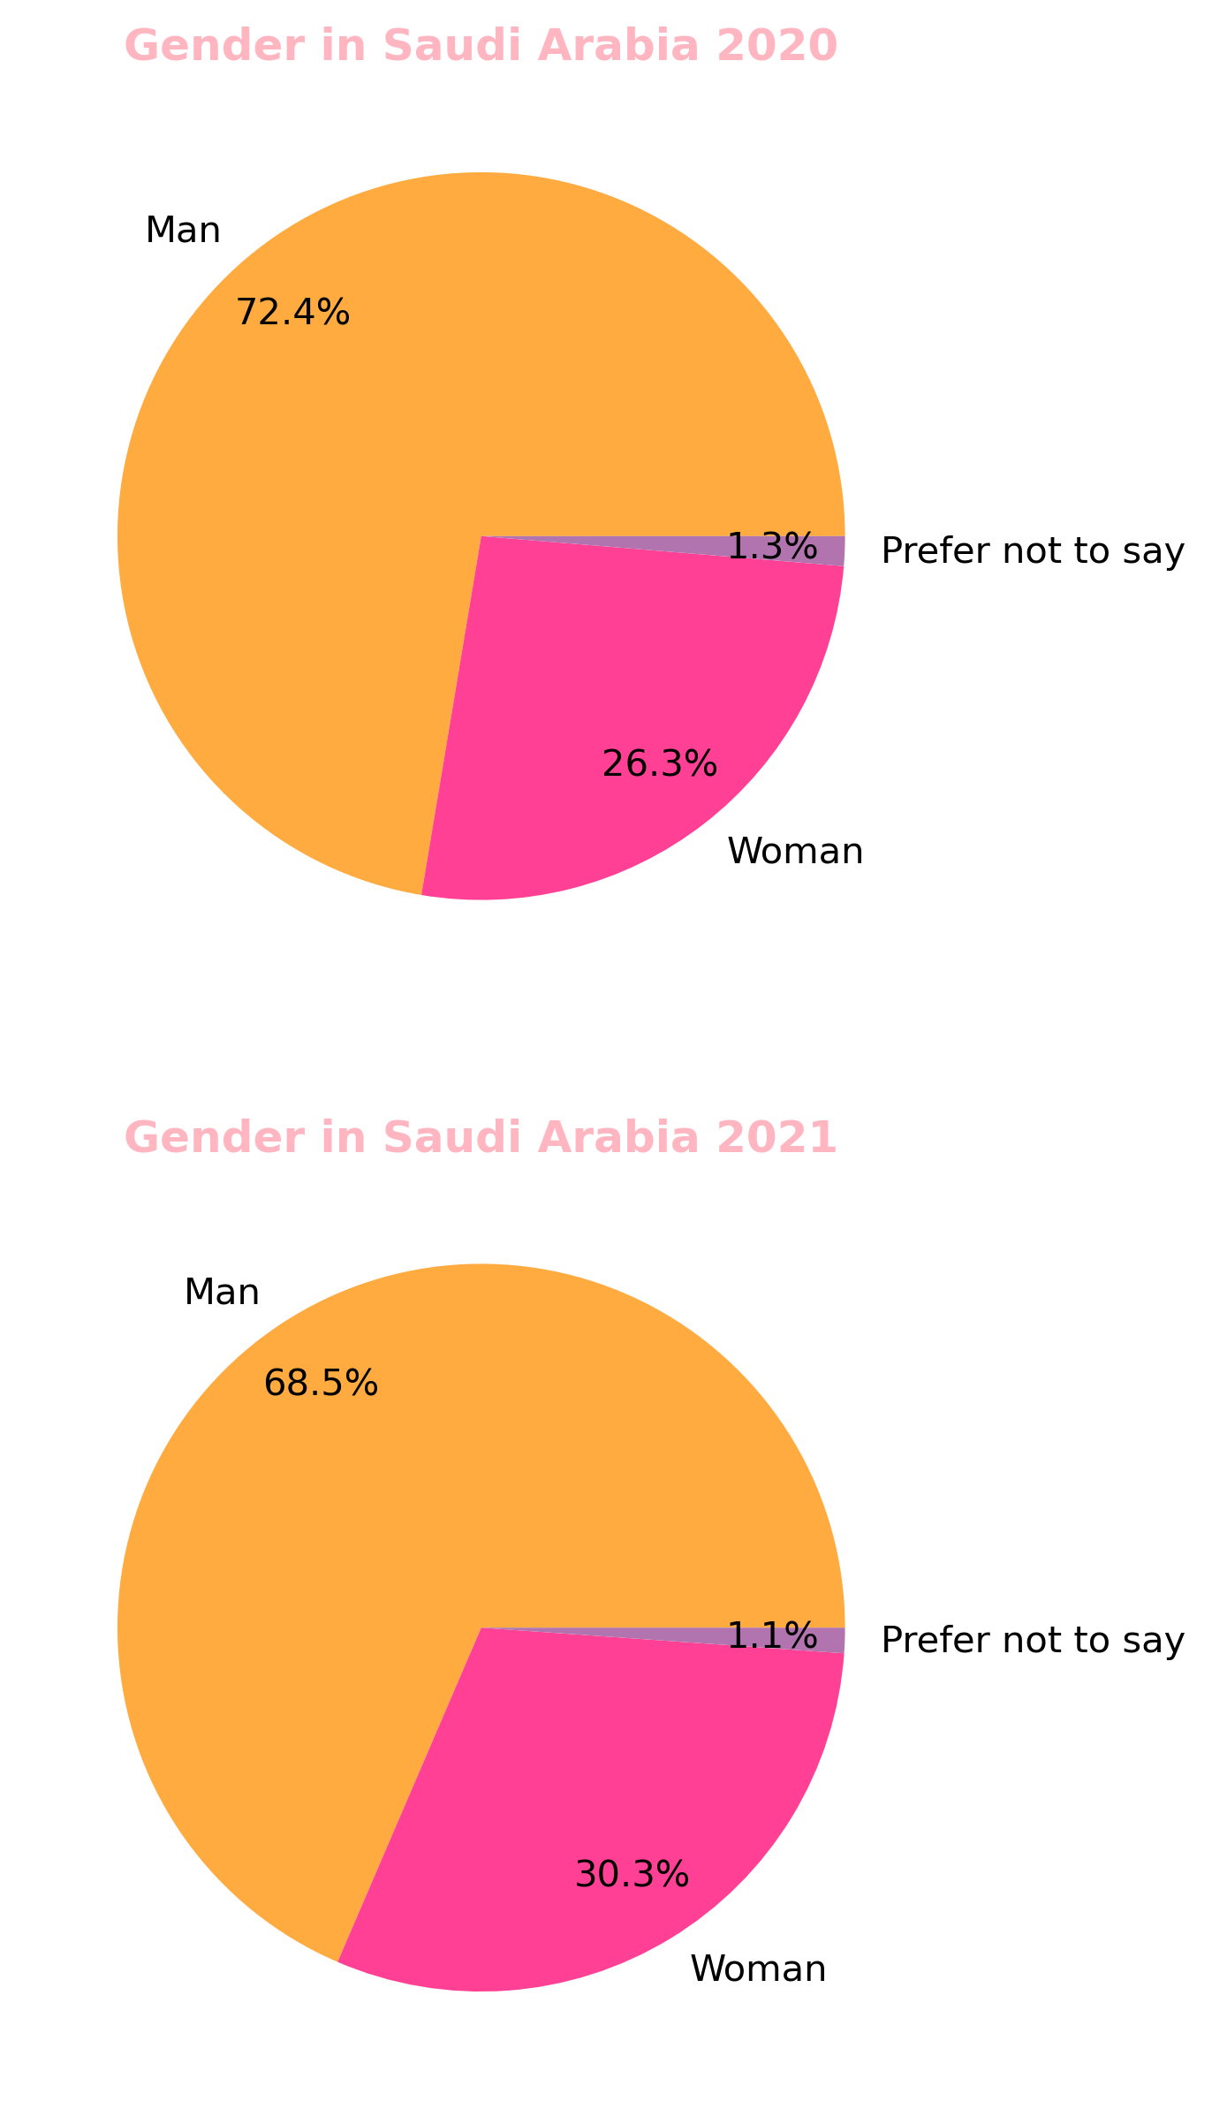
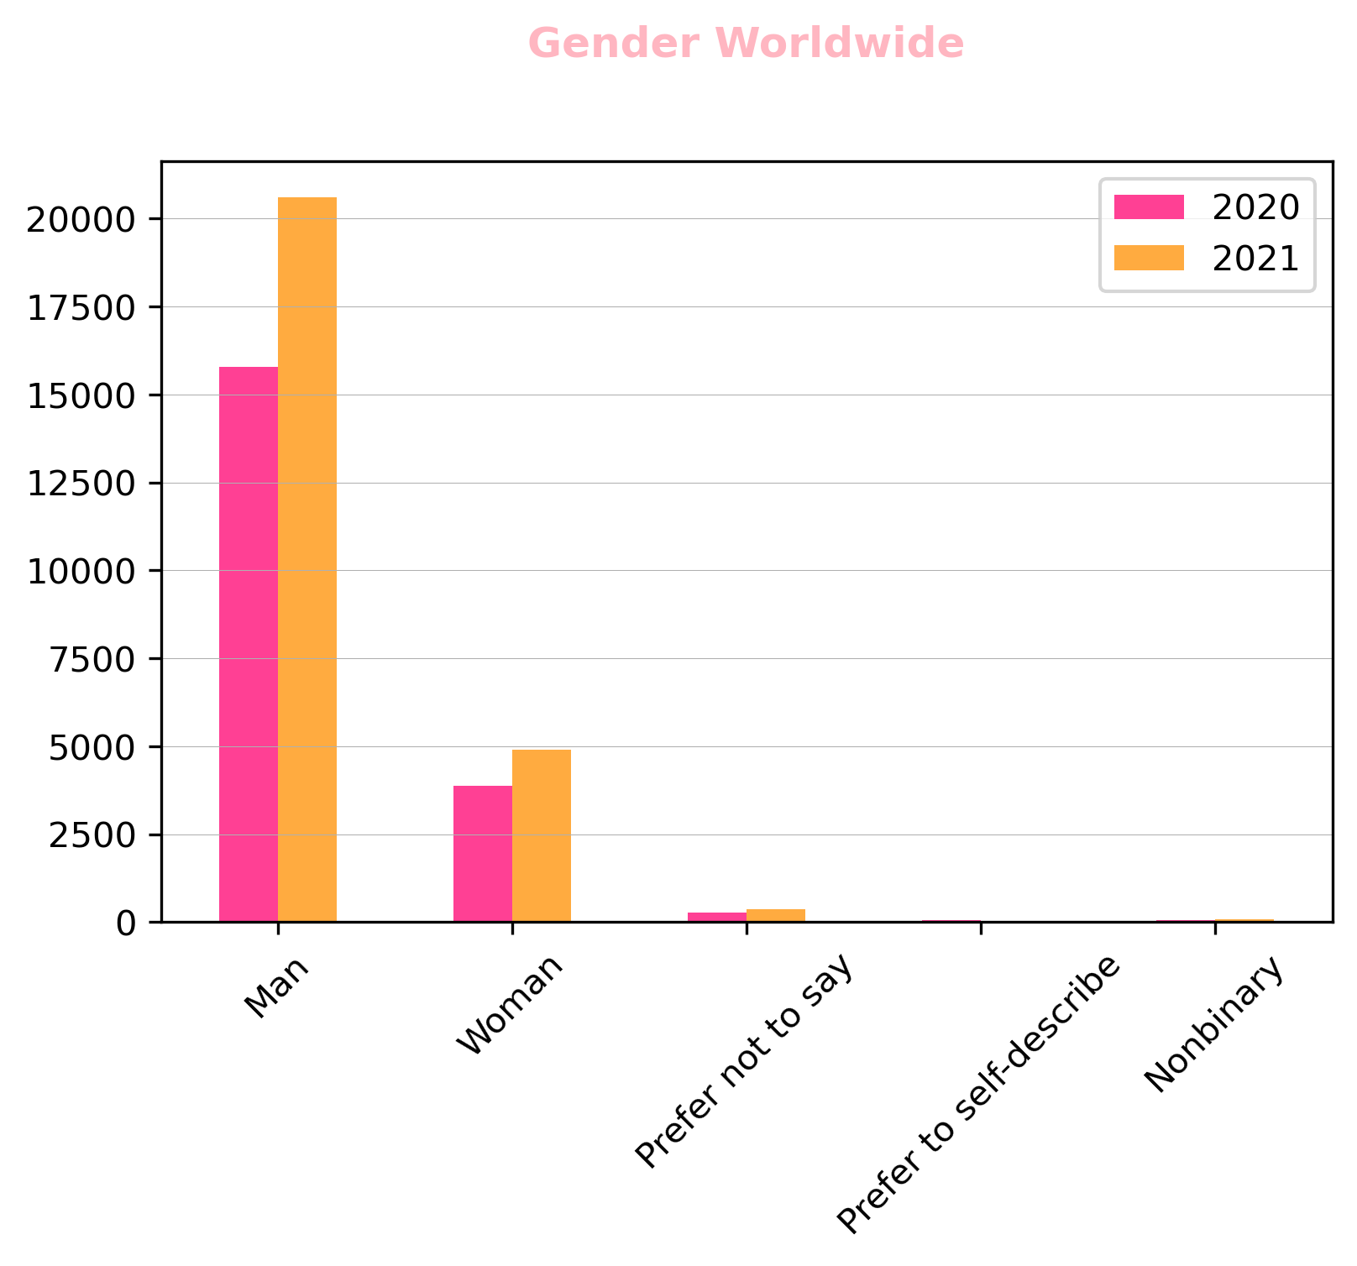
Results

Slide 7
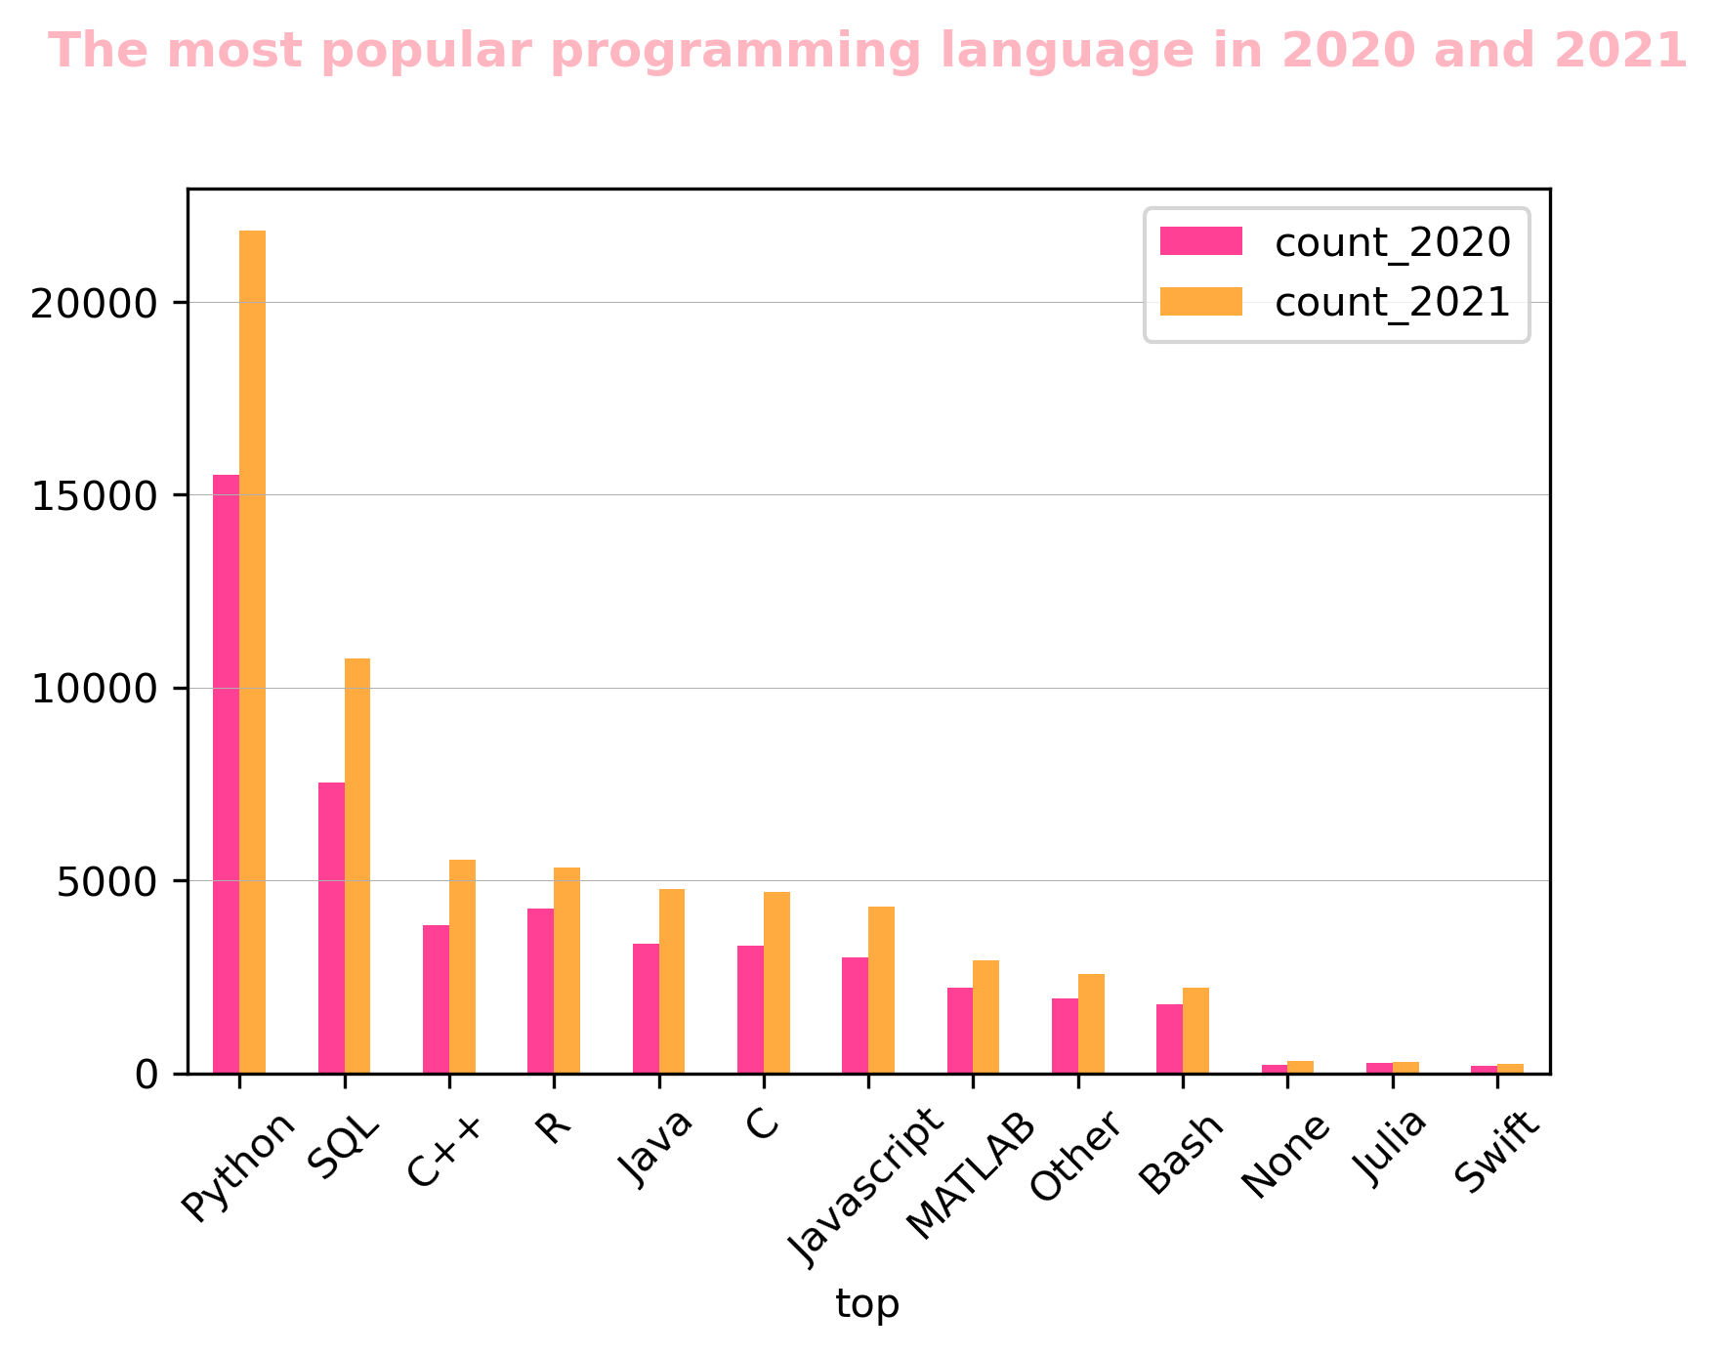
Results

Slide 8
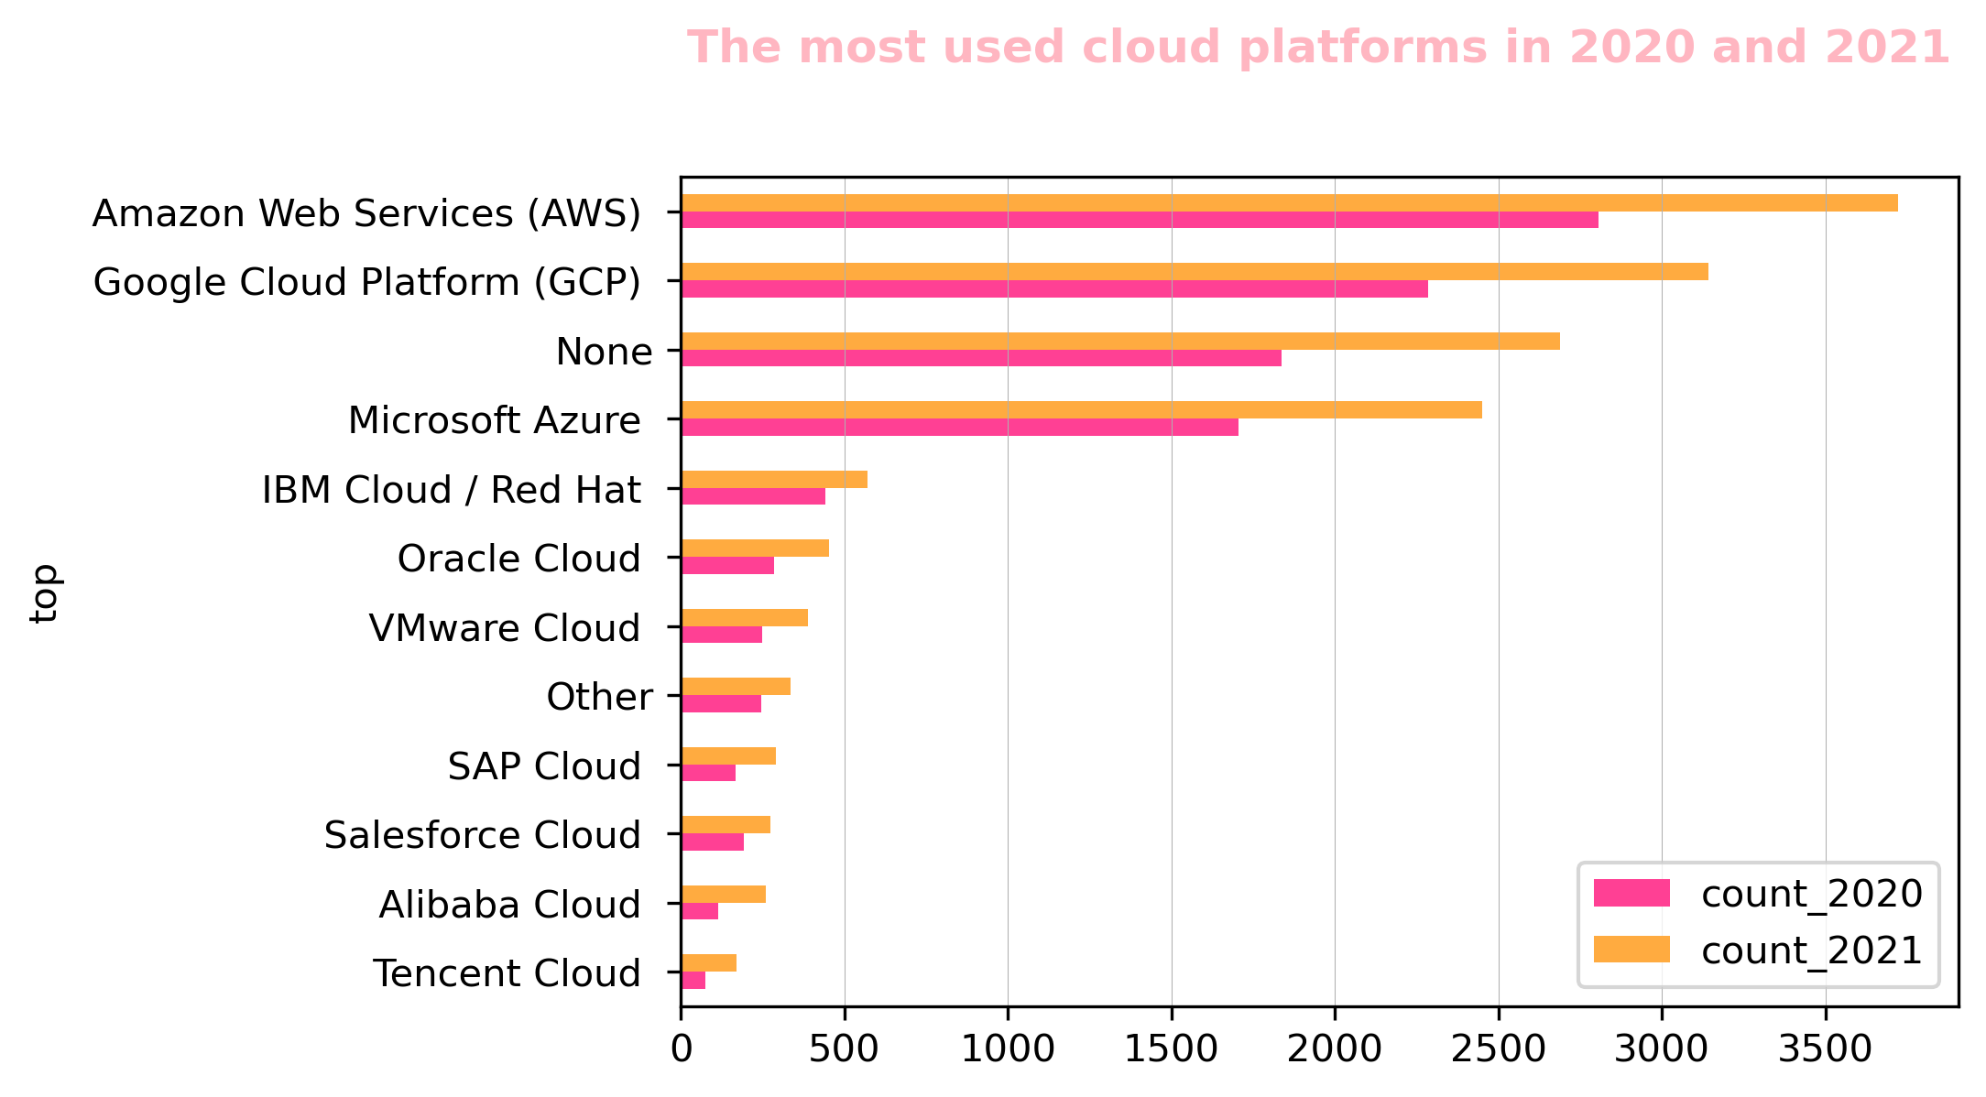
Results

Slide 9
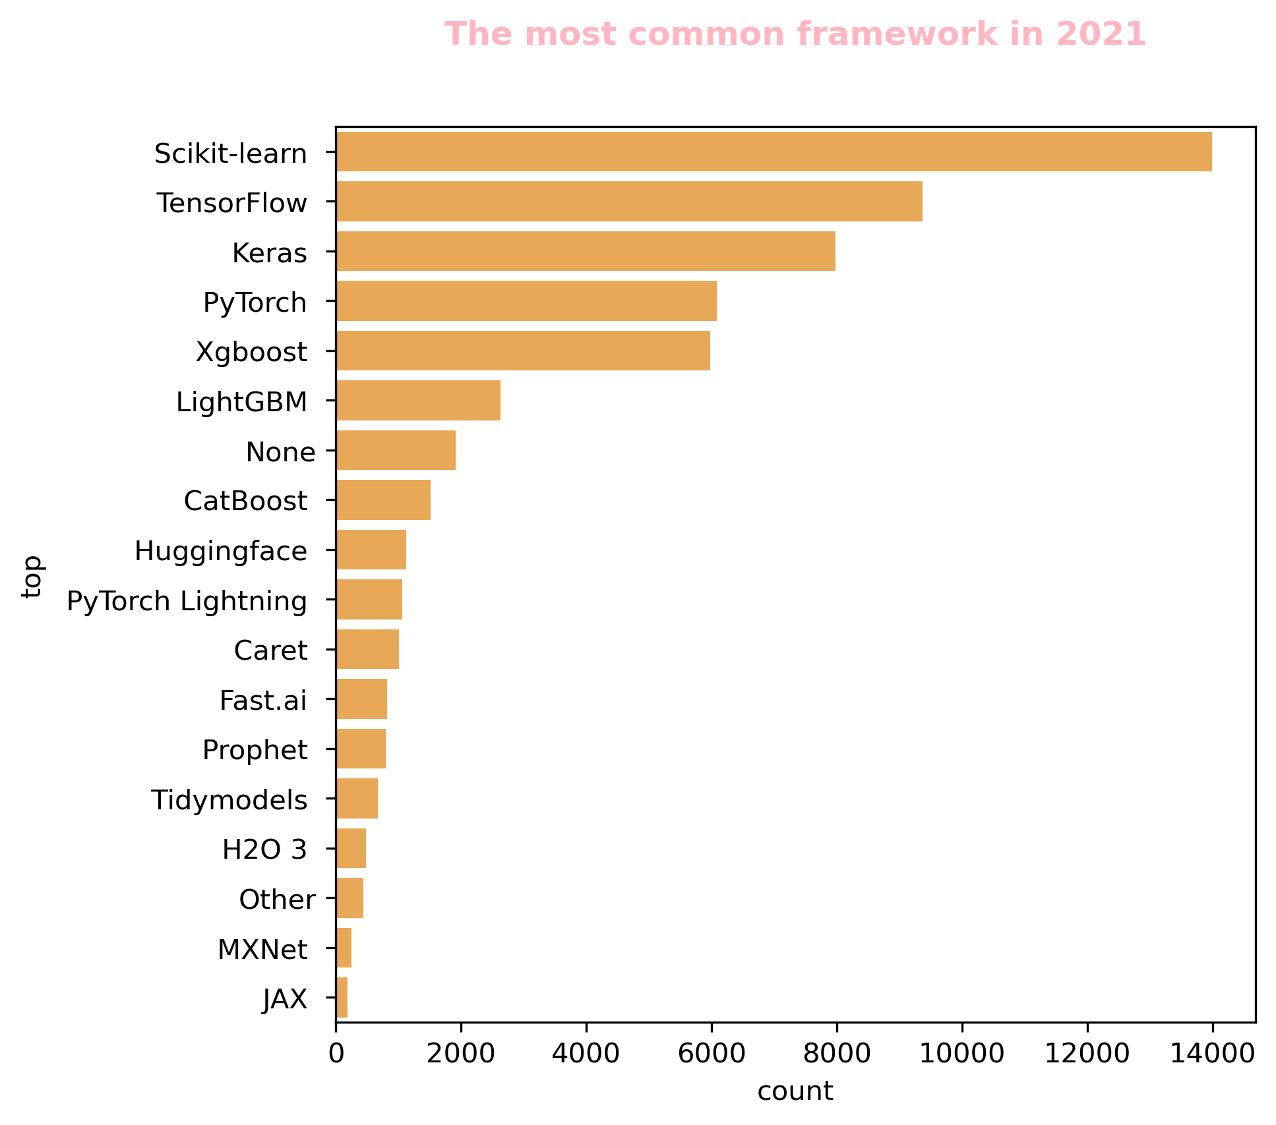
Results

Slide 10
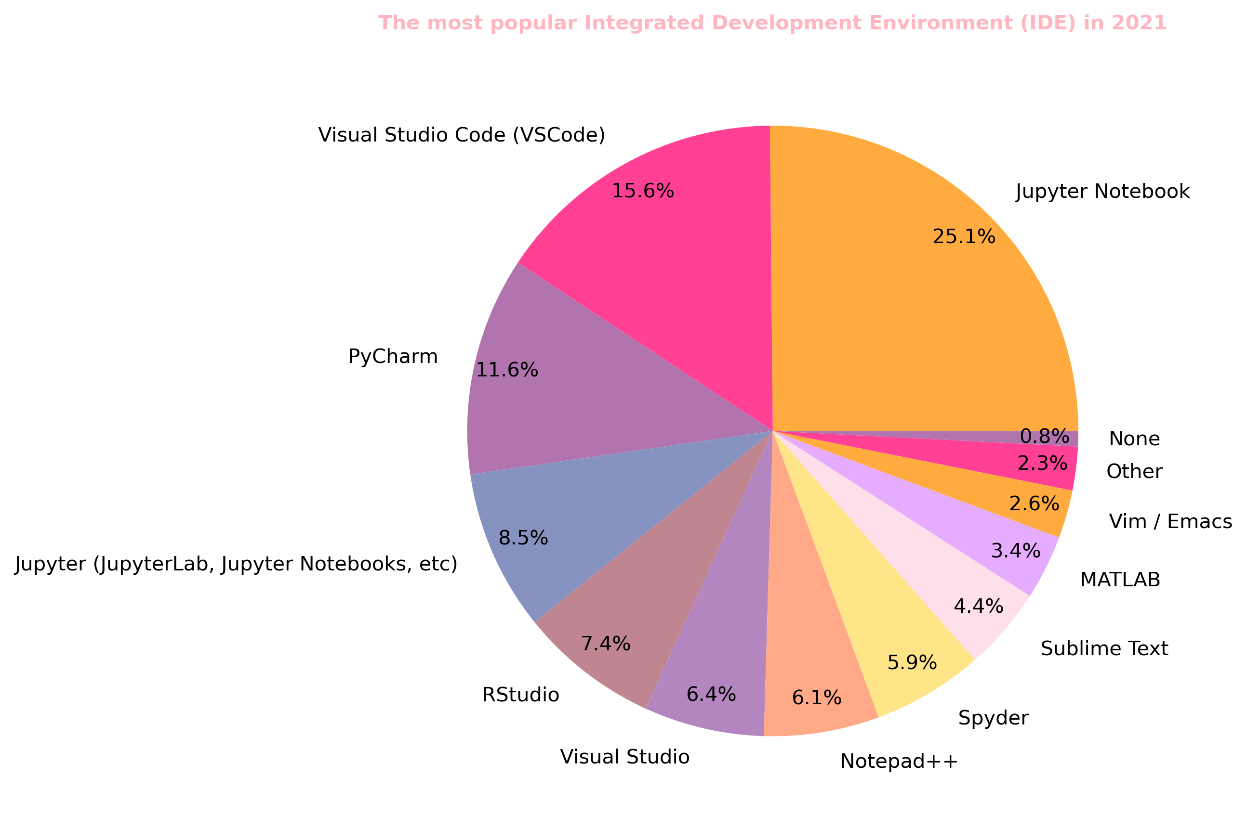
Results

Slide 11
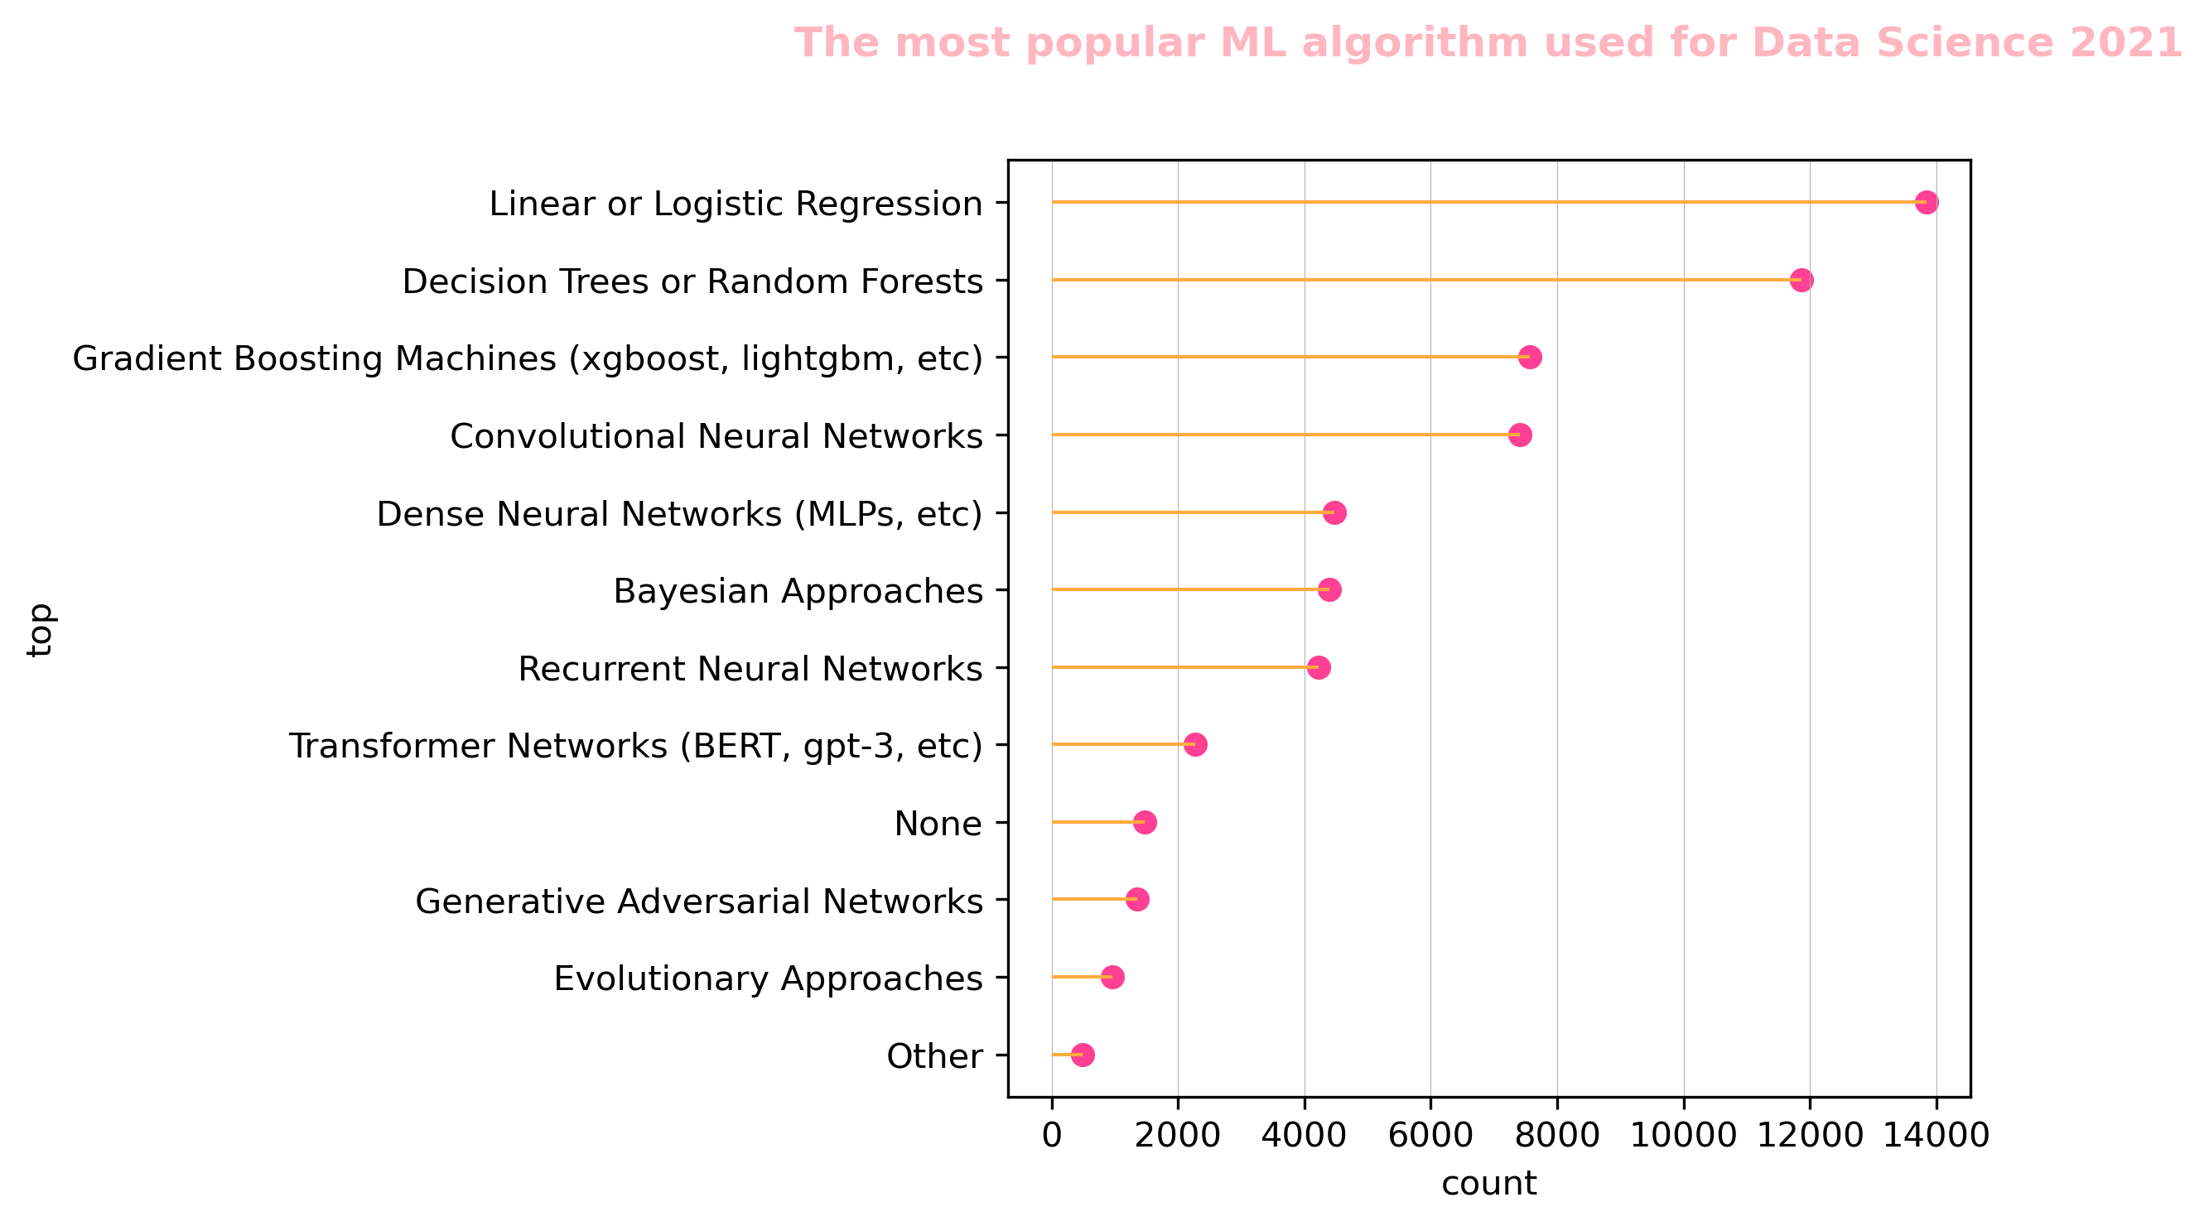
Results

Slide 12
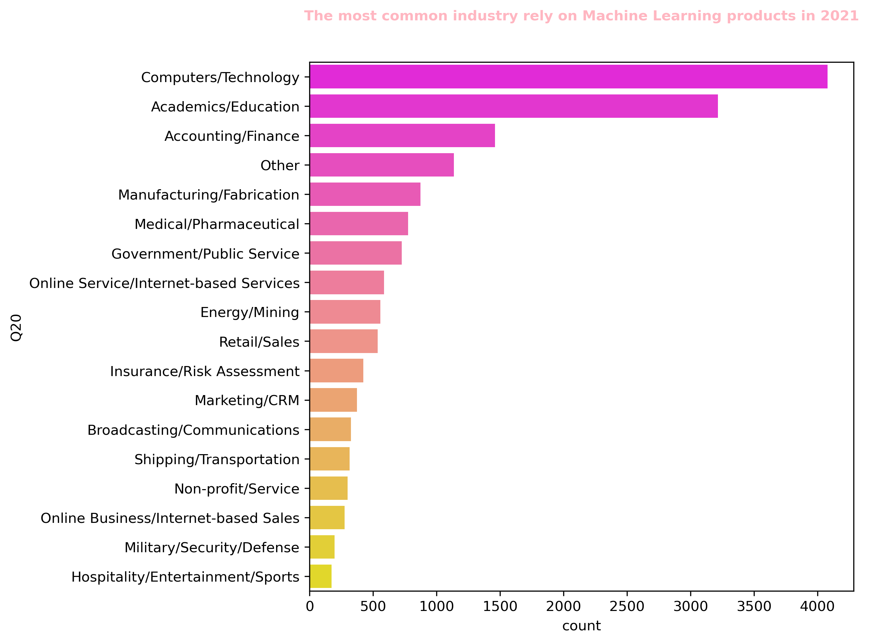
Results

Slide 13
Conclusion
Increasing in the number of men using ML worldwide and the number of women worldwide and in SA.
The most popular programming language in 2020 and 2021 is Python.
The most used cloud platforms in 2020 and 2021 is AWS.
The most common framework in 2021 is Scikit-learn.
The most popular Integrated Development Environment (IDE) in 2021 is Jupyter Notebook.
The most popular ML algorithm used for Data Science 2021 is Linear or Logistic Regression.
The most common industry rely on Machine Learning products in 2021 is Computers and Technology.

Slide 14

THANK YOU!

