Slide 1
Lab: Version Controlling with Git in Azure Repos
In this lab, Version Controlling with Git in Azure Repos, you will establish and work with a local Git repository.
You will learn how to:
Exercise 1: Cloning an existing repository
Exercise 2: Save work with commits
Exercise 3: Review history
Exercise 4: Manage branches from Visual Studio
Exercise 5: Managing branches from Azure DevOps
✔️ Note that you must have already completed the prerequisite labs in the Welcome section.
Notes:
Exercise 6 and 7 will be completed in Module 2.
Version Controlling with Git in Azure Repos - https://www.azuredevopslabs.com/labs/azuredevops/git/
✔️ Note that you must have already completed the prerequisite labs in the Welcome section.

Slide 2
Lab: Deploying a Multi-container Application to AKS
In this lab, Deploying a multi-container application to Azure Kubernetes Services, you will deploy and manage Docker containers using Kubernetes.
You will learn how to:
Create an Azure Container Registry (ACR), AKS and Azure SQL server
Provision the Azure DevOps Team Project with a .NET Core application using the Azure DevOps Demo Generator tool
Configure application and database deployment, using Continuous Deployment (CD) in the Azure DevOps
Initiate the build to automatically deploy the application
✔️ Note that you must have already completed the prerequisite labs in the Welcome section.
Notes:
Deploying a Multi-container application to Azure Kubernetes Service - https://www.azuredevopslabs.com/labs/vstsextend/kubernetes/
✔️ Note that you must have already completed the prerequisite labs in the Welcome section.

Slide 3
Lab: Configuring a CD pipeline for your Jenkins CI
In this lab, Configuring a CD pipeline for your Jenkins CI, you will examine two methods for integrating Jenkins: run CI jobs in Jenkins separately, and wrap a Jenkins CI job inside an Azure pipeline. You will learn how to:
Provision Jenkins on Azure VM using the Jenkins template available on the Azure Marketplace
Configure Jenkins to work with Maven and Azure DevOps
Create a build job in Jenkins
Configure Azure Pipeline to integrate with Jenkins
Configure a CD pipeline in Azure Pipelines to deploy the build artifacts
✔️ Note that you must have already completed the prerequisite labs in the Welcome section.
Notes:
Configuring a CD pipeline for your Jenkins CI- https://www.azuredevopslabs.com/labs/vstsextend/jenkins/
Be sure to complete the Before you begin steps.
✔️ Note that you must have already completed the prerequisite labs in the Welcome section.

Slide 4
Lab: Integrate Your GitHub Projects With Pipelines
In this lab, Integrate Your GitHub Projects With Azure Pipelines, you will how easy it is to set up Azure Pipelines with your GitHub projects and how you can start seeing benefits immediately. You will learn how to:
Install Azure Pipelines from the GitHub Marketplace.
Integrate a GitHub project with an Azure DevOps pipeline.
Track pull requests through the pipeline.
✔️ Note that you must have already completed the prerequisite labs in the Welcome section.
Notes:
Integrate Your GitHub Projects With Azure Pipelines - https://www.azuredevopslabs.com/labs/azuredevops/github-integration/
✔️ Note that you must have already completed the prerequisite labs in the Welcome section.

Slide 5
Lab: Deploying a Multi-container Application to AKS
In this lab, Deploying a multi-container application to Azure Kubernetes Services, you will deploy and manage Docker containers using Kubernetes.
You will learn how to:
Create an Azure Container Registry (ACR), AKS and Azure SQL server
Provision the Azure DevOps Team Project with a .NET Core application using the Azure DevOps Demo Generator tool
Configure application and database deployment, using Continuous Deployment (CD) in the Azure DevOps
Initiate the build to automatically deploy the application
✔️ Note that you must have already completed the prerequisite labs in the Welcome section.
Notes:
Deploying a Multi-container application to Azure Kubernetes Service - https://www.azuredevopslabs.com/labs/vstsextend/kubernetes/
✔️ Note that you must have already completed the prerequisite labs in the Welcome section.

Slide 6
Lab: Integrating Azure Key Vault with Azure Pipeline
Complete the Integrating Azure KeyVault with Azure DevOps. You will learn how to:
Create a key vault, from the Azure portal, to store a MySQL server password
Configure permissions to let a service principal to read the value
Retrieve the password in an Azure pipeline and passed on to subsequent tasks
Notes:
Integrating Azure KeyVault with Azure DevOps - https://www.azuredevopslabs.com/labs/vstsextend/azurekeyvault/

Slide 7
Lab: SonarCloud
In this lab, Driving continuous quality of your code with SonarCloud, you will you will learn how to integrate Visual Studio Team Services with SonarCloud. You will learn how to:
Setup a VSTS project and CI build to integrate with SonarCloud
Analyze SonarCloud reports
Integrate static analysis into the VSTS pull request process
✔️ Note that you must have already completed the prerequisite labs in the Welcome section.
Notes:
Driving continuous quality of your code with SonarCloud - https://www.azuredevopslabs.com/labs/vstsextend/sonarcloud/
✔️ Note that you must have already completed the prerequisite labs in the Welcome section.

Slide 8
Lab: WhiteSource
In this lab, Managing Open-source security and license with WhiteSource, you can use WhiteSource Bolt with Azure DevOps to automatically detect alerts on vulnerable open source components, outdated libraries, and license compliance issues in your code. You will learn how to:
Detect and remedy vulnerable open source components.
Generate comprehensive open source inventory reports per project or build.
Enforce open source license compliance, including dependencies’ licenses.
Identify outdated open source libraries with recommendations to update.
✔️ Note that you must have already completed the prerequisite labs in the Welcome section.
Notes:
Managing Open-source security and license with WhiteSource - https://www.azuredevopslabs.com/labs/vstsextend/WhiteSource/
✔️ Note that you must have already completed the prerequisite labs in the Welcome section.

Slide 9
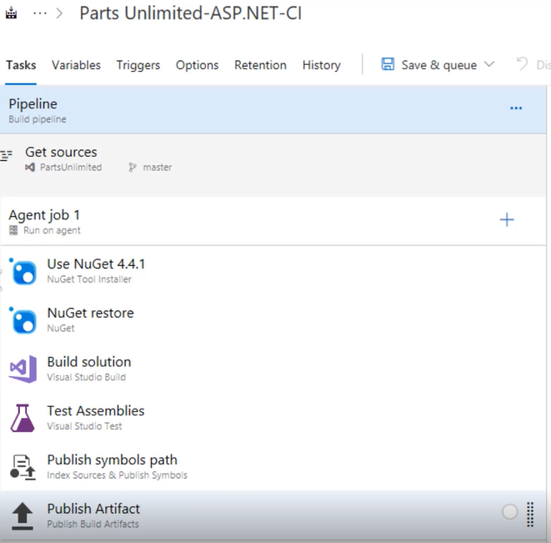
Demonstration: Implementating Continuous Integration in Azure DevOps
Notes:
Implementing Continuous Integration in Azure DevOps - https://www.youtube.com/watch?v=swd_0burbhI

Slide 10
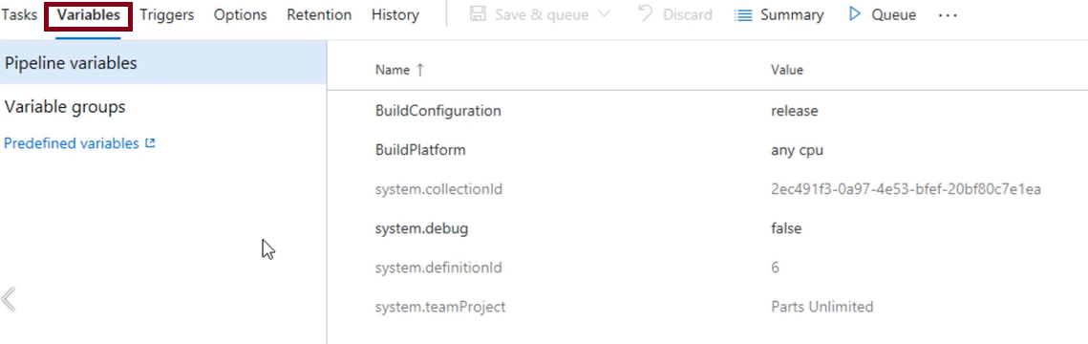
Demonstration: Using Variables to Avoid Hard-coded Values
Notes:
For more information, you can see: Predefined Build Variables - https://docs.microsoft.com/en-us/azure/devops/pipelines/build/variables?view=vsts
Using Variables to Avoid Hard-coded Values - https://www.youtube.com/watch?v=dRFgqaJDTlw

Slide 11
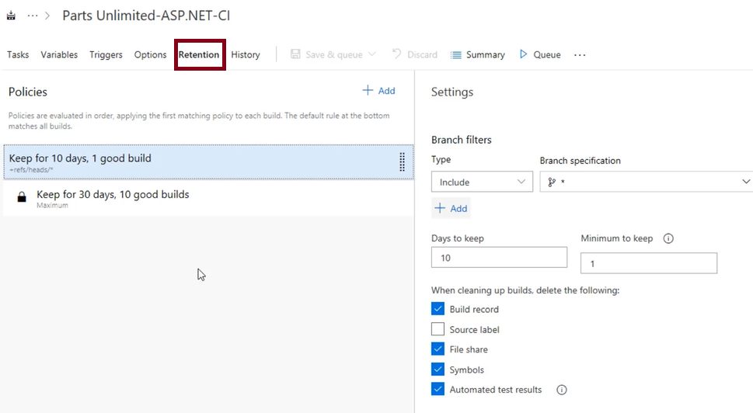
Video: Configuring Build Retention
Notes:
Configuring Build Retention - https://www.youtube.com/watch?v=q-HMPLwu8-0

Slide 12
Lab: Enabling Continuous Integration with Azure Pipelines
In this hands-on lab, you will learn how to configure continuous integration with Azure Pipelines. You will perform the following tasks:
Creating a basic build pipeline from a template
Tracking and reviewing a build
Invoking a continuous integration build
✔️ Note that you must have already completed the prerequisite labs in the Welcome section.
Notes:
✔️ Note that you must have already completed the prerequisite labs in the Welcome section.
Enabling Continuous Integration with Azure Pipelines - https://www.azuredevopslabs.com/labs/azuredevops/continuousintegration/

Slide 13
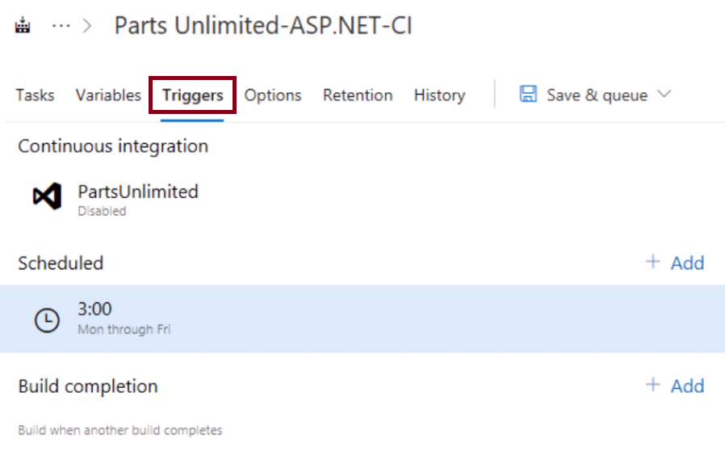
Video: Implementing Build Triggers
Notes:
Implementing Build Triggers -https://www.youtube.com/watch?v=3Bu7CLePL3E

Slide 14
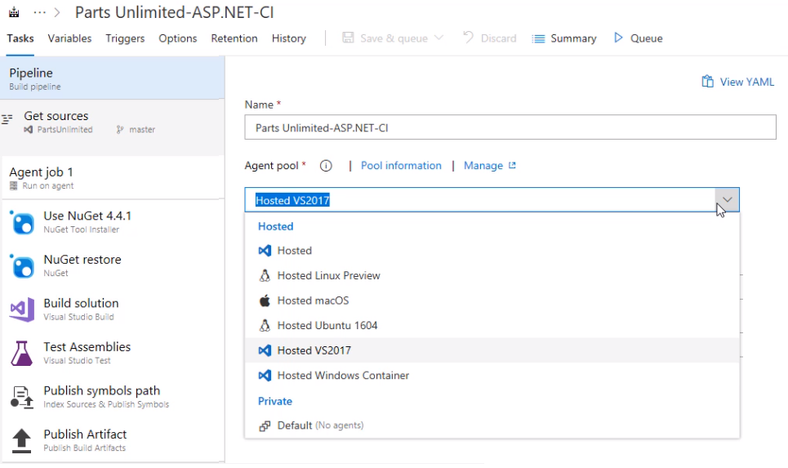
Video: Working with Hosted Agents
Notes:
Working with Hosted Agents - https://www.youtube.com/watch?v=yjZWPExCjE8

Slide 15
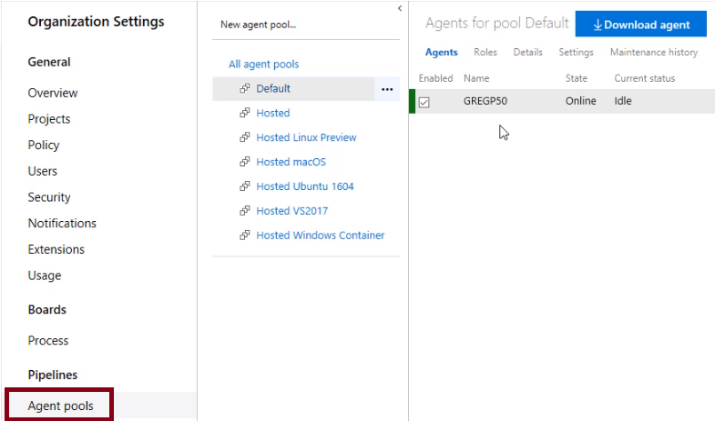
Video: Implementing a Hybrid Build Process
Notes:
Implementing a Hybrid Build Process - https://www.youtube.com/watch?v=DDcc7dpWMw8

Slide 16
Lab: Creating a Jenkins Build Job and Triggering CI
In this hands-on lab, you will learn how to create a build job in Jenkins and to enable continuous integration. You will learn how to:
Provision Jenkins on Azure VM using the Jenkins template available on the Azure Marketplace
Configure Jenkins to work with Maven and Azure DevOps
Create a build job in Jenkins
Configure Azure Pipeline to integrate with Jenkins
Configure a CD pipeline in Azure Pipelines to deploy the build artifacts
✔️ In this lab, you will try two approaches to triggering continuous integration
Notes:
Integrating Jenkins CI with Azure Pipelines -https://www.azuredevopslabs.com/labs/vstsextend/jenkins/

Slide 17
Video: Code Quality Defined
Short deadlines, a lack of coding standards, and poor technical skills can lead to code that is NOT:
Clear and readable
Documented
Efficient
Maintainable
Extensible
Secure
Notes:
Code Quality Defined - https://www.youtube.com/watch?v=PwF09SwNk90

Slide 18
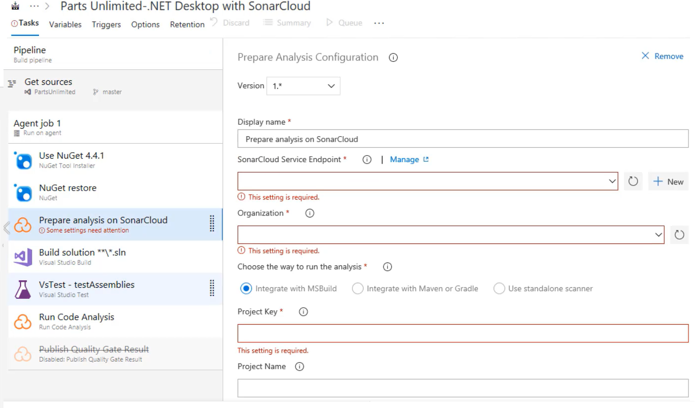
Demonstration: Configuring SonarCloud in a Build Pipeline
Notes:
Configuring SonarCloud in a Build Pipeline - https://www.youtube.com/watch?v=XhgNyF-TwDQ

Slide 19
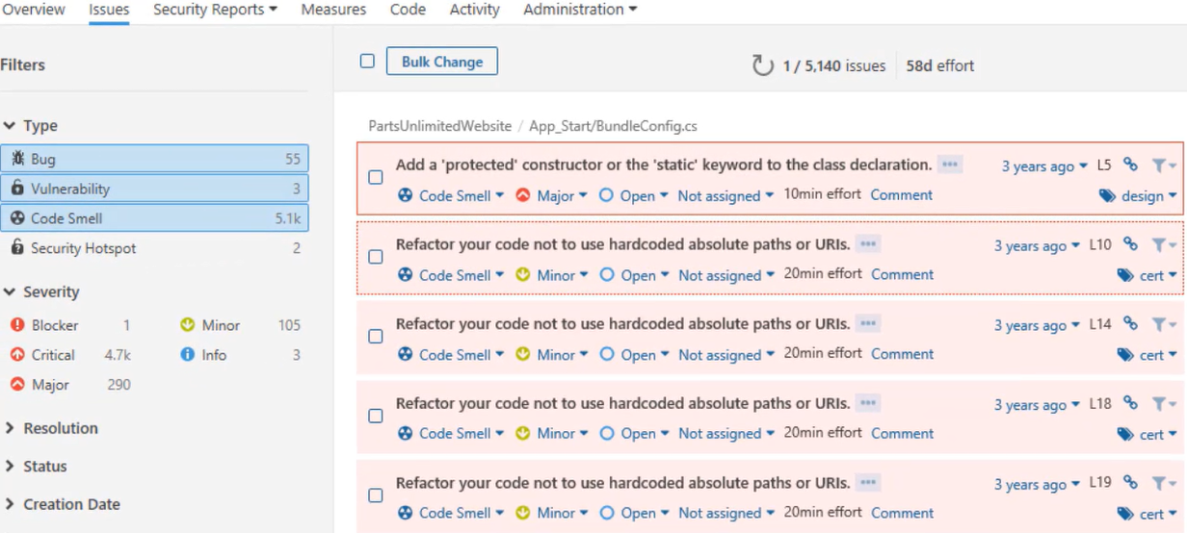
Demonstration: Reviewing SonarCloud Results and Resolving Issues
Notes:
Reviewing SonarCloud Results and Resolving Issues - https://www.youtube.com/watch?v=uOkCl3GzSOw

Slide 20
Lab: Managing Technical Debt with Azure DevOps and SonarCloud
In this hands-on lab, you will learn how to manage and report on technical debt using SonarCloud integration with Azure DevOps. You will perform the following tasks:
Integrate SonarCloud with Azure DevOps and run an analysis
Analyze the results
Configure a quality profile to control the rule set used for analyzing your project
✔️ Note that you must have already completed the prerequisite labs in the Welcome section.
Notes:
✔️ Note that you must have already completed the prerequisite labs in the Welcome section.
Managing Technical Debt with Azure DevOps and SonarCloud -https://www.azuredevopslabs.com/labs/azuredevops/sonarcloud/

Slide 21
Video: Open Source Licensing Challenges
Open source software is code that everyone can read, modify, enhance, and share
Incorporating open source code is convenient but can cause issues:
Security
Quality
Old versions
Licensing
Minimize risk by implementing automated systems to manage the code
Notes:
Open Source Licensing Challenges – https://www.youtube.com/watch?v=XLrPryCen6U
For more information, you can see:
Common Vulnerabilities and Exposures - https://cve.mitre.org/about/

Slide 22
Video: Avoiding OWASP Top Ten
Injection Attacks
Broken Authentication
Sensitive Data Exposure
XML External Entities
Broken Access Control
Notes:
Avoiding OWASP Top Ten – https://www.youtube.com/watch?v=x_Z4_ap2BfY
For more information, you can see:
OWASP Top Ten - https://www.owasp.org/index.php/Category:OWASP_Top_Ten_Project

Slide 23
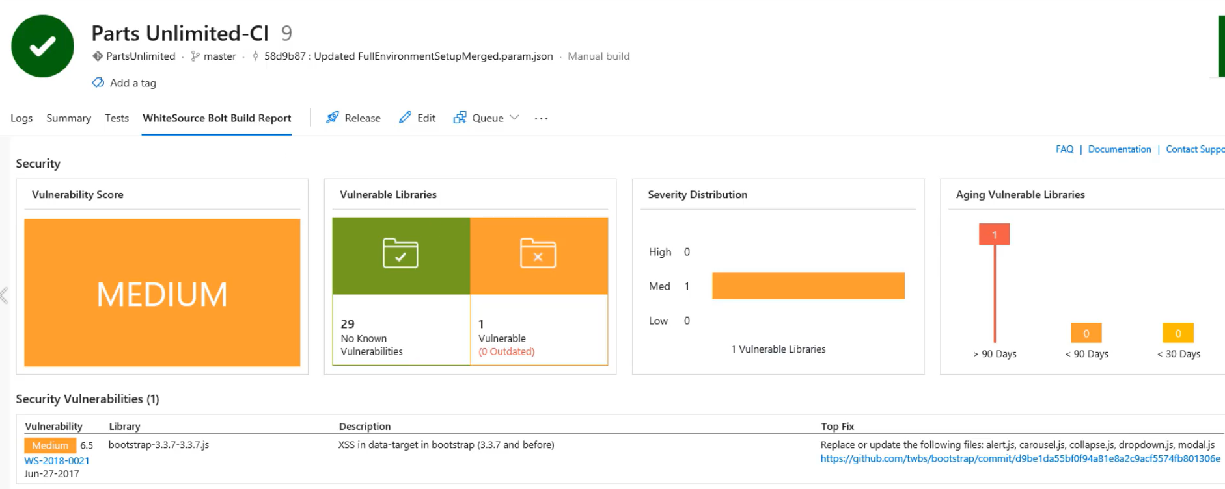
Demonstration: Detecting Open Source Issues with WhiteSource Bolt
Notes:
Detecting Open Source Issues with WhiteSource Bolt - https://www.youtube.com/watch?v=OhxCgZHPY_U

Slide 24
Lab: Checking Vulnerabilities using WhiteSource Bolt with Visual Studio Team Services
In this hands-on lab, you will learn how to check for open source vulnerabilities using WhiteSource Bolt in conjunction with Azure DevOps. You will learn how to:
Integrate WhiteSource Bolt with you Azure DevOps build process
Detect and remedy vulnerable open source components
Generate comprehensive open source inventory reports per project or build
Enforce open source license compliance, including licenses for dependencies
Identify outdated open source libraries with recommendations to update
✔️ Note that you must have already completed the prerequisite labs in the Welcome section.
Notes:
Checking Vulnerabilities using WhiteSource Bolt with Visual Studio Team Services - https://www.azuredevopslabs.com/labs/vstsextend/WhiteSource/
✔️ Note that you must have already completed the prerequisite labs in the Welcome section. Also, that at the time of writing, this lab refers to VSTS instead of Azure DevOps.

Slide 25
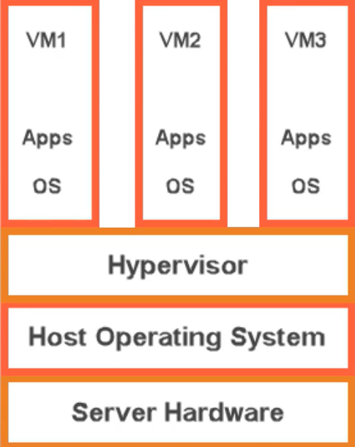
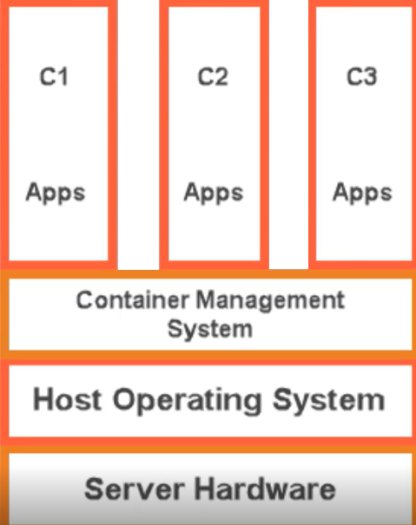
Video: Overview of Containers
Notes:
Overview of Containers - https://www.youtube.com/watch?v=-0J3-gISFMY

Slide 26
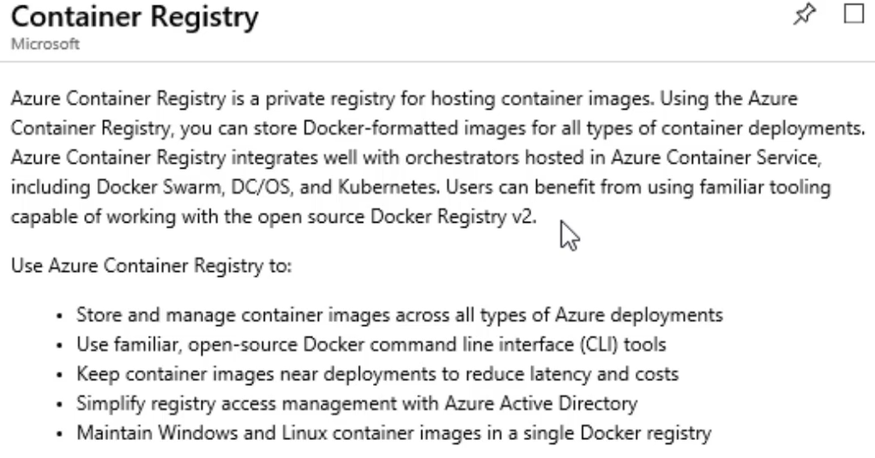
Demonstration: Create an Azure Container Registry
Notes:
Create an Azure Container Registry - https://www.youtube.com/watch?v=IWbDG9cXa6s

Slide 27
Demonstration: Add Docker Support to an Existing Application
FROM microsoft/dotnet:2.1-aspnetcore-runtime AS base
WORKDIR /app
EXPOSE 6636
EXPOSE 44320
FROM microsoft/dotnet:2.1-sdk AS build
WORKDIR /src
COPY ["WebApplication1/WebApplication1.csproj", "WebApplication1/"]
…
RUN dotnet build "WebApplication1.csproj" -c Release -o /app
FROM build AS publish
RUN dotnet publish "WebApplication1.csproj" -c Release -o /app
FROM base AS final
WORKDIR /app
COPY --from=publish /app .
ENTRYPOINT ["dotnet", "WebApplication1.dll"]
Notes:
Add Docker Support to an Existing Application - https://www.youtube.com/watch?v=pYkQjmUsA-8

Slide 28
Lab: Existing .NET Applications with Azure and Docker Images
In this hands-on lab, you will learn how to modernize an existing ASP.NET application with migration to Docker images managed by the Azure Container Registry. You will learn how to:
Migrate the LocalDB to SQL Server in Azure
Using the Docker tools in Visual Studio 2017, add Docker support for the application
Publish Docker Images to Azure Container Registry (ACR)
Push the new Docker images from ACR to Azure Container Instances (ACI)
Notes:
Follow the instructions at this location:
Modernizing your existing ASP.NET Apps with Azure -https://www.azuredevopslabs.com/labs/vstsextend/aspnetmodernize/

Slide 29

Automating your infrastructure deployments in the Cloud with Terraform and Azure Pipelines
HANDS-
ON
Notes:
https://azuredevopslabs.com/labs/vstsextend/terraform/

Slide 30
Deploying to Azure VM using Deployment Groups
HANDS-
ON
Notes:
https://azuredevopslabs.com/labs/vstsextend/deploymentgroups/

Slide 31
Setting up secrets in the pipeline with Azure Key vault
HANDS-
ON
Notes:
https://azuredevopslabs.com/labs/vstsextend/azurekeyvault/

Slide 32
Setting up and Running Load Tests
HANDS-
ON
Notes:
https://azuredevopslabs.com/labs/azuredevops/load/

Slide 33
Setting up and Running Functional Tests
HANDS-
ON

Slide 34
Using Azure Monitor as Release Gate
HANDS-
ON
Notes:
https://azuredevopslabs.com/labs/vstsextend/releasegates/

Slide 35
Creating a Release Dashboard
HANDS-
ON

Slide 36
Blue-Green Deployment
In this lab, you will learn how to do a Blue-Green Deployment in the pipeline.
HANDS-
ON

Slide 37
Traffic Manager
In this lab, you will learn how to do a Blue-Green Deployment in the pipeline.
HANDS-
ON

Slide 38
Package management
Create a package feed
Connect to the feed
Create a NuGet package and publish it to the feed
Import the new NuGet package into an existing project
Update a NuGet package in the feed
HANDS
ON

Slide 39
Lab:
The Module 1 lab can be accessed at the below location:
Lab : Azure Deployments using Resource Manager templates
In this lab we will customize an Azure Resource Manager template, by modularizing the resource definitions, then create a custom script extension as part of our template definition. Then we will deploy the defined resources into Azure and validate those resources have deployed successfully.
Notes:
Lab Steps in this course are available on GitHub at the below, under the Infrastructure as Code sections.
https://microsoft.github.io/PartsUnlimited
https://microsoft.github.io/PartsUnlimitedMRP

Slide 40
Lab:
The Module 2 labs can be accessed at the below locations:
You can choose to do either, or both, labs depending on your available time:
Lab 1: Azure Automation Runbook Deployments
In this lab we will crate an Azure Automation account, configure automation assets in Azure and deploy two load balanced virtual machines in Azure in parallel using Windows PowerShell based runbook
Lab 2: Azure Automation State configuration DSC
In this lab we will create a Desired State configuration file, import it into an Azure Automation account and compile it, then apply that configuration to Azure virtual machines
Notes:
Lab Steps in this course are available on GitHub at the below, under the Infrastructure as Code sections.
https://microsoft.github.io/PartsUnlimited
https://microsoft.github.io/PartsUnlimitedMRP

Slide 41
Lab:
The Module 3 labs can be accessed at the below locations:
You can choose to do either, or both, labs depending on your available time:
Lab 1: Deploy Application to Azure App Services using Azure DevOps
In this lab we will deploy an application to Azure App Services using Azure DevOps
Lab 2: Deploy Application to Azure Kubernetes Service
In this lab we will deploy an application to Azure Kubernetes Service
Notes:
Lab Steps in this course are available on GitHub at the below, under the Infrastructure as Code sections.
https://microsoft.github.io/PartsUnlimited
https://microsoft.github.io/PartsUnlimitedMRP

Slide 42
Lab:
The Module 4 labs can be accessed at the below locations:
You can choose to do any one of the following labs:
Lab 1: Deploy app with Chef on Azure
In this lab we will deploy an application to Azure using Chef
Lab 2: Deploy app with Puppet on Azure
In this lab we will deploy a java based application to Azure using Puppet
Lab 3: Ansible with Azure
In this lab we deploy a basic environment in Azure that allows to test some of the functionality of the integration between Azure and Ansible
Notes:
Lab Steps in this course are available on GitHub at the below, under the Infrastructure as Code sections.
https://microsoft.github.io/PartsUnlimited
https://microsoft.github.io/PartsUnlimitedMRP

Slide 43
Lab: Implement Security and Compliance in Azure DevOps pipelines
The Module 1 lab can be accessed at the location:
Implement Security and Compliance in Azure DevOps pipelines
In this lab we will:
Implement various security techniques and solutions into an Azure DevOps pipeline
Notes:
Lab Steps in this course are available on GitHub at the below, under the Infrastructure as Code sections.
https://microsoft.github.io/PartsUnlimited
https://microsoft.github.io/PartsUnlimitedMRP

Slide 44
Lab: Agile Planning and Portfolio Management with Azure Boards
In this lab, Agile Planning and Portfolio Management with Azure Boards, you will learn about Azure Boards and how they can help you quickly plan, manage, and track work across your entire team. Tasks include:
Working with teams, areas, and iterations.
Working with work items.
Managing sprints and capacity.
Customizing Kanban Boards.
Defining dashboards.
Customizing team processes.
✔️ Note that you must have already completed the prerequisite labs in the Welcome section.
Notes:
Agile Planning and Portfolio Management with Azure Boards - https://www.azuredevopslabs.com/labs/azuredevops/agile/

Slide 45
Lab: Feature Flag Management with LaunchDarkly and AzureDevOps
In this hands-on lab, Feature Flag Management with LaunchDarkly and AzureDevOps, you will investigate the use of feature flags and learn:
How to implement a very simple feature flag for an ASP.NET MVC application
How to integrate LaunchDarkly with Azure DevOps
How to roll-out LaunchDarkly feature flags in Azure DevOps release pipelines
✔️ Note that you must have already completed the prerequisite labs in the Welcome section.
Notes:
Feature Flag Management with LaunchDarkly and AzureDevOps - https://www.azuredevopslabs.com/labs/vstsextend/launchdarkly/
✔️ Note that you must have already completed the prerequisite labs in the Welcome section.

Slide 46
Lab: Integrating Azure Repos and Pipelines with Eclipse
In this lab, Integrating Azure Repos and Pipelines with Eclipse, you will walk you through a typical end-to-end workflow for a Java developer using Azure DevOps and working with Eclipse.
You will learn how to:
Provision an Azure DevOps Organization team project with sample data and users
Install Eclipse Photon and Team Explorer Everywhere
Install and explore Azure Toolkit for Eclipse
Setup an Azure Build pipeline to build and test the code, then push it to an Azure Container Registry
Setup an Azure Web app and configure an Azure Release pipeline to deploy the image to Azure Web App
✔️ Note that you must have already completed the prerequisite labs in the Welcome section.
Notes:
Integrating Azure Repos and Azure Pipelines with Eclipse - https://www.azuredevopslabs.com/labs/vstsextend/eclipse/
✔️ Note that you must have already completed the prerequisite labs in the Welcome section.

