Slide 1
Seminar 2
The Evolution of Environmental Transparency: A Longitudinal Analysis of Symbolic vs. Substantive Disclosure (2002–2016)
Course: Data Analysis and Visualisation
Date: 24.03.2026
Group 10: Aikaterini Toumpa, Al Amin Alif, Charitha Wickramasinghe, Tharindu Senanayake
Instructor: Asif Huq

Slide 2


The Background
Environmental disclosure is a key part of CSR reporting, but its credibility is debated
1
Key distinction:
– Symbolic disclosure → intentions / commitments
– Substantive disclosure → measurable outcomes
2
3
Firms may use reporting strategically (greenwashing)
Introduction & Research Focus
GRI frameworks (G3, G4) improved structure, but impact on quality is unclear
4
Research Gap
Limited evidence on how disclosure quality evolves over time
Research Questions
Main RQ: How has environmental disclosure evolved (2002–2016)?
Sub-Q 1: Has the balance between symbolic and substantive changed?
Sub-Q 2: Did GRI frameworks improve reporting quality?

Slide 3
Keyword Lexicon
Dictionary Type | Function | Example Terms
ENVIRONMENTAL KEYWORDS | Sentence must contain at least one to be analysed. | emissions, carbon, climate change, energy consumption, renewable energy, solar, water use, scarcity, landfill, recycling rate, hazardous waste, biodiversity, ecosystem, air quality, pollutants, iso 14001, sustainability report
WORD TYPE 1 | Detects a directional action or change related to the environment. | reduced, decreased, lowered, cut, improved, increased, eliminated, deployed, installed, transitioned
WORD TYPE 2 | Confirms the action is a completed result, not just a plan. | achieved, resulted, met, verified, confirmed, exceeded, delivered, demonstrated, recorded, on track
PAST PARTICIPLE | Catches completed actions where grammar alone confirms the result, even without a Type_2 word present. | deployed, installed, retrofitted, upgraded, lowered, dropped, declined, improved, increased, offset
SYMBOLIC WORDS | Identifies future intentions or commitments without confirmed outcomes. | committed, aims to, plan to, will reduce, intends to, working towards, ambition, roadmap, pledge, striving to

Slide 4
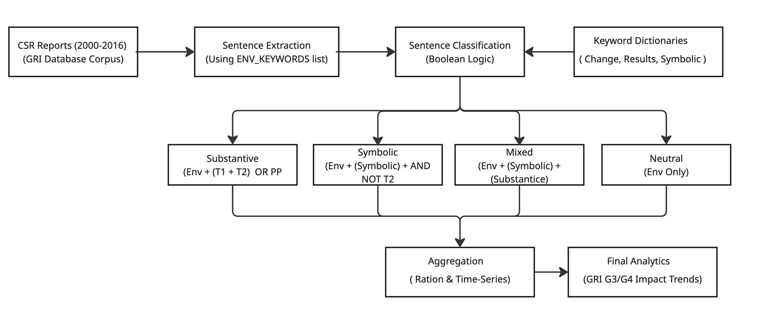
Methodology
Dictionary-based approach chosen for transparency and interpretability
Directly operationalizes symbolic vs. substantive disclosure and enables comparison over time

Slide 5
Sample Selection Table
Step | Description | Reports Remaining
Starting population | GRI database reports 2002–2016 | 5789
After language filter | English only | 1632
After minimum sentence filter | At least 10 sentences | 1347
After removing corrupted files | Valid text files only | 1347

Slide 6
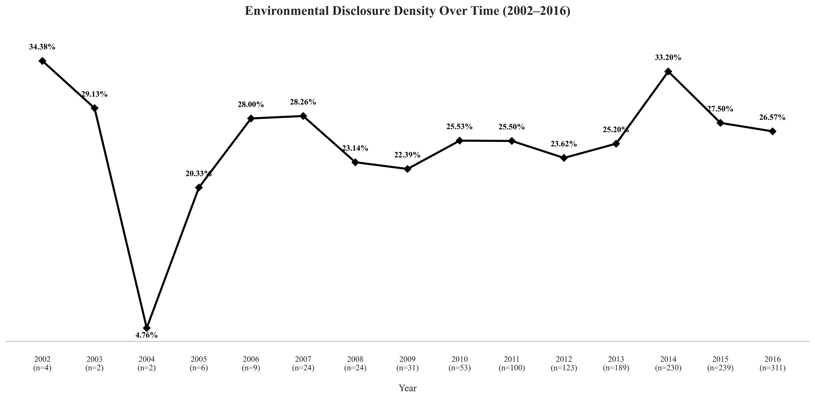
Main RQ: How has the nature of environmental disclosure in industries evolved from
2002 to 2016 in terms of language and reporting quality?
Observation: Environmental disclosure expands in breadth rather than depth, with more companies reporting but no increase in relative emphasis within reports.

Slide 7
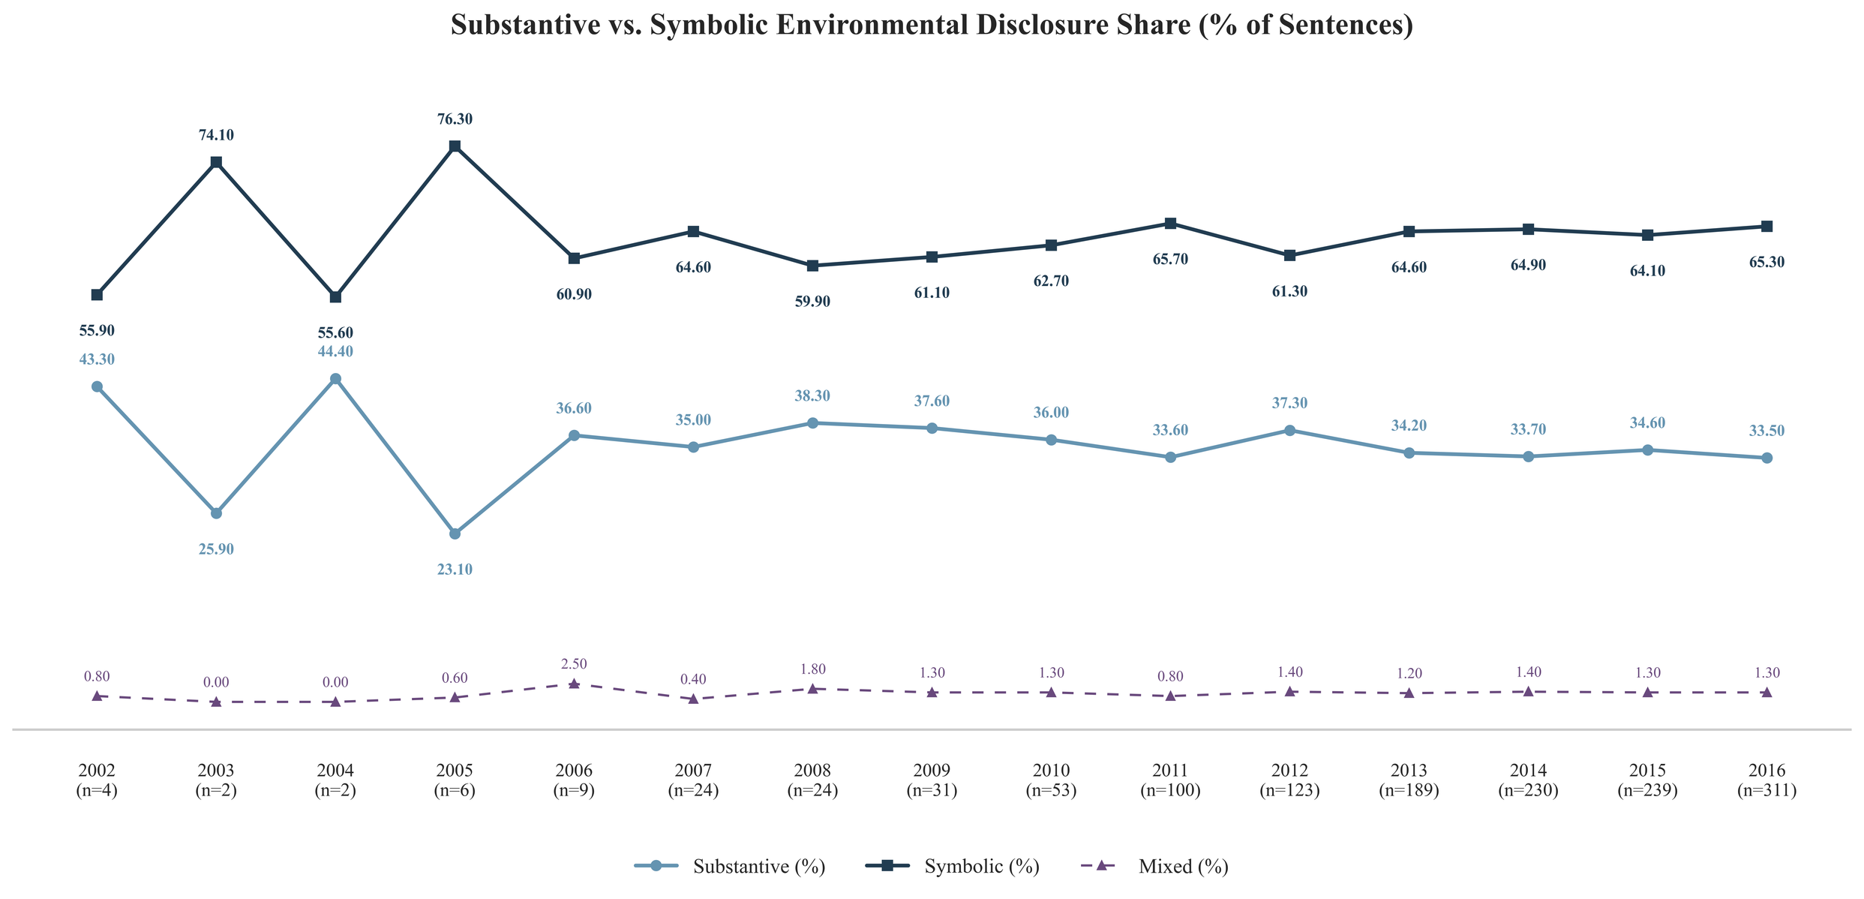
Sub-Q 1: To what extent has the balance between symbolic and substantive disclosure shifted within these reports over time?
Observation: The data suggests a gradual shift toward more symbolic and less substantive language as CSR reporting became more widespread.

Slide 8
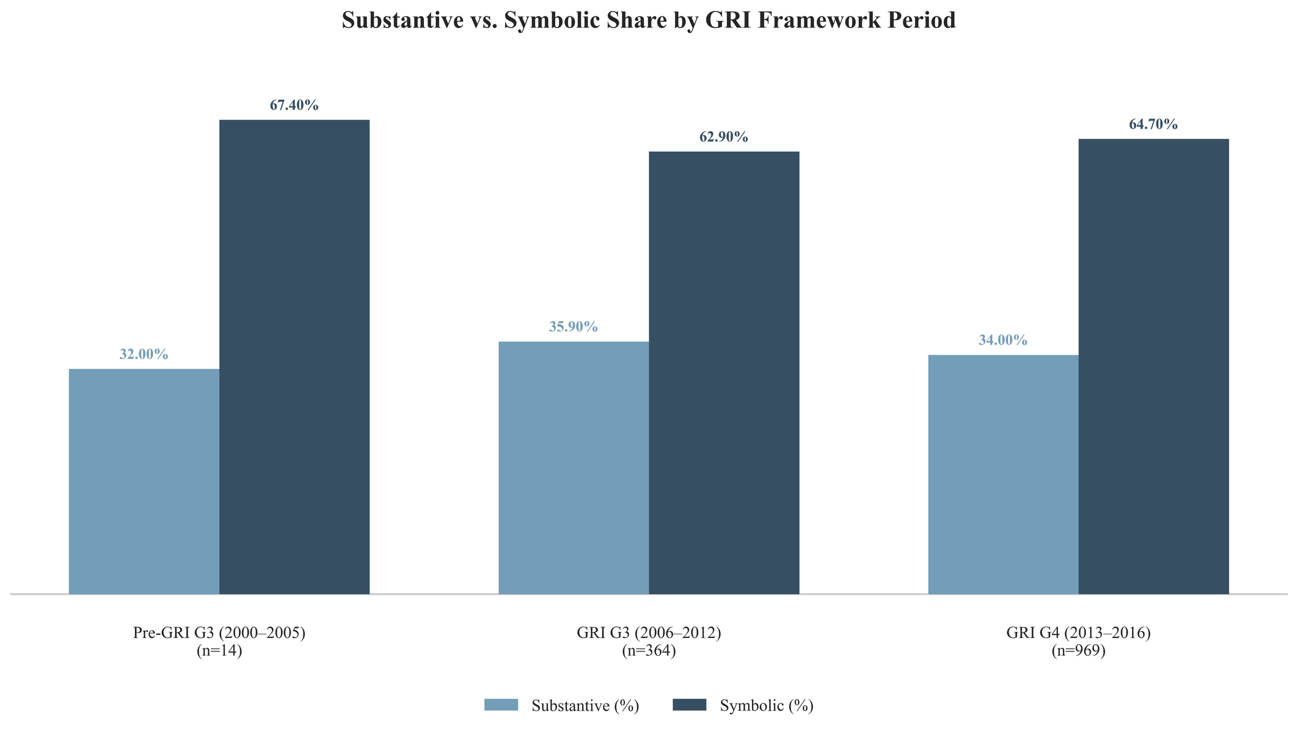
Sub-Q 2: Did the introduction of GRI G3 (2006) and GRI G4 (2013) frameworks act as a catalyst in shifting industries from symbolic to substantive reporting?
Observation: GRI frameworks increased reporting volume without significantly improving accountability.

Slide 9

Conclusions
Environmental reporting increased (2002–2016), however, disclosures remain largely symbolic
No clear shift toward measurable outcomes
GRI frameworks improved structure, not accountability
Conclusions and Limitations
Limitations
Only English reports → potential regional bias
Rule-based method → may miss context / negation
Data quality issues (PDF conversion noise)
Uneven dataset → early years less reliable

Slide 10
Thank you!
Questions?

