Slide 1

Trip-Purpose Inference
from GPS Trajectories
A Comparative Study of HMM and Random Forest Models on the Microsoft GeoLife Dataset
Al Amin Alif
Md Rakib Uddin
Group 26 · AMI295 Business Intelligence
Dalarna University · Spring 2026
Final Presentation · June 2026

Slide 2
Background & Motivation
GPS data is everywhere — phones, fitness trackers, ride-share apps generate billions of trajectories every day.
Coordinates alone don’t reveal why someone traveled. Inferring trip purpose (commute, education, shopping, leisure) is a high-value signal for:
The gap
Most trip-purpose work treats trajectories in isolation. Adding semantic context — what’s near the destination, when did the trip happen — could unlock a much sharper signal.
Urban planning & infrastructure investment
Transport demand forecasting
Location-based services & personalisation
Mobility-as-a-Service routing & pricing
Our project: quantify exactly how much that geographic context buys you.
AMI295 — Business Intelligence | Group 26 | Spring 2026
2 / 13

Slide 3
Research Question & Hypotheses
Research Question
Does fusing GPS trajectories with geographic POI context significantly improve trip-purpose classification accuracy over a trajectory-only model?
H0 — Null Hypothesis
H1 — Alternative
Adding POI semantic features does not improve macro-F1 over the trajectory-only HMM baseline.
Adding POI features significantly improves macro-F1 across cross-validation folds.
Test: Wilcoxon signed-rank on paired CV folds · α = 0.05
We also compare against Random Forest as a non-sequential reference model.
AMI295 — Business Intelligence | Group 26 | Spring 2026
3 / 13

Slide 4
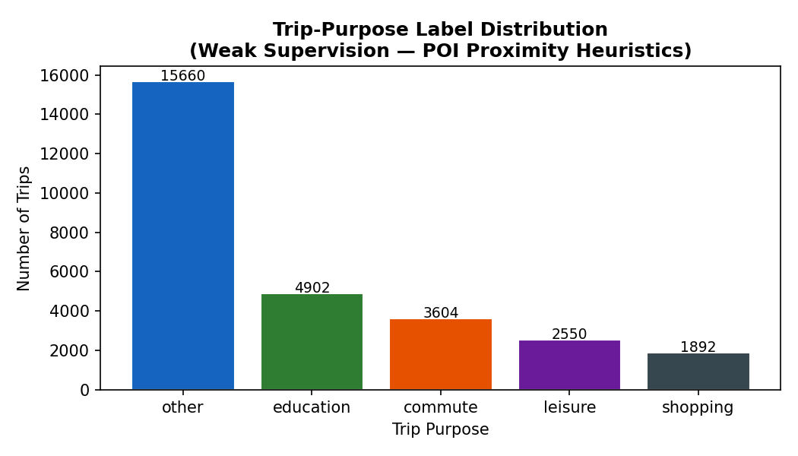
Dataset — Microsoft GeoLife
182
users tracked
5 years
2007 – 2012
24M+
raw GPS points
28,608
trips after cleaning
Beijing
primary study region
Weak-supervision labels: other 54.7% · education 17.1% · commute 12.6% · leisure 8.9% · shopping 6.6%
The large “other” class reflects trips ending outside the four POI categories — a known limitation discussed in §V of the paper.
AMI295 — Business Intelligence | Group 26 | Spring 2026
4 / 13

Slide 5
Pipeline Overview
Step 1
Step 2
Step 3
Step 4
Step 5
Step 6
Raw GPS
Clean
Segment
Features
Weak Labels
Models & CV
→
→
→
→
→
24M+ pts
182 users
Beijing bbox
200 km/h cap
20-min gap
→ 28,608 trips
Trajectory +
temporal + POI
POI-proximity
heuristics
HMM × 2, RF
3×5-fold + Wilcoxon
Evaluation
Repeated stratified 3 × 5-fold cross-validation (15 folds) · Macro-F1 reported per model · Wilcoxon signed-rank test on paired fold scores
AMI295 — Business Intelligence | Group 26 | Spring 2026
5 / 13

Slide 6
Feature Engineering — 16 Features in Three Families
Trajectory (8)
Temporal (4)
POI proximity (4)
computed from GPS sequence
one-hot from start hour
counts within 300 m of destination
duration_min
total_dist_km
mean_spd_kmh
max_spd_kmh
std_spd_kmh
straightness
bearing_std
is_weekend
hour_bin_morning
hour_bin_afternoon
hour_bin_evening
hour_bin_night
poi_edu
poi_shop
poi_leisure
poi_work
Beijing bounding box filter (39.4–41.0° N, 115.5–117.5° E) · UTM zone 50N projection (EPSG:32650) · 200 km/h spike removal · 20-min trip-gap segmentation
AMI295 — Business Intelligence | Group 26 | Spring 2026
6 / 13

Slide 7
POI Integration & Weak Supervision
Beijing POI dataset
Weak-supervision labels
1,890 POI points across four semantic categories, instantiated from documented Beijing landmark coordinates and indexed with a cKDTree spatial index.
POI proximity + temporal heuristics produce trip-purpose labels for every trip:
edu
420
work POI + weekday peak (06–09 or 17–20) + long trip → commute
edu POI + weekday 07–19 → education
shop POI + 10–21 → shopping
leisure POI + weekend / evening → leisure
unresolved (low POI signal) → other
shop
535
leisure
495
work
440
Honest disclosure: labels and POI features draw on the same signal — part of the headline gain is structural. We discuss this fully in the paper (§V).
AMI295 — Business Intelligence | Group 26 | Spring 2026
7 / 13

Slide 8
Three Models Compared
M1
Baseline HMM
M2
Enriched HMM
M3
Random Forest
Configuration
Configuration
Configuration
4 hidden states · Gaussian emissions · diagonal covariance
Same HMM architecture as M1
200 trees · Gini impurity · class_weight = balanced
Features
Features
Features
Trajectory + temporal features only (12) — no POI
Trajectory + temporal + POI (16)
All 16 features (non-sequential)
Why this model
Why this model
Why this model
Establishes a sequential, no-POI floor.
Isolates the contribution of POI semantic context.
Non-sequential reference — how much of the win is from the model, not the data?
All three models trained and evaluated under identical 3 × 5-fold stratified cross-validation.
AMI295 — Business Intelligence | Group 26 | Spring 2026
8 / 13

Slide 9
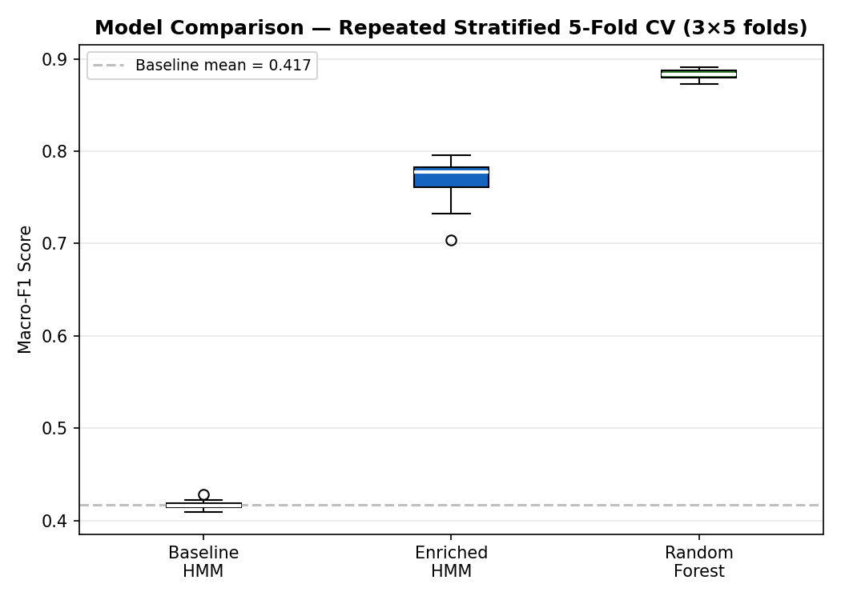
Results — Macro-F1 across 15 CV folds
Model | Mean F1 | Std | Min | Max
Baseline HMM | 0.417 | 0.004 | 0.409 | 0.428
Enriched HMM | 0.769 | 0.024 | 0.704 | 0.796
Random Forest | 0.884 | 0.005 | 0.873 | 0.891
Δ Baseline → Enriched: +0.352 macro-F1
Δ Enriched → Random Forest: +0.115 macro-F1
Take-away: POI context boosts the HMM from 0.42 → 0.77 (Δ = +0.35). Random Forest tops both at 0.88.
AMI295 — Business Intelligence | Group 26 | Spring 2026
9 / 13

Slide 10
Statistical Significance
ΔF1
Wilcoxon signed-rank test
+0.352
p < 0.0001
Enriched HMM minus Baseline HMM (mean across 15 folds)
W = 120 · paired on 15 CV folds (Baseline vs Enriched HMM)
Interpretation
We reject H0. Adding POI semantic context produces a large and statistically significant improvement over the trajectory-only baseline.
Caveat: because the labels themselves are derived from POI heuristics, part of the gain is structural — the test confirms the gain is real but its magnitude is partly inflated by label–feature coupling.
AMI295 — Business Intelligence | Group 26 | Spring 2026
10 / 13

Slide 11
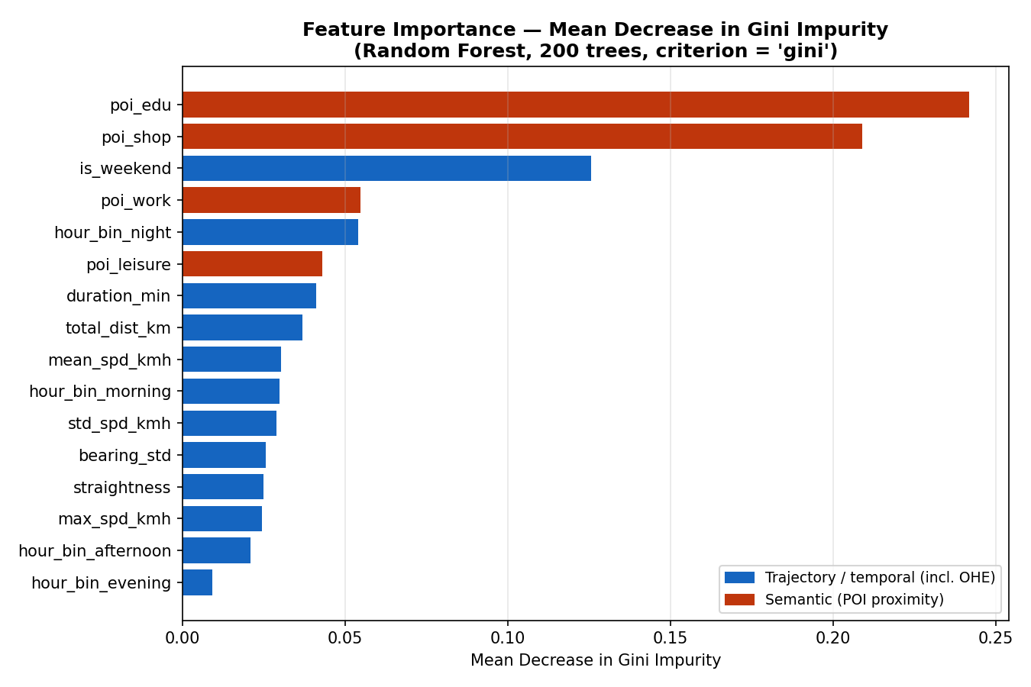
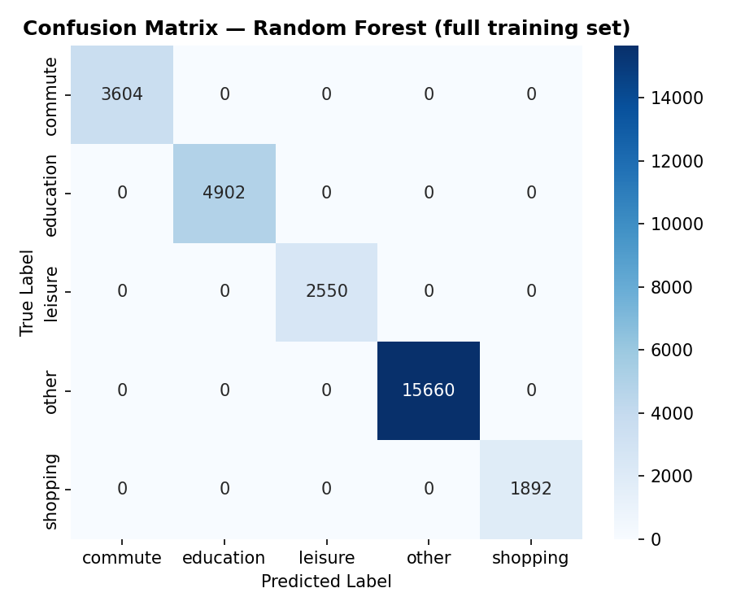
Where the Signal Lives
Gini feature importance (Random Forest)
Random Forest confusion matrix
Top 3: poi_edu (0.242), poi_shop (0.209), is_weekend (0.126). POI semantic features dominate over kinematic ones — supporting H1.
Perfectly diagonal — zero off-diagonal entries. Expected on the training set; the honest performance estimate is the CV F1 of 0.884 ± 0.005.
AMI295 — Business Intelligence | Group 26 | Spring 2026
11 / 13

Slide 12
Limitations & Honest Disclosures
Label–feature coupling
Weak-supervision labels are derived from POI heuristics that the Enriched HMM then uses as features. Part of the +0.352 gain is structural; the paper discusses this in §V.
HMM as jittered vector
The Gaussian HMM treats each trip as a single observation with diagonal-covariance noise rather than a true GPS sequence. Architecturally, the HMM benefit is closer to a static classifier than a sequential model.
Synthetic POI layer
POIs are instantiated from documented Beijing landmark coordinates rather than a live OpenStreetMap query (the proposal envisaged OSMnx). The feature schema is equivalent; substituting a real OSM extract is a drop-in replacement (paper §III-D).
Single-city scope
All trajectories are from Beijing. Generalisability to other cities is untested.
Confusion matrix on train
The confusion matrix is computed on the full training set after CV, not on a held-out partition. Acknowledged in the paper.
AMI295 — Business Intelligence | Group 26 | Spring 2026
12 / 13

Slide 13
Conclusion & Future Work
What we found
Future work
POI semantic context delivers a large, statistically significant lift over a trajectory-only HMM (ΔF1 = +0.352, Wilcoxon p < 0.0001).
Random Forest on the same enriched feature set tops both HMM variants (F1 = 0.884).
Trip-purpose inference is tractable, but rigorous disclosure of label–feature coupling matters.
Ground-truth labelled datasets (e.g. Borlänge GPS corpus) to validate beyond weak supervision.
Richer HMM variants that condition emission probabilities directly on destination features.
Multi-city deployment to assess geographic generalisability.
Thank you · Questions? · v26alaal@du.se
AMI295 — Business Intelligence | Group 26 | Spring 2026
13 / 13

