Slide 1
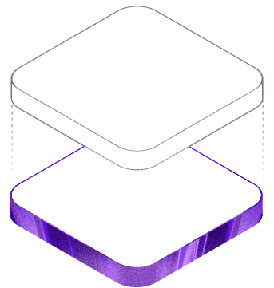
SMART E-HOME
ESP32-based IoT home monitoring and control
Presented by: R. ANANDH
Final Project Presentation

Slide 2
The Problem
Scattered controls
Limited visibility
Slow response
Home devices are controlled separately, making everyday management less convenient.
Users may not know the current temperature, humidity, gas status, or device state.
Without a connected dashboard, reacting to an unsafe or unusual condition can take longer.
Goal: build one simple interface for live monitoring and reliable device control.
SMART E-HOME • 02

Slide 3
Main Features
Demo login
Device control
Group actions
Validates email and password before opening the dashboard.
Controls 3 lights, a buzzer, and a fan.
Turn all devices on or off from one place.
Live sensors
Status checks
Error handling
Displays temperature, humidity, and gas state.
Shows API, MQTT, and ESP32 connectivity.
Explains offline backend, broker, or ESP32 conditions.
SMART E-HOME • 05

Slide 4
Our Solution
A web dashboard connected to an ESP32 through MQTT.
Monitor
Control
Record
View live temperature, humidity, gas reading, MQTT status, and ESP32 connectivity.
Turn five connected devices on or off individually, or use all-on and all-off controls.
Save sensor readings and device-function logs in PostgreSQL for later review.
SMART E-HOME • 03

Slide 5
How the System Works
React UI
→
Express API
→
MQTT Broker
→
ESP32
→
Devices + Sensors
Commands flow to the hardware; device states and sensor data flow back to the dashboard.
PostgreSQL stores sensor logs and function logs.
SMART E-HOME • 04

Slide 6
Technology Stack
Frontend
Backend
React 19 • Vite • CSS • Lucide icons
Node.js • Express • REST API
IoT communication
Hardware
MQTT • Aedes local broker • mqtt.js
ESP32 • connected devices • environmental sensors
Database
Deployment
PostgreSQL • sensor logs • function logs
Frontend API URL configured with environment variables
SMART E-HOME • 06

Slide 7
Thank You
Questions?
SMART E-HOME
A connected dashboard for safer and simpler home control.
SMART E-HOME • 10

