Slide 1



Slide 2
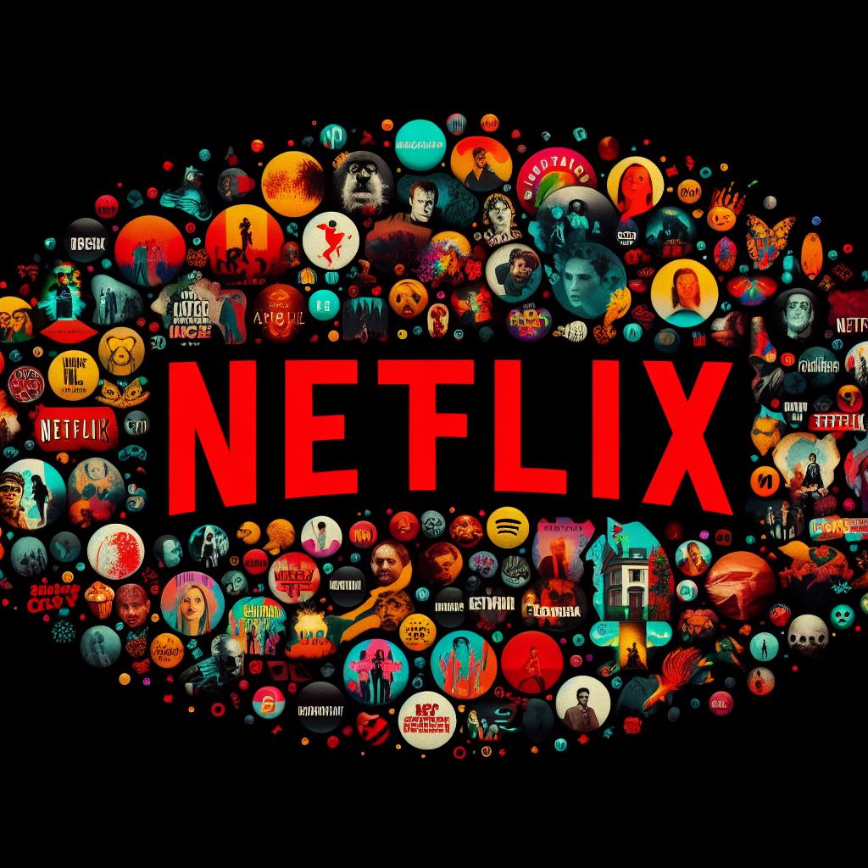
Problem Statement
Project's Primary Objective : Group Netflix shows into clusters.
Desired Outcome : Shows within the same cluster exhibit similarity, while those in different clusters diverge significantly.
Purpose : Enhance overall user experience and reduce subscriber churn.

Slide 3
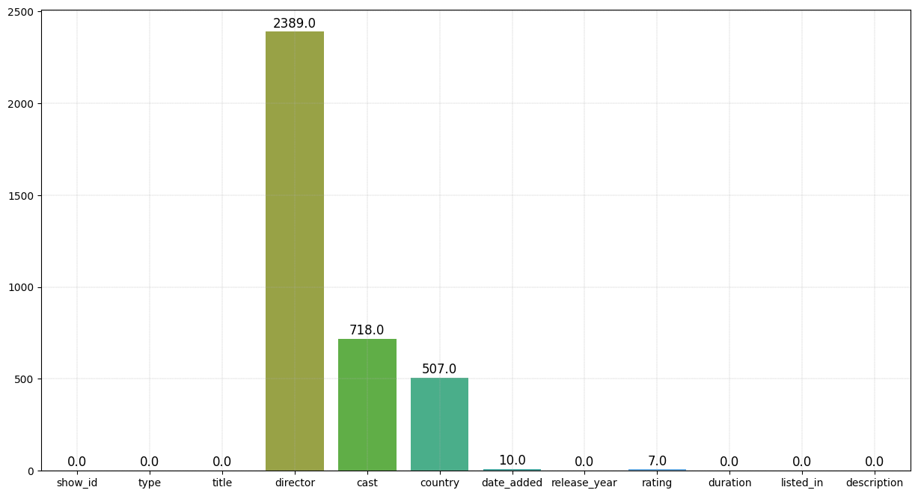
Data Summary
This dataset contains 7787 rows and 12 columns.
There are no duplicate values in this dataset.
Missing Values:
- Director: 30.68%
- Cast: 9.2%
- Country: 6.5%
- Date Added: 0.93%
- Rating: 0.09%

Slide 4
Data Cleaning
For 'date_added' and 'rating,' which have low percentages of null values, we will exclude those data points to maintain model impartiality.
For 'director' and 'cast,' where null values are relatively high and we lack information about the actual movies or TV shows, we will replace these entries with 'unknown.'
Regarding 'country,' since only 6% of the values are missing, and the majority of movies/shows originate from the US, we will fill the null values with the mode.

Slide 5
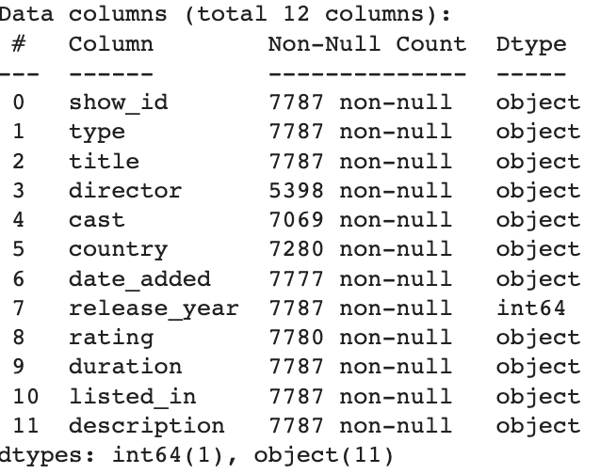
Data Manipulation
Converted improper data types (e.g., 'date_added' and 'duration') to desired formats.
Identified that 'type' feature consists of more movies than TV shows.
Created a word cloud to highlight common title words.
Focused on primary country and genre for shows filmed in multiple locations.
Adjusted ratings to cater to diverse viewer preferences (TV-MA, TV-14, TV-PG).
Noted that 50% of Netflix shows target adults, with fewer specifically for teenagers.

Slide 6
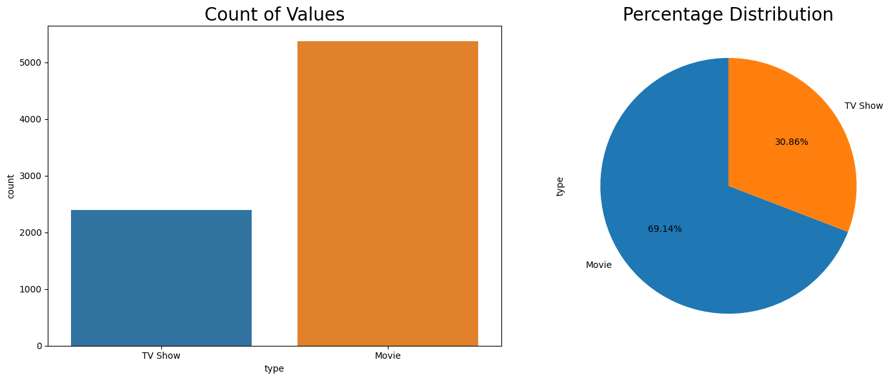
Exploratory Data Analysis
Content Variety on Netflix:
"Movies" dominate Netflix's content offerings.
"TV Shows" represent a smaller share.

Slide 7
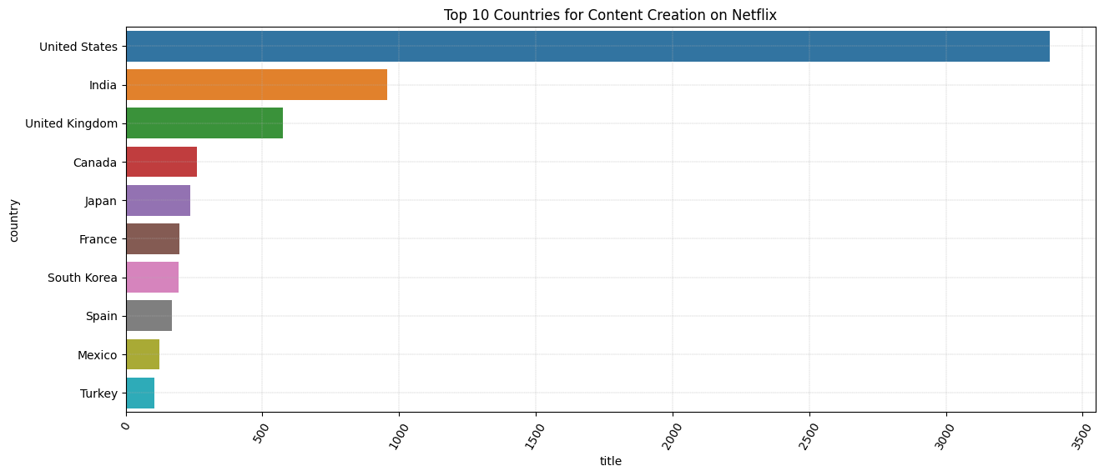
Exploratory Data Analysis
Leading Nations in Content Production
The United States leads in Netflix content, reflecting its robust entertainment industry.
India, the UK, Canada, and Japan contribute significantly, offering diverse content for worldwide audiences.
Notable contributions from South Korea, Spain, and Mexico highlight the popularity of international shows.

Slide 8
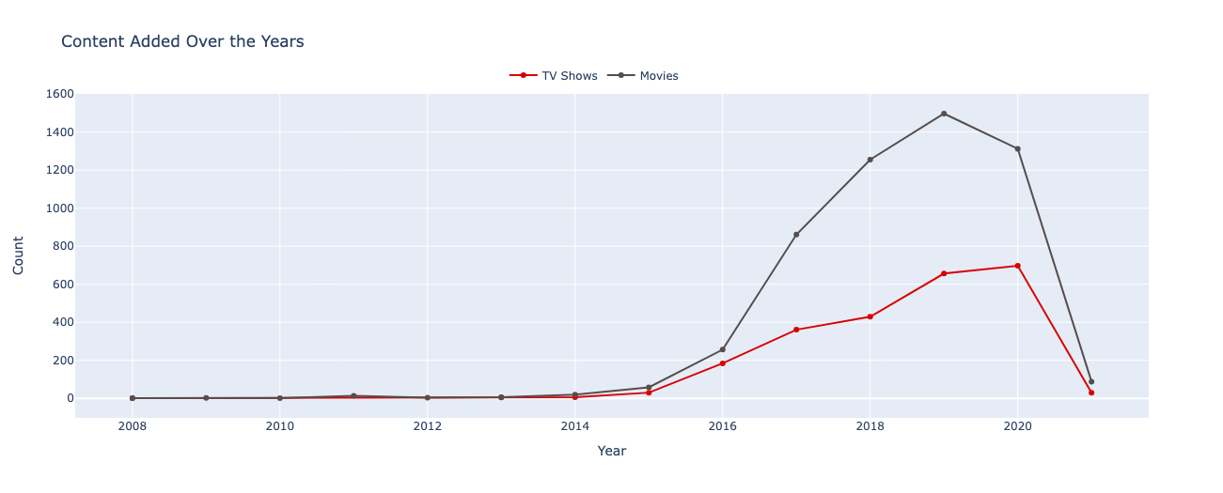
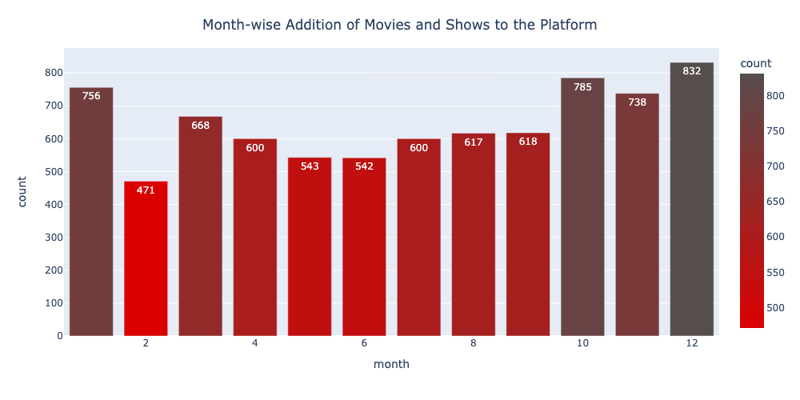
Exploratory Data Analysis
Content Development Across Years:
TV Shows: Limited additions in early years (2008-2010) signifying Netflix's original content creation.
Peak TV show growth from 2016 to 2020, with a decline in 2021.
Movies: Notable increase from 2014, peaking in 2019.
Dip in 2020 may be due to COVID-19-related production delays.
Busiest Month for Content Releases:
High-Volume Months: December (833), October (785), January (757).
End-of-year peak in December aligns with the holiday season.
Potential seasonal patterns influenced by holidays, viewer behaviour.

Slide 9
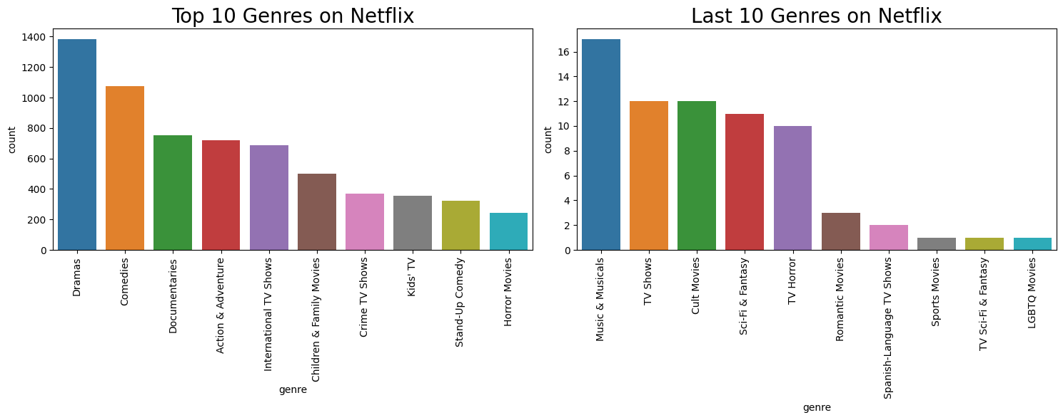
Exploratory Data Analysis
Genre Rankings: Top and Bottom 10
Top 10 Genres:
Diverse Genres: Spanning dramas, comedies, documentaries, and action & adventure.
Family-Friendly: Catering to families with "Children & Family Movies," "Kids' TV," and "Animation."
Entertainment Variety: Featuring "Stand-Up Comedy" and "Music & Musicals."
Last 10 Genres:
Niche & Specialized: Targeting specific audiences with "Cult Movies," "TV Horror," and "Sci-Fi & Fantasy."
Limited Appeal: Including genres like "LGBTQ Movies" and "Sports Movies" with niche audiences.
Highly Specific: Targeting genre enthusiasts with "TV Sci-Fi & Fantasy" and "TV Horror."
Viewer Diversity: "TV Shows" and "Romantic Movies" cater to diverse interests.

Slide 10
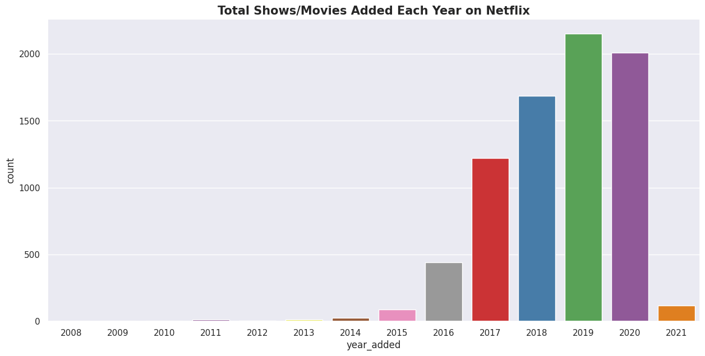
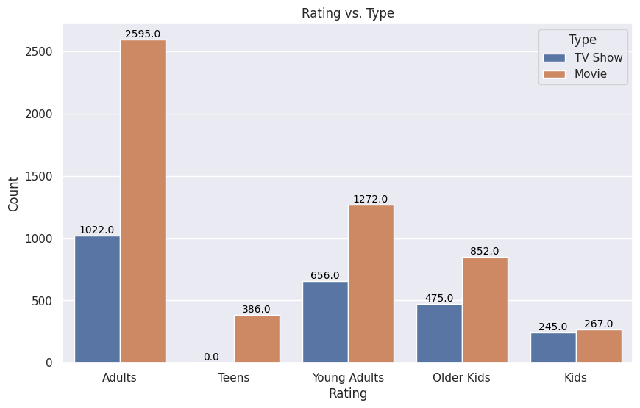
Exploratory Data Analysis
Content Growth:
Rapid Growth: Peak in 2019 (2153) and 2020 (2009) content additions.
Consistent Expansion: Steady growth in 2018 (1685).
Recent Decline in 2021 (117).
Rating Trends:
"Adults" Rating: More movies (2595) than TV shows (1025), favouring movies.
"Teens" Rating: Focus on teen movies (386).
"Young Adults" Rating: Balanced distribution (1272 movies, 659 TV shows).
"Older Kids" and "Kids" Ratings: More movies in both (852/478 and 267/246), catering to children.

Slide 11
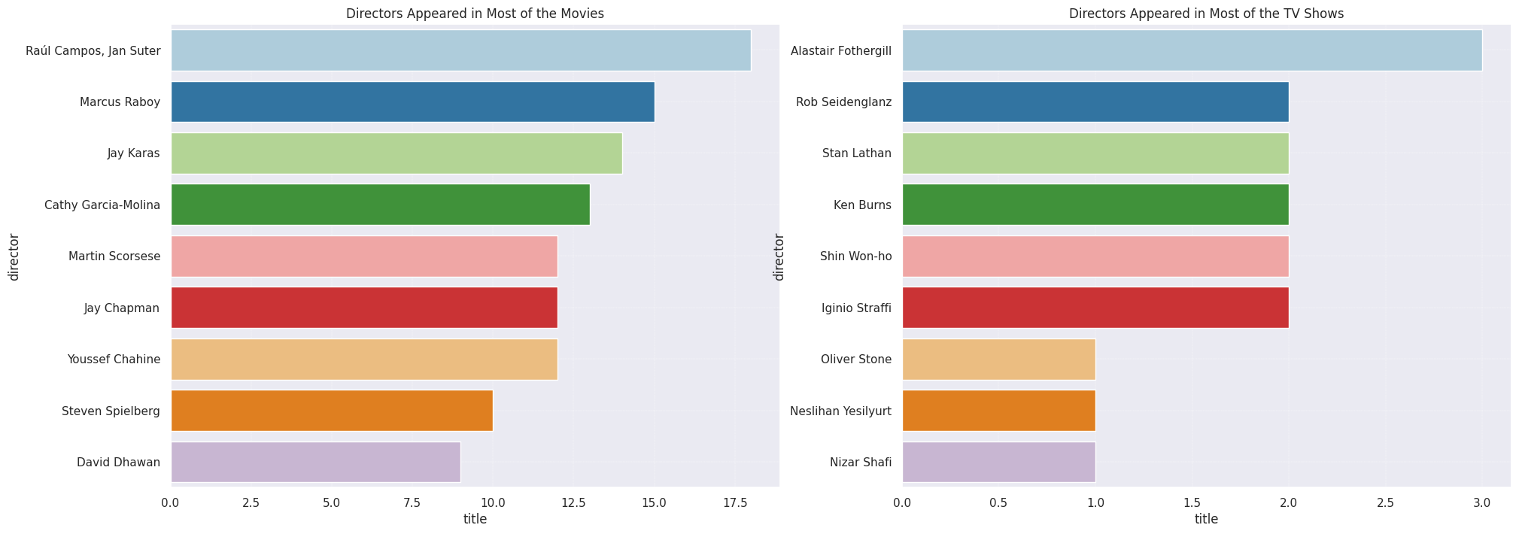
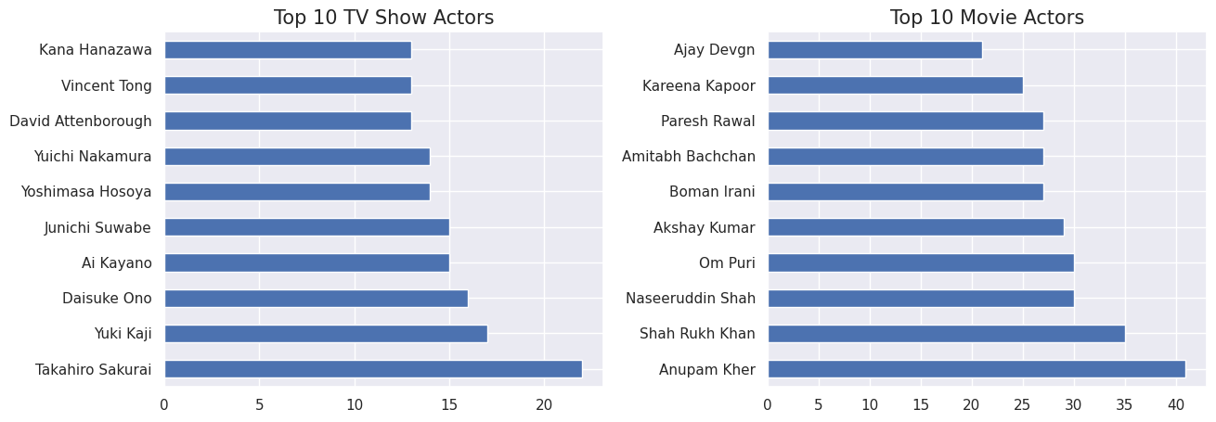
Exploratory Data Analysis
Netflix's Top Directors and Actors
Top Movie & TV Show Directors:
Diverse Directorship: Alastair Fothergill leads with 3 shows directed, while others have 2 each.
Variety in Content: Multiple directors contribute to Netflix's TV shows, indicating diversity.
Highly Prolific Directors: Raúl Campos and Jan Suter top with 18 movies.
Diverse Genres: Directors like Cathy Garcia-Molina and Youssef Chahine cover various movie genres.
Top Movie & TV Show Actors:
Japanese Voice Actors: Strong representation of anime content with actors like Takahiro Sakurai and Yuki Kaji.
Diverse Genres: These actors appear in various genres beyond animation.
Bollywood Dominance: Bollywood stars like Shah Rukh Khan and Akshay Kumar dominate, reflecting Indian cinema's presence.
Versatile Actors: Exhibit versatility across various genres in Indian cinema.

Slide 12
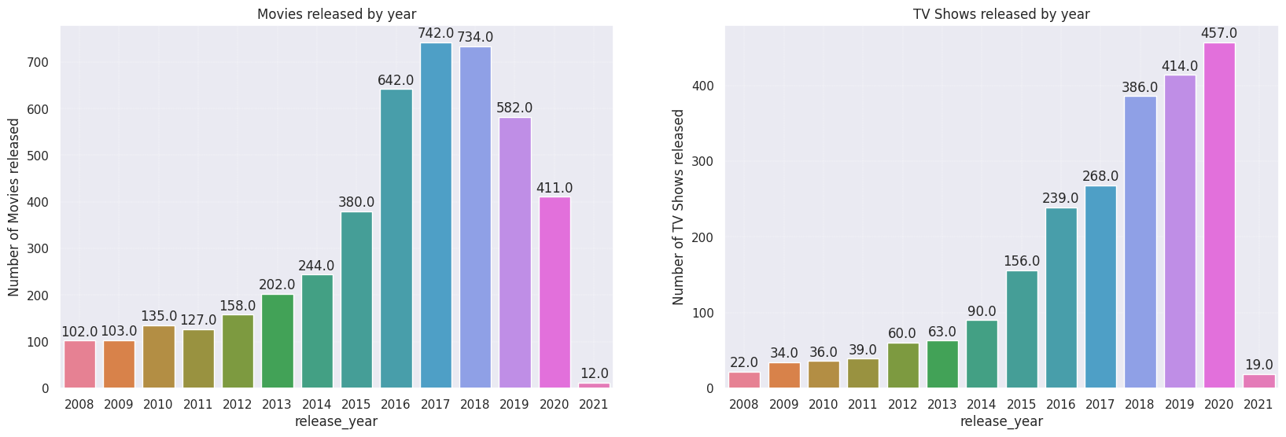
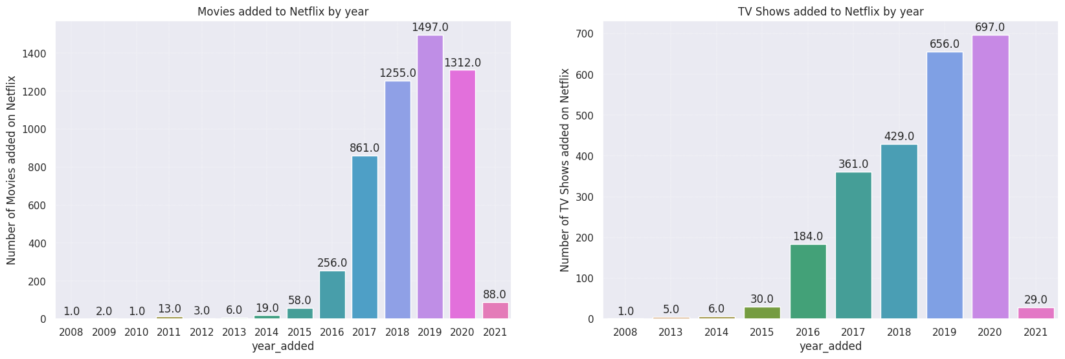
Exploratory Data Analysis
Annual Count of Movies and TV Shows on Netflix
Recent years, especially from 2016 to 2020, witnessed a surge in both TV show and movie releases.
Likely driven by the rise of streaming platforms and original content.
In 2020, the highest number of TV shows were released, closely followed by 2019 and 2018.
Indicates a trend of increased TV show production in recent years.
2017 saw the most movie releases on Netflix, followed by 2018, 2016, and 2019.
Points to a notable rise in movie production in recent times.

Slide 13
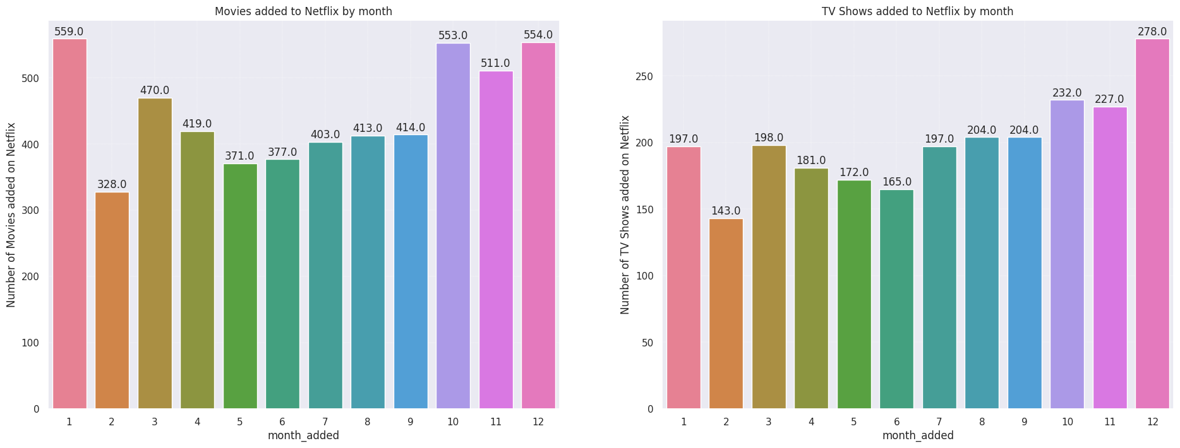
Exploratory Data Analysis
Monthly Netflix Content Additions
TV Shows:
Peak Months: October, November, and December are the top months for TV show additions.
Lowest Activity: February experiences the lowest TV show additions on Netflix.
Movies:
Peak Months: January, October, and December see the most movie additions.
Lowest Activity: February experiences the lowest movie additions on Netflix.

Slide 14
Hypothesis Testing
Hypothetical Statements for Netflix Analysis
Statement 1: Drama vs. Comedy Movie Ratings
Question: Do drama and comedy movies on Netflix have different viewer ratings?
Null Hypothesis (H0): Ratings for drama and comedy movies are the same.
Alternative Hypothesis (H1): Ratings for drama and comedy movies are significantly different.
Statement 2: TV Show Durations
Question: Are the average durations of TV shows introduced in 2020 and 2021 on Netflix the same?
Null Hypothesis (H0): The average durations are the same.
Alternative Hypothesis (H1): The average durations are significantly different.
Statement 3: American-Produced Content Proportions
Question: Is there a difference in the proportion of American-produced TV shows and movies on Netflix?
Null Hypothesis (H0): The proportions are the same.
Alternative Hypothesis (H1): The proportions are significantly different.

Slide 15
Data Pre-processing
Textual data preparation for analysis and modelling:
Steps:
Lower Casing
Removing Punctuations
Removing URLs, words with digits
Removing Stop words and White Spaces
Goal: Improve accuracy and effectiveness.
Text Normalization:
Standardizing the format of textual data.
Ensures consistency and readability.
Feature Engineering: TF-IDF Vectorization:
Instead of Bag of Words, TF-IDF captures word significance within documents.
Assigns higher weight to exclusive and uncommon words.
Enhances their importance in the representation.
Dimensionality Reduction: PCA (Principal Component Analysis):
Reducing dimensionality of high-dimensional datasets.
Preserves essential information.
Helps manage and visualize complex data.

Slide 16
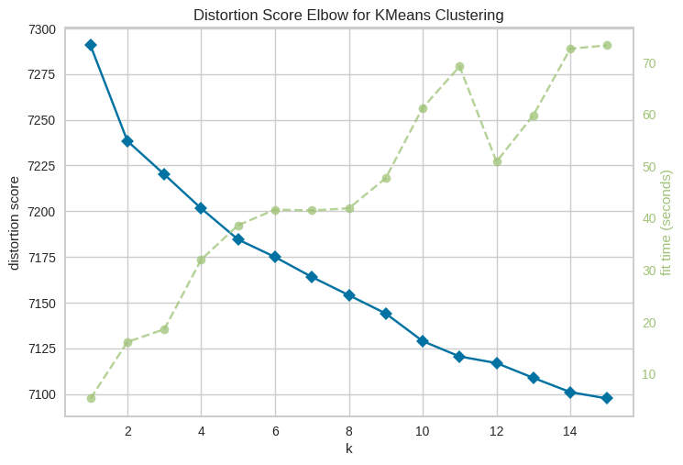
K-Means Clustering - Model Evaluation
Created an instance of the K-Means clustering model
It appears that there might be an elbow forming at the 2-cluster point.

Slide 17
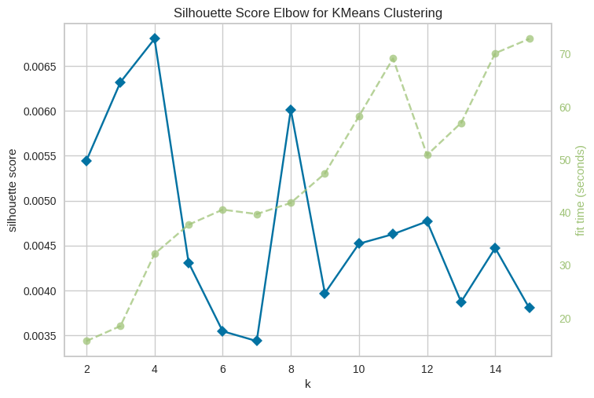
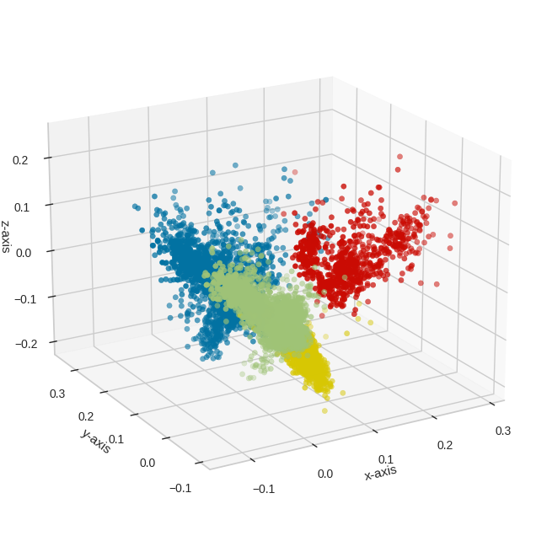
Silhouette Score and 3D Visualization
The Silhouette Score measures how closely an object within a cluster aligns with its cluster compared to other clusters.
I've used K-Means to cluster our data into four distinct clusters, and we're representing these clusters in three dimensions. Each color represents a different cluster.
This visualization provides an intuitive way to see how data is divided into clusters, and the Silhouette Score helps us quantify the quality of these clusters. Both the visualization and the Silhouette Score are crucial tools in evaluating our K-Means Clustering model.

Slide 18
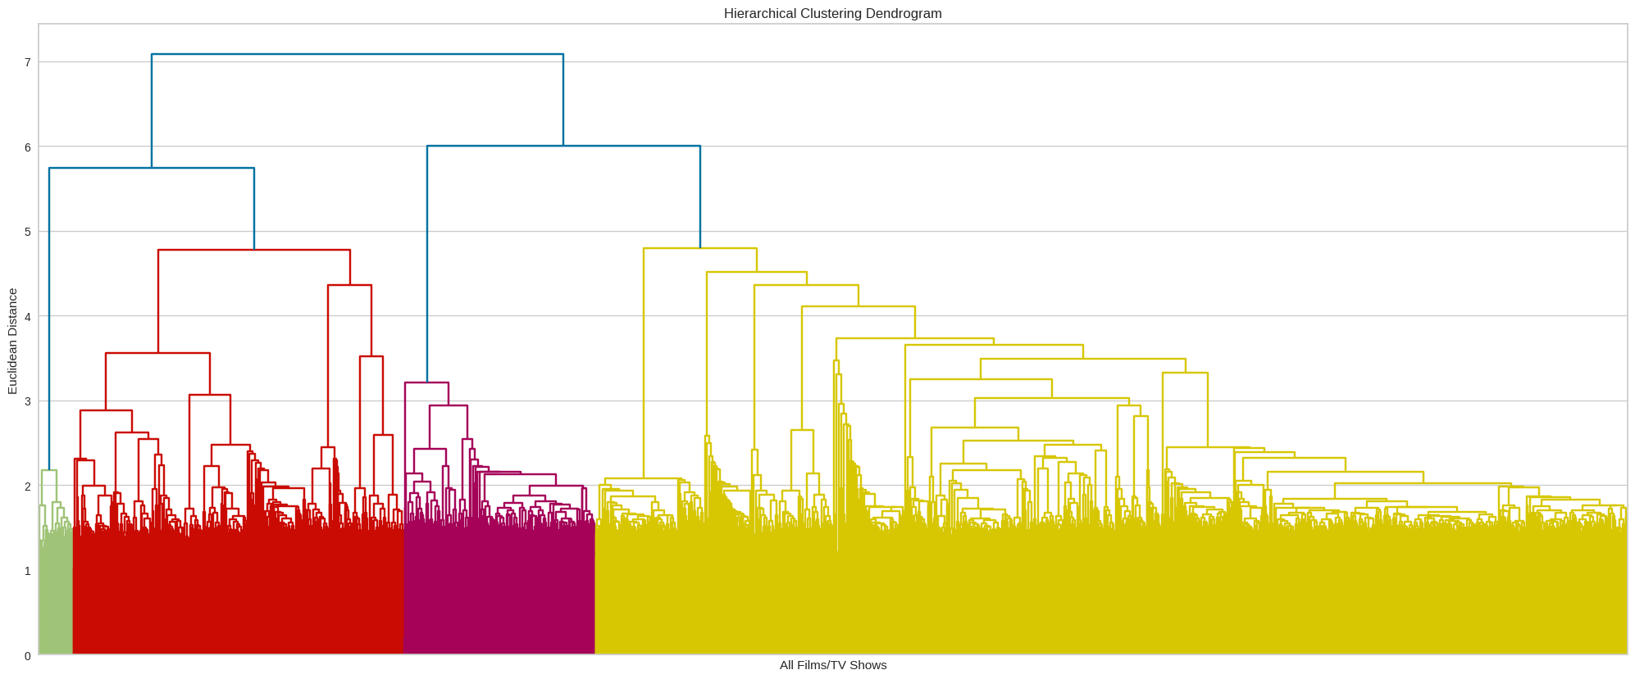
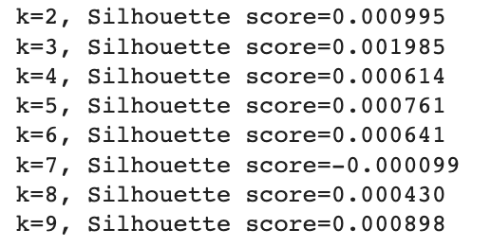
Hierarchical Clustering and Optimal Cluster Determination
Created a dendrogram to visualize the hierarchical structure.
Calculated Silhouette Scores for cluster numbers from 2 to 9.
Optimal number of clusters is 2, supported by dendrogram and high Silhouette Score.

Slide 19
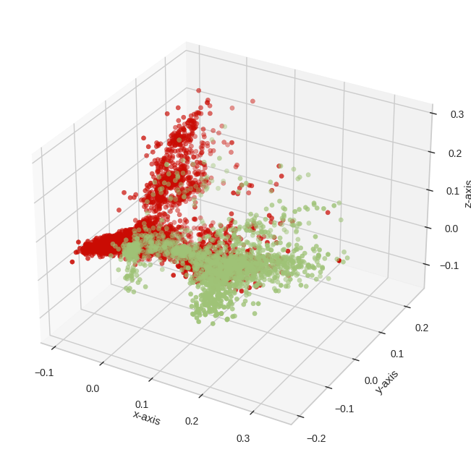
Visualizing Two Distinct Clusters
Created an Agglomerative Clustering model with 2 clusters and applied it to our data.
The scatter plot shows the two distinct clusters formed. This visual representation offers a clear understanding of how our data is divided into two separate groups.

Slide 20
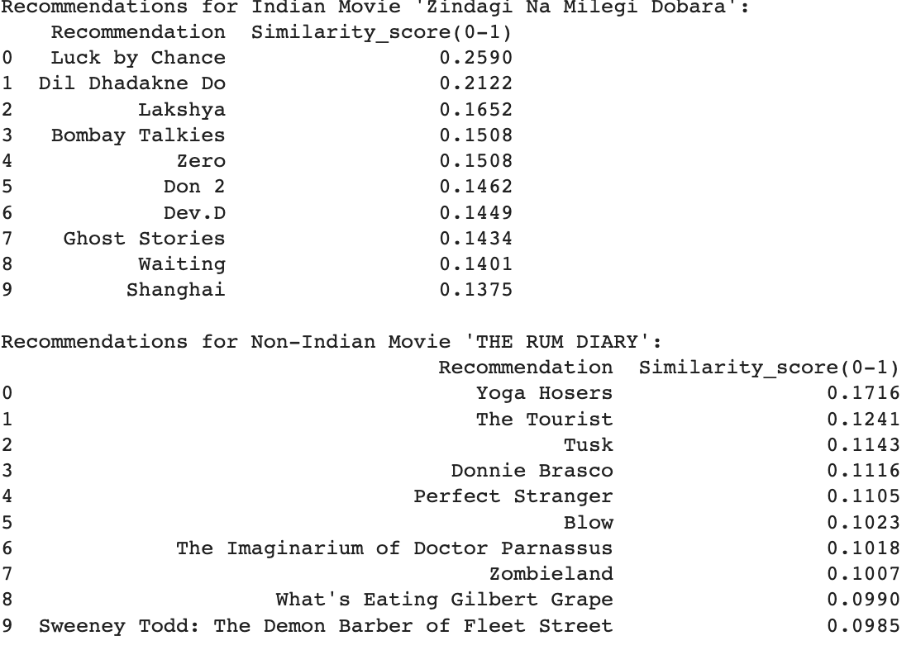
Building and Testing Recommendation System
Approach
Leveraging Cosine Similarity and TF-IDF Vectorization.
Empowering our recommendation system.
Creating Recommendations
Transforming Netflix content data using TF-IDF.
Calculating content similarity with Cosine Similarity.
Results
Personalized content suggestions for users.
Enhanced user experience and engagement.

Slide 21
Conclusion
Key Insights - EDA and Machine Learning
Content Diversity & Global Reach
Netflix offers diverse content for a global audience.
Focus on international TV and popular genres like crime and kids' shows.
Production Trends
Netflix has ramped up original content production.
Adapts to evolving streaming trends.
Viewer Engagement
Viewer preferences vary widely across genres.
Emphasis on quality and collaborations with renowned talent.
Regional Influences
Success stories include South Korean dramas and Canadian support.
Machine Learning Findings
Clustering suggests 4 clusters (K-Means) and 2 clusters (Hierarchical).
Silhouette Score chosen as an evaluation metric.
Development of personalized content recommendation system.

Slide 22
Thank You

