Slide 1

Basic Details of the Team and Problem Statement
Ministry/Organization Name/Student Innovation:
Ministry of Rural Development
PS Code: SH1005 Problem Statement Title: Develop a system which can read and analyse handwritten text and convert it into normal editable text. Team Name:
Ctrl + CV Team Leader Name:
Ananth R Shenoy Institute Code (AISHE):
1-14163741 Institute Name:
Rajagiri College Of Social Sciences
Theme Name: Smart Automation

Slide 2
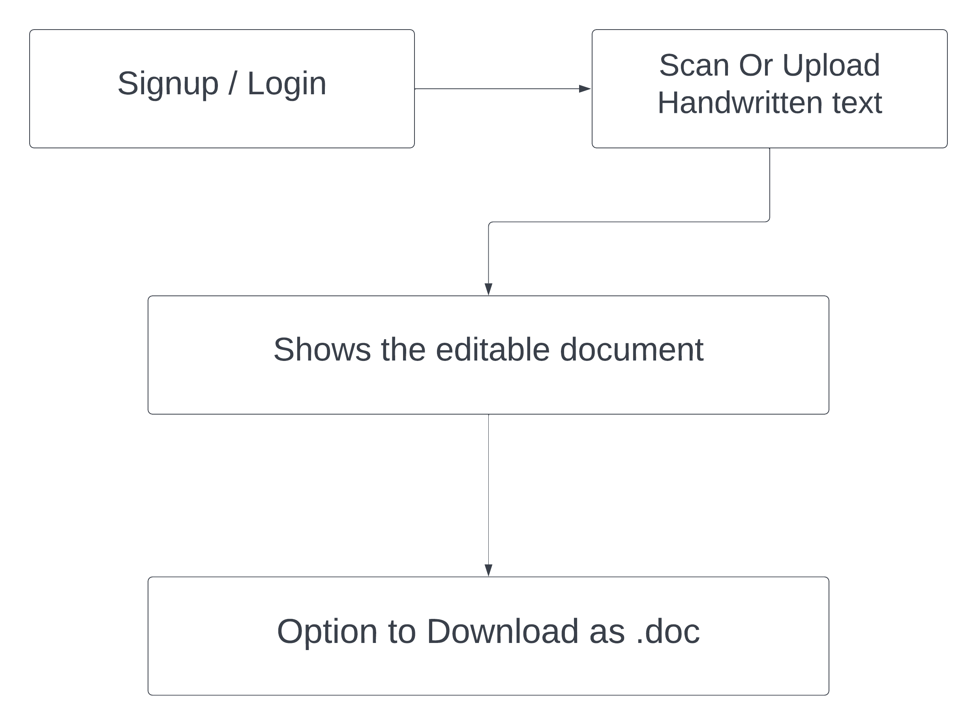
Idea/Approach Details
Describe your idea/Solution/Prototype here:
The main aim of the system is to Converting text.
Read and analyze handwritten text.
Convert it into normal editable text (English And Respective local language).User friendly app which a user can use through mobile phones
User can scan the handwritten text through this app and immediately after scanning the text will be displayed in an editable format.
User can make the choice whether the text is should be in a word, ppt, pdf format.
Describe your Technology stack here:
Operating System : Android
Java / Python

Slide 3
Idea/Approach Details
Describe your Use Cases here
Describe your Dependencies / Show stopper here

Slide 4
Team Member Details
Team Leader Name: Ananth R Shenoy
Branch MCA Stream (ECE, CSE etc): Computer Science Year (I,II,III,IV): I
Team Member 1 Name: Mariya Johnson
Branch MCA Stream (ECE, CSE etc): Computer Science Year (I,II,III,IV): I
Team Member 2 Name: Sneha Sara Santhosh
Branch : MCA Stream (ECE, CSE etc): Computer Science Year (I,II,III,IV): I
Team Member 3 Name: Antony Kevin Newniz
Branch : MCA Stream (ECE, CSE etc): Computer Science Year (I,II,III,IV): I
Team Member 4 Name: Antony Christos
Branch : MCA Stream (ECE, CSE etc): Computer Science Year (I,II,III,IV): I
Team Member 5 Name: Arjun Vijay
Branch : MCA Stream (ECE, CSE etc): Computer Science Year (I,II,III,IV): I
Team Mentor 1 Name: Fr.Angelo Baby
Category (Academic/Industry): Academic Expertise (AI/ML/Blockchain etc): AI Domain Experience (in years): 1
Team Mentor 2 Name:
Category (Academic/Industry): Expertise (AI/ML/Blockchain etc): Domain Experience (in years):

Slide 5
Important Pointers
Please ensure below pointers are met while
Kindly keep the maximum slides limit to 4 pages
All the topics should be utilized for description of your idea
Try to avoid paragraphs and post your idea in points
Keep your explanation precisely and easy to understand
Idea should be unique and novel. If it has a business potential more weightage will be given.
Apart from this PPT abstract of your idea will be asked separately while submitting
You need to save the file in PDF and upload the same on portal. No PPT, Word Doc or any other format will be supported
You can delete this slide (Important Pointers) when you upload the details of your idea on SIH portal.

