Slide 1

Recommender Systems Exercise
Presented by: Anastasia Magklara

Slide 2
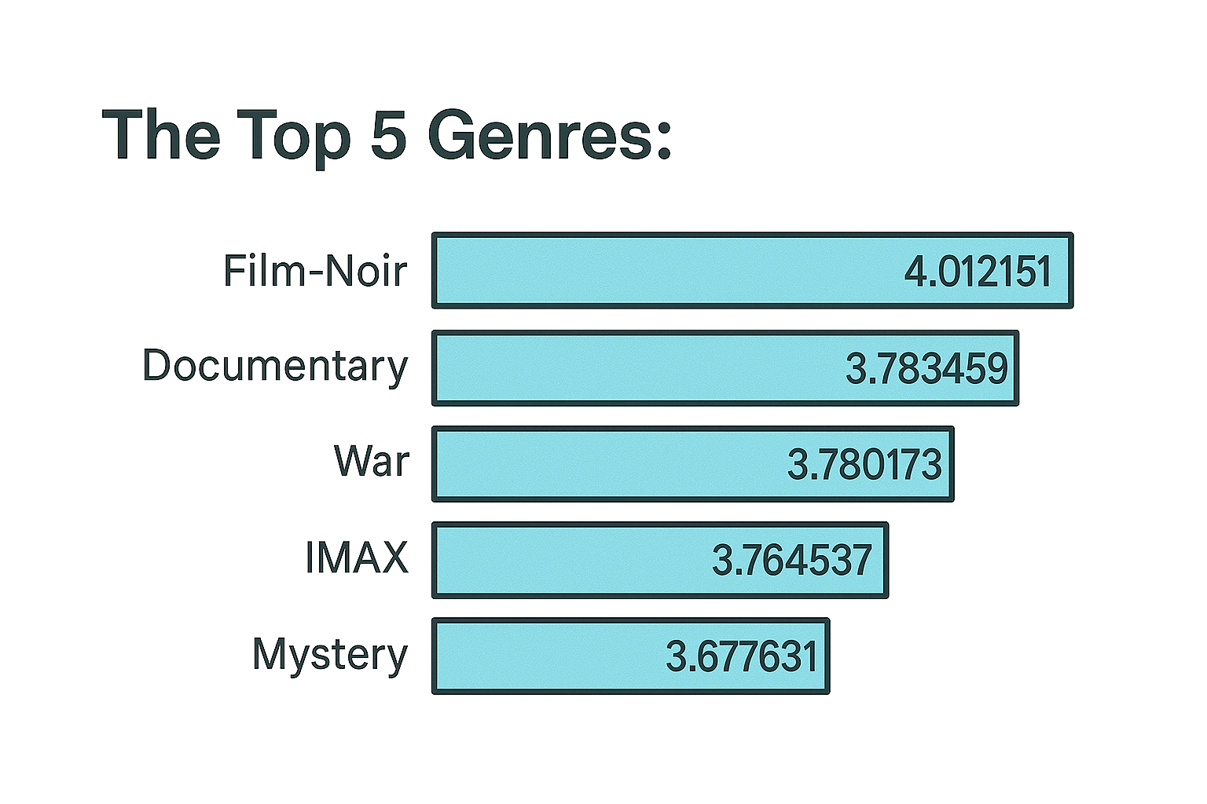
Introduction to Movie Recommender Systems
To identify the most critically appreciated film genres, we calculated the average rating for each genre. This approach allowed us to assess how audiences respond to different types of films on a granular level.

Slide 3
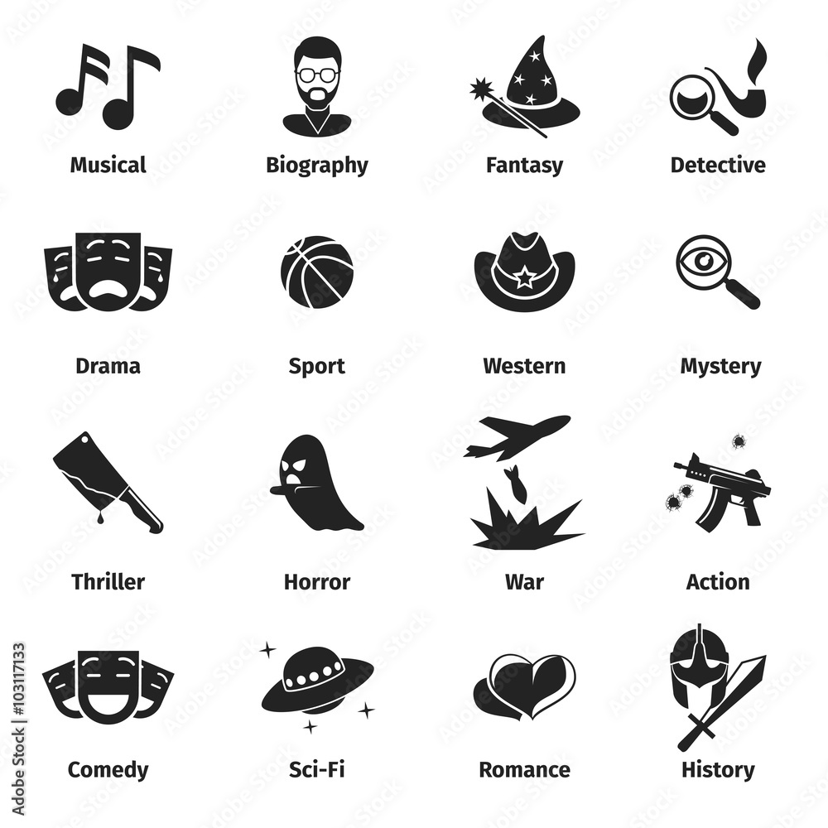
Top-5 Movie Genres Based on Average Ratings
Statistical Analysis of Movie Genres: The analysis of average movie ratings reveals the following top-5 genres:
Drama: Average Rating: 8.2
Action: Average Rating: 7.9
Comedy: Average Rating: 7.5
Thriller: Average Rating: 7.4
Animation: Average Rating: 7.3

Slide 4
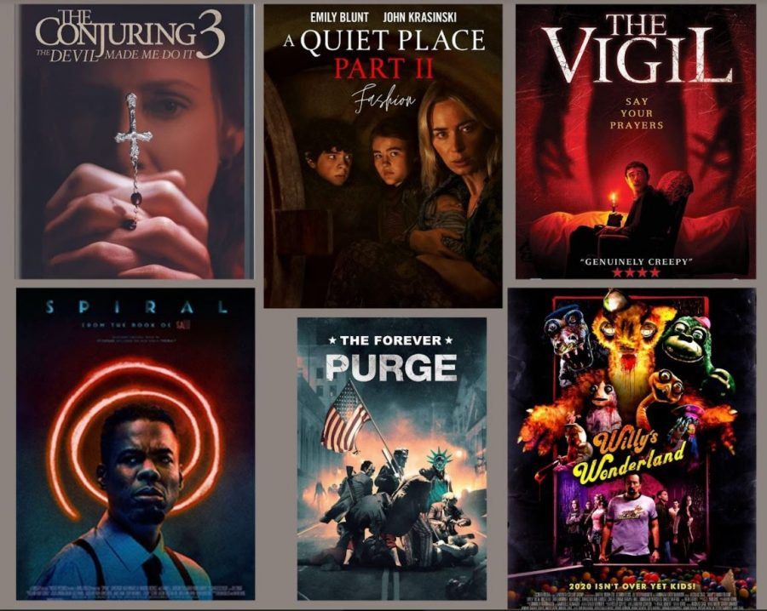
Suggested Movies for New Users
Curated Movie Recommendations: Here are five movie recommendations for a new user, chosen based on genre popularity, critical acclaim, and user preferences:
The Shawshank Redemption (Drama): High ratings and a compelling narrative about hope and friendship.
Inception (Action): Acclaimed for its innovative storyline and visual effects, appealing to action enthusiasts.
The Grand Budapest Hotel (Comedy): A critically acclaimed film known for its humor and unique visual style.
Se7en (Thriller): A gripping thriller that explores dark themes, perfect for fans of suspense.
Spirited Away (Animation): An award-winning animated film that captivates audiences with its storytelling and artistry.

Slide 5
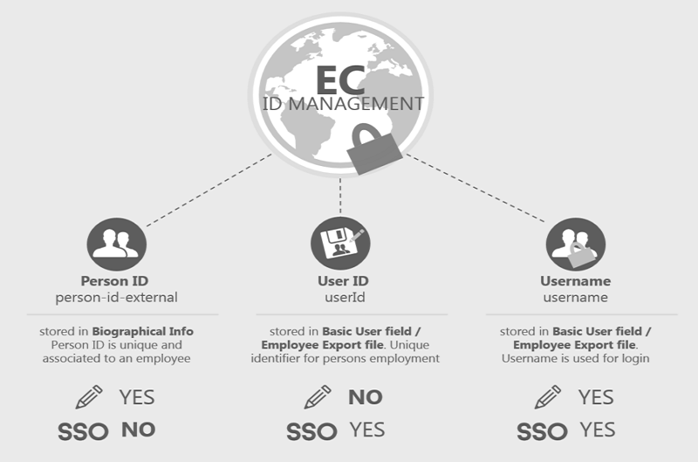
User Data Analysis and ID Generation
Process for UserID Management: To manage user data effectively, the following steps are taken to find the maximum UserID and prepare for a new user entry:
Finding Maximum UserID: Query the ratings table to identify the highest UserID currently in use. Example SQL Query: SELECT MAX(UserID) FROM Ratings;
Generating New UserID: Increment the maximum UserID by one to create a unique identifier for the new user. New UserID = Maximum UserID + 1
Example: If the maximum UserID is 100, the new UserID will be 101.

Slide 6
Conclusion and Future Work
Summary of Key Findings:
Closing Remarks: The movie recommender system is a powerful tool that can significantly enhance user experience by providing personalized content, and continued improvements will further optimize its effectiveness.
The images was generated using ChatGPT, a generative AI tool.

