Slide 1

Dengue Hotspots
By the Team Stream

Slide 2
#TeamStream
Ciprian Iamandi - ciprian.iamandi@gmail.com
Sabrina Trifi - sabtri@hotmail.com
Laurent Exsteens
Laszlo Kupcsik - koopac@gmail.com
Hannah Pinson

Slide 3
The Benefits of real time monitoring

Slide 4
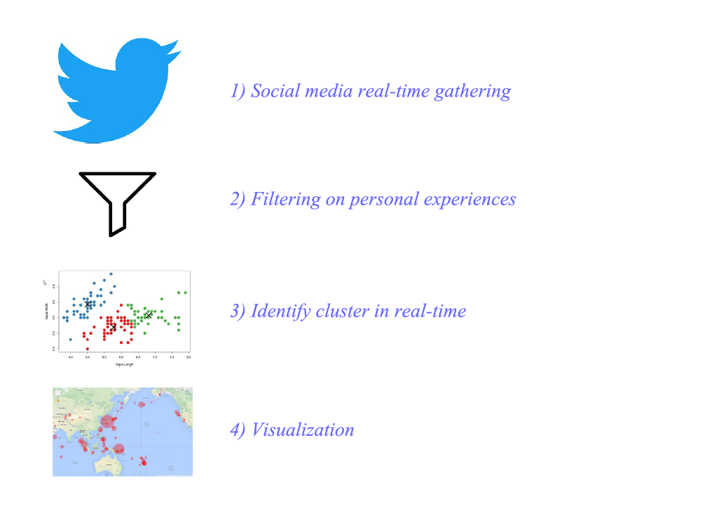

Slide 5
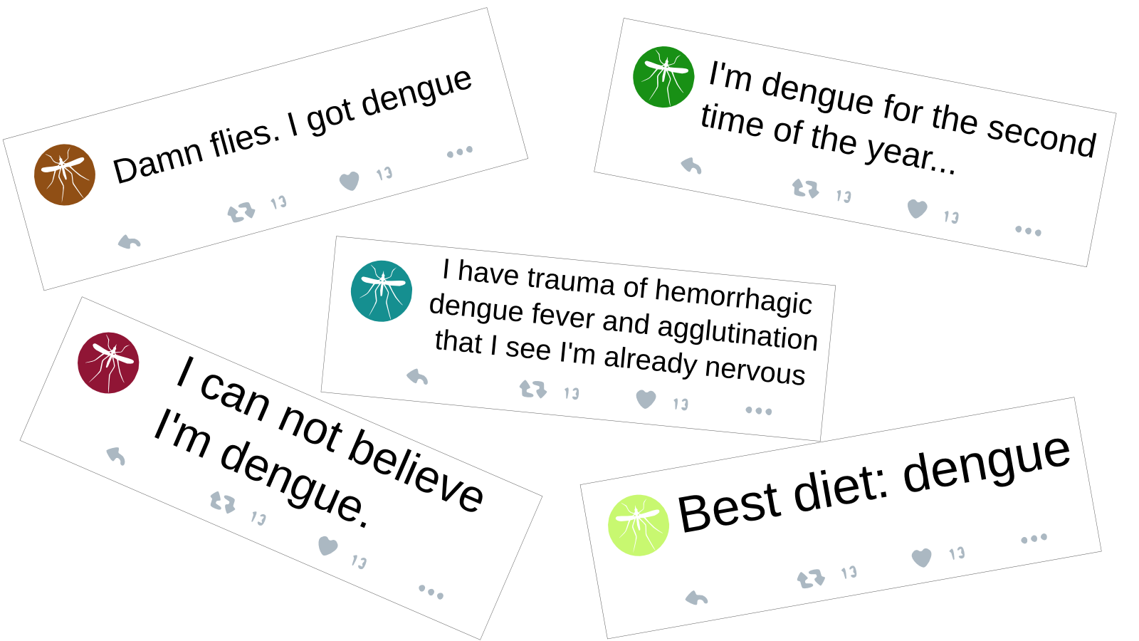
Personal experience tweets examples

Slide 6
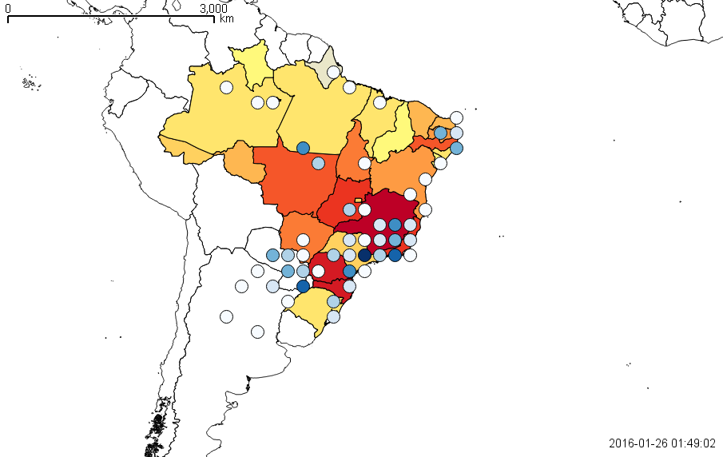

Slide 7

Demo

Slide 8
Further applications

