Slide 1
CMG Lab Report
Group 5
SGB15132

Slide 2
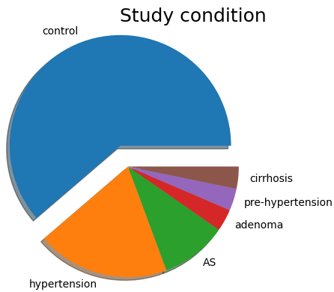
Our Data
Completeness
Redundancy
Min (%) | Average (%) | Max (%)
97.32 | 98.2 | 99.33
Min (%) | Average (%) | Max (%)
0.0 | 0.57 | 2.25

Slide 3
Methods
Gene Annotation
Pangenome Building
Tree Building
Additional Tools
Prokka
Roary
(Core Gene Alignment)
FastTreeMP
Web Visualiser (iTOL)
PhyloPhlAn

Slide 4
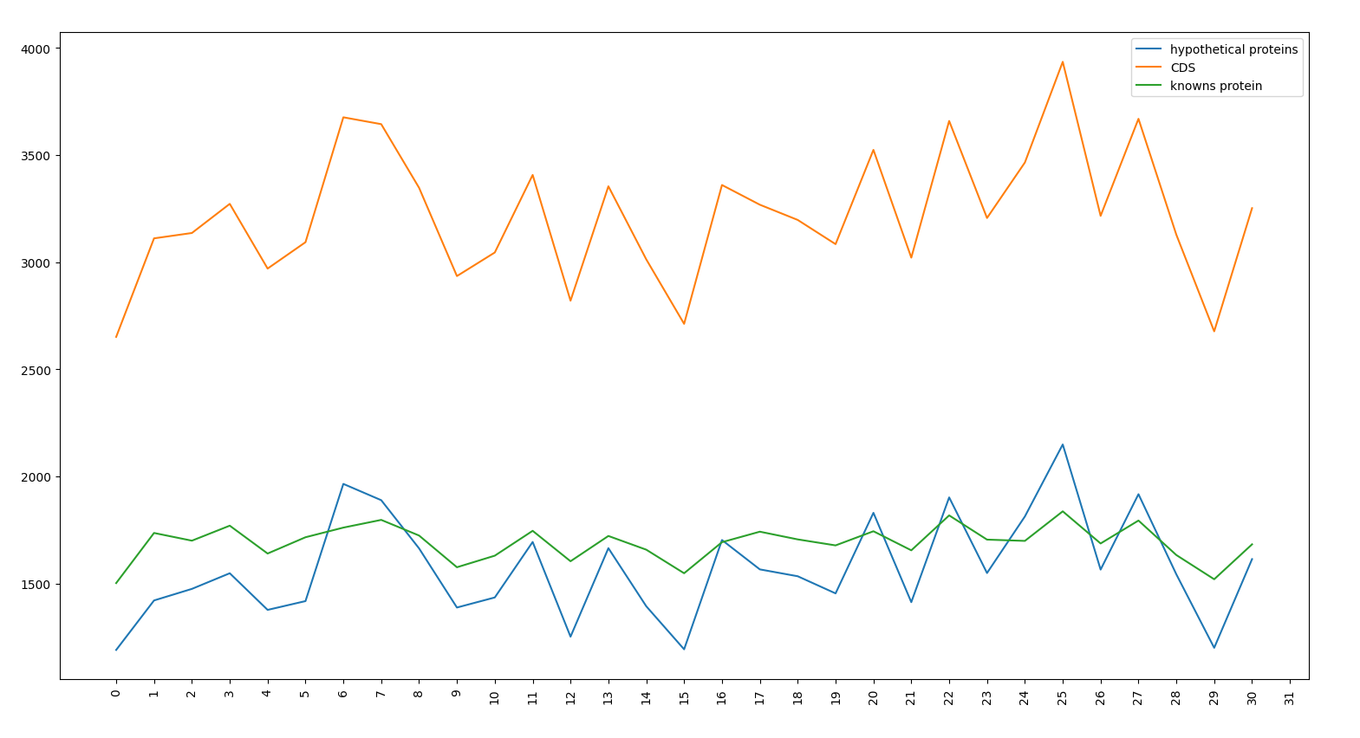
Prokka results
Hypothetical proteins
Min | Avarage | Max
1190 | 1517.6 | 2149
Coding sequences
Min | Avarage | Max
2651 | 3220.9 | 3935
Known proteins
Min | Avarage | Max
1502 | 1691.1 | 1837

Slide 5
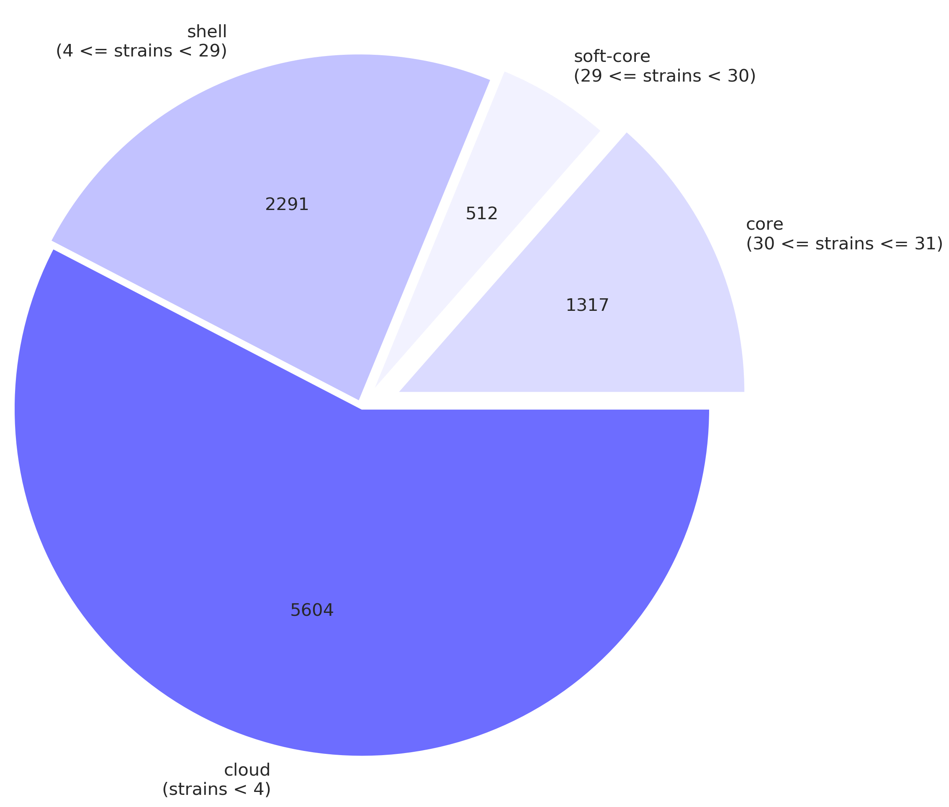
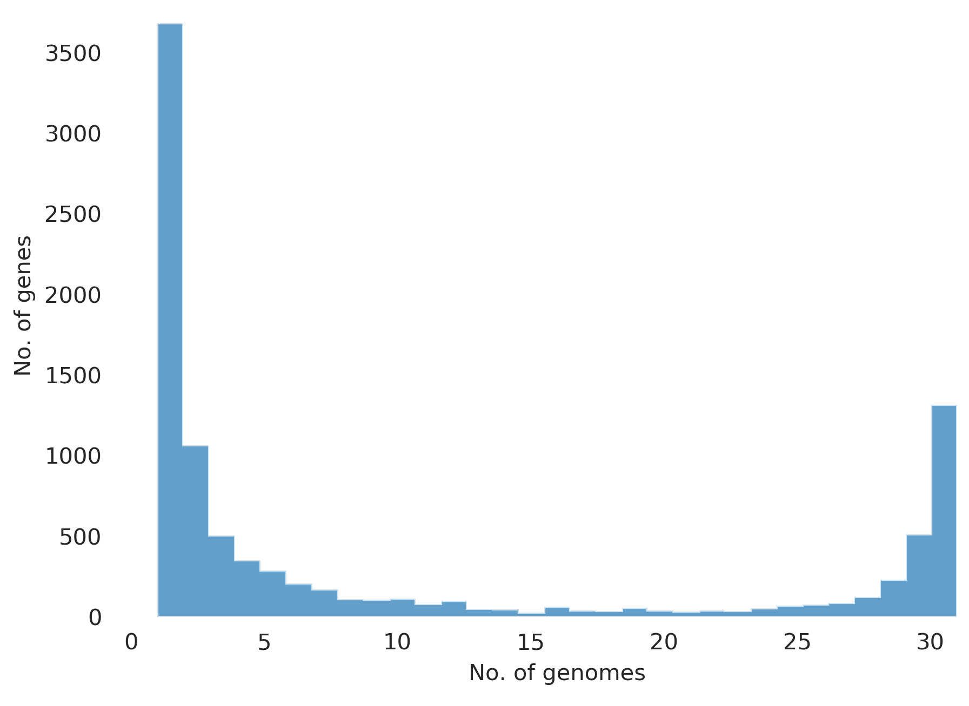
Pangenome analysis
shell
(4 <= strains < 29)
soft-core
(29 <= strains < 30)
core
(30 <= strains < 31)
cloud
(strains < 4)

Slide 6
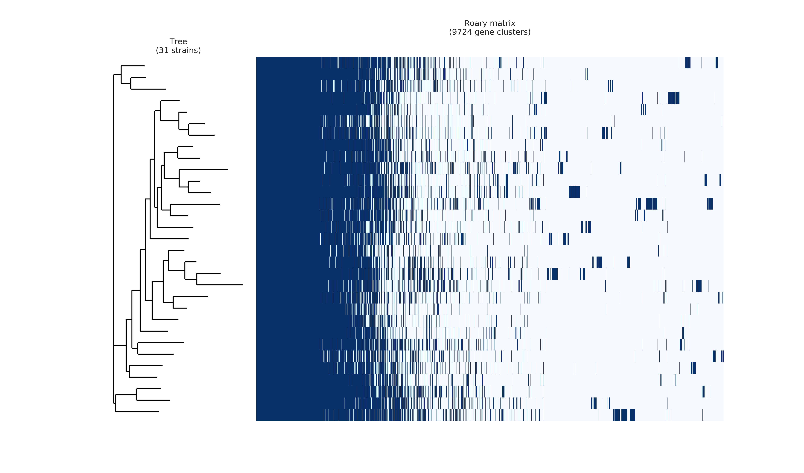
Presence-absence pangenome matrix

Slide 7
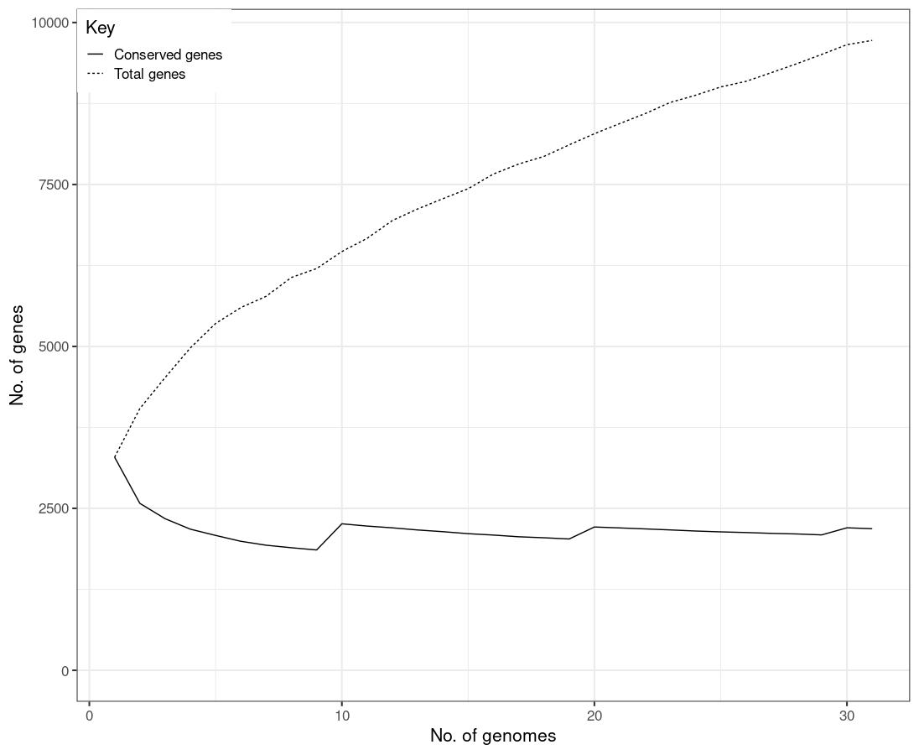
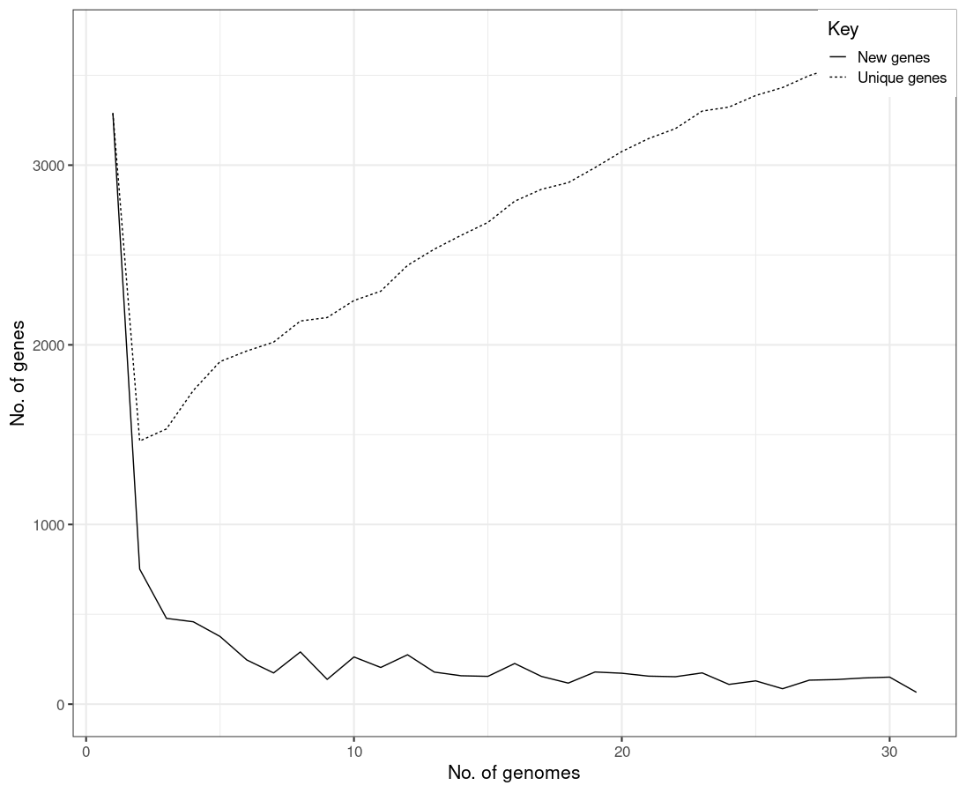
Pangenome Genes Comparison

Slide 8
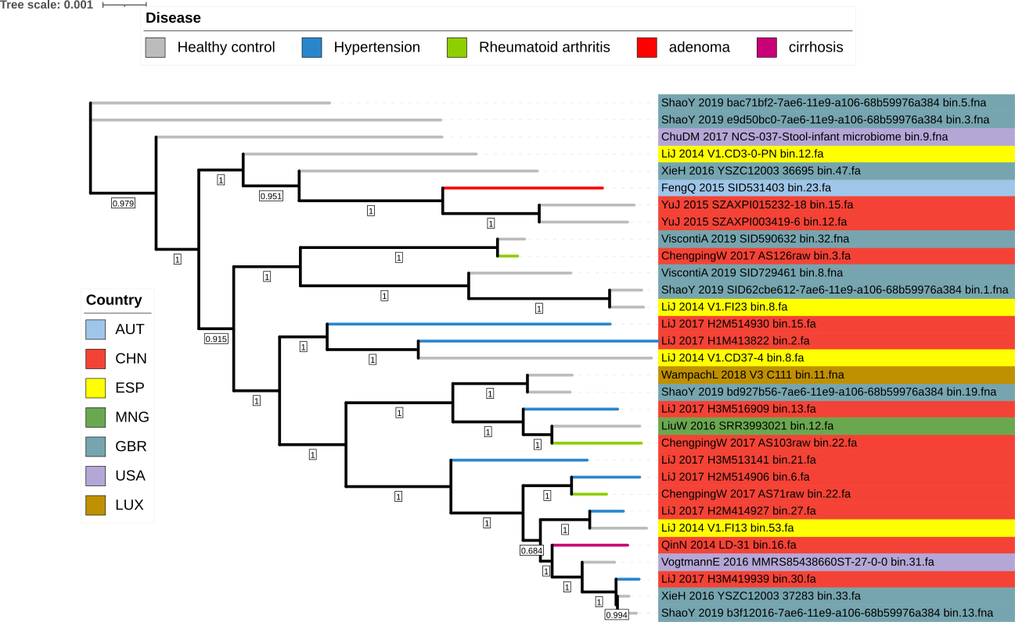
Core gene alignment phylogenetic tree

Slide 9
Conclusion
Taxonomic assignment:
k__Bacteria|p__Firmicutes|c__Clostridia|o__Eubacteriales|f__Oscillospiraceae|g__Flavonifractor|s__Flavonifractor_plautii|t__SGB15132
no notable differences between the genomes
future work: run again the pipeline with more genomes and different parameters

Slide 10
Thank you for your kind attention!

