Slide 1
Sales Dashboard – Task 4
Created using Power BI

Slide 2
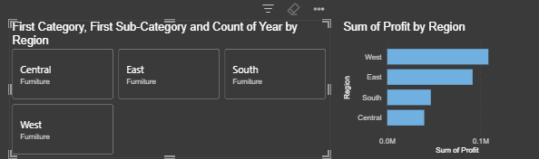
Key KPIs

Slide 3
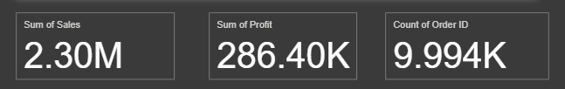
Dashboard Overview

Slide 4
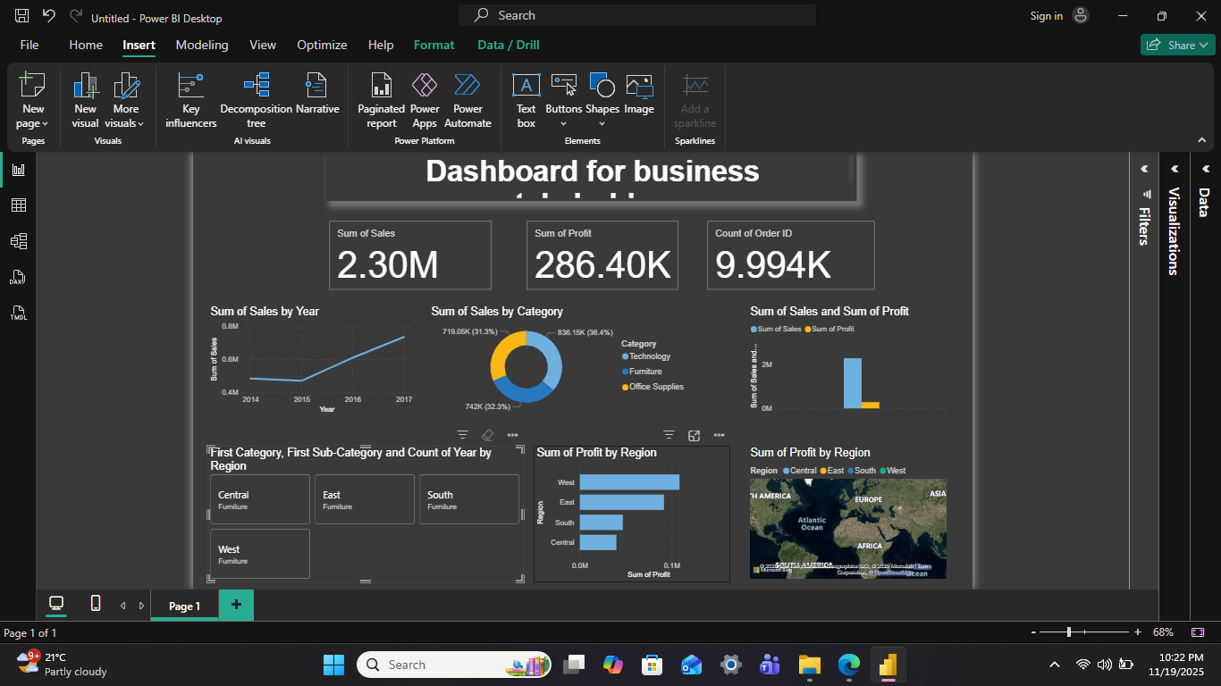
Visual Highlights

Slide 5
Insights Summary
- Sales total: 2.30M
- Profit generated: 286.40K
- Total Orders: 9,994
- West region shows highest profit
- Technology category contributes the most
- Upward sales trend observed from 2015–2017

