Slide 1

A Local AI Programming Assistant
Small, coursework-adapted models on a 6 GB student laptop
Arpita Ghadai (B523010) · Arpita Nayak (B523011) · Manish Biswal (B523035)
Supervisor: Prof. Anjali Mohapatra · Evaluation Panel 2 · Technical Writing, November 2026
Notes:
ARPITA GHADAI. Good morning. We are Arpita Ghadai, Arpita Nayak and Manish Biswal, supervised by Prof. Anjali Mohapatra. Our project asks whether a small AI model can run on a normal student laptop and help with a programming course, instead of paying for an online AI service. I will introduce the problem, Manish will explain the technical design, and Arpita Nayak will cover our plan and conclusion.

Slide 2



Students pay for online AI coding help
Arpita Ghadai · Intro
It costs money
Code leaves your laptop
It needs the internet
Subscriptions every month, for the whole semester.
Every question sends the student's code to someone else's server.
No connection in the hostel or lab means no help.
Our idea: run a small AI model on the student's own laptop, taught our programming courses, and check every answer by running tests.
Notes:
ARPITA GHADAI. Today most students use online tools like ChatGPT for programming help. That has three problems. First, cost: good plans are paid monthly. Second, privacy: your code is sent to a company's server. Third, you need internet. Our idea is to run a smaller AI model directly on the laptop, teach it our programming courses, and make sure its code is correct by running tests on it, like an automatic examiner.

Slide 3





Our research question
Arpita Ghadai · Intro
“Can a small AI model, taught our programming courses, give correct programming help on a 6 GB laptop — fast enough and cheap enough to be useful?”
Quality How many exercises does it solve correctly?
Fit Which models fit in 6 GB of GPU memory?
Speed How quickly does the answer appear?
Teaching Does training on our courses make it better?
Cost What does one exercise cost, local vs paid?
Notes:
ARPITA GHADAI. Our main question is on the slide. We split it into five smaller questions: quality, does the code actually work; fit, does the model fit in the laptop's graphics memory, which is only 6 GB; speed, how fast the answer comes; teaching, does training it on our course help; and cost, how much one exercise costs compared with a paid service. Every experiment we plan answers one of these five.

Slide 4
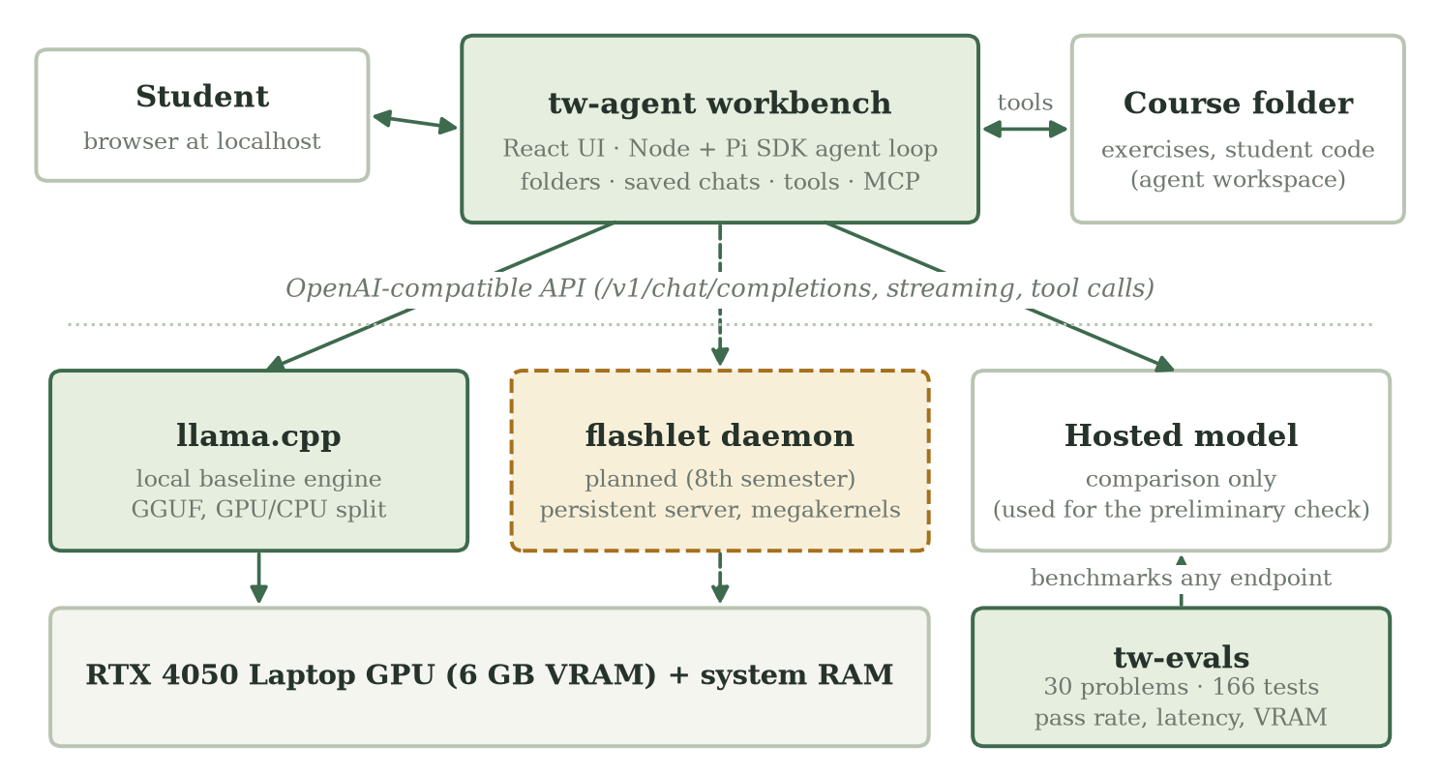
The whole system in one picture
Arpita Ghadai · Intro
Student app
tw-agent: chat with an AI that can read, write and run code in your folder
Engine
the program that runs the model on the laptop GPU
Examiner
tw-evals: 30 problems with tests that grade the code automatically
Notes:
ARPITA GHADAI. Here is the whole system. At the top is the app the student uses, called tw-agent. It talks to an engine, which is the program that actually runs the AI model on the laptop's graphics card. We built our own engine for this, called flashlet, and we also use a popular open-source engine called llama.cpp as a baseline to compare against. On the right is tw-evals, our automatic examiner, which checks whether code is correct by running tests. Now Manish will explain how it works inside.

Slide 5
How it works
What we built · the 6 GB problem · mixture of experts · offloading · megakernels · teaching the model
Notes:
MANISH BISWAL. I will cover what we have already built, then the main technical problem, which is memory, and the three ideas we use to solve it: mixture-of-experts models, offloading, and megakernels. Then how we teach the model our course.

Slide 6



Built first: the flashlet inference engine
Manish Biswal · Tech
112.5
5,961
140
99.3%
words/s for one user
words/s with 128 users
words/s with our megakernel
match with the reference model
Continuous batching
Paged memory
Megakernel prototype
New requests join while others are still being answered
Conversation memory handed out in small pages, like an operating system does
Whole model in one GPU program: the idea we scale up next
Measured on our RTX 4050 laptop GPU with a small 0.5B model (Qwen2.5-0.5B). Built this semester, before tw-agent and tw-evals.
Notes:
MANISH BISWAL. The first thing we built this semester was our own inference engine, flashlet, the program that runs the model on the GPU. It already handles many users at once with continuous batching, where new questions join while others are being answered, and it hands out conversation memory in small pages, the way an operating system manages RAM. On our laptop with a small half-billion parameter model it writes 112 words per second for one user and almost 6,000 per second in total with 128 users, and its answers match the reference implementation 99.3% of the time. We also wrote a megakernel prototype that reaches 140 words per second for one user; I will explain what a megakernel is in a few slides. Next semester flashlet becomes an always-on server for our target models.

Slide 7
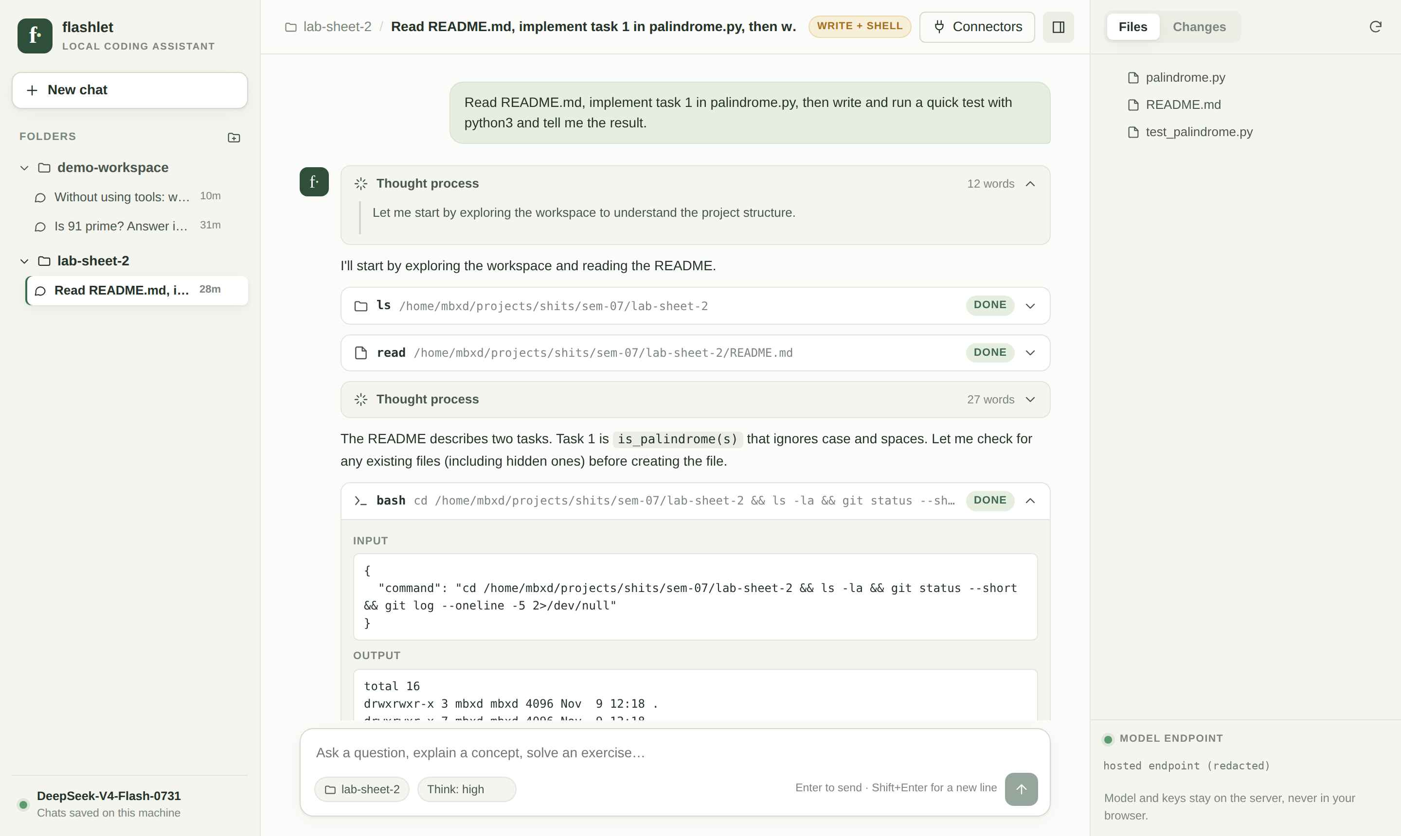




Built: the tw-agent workbench
Manish Biswal · Tech
Folders & saved chats
Each lab sheet is a folder; chats survive restarts
Visible thinking
The model's reasoning streams live
Tool cards
Every file read, write and command it runs
Changes view
A diff of every edit to your files
Notes:
MANISH BISWAL. This is tw-agent, which we built this semester. It is a coding agent: the model does not just chat, it can list files, read them, write code and run it, and every step appears as a card. Its reasoning streams live, and the Changes tab shows exactly what it edited. Chats are saved per folder, so a student can come back to a lab sheet days later. It works with any model server, so we can switch from a hosted model to our local engine by changing one setting. (Optional: show the live demo here.)

Slide 8
Built: an examiner that runs the code
Manish Biswal · Tech
30
166
166/166
practice problems
executable tests
reference solutions pass
First end-to-end check (hosted model, testing the pipeline)
Problem 021 — prime factors
6/6
Lab sheet — palindrome
10/10
Agent wrote the solution and its own check script
Read the README, wrote palindrome.py and a test, ran it
tests, confirmed by tw-evals
of the agent's tests
Notes:
MANISH BISWAL. To trust any result, we need an examiner. tw-evals has 30 introductory problems with 166 tests. We first checked the examiner itself: all 30 correct reference solutions pass all 166 tests. Then we connected the agent to a hosted model just to test the pipeline. On problem 21 the agent wrote a solution and the examiner independently confirmed 6 out of 6. On a lab sheet it wrote and tested a palindrome function, 10 out of 10. These are pipeline checks, not our final local results; those come next semester.

Slide 9
The catch: only 6 GB of GPU memory
Manish Biswal · Tech
What uses GPU memory
Weights: the model's knowledge, billions of numbers
Conversation memory: grows with longer chats
Buffers: scratch space while computing
The 8B model barely fits (5.9 of 6 GB). Moving rarely-used parts to normal RAM frees most of the GPU.
Notes:
MANISH BISWAL. The main problem is memory. A graphics card has its own fast memory; ours has only 6 GB. Three things live there: the weights, which are the model's learned numbers; the KV cache, which is the model's memory of the conversation so far; and working buffers. A 1.2 billion parameter model fits easily. The 8 billion parameter model we want almost fills the whole card, leaving no room for long chats. These bars are planning estimates; measuring them exactly is our first experiment. The fix is to move parts that are rarely used into normal RAM, which is offloading. To understand which parts, we need mixture of experts.

Slide 10
What is a Mixture of Experts (MoE)?
Manish Biswal · Tech
8.3 B
numbers stored
a word
(token)
Router
next
word
1.5 B
used per word
32 experts — only 4 work on each word
Analogy: a hospital with 32 specialists. A receptionist (the router) sends each patient (word) to the 4 doctors who fit best. The hospital is big, but each visit is quick.
Notes:
MANISH BISWAL. A normal model uses all of its numbers for every word. A mixture-of-experts model is split into many small expert networks. For each word, a small router picks only a few experts. Our target model, LFM2.5-8B-A1B, stores 8.3 billion numbers but uses only about 1.5 billion for each word, because it has 32 experts per layer and uses 4. Think of a hospital: 32 specialists, but each patient sees only the 4 relevant doctors. So it is as smart as a big model but nearly as fast as a small one. The catch: all 32 experts still need to be stored somewhere.

Slide 11
Offloading experts to normal RAM
Manish Biswal · Tech
GPU memory (6 GB)
System RAM
Fast: about 192 GB/s
Large but far away
Shared layers (always needed)
PCIe link
≈ 16 GB/s — 12× slower
Expert cache: recently used experts
Conversation memory
all other experts
1
Load on demand
2
Keep a cache
3
Guess ahead
Router asks for an expert not on the GPU → copy it in
Recently used experts stay; the oldest is evicted (LRU)
Predict the next experts and copy them early, then measure if it helps
Notes:
MANISH BISWAL. Offloading means keeping only what is needed on the graphics card and the rest in normal RAM. Think of a desk and a bookshelf: the desk is small but everything on it is at hand; the bookshelf is big but you must get up to fetch a book. GPU memory is the desk at about 192 gigabytes per second; the link to RAM is about 16, roughly twelve times slower. So we keep the shared layers and a cache of recently used experts on the GPU. When the router asks for an expert that is not there, we copy it in, evicting the one used longest ago. Finally we can try to guess the next experts and fetch them early; whether guessing actually helps is something we will measure, not assume.

Slide 12
Speed is limited by memory, not maths
Manish Biswal · Tech
words per second ≤ memory speed ÷ bytes read per word
192 GB/s
≈ 194
140
72%
memory speed of our
RTX 4050 laptop GPU
words/s ceiling for a
0.5B model (1 GB to read)
words/s our megakernel
prototype reached
of the ceiling
already used
In simple words: to write each new word the GPU must re-read every active weight once. The faster it can read memory, the faster it can write. So we try to read less (small, quantised models, MoE) and never leave the GPU idle.
Notes:
MANISH BISWAL. When one student asks one question, the model writes one word at a time, and for each word it must read all of its active weights from memory. So the speed limit is memory speed divided by how many bytes it reads per word. Our card reads about 192 gigabytes per second. A half-billion parameter model is about 1 GB, so at most about 194 words per second. Our megakernel prototype, built this semester, already reaches 140, which is 72% of that limit. For the 8B mixture-of-experts model only 1.5 billion parameters are read per word, so the ceiling is still around 225 words per second if everything fits on the GPU.

Slide 13
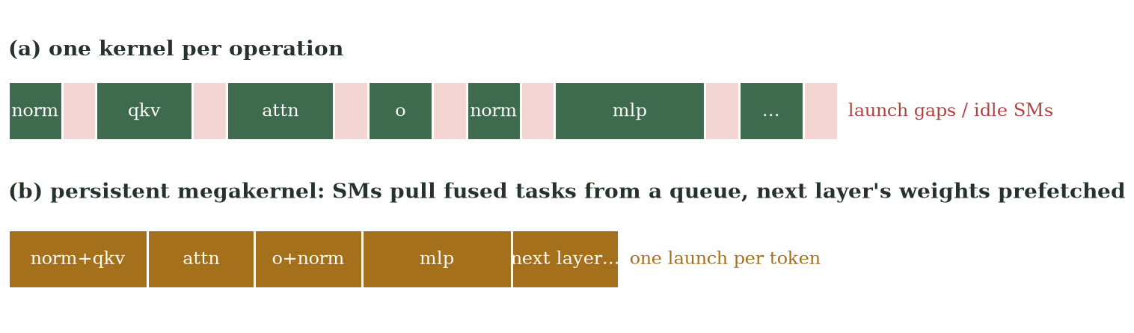
What is a megakernel?
Manish Biswal · Tech
Kernel
Today
Megakernel
one small program the GPU runs, e.g. “multiply these matrices”
~dozens of kernels per layer, with idle gaps between each launch
one long-running program does the whole model, picking tasks from a queue and fetching the next layer while working
Notes:
MANISH BISWAL. A kernel is one small program the GPU runs, like multiply these two matrices. Normally the model is run as dozens of kernels per layer, one after another, and between each one the GPU sits idle for a moment while the next is launched. When we only generate one word at a time, those gaps add up. A megakernel fuses the whole forward pass into one long-running program: every part of the GPU pulls the next small task from a queue, and while it computes one layer it already fetches the next layer's weights. Analogy: instead of 30 trips to the kitchen, one trip carrying everything. We will write it in NVIDIA's CuTe library, building on the prototype we wrote this semester.

Slide 14
Two engines: llama.cpp, then flashlet
Manish Biswal · Tech
llama.cpp
flashlet daemon
Our baseline (December)
Engine built this semester; daemon Jan–Apr
Ready-made, widely used
Runs compressed (4-bit) models
Lets us choose which layers sit on the GPU
Gives honest first numbers
Always-on background server: no waiting to load
Paged conversation memory, many requests at once
Megakernel for fast single-student answers
Same API, so tw-agent just switches URL
Fair comparison: same laptop, same model and same exercises on both engines — we compare words per second, time to first word and memory (experiments E3, E4).
Notes:
MANISH BISWAL. We use two engines. llama.cpp is a popular open-source engine that already runs compressed models on laptops; it gives us honest first numbers in December. Then we turn our own engine, flashlet, into a daemon: a background server that keeps the model loaded and ready, handles conversation memory efficiently, and uses the megakernel for speed. Because both speak the same API, tw-agent can switch between them by changing one URL, and we compare them on the same laptop.

Slide 15



Teaching the model our course
Manish Biswal · Tech
Course data
Step 1: SFT
Step 2: GRPO
Exercises + worked solutions; test problems kept separate
Learn from examples. LoRA adds a small trainable add-on instead of changing the whole model
Try 8 answers per exercise, run the tests, learn more from the answers that scored better
Reward = tests passed ÷ total tests (0 if it crashes or times out)
No human grading needed: the tests are the teacher. Test problems are never used for training, so the final score is fair.
Notes:
MANISH BISWAL. Finally, teaching the model our course. Step one is supervised fine-tuning: we show it exercises with good solutions. We use LoRA, which trains a small add-on instead of the whole model, so it fits on modest hardware. Step two is reinforcement learning with GRPO: for each exercise the model writes, say, eight answers, we run the tests on each, and the reward is the fraction of tests passed. Answers better than the group average are reinforced. The tests act as the teacher, so no human grading is needed, and the exercises we use for the final score are never seen during training. That completes the technical part; Arpita Nayak will present our plan.

Slide 16
Plan and conclusion
How we will measure success · timeline · where we stand
Notes:
ARPITA NAYAK. Thank you Manish. I will explain how we will measure success, our timeline, and where the project stands today.

Slide 17



How we will measure success
Arpita Nayak · Conclusion
Correct
Fast
pass@1: share of exercises solved on the first try
time to first word, and words per second
Fits
Cheap
peak GPU and RAM memory on the 6 GB laptop
₹ per 100 exercises: electricity vs paid API
Fair-test rules: same exercises and settings for every system · failures are recorded, not hidden · every number saved with its exact setup · compared against a hosted model
Notes:
ARPITA NAYAK. We measure four things. Correct: the share of exercises solved on the first attempt, called pass at 1. Fast: how long until the first word appears and how many words per second. Fits: the peak memory used, to prove it runs on a 6 GB laptop. Cheap: the cost in rupees per 100 exercises, electricity for the laptop versus the bill from a paid service. We follow fair-test rules: same exercises and settings for every system, failures are kept, and every number is saved with its exact setup so anyone can repeat it.

Slide 18
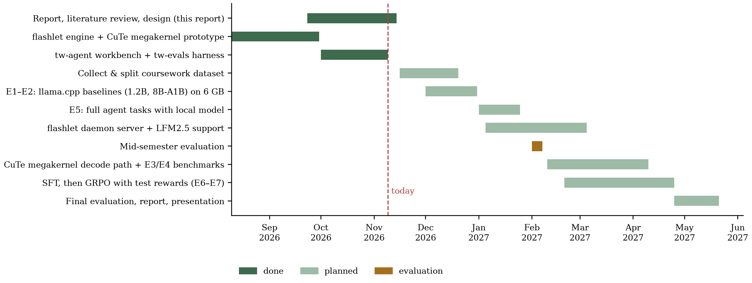
Timeline
Arpita Nayak · Conclusion
Notes:
ARPITA NAYAK. This is our timeline. The dark bars are done: the flashlet engine with its megakernel prototype, this report, the agent workbench and the examiner. In December we collect exercises from our programming courses and run the first local baselines with llama.cpp. In January we run full agent tasks with the local model and start the flashlet server. The mid-semester review is in the first week of February. From February to April we build the megakernel and train the model with fine-tuning and GRPO, and in May we run the final evaluation.

Slide 19


Where we stand
Arpita Nayak · Conclusion
Done this semester
Next semester
Research questions, literature review and design
Local baselines with llama.cpp (Dec)
flashlet engine + megakernel (140 tok/s)
Full agent tasks on the laptop (Jan)
tw-agent workbench, tested end to end
flashlet daemon + megakernel (Jan–Apr)
tw-evals examiner, verified (166/166)
Course training: SFT then GRPO (Feb–Apr)
First pipeline checks: 6/6 and 10/10
Detailed plan for every experiment
Final comparison: quality, speed, memory, cost
Notes:
ARPITA NAYAK. To conclude: this semester we defined the research questions, reviewed the literature, designed the system, and built three working tools: the flashlet inference engine with its megakernel prototype, the agent workbench and the automatic examiner, all verified and tested end to end. Next semester we run the local baselines, turn flashlet into an always-on server with the megakernel, and train the model on our programming courses, and finally compare quality, speed, memory and cost against a paid service. Our goal is an honest answer to whether a student's own laptop can be a useful, private and free programming assistant.

Slide 20
Thank you
Questions welcome
github.com/iamanishx/flashlet · tw-agent · tw-evals
Notes:
ARPITA NAYAK. Thank you. We are happy to take questions. Likely questions and who answers: Why not just use ChatGPT? (Arpita Ghadai: cost, privacy, offline). How does MoE save memory? (Manish). Is anything working today? (Manish: show tw-agent demo). How will you know it is better? (Arpita Nayak: metrics and fair-test rules). Which courses? (Arpita Ghadai: undergraduate programming courses such as introductory programming and data structures; results are reported per course).

