Slide 1
लक्ष्य · the target
Lakshya
Stop revising the chapter you already know.
An AI learning assistant that works out what you actually know, then builds a
day-by-day study plan around the gaps and the hours you genuinely have left.
Team RICR-HIM-1083 · Ankit Kumar & Kamalneet Kaur · HackInMotion 2026

Slide 2
THE PROBLEM
Students do not lack material. They lack a plan.
“Two weeks to the exam and I spent the first four days revising the one
chapter I already knew.”
You cannot see your own gaps
Timetables ignore reality
Falling behind ends the plan
The topics that feel hard and the topics you actually lose marks on are rarely the same ones.
A plan built on eight hours a day is useless if you have two.
Miss three days and a fixed timetable is dead. Most students stop using it.
So the hard part is not finding content. It is deciding what to do today.

Slide 3
WHAT THE STUDENT DOES
Four steps, and none of them is “make a timetable yourself”
01
Say what you are up against
Subject, exam, deadline, and how many hours a day you honestly have.
02
Take a short diagnostic
Eight questions across the syllabus. It is looking for gaps, not marking you.
03
Get a plan that admits the truth
Weak topics get the time. Topics you know get a quick refresh.
04
Fall behind, and it rebuilds
Miss sessions and the schedule reshapes around what is actually left.

Slide 4
THE CORE OF IT
How a plan actually gets built
Subject in
AI splits it
Quiz finds gaps
Our scheduler
Plan out
“Human Anatomy,
MBBS first year”
→
Topics, in order,
with prerequisites
→
Mastery score
per topic
→
Fits it into the days
and hours left
→
What to study
today, and why
The AI writes the content
Our own code builds the plan
Splitting a subject into topics, writing quiz
questions, answering doubts. Things that need
real subject knowledge.
Prerequisite ordering, spaced repetition, fitting
the hours, rebuilding when you slip. Things that
need to be correct every single time.
We did not hand the scheduling to the model. A plan has to be right, not plausible.

Slide 5
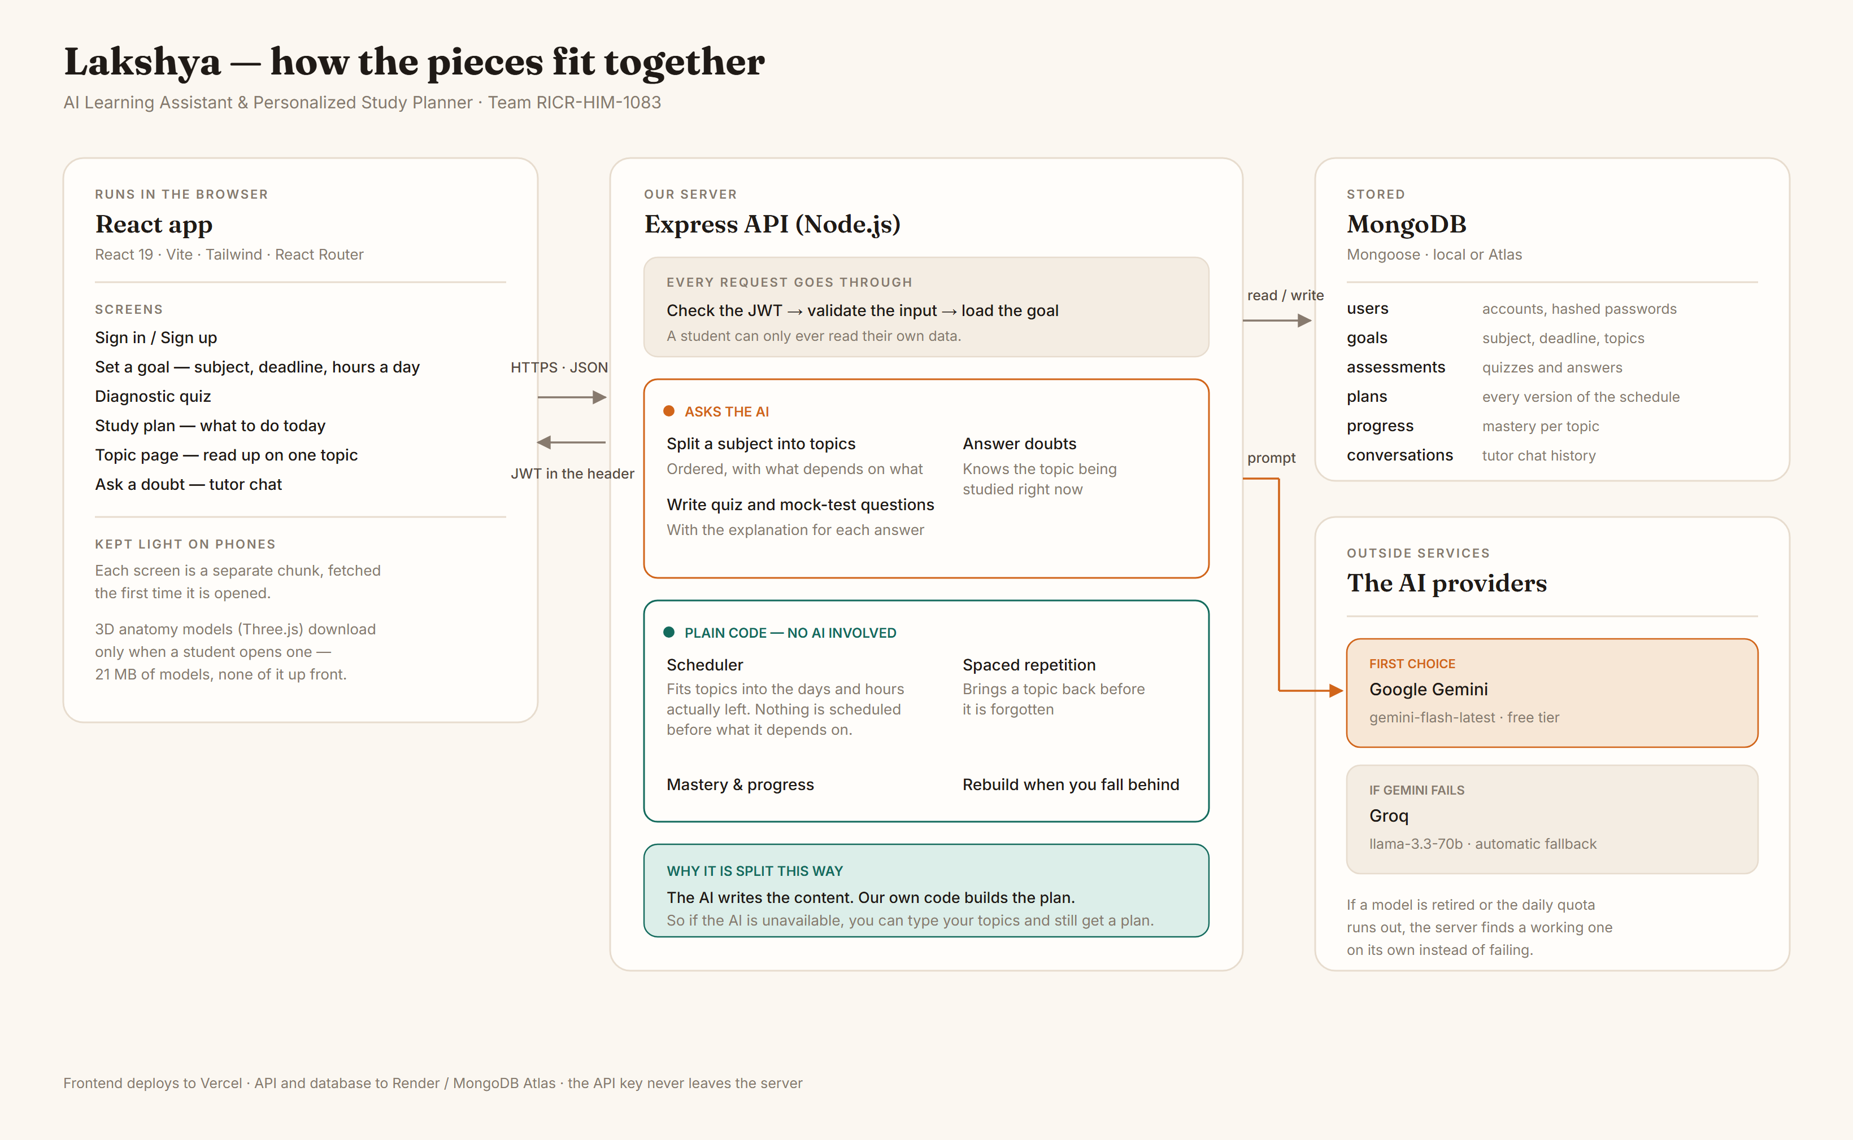
ARCHITECTURE
How the pieces fit together

Slide 6
THE AI
Why Gemini, and what happens when it fails
Google Gemini — first choice
Groq — the backup
• Free tier with no card required
• Enforces a JSON shape server-side, so the
plan and quizzes come back parseable
• Fast enough that a plan builds while you wait
• Also free, and very fast
• Takes over automatically if Gemini errors
• Different company, so an outage on one
side does not take the demo down
Being honest about the free tier
The free quota is roughly 20 requests a day per model, and a single full run through the app uses about four.
We hit that limit while testing. Two things came out of it: the server now switches to another model instead of
retrying a dead one, and the app still produces a real plan with no AI at all if you type your own topics.

Slide 7
WHAT WE ARE PROUD OF
It still works when the AI does not
Every AI feature has somewhere to fall back to. We tested this by pulling the API key out entirely.
Feature
Normally
With no AI available
Topics
AI splits the subject
Type your own syllabus
Study plan
Built from those topics
Still builds — the scheduler is ours
Quiz
AI writes questions
Self-rating still feeds the plan
Tutor
AI answers doubts
Says so plainly and saves the question
Graceful failure was in the brief. We took it literally: no blank screens, no stack traces, and never a dead end.

Slide 8
GOING FURTHER
Some things a paragraph cannot explain
Anatomy is the clearest case where reading fails. When a study topic is about muscles, nerves, bones or
organs, the plan offers the matching body system as a model you can turn around.
499 MB → 21 MB
Nothing up front
Works on a phone
What the raw models weighed, and what we
ship. Cut 24× while keeping every part
separately named.
The 3D code and the models download only
when a student opens one. The rest of the
app never pays for it.
Tested on a 390px screen. The brief asked for
mobile, so a heavy feature had to earn its
place without slowing anything down.
Models come from Z-Anatomy, the open-source anatomy atlas (CC BY-SA 4.0). The compression, the topic
matching and the viewer are ours.

Slide 9
WHERE IT STANDS
What is done, and what we would do next
Working now
Next, honestly
Accounts and login
Goal setup with a real calendar
Diagnostic quiz and mock tests
AI study plan generation
Progress tracking and rebuilding
Tutor chat that knows your topic
3D anatomy models
Light and dark, and it fits a phone
A paid AI tier — the free quota is the one
thing that would stop real students using it
Visuals for subjects other than anatomy
Remembering which explanations helped you,
and answering in that style next time
A proper accessibility pass
We would rather show you a short list that works than a long list that does not.

Slide 10
THANK YOU
Lakshya
Know what to study next.
Team RICR-HIM-1083
Ankit Kumar — API, database, AI integration, scheduling
Kamalneet Kaur — interface, design system, all screens
github.com/iamankit07/HackInMotion-RICR-HIM-1083

