Slide 1
FINAL CAPSTONE PROJECT
BY ANSHUL MOURYA

Slide 2
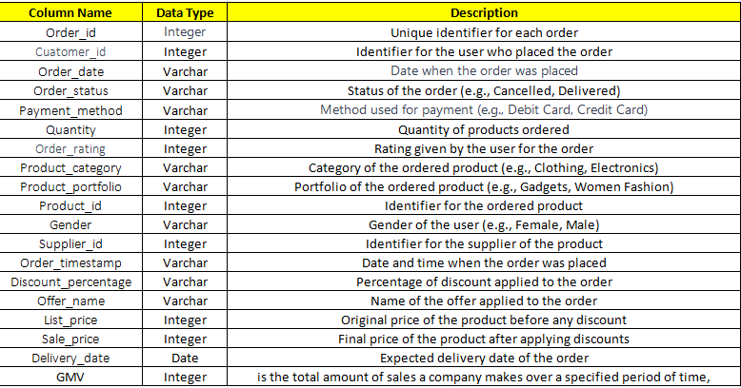
1.Create a data dictionary for the table with the best of your understanding

Slide 3
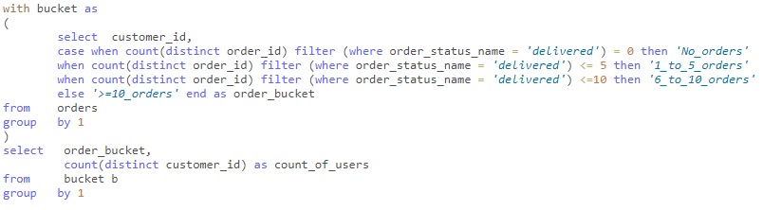
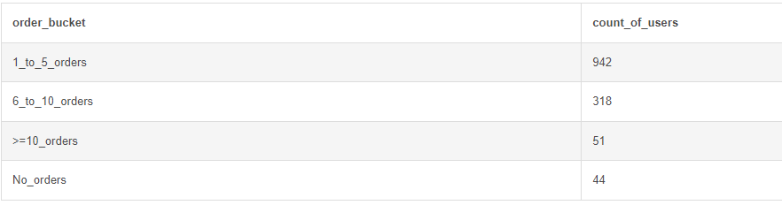
1.Write an SQL query to find the count of users in each order bucket based on their order history. The order buckets are categorized as 'No_orders' for customers with no delivered orders, '1_to_5_orders' for those with 1 to 5 delivered orders, '6_to_10_orders' for 6 to 10 delivered orders, and '>=10_orders' for customers with more than 10 delivered orders. The result should display the order bucket and the corresponding count of users.

Slide 4
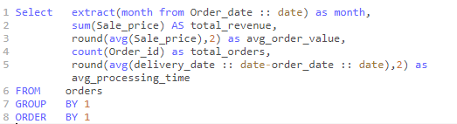
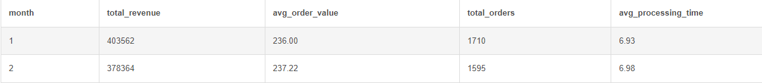
Fetch the below metrics for month on month comparison of:
1. Total Revenue,2.Avg Order Value,3. Total Orders,4.Avg ProcessingTime

Slide 5
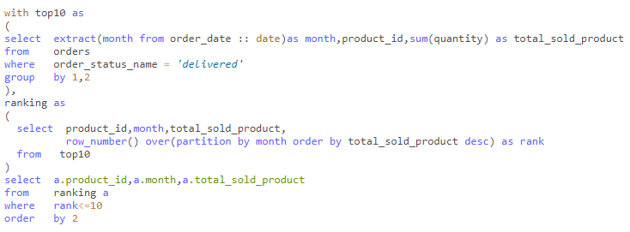
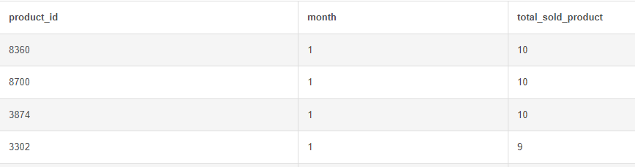
2(5). Top 10 highest selling products
OUTPUT:

Slide 6

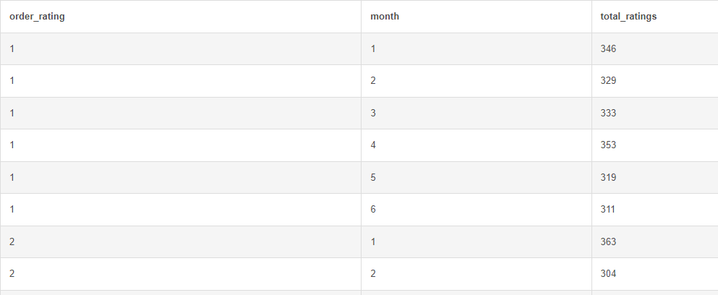
2.(6)Bucket DIstribution of different ratings and count of orders in it

Slide 7

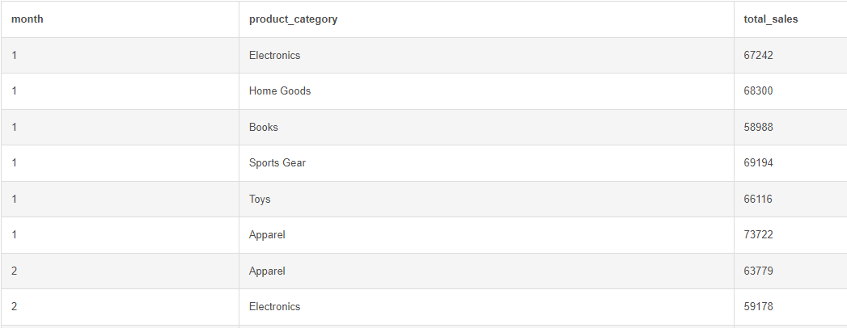
2.(7)Sales by Product Category

Slide 8
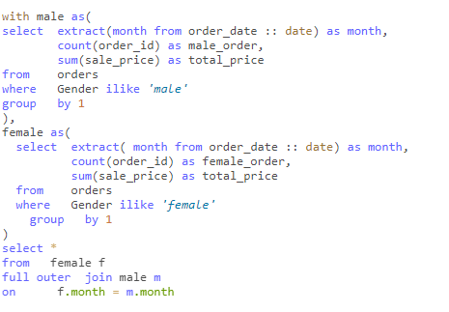
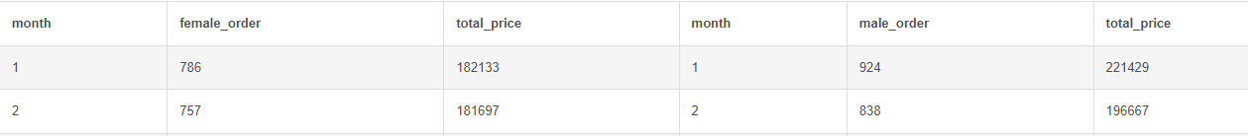
2(8).Sales and Orders by Gender

Slide 9
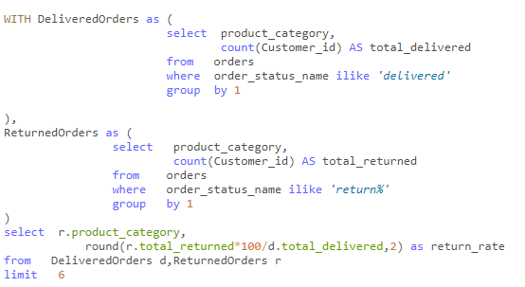
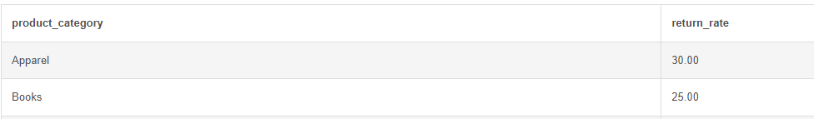
5.Calculate the return rate for each product category. The return rate is defined as the percentage of orders that have been returned out of the total delivered orders for each product category.

Slide 10
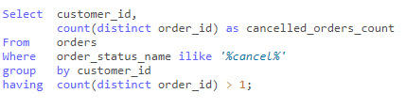
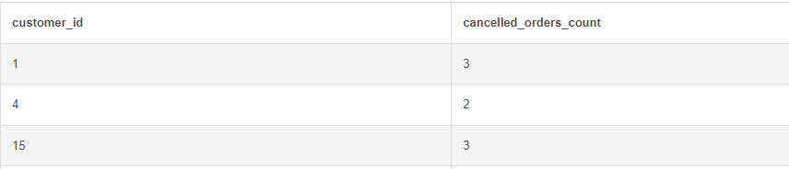
6.Write a SQL query to fetch only those customers who placed an order but cancelled the same orders more than once.
OUTPUT:

Slide 11
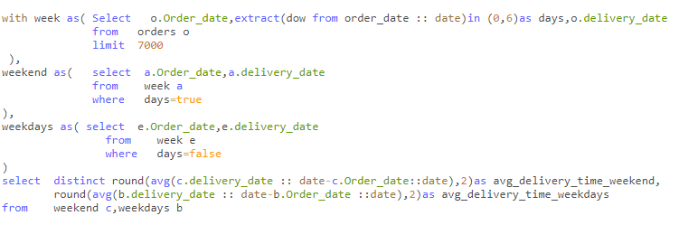
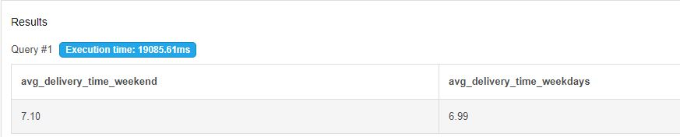
7.Write a query to find what is the Average delivery time for orders placed on weekdays versus weekends
OUTPUT:

Slide 12
8.Write a query to Determine the percentage contribution of each supplier to the total quantity of products sold in different product categories
with each_supplier as (
select supplier_id, product_category, sum(quantity) as total_quantity
from orders
group by 1,2
),
total_quant as (
select sum(quantity) as total
from orders
)
select supplier_id, product_category, (total_quantity*100/total) as total_percentage_contribution
from each_supplier, total_quant;

Slide 13

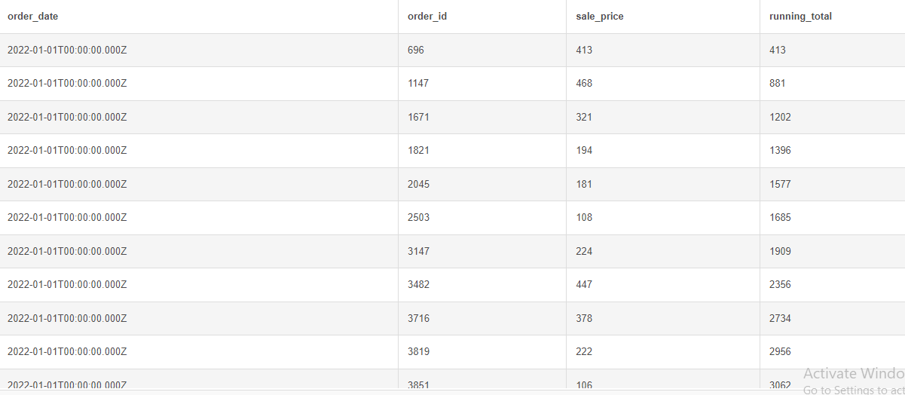
9.Write a query to Calculate the running total of orders delivered over time to identify trends in the order delivery volume.

Slide 14

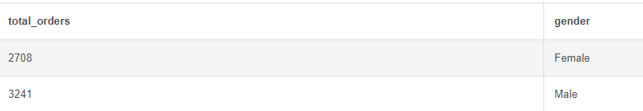
10.(A)Evaluate the distribution of orders delivered based on gender to understand any gender-related trends

Slide 15

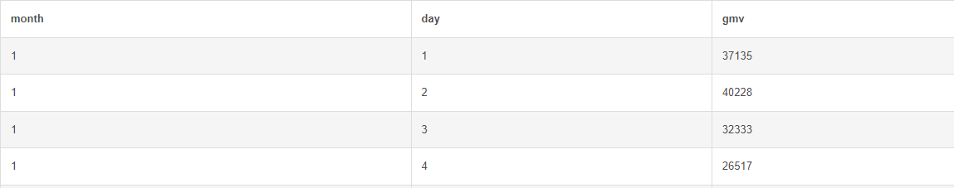
10.(B)Day over Day trend of GMV

