Slide 1

TRAINING CONTENT
Ansible
YOUR NEXT DESTINATION
OF SOFTWARE OUTSOURCING
Image Placeholder

Slide 2

Ansible Session-01
Introduction to Ansible
What is Ansible.
Why Ansible.
Use Case of Ansible.
Setting up Ansible - Lab Environment
Ansible Architecture
Ansible Installation
Ansible Configuration
Ansible Inventory
Hands-On
Ansible Ad-Hoc Commands
Hands-On

Slide 3
Ansible Session-01
Introduction to Ansible
Ansible is an open-source automation tool used for configuration management, application deployment, and orchestration of IT infrastructure.
Ansible uses SSH or WinRM to remotely execute these tasks on target hosts.
Benefits of Ansible
Free: Ansible is an open-source tool.
Very simple to set up and use: No special codeing skills are necessary to use Ansible’s playbooks (more on playbooks later).
Powerful: Ansible lets you model even highly complex IT workflows.
Flexible: You can orchestrate the entire application environment no matter where it’s deployed. You can also customize it based on your needs.
Agentless: You don’t need to install any other software or firewall ports on the client systems you want to automate. You also don’t have to set up a separate management structure.
Efficient: Because you don’t need to install any extra software, there’s more room for application resources on your server.

Slide 4
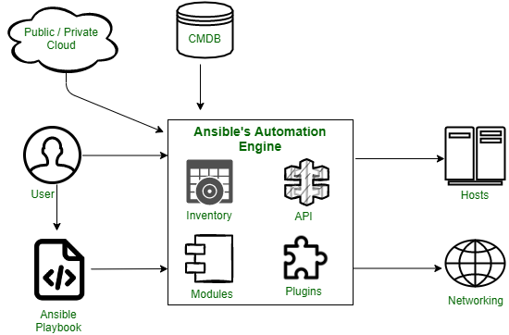
Ansible Session-01
Ansible Architecture:
Inventories – lists of hosts [Unix, Linux, Windows]
APIs – interaction of end to end modules
Modules – modules are directly run using playbooks
Plugins – All necessary cache, logging purpose
Playbooks – interacts with the ansible automation engine and
configuration Management Database
CMDB – repository or data warehouse

Slide 5
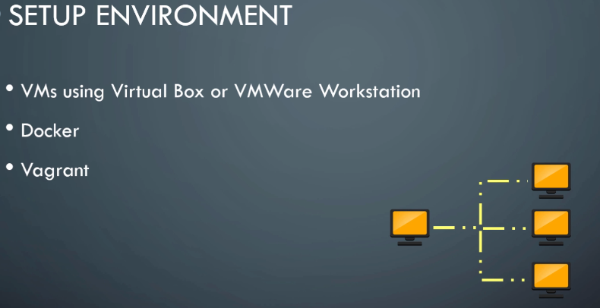
Ansible Session-01

Slide 6
Ansible Session-01
Ansible Installation: [Debian Like System]
Configure the PPA Repository
sudo apt-add-repository ppa:ansible/ansible
Update the repository and install Ansible
sudo apt update
sudo apt install ansible -y
Ansible Installation: [RHEL Like System]
Configure the EPEL Repository
sudo dnf install -y epel-reléase
Install Ansible With the dnf Command
sudo dnf install ansible –y
ansible --version

Slide 7
Ansible Session-01
Ansible Configuration
The default configuration directory for Ansible is /etc/ansible/. Within this directory, you can find several important files and subdirectories that are used for configuring and managing Ansible. Here's a brief overview of some of the key items you can find within the default configuration directory:
ansible.cfg: This is the main configuration file for Ansible. It allows you to specify various settings, such as the default inventory file, remote user, connection type, and more.
hosts: This file is the default inventory file, where you define the hosts and groups that Ansible will manage. It specifies the target systems on which Ansible will perform tasks.
roles/: This directory is used to organize and store Ansible roles. Roles are self-contained units of automation that can be reused across multiple playbooks.
group_vars/ and host_vars/: These directories allow you to define variables specific to groups of hosts (group_vars/) or individual hosts (host_vars/). This enables you to customize the behavior of playbooks based on specific groups or hosts.
library/ and module_utils/: These directories are used for storing custom Ansible modules or module utilities that you may develop for your environment.

Slide 8
Ansible Session-01
Ansible Configuration
Configure the ansible.cfg file under the folder /etc/ansible
Configure the hosts file under the folder /etc/ansible
Must create SSH keys for your remote_user and share them among all the managed host servers
ssh-keygen
ssh-copy-id nouf-admin@172.31.2.186
Execute the below command on each managed host server to run all the commands without prompting a password.
echo "nouf-admin ALL=(ALL) NOPASSWD:ALL" > /etc/sudoers.d/nouf-admin

Slide 9
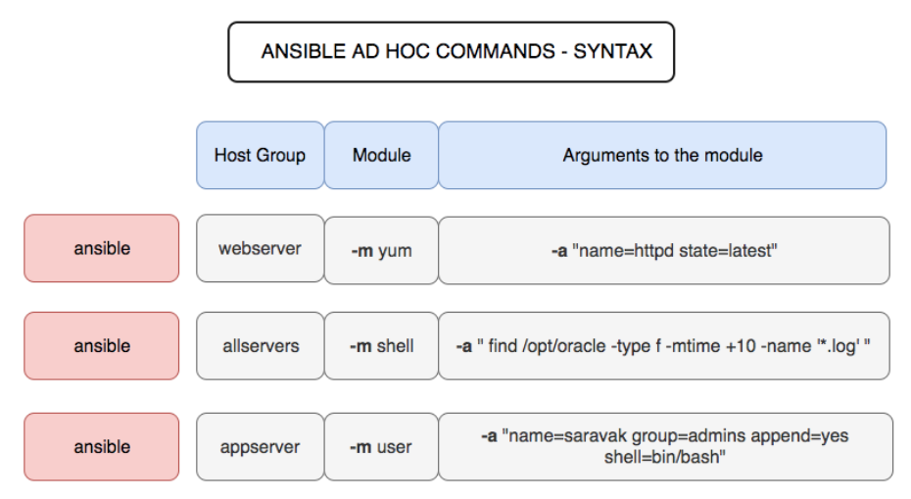
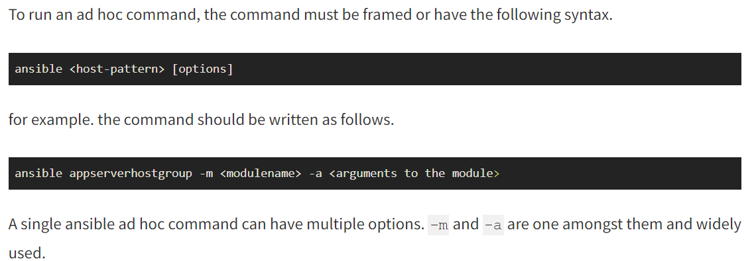
Ansible Session-01
Introduction to Ansible Ad-hoc command
An Ansible ad-hoc command is a one-liner command that allows you to perform a single task against a set of hosts. It's useful for quick, one-time tasks that you don't need to automate with a playbook.

Slide 10
Ansible Session-01
Ansible Ad-hoc command [Demo]
In this example, we are going to test the remote nodes or hosts and make sure they respond back using Ansible's default SSH channel
$ ansible multi -m ping -i ansible_hosts – user=ansible
In this example, we are going to know the uptime of the hosts.
$ ansible multi -m command -a uptime
$ ansible multi -m shell -a uptime
The following ansible ad hoc command would help you get the free memory of all the hosts in the host group named multi
$ ansible multi -a "free -m" -i ansible_hosts
To accomplish this example we are going to use two commands together so we must opt to shell module.
$ ansible multi -m shell -a "cat /proc/meminfo|head -2"
In the earlier versions of ansible there is an option named as sudo (deprecated), Since ansible 2.0 there are two new options named as become and become_user
$ ansible multi -m shell -a "cat /etc/passwd|grep -i vagrant" -s – ask-sudo-pass
$ ansible multi -m shell -a "cat /etc/passwd|grep -i vagrant" -b -K

Slide 11
Ansible Session-01
Ansible Ad-hoc command [Demo]
Example 6: ansible ad hoc become - Execute a command as a different user (sudo su)
In the following ad-hoc command snapshot you can see we have given the username we want to switch to using --become-user=weblogic option
$ ansible app -m file -a "path=/opt/oracle/binaries state=directory mode=0755" -i ansible_hosts -b – become-user=weblogic
Example 7: Create a user group with ansible ad hoc command
Here we are creating a user name group named weblogic using the ansible group module, the same task can be reversed to delete the group if you change the state to absent
$ ansible app -s -m group -a "name=weblogic state=present"
Example 8: Create a unix user with ansible ad hoc command
In this example, we are going to create a UNIX user using the ansible user module
$ ansible app -m user -a "name=weblogic group=weblogic createhome=yes" -b
Example 9: Create a Directory with 755 permission using ansible ad hoc command
In this example, we are going to create a new directory with 755 permisssion this is done using the ansible file module
$ ansible app -m file -a "path=/opt/oracle state=directory mode=0755" -b
Example 10: Create a file with 755 permission using ansible ad hoc commands
Like the previous example, we are going to create a file this time with 755 permission
$ ansible app -m file -a "path=/tmp/testfile state=touch mode=0755"
Example 11: Change ownership of a file using ansible ad hoc command
In this example, we are going to change the ownership of the file using ansible ad hoc command with ansible file module
ansible app -m file -a "path=/opt/oracle group=weblogic owner=weblogic" -i ansible_hosts -b

Slide 12
Ansible Session-01
Ansible Ad-hoc command [Demo]
Example 12: how to check free disk space of hosts using ansible ad hoc commands
Most of us would like to quickly check the disk space of many machines with a single command. this is that command
$ ansible multi -a "df -h"
Example 13: ad hoc command to Install a package using yum module
How to install a package or software in linux using yum module of ansible
$ ansible multi -s -m yum -a "name=httpd state=installed"
Example 14: ad hoc command to Start or stop the service
You really do not have to log in to start or stop the service running in your Linux system. you can simply use this ansible service module ad hoc command
# To Start
$ ansible multi -s -m service -a "name=httod state=started enabled=yes"
# To Stop
$ ansible multi -s -m service -a "name=httpd state=stop enabled=yes"
Example 15: Install and configure python Django application server with ansible ad hoc commands
These are set of commands you have to execute to install the Django application server and Mysql libraries. Here we are using easy_install which is an ansible module it helps to find the easy installation option from ansible galaxy
$ ansible app -s -m yum -a "name=MySQL-python state=present"
$ ansible app -s -m yum -a "name=python-setuptools state=present"
$ ansible app -s -m easy_install -a "name=django"

Slide 13
Ansible Session-01
Ansible Ad-hoc command [Demo]
Example 16: Managing Cron Job and Scheduling with Ansible ad hoc
We can easily manage the Cron jobs with Ansible cron module. Here are the list commands you can keep handy
# Run the job every 15 minutes
$ ansible multi -s -m cron -a "name='daily-cron-all-servers' minute=*/15 job='/path/to/minute-script.sh'"
# Run the job every four hours
$ ansible multi -s -m cron -a "name='daily-cron-all-servers' hour=4 job='/path/to/hour-script.sh'"
# Enabling a Job to run at system reboot
$ ansible multi -s -m cron -a "name='daily-cron-all-servers' special_time=reboot job='/path/to/startup-script.sh'"
# Scheduling a Daily job
$ ansible multi -s -m cron -a "name='daily-cron-all-servers' special_time=daily job='/path/to/daily-script.sh'"
# Scheduling a Weekly job
$ ansible multi -s -m cron -a "name='daily-cron-all-servers' special_time=weekly job='/path/to/daily-script.sh'"
Example 17: ansible ad hoc command to check the service status
In this example, we are going to see how to check the status of service using ansible ad hoc command
$ ansible testserver -m service -a "name=httpd" -i ansible_hosts -u vagrant
Example 20: ansible ad hoc command to copy file - Local to remote
The following ad hoc command with copy module copies the file from Src location on the local control machine to the specified location on the remote server
$ ansible testserver -m copy -a "src=~/Downloads/index.html dest=/var/www/html owner=apache group=apache mode=0644"

Slide 14
Ansible Session-01
Ansible Ad-hoc command [Demo]
Example 21: ansible ad hoc command to copy directory - Local to remote
This is an ansible AD HOC command to copy a directory to the remote server
$ ansible testserver -m copy -a "src=~/Downloads/logos dest=/var/www/html/ owner=apache group=apache mode=0644 " -i ansible_hosts -b
Example 26: ansible ad hoc command to check listening ports
To check the list of open ports you can use netstat or ss commands over the Ansible shell module but the preferred way is to use the ansible community plugin listen_ports_facts module
$ ansible testserver -m listen_ports_facts -i prod-ansible-hosts

