Slide 1

TRAINING CONTENT
Ansible
YOUR NEXT DESTINATION
OF SOFTWARE OUTSOURCING
Image Placeholder

Slide 2

Ansible Session-02
Introduction to YAML
Introduction to Ansible Playbook
Simple playbook example
Demo

Slide 3
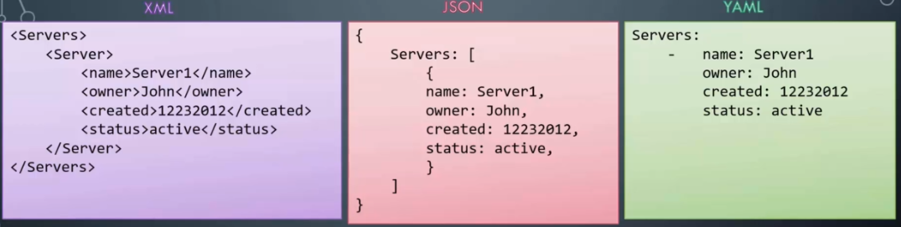
Ansible Session-02
Introduction to YAML
YAML (short for "YAML Ain't Markup Language") is a human-readable data serialization language. It's often used for configuration files, data exchange between applications, and generating structured data for programmatic consumption.
The --- at the beginning is a YAML document marker, which indicates the start of a new YAML document. The data is structured using indentation, with the address field being a nested object.

Slide 4
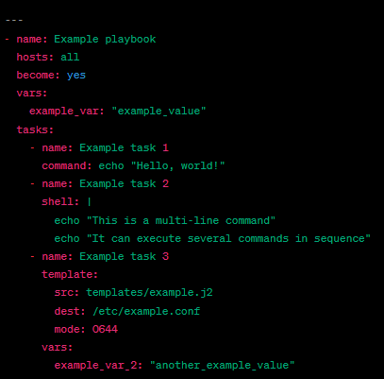
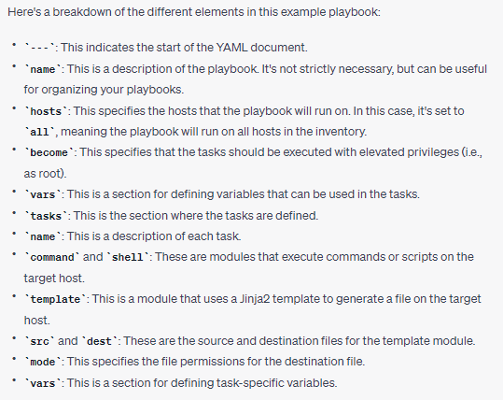
Ansible Session-02
Introduction to Playbook
An Ansible playbook is a YAML file that contains a set of tasks that define the automation steps to be executed on a set of target hosts. Here is an example syntax of an Ansible playbook:

Slide 5

Ansible Session-02

