Slide 1

TRAINING CONTENT
Ansible
YOUR NEXT DESTINATION
OF SOFTWARE OUTSOURCING
Image Placeholder

Slide 2

Ansible Session-03
Overview of Ansible variables
How to declare and use variables
Conditional statements in Ansible playbooks
Loops in Ansible playbooks

Slide 3
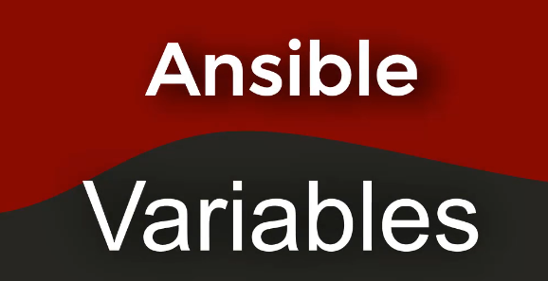
Ansible Session-03

Slide 4
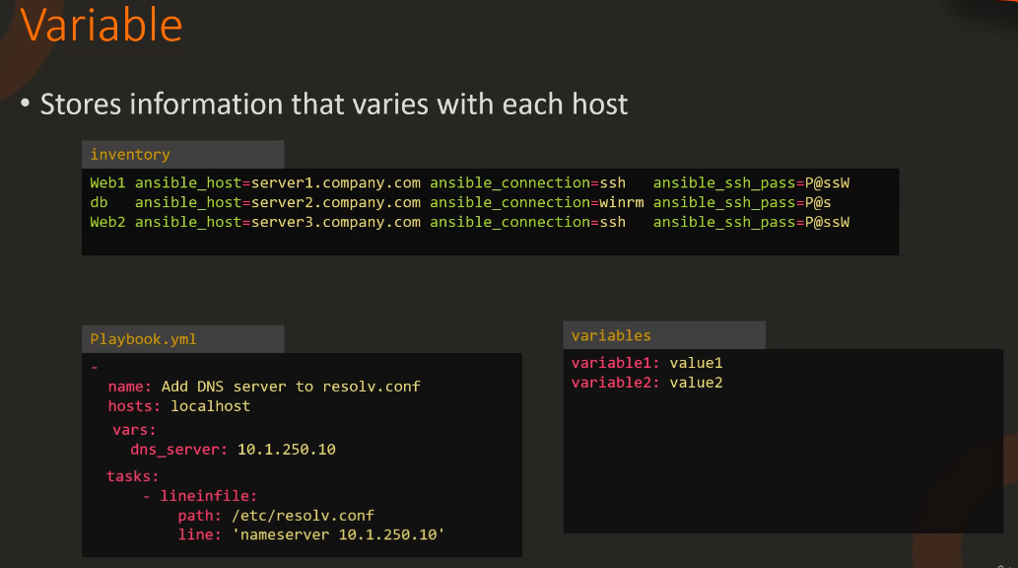
Ansible Session-03

Slide 5
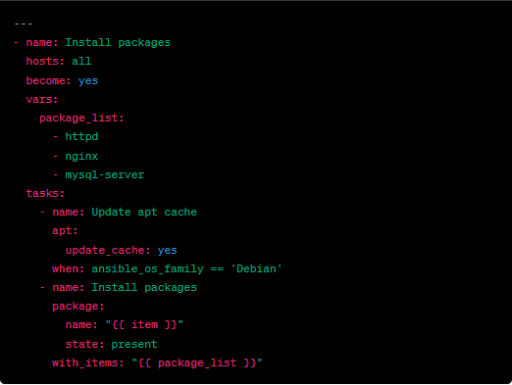
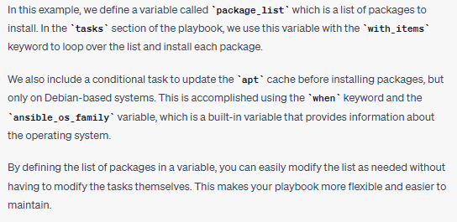
Ansible Session-03
Using Variable In Playbook

Slide 6
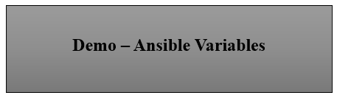
Ansible Session-03

Slide 7

Ansible Session- 03

Slide 8
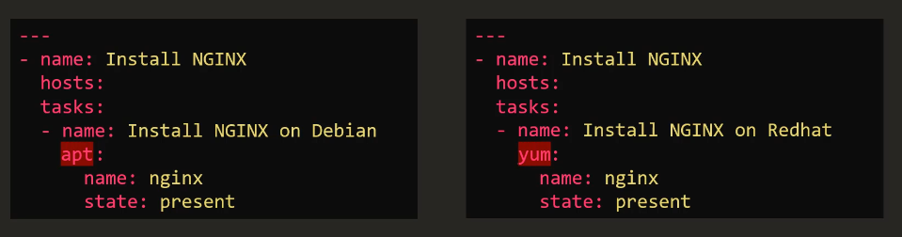
Ansible Session-03
Ansible Playbook without Condition

Slide 9
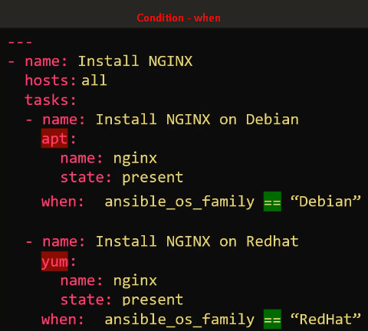
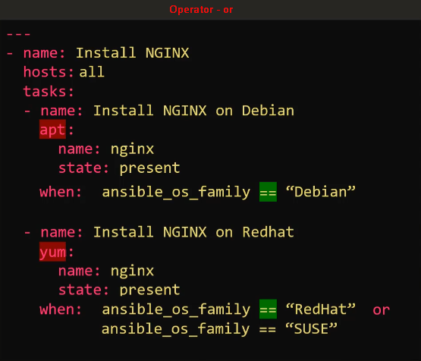
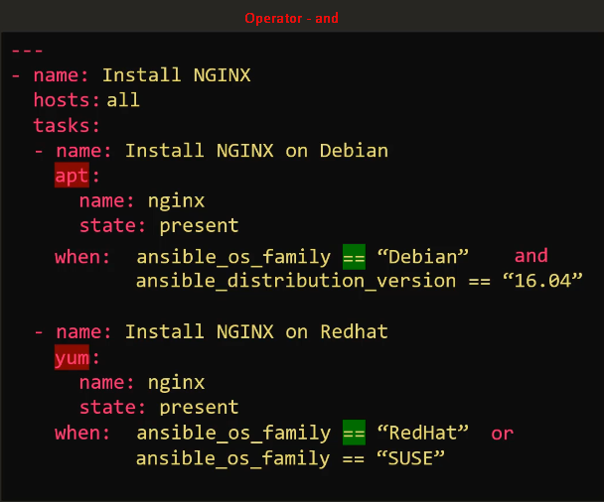
Ansible Session-03

Slide 10
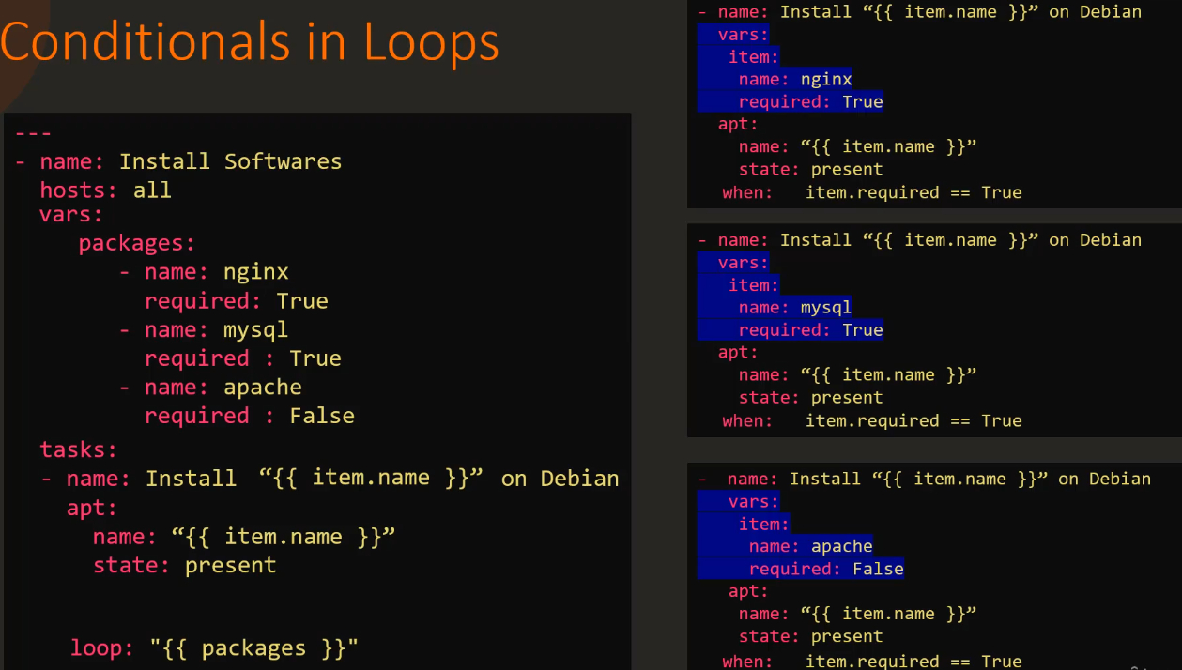
Ansible Session-03

Slide 11
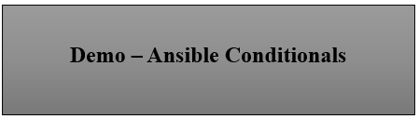
Ansible Session-03

