Slide 1

TRAINING CONTENT
Ansible
YOUR NEXT DESTINATION
OF SOFTWARE OUTSOURCING
Image Placeholder

Slide 2

Ansible Session-04

Slide 3
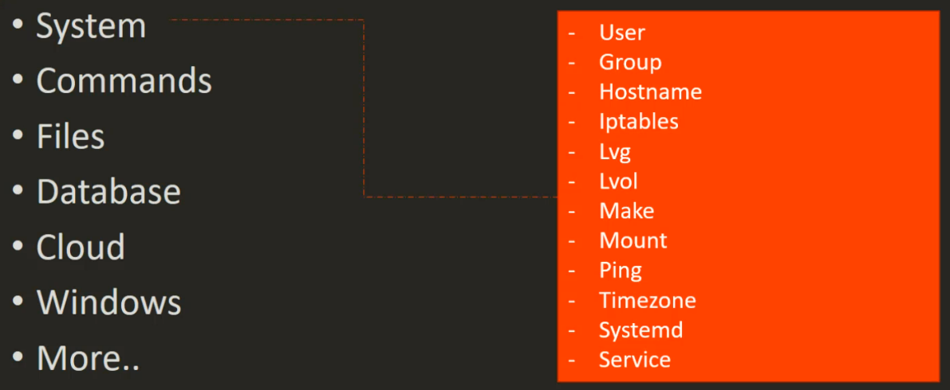
Ansible Session-04
Ansible System Modules

Slide 4
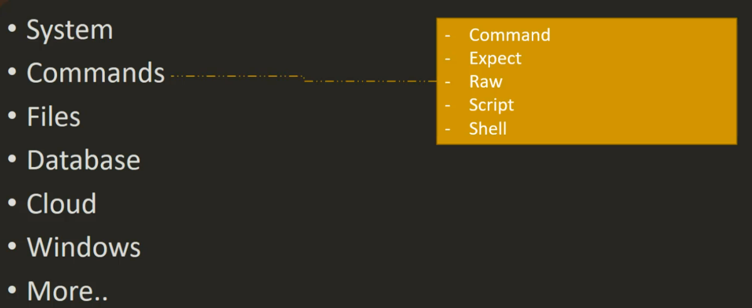
Ansible Session-04
Ansible Commands Modules

Slide 5
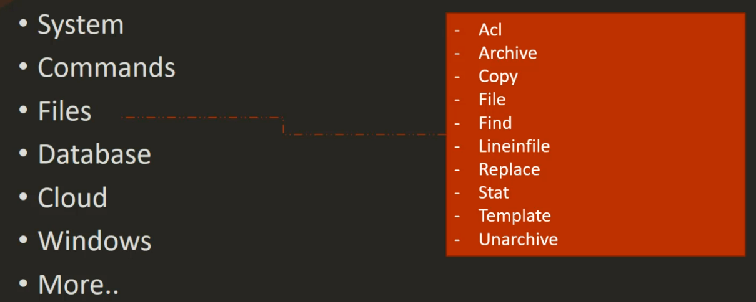
Ansible Session-04
Ansible Files Modules

Slide 6
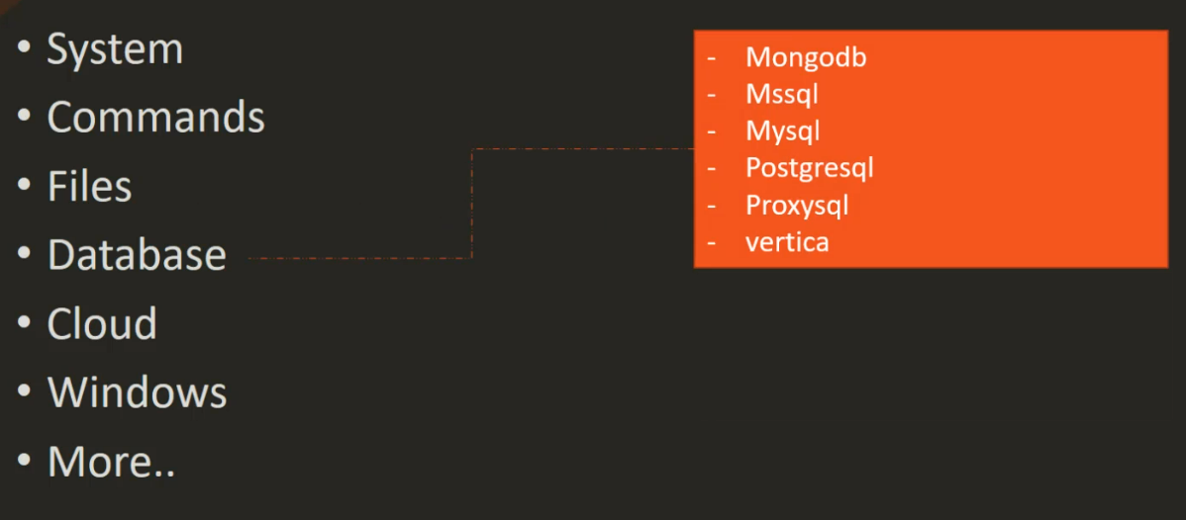
Ansible Session-04
Ansible Database Modules

Slide 7
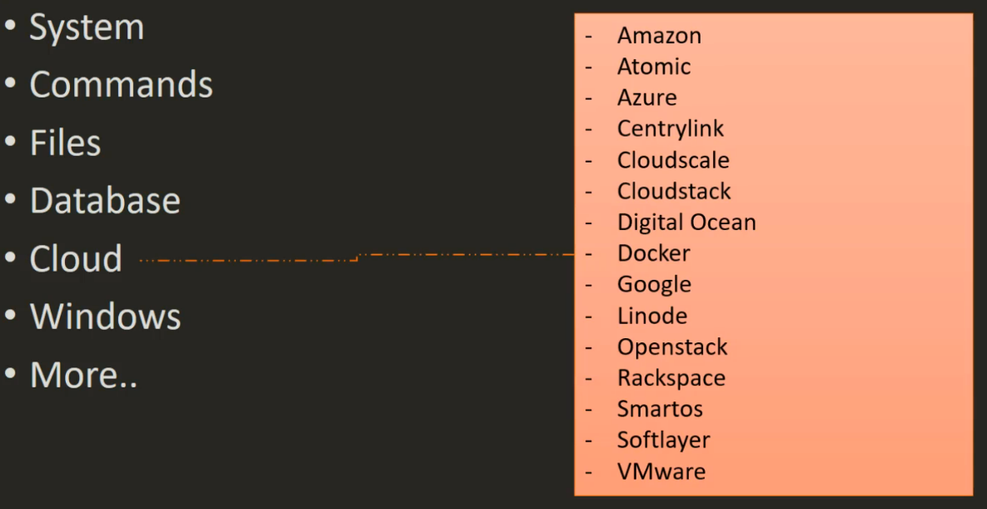
Ansible Session-04
Ansible Cloud Modules

Slide 8
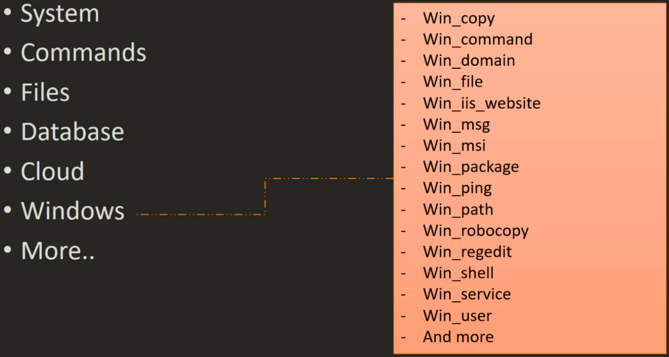
Ansible Session-04
Ansible Windows Modules

Slide 9
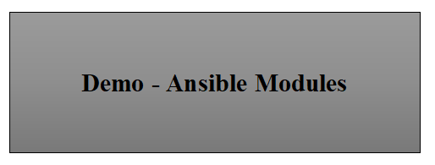
Ansible Session-04

